Slide 1

SkillBridge AI – An Agentic Career Readiness and Opportunity Orchestration Platform
SOA Project Review-2
 | Under the Guidance of Dr. NEELIMA GOGINENI Assistant Professor, Department of Computer Science and Engineering, KLH CSE Bowrampet Campus
Team Members Somu Vaishnavi - 2420030024 Maineni Srihitha - 2420030405

Slide 2
Project Design
SkillBridge AI is designed as a modular, service-oriented platform in which individual career-readiness functions are implemented as independent services.
The system is divided into three major layers:
1. Presentation Layer
Student interface
Career dashboard
Skill and progress visualization
2. Application Layer
API Gateway
Authentication
Microservices
AI agent orchestration
3. Data & Communication Layer
Databases
REST APIs
Apache Kafka
Event-driven communication
Design Goal:
To make individual components independently manageable, scalable and replaceable.

Slide 3
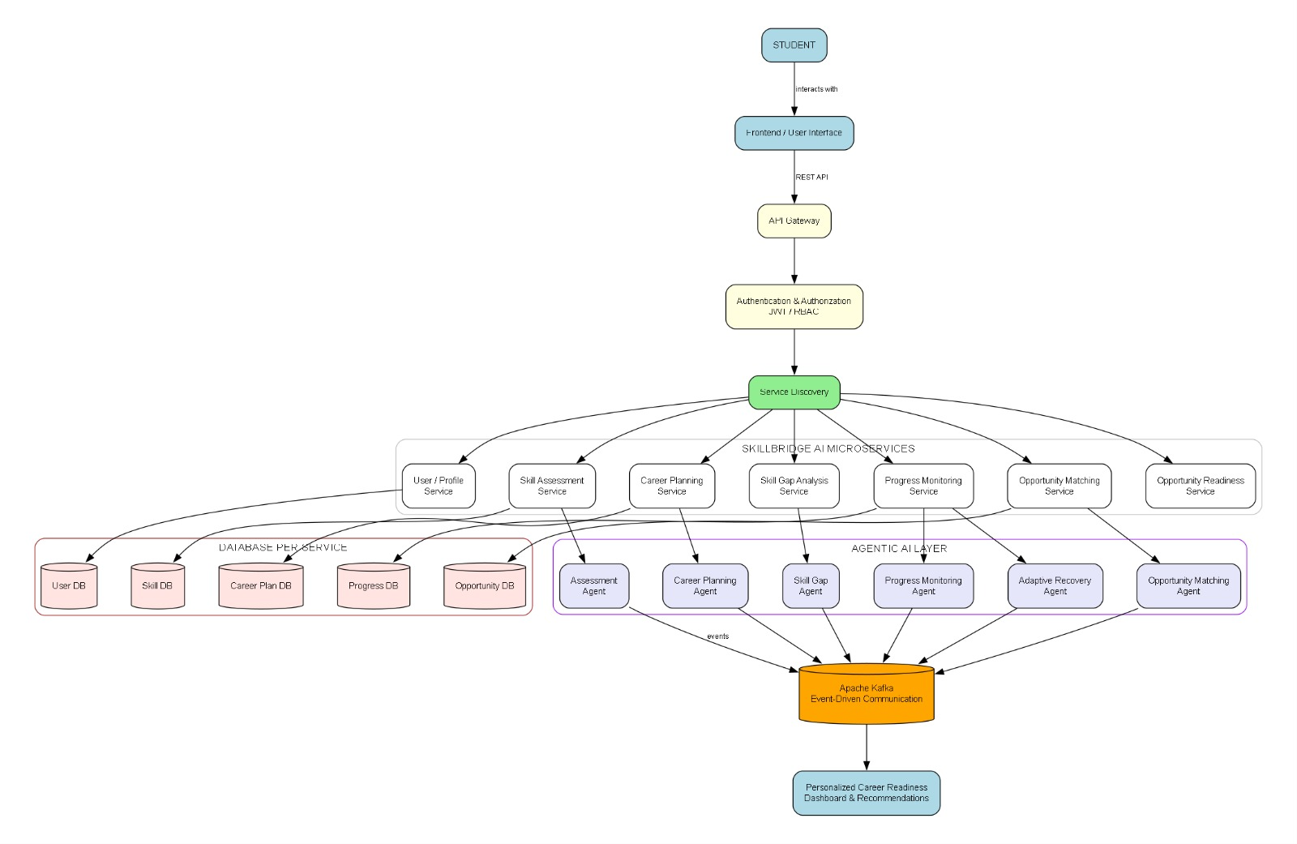
System Architecture

Slide 4
Component Design
Component | Responsibility
Frontend | User interaction and dashboard
API Gateway | Central entry point for requests
User/Profile Service | Manages student information
Skill Assessment Service | Evaluates student competencies
Skill Gap Service | Identifies missing career-specific skills
Career Planning Service | Generates personalized action plans
Progress Service | Tracks learning and performance
Opportunity Service | Processes relevant opportunities
AI Agents | Perform intelligent analysis and decision-making
Kafka | Handles asynchronous event communication
Database | Stores service-specific data

Slide 5
Development Methodology
Requirement Analysis
↓
System Design
↓
Service Decomposition
↓
API Development
↓
AI Agent Development
↓
Service Integration
↓
Testing & Validation
↓
System Refinement
Methodology Characteristics
Modular Development — each service is developed independently.
Incremental Integration — services are integrated progressively.
API-First Communication — services communicate through defined APIs.
Event-Driven Processing — Kafka is used for asynchronous events.
Continuous Testing — individual components are tested before integration.

Slide 6
System Execution Workflow
Student Profile
↓
Career Goal Selection
↓
Skill Assessment
↓
Skill Gap Analysis
↓
Personalized Plan Generation
↓
Student Performs Activities
↓
Progress Evaluation
↓
Plan Adaptation
↓
Opportunity Analysis
↓
Readiness Evaluation
↓
Career Recommendations

Slide 7
Service Communication Methodology
Synchronous Communication
REST APIs
Request-response interaction
Used when an immediate response is required
Asynchronous Communication
Apache Kafka
Event-based communication
Used for background processing and service coordination

Slide 8
Technology Stack & Implementation
Technology Stack
Frontend
HTML
CSS
JavaScript / React (use only what you actually implemented)
Backend
Java / Spring Boot (if this is what you are implementing)
REST APIs
Architecture
Spring Cloud / Microservices
API Gateway
Service Discovery
AI
LLM / Agentic AI framework (put your actual framework)
Messaging
Apache Kafka
Database
PostgreSQL / your actual database
Security
JWT
Role-Based Access Control

Slide 9
Technical Validation & Testing
Test Area | Validation
API Testing | Verify request and response correctness
Service Testing | Validate individual microservices
Database Testing | Verify data storage and retrieval
Integration Testing | Verify communication between services
Kafka Testing | Verify event production and consumption
AI Output Testing | Check relevance and consistency of generated results
Security Testing | Validate authentication and authorization
Error Handling | Verify handling of invalid inputs and service failures

Slide 10
Thank You

