Slide 1

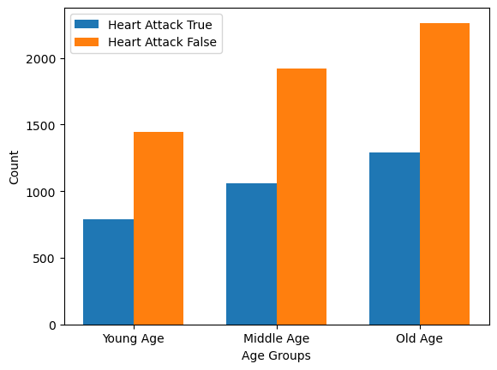


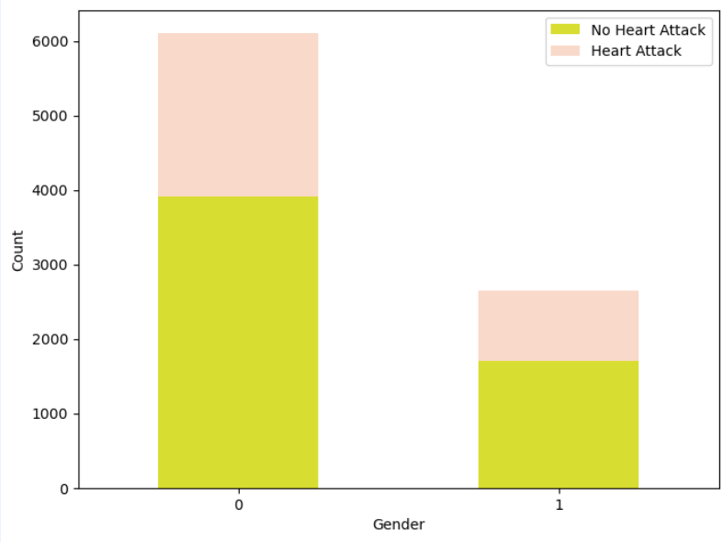

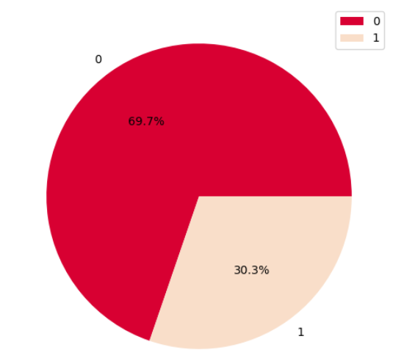
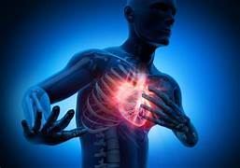
Unveiling Hidden Heart Attack Risks
Insights from Medical Data by Varshini Vaisnavi Srinivasan
Introduction
Predictive Analysis for Heart Attack Prevention: Creating a Multivariate Risk Model from Patient Health Data. Our aim: develop an actionable risk calculator using diverse health factors to empower early intervention. By unraveling demographic, genetic, and lifestyle influences, we target timely identification of at-risk individuals for proactive measures. Our mission: prevent tragedies by enabling crucial lifestyle changes and timely medical attention. Through compassionate data science, we pave the way to vibrant heart health
Data Set
Our dataset offers a comprehensive array of patient information crucial for heart attack risk prediction. It includes diverse health metrics, heart-related history, medical records, and demographic details. This multifaceted dataset serves as the cornerstone for developing an accurate machine learning model aimed at predicting heart attack risks. The dataset contains 8,764 rows and 26 columns.
Conclusion
Age and heart rate emerge as pivotal risk factors for heart attacks, showcasing a clear correlation between their increase and heightened risk across different age groups. Notably, high triglyceride levels don't consistently predict heart attack risk, while low levels don't assure safety.
However, the most impactful factor identified in this study influencing heart attack risk is smoking. While lifestyle adjustments like regular exercise, a balanced diet, and stress management remain crucial for all, prioritizing smoking cessation could significantly reduce the risk of heart attacks across various demographics
Background
Heart disease remains a leading cause of mortality globally, often striking unexpectedly with severe consequences. Sudden heart attacks, like the one experienced by my grandfather, highlight the urgency for more effective predictive measures. Current risk assessment methods often fall short, necessitating the development of advanced predictive models using machine learning. This project aims to leverage data-driven approaches to accurately predict heart attack risks, potentially revolutionizing early detection and intervention strategies to save live.
Data Analysis
Here are some of the EDA for the dataset
heart rate is a significant risk factor for heart attack, and that the risk increases with increasing heart rate
The pie chart shows that males represent 69.7% of heart attack patients, while females represent 30.3% majority of male are affected by heart Attack
Elderly individuals, especially, should be vigilant due to their higher age-related risk, as depicted in the graph
Results
This indicates that all four models have a high accuracy, recall, precision, and F1-score.
Model | Accuracy | Recall | F1-score | Precision
KNN | 92.5 | 1.0 | 0.93 | 0.83
SVM | 97.5 | 1.0 | 0.97 | 0.95
Naïve Bayes | 92.5 | 1.0 | 0.93 | 0.86
Neural Network | 92.5 | 1.0 | 0.93 | 0.86
Overall, the results of this project indicate that all four models are capable of accurately predicting heart disease. However, the SVM model has the highest overall performance.
References
https://www.kaggle.com/datasets/iamsouravbanerjee/heart-attack-prediction-dataset/code
https://ieeexplore.ieee.org/document/10079409
https://ieeexplore.ieee.org/document/9507928
Institute for Insight Robinson College of Business
gsu.edu
1- female, 0- male.

