Slide 1

MiniLex: Visual Lexical Analyzer
Compiler Design Hackathon
2nd November 2026
 | Under the Guidance of B Dwarakanath Department of Computer Science and Engineering KLH University Hyderabad
Team Members Raga Padmini 2420030019 Vuppuluri Harshita 2420030531 M.Vaishnavi 2420030655 Vokitha T 2420030462

Slide 2
Outline of Project Work
Focus
Introduction
Literature Survey
Challenges
Research Objectives
Conclusion & Future Work
References
Publications Details

Slide 3
Problem Statement
Lexical analysis is the first phase of a compiler, where source code is converted into meaningful units called tokens. Students often find it difficult to understand how Regular Expressions are converted into NFA and DFA and how these automata are used to recognize tokens.
The proposed system, MiniLex –Visual Lexical Analyzer, aims to develop an interactive tool that allows users to define token rules, enter source code, visualize NFA and DFA construction, and generate token streams. It also identifies invalid characters and displays lexical errors with line numbers.
Main Goal: To simplify the understanding of lexical analysis by combining Regular Expressions, NFA, DFA, and token generation into one visual platform.

Slide 4
Objectives
Understand Lexical Analysis: Explain how source code is divided into meaningful tokens.
Define Token Rules: Allow users to create token patterns using Regular Expressions.
Visualize NFA and DFA: Show how Regular Expressions are converted into NFA and DFA.
Generate Tokens: Identify keywords, identifiers, operators, constants, and symbols from source code.
Detect Lexical Errors: Identify invalid characters and display errors with line numbers.
Provide an Interactive Interface: Make the lexical analysis process easy to understand through visual diagrams and step-by-step execution.

Slide 5
Problem Gap Identification
Research Gap Identification
Limited Visualization: Traditional lexical analyzers mainly show the final output without clearly explaining how NFA and DFA are constructed.
Difficult Concepts: Students find it challenging to understand the conversion of Regular Expressions into NFA and DFA.
Lack of Step-by-Step Learning: Existing tools may not provide a clear, step-by-step explanation of the lexical analysis process.
Limited Error Explanation: Some tools identify invalid input but do not clearly explain lexical errors with line numbers.
Less Interactive Learning: Students often lack a single platform to experiment with token rules and observe how source code is analyzed.

Slide 6
Innovation, Creativity, and Novelty
Visual Automata Construction: Provides a visual representation of how Regular Expressions are converted into NFA and DFA.
Interactive Learning: Allows students to enter source code and observe the lexical analysis process step by step.
Automatic Token Generation: Identifies and classifies keywords, identifiers, operators, constants, and symbols automatically.
Real-Time Error Detection: Detects invalid characters and displays lexical errors along with line numbers.
All-in-One Platform: Combines Regular Expressions, NFA, DFA, token generation, and error detection in a single tool.
Student-Friendly Interface: Makes complex compiler concepts easier to understand through simple visual explanations.

Slide 7
Feasibility and Project Plan
Feasibility
Technical Feasibility: Can be developed using programming languages and tools such as Python, HTML, CSS, and JavaScript.
Economic Feasibility: Uses open-source tools and technologies, reducing development costs.
Operational Feasibility: Provides a simple, user-friendly interface that students can easily operate.
Time Feasibility: The project can be completed within the hackathon timeline by dividing the work into module
Practical Feasibility: Can be tested using sample source code and different token patterns.
Project Plan
Phase 1
Requirement analysis and interface design
Phase 2
Define token patterns using Regular Expressions
Phase 3
Implement Regular Expression to NFA conversion
Phase 4
Implement NFA to DFA conversion
Phase 5
Develop token generation and lexical error detection
Phase 6
Integrate all modules and create visualizations
Phase 7
Testing, debugging, and final demonstration

Slide 8
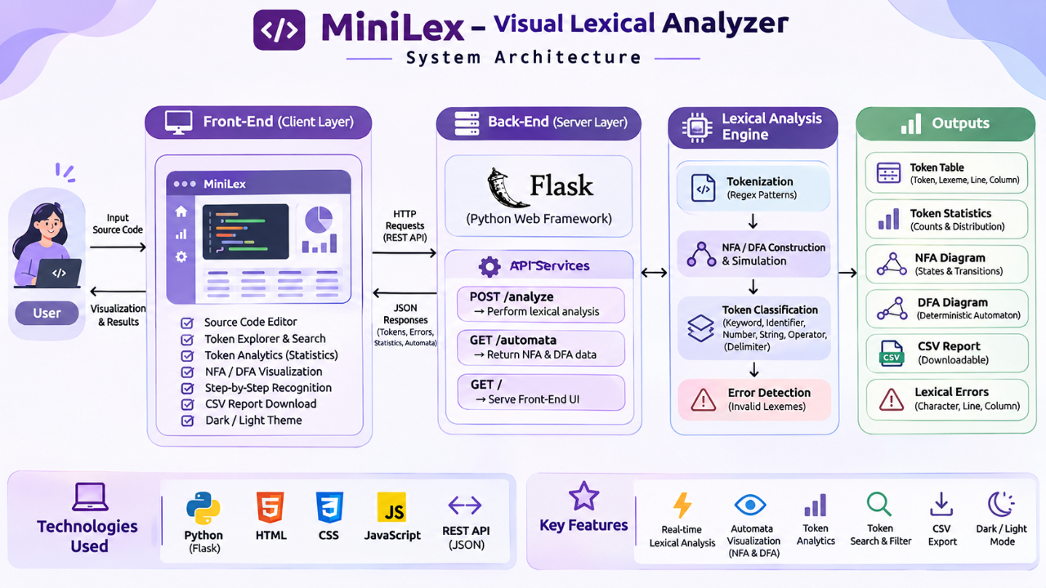
System Architecture :

Slide 9
System Workflow :
Start: User opens the MiniLex application.
Enter Input: User enters source code or defines token patterns.
Pattern Processing: The system uses Regular Expressions to define token rules.
NFA Construction: Converts Regular Expressions into an NFA.
DFA Conversion: Converts the NFA into a DFA for efficient token recognition.
Token Recognition: Scans the input source code and identifies different tokens.
Token Classification: Classifies tokens as keywords, identifiers, operators, constants, and symbols.
Error Detection: Identifies invalid characters and displays lexical errors with line numbers.
Display Output: Shows NFA/DFA diagrams, token tables, and error details.

Slide 10
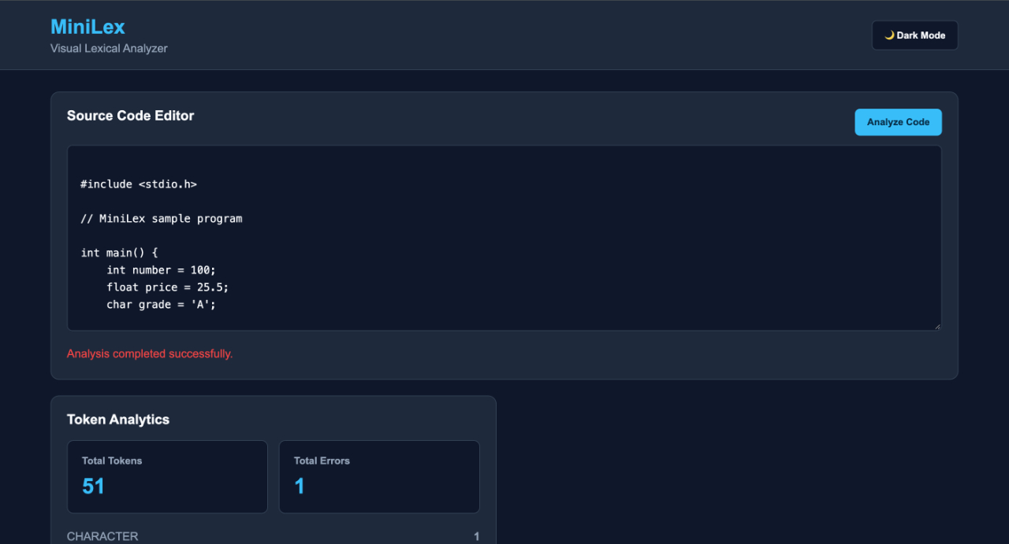
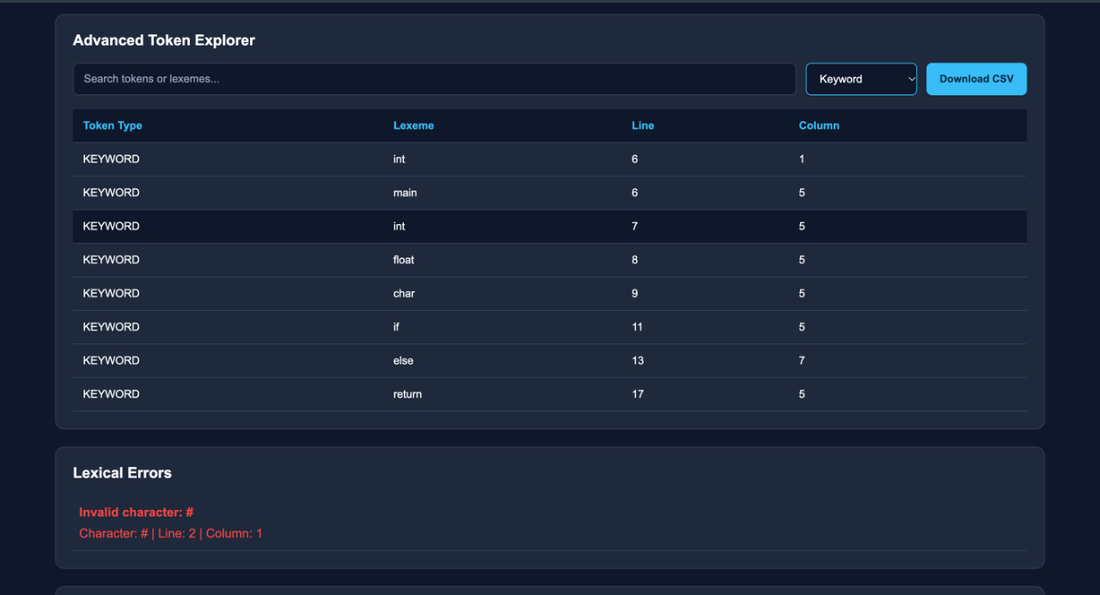
Expected Output :

Slide 11
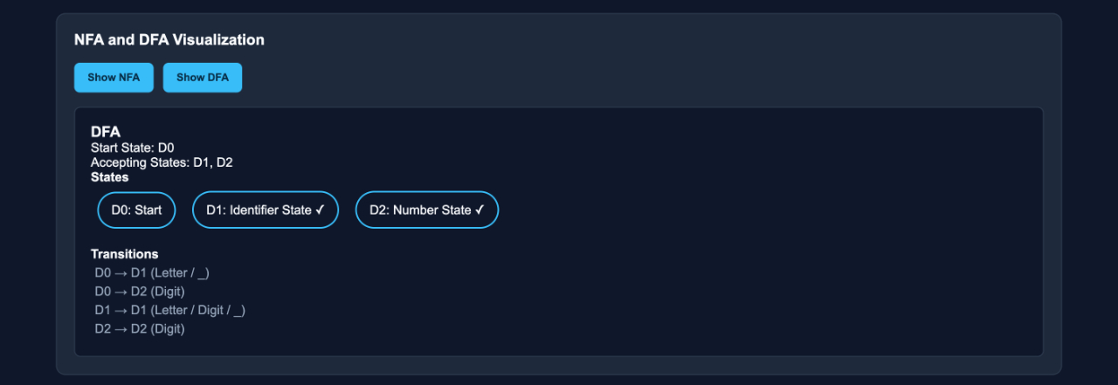
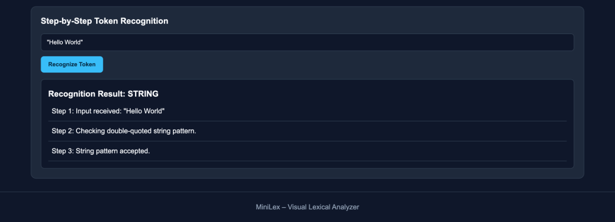
Expected Output :

