Slide 1
Medical Transcriptions
Venkata Naga Sai Sri Vaishnavi Appala
Sai Sruthi Avula
Namratha Bolar
Natural Language Processing (2025, semester II)
Professor: Satish Mahadevan Srinivasan.

Slide 2
Motivation
This project was inspired by a personal experience. After a minor accident, my mother was diagnosed with a small air crack near her lung and treated with medication. However, her condition worsened. Multiple doctors focused on the same diagnosis until a pulmonologist later identified the real issue, a lung infection requiring urgent treatment.
This showed us how easily critical conditions can be missed when symptoms are not reviewed across specialties. Our NLP model aims to bridge that gap by analyzing medical transcriptions to surface all potentially relevant diagnoses and departments, helping doctors make faster, more informed decisions.

Slide 3
Research Question
To what extent can medical NLP models detect cross-specialty overlap in transcription content (e.g., chest pain in orthopedics indicating a pulmonary issue)?
Can we build a cross-specialty referral suggestion engine using symptom-specialty mappings extracted from model interpretations? E.g., Using extracted symptoms + predicted specialty → recommend additional specialties.

Slide 4
Data Collection
Data is collected from two primary sources Kaggle(MTSamples Dataset) and Hugging Face. MTSamples contains 5000 real-world medical transcriptions. These transcriptions include a diverse range of clinical documentation such as discharge summaries, surgical notes, consultation reports, and patient histories.
Medical report dataset was sourced from the Hugging Face Datasets Hub includes around 3,600 records formatted for deep learning pipelines, featuring a text column that contains structured diagnostic summaries (e.g., CT findings, surgical impressions) and a label column encoded as class indices.
Each record is labeled with a corresponding medical specialty from a total of 39 classes, such as Surgery, Radiology, Neurology, Gastroenterology and many other. The key fields used from this dataset include description, transcription as the input text for modeling, and medical_specialty as the target label.

Slide 5
Dataset Description
Column Name | Description
description | A brief title or summary of the case (e.g., "Lung Infection Follow-up").
medical_specialty | The ground truth label — the medical department associated with the case (e.g., Pulmonology, Orthopedics). Important for classification tasks.
sample_name | Identifier or filename for the transcription. May be useful for tracing source cases.
transcription | The core clinical note (free-text). This is your primary input for NLP tasks like classification and entity linking.
keywords | A semi-structured list of terms extracted from the transcription. Useful for validation or keyword-based tagging, but not always present.

Slide 6
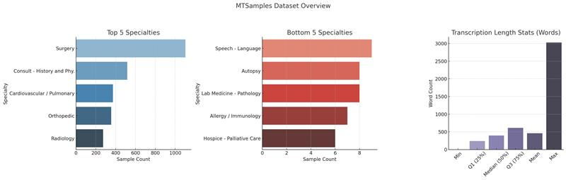
Data Analysis
The dataset contains a total of 8,500 medical transcriptions across 40 unique medical specialties. Contains high-frequency specialties Surgery (1,103 Records), followed by History and Physical Consultation (516), Cardiovascular/Pulmonary (372), Orthopedic (355), and Radiology (273).
Some samples are less than 10, leading to a class imbalance that needs to be checked further. Transcription length varies significantly, with a mean of approximately 462 words and a maximum length reaching over 3,000 words. Most transcriptions fall between 239 and 614 words.

Slide 7
Data Preprocessing
The data contains some missing values.
The missing values are filled with None Values.
Considered a function, basic clean, which contains the text-related cleaning process.
Converts all text to lowercase to ensure uniformity, then removes punctuation and digits to reduce noise.
Normalizes whitespace by replacing multiple spaces with a single space and trimming any leading or trailing spaces.
Code calculates the word count of each cleaned transcription using a lambda function that splits the text by spaces and counts the resulting tokens.
Advanced Cleaning Process
Lemmatization ensures that different word forms are treated the same (e.g., “diagnosing”, “diagnosed” → “diagnose”), improving generalization.
Stop word removal filters out common words that don’t contribute meaningful information to classification tasks.
Filtering non-alphabetic tokens helps remove noise (like numbers or special symbols) that might confuse the model.

Slide 8
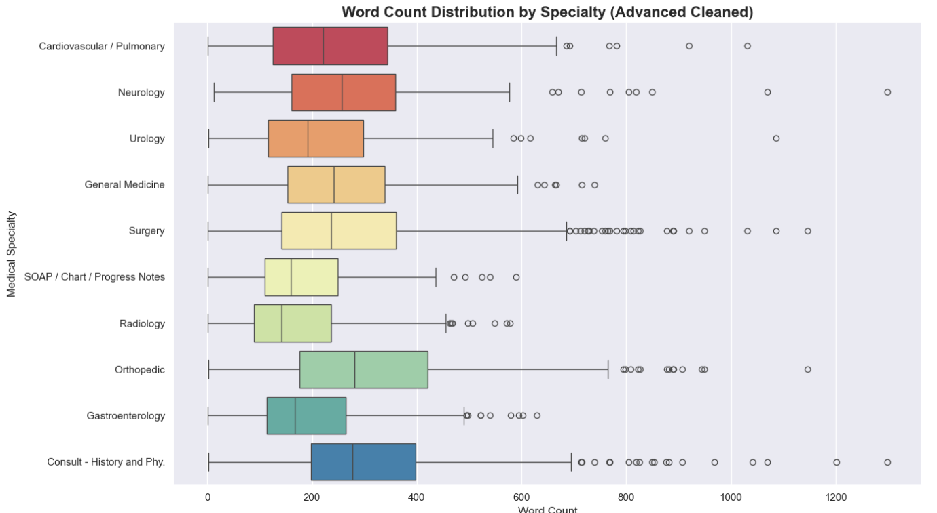
Data Visualizations (After Cleaning)
Outliers in some specialties indicate detailed or complex cases.

Slide 9
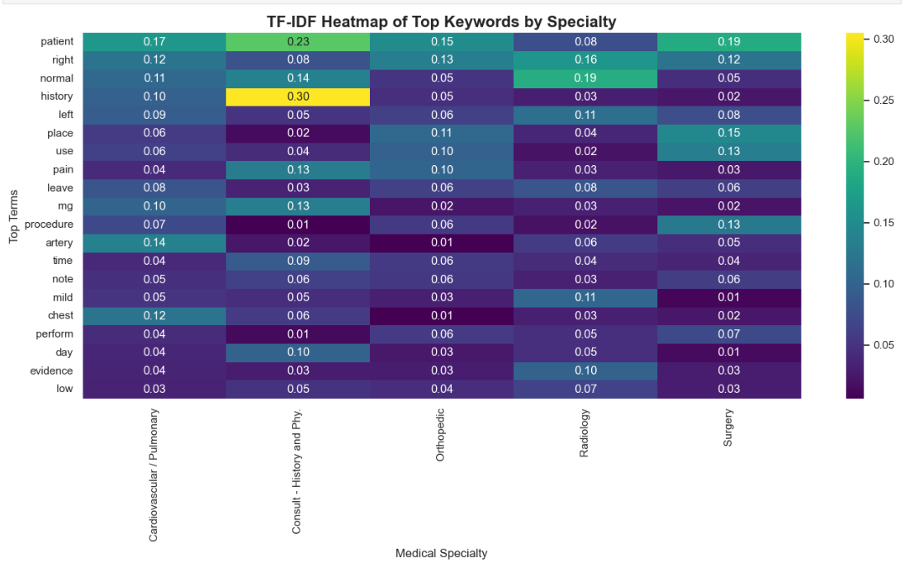
Data Visualizations (After Cleaning)
TF-IDF (Term Frequency–Inverse Document Frequency) measures how important a word is in a particular specialty relative to others. For instance, terms like “history” and “patient” have high relevance in Consult - History and Physical, while “artery” and “chest” are more prominent in Cardiovascular/Pulmonary. This analysis helps identify domain-specific terminology, supporting tasks such as specialty classification and keyword-based retrieval.

Slide 10
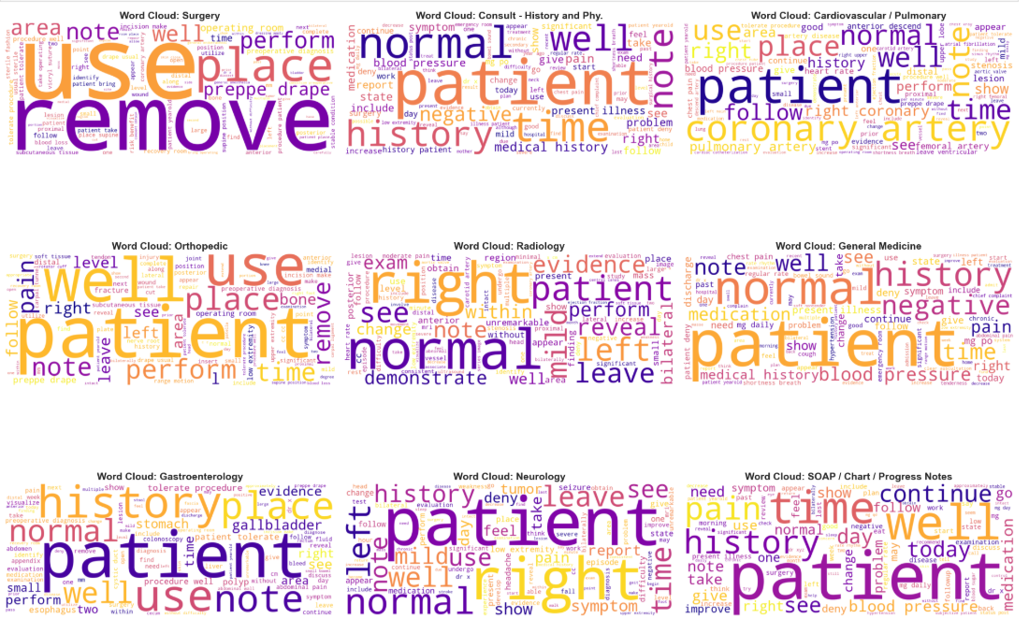
Data Visualizations (After Cleaning)
Each cloud highlights the dominant language patterns used by practitioners within a specific field. Cardiovascular/Pulmonary emphasizes terms like "artery", "coronary", and "patient". Fields such as General Medicine, Neurology, and Radiology commonly include terms like "history", "normal", "right", and "time", which reflect routine evaluations and observations. These visualizations help highlight the semantic uniqueness of each specialty.

Slide 11
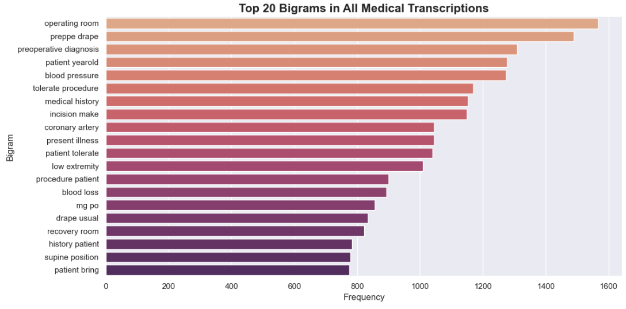
Data Visualizations (After Cleaning)
Terms like "operating room", "prep drape", and "preoperative diagnosis" reflect the procedural and surgical nature of many reports. Bigrams such as "blood pressure", "medical history", and "present illness" highlight commonly documented clinical assessments and patient histories. These frequent bigrams are valuable for understanding domain-specific language patterns and can enhance feature engineering for NLP tasks like classification or information retrieval.

Slide 12
Model & Architecture
To address the task of medical specialty classification from clinical text, we implemented three diverse deep learning architectures: DistilBERT, Bio_ClinicalBERT, and BiLSTM.
BioClinicalBrERT: Bio_ClinicalBERT, a domain-specific variant of BERT, is pre-trained on PubMed abstracts and MIMIC-III clinical notes. It brings rich biomedical contextual understanding, making it particularly effective in capturing medical terminology and nuances.
DistilBERT: DistilBERT is a lightweight transformer model distilled from BERT, offering faster inference while retaining much of BERT’s language understanding capabilities. It employs a multi-head self-attention mechanism and positional encoding to model word relationships over long text spans.
BiLSTM: Bidirectional LSTM (BiLSTM) is a type of recurrent neural network that processes input sequences in both forward and backward directions. This allows the model to capture contextual dependencies from both past and future tokens, which is particularly beneficial in understanding long-form clinical narratives such as transcriptions and patient histories.

Slide 13
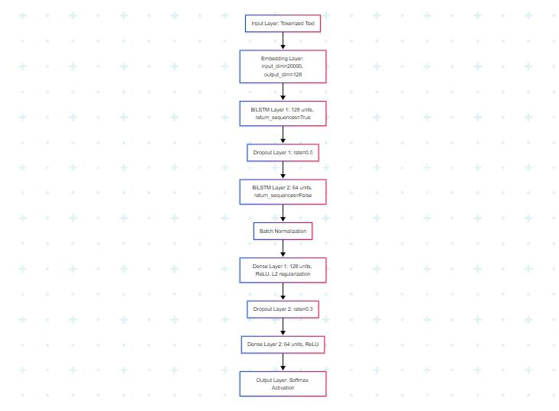
Training Stratergy
BiLSTM
Training Settings | Regularization | Advanced Techniques | Fine-tuning Phase
Optimizer: Adam LR: 1e-3 Epochs: 5 Batch Size: 64 | Dropout (0.3 & 0.5) L2 Regularization BatchNorm | Bidirectional LSTM Layers Embedding Layer Gradient Clipping | Model saved after best val_accuracy Predictions and evaluation via sklearn report

Slide 14
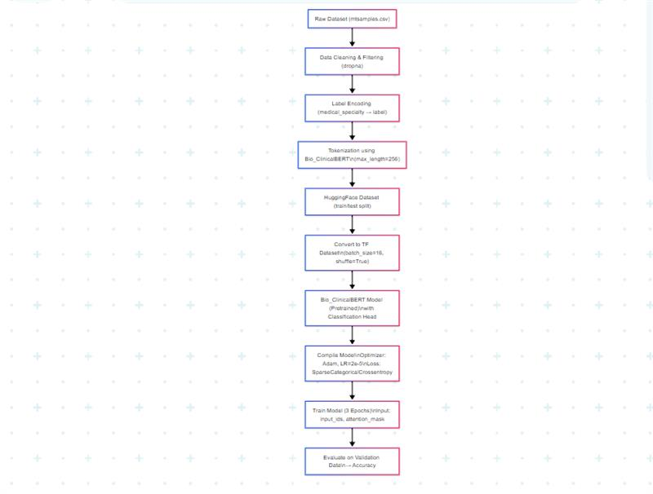
Training Stratergy
BioClinicalBrERT:
Training Settings | Regularization | Advanced Techniques | Fine-tuning Phase
Optimizer: Adam LR: 2e-5 Epochs: 3 Batch Size: 16 | Dropout (0.1) Class Weights Validation Split | Tokenization (max_len=256) Pretrained Biomedical Embeddings TF Dataset with DataCollator | Tokenized prediction Validation evaluation Class label decoding

Slide 15
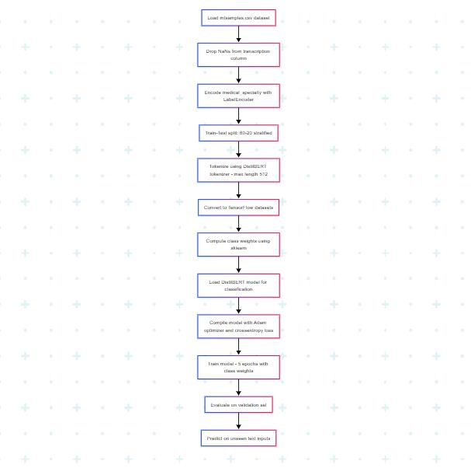
Training Stratergy
DistilBERT
Training Settings | Regularization | Advanced Techniques | Fine-tuning Phase
Optimizer: Adam LR: 2e-5 Epochs: 5 Batch Size: 16 | Dropout (0.1) Class Weights Validation Split | Tokenization (max_len=512) Pretrained Embeddings Hugging Face Pipeline | Predict on unseen data (tokenized) Class label decoding Evaluate with classification report

Slide 16
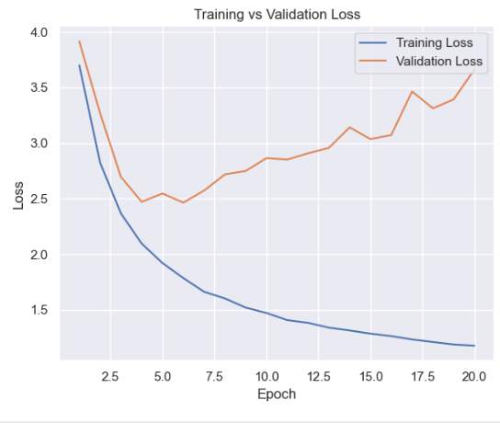
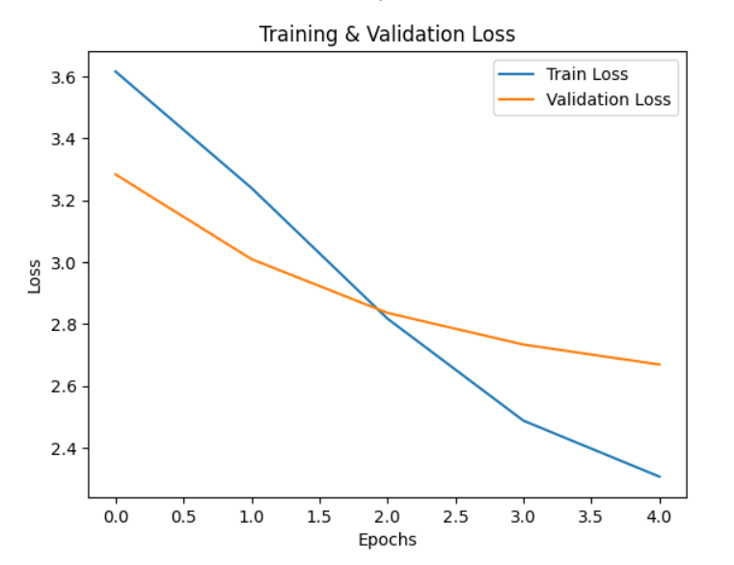
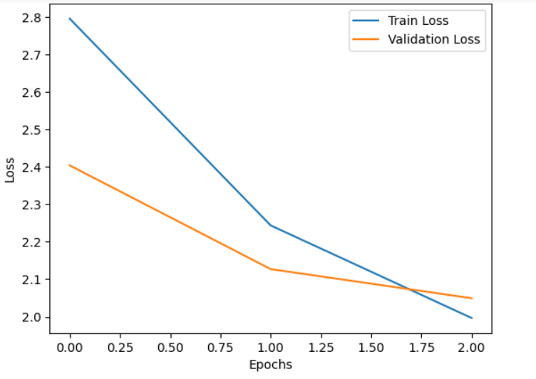
Results
Bi-LSTM
DistilBERT
BioClinicalBERT

Slide 17
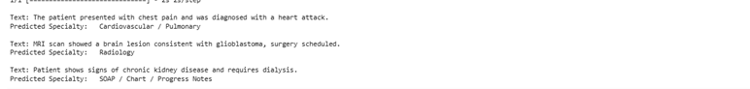
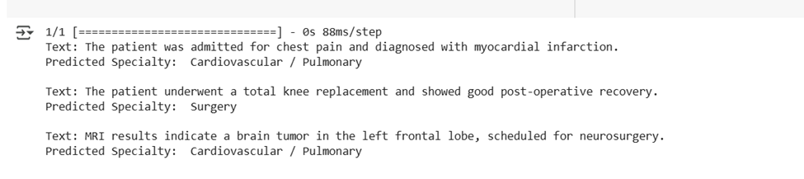
Results
BiLSTM
DistilBert
Bio-ClinicalBERT

Slide 18
Conclusion
This study applied deep learning models for classifying clinical narratives into medical specialties using the MTSamples dataset.
Transformer-based models like DistilBERT and Bio_ClinicalBERT effectively captured semantic and contextual relationships due to their self-attention mechanisms and pretrained biomedical embeddings.
The BiLSTM model learned temporal patterns in longer sequences and showed stable convergence. Overall, the results emphasize the importance of domain-specific pretraining and contextualized embeddings.
Future improvements can focus on fine-tuning strategies, and adaptive regularization to enhance generalization for less frequent medical categories.

Slide 19
Thank You

