Slide 1
Overview
History
Installing & Running Python
Names & Assignment
Sequences types: Lists, Tuples, and Strings
Mutability

Slide 2
Brief History of Python
Invented in the Netherlands, early 90s by Guido van Rossum
Named after Monty Python
Open sourced from the beginning
Considered a scripting language, but is much more
Scalable, object oriented and functional from the beginning
Used by Google from the beginning
Increasingly popular

Slide 3
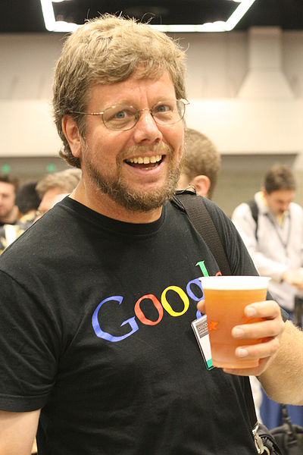
Python’s Benevolent Dictator For Life
“Python is an experiment in how much freedom program-mers need. Too much freedom and nobody can read another's code; too little and expressive-ness is endangered.”
- Guido van Rossum

Slide 4
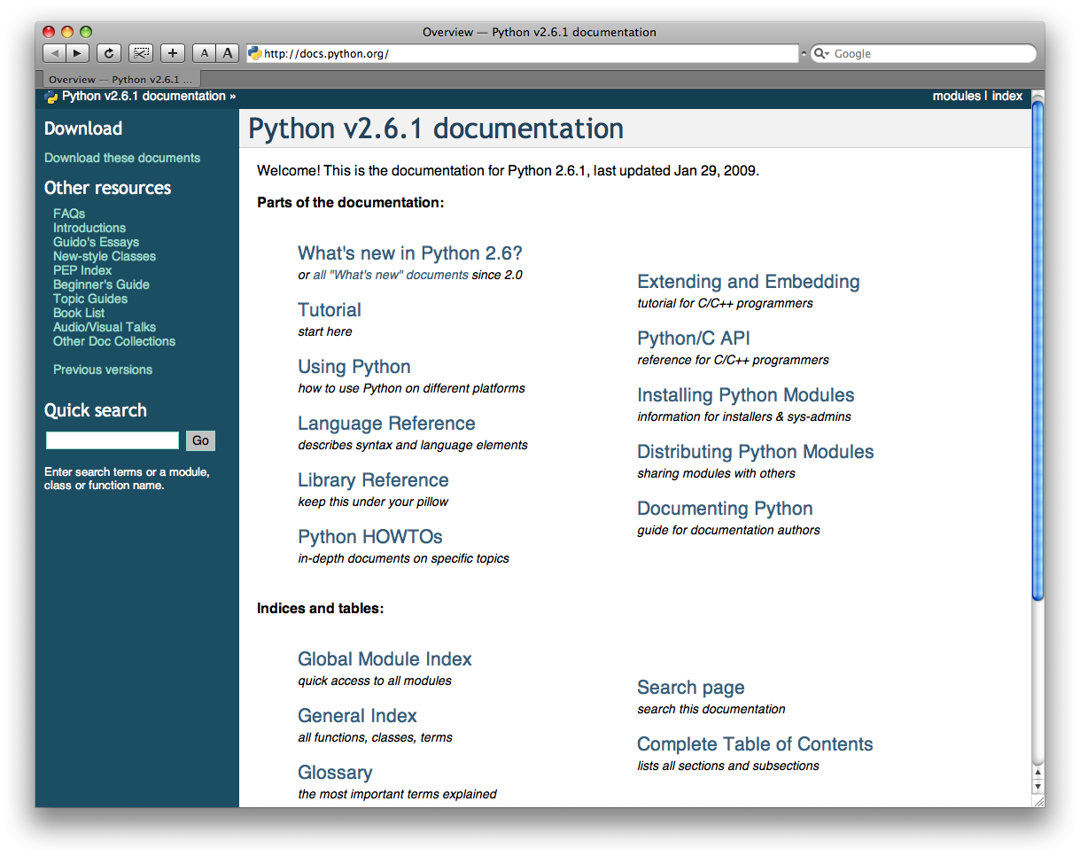
http://docs.python.org/

Slide 5
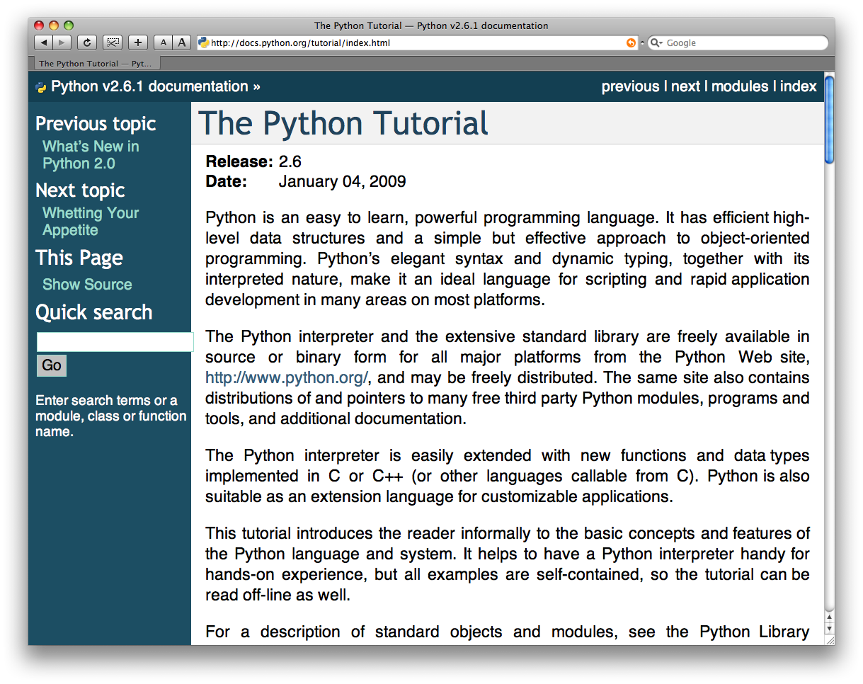
The Python tutorial is good!

