Slide 1
Assignment 3
Vaishnavi Khismatrao
Sanika Patne
Nirmayee Dighe

Slide 2
Problem Statement
To build a university performance model which will help them keep a track of their graduate students and their employment status over a period of 5 years. Also, it will maintain a record of the jobs and promotions, graduates get over time as well as allot rankings accordingly.
Compare connections of graduate student courses and relevant growth. Define a ranking system for students to decide where they want to go for their studies.

Slide 3
Proposed Solution
Summary:
The goal is to provide career-oriented students with quality education that is tailored to current market demands and trends by improving real time with the feedbacks of university’s alumni.
The goal is to create a system that analyzes statistical data gathered from student/alumni feedback, tracks student advancement in a professional context, and examines the courses that assisted students in their professional development.

Slide 4
Proposed Solution
Execution:
To create a performance management solution that would analyze the dependency of faculty and courses and how it contributes to the professional growth of graduates, it is essential to keep a record of all courses that the students have taken and how these courses proved to be relevant for their future career.
We have also taken surveys from employers which would help us know the current trends in the market. These surveys will help keep departments up to date with the recent technologies and change their curriculum accordingly.

Slide 5
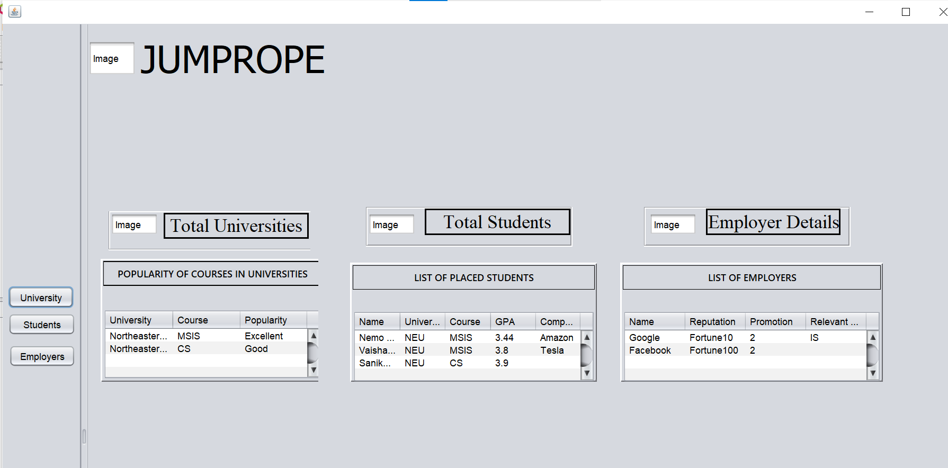
Application Dashboard Homepage

Slide 6
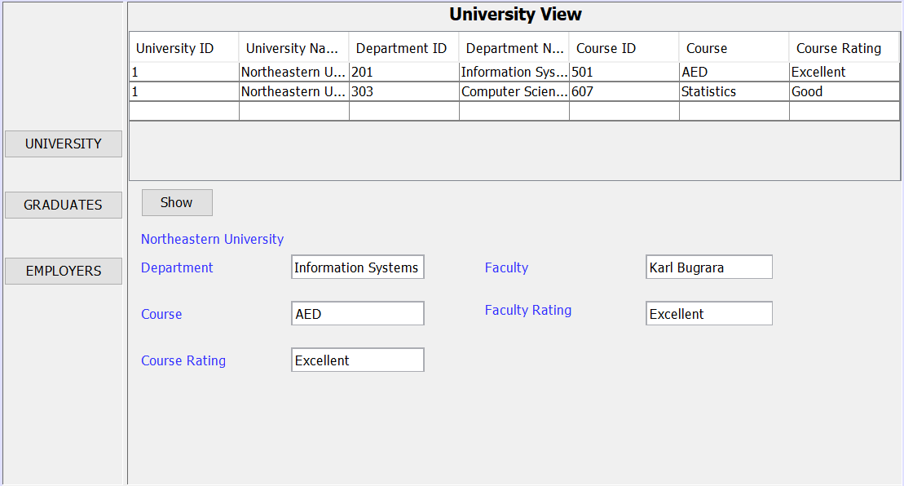
Application Dashboard

Slide 7
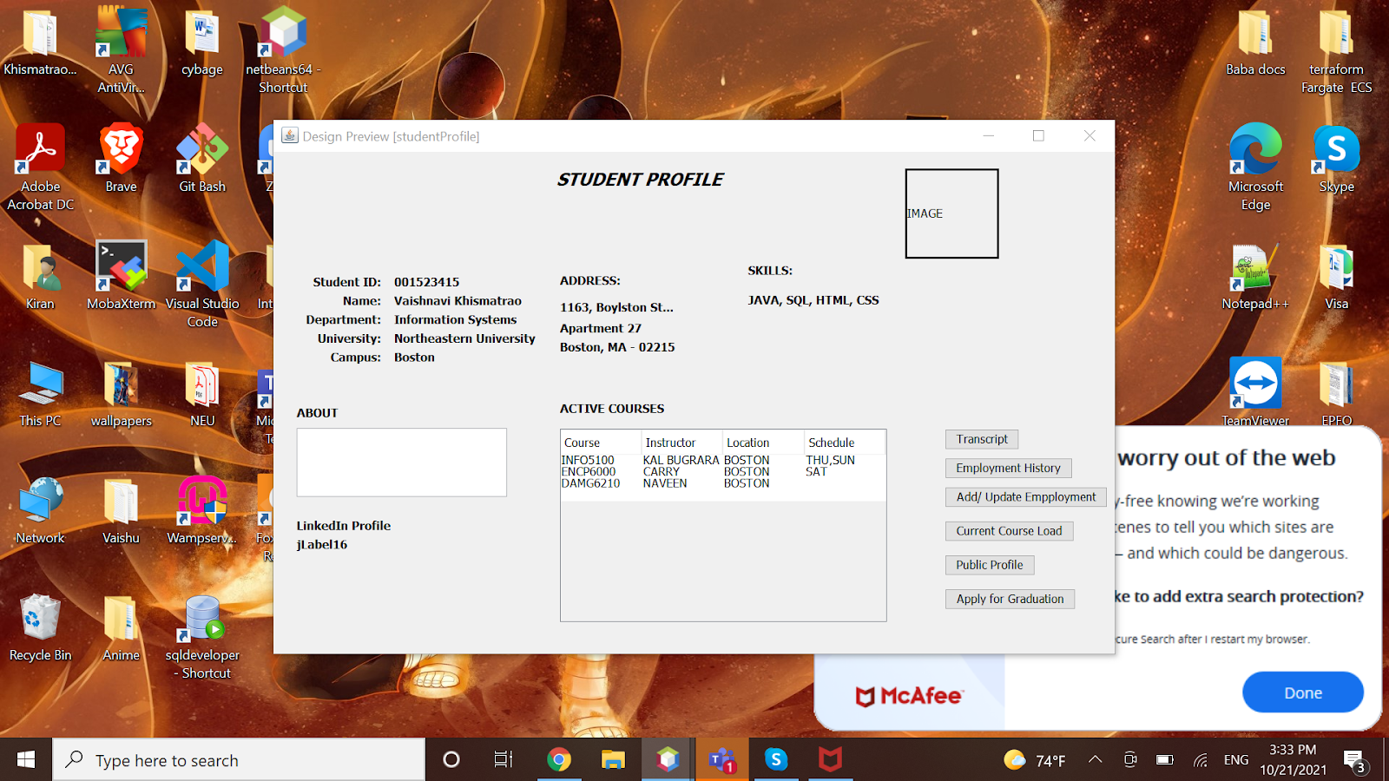
Student Profile
The user can access all the academic and personal information of the students.
This view will give user a brief idea about a student’s academic record, their courses, skills, etc.
This page will also allow a user to keep track of the coursework of the students and their progress.
A student can update his/her information i.e. they can update their employment status.
Thus this page will enable user to keep a track of his/her employment status and their professional growth over a period of time.

Slide 8
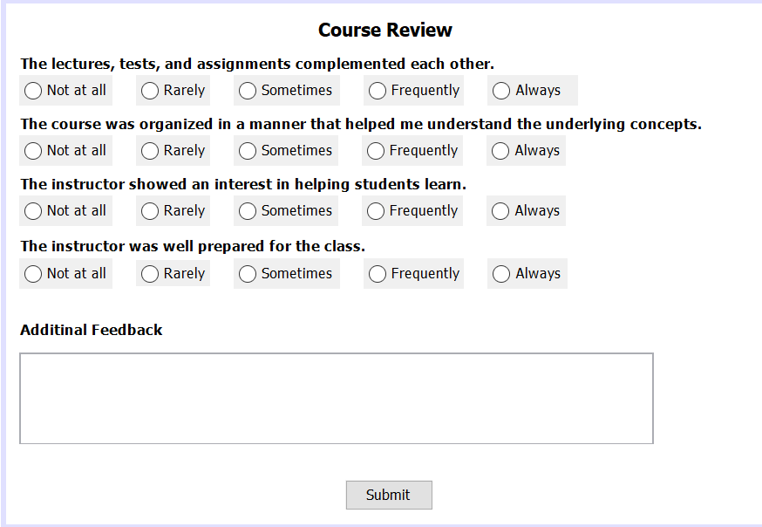
Course Review
It is essential to take a periodic feedback from students, this feedback will b stored and analyzed.
It is the feedback data which will play a major role in course rating. Student’s identity will be kept anonymous so that an honest feedback is received.
This feedback will serve the user with information about what the students think of each courses and how helpful have they been in their life.
The questions we have been serve as a prototype as to what type of questions are to be included in the feedback form.

Slide 9
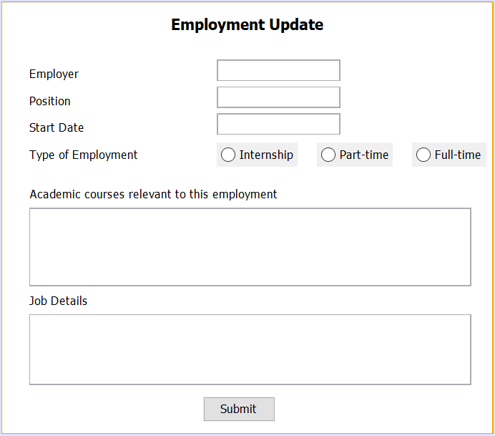
Employment Update
This page is only accessible to the students and can access it after logging in the system.
Students can update their employment status and mention what courses where relevant to the job or internship secured.
Students can provide information like job details and skillsets required.
This information will be displayed on the student portal and the user will be able to view it on the Student Profile Page.

Slide 10
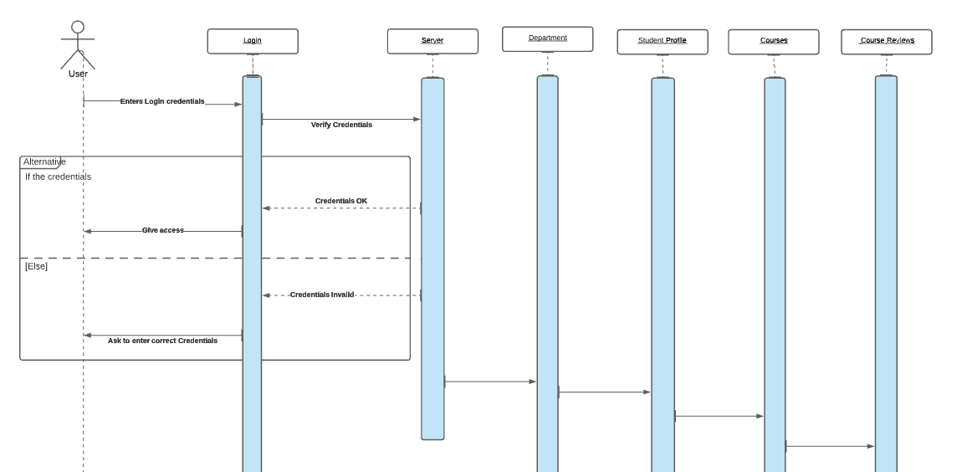
Sequence Diagrams
Sequence diagram for an user (student) to enter course reviews

Slide 11
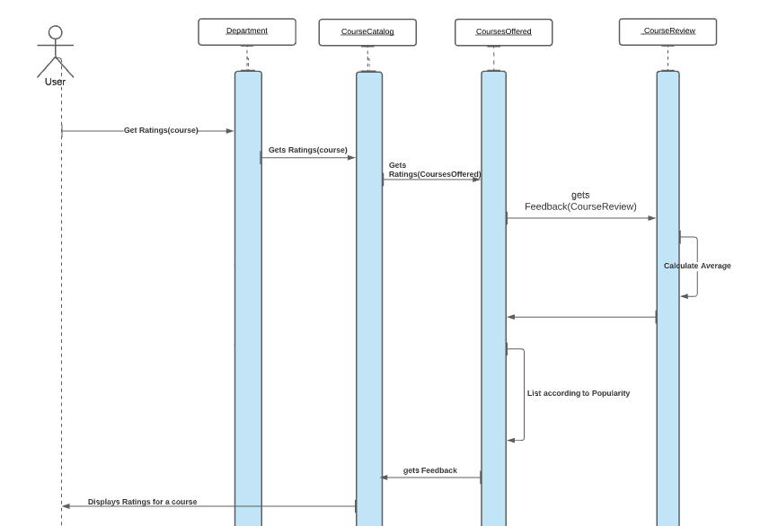
Sequence Diagrams
Sequence diagram for an user to get ratings for a course

Slide 12
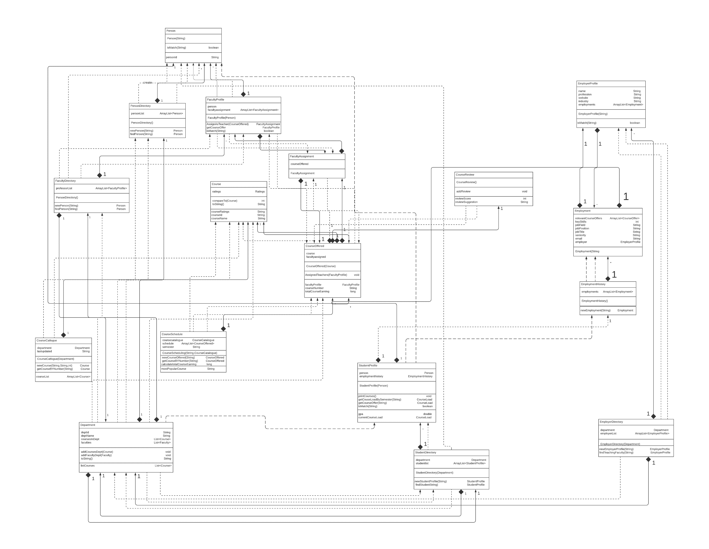
Object Model

