Slide 1

Unified Healthcare Appointment
and Immunization Tracking System
MCA MINI PROJECT — FIRST REVIEW
Team:
Induja E (25MX315)
Vaishali S (25MX355)
Guide:
Ms. A. Kalyani
MCA — Semester 3, PSG College of Technology
Notes:
1

Slide 2
INTRODUCTION
Acknowledgement
We express our sincere gratitude to the respected Review Panel for their valuable time, guidance, and insightful suggestions in evaluating our project. We would like to extend our heartfelt thanks to:
Dr. N. Ilayaraja
Ms. A. Kalyani
Dr. S. Bhama
Ms. R. Aruna
for their encouragement, constructive feedback, and expert recommendations, which will help us improve the quality of our project. We also express our sincere thanks to our project guide, the faculty members, and the Department of Computer Applications, PSG College of Technology, for their continuous support and guidance throughout this project.
Thank You.
Unified Healthcare Appointment and Immunization Tracking System
2
Notes:
2

Slide 3
RECAP
Project at a Glance
PROPOSED MODULES
A web application that unifies appointment booking, automated reminders, and a patient's complete medical history across every hospital they visit — while integrating with the government-issued ID used to track a pregnancy through delivery and a child's immunization.
Appointment booking
Automated reminders
Unified medical history
Since the Zeroth Review
Emergency data transfer
Finalized the 4 system roles and their access levels
Began module-wise implementation on the MERN stack
5 of 8 proposed modules are now functional
Government ID integration
Hospital dashboard
Immunization Records
Unified Healthcare Appointment and Immunization Tracking System
3
Notes:
3

Slide 4
SYSTEM DESIGN
Roles in the System
1
Patient
2
Doctor
Books appointments, views unified medical history, and receives automated reminders. Can link a government maternal ID for pregnancy and immunization tracking.
Views assigned appointments and patient history at the point of care, and records consultation outcomes.
3
Hospital Staff
4
Administrator
Manages appointment slots, updates patient records, and handles inter-hospital data transfer during referrals.
Oversees data and activity across all participating hospitals in the system.
Unified Healthcare Appointment and Immunization Tracking System
4
Notes:
4

Slide 5
IMPLEMENTATION
Technology Stack
MongoDB
Express.js
React.js
Node.js
DATABASE
BACKEND FRAMEWORK
FRONTEND
RUNTIME
Stores patient, appointment, and record data as documents
Handles REST API routing and business logic
Patient and hospital-facing web interface
Powers the backend server and API layer
Together: MongoDB + Express.js + React.js + Node.js (MERN) — one JavaScript stack from database to browser.
Unified Healthcare Appointment and Immunization Tracking System
5
Notes:
5

Slide 6
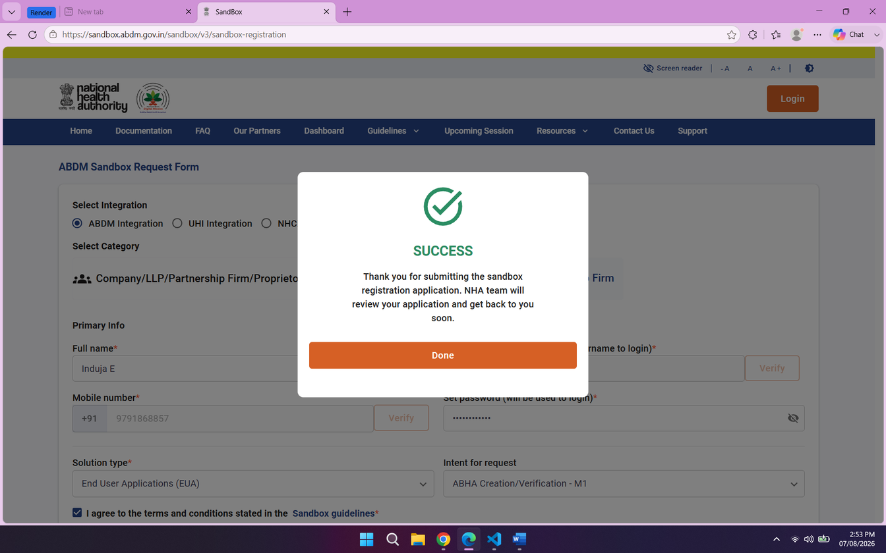
Zeroth Review Comments
Comments
Check Feasibility of getting the government DB
ABHA ID Integration
Implemented ABHA ID registration and authentication using the ABHA Sandbox API for secure digital health identity integration.
Machine Learning Dataset Integration
Collected and integrated a Kaggle volunteer dataset for the ML module, followed by data preprocessing and model training for prediction and analysis.

Slide 7
PROGRESS
Modules — Progress Status
Completed
Planned / Upcoming
Appointment Booking
Automated Reminders
DONE
PLANNED
Government ID Integration
Unified Medical History
DONE
PLANNED
Hospital Dashboard
Emergency Data Transfer
DONE
PLANNED
Immunization Records
DONE
ML Integration
DONE
Unified Healthcare Appointment and Immunization Tracking System
6
Notes:
6

Slide 8
PROGRESS
Completed Modules
Appointment Booking
Government ID Integration
Hospital Dashboard
DONE
DONE
DONE
Patients search for nearby healthcare providers and book an appointment online by choosing doctor, date, time, and type.
Links a patient's antenatal, delivery, and immunization records to their existing government-issued ID.
Lets hospital staff view and update patient records, manage appointment slots, and log vaccination entries.
Unified Healthcare Appointment and Immunization Tracking System
7
Notes:
7

Slide 9
PROGRESS
Completed Modules
Immunization Records
ML Integration
DONE
DONE
The system maintains comprehensive vaccination tracking for patients, allowing healthcare providers to record, monitor, and retrieve immunization histories with due-date reminders for upcoming doses.
A Gradient Boosting machine learning model analyzes patient data — including age, medical condition, and test results — to intelligently suggest appointment types and balance doctor workloads through real-time risk scoring.
Unified Healthcare Appointment and Immunization Tracking System
7
Notes:
7

Slide 10
ML Integration
Machine Learning
What is Gradient Boosting?
A powerful ensemble learning algorithm that builds 200 decision trees sequentially, where each tree learns from the mistakes of the previous one — resulting in a highly accurate final prediction.
Model 1 — Appointment Type Prediction
Model 2 — Doctor Risk Scoring & Workload Balancing
Unified Healthcare Appointment and Immunization Tracking System
7
Notes:
7

Slide 11
ML Integration
Machine Learning
Model 1 — Appointment Type Prediction
Input: Age, Gender, Blood Type, Medical Condition, Medication, Test Results
Output: Emergency | Consultation | Follow-up | General Checkup | Vaccination
Steps:
Patient profile is passed as input
200 trees analyze and correct each other's predictions
Final appointment type is suggested with confidence score
Model 2 — Doctor Risk Scoring & Workload Balancing
Input: Age, Medical Condition, Test Results
Output: Low | Moderate | High | Critical
Steps:
Each active patient of a doctor is risk-scored (0–100)
Average risk score is calculated per doctor
Doctor with lowest score is recommended for new appointment
Unified Healthcare Appointment and Immunization Tracking System
7
Notes:
7

Slide 12
IMPLEMENTATION
Database Models — Draft Schema
Model | Key Fields
User | name, email, password, role, hospitalId, contactInfo
Appointment | patientId, doctorId, hospitalId, date, time, type, status, notes
MaternalRecord | govtMaternalId, patientId, antenatalVisits[], deliveryDetails, immunizationLinks
Slot | hospitalId, doctorId, date, time, isBooked
Vaccination | patientId, vaccineName, date, status, administeredBy
Draft schema based on modules proposed at the Zeroth Review — to be aligned with the actual implementation.
Unified Healthcare Appointment and Immunization Tracking System
8
Notes:
8

Slide 13
IMPLEMENTATION
API Endpoints — Completed Modules
Method | Route | Purpose
GET | /api/appointments/search | Search nearby healthcare providers
POST | /api/appointments | Book an appointment
GET | /api/maternal/:govtId | Look up a maternal record by government ID
POST | /api/maternal | Register a maternal record and link the government ID
POST | /api/hospital/slots/:id | Update an appointment slot
GET | /api/hospital/vaccinations | Log a vaccination entry
Sample route naming for the three completed modules — adjust to match your actual API.
Unified Healthcare Appointment and Immunization Tracking System
9
Notes:
9

Slide 14
ROADMAP
Remaining Work
1
2
3
Automated Remainders
Unified Medical History
Emergency Data Transfer
Alerts for check-ups, follow-ups, and medication schedules.
Consolidates diagnoses, treatment, and test records across hospitals.
Shares patient history with a receiving hospital during referral.
Unified Healthcare Appointment and Immunization Tracking System
10
Notes:
10

Slide 15
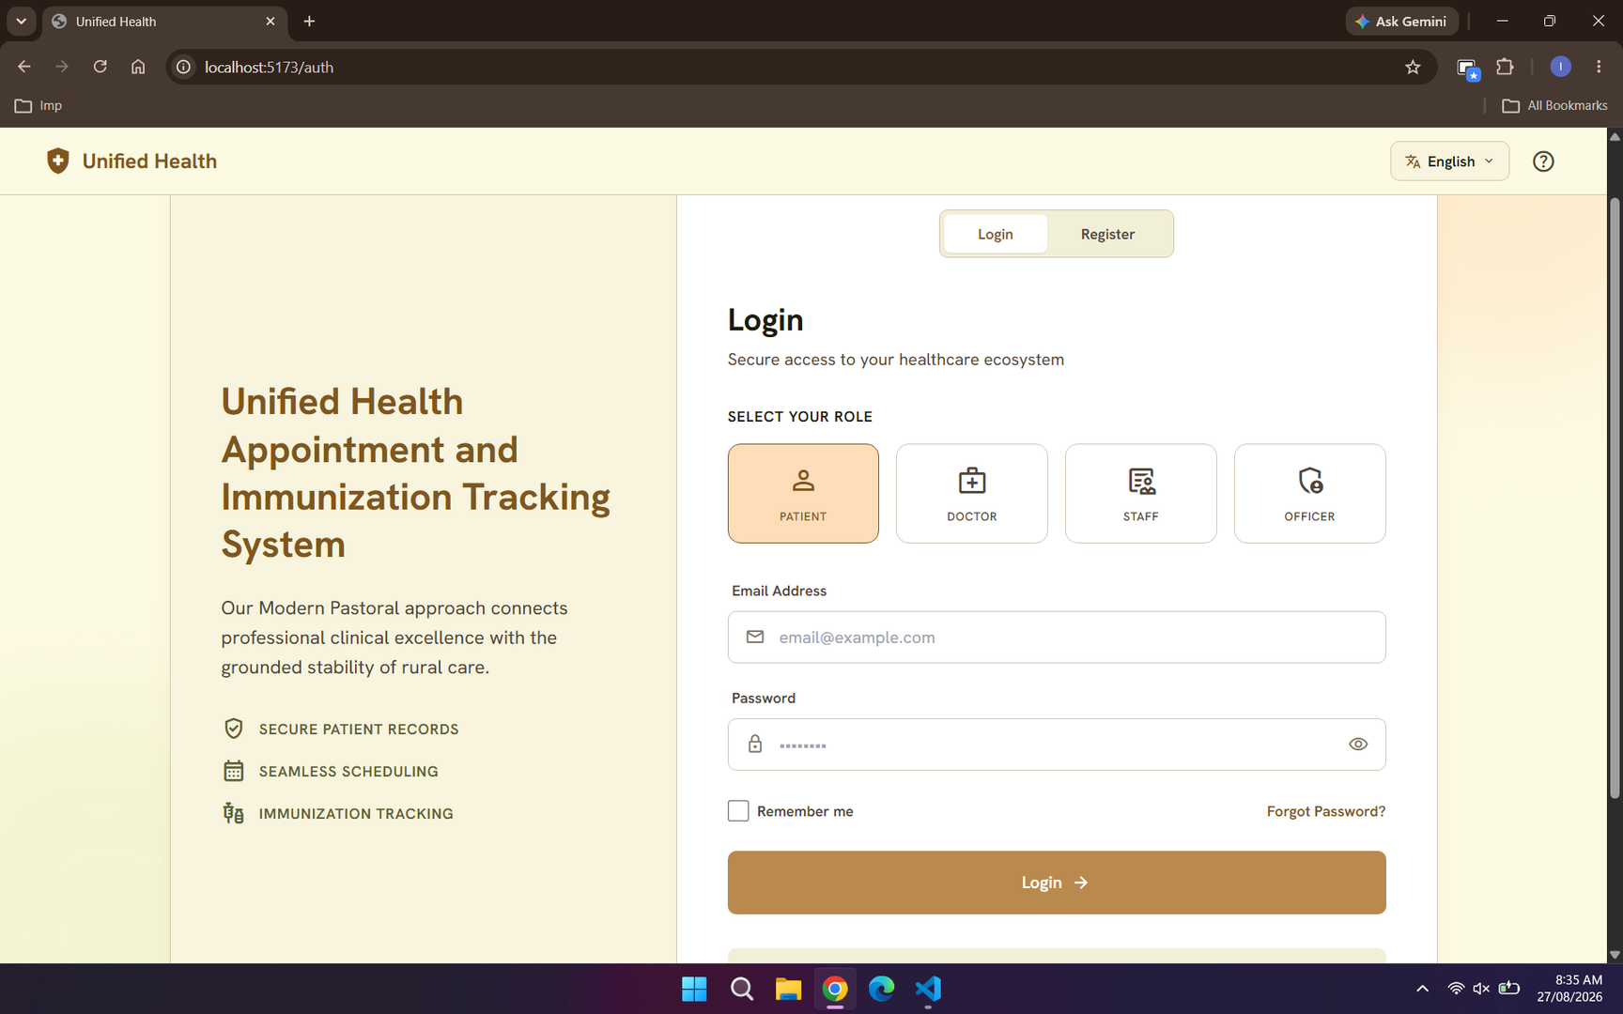
Login Page
Notes:
11

Slide 16
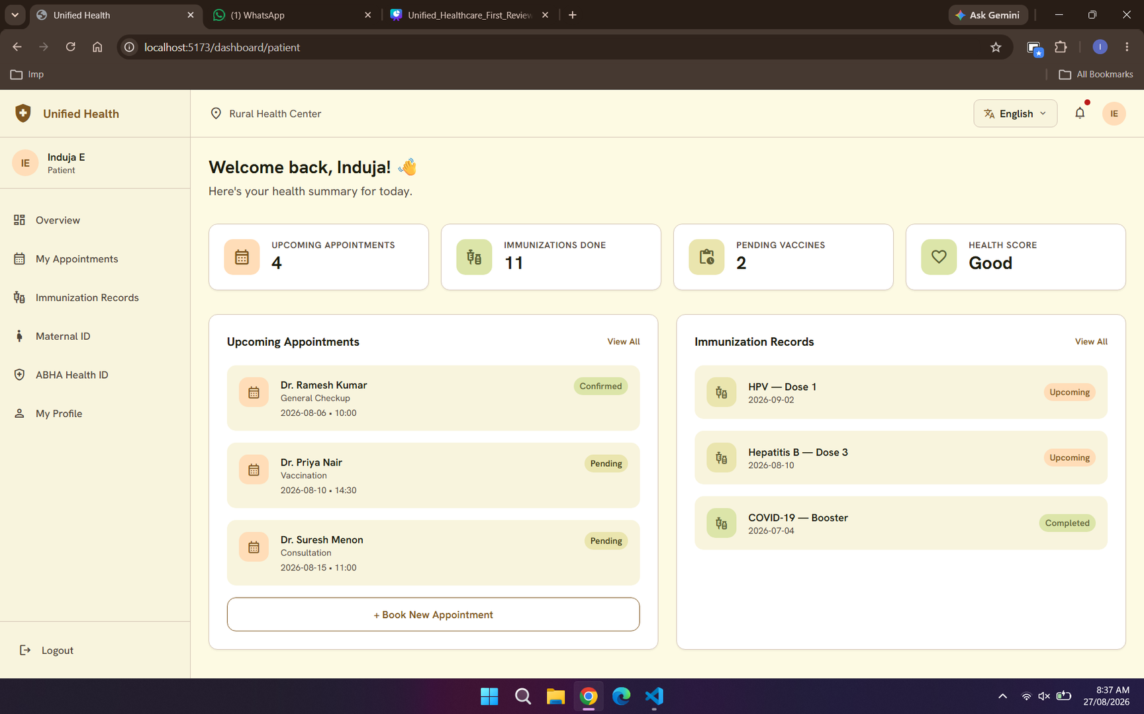
Dashboard
Notes:
11

Slide 17
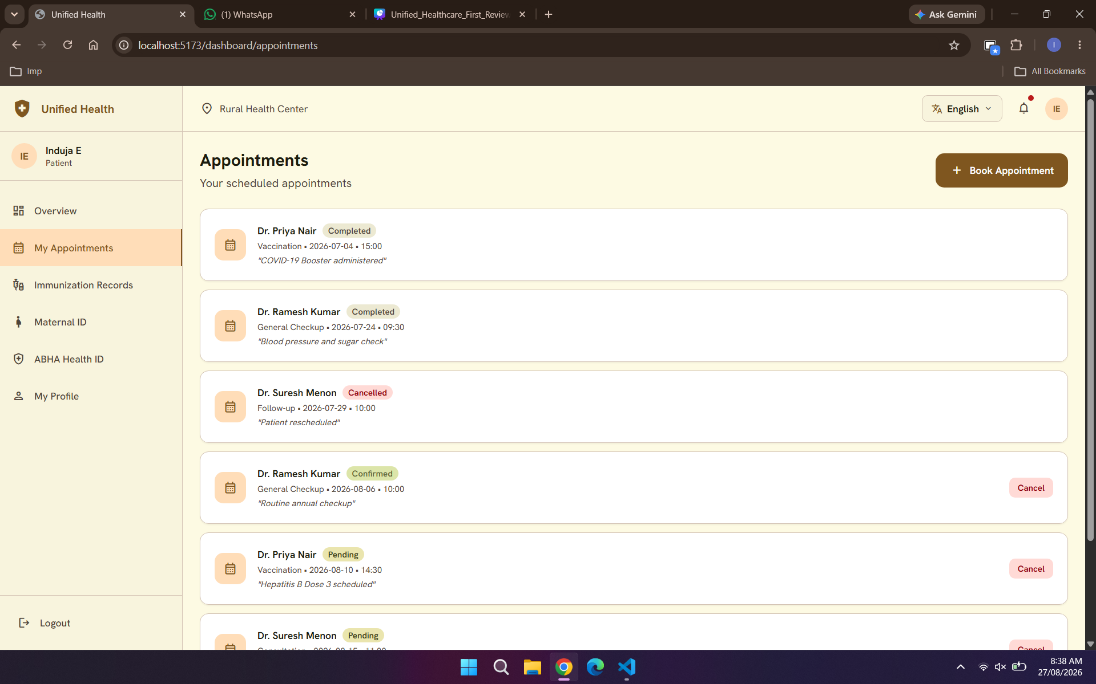
Appointments
Notes:
11

Slide 18
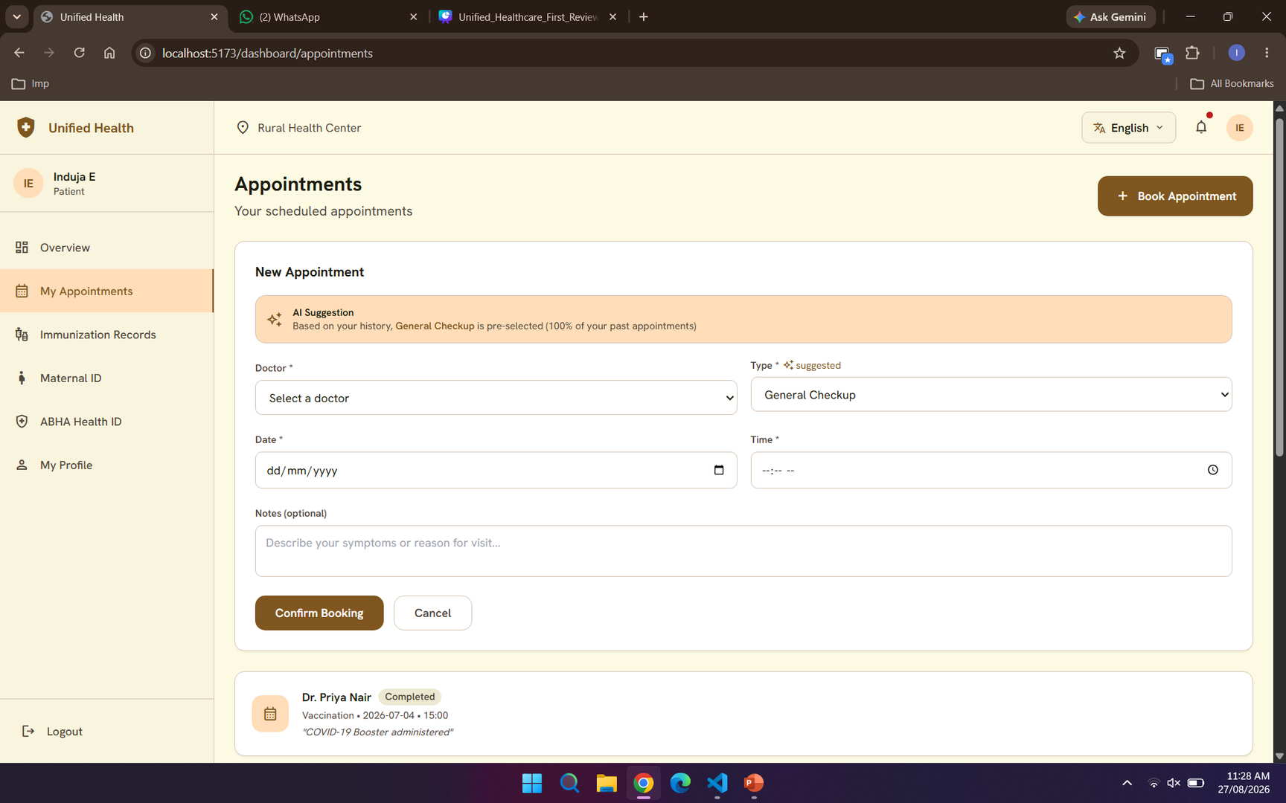
Appointment suggestions

Slide 19
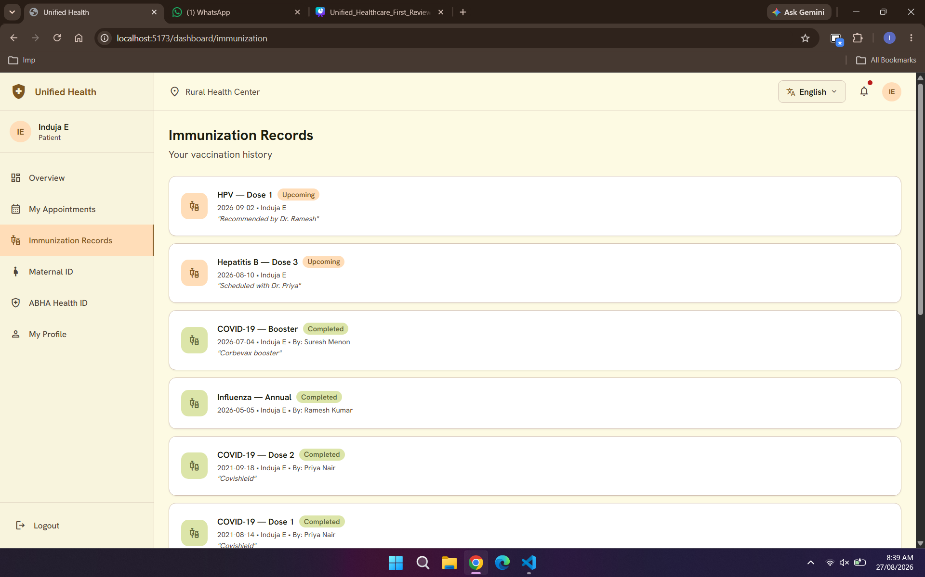
Immunization Records
Notes:
11

Slide 20
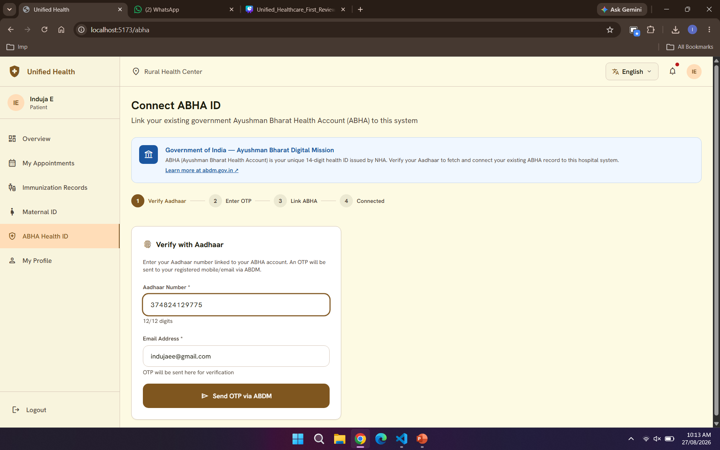
ABHA ID
Notes:
11

Slide 21
Demo Video
Notes:
11

Slide 22
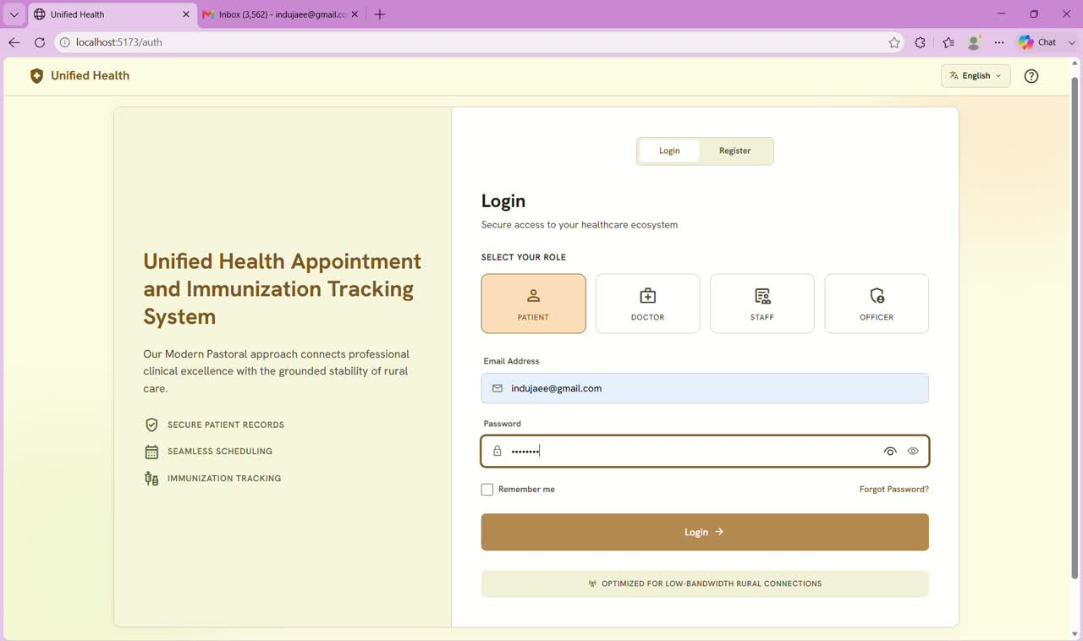

Slide 23
Queries & Suggestions
Notes:
11

Slide 24
Thank You
Notes:
11

