Slide 1

HR Analyst

Slide 2

A
Introduction
Problem Statement
Conclusion
Business Objective
KPIS
DashBoard
G
E
N
D
A

Slide 3

Introduction
HR analytics involves collecting and analyzing employee-related data.
Focuses on performance metrics and other key HR data points.
Uses advanced analytical tools and techniques.
Provides insights into HR trends and processes.
Enables data-driven decision-making to improve employee performance and organizational outcomes.

Slide 4
Business Objective
The goal of this project is to analyze employee retention and attrition rates within the organization and provide actionable insights to the HR team for enhancing retention strategies. Using data analysis and visualizations, the project will:
Identify key factors influencing employee turnover and attrition.
Assess the effectiveness of current retention strategies.
Evaluate employee satisfaction levels within the organization.
Offer recommendations to improve employee retention and engagement.

Slide 5
Problem Statement
1. Average attrition rate for all Departments .
2. Average hourly rate of Male Research Scientist.
4. Average working years for each Department.
5. Job role Vs Work life balance.
3. Attrition rate Vs Monthly Income stats.
6. Attrition rate Vs Years Since last promotion.

Slide 6
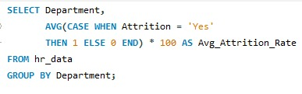
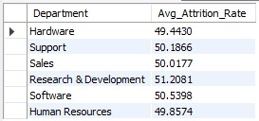
KPI 1
Query and Output
Average attrition rate for all Department
The attrition rate across all departments is nearly 50%
This shows that attrition is not dependent on the department.
Approximately 50% of employees leave the company, regardless of their department.
Strong strategies are needed to reduce the attrition rate.
Improving employee retention will help balance company growth and retain the right talent.

Slide 7


KPI 2
Query and Output
Average Hourly rate of Male Research Scientist
This KPI is to find out the average hourly rate of male research scientists which is 114.45.

Slide 8
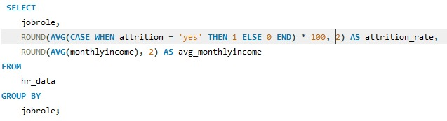
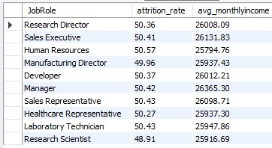
KPI 3
Query and Output
Attrition rate Vs Monthly income stats
Highest Attrition Rate: Human Resources (50.57%)
Lowest Attrition Rate: Research Scientist (48.91%)
Highest Monthly Income: Manager (₹26,365.30)
Key Insight: Attrition is high in both high and low-income roles, suggesting factors beyond salary affect employee turnover.

Slide 9

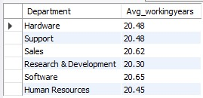
KPI 4
Query and Output
Average working years for each Department
The Sales Department has the highest average working years.
The Research and Development Department has the lowest average working years.
On average, employees work approximately 20 years across all departments.

Slide 10

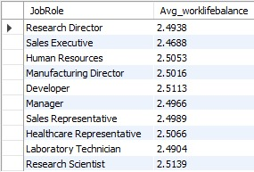
KPI 5
Query and Output
Job Role Vs Work life balance
Poor work-life balance: Research Directors and Laboratory Technicians.
Fair work-life balance: Sales Representatives, Managers, Manufacturing Directors, and Sales Executives.
Good work-life balance: Research Scientists, Healthcare Representatives, and Developers.
Excellent work-life balance: Human Resources.
Insight: Work-life balance is different for each role, so strategies should be designed to meet the specific needs of each group.

Slide 11
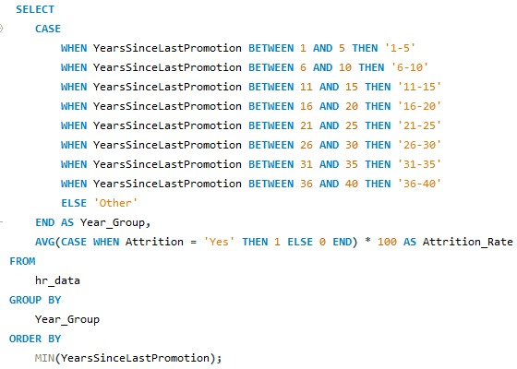
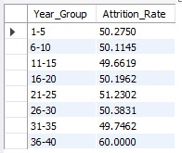
KPI 6
Attrition rate Vs Year since last promotion relation.
Query and Output
Attrition rate remains relatively consistent across most year groups, with slight fluctuations.
The highest attrition rate (60%) is observed in the group 36-40 years since the last promotion.
Groups with fewer years since the last promotion (1-5 and 6-10 years) show moderately lower attrition rates (~50%).
The attrition rate dips slightly for 11-15 years (49.66%) but rises again for employees with 21+ years since their last promotion.

Slide 12
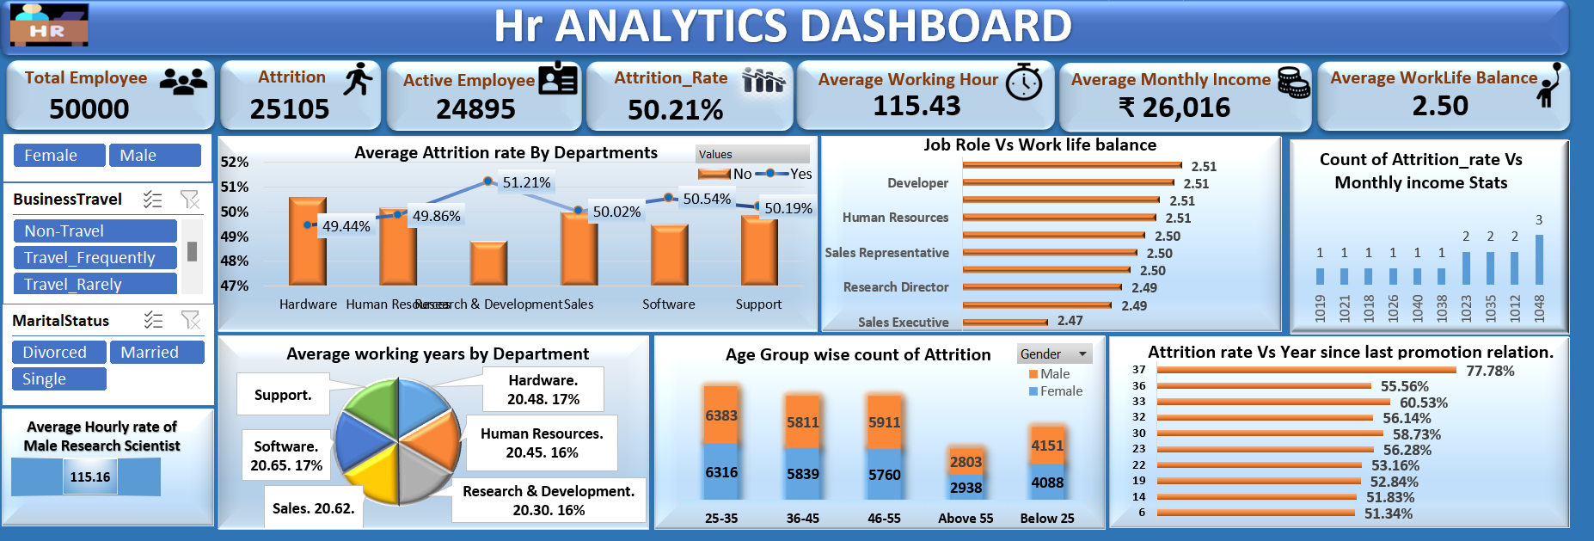
Excel Dashboard

Slide 13
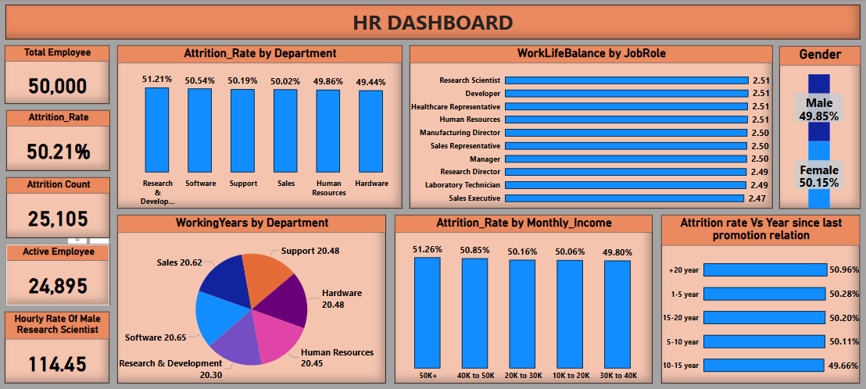
Power Bi Dashboard

Slide 14
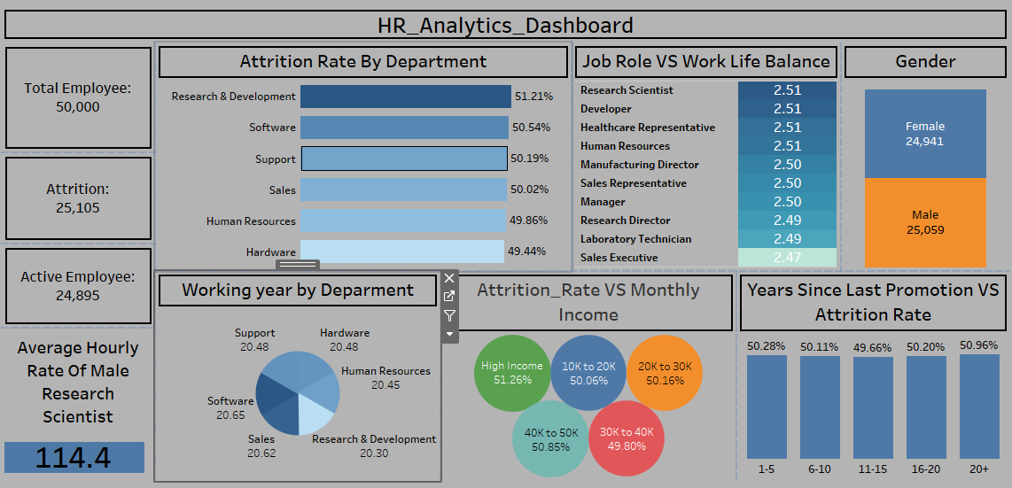
Tableau Dashboard

Slide 15
Conclusion
Attrition Insights: High attrition linked to delayed promotions and income levels.
Department Metrics: Identified average working years and attrition rates across departments.
Job Role Analysis: Examined work-life balance and pay disparities by role.
Tools Used: SQL, Excel, Power BI, and Tableau for comprehensive analysis.
Recommendations: Focus on reducing attrition by improving promotions, pay fairness, and work-life balance.

Slide 16
Thank You

