Slide 1

Amrutvahini College of Engineering, Sangamner
Subject Name - Project Based Learning
Topic Name - Portfolio Web Development
 | Presented by
 | Students Name | Roll No.
1. | Argade Vaishnavi Prashnat | 2107
2. | Baheti Ritika Manoj | 2112
3. | Bhalerao Sayali Sandip | 2118
Under the Guidance of
Dr.A.R.Panhalkar
Portfolio Web Development
<number>

Slide 2
Introduction
Contents
Introduction
Problem Statement
Objective
Outcome
<number>
Portfolio Web Development

Slide 3

Portfolio Web Development
<number>

Slide 4
Introduction
Topic Name- Portfolio Web Development
What is portfolio?
A portfolio is a collection of work samples that you can bring to an interview, send to a prospective employer, or even post online.
Portfolios can: Provide evidence of work that you've done. Illustrate your skills and abilities. Show the quality of your work.
Portfolio Web Development
<number>

Slide 5
Introduction
It is a collection of photographs, drawings, documents, etc. that you carry as an example of your work, especially when applying for a job.
It provides a platform to highlight your best work.
It provides great first impression for the employers.
It reflects your Personality and Creativity.
It improves chances of gaining customer.
Portfolio Web Development
<number>

Slide 6
Problem Statement
Introduction and Advertisement are very important for any business. therefore, the proposed solution is having a portfolio website that will help a company or a job seekers a lot. because the website will contain information about the company’s employees and the job seekers ,their previous projects and information and also contact information. the company can put information to help their customers and the job seekers to find some useful information about the company and required job.
Porfolio Web Development
<number>

Slide 7
Objectives
A portfolio website is a unique way to showcase your work and let others know about yourself.
It's like an evergreen platform for your projects, case studies, and information about you.
It is one of the best ways to express your personality, experience, and capabilities.
a portfolio career exposes you to a variety of fields and positions.
you'll gain many skills and experiences.
Portfolio Web Development
<number>

Slide 8
Outcomes
Contents of the website-
A High-Quality Image of Yourself
Information about yourself
Your best projects
Services
Contact information
Free samples
Portfolio web development
<number>

Slide 9
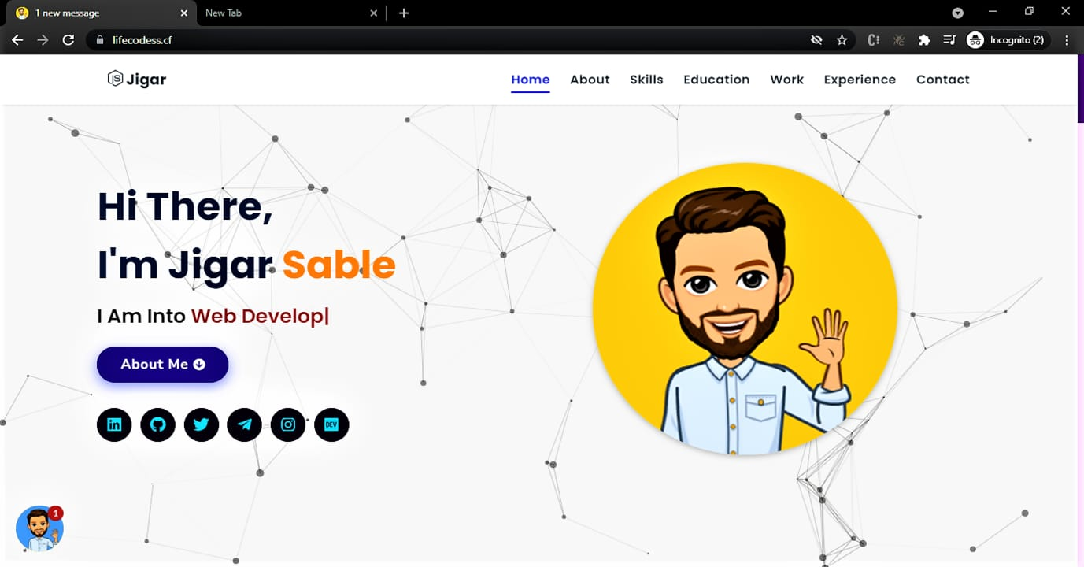
Outcomes
Portfolio Web Development
<number>

