Slide 1
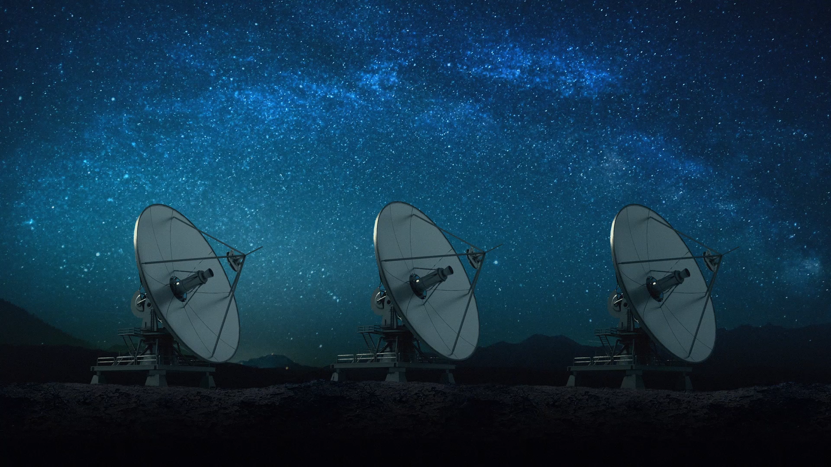
Spacecraft Communications
ENAE 694
Demodulation, BER,
and Coding
Dave Israel (disrael@umd.edu)
October 26, 2026

Slide 2
Tonight’s Engineering Trades
Recover the carrier frequency and phase, then recover symbol timing.
Choose modulation by required power and bandwidth.
Use known mathematical relationships to correct received errors.
Trade coding gain against bandwidth, complexity, and delay.
ENAE 694 • Demodulation, BER, and Coding
2

Slide 3
Coherent Demodulation: Recover the Reference
Infer the carrier that would be present without the information modulation.
Frequency
Track the received carrier, including Doppler and oscillator offset.
Phase
Align the reference so modulation changes can be measured.
Symbol timing
Find the boundaries and the right instant to decide each symbol.
*Timing belongs to the data symbols. Carrier recovery supplies frequency and phase. Known patterns or differential methods resolve phase ambiguity.
[3, 16, 17]
ENAE 694 • Demodulation, BER, and Coding
3

Slide 4
Rate Review: Bits Grouped Into Symbols
Same 12 bits in the same 2.0 µs interval: R_{b} = 6.0 Mbit/s
BPSK
1
0
1
1
0
0
1
0
1
0
1
1
12 symbols / 2.0 µs = 6.0 Msymbol/s
QPSK
10
11
00
10
10
11
6 symbols / 2.0 µs = 3.0 Msymbol/s
8PSK
101
100
101
011
4 symbols / 2.0 µs = 2.0 Msymbol/s
R_{s} = R_{b} / m m = log₂(M) bits/symbol
[3, 11]
ENAE 694 • Demodulation, BER, and Coding
4

Slide 5
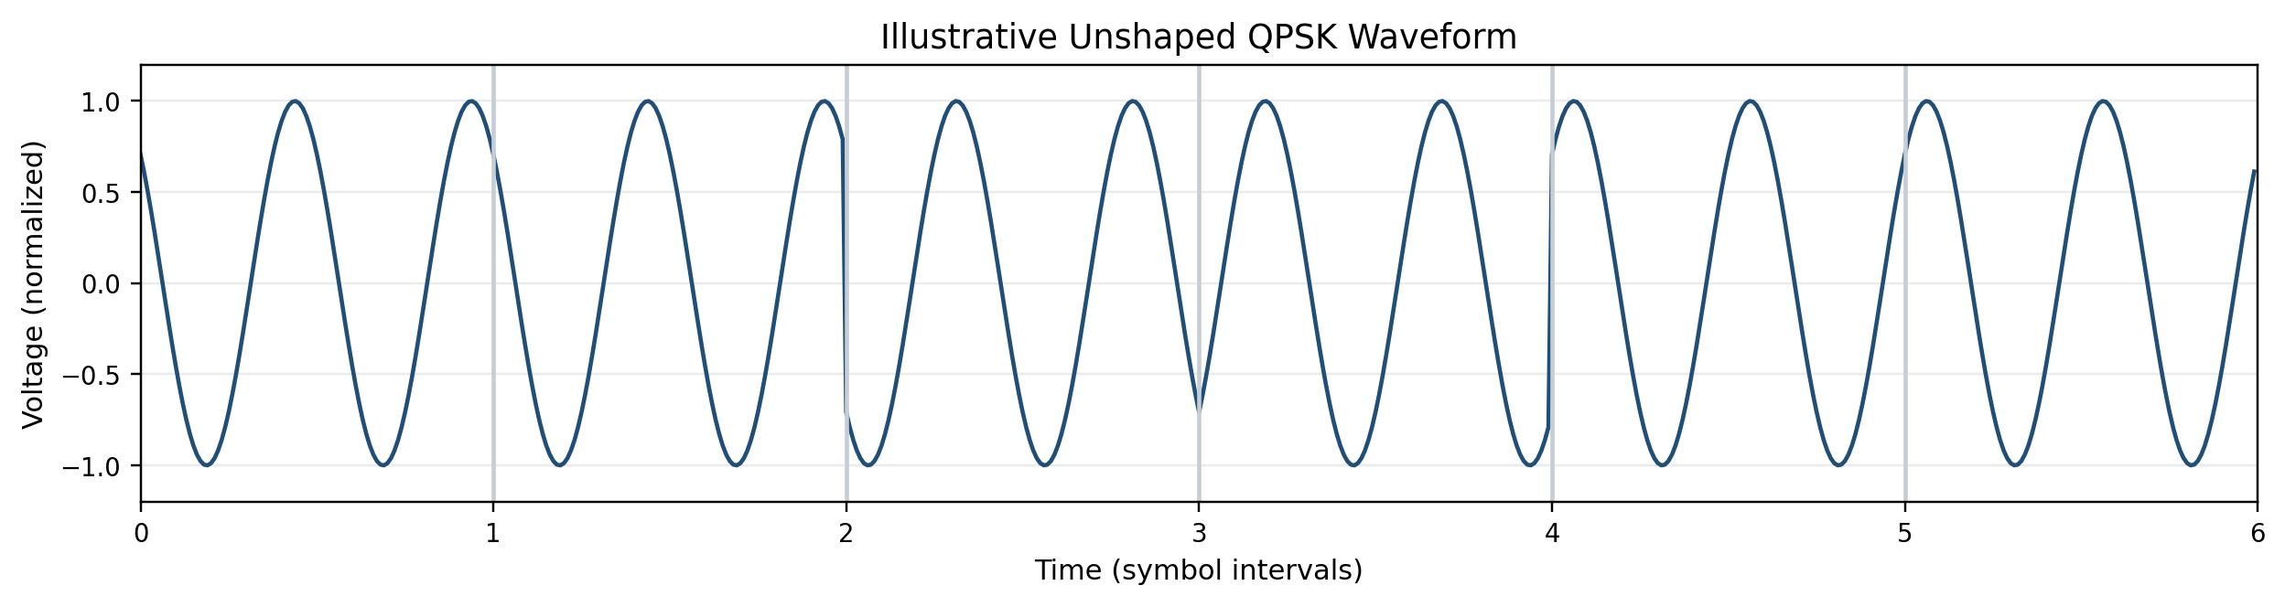
QPSK: Symbols, Phase, and the RF Waveform
00
00
01
11
10
10
45°
45°
135°
225°
315°
315°
Repeated symbol: 0° change. Other boundaries: ±90° or 180°.
*Two RF cycles per symbol for illustration. Pulse shaping smooths the transitions.
[3, 6]
ENAE 694 • Demodulation, BER, and Coding
5

Slide 6
Receiver Walkthrough: Test Points
Received RF / IF
after the front end
1
2
Low-Pass
Filter
3
Matched Filter
One Bit Period
4
Sample +
Decide
5
×
cos(2πf_{c} t)
Recovered
Carrier
Bit Synchronizer
Recovered Clock
Clock chooses decision instants
BPSK: 1 bit per symbol. A channel decoder follows these decisions or soft values.
[3, 7, 14, 15]
ENAE 694 • Demodulation, BER, and Coding
6

Slide 7
Receiver Walkthrough: Why Mixing Recovers Data
×
Low-Pass Filter
Recovered data
m(t) = +1 or −1. Ideal phase-aligned carrier, initially without noise.
r(t) = A m(t) cos(2πf_{c} t)
r(t) cos(2πf_{c} t) = A m(t) cos²(2πf_{c} t)
= (A/2)m(t) + (A/2)m(t) cos(4πf_{c} t)
Baseband data
Copy centered at 2f_{c}
cos²x = (1 + cos 2x)/2. Baseband is centered at zero frequency; changing data is not constant DC.
[3, 7, 14, 15]
ENAE 694 • Demodulation, BER, and Coding
7

Slide 8
Receiver Walkthrough: Noise Follows the Signal
1 RF input
r(t) = A m(t) cos(2πf_{c} t) + n_{RF}(t)
2 Mixer output
v(t) = (A/2)m(t) + (A/2)m(t) cos(4πf_{c} t)
+ n_{RF}(t) cos(2πf_{c} t)
3 After low-pass filtering
y(t) ≈ (A/2)m(t) + n_{BB}(t)
The filter rejects the 2f_{c} term and out-of-band noise. Noise translated into the data band remains. Finite receive bandwidth also rounds transitions.
[3, 7, 14, 15]
ENAE 694 • Demodulation, BER, and Coding
8

Slide 9
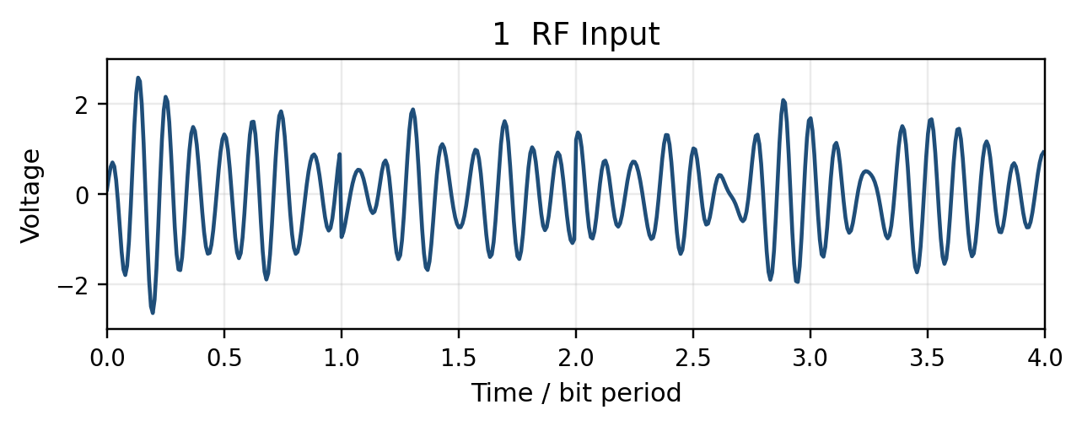
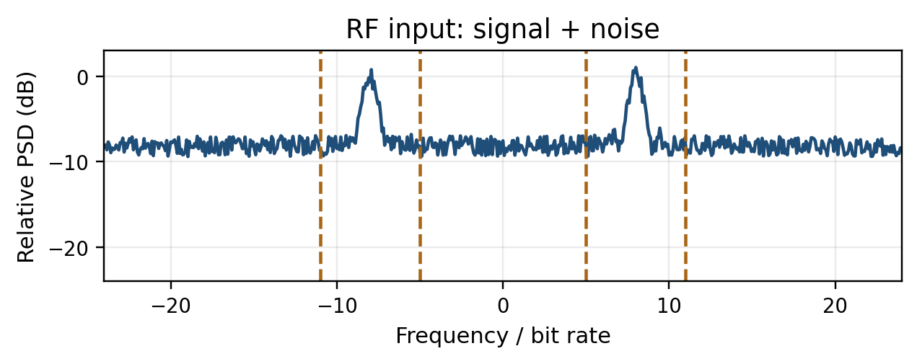
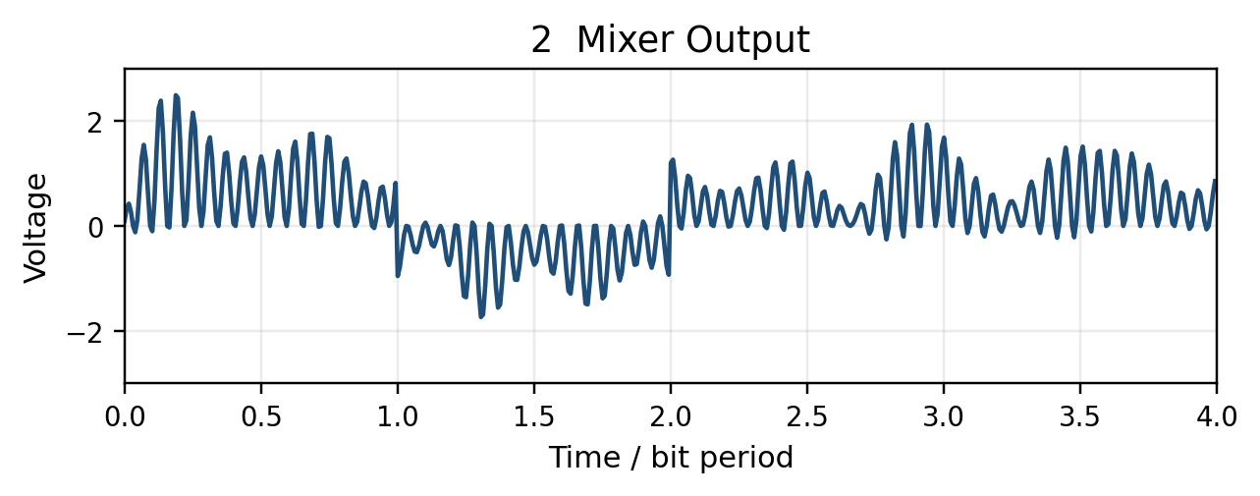
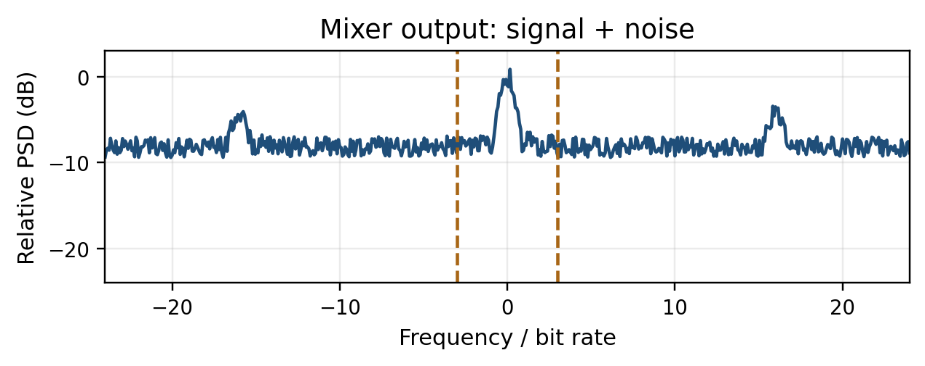
Receiver Walkthrough: RF Input and Mixer Output
Illustrative analyzer traces, signed-frequency view. Blue includes noise; weak sidelobes are buried.
Dashed: RF passband edges at ±5 and ±11 Rᵦ; next low-pass cutoff at ±3 Rᵦ. carrier frequency = 8 × bit rate.
[3, 7, 14, 15]
ENAE 694 • Demodulation, BER, and Coding
9

Slide 10
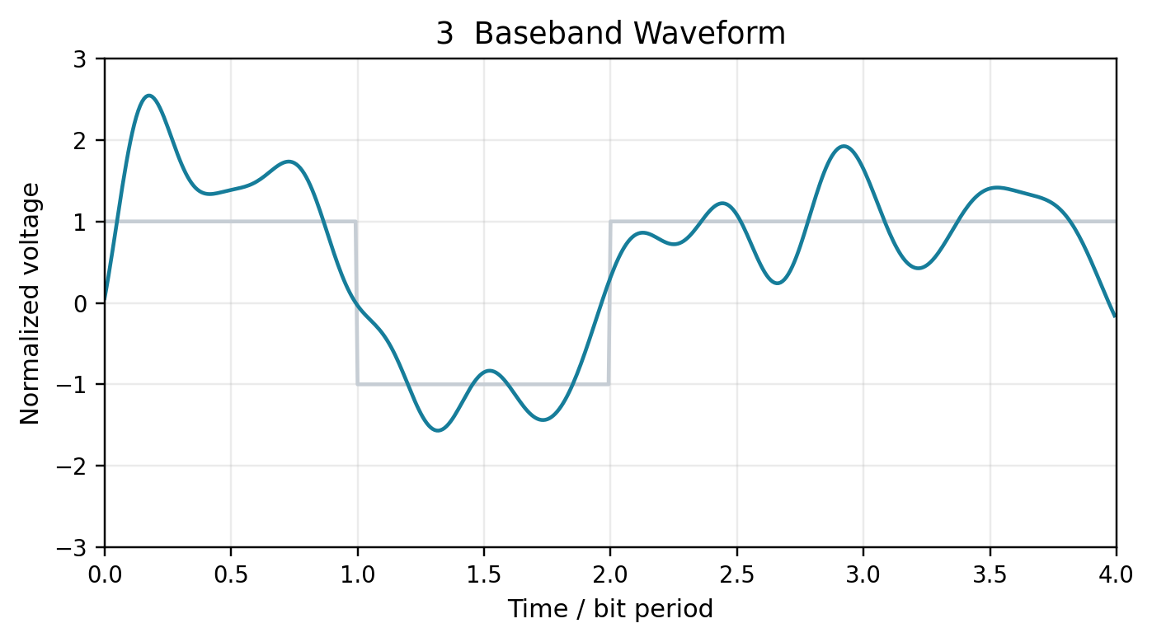
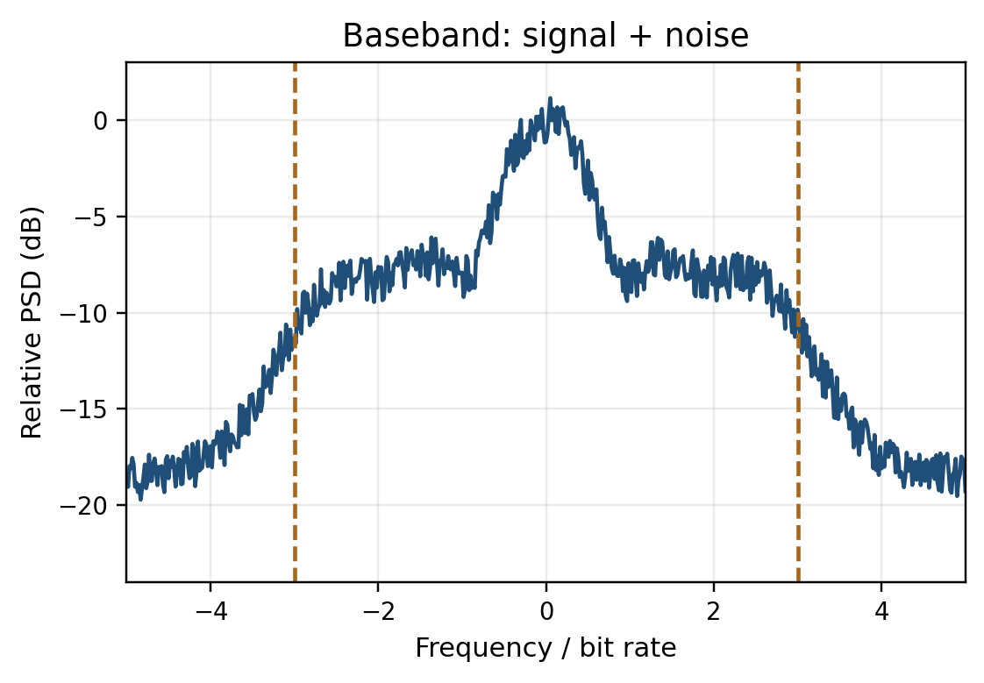
Receiver Walkthrough: Baseband After the Low-Pass Filter
The carrier is gone. The noise in the data band is still present.
*Dashed lines: low-pass cutoff at ±3 Rᵦ. Noise in the data band remains.
Illustrative analyzer trace includes a measurement floor; it is not a calibrated Eᵦ/N₀ measurement.
[3, 7, 14, 15]
ENAE 694 • Demodulation, BER, and Coding
10

Slide 11
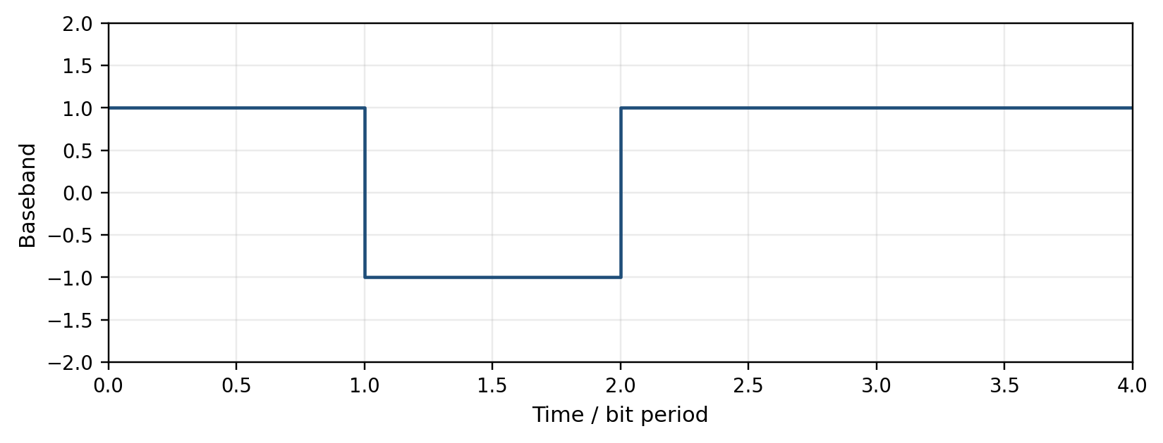
Bit Decisions: Integrate One Bit, Then Decide
After coherent demodulation, bit 1 has positive amplitude; bit 0 has negative amplitude.
1
0
1
1
For EACH bit period:
Integrate the baseband.
Decide from the sign.
Reset for the next bit.
Aligned averages: +1 −1 +1 +1
Recovered bits: 1 0 1 1
Decision statistic = (1/T_{b}) × integral over one bit period. Positive → 1; negative → 0.
Ideal rectangular BPSK after carrier recovery; noise omitted here to show the operation.
ENAE 694 • Demodulation, BER, and Coding
11

Slide 12
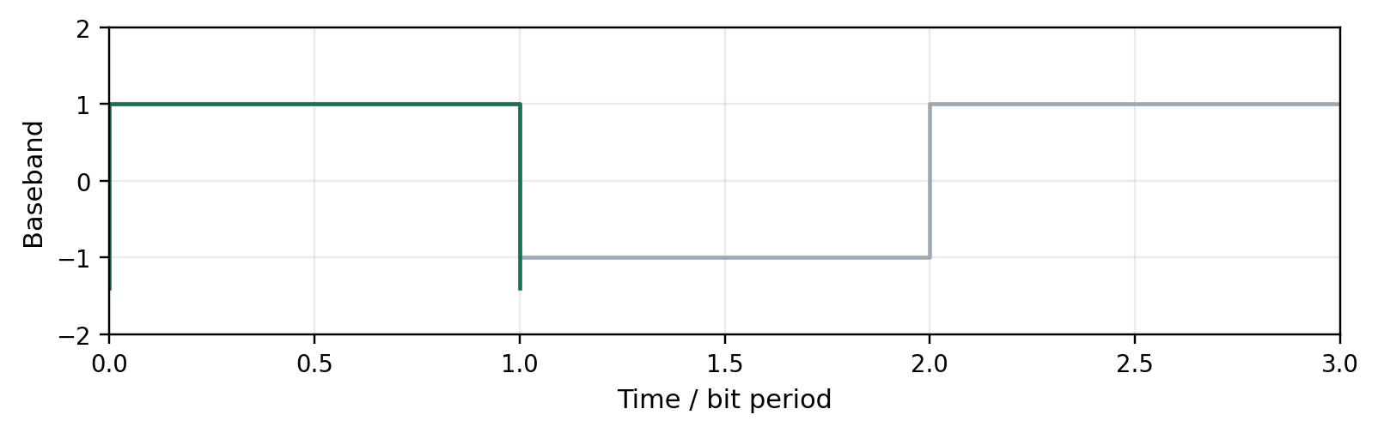
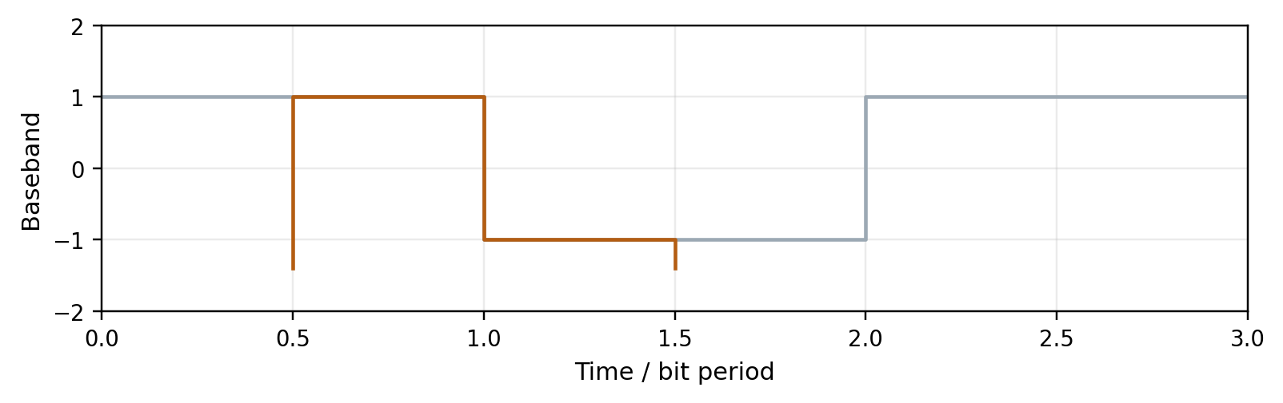
Bit Decisions: The Window Must Match the Bit
ALIGNED: integrate 0 to 1 bit period
One complete +1 bit
Average = +1
Clear decision: 1
HALF A BIT LATE: integrate 0.5 to 1.5
Half +1 and half −1
Average = 0
Noise can decide the bit.
Colored edges mark the integration window, not extra signal transitions. Both windows last T_{b}.
Bit sync aligns the window boundaries. Cancellation shown for neighboring bits of opposite sign.
ENAE 694 • Demodulation, BER, and Coding
12

Slide 13
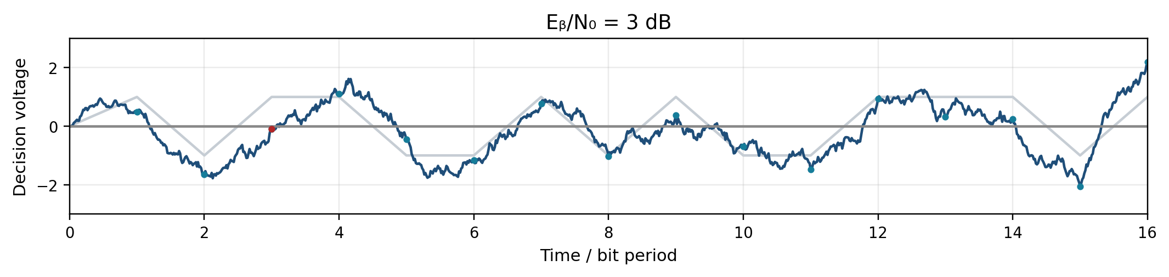
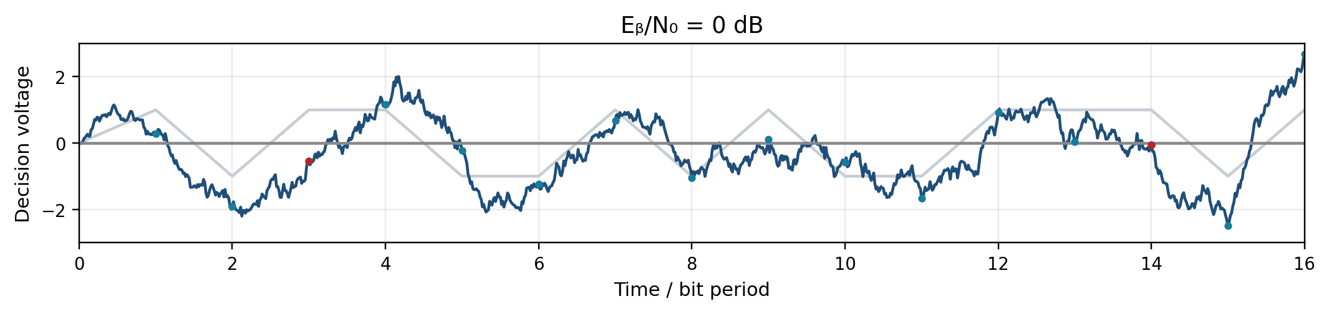
Bit Decisions: Noise Can Still Cause Errors
Sent bits: 1 0 1 1 0 0 1 0 1 0 0 1 1 1 0 1
σ = 0.50
Theory BER
2.3e-2
1 / 16 errors
σ = 0.71
Theory BER
7.9e-2
2 / 16 errors
Timing aligned. Teal: sample; red: error; gray: ideal. Threshold = 0.
Noise can push the integrated value across zero and cause a wrong bit.
[3, 7, 14, 15]
ENAE 694 • Demodulation, BER, and Coding
13

Slide 14
The I and Q View of a Demodulator
I + noise
Low-Pass
Filter
Matched Filter
+ Sample
I / Q
Decisions
to
Serial Bits
×
RF input
+ noise
cos(2πf_{c} t)
Low-Pass
Filter
Matched Filter
+ Sample
×
Q + noise
−sin(2πf_{c} t)
Recovered
Carrier
+90°
Quadrature references differ by 90°. Bit / symbol timing controls both samplers.
[3, 7, 14, 15]
ENAE 694 • Demodulation, BER, and Coding
14

Slide 15
Constellations: Coordinates at Decision Times
Q
Each point is one allowed decision state.
01
00
I and Q are Cartesian coordinates.
I
Radius represents amplitude.
11
10
Energy is proportional to radius squared.
Equal physical scale on both axes
[3, 6]
ENAE 694 • Demodulation, BER, and Coding
15

Slide 16
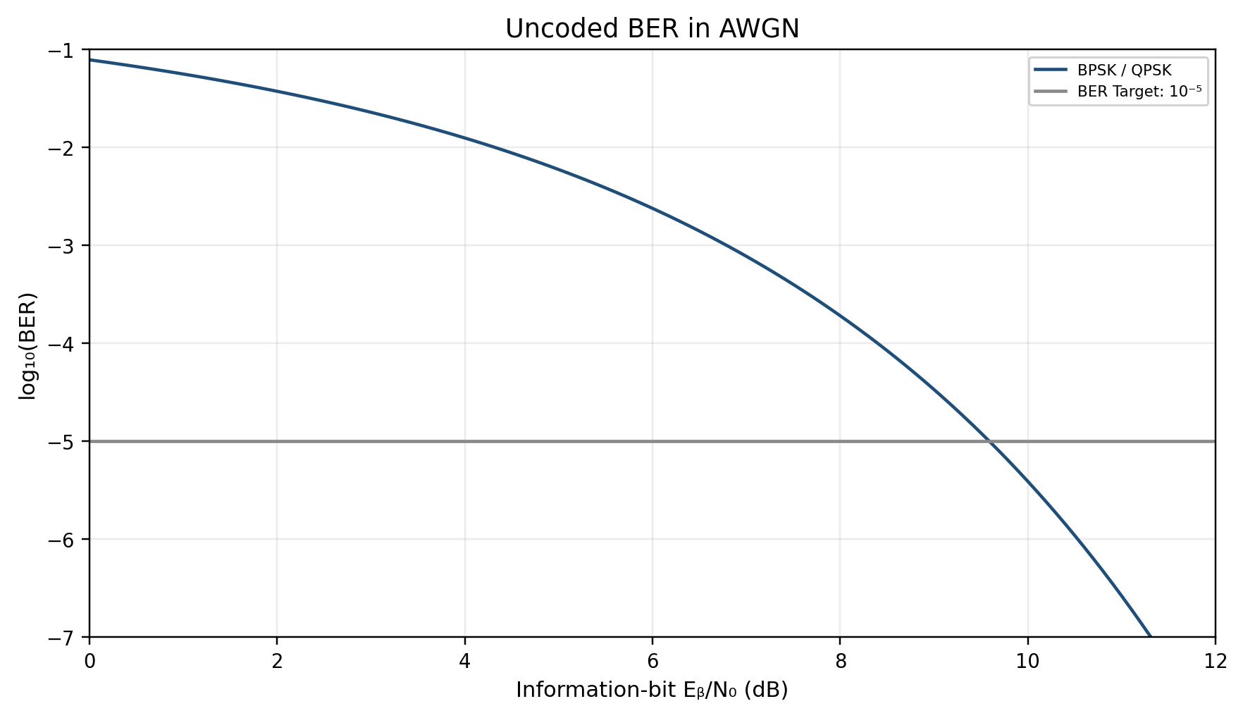
BER Curves: Reading the Requirement
Requirement
9.6 dB
Ideal coherent detection
AWGN
Correct synchronization
−5 on the vertical axis means BER = 10⁻⁵. Lower curves mean fewer bit errors.
[7]
ENAE 694 • Demodulation, BER, and Coding
16

Slide 17
Higher-Order Modulation: More Choices
BPSK
QPSK
8PSK
16QAM
Q
Q
Q
Q
I
I
I
I
1 bits/symbol
2 bits/symbol
3 bits/symbol
4 bits/symbol
Equal average symbol energy. More states place some decisions closer together.
[3, 6, 7]
ENAE 694 • Demodulation, BER, and Coding
17

Slide 18
Noise and Phase Error Look Different
Additive Noise
Phase Noise
Q
Q
I
I
Samples scatter around each state.
Phase fluctuations spread samples
around the circle.
*Illustrative samples. Phase noise is an oscillator / tracking impairment, not a temperature added to T_{sys}.
[3, 4]
ENAE 694 • Demodulation, BER, and Coding
18

Slide 19
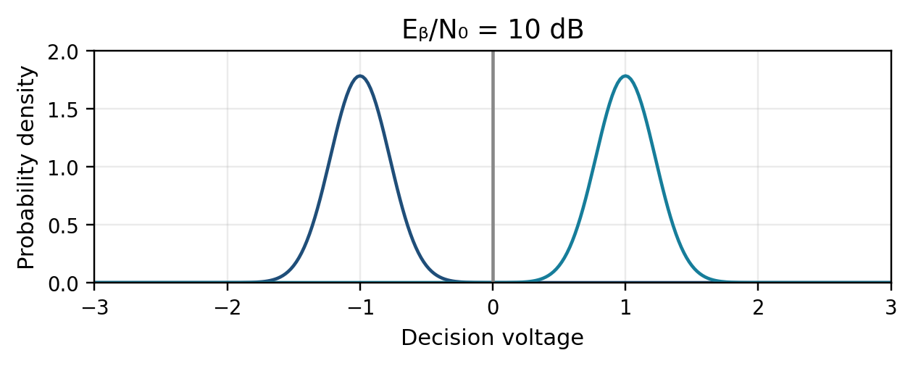
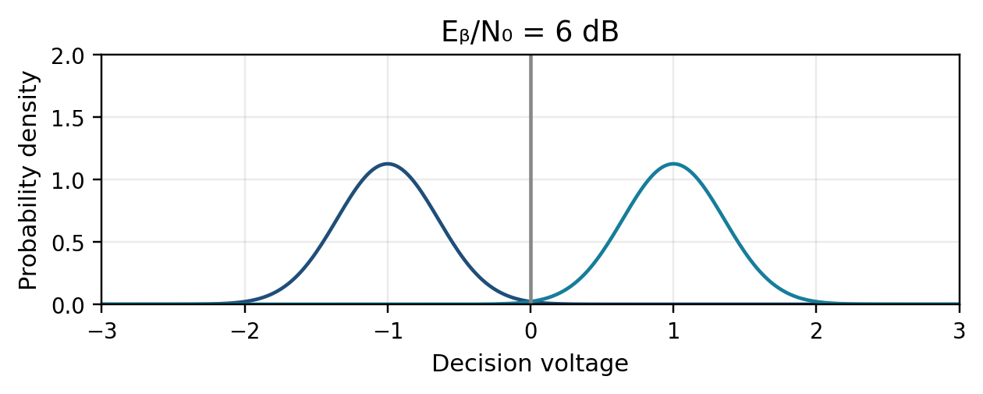
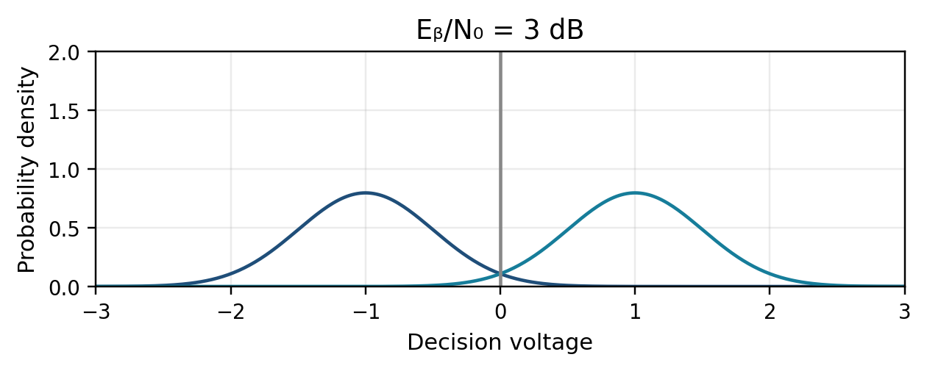
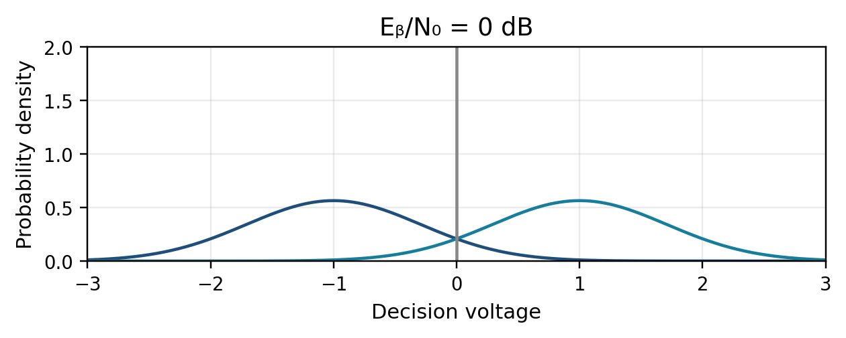
Receiver Walkthrough: Overlapping Decisions
Blue: sent 0 (mean −1). Teal: sent 1 (mean +1). Wrong-side tails cause errors.
[3, 7, 14, 15]
ENAE 694 • Demodulation, BER, and Coding
19

Slide 20
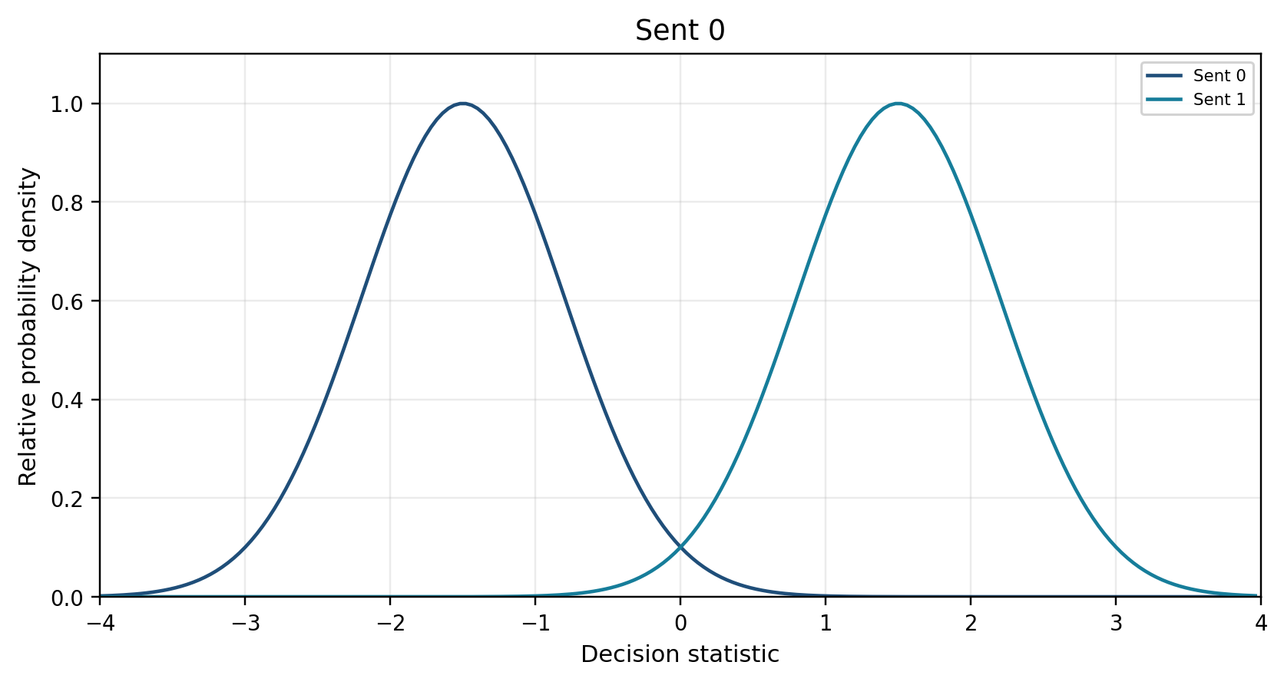
Additive Noise at the Decision
Noise adds a random error to each decision coordinate.
AWGN models Gaussian samples with a flat spectral density over the band of interest.
Interference and loss of lock require additional analysis.
Decision threshold = 0
[3, 7]
ENAE 694 • Demodulation, BER, and Coding
20

Slide 21
A BPSK Error Is a Wrong-Side Decision
Sent 0: the decision statistic is usually negative.
Sent 1: it is usually positive.
An error occurs when noise pushes the sample across zero.
More E_{b}/N₀ makes wrong-side samples less likely.
Decision threshold = 0
[3, 7]
ENAE 694 • Demodulation, BER, and Coding
21

Slide 22
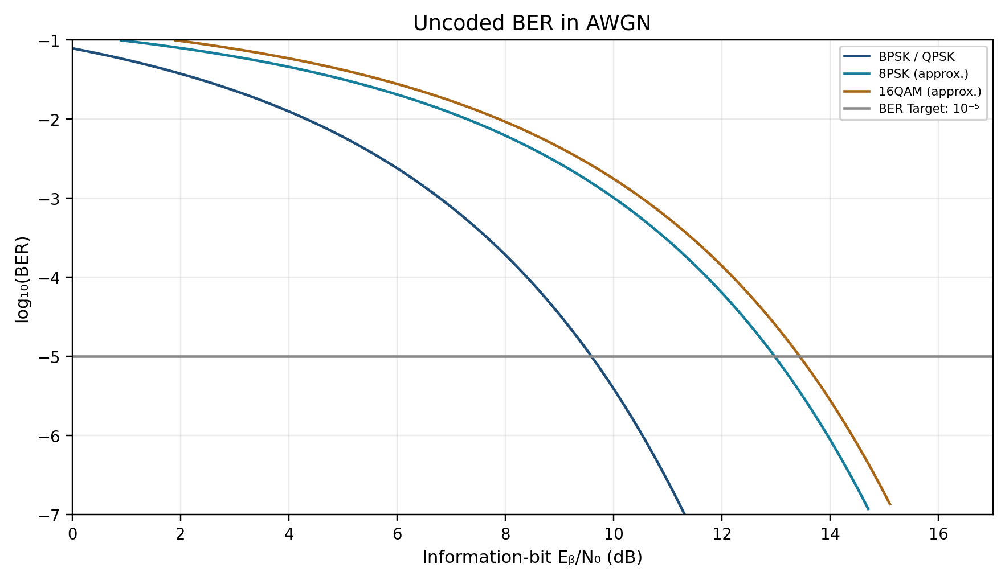
BER Comparison
At BER = 10⁻⁵
BPSK / QPSK 9.6 dB
8PSK 13.0 dB
16QAM 13.4 dB
Higher-order curves:
Gray mapping, high-SNR
approximation, AWGN
−5 on the vertical axis means BER = 10⁻⁵. Lower curves mean fewer bit errors.
[7, 12]
ENAE 694 • Demodulation, BER, and Coding
22

Slide 23
Question: Does 8PSK Create Bit Energy?
Keep information rate, received data power, and N₀ fixed. Replace uncoded QPSK with uncoded 8PSK.
A. Available E_{b}/N₀ increases by 3.0 dB.
B. Available E_{b}/N₀ stays the same.
C. Available E_{b}/N₀ decreases by 3.0 dB.
ENAE 694 • Demodulation, BER, and Coding
23

Slide 24
Worked Answer: Does 8PSK Create Bit Energy?
B. Available E_{b}/N₀ Stays the Same
E_{b} = S_{data} / R_{b}. Neither quantity changed.
8PSK reduces symbol rate and bandwidth at this information rate.
Its closer phase states require more E_{b}/N₀ for the same uncoded BER.
ENAE 694 • Demodulation, BER, and Coding
24

Slide 25
Modulation Trade: One Common Information Rate
Uncoded Format | R_{s} at 6.0 Mbit/s | RF Bandwidth* | Required [E_{b}/N₀]†
BPSK | 6.0 Msymbol/s | 12.0 MHz | 9.6 dB
QPSK | 3.0 Msymbol/s | 6.0 MHz | 9.6 dB
8PSK | 2.0 Msymbol/s | 4.0 MHz | 13.0 dB
16QAM | 1.5 Msymbol/s | 3.0 MHz | 13.4 dB
*Unfiltered rectangular symbols: B_{RF} = 2R_{s}, first null to first null. Sidelobes extend beyond. †BER = 10⁻⁵ in AWGN.
[7, 11, 12]
ENAE 694 • Demodulation, BER, and Coding
25

Slide 26
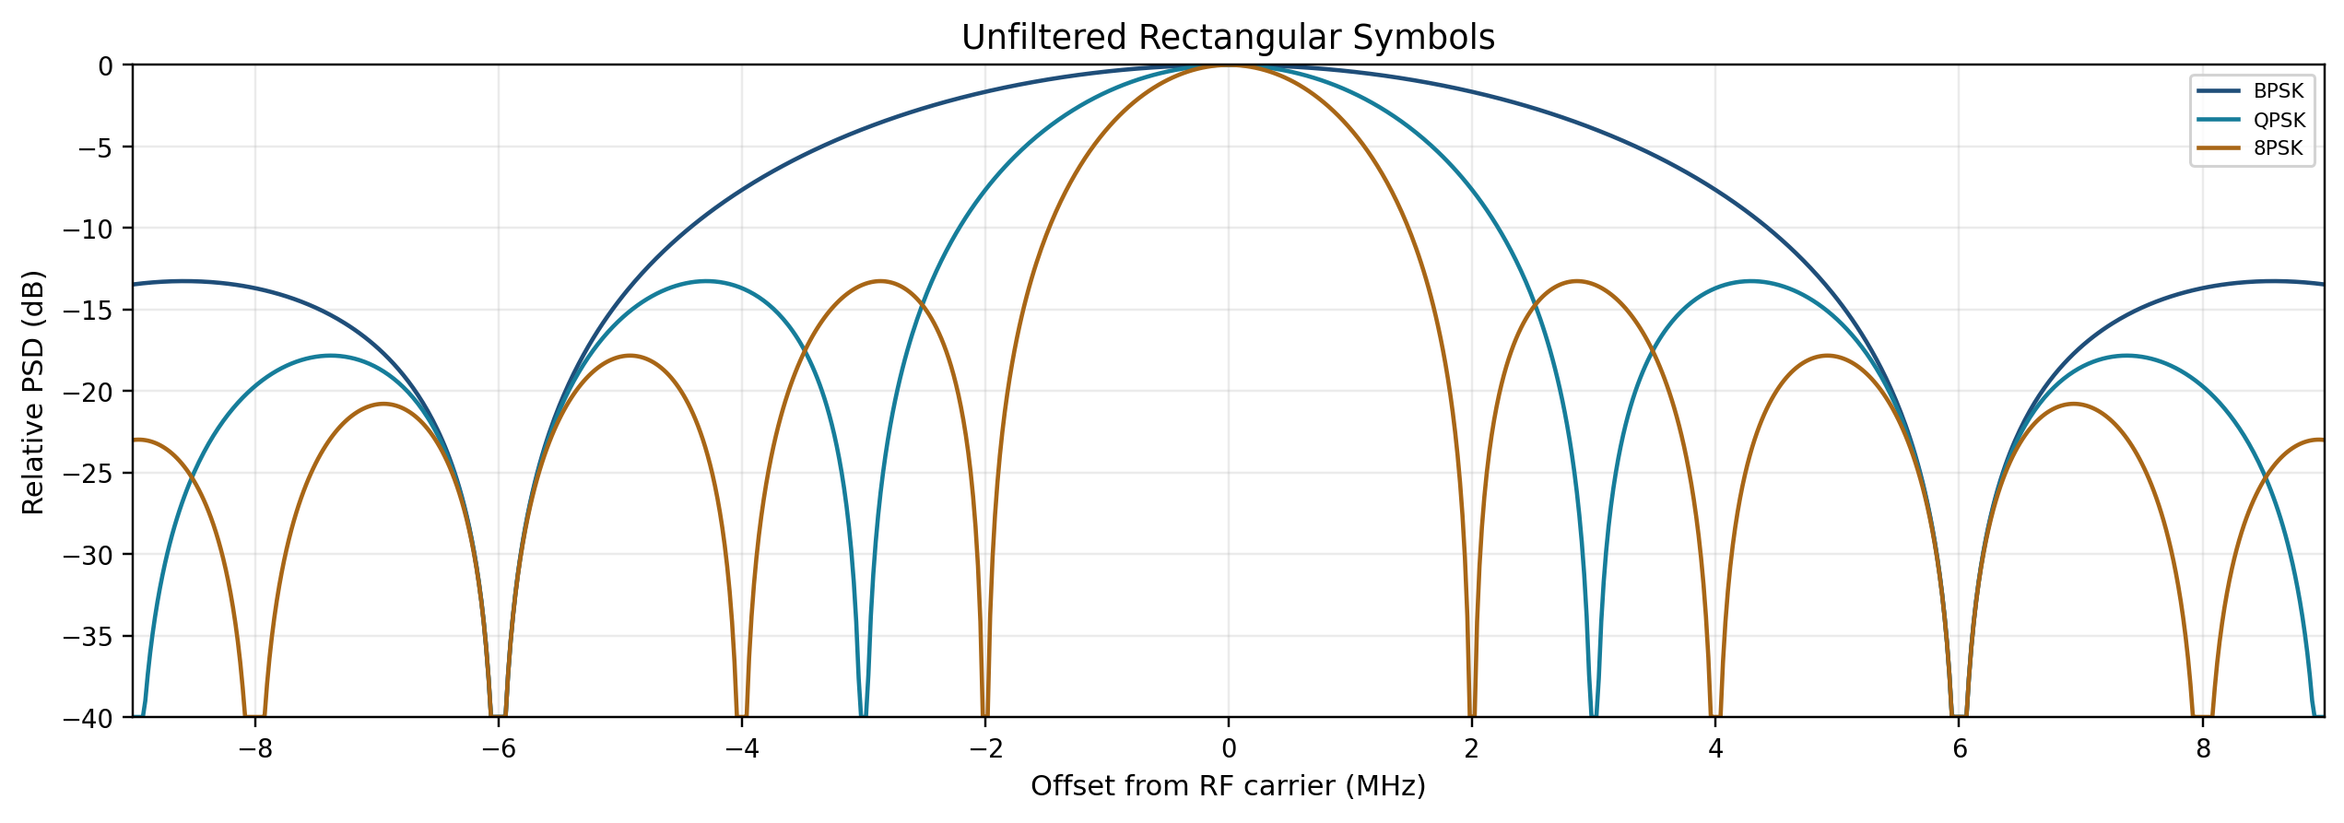
RF Bandwidth: The Same MHz Scale
R_{b} = 6.0 Mbit/s. First nulls: ±6, ±3, and ±2 MHz. B_{RF} = 2R_{s}.
*Each peak is normalized to 0 dB. Sidelobes extend beyond the stated mainlobe bandwidth.
[11]
ENAE 694 • Demodulation, BER, and Coding
26

Slide 27
Question: Downlink Bandwidth
Send 6.0 Mbit/s using uncoded 8PSK.
Each symbol carries 3 bits.
What is the unfiltered first-null RF bandwidth?
A. 2.0 MHz B. 4.0 MHz C. 6.0 MHz
Use R_{s} = R_{b} / m, then B_{RF} = 2R_{s}.
ENAE 694 • Demodulation, BER, and Coding
27

Slide 28
Worked Answer: Downlink Bandwidth
B. 4.0 MHz
R_{s} = R_{b} / m = 6.0 / 3 = 2.0 Msymbol/s
B_{RF} = 2R_{s} = 2 × 2.0 = 4.0 MHz
8PSK fits a 4.0 MHz first-null bandwidth limit.
This step checks bandwidth. The next step checks the available bit energy.
ENAE 694 • Demodulation, BER, and Coding
28

Slide 29
Worked Example: Downlink Margin
For this 8PSK link: available [E_{b}/N₀] = 17.0 dB.
Required [E_{b}/N₀] = 13.0 dB. Implementation loss = 1.0 dB.
Margin = available − required − implementation loss
Margin = 17.0 − 13.0 − 1.0 = 3.0 dB
The link meets a 3.0 dB reserve.
At BER = 10⁻⁵. Use the rounded 13.0 dB requirement supplied in the modulation comparison.
ENAE 694 • Demodulation, BER, and Coding
29

Slide 30
Modulation: Bandwidth Versus Required Power
At the same information rate and BER, compare both requirements.
QPSK halves BPSK’s mainlobe width at the same ideal E_{b}/N₀.
8PSK saves more bandwidth, but needs more E_{b}/N₀.
The useful choice fits the spectrum and the available link power.
[7, 11, 12]
ENAE 694 • Demodulation, BER, and Coding
30

Slide 31
Break
ENAE 694 • Demodulation, BER, and Coding
31

Slide 32
Coding: Known Math at Both Ends
Original Data
Known Encoding Rule
Redundant Codeword
Noisy Channel
Received Evidence
Known Decoding Rule
The encoder creates mathematical relationships among the transmitted bits.
The decoder tests those relationships to infer the original data.
Only selected patterns are valid. That structure makes correction possible.
*Both ends agree on the code in advance. The decoder estimates the message and can still fail when errors exceed its capability.
[8, 13]
ENAE 694 • Demodulation, BER, and Coding
32

Slide 33
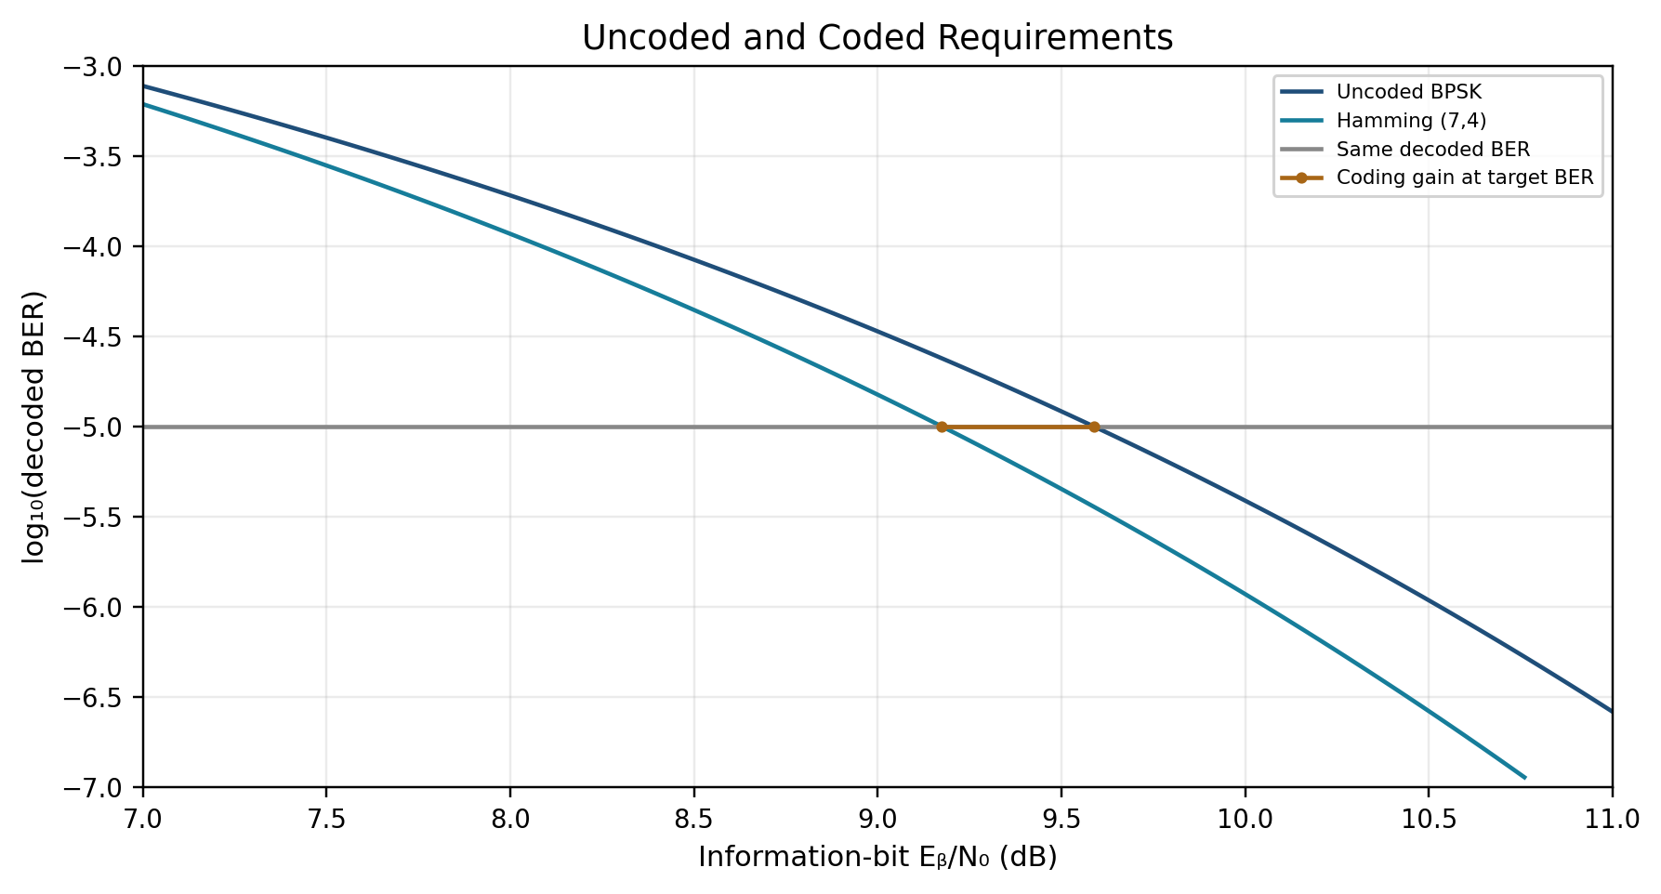
Coding Gain: Reading the Horizontal Difference
At BER = 10⁻⁵
Uncoded: 9.6 dB
Coded: 9.2 dB
Coding gain:
9.6 − 9.2 = 0.4 dB
*Coherent BPSK, AWGN, hard-decision Hamming decoding. Exact error-pattern calculation. This small teaching code gives only a small gain.
[7, 8, 13]
ENAE 694 • Demodulation, BER, and Coding
33

Slide 34
Coding Gain: A Worked Link-Budget Credit
G_{c} = required uncoded [E_{b}/N₀] − required coded [E_{b}/N₀]
At the same BER = 10⁻⁵: G_{c} = 9.6 − 3.0 = 6.6 dB.
At fixed information rate, required EIRP can fall by 6.6 dB.
The receiver needs less bit energy to reach the same decoded BER.
*The 3.0 dB coded threshold is an assumed design input, not a specification for every rate-1/2 code.
[7, 8]
ENAE 694 • Demodulation, BER, and Coding
34

Slide 35
Coding Gain: Power, Rate, or Margin
Use of 6.6 dB Gain* | Hold Fixed | Result
Reduce transmit power | Information rate, path, receiver | Required EIRP falls 6.6 dB
Increase information rate | EIRP, path, receiver | Up to 4.6 × rate if bandwidth permits
Increase link margin | EIRP and information rate | 6.6 dB more margin
*One 6.6 dB credit to allocate. 10^{6.6/10} = 4.6. Receiver, code, and bandwidth limits still apply.
ENAE 694 • Demodulation, BER, and Coding
35

Slide 36
Coded Link: What Does “Symbol” Mean?
Information: 1.0 Mbit/s enters a rate-1/2 encoder.
Coded bits: 1.0 / 0.5 = 2.0 Mbit/s leaves the encoder.
QPSK: 2 coded bits/symbol gives 1.0 Msymbol/s.
BPSK: 1 coded bit/symbol gives 2.0 Msymbol/s.
Coding documents often call each coded bit a “symbol.”
A modulation symbol can carry more than one coded bit.
Always identify which symbol is meant. Here E_{b}/N₀ uses information-bit energy.
Sources: CCSDS 130.1-G-3, §§3–4; CCSDS 131.0-B, convolutional coding.
ENAE 694 • Demodulation, BER, and Coding
36

Slide 37
Coding Reduces the Required Bit Energy
Available E_{b}/N₀ comes from received power and information rate.
At fixed power and information rate, coding leaves it unchanged.
A rate-1/2 code sends twice as many bits, each with half the energy.
The decoder uses the known relationships to correct errors.
The benefit: a lower required E_{b}/N₀ at the same decoded BER.
E_{b} = S_{data}/R_{b}. E_{c} = rE_{b}, so rate 1/2 gives [E_{c}/N₀] = [E_{b}/N₀] − 3.0 dB.
ENAE 694 • Demodulation, BER, and Coding
37

Slide 38
Question: Coding and Bit Rate
Information arrives at 4.0 Mbit/s.
A rate-1/2 encoder sends 2 coded bits for every input bit.
What coded bit rate leaves the encoder?
A. 2.0 Mbit/s B. 4.0 Mbit/s C. 8.0 Mbit/s
Code rate r = information bits / transmitted coded bits.
ENAE 694 • Demodulation, BER, and Coding
38

Slide 39
Worked Answer: Coding and Bit Rate
C. 8.0 Mbit/s
R_{c} = R_{b} / r
R_{c} = 4.0 / 0.5 = 8.0 Mbit/s
The information rate remains 4.0 Mbit/s.
For QPSK, the next step is R_{s} = R_{c} / 2 = 4.0 Msymbol/s.
ENAE 694 • Demodulation, BER, and Coding
39

Slide 40
Concatenated Rates: A Historical Example
At 1.0 Mbit/s Information | Overall Code Rate r | R_{c} (Mbit/s) | NRZ BPSK Mainlobe*
Uncoded | 1 | 1.0 | 2.0 MHz
RS(255,223) | 223/255 | 1.1 | 2.3 MHz
RS + Rate-1/2 CC | 223/510 | 2.3 | 4.6 MHz
LDPC(8176,7156) | 7156/8176 | 1.1 | 2.3 MHz
*First-null-to-first-null bandwidth = 2R_{s}. Rectangular pulses have sidelobes outside this mainlobe.
[5, 8]
ENAE 694 • Demodulation, BER, and Coding
40

Slide 41
Parity Detects Errors but Cannot Locate Them
Data 1100111 contains five 1s. Even parity adds a 1.
A single flipped bit changes the parity result.
Two flipped bits can pass the parity test.
Detection may lead to discard or retransmission. FEC attempts correction.
DATA EVEN PARITY
1 1 0 0 1 1 1 1
Six 1s in the transmitted eight-bit word.
[5, 8]
ENAE 694 • Demodulation, BER, and Coding
41

Slide 42
Hamming Example: Why One Error Is Correctable
4 information bits + 3 check bits = 7 transmitted bits
Only 16 of the 128 possible seven-bit patterns are valid codewords.
Valid codewords differ in at least 3 bit positions.
Example pair at the minimum separation:
Valid A
0
0
0
0
0
0
0
Received differs from A in 1 bit
Received
0
0
0
0
1
0
0
Valid B
1
0
0
0
1
1
0
Received differs from B in 2 bits
One flipped bit leaves a unique nearest valid word: choose A.
Every other valid word is at least 2 bits from this received pattern.
Assumes at most one bit error. Source: Hamming (1950), Error Detecting and Error Correcting Codes.
ENAE 694 • Demodulation, BER, and Coding
42

Slide 43
Hamming Example: Encoding 1010
d₁
d₂
d₃
d₄
p₁
p₂
p₃
1
0
1
0
1
0
1
p₁ = d₁ ⊕ d₂ ⊕ d₄ = 1
p₂ = d₁ ⊕ d₃ ⊕ d₄ = 0
p₃ = d₂ ⊕ d₃ ⊕ d₄ = 1
Codeword: 1010101 ⊕ means XOR (addition modulo 2)
[13]
ENAE 694 • Demodulation, BER, and Coding
43

Slide 44
Hamming Example: Encode, Locate, Correct
1 Encode with modulo-2 arithmetic
d = [1 0 1 0] c = dG = [1 0 1 0 1 0 1]
⎡1 0 0 0 1 1 0⎤
⎢0 1 0 0 1 0 1⎥
⎢0 0 1 0 0 1 1⎥
⎣0 0 0 1 1 1 1⎦
⎡1 1 0 1 1 0 0⎤
⎢1 0 1 1 0 1 0⎥
⎣0 1 1 1 0 0 1⎦
G =
H =
2 Bit 5 flips: received r = [1 0 1 0 0 0 1]
3 Calculate s = Hrᵀ: each row of H selects bits to XOR
s₁ = r₁ ⊕ r₂ ⊕ r₄ ⊕ r₅
= 1 ⊕ 0 ⊕ 0 ⊕ 0 = 1
s₂ = r₁ ⊕ r₃ ⊕ r₄ ⊕ r₆
= 1 ⊕ 1 ⊕ 0 ⊕ 0 = 0
s₃ = r₂ ⊕ r₃ ⊕ r₄ ⊕ r₇
= 0 ⊕ 1 ⊕ 0 ⊕ 1 = 0
4 s = [1 0 0]ᵀ matches column 5 of H. Flip bit 5; recover data 1010.
XOR is addition modulo 2: 1 ⊕ 1 = 0. This example assumes one bit error.
Source: Hamming (1950), Error Detecting and Error Correcting Codes.
ENAE 694 • Demodulation, BER, and Coding
44

Slide 45
Hamming Example: Limits of the Promise
t = floor[(d_{min} − 1)/2] = 1 bit error correctable.
A single-error decoder can miscorrect two errors.
Zero syndrome means an allowed codeword, not proof of an error-free channel.
Coding gain must be checked at the chosen decoded BER.
[8, 13]
ENAE 694 • Demodulation, BER, and Coding
45

Slide 46
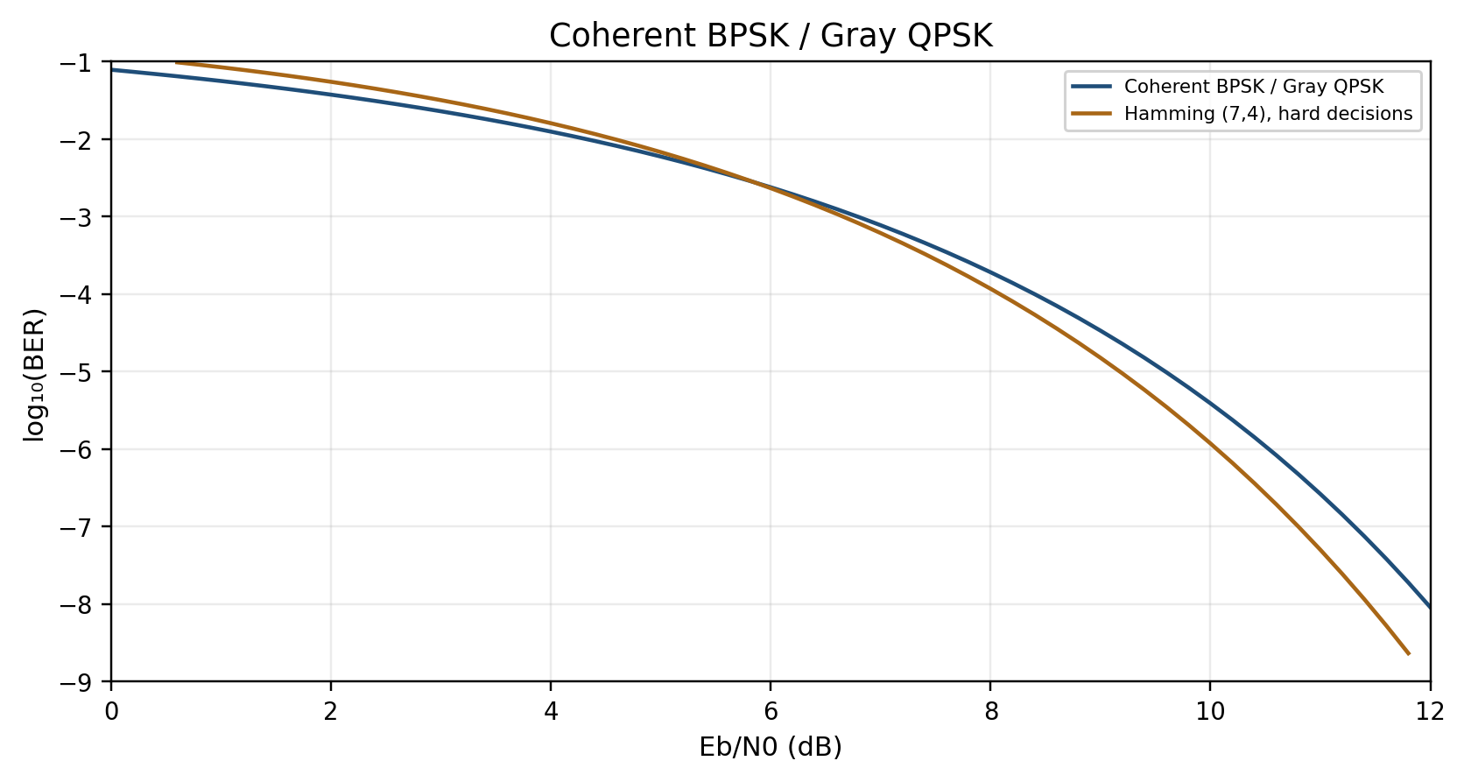
Hamming (7,4): Hard-Decision BER
Exact enumeration of all 128 possible channel error patterns.
Coherent BPSK in AWGN; r = 4/7; syndrome decoding; information-bit E_{b}.
A small code can have a crossover region. Coding gain depends on the chosen BER.
−5 on the vertical axis means BER = 10⁻⁵.
Teaching calculation
ENAE 694 • Demodulation, BER, and Coding
46

Slide 47
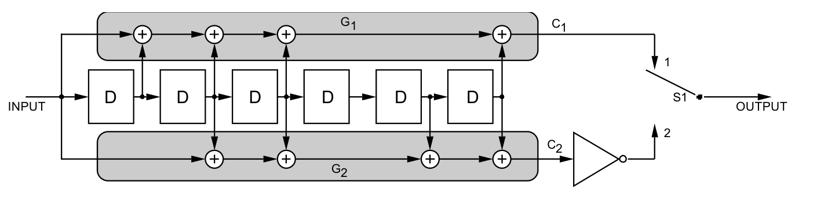
Convolutional Coding: Registers and XORs
D stores one bit. Each clock shifts the history one position.
⊕ is XOR. The connections form two parity checks from that history.
Two output bits per input bit: r = 1/2. Current bit + 6 delays: K = 7.
S1 sends the two outputs in sequence. The lower output is inverted by the CCSDS convention.
Source: CCSDS 130.1-G-3, Fig. 4-1, p. 4-2. Viterbi decoding compares possible bit histories.
ENAE 694 • Demodulation, BER, and Coding
47

Slide 48
Reed–Solomon: Byte-Symbol Errors
Code | Parity Symbols | Unknown Symbol Errors Correctable
RS(255,223) | 32 | 16
RS(255,239) | 16 | 8
One RS symbol is one 8-bit byte, distinct from a modulation symbol. t = (n − k)/2 for unknown symbol errors.
[5, 8]
ENAE 694 • Demodulation, BER, and Coding
48

Slide 49
Reed–Solomon: Burst Length Needs Care
Any 16 erroneous byte symbols can be corrected by RS(255,223).
A contiguous 128-bit burst can touch 17 bytes when it is not byte-aligned.
Thus “corrects any 128-bit burst” is not a safe general claim.
Interleaving distributes a burst across multiple codewords.
[5, 8]
ENAE 694 • Demodulation, BER, and Coding
49

Slide 50
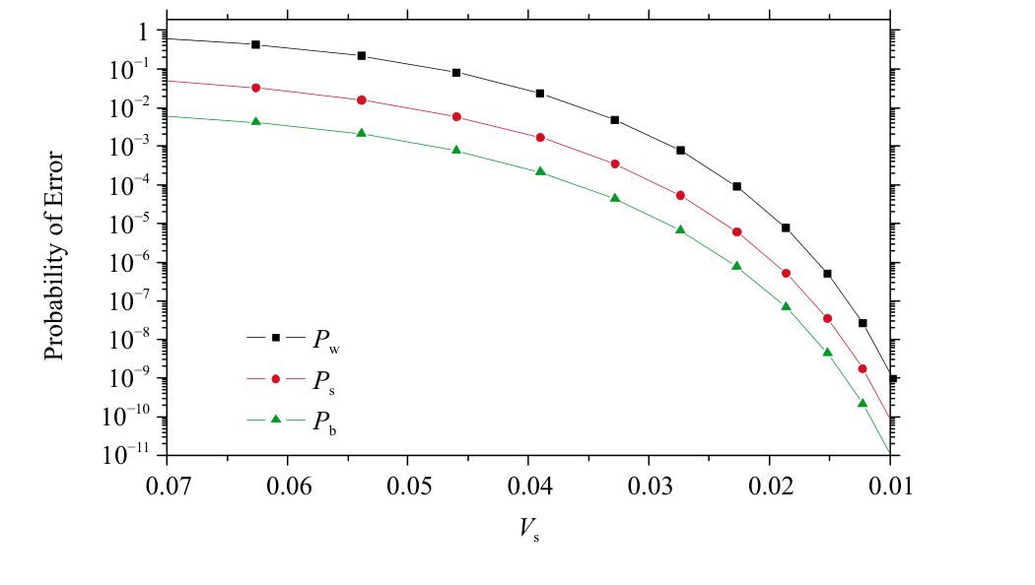
Reed–Solomon: Input Errors and Output Errors
Horizontal axis: input RS-symbol error probability.
V_{s} decreases to the right.
Output word, symbol, and bit errors are different metrics.
This plot is not an E_{b}/N₀ curve.
*Source: CCSDS 130.1-G-3, Figure 5-5, p. 5-8. RS(255,223), 16-symbol correction.
[8]
ENAE 694 • Demodulation, BER, and Coding
50

Slide 51
Concatenated Coding: Why This Order?
TRANSMIT
RS encoder → interleaver → convolutional encoder → modulator
RECEIVE
Demodulator → Viterbi decoder → deinterleaver → RS decoder
Viterbi handles channel noise, but residual errors may arrive in bursts.
Deinterleaving spreads those bursts across different RS codewords.
RS then corrects residual byte errors: up to 16 for RS(255,223).
RS goes first at the transmitter so it acts last at the receiver. Interleaving itself corrects no errors.
Source: CCSDS 130.1-G-3, §6.
ENAE 694 • Demodulation, BER, and Coding
51

Slide 52
Interleaving Distributes a Burst
Transmit A1, B1, C1, A2, B2, C2, …
A three-symbol burst affects one symbol in each word in this example.
Interleaving spreads errors. The code supplies correction.
Memory and waiting time are costs.
Word A | A1 | A2 | A3 | A4
Word B | B1 | B2 | B3 | B4
Word C | C1 | C2 | C3 | C4
Transmit: A1, B1, C1, A2, B2, C2, …
[5, 8]
ENAE 694 • Demodulation, BER, and Coding
52

Slide 53
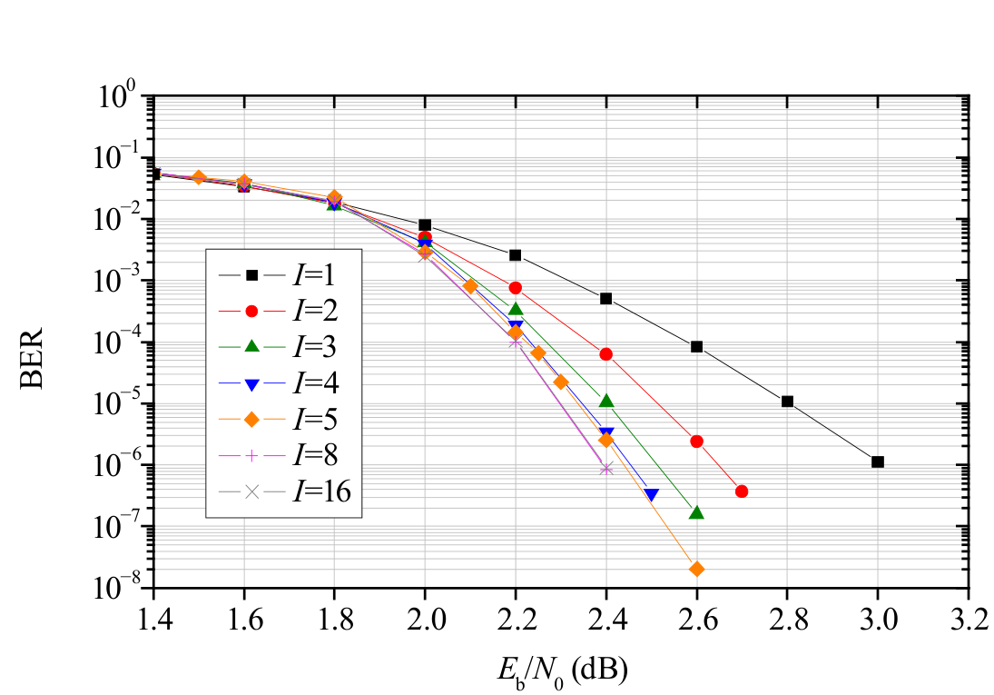
Concatenated Code: Interleaving Depth
Outer RS(255,223), inner rate-1/2 convolutional code.
I is interleaving depth. Compare curves at the same BER.
At this operating point, deeper interleaving reduces the required bit energy.
*Source: CCSDS 130.1-G-3, Figure 6-7, p. 6-9. Original simulation assumptions apply.
[8]
ENAE 694 • Demodulation, BER, and Coding
53

Slide 54
Concatenated Coding: The Design Trade
The inner decoder handles the weak, noisy signal.
Interleaving helps the outer RS code handle remaining error bursts.
More interleaving requires more memory and adds delay.
Read coding gain at the required BER for the complete scheme.
Code rates multiply: r_{total} = r_{RS} × r_{CC}. State the codes, interleaver and error metric.
Source: CCSDS 130.1-G-3, §6.
ENAE 694 • Demodulation, BER, and Coding
54

Slide 55
Turbo and LDPC Codes
Turbo codes iteratively exchange reliability estimates.
LDPC decoders work with sparse parity checks.
Code rate, block length, iterations, and error target all affect performance.
EG-LDPC is one family within LDPC.
Received
Reliabilities
Sparse Parity
Checks
Updated Bit
Reliabilities
Repeat message passing, then test parity checks.
[5, 8]
ENAE 694 • Demodulation, BER, and Coding
55

Slide 56
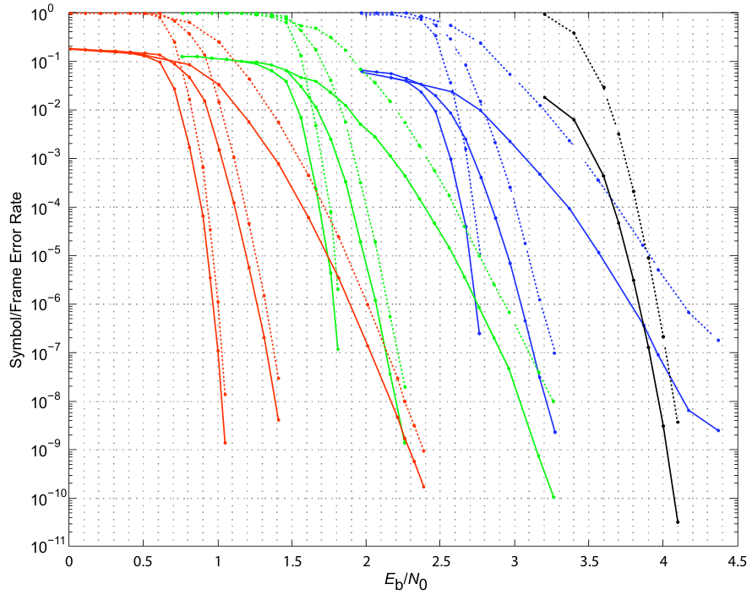
LDPC: Rate and Block Length Matter
Red: r = 1/2
Green: r = 2/3
Blue: r = 4/5
Black: C2, r ≈ 7/8
Within each color group,
left to right:
k = 16,384; 4,096; 1,024
C2: k = 7,156
Solid: BER
Dashed: frame-error rate
k = information bits per block. C2 rate = 7156/8176.
Source: CCSDS 130.1-G-3, Fig. 8-8, p. 8-10. Original decoder assumptions apply.
ENAE 694 • Demodulation, BER, and Coding
56

Slide 57
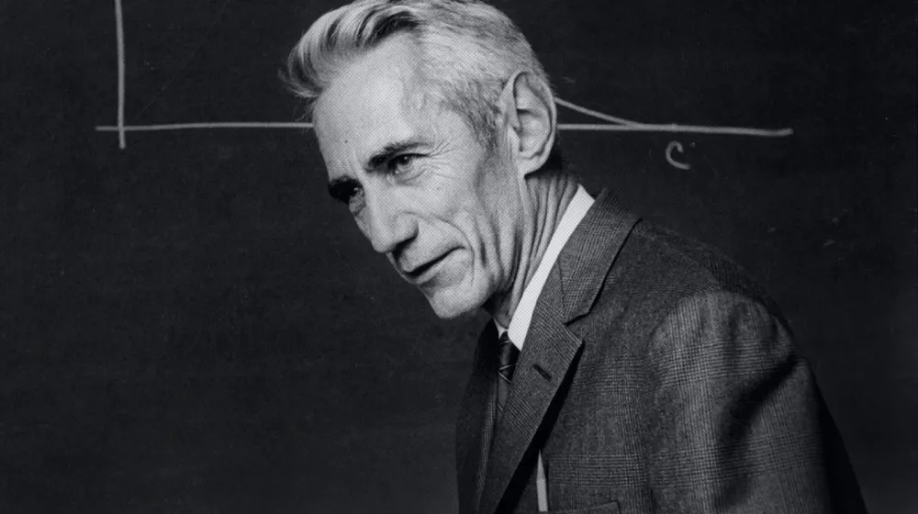
Shannon: The Limit Behind Coding Gain
C = B log₂(1 + S/N)
At capacity, η = R_{b}/B and
E_{b}/N₀ = (2^{η} − 1)/η
As η approaches zero:
minimum [E_{b}/N₀] approaches −1.6 dB.
Claude Shannon, Bell Labs
1948: A Mathematical Theory
of Communication
A fixed modulation and code rate impose
a tighter bound. Practical codes need margin.
B is the capacity-model bandwidth, not a first-null RF width.
Sources: Shannon (1948); portrait and biography: Nokia Bell Labs, Information Theory Turns 75.
ENAE 694 • Demodulation, BER, and Coding
57

Slide 58
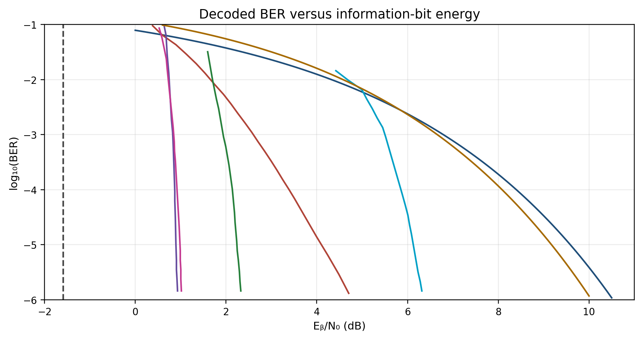
BER: Coding Schemes on One Graph
Uncoded BPSK
Convolutional K=7, r=1/2
RS(255,223)
Concatenated RS + CC
Turbo r=1/2, k=8920
LDPC r=1/2, k=16384
Hamming (7,4), hard decision
Dashed: −1.6 dB ultimate
wideband Shannon limit.
Fixed-rate bounds are higher.
Approximate coded traces from CCSDS 130.1-G-3, Fig. 3-5, p. 3-7. BPSK/AWGN, no sync loss.
Ideal interleaving for concatenation. Hamming: exact hard-decision calculation, r = 4/7.
ENAE 694 • Demodulation, BER, and Coding
58

Slide 59
Coding: Gain, Bandwidth, and Complexity
Benefit or Cost | What It Means for the Design
Coding gain | Less required E_{b}/N₀ at the same decoded error target
Bandwidth | At fixed R_{b} and modulation: B_{RF} = 2R_{b} / (r log₂M)
Complexity and delay | Decoder processing, memory, electrical power, and latency
*For this lecture: unfiltered rectangular symbols, first-null-to-first-null bandwidth. Code rate alone does not specify coding gain.
[5, 8]
ENAE 694 • Demodulation, BER, and Coding
59

Slide 60
Lunar Link: The Coded Candidate
Given: [S_{data}/N₀] = 74.5 dBHz and R_{b} = 4.0 Mbit/s.
Available [E_{b}/N₀] = 74.5 − 10 log₁₀(4.0 × 10⁶) = 8.5 dB.
Assume a rate-1/2 decoder threshold of 3.0 dB at BER = 10⁻⁵.
Margin = 8.5 − 3.0 − 1.0 = 4.5 dB ≥ 3.0 dB reserve.
The threshold excludes the separate assumed 1.0 dB implementation loss. Use information-bit energy.
ENAE 694 • Demodulation, BER, and Coding
60

Slide 61
Lunar Link: The Bandwidth Cost
R_{c} = R_{b}/r = 4.0/0.5 = 8.0 Mbit/s.
QPSK: R_{s} = R_{c}/2 = 4.0 Msymbol/s.
B_{RF} = 2R_{s} = 2 × 4.0 = 8.0 MHz.
This is mainlobe width. Sidelobes extend beyond the first nulls; a spectral mask needs a separate check.
ENAE 694 • Demodulation, BER, and Coding
61

Slide 62
Question: Does This Link Fit?
The coded QPSK signal needs 8.0 MHz of first-null bandwidth.
The channel allows 5.0 MHz.
The power budget already passes. Can we use this design?
A. Yes B. No
ENAE 694 • Demodulation, BER, and Coding
62

Slide 63
Worked Answer: Does This Link Fit?
B. No. The signal is too wide.
Required bandwidth ≤ allowed bandwidth
8.0 MHz ≤ 5.0 MHz is false.
Enough received power does not remove the bandwidth limit.
Next, lower the information rate while keeping rate-1/2 coding and QPSK.
ENAE 694 • Demodulation, BER, and Coding
63

Slide 64
Worked Example: Maximum Rate From Bandwidth
Given B_{RF} = 5.0 MHz, r = 0.5, and QPSK (m = 2).
B_{RF} = 2R_{s} = 2R_{b} / (r m)
Rearrange: R_{b,max} = B_{RF} r m / 2
R_{b,max} = 5.0 × 0.5 × 2 / 2 = 2.5 Mbit/s
That is the maximum information rate for this bandwidth.
ENAE 694 • Demodulation, BER, and Coding
64

Slide 65
Worked Example: Maximum Rate From Power
Given [S_{data}/N₀] = 74.5 dBHz and required [E_{b}/N₀] = 3.0 dB.
Allow 1.0 dB implementation loss and 3.0 dB reserve.
[R_{b,max}] = 74.5 − 3.0 − 1.0 − 3.0 = 67.5 dB(bit/s)
R_{b,max} = 10^{67.5/10} = 5.6 Mbit/s
Bandwidth permits only 2.5 Mbit/s, so bandwidth controls.
ENAE 694 • Demodulation, BER, and Coding
65

Slide 66
Randomization, Idle Fill, and Coding
Function | Purpose | Effect on Bit Count
Randomization | Reversible XOR reduces troublesome patterns | No redundancy from XOR alone
Idle fill | Keeps a service running without user data | Consumes transmitted capacity
Channel coding | Adds relationships used for error correction | R_{c} = R_{b} / r
Randomization does not guarantee a transition every symbol. It is separate from encryption and FEC.
[5]
ENAE 694 • Demodulation, BER, and Coding
66

Slide 67
The Decisions This Lecture Enables
Demodulation: recover carrier frequency, phase, and symbol timing.
Modulation: trade required power against bandwidth.
Coding: apply known math so the receiver can infer the original data.
Code selection: trade coding gain against bandwidth and complexity.
ENAE 694 • Demodulation, BER, and Coding
67

Slide 68
The Complete Performance Budget
[E_{b}/N₀] = [EIRP_{data}] − [L_{p}] − [L_{other}] + [G/T] + 228.6 − [R_{b}]
Margin = available [E_{b}/N₀] − required [E_{b}/N₀] − [L_{impl}]
The margin must meet the required reserve.
The waveform must also fit the bandwidth and receiver capabilities.
EIRP_{data} includes the data-power fraction once. [k] = −228.6 dBW/Hz/K.
ENAE 694 • Demodulation, BER, and Coding
68

Slide 69
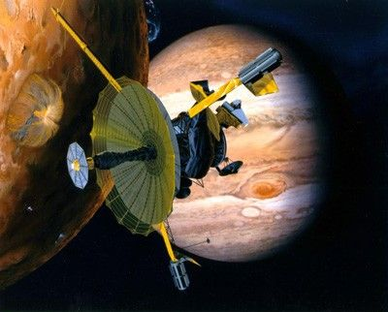
Galileo: The Antenna That Would Not Open
1991: high-gain antenna
failed to deploy fully.
Planned maximum: 134.4 kbps
Low-gain link at Jupiter,
before improvements: 8–16 bps
What could engineers still change?
Illustration shows the intended deployed antenna, not its failed configuration. Image: NASA.
Source: JPL, Galileo Jupiter Arrival Press Kit (1995), Telecommunications Strategy.
ENAE 694 • Demodulation, BER, and Coding
69

Slide 70
Galileo: Each Improvement Helped the Link
What engineers changed | Link-budget benefit | Gain*
Combined ground antennas | Higher effective G/T | Up to 4.0 dB
Canberra “ultracone” feed + LNA | Lower system noise | 1.7 dB
Suppressed the residual carrier | More RF power in data | 3.3 dB
Advanced coding and decoding | Lower required Eᵦ/N₀ | 1.7 dB
Listed gains add to as much as 10.7 dB: about 12× power-limited rate.
Compression: fewer bits to send; no separate RF-link dB credit.
*JPL improvement-budget figures; actual benefit varied with station and mode. Coding gain is incremental.
Source: Taylor, Cheung & Seo, Galileo Telecommunications (2002), p. 21, note 4; §§4.2, 6.1.
ENAE 694 • Demodulation, BER, and Coding
70

Slide 71
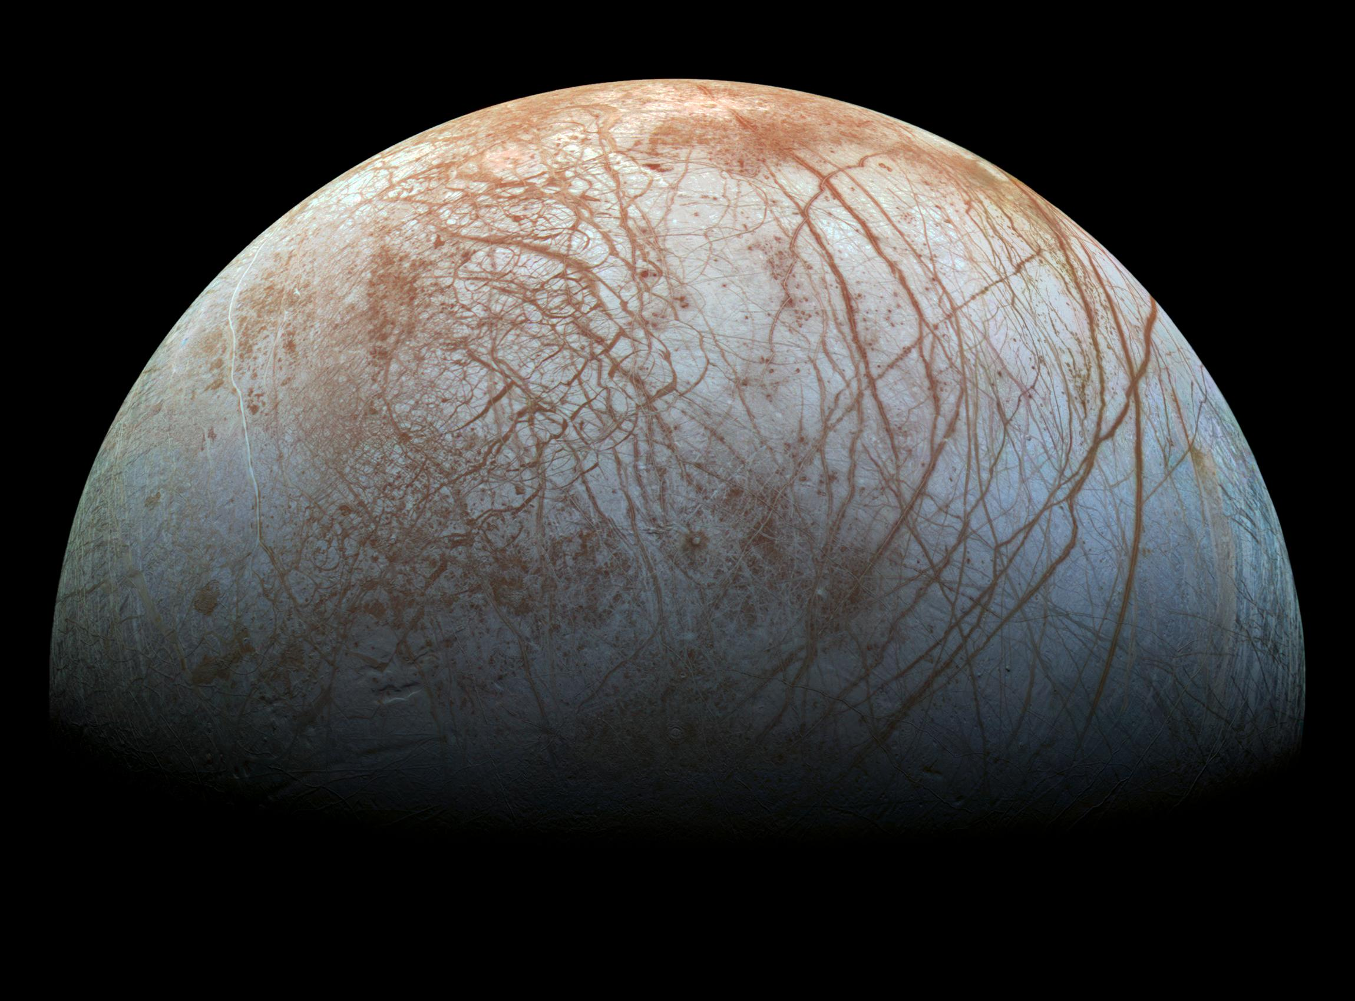
Galileo: This Is What Came Home
Europa
A fractured, icy surface
seen by Galileo’s camera.
The goal was useful
science returned to Earth.
Reprocessed color mosaic from Galileo SSI images. Credit: NASA/JPL-Caltech/SETI Institute.
PIA19048; some color gaps reconstructed. science.nasa.gov/photojournal/europas-stunning-surface-2/
ENAE 694 • Demodulation, BER, and Coding
71

Slide 72
References and Further Reading
[3] Gallager, MIT 6.450, Chapter 6: Channels, Modulation, and Demodulation.
[4] JPL DSN 810-005, Module 206E: Telemetry General Information.
[5] CCSDS 131.0-B-5: TM Synchronization and Channel Coding.
[6] Keysight Application Note 1298: Digital Modulation in Communications Systems.
ENAE 694 • Demodulation, BER, and Coding
72

Slide 73
References and Further Reading
[7] MathWorks: Analytical Expressions Used in berawgn.
[8] CCSDS 130.1-G-3: TM Synchronization and Channel Coding, Concept and Rationale.
[9] MIT 6.450, Lecture 23: channel capacity and the wideband energy limit.
[11] Analog Devices AN-922: Digital Pulse-Shaping Filter Basics.
ENAE 694 • Demodulation, BER, and Coding
73

Slide 74
References and Further Reading
[12] liquid-dsp: Linear Modem Bit Error Rates, Part II.
[13] MacKay: Information Theory, Inference, and Learning Algorithms, Chapters 1 and 11.
ENAE 694 • Demodulation, BER, and Coding
74

Slide 75
Receiver Models and Further Reading
[14] TUM LNTwww: Matched Filter.
[15] MathWorks: AWGN Channel.
[16] MathWorks: Carrier Synchronizer. Frequency, phase, and ambiguity.
[17] MathWorks: Symbol Synchronizer. Symbol timing recovery.
ENAE 694 • Demodulation, BER, and Coding
75

Slide 76
References: Shannon and Galileo
Shannon (1948). A Mathematical Theory of Communication.
Nokia Bell Labs. Information Theory Turns 75.
JPL (1995). Galileo Jupiter Arrival Press Kit, pp. 22–30.
Statman (1994). Optimizing the Galileo Space Communication Link.
Taylor, Cheung & Seo (2002). Galileo Telecommunications, p. 21, note 4.
descanso.jpl.nasa.gov/DPSummary/Descanso5--Galileo.pdf
jpl.nasa.gov/news/press_{kits}/gllarpk.pdf • ntrs.nasa.gov/citations/19940025160
ENAE 694 • Demodulation, BER, and Coding
76

