Slide 1
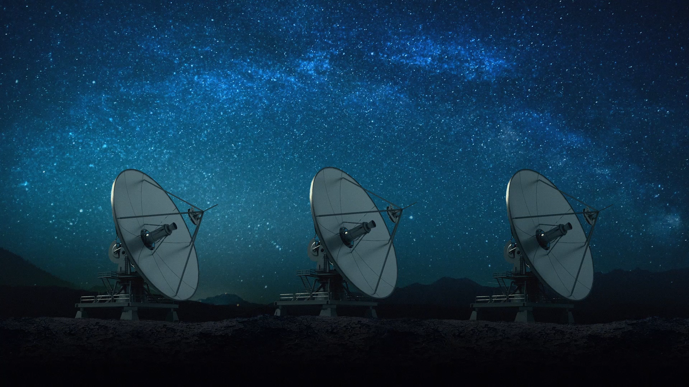
Spacecraft Communications
ENAE 694
Spacecraft Components
and Systems
Dave Israel (disrael@umd.edu)
November 2, 2026

Slide 2
Tonight’s Class
Part | Focus | Outcome
1 | Components and RF paths | Explain what each component does
Break
2 | Redundancy and complete systems | Trace normal and failed operating modes
The hardware diagram and the link budget must describe the same system.
ENAE 694 • Spacecraft Components and Systems
2

Slide 3
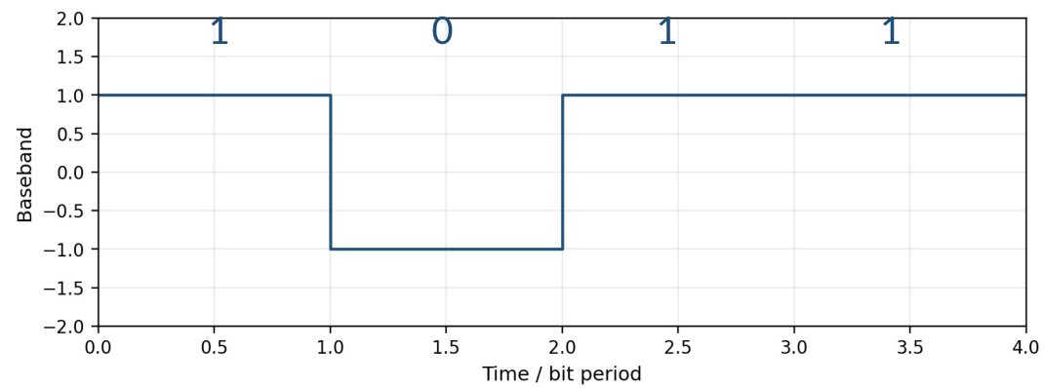
Review from Last Week: Integrate, Then Decide
For each bit interval
Integrate the signed
baseband value.
Compare with zero.
Reset for the next bit.
Average over each aligned bit: +1 −1 +1 +1
Recovered bits: 1 0 1 1
*Keep the sign. Squaring the baseband first would erase the bit distinction.
[12] • Ideal rectangular BPSK after carrier recovery.
ENAE 694 • Spacecraft Components and Systems
3

Slide 4
Correction from Last Week: Coding and Error Checks
Term or result | Meaning
Information bits / coded bits | Coding adds transmitted bits, not new information
Modulation symbol | One selected waveform state per symbol interval
RS(255,223) symbol | One 8-bit byte
Zero syndrome | The checks pass; an undetected error is still possible
A single parity check detects an odd number of bit flips.
[12]
ENAE 694 • Spacecraft Components and Systems
4

Slide 5
New Material: The Onboard Communications System
Which radios, amplifiers and antennas must fly?
How do RF paths change with operating mode?
What remains usable after a specified failure?
ENAE 694 • Spacecraft Components and Systems
5

Slide 6
A Command Receiver Must Be Available and Listening
Command antenna
Receive path
including RF loss
Powered receiver
Command decoder
and spacecraft computer
Keep a usable command path through every operating mode.
Ready to listen does not guarantee continuous Earth visibility or network access.
NASA/JPL onboard systems and fault protection [1, 10].
ENAE 694 • Spacecraft Components and Systems
6

Slide 7
The Design Starts With Operating Modes
Mode | Required communication | Likely antenna need
Science return | High data rate to Earth | Pointed high-gain antenna
Routine command | Reliable command reception | High-gain or broad-coverage path
Safe mode | Low-rate command and telemetry | Coverage with limited pointing
After a radio failure | Recover command and basic telemetry | A usable alternate RF path
A science link alone does not satisfy the spacecraft’s communications needs.
Teaching example
ENAE 694 • Spacecraft Components and Systems
7

Slide 8
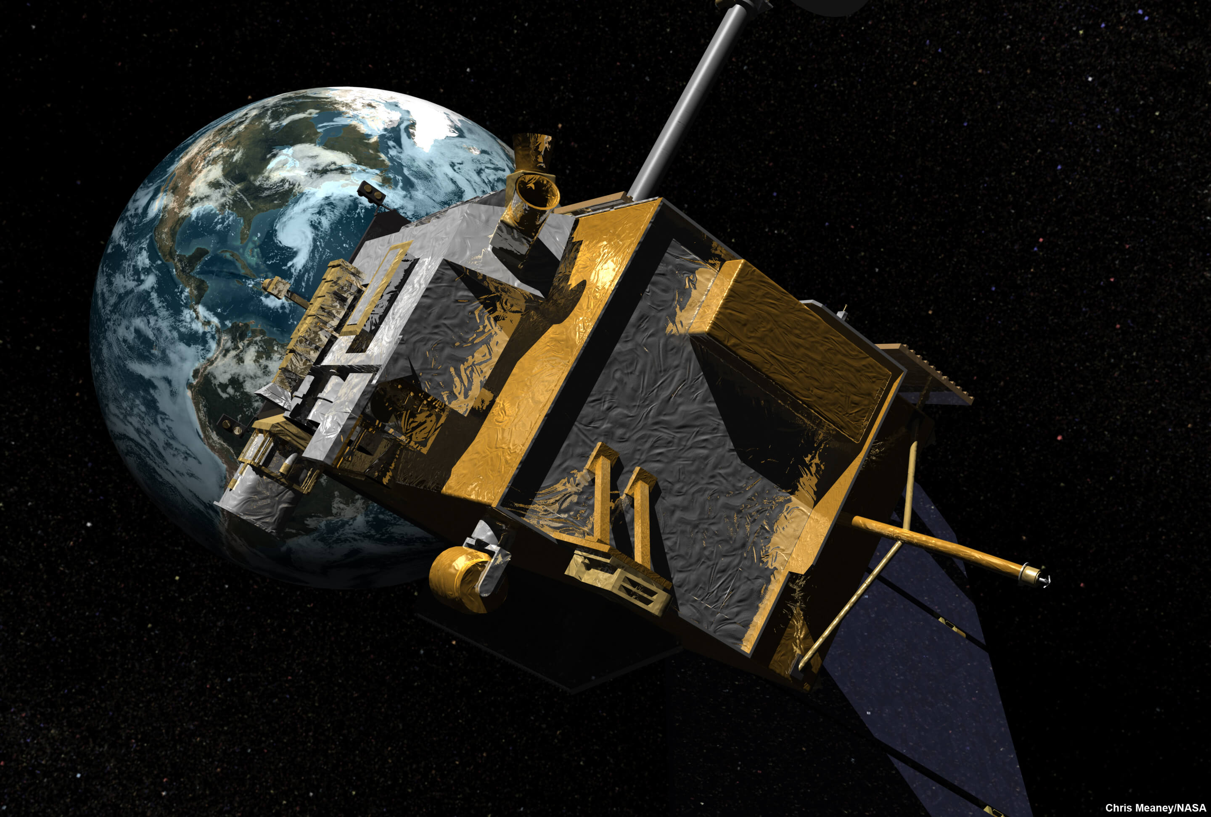
Real Hardware Occupies Real Places
Antennas need a clear view.
Radios and amplifiers need
power and thermal paths.
Cables connect the locations
and introduce RF loss.
Illustration: Chris Meaney/NASA [4]
ENAE 694 • Spacecraft Components and Systems
8

Slide 9
Example A: Separate Transmit and Receive Paths
Downlink data
Transmitter
Transmit antenna
C&DH
data and commands
Receiver
(including LNA)
Receive antenna
Uplink commands
Digital interfaces connect the radio to the spacecraft computer.
[1]
ENAE 694 • Spacecraft Components and Systems
9

Slide 10
Transmitter, Transceiver, and Transponder
Equipment | What it provides
Transmitter | Data modulation and an RF output
Receiver | RF reception, synchronization and recovered data
Transceiver | Transmit and receive functions in one unit
Transponder | Receives uplink signals and provides a downlink response
The required functions determine what must be inside the box.
[1, 11]
ENAE 694 • Spacecraft Components and Systems
10

Slide 11
Example A: One Antenna, Two Frequency Bands
TX
2.3 GHz
TX band
Diplexer
Shared antenna
RX
2.1 GHz
Band-pass filters
RX band
A diplexer separates bands. It does not select which radio is active.
[2]
ENAE 694 • Spacecraft Components and Systems
11

Slide 12
Isolation Protects the Receiver
Transmitter
+40.0 dBm
TX-to-RX isolation
60.0 dB
Leakage at RX port
−20.0 dBm
[P_{leak}] = [P_{TX}] − isolation = 40.0 − 60.0 = −20.0 dBm
Check receiver blocking, compression, damage limits, and TX noise
in the receive band. Isolation is frequency dependent.
[2, 3]
ENAE 694 • Spacecraft Components and Systems
12

Slide 13
Insertion Loss: What Changes When a Part Is Added?
Input reference plane
P_{in}
Cable, switch
or filter
Output reference plane
P_{out}
IL = 10 log₁₀(P_{before} / P_{after})
For matched ports: IL = [P_{in}] − [P_{out}]
Example: 10.0 W in, 5.0 W out gives 3.0 dB loss.
*Compare the same load and source conditions. Specify frequency and selected ports.
[3, 5] • Matched ports for the input/output form below.
ENAE 694 • Spacecraft Components and Systems
13

Slide 14
Insertion Loss Along an RF Route
Cable
0.4 dB
Switch
0.3 dB
Filter
0.3 dB
L_{route} = 0.4 + 0.3 + 0.3 = 1.0 dB
[P_{out}] = 10.0 dBW − 1.0 dB = 9.0 dBW
P_{out} = 10^{9.0/10} = 7.9 W
A two-way splitter adds 3.0 dB division to each branch, plus any excess loss.
Teaching example • Matched ports at one operating frequency.
ENAE 694 • Spacecraft Components and Systems
14

Slide 15
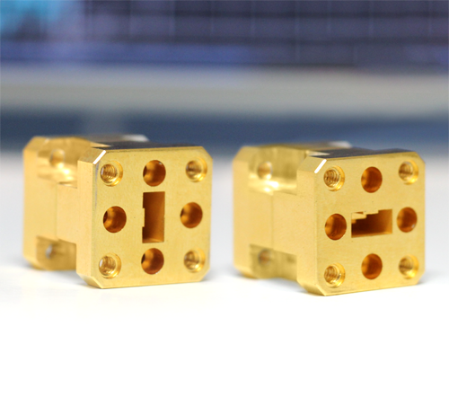

Coaxial Cable and Hollow Waveguide
Coaxial cable
Hollow waveguide
Center conductor and shield
Fields travel inside the metal guide
Flexible routing, broad frequency use
Low loss and high power in its band
Loss rises with frequency and length
Bulk, flanges, bends and cutoff matter
Images: Times Microwave [19], Eravant [20].
ENAE 694 • Spacecraft Components and Systems
15

Slide 16
Cable Loss: Length and Frequency Both Matter
Frequency | Catalog attenuation | Loss in 5.0 m
0.9 GHz | 0.13 dB/m | 0.7 dB
2.5 GHz | 0.23 dB/m | 1.2 dB
5.8 GHz | 0.36 dB/m | 1.8 dB
L_{cable} = α(f) × length
At 5.8 GHz: 0.36 dB/m × 5.0 m = 1.8 dB
*Add connector and joint losses. Use the selected cable’s frequency and temperature data.
[19] • LMR-400 catalog example, not a spacecraft qualification.
ENAE 694 • Spacecraft Components and Systems
16

Slide 17
Routing Loss: The Location Changes the Consequence
PA output
Cable / waveguide
L_{TXroute}
Antenna
[EIRP] = [P_{PA}] − L_{TXroute} + [G_{TX}]
Antenna
Cable / waveguide
L_{pre}
LNA / receiver
NF_{total} = L_{pre} + NF_{receiver} (at 290 K)
[6] • Passive input loss at 290 K for the NF relation.
ENAE 694 • Spacecraft Components and Systems
17

Slide 18
RF Transfer Switch: The “Baseball” Symbol
State A: TX A to antenna
State B: TX B to antenna
TX A
TX A
50 Ω load
Antenna
50 Ω load
Antenna
TX B
TX B
Four ports, two RF paths. Switching changes both connections.
Here the spare TX connects to the load and stays off.
[16, 17] • Connections are reciprocal. Check power rating and switching conditions.
ENAE 694 • Spacecraft Components and Systems
18

Slide 19
Power Splitter: Division Plus Excess Loss
Equal two-way splitter
4.5 W
6.5 dBW
10.0 W input
10.0 dBW
4.5 W
6.5 dBW
L_{branch} = 3.0 dB division + 0.5 dB excess = 3.5 dB
[P_{out}] = 10.0 − 3.5 = 6.5 dBW per output
[5] • Teaching value: 0.5 dB excess loss. Matched ports.
ENAE 694 • Spacecraft Components and Systems
19

Slide 20
Example B: Question: Switch or Splitter?
One 10.0 W transmitter must feed the selected antenna.
Design | Path loss | Antenna gain
A: switch | 0.5 dB | 10.0 dBi
B: equal splitter | 3.5 dB total | 10.0 dBi
Which gives the higher EIRP toward the selected antenna’s target?
*Splitter: 3.0 dB division + 0.5 dB excess loss. Other routing losses omitted equally.
Teaching example
ENAE 694 • Spacecraft Components and Systems
20

Slide 21
Example B: Worked Answer: Power in the Selected Path
[P_{TX}] = 10 log₁₀(10 W / 1 W) = 10.0 dBW
[EIRP] = [P_{TX}] − L_{route} + [G_{TX}]
A: 10.0 − 0.5 + 10.0 = 19.5 dBW
B: 10.0 − 3.5 + 10.0 = 16.5 dBW
The switch preserves 3.0 dB more EIRP in the selected path.
The splitter buys simultaneous connections at the cost of power per path.
Teaching example
ENAE 694 • Spacecraft Components and Systems
21

Slide 22
Switch, Splitter, or Diplexer?
Choice | What it provides | Main trade
RF switch | Select a path or paired paths | Low selected-path loss; actuation and failure state matter
Equal splitter / hybrid | Simultaneous connections | 3.0 dB division per branch, plus excess loss
Diplexer | Separate different frequency bands | Filter loss and finite rejection; shared common port
Check: required simultaneous paths, isolation, power handling and failures.
[2, 3, 5, 16, 17]
ENAE 694 • Spacecraft Components and Systems
22

Slide 23
Combining Power: Phase and Frequency Matter
Input A
5.0 W
Coherent combiner
Matched phase
8.9 W output
Input B
5.0 W
Total input: 10.0 W. Output: 10.0 dBW − 0.5 dB = 9.5 dBW.
Correct relative phase combines both inputs. A diplexer joins different bands.
[2, 5] • Matched coherent inputs. Teaching combiner excess loss: 0.5 dB.
ENAE 694 • Spacecraft Components and Systems
23

Slide 24
A Coupler Samples Power Without Equal Division
Most RF power continues to the antenna.
Directional coupler
Through power
Antenna
Power amplifier
Sample
50 Ω
Power detector
telemetry
The coupled port samples power. It is not an equal split.
[5, 18] • The isolated port has a matched termination.
ENAE 694 • Spacecraft Components and Systems
24

Slide 25
Receive-Path Loss Changes the Noise Figure
Antenna
reference plane
Total path loss
3.5 dB at 290 K
LNA
NF = 2.0 dB
At 290 K: NF_{total} = L_{passive} + NF_{LNA}
NF_{total} = 3.5 + 2.0 = 5.5 dB
A splitter or cable ahead of the LNA affects receiver sensitivity.
[6]
ENAE 694 • Spacecraft Components and Systems
25

Slide 26
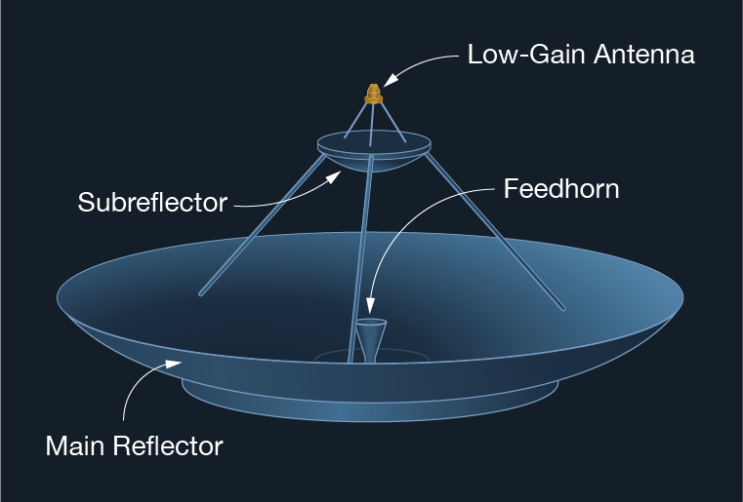
Multiple Antennas Serve Different Conditions
High gain: more link performance,
more pointing dependence.
Low gain: broader coverage,
lower achievable rate.
Two low-gain antennas can reduce
spacecraft blockage.
Image: NASA/JPL-Caltech [1]
ENAE 694 • Spacecraft Components and Systems
26

Slide 27
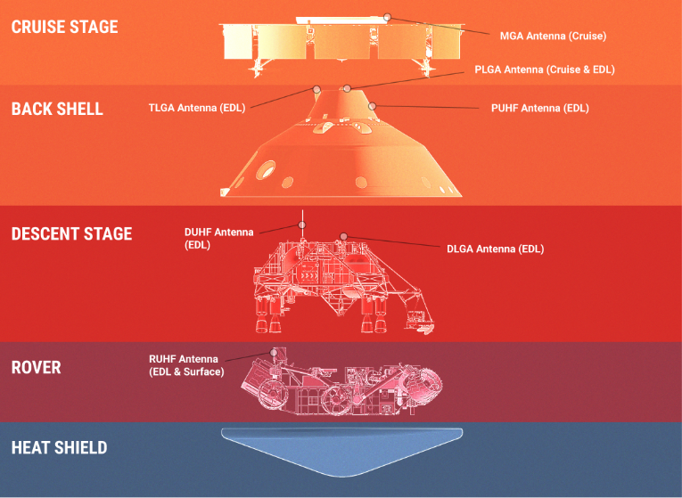
Perseverance: Antennas Change With Mission Phase
Cruise
Entry, descent, and landing
Surface operations
The useful RF path changes
as the vehicle configuration
and geometry change.
Image and mission facts: NASA/JPL-Caltech [7]
ENAE 694 • Spacecraft Components and Systems
27

Slide 28
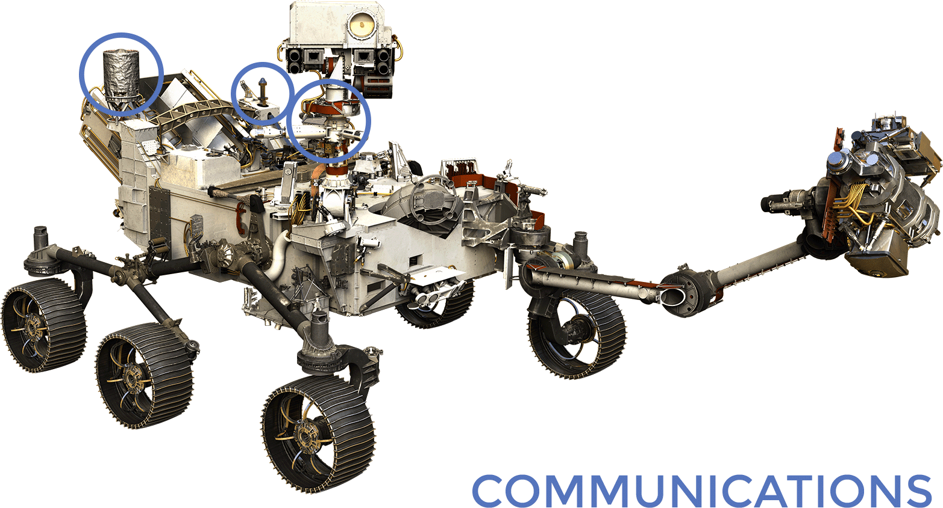
Perseverance: Different Antennas, Different Services
UHF antenna | X-band high gain | X-band low gain
Relay via Mars orbiters | Pointed direct-to-Earth link | Broad-coverage direct link
Image: NASA/JPL-Caltech [7]
ENAE 694 • Spacecraft Components and Systems
28

Slide 29
Power Amplifiers Also Consume Spacecraft Power
DC power
50.0 W
RF output
20.0 W
Power amplifier
40% DC-to-RF efficiency
Heat
≈ 30.0 W
P_{DC} = P_{RF} / η = 20.0 / 0.40 = 50.0 W
P_{heat} ≈ P_{DC} − P_{RF} = 50.0 − 20.0 = 30.0 W
Teaching example • Efficiency excludes other spacecraft loads
ENAE 694 • Spacecraft Components and Systems
29

Slide 30
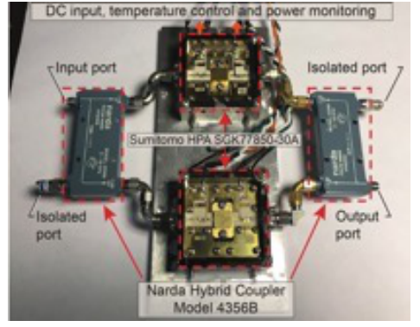
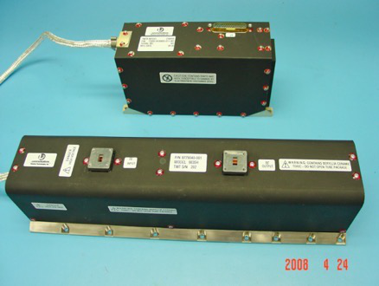
SSPA and TWTA: Both Remain Relevant
Solid-state power amplifier
Traveling-wave tube amplifier
Semiconductor devices, including GaN.
Compare linearity, efficiency,
power, radiation tolerance and heritage.
Electron beam transfers DC energy to RF.
Useful at high microwave power.
Includes a high-voltage power conditioner.
Images and technology comparison: NASA Glenn, R. N. Simons [8]
ENAE 694 • Spacecraft Components and Systems
30

Slide 31
LRO: Separate Science and Command Functions
Two S-band
omni antennas
Command and
low-rate telemetry
S-band
transponder
S-band antenna
routing
High-gain aperture
S-band / Ka-band
Science data
Ka-band modulator
and TWTA
One spacecraft can need several RF paths and more than one antenna.
NASA PDS LRO Radio Science Subsystem [9]
ENAE 694 • Spacecraft Components and Systems
31

Slide 32
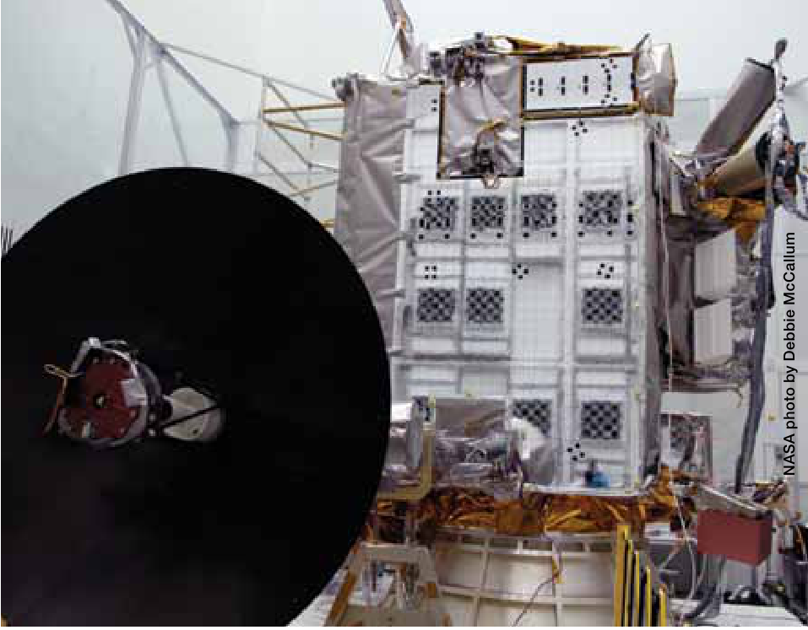
LRO: Two Bands Share the Flight Antenna
S-band
command / telemetry
Ka-band
science downlink
Separate RF feeds use one reflector
and one pointing assembly.
Ka-band has the narrower beam.
A pointing failure can affect both bands.
Shared S-/Ka-band high-gain antenna
Photographs: NASA/GSFC [35]. Functional paths: [9, 23].
ENAE 694 • Spacecraft Components and Systems
32

Slide 33
Break
Next: what still works
when something fails?
ENAE 694 • Spacecraft Components and Systems
33

Slide 34
Redundancy Applies to a Complete Function
Command
antenna
Receiver
Command
decoder / C&DH
A command path also depends on power, cables, switching,
control logic, and the ability to select the surviving path.
Two radios do not establish redundancy if one shared failure disables both.
[10]
ENAE 694 • Spacecraft Components and Systems
34

Slide 35
Example C: Question: Two Radios, One Antenna
Choose one TX. Keep both RX inputs connected.
Transponder A
TX and RX
RF connections
to be designed
Shared antenna
Transponder B
TX and RX
Where do the switch, splitter, and diplexer belong?
Teaching example
ENAE 694 • Spacecraft Components and Systems
35

Slide 36
Example C: Worked Answer: The RF Connections
TX transfer switch
Transponder A
TX
Diplexer
RX
TX
50 Ω
Shared antenna
RX
Transponder B
RX splitter
TX
RX
One transmitter connects to the antenna. Both receivers listen.
Teaching topology • Each selected path includes cable, switch, diplexer and splitter loss.
ENAE 694 • Spacecraft Components and Systems
36

Slide 37
Example C: Normal Transmit Path
TX transfer switch
Transponder A
TX
Diplexer
RX
TX
50 Ω
Shared antenna
RX
Transponder B
RX splitter
TX
RX
The switch directs the active transmitter’s power into one RF path.
Teaching topology • Each selected path includes cable, switch, diplexer and splitter loss.
ENAE 694 • Spacecraft Components and Systems
37

Slide 38
Example C: Command Reception
TX transfer switch
Transponder A
TX
Diplexer
RX
TX
50 Ω
Shared antenna
RX
Transponder B
RX splitter
TX
RX
Command reception does not require switching to the other receiver.
Teaching topology • Each selected path includes cable, switch, diplexer and splitter loss.
ENAE 694 • Spacecraft Components and Systems
38

Slide 39
Example C: Transponder A Fails
TX transfer switch
Transponder A
TX
Diplexer
RX
TX
50 Ω
Shared antenna
RX
Transponder B
RX splitter
TX
RX
After failover: TX B reaches the antenna. RX B still accepts commands.
Teaching topology • Each selected path includes cable, switch, diplexer and splitter loss.
ENAE 694 • Spacecraft Components and Systems
39

Slide 40
Example C: Question: The TX Switch Fails Open
TX transfer switch
Transponder A
TX
Diplexer
RX
TX
50 Ω
Shared antenna
RX
Transponder B
RX splitter
TX
RX
Can the second transmitter restore the downlink through this switch?
Teaching example • Fault: the switch antenna-side port becomes an open circuit.
ENAE 694 • Spacecraft Components and Systems
40

Slide 41
Example C: Worked Answer: Shared Hardware
No. Both transmitters depend on the same antenna-side switch port.
The receiver paths may still accept commands.
A spare transmitter does not bypass an open RF connection.
A separate path can improve fault coverage, but adds hardware.
Name the failure that the design tolerates, and the failures it does not.
[10]
ENAE 694 • Spacecraft Components and Systems
41

Slide 42
Recovery Must Be Possible Without the Lost Link
No valid commands
for allowed interval
Onboard fault
protection logic
Predefined recovery
configuration
A timer or fault detector can request a radio/path change.
The recovery logic needs surviving power and control interfaces.
A recovery command cannot depend entirely on the failed receiver.
NASA fault-protection guidance [10]
ENAE 694 • Spacecraft Components and Systems
42

Slide 43
Example D: Operating Modes and Their RF Paths
Science recorder
High-rate TX / PA
SCIENCE RETURN
High-rate TX → HGA.
Receiver A or B keeps listening.
HGA
Diplexer A
SAFE MODE
Low-rate A → LGA A.
Keep command receivers listening.
Transponder A
LGA A
A CHAIN LOST
Use B and LGA B for TX and RX.
Diplexer B
Transponder B
HGA POINTING LOST
LGA B
Use a low-rate path within coverage.
Teaching architecture • Include each route’s RF loss. Check coverage, power and link margin.
ENAE 694 • Spacecraft Components and Systems
43

Slide 44
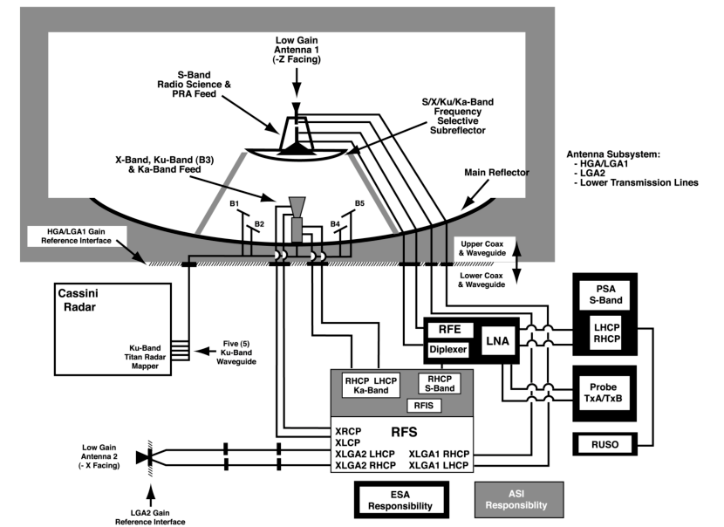
Cassini: One Spacecraft, Several RF Services
X-band: command
and telemetry
S / Ka: radio science
S-band: Huygens relay
Ku-band: radar
HGA + two X-band LGAs
Image: NASA/JPL, DESCANSO 3, Fig. 3-2 [21]; mission context [22].
ENAE 694 • Spacecraft Components and Systems
44

Slide 45
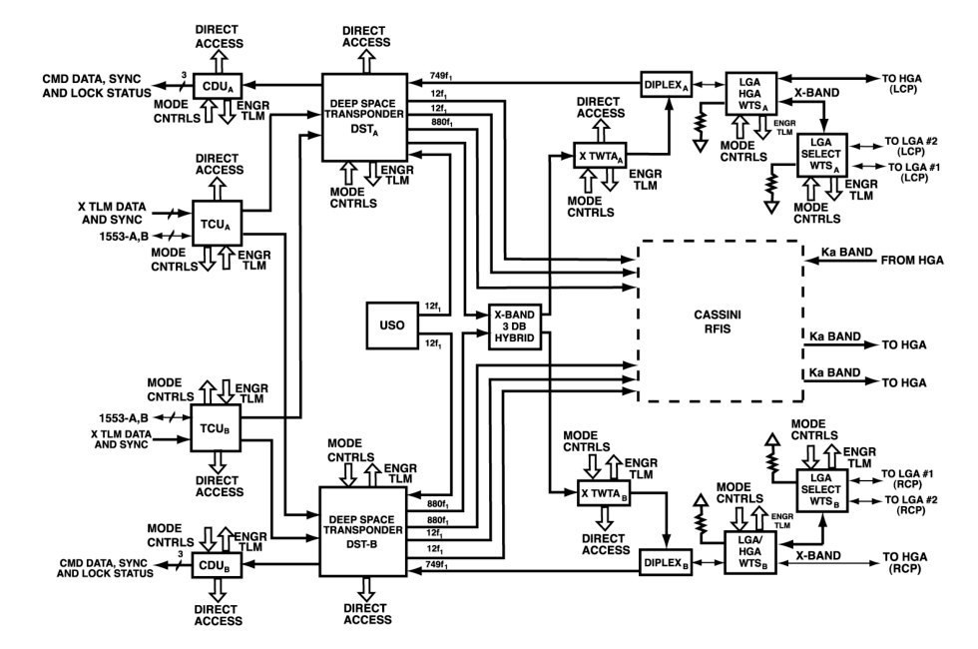
Cassini: Normal and Alternate RF Paths
NORMAL PAIRING
DST A → TWTA B
IF TWTA B FAILS
DST A → TWTA A
The hybrid connects
either exciter to
either amplifier.
Match the downlink
polarization on Earth.
NASA/JPL, DESCANSO 3, Fig. 3-4 [21]. WTS = waveguide transfer switch.
ENAE 694 • Spacecraft Components and Systems
45

Slide 46
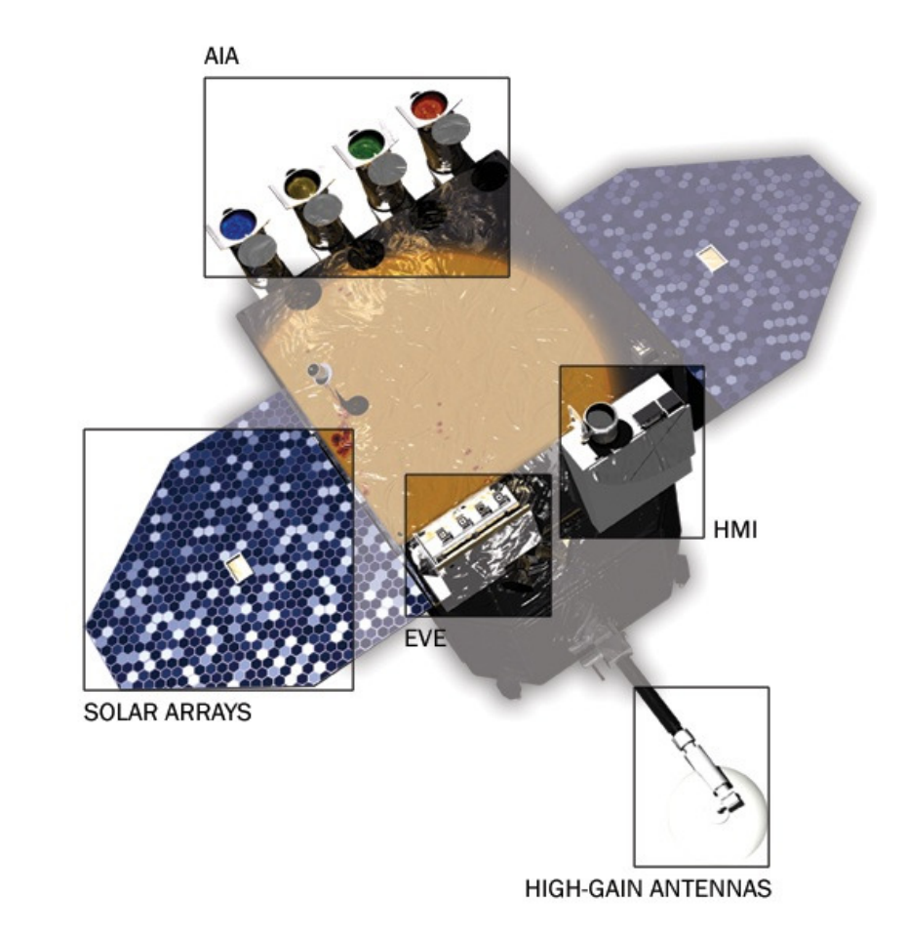
SDO: Communications Shapes the Spacecraft
The observatory points at the Sun.
Steerable antennas track Earth.
Solar-array shape avoids
blocking the antenna view.
Science downlink: 130 Mbit/s
at about 26 GHz.
Image and facts: NASA/GSFC SDO press kit, p. 6 [13]
ENAE 694 • Spacecraft Components and Systems
46

Slide 47
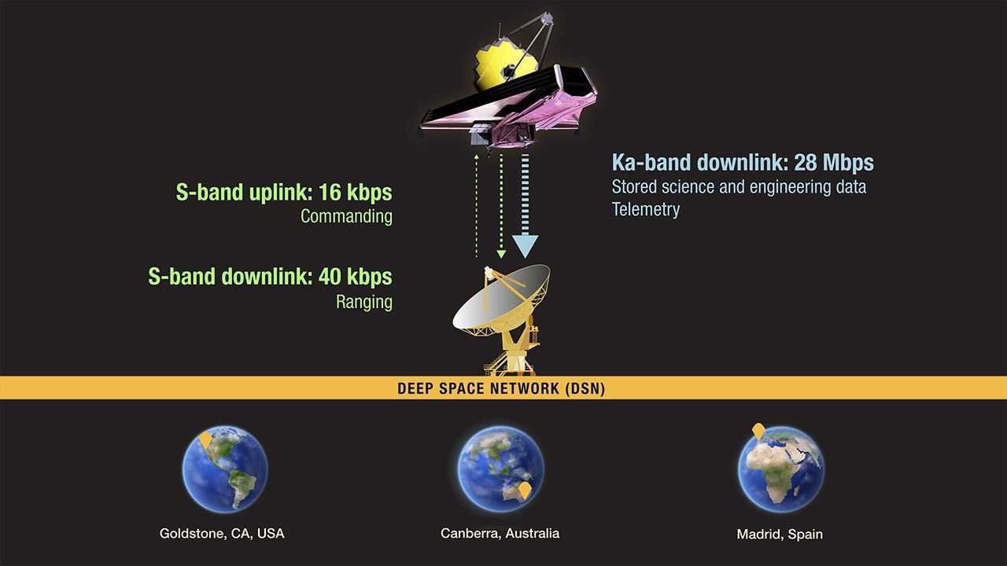
Webb: Science Data and Command Use Different Bands
Ka-band HGA
Science downlink
S-band MGA
Command and telemetry
A shared mission can require different RF services and antenna gains.
Illustration: NASA, ESA, CSA, Pam Jeffries (STScI) [14]
ENAE 694 • Spacecraft Components and Systems
47

Slide 48
Example E: The Losses Must Follow the Actual Route
PA output
10.0 W
Routing loss
1.0 dB total
Antenna gain
10.0 dBi
L_{route} = 2(0.1) + 0.5 + 0.3 = 1.0 dB
[EIRP] = [P_{TX}] − L_{route} + [G_{TX}]
[EIRP] = 10.0 − 1.0 + 10.0 = 19.0 dBW
Two cables + one switch + one diplexer. Do not subtract these losses twice.
Teaching values • Antenna gain referenced to its feed terminal.
ENAE 694 • Spacecraft Components and Systems
48

Slide 49
Example F: Question: Where Should the Splitter Go?
Which arrangement gives the lower overall noise figure?
LNA: gain 40.0 dB
NF = 2.0 dB
Splitter: 3.5 dB
RX
NF = 10.0 dB
A
LNA: gain 40.0 dB
NF = 2.0 dB
Splitter: 3.5 dB
RX
NF = 10.0 dB
B
Teaching example • Splitter: 3.0 dB division + 0.5 dB excess. Passive parts at 290 K.
ENAE 694 • Spacecraft Components and Systems
49

Slide 50
Example F: Worked Answer: Noise Figure and Redundancy
F_{total} = F₁ + (F₂ − 1)/G₁ + (F₃ − 1)/(G₁G₂)
Splitter: F = 2.239, G = 0.447. LNA: F = 1.585, G = 10,000.
A: F_{total} = 2.239 + (1.585 − 1)/0.447 + 9/(0.447 × 10,000)
B: F_{total} = 1.585 + (2.239 − 1)/10,000 + 9/(10,000 × 0.447)
NF = 10 log₁₀(F): A = 5.5 dB B = 2.0 dB
B has lower NF, but the shared first LNA is a common failure point.
[6] • Splitter total loss 3.5 dB. Other port matched at 290 K.
ENAE 694 • Spacecraft Components and Systems
50

Slide 51
Radio Selection Includes More Than Data Rate
Check | Why it matters
RF band, power, NF and interfaces | The radio must fit the physical link and spacecraft
Modulation, coding and data rates | Both ends must support the same modes
Radiation, temperature and flight heritage | A laboratory specification is not flight qualification
Software-defined functions | Reconfiguration helps only within hardware limits
Power states and recovery behavior | A spare must be usable after the assumed failure
NASA Small Spacecraft State-of-the-Art, Communications [15]
ENAE 694 • Spacecraft Components and Systems
51

Slide 52
Question: What Else Must Survive?
The RF paths are separate. What common failure can still defeat both?
Antenna A / RX A
Antenna B / RX B
One shared power feed
Power connections shown in gold.
Teaching example
ENAE 694 • Spacecraft Components and Systems
52

Slide 53
Worked Answer: Independence Extends Beyond RF
A failure of the shared power feed can disable both receivers.
Independent, protected feeds can improve the intended fault coverage.
Also check shared decoders, control lines, connectors and software.
A credible design identifies both the surviving path and the limits of its redundancy.
[10]
ENAE 694 • Spacecraft Components and Systems
53

Slide 54
What a Complete Communications Design Must Show
Evidence | Question it answers
Operating concept and modes | When and how does the spacecraft communicate?
Hardware diagram | What equipment and connections must fly?
Path-specific link budgets | Does each required link have enough margin?
Failure-response table | What survives, and how do we select it?
Trade rationale | Why is this combination appropriate?
ENAE 694 • Spacecraft Components and Systems
54

Slide 55
The Hardware Choices Return to the Link Equation
[S/N₀] = [EIRP] − L_{p} − L_{atm} − L_{point} − L_{pol} + [G/T] + 228.6
[EIRP] = [P_{TX}] − L_{TXroute} + [G_{TX}]
[G/T] = [G_{RX}] − [T_{sys}]
[E_{b}/N₀] = [S/N₀] − 10 log₁₀(R_{b} / 1 bit/s)
TX routing changes EIRP. RX routing changes system noise.
Antenna choice and pointing change the usable link in each mode.
[6, 12] • Loss terms are positive dB quantities.
ENAE 694 • Spacecraft Components and Systems
55

Slide 56
GRO: Closing the Gap in Relay Visibility
BEFORE: a relay-visibility gap
AFTER: TDRS-1 covers that gap
TDRS-E
TDRS-E
GRO orbit
GRO orbit
TDRS-1
repositioned
ZOE
Earth
Earth
Earth
No relay
in view
GRO
TDRS-W
TDRS-W
Green: a relay is in view.
Amber: no relay is in view.
At least one TDRS in view
through the full orbit
TDRS-1 could no longer see White Sands. Canberra supplied its ground connection.
Conceptual redraw from the GRTS engineering history [32]. Not to scale or exact orbital geometry.
ENAE 694 • Spacecraft Components and Systems
56

Slide 57
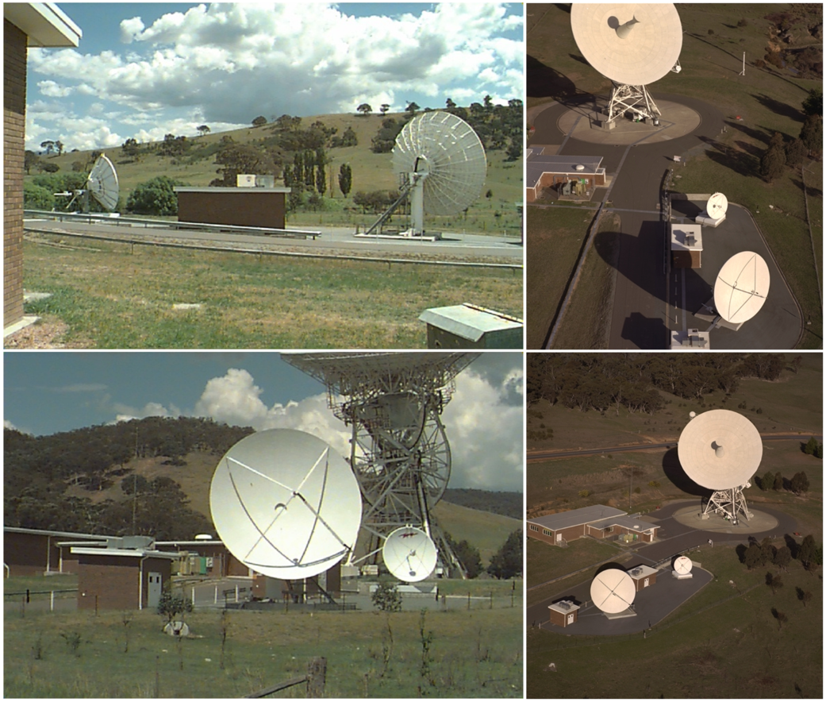
GRTS: Closing the Relay Network’s Coverage Gap
1. Move TDRS-1 to close the ZOE.
2. TDRS-1 is now outside
White Sands’ field of view.
3. Add Canberra ground capability
for the repositioned relay.
Relay-network reconfiguration enabled full-orbit coverage.
Images/history: NASA [31]; Zillig and Valvano [32]. ZOE = Zone of Exclusion.
ENAE 694 • Spacecraft Components and Systems
57

Slide 58
BATSE → BACODINE → GCN → Swift
BATSE / GRO
real-time telemetry
BACODINE
ground localization
Observatories
rapid follow-up
1993: use the live telemetry stream to distribute burst positions.
Swift
onboard localization
TDRSS + GCN
short urgent alerts
Observatories
rapid follow-up
Swift also repoints its own X-ray and UV/optical telescopes autonomously.
NASA GCN history [33]; original BACODINE description [34]; Swift [24].
ENAE 694 • Spacecraft Components and Systems
58

Slide 59
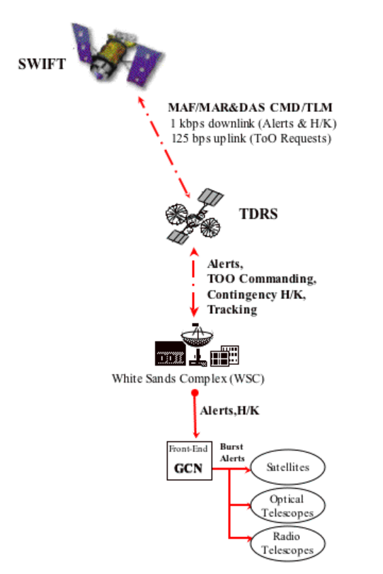
Swift: Communications as Part of the Discovery
A gamma-ray burst is unpredictable.
Its afterglow begins fading immediately.
Swift points its own telescopes
and alerts the rest of the world.
The mission has ended. The architecture remains a powerful lesson.
NASA/GSFC mission-flow illustration [24]; mission status [28].
ENAE 694 • Spacecraft Components and Systems
59

Slide 60
Swift: Two Data Paths, Two Different Jobs
SWIFT
BAT / XRT / UVOT
Onboard recorder
full science data
Scheduled ground
station contact
Short alert
position + time
1 kbps
TDRS relay
S-band MA return
White Sands
→ GCN alerts
Urgent path: tell others where to look now.
Bulk path: deliver the detailed measurements.
Follow-up
observatories
Functional redraw from NASA Swift [24, 26] and SpaceOps [25].
ENAE 694 • Spacecraft Components and Systems
60

Slide 61
Swift: Multiple Access and Demand Access
MULTIPLE ACCESS
DEMAND ACCESS
Several spacecraft can share
the TDRS relay service.
A burst alert can use the relay
without waiting for a routine
preplanned ground pass.
Question: Which matters most for the first burst alert?
Answer: low delivery delay. A short message can start observations
while the transient is still bright.
[24–26] • Access requires a visible relay with available capacity.
ENAE 694 • Spacecraft Components and Systems
61

Slide 62
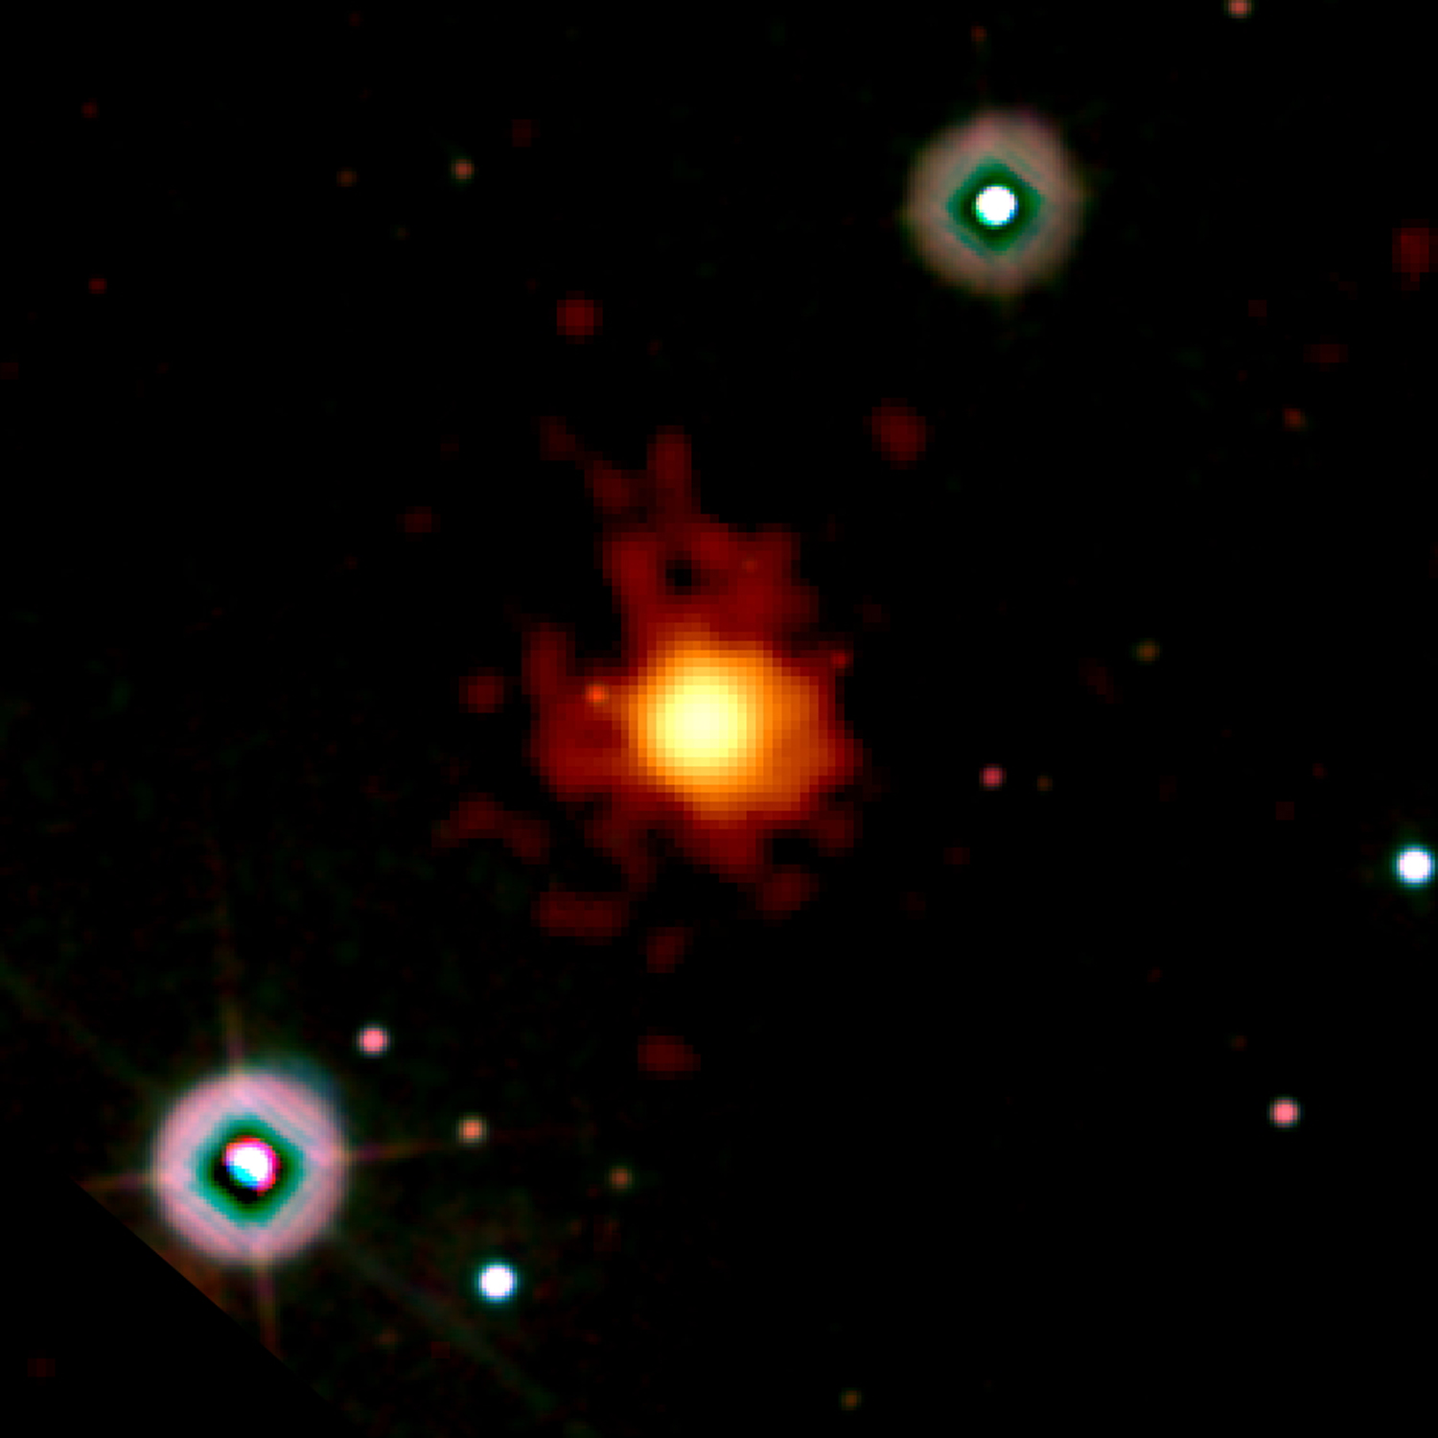
Swift Discovery: A Burst from the Young Universe
23 April 2009: Swift finds GRB 090423.
Rapid position alerts guide follow-up.
Ground infrared observations: z ≈ 8.2.
A massive star died when the universe
was only about 600 million years old.
Fast communication turned a fleeting event into a measurable discovery.
Image: NASA/Swift/Stefan Immler [27]. Science: ESO [29]; event TDRSS archive [30].
ENAE 694 • Spacecraft Components and Systems
62

Slide 63
Next: A Closed Link Is Not Enough
The RF hardware must provide a usable path.
The link budget must support the information rate.
The network must provide access when the information matters.
How can many spacecraft share a relay
and still deliver urgent information promptly?
ENAE 694 • Spacecraft Components and Systems
63

Slide 64
References and Further Reading: Components
[1] NASA/JPL. Basics of Space Flight, Chapter 11: Onboard Systems.
[2] Mini-Circuits. RF Diplexers and Triplexers.
[3] Analog Devices. AN-2558: RF Switch Performance with Arbitrary Loads.
[5] Mini-Circuits. AN10-006: Understanding Power Splitters.
[6] Analog Devices. System Noise-Figure Analysis for Modern Radio Receivers.
[8] R. N. Simons, NASA Glenn. Microwave Power Amplifiers for NASA Missions (2023).
[16] Keysight. 87222C/D/E Coaxial Transfer Switches.
[17] JFW Industries. What Is an RF Transfer Switch?
[18] M. Steer. Microwave and RF Design IV, Appendix 1.A: Schematic Symbols.
ENAE 694 • Spacecraft Components and Systems
64

Slide 65
References and Further Reading: Missions and Systems
[4] NASA/GSFC. LRO: Spacecraft and Instruments.
[7] NASA/JPL-Caltech. Mars 2020 Perseverance Landing Press Kit: Telecommunications.
[9] NASA PDS. LRO Radio Science Subsystem, context record.
[10] NASA. Basics of Space Flight: Fault Protection; Lessons Learned 799.
[11] CCSDS/SANA. Carrier Reception Transponder Ratio registry.
[12] CCSDS. TM Synchronization and Channel Coding: Summary of Concept and Rationale.
[13] NASA/GSFC. SDO Press Kit (2010), p. 6; SDO mission overview.
[14] NASA/STScI. How Do We Communicate With Webb?
[15] NASA. Small Spacecraft State-of-the-Art: Communications.
ENAE 694 • Spacecraft Components and Systems
65

Slide 66
References and Further Reading: Added Hardware Topics
[19] Times Microwave Systems. LMR-400 cable assembly data sheet.
[20] Eravant. Waveguide Connector, Uni-Guide; millimeter-wave component guide.
[21] J. Taylor, L. Sakamoto, C.-J. Wong. Cassini Orbiter/Huygens Probe Telecommunications. NASA/JPL DESCANSO 3 (2002).
[22] J. L. Webster. Cassini Spacecraft Engineering Tutorial. NASA/JPL (2006).
[23] NASA. Shaped reflector dual S-band and Ka-band high gain antenna. US11581663B1, description of LRO heritage (2023).
[35] NASA/GSFC. Goddard Tech Transfer News, Summer 2009, p. 8.
ENAE 694 • Spacecraft Components and Systems
66

Slide 67
References: Swift and Time-Critical Science
[24] NASA/GSFC. Swift mission flow: GCN and TDRSS data paths.
[25] Sobchak, Shinners, Shaw. NASA Space Network Project Operations Management. SpaceOps 2018, Fig. 7.
[26] NASA Swift Burst Advocate Guide, v0.8. TDRSS and ground links.
[27] NASA Imagine the Universe. Swift finds GRB 090423 (2009).
[28] NASA Swift mission-end update (23 October 2026); Aerospace reentry prediction (checked 1 November).
[29] ESO. The Most Distant Object Yet Discovered (28 April 2009).
[30] NASA Swift BAT archive. GRB 090423 TDRSS data products.
ENAE 694 • Spacecraft Components and Systems
67

Slide 68
References: BATSE, GRTS and the Origins of GCN
[31] NASA. March 1994: GRTS Declared Operational.
[32] D. J. Zillig and J. Valvano. The GRO Remote Terminal System. SpaceOps 1994; NASA NTRS 19950010773.
[33] NASA. History of GCN.
[34] NASA/GSFC. GCN/CGRO GRB Notices: original BACODINE description.
ENAE 694 • Spacecraft Components and Systems
68

