Slide 1
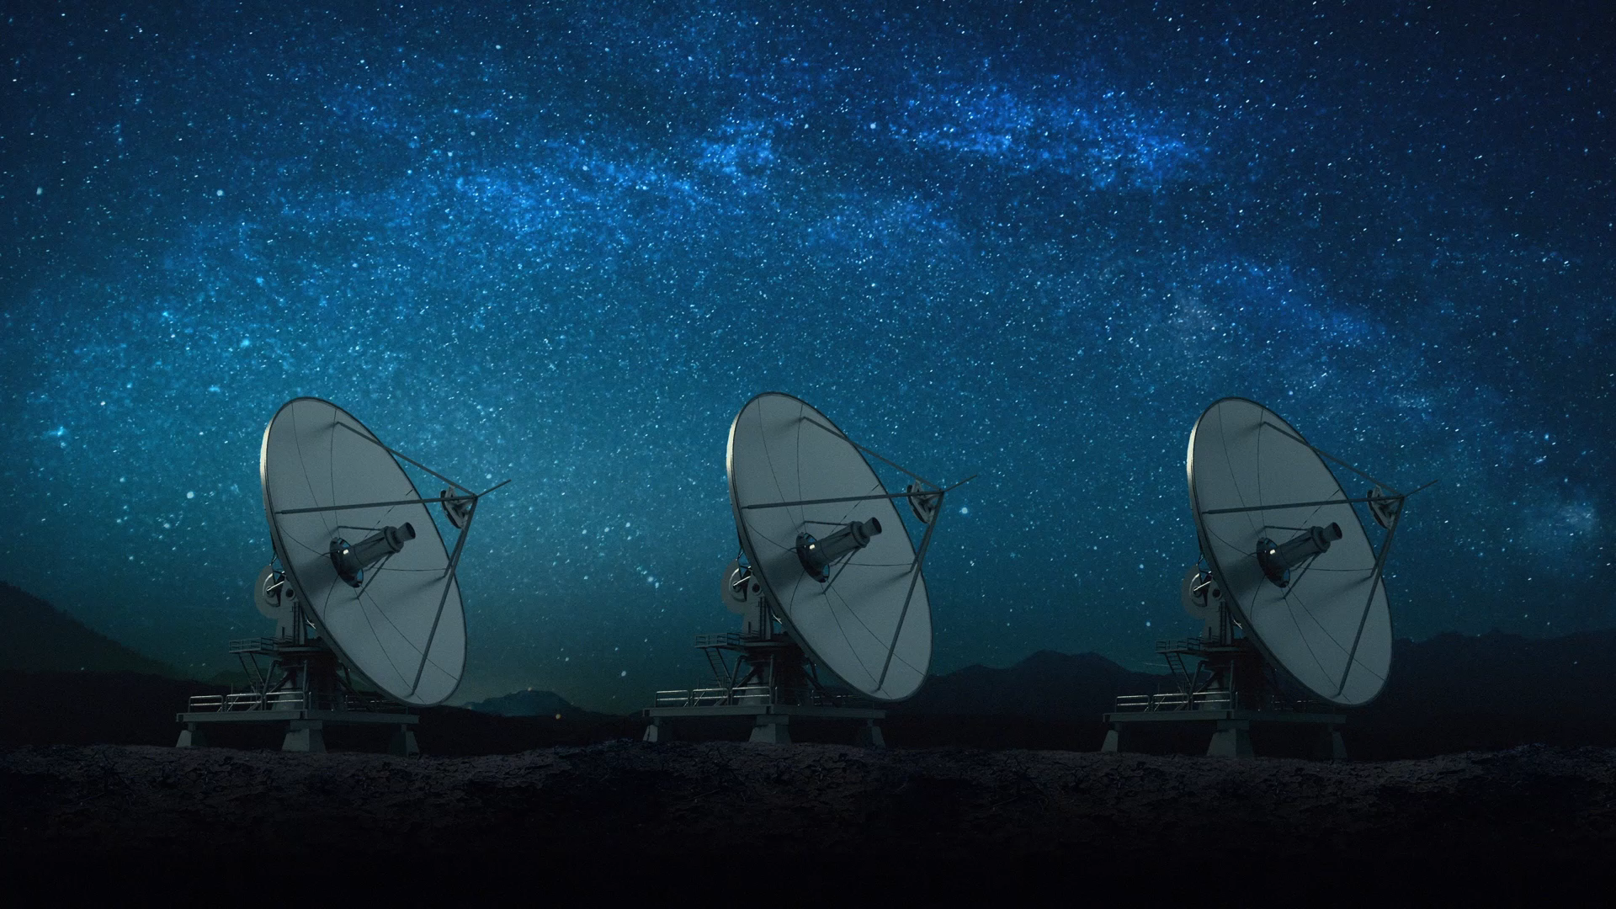
Spacecraft Communications
ENAE 694 • Received Power and Link Geometry
Dave Israel (disrael@umd.edu)
September 14, 2026

Slide 2
The Physical Question
How much signal power reaches the receiver?

Slide 3
Tonight’s Three Parts
Link Geometry and Slant Range
Received Power: Gains and Losses
The TERPSat Link Budget and Design Trades

Slide 4
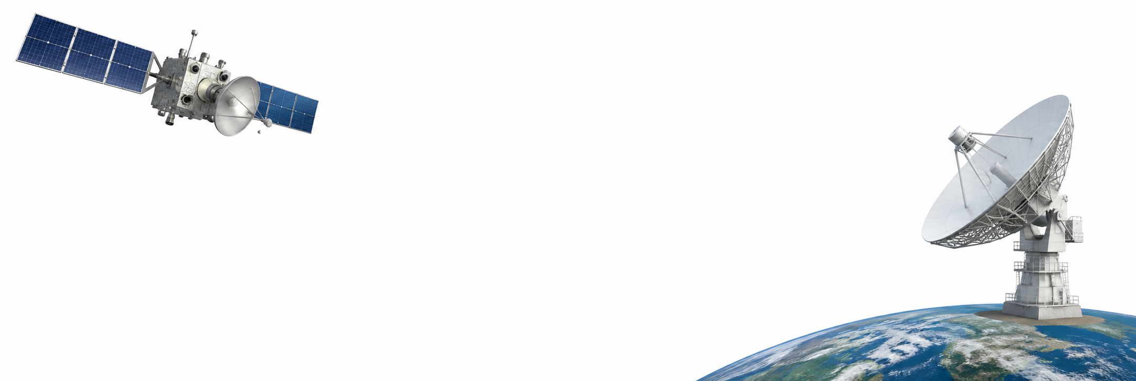
One Link, Two Design Viewpoints
Spacecraft Team
Network Provider
Transmit Power and Antenna
Pointing and Orbit
Station Antenna and Receiver
Supported Frequencies and Scheduling

Slide 5
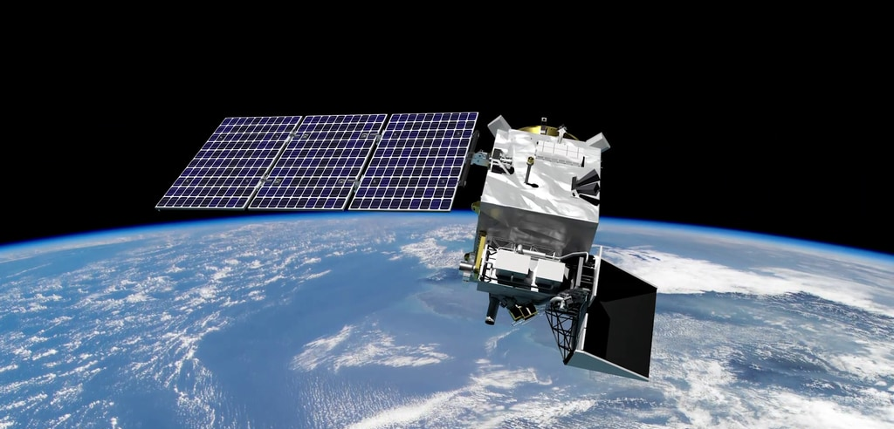

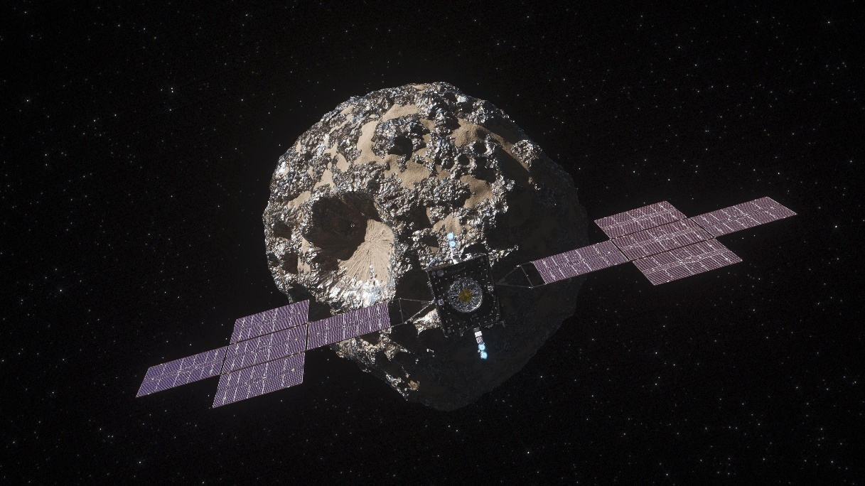
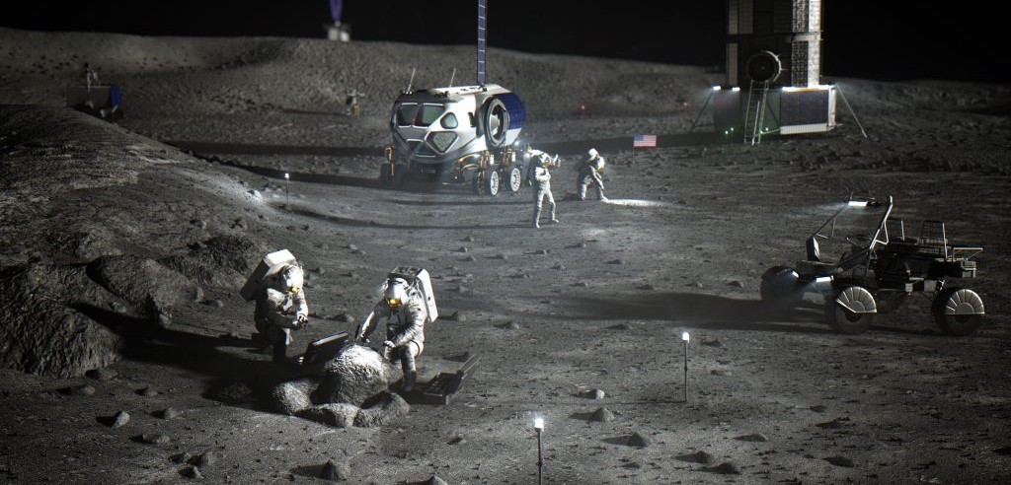

Slide 6
One Direction at a Time
one transmitter → one receiver → one direction
TX
RX
The reciprocal link needs its own budget. Transmitter and receiver parameters can differ.

Slide 7
Received Power Is Only a Start
Tonight we calculate carrier power at the receiver input
We do not yet know whether the receiver can recover the data
That requires noise, waveform performance, and margin
A respectable number in dBW is not yet a working communications service

Slide 8
When Does a Path Exist?
1 Earth, terrain, or structures
can block line of sight
2 Service begins above eₘᵢₙ
3 Slant range R(t) changes
throughout the pass
4 Design to the worst useful
geometry—not merely visibility
S/C
Slant Range R(t)
Ground Station
Minimum Elevation
Local Horizon (0°)
Earth
Higher Elevation Mask: Shorter Maximum Range, Less Contact Time

Slide 9
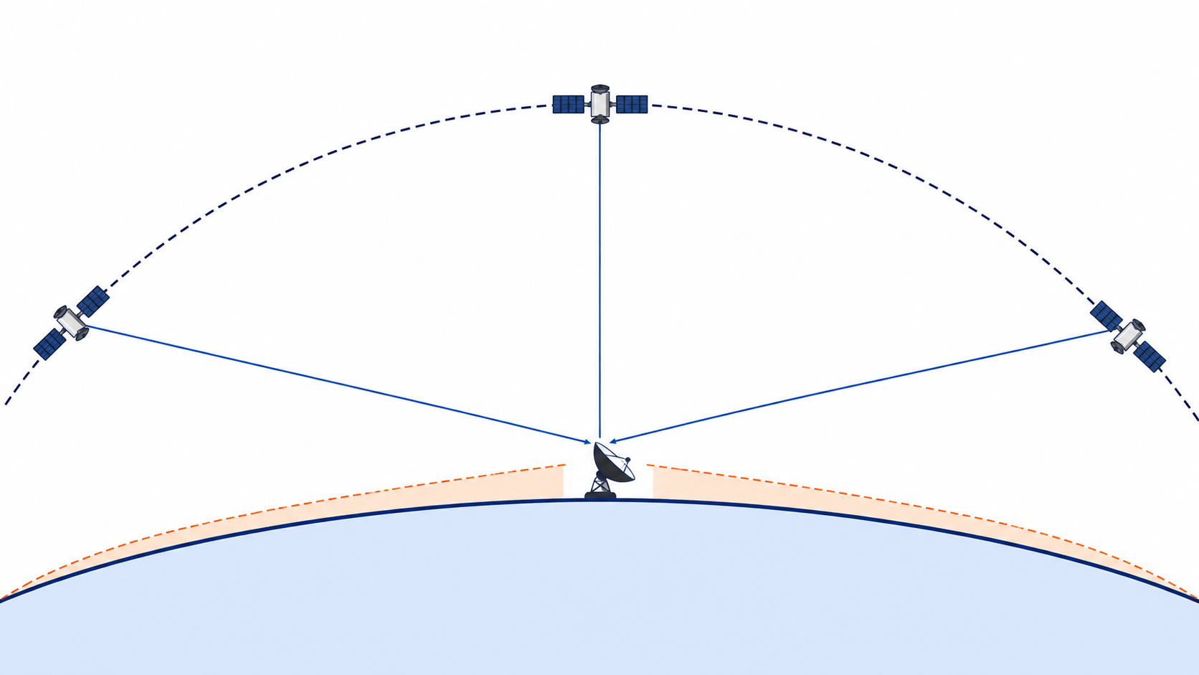
A Pass Is Not One Range
RISING
OVERHEAD
SETTING
AOS
long range
weakest power
MAXIMUM
ELEVATION
shortest range
strongest power
LOS
long range
weakest power
Range, path loss, and pointing change continuously.
AOS = Acquisition of Signal LOS = Loss of Signal

Slide 10
TERPSat Link Geometry
EARTH RADIUS
6,378 km
ORBIT ALTITUDE
705 km
MINIMUM ELEVATION
5°
d
S/C
e = 5°
Rₑ
Rₑ + h

Slide 11
Calculating Slant Range
d =
(Rₑ + h)² − Rₑ² cos² e
− Rₑ sin e
2,574 km
Rₑ = 6,378 km • h = 705 km • e = 5°
e = 5°
d ≈ 2,574 km
At 90°: d = h = 705 km
Geometry alone creates a 3.65:1 range swing.

Slide 12
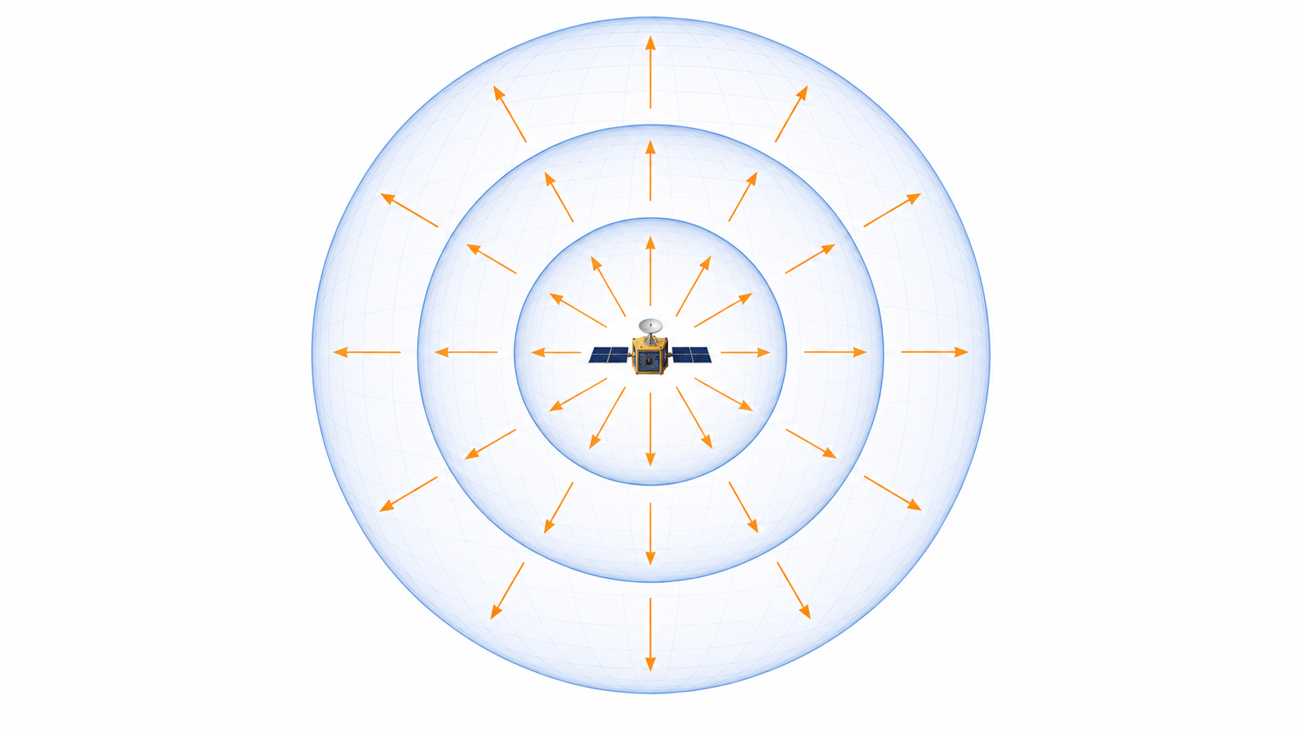
Why Power Falls with Range
Same transmitted power.
Larger spherical area.
AREA = 4πR²
FLUX ∝ 1/R²
R → 2R
area ×4 • flux ÷4
Δ[Pᵣ] = −6 dB

Slide 13
What Is a Decibel?
Power ratio in dB = 10 log₁₀(P₂ / P₁)
[P] in dBW = 10 log₁₀(P / 1 W)
P is linear power; [P] is its decibel representation.
Try it: 1 W → 10 W → 100 W. What about 2 W?

Slide 14
Linear Power and Decibel Power
Course notation: P is linear power; [P] is that power expressed in dB.
P = 1 mW
P = 10 mW
P = 0.1 W
P = 1 W
P = 10 W
[P] = −30 dBW
[P] = −20 dBW
[P] = −10 dBW
[P] = 0 dBW
[P] = 10 dBW
[P] = 0 dBm
[P] = 10 dBm
[P] = 20 dBm
[P] = 30 dBm
[P] = 40 dBm
Every +10 dB step multiplies power by 10. Gains add; losses subtract.

Slide 15
Useful Decibel Relationships
Predict the sign and scale before touching the calculator.
CHANGE
PHYSICAL EFFECT
RECEIVED POWER
POWER ×2
twice the watts
Δ[Pᵣ] = +3 dB
POWER ×10
ten times the watts
Δ[Pᵣ] = +10 dB
RANGE ×2
four times the sphere area
Δ[Pᵣ] = −6 dB
RANGE ×10
one hundred times the area
Δ[Pᵣ] = −20 dB

Slide 16
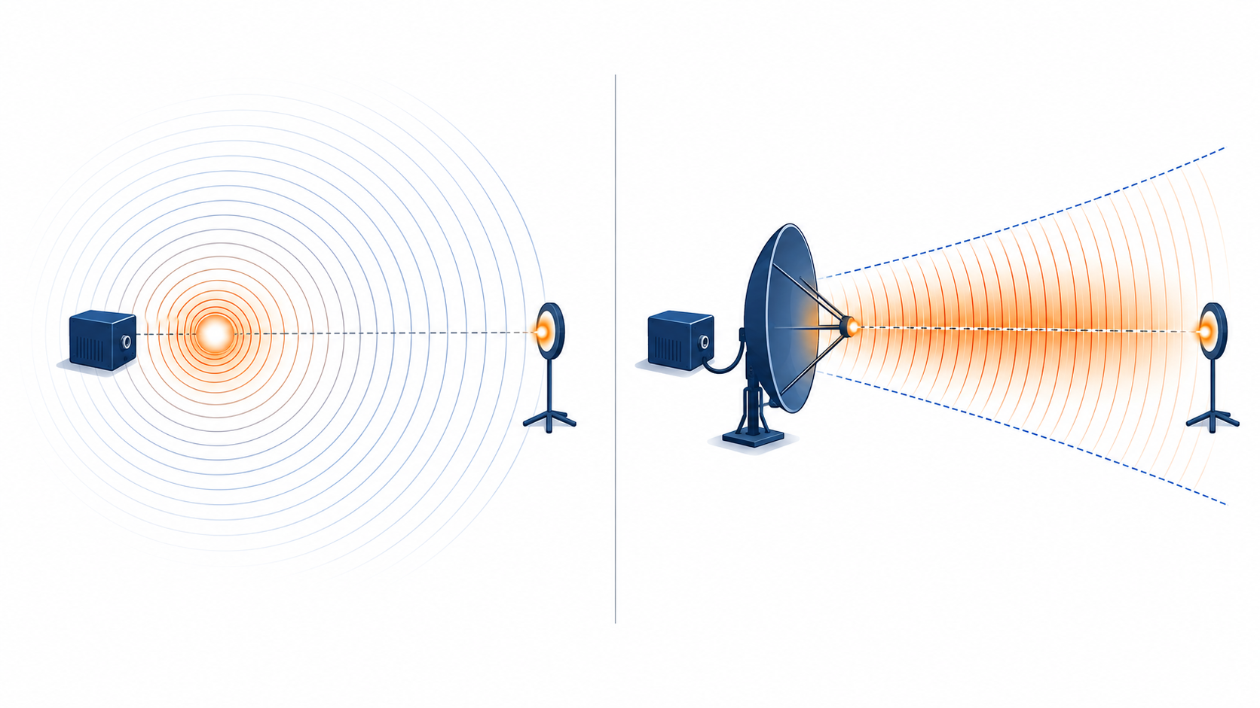
Equivalent Isotropically Radiated Power
[EIRP] = [Pₜ] − [Lₜ] + [Gₜ]
ISOTROPIC REFERENCE
DIRECTIONAL ANTENNA
Equivalent on-axis intensity—not a new power amplifier.

Slide 17
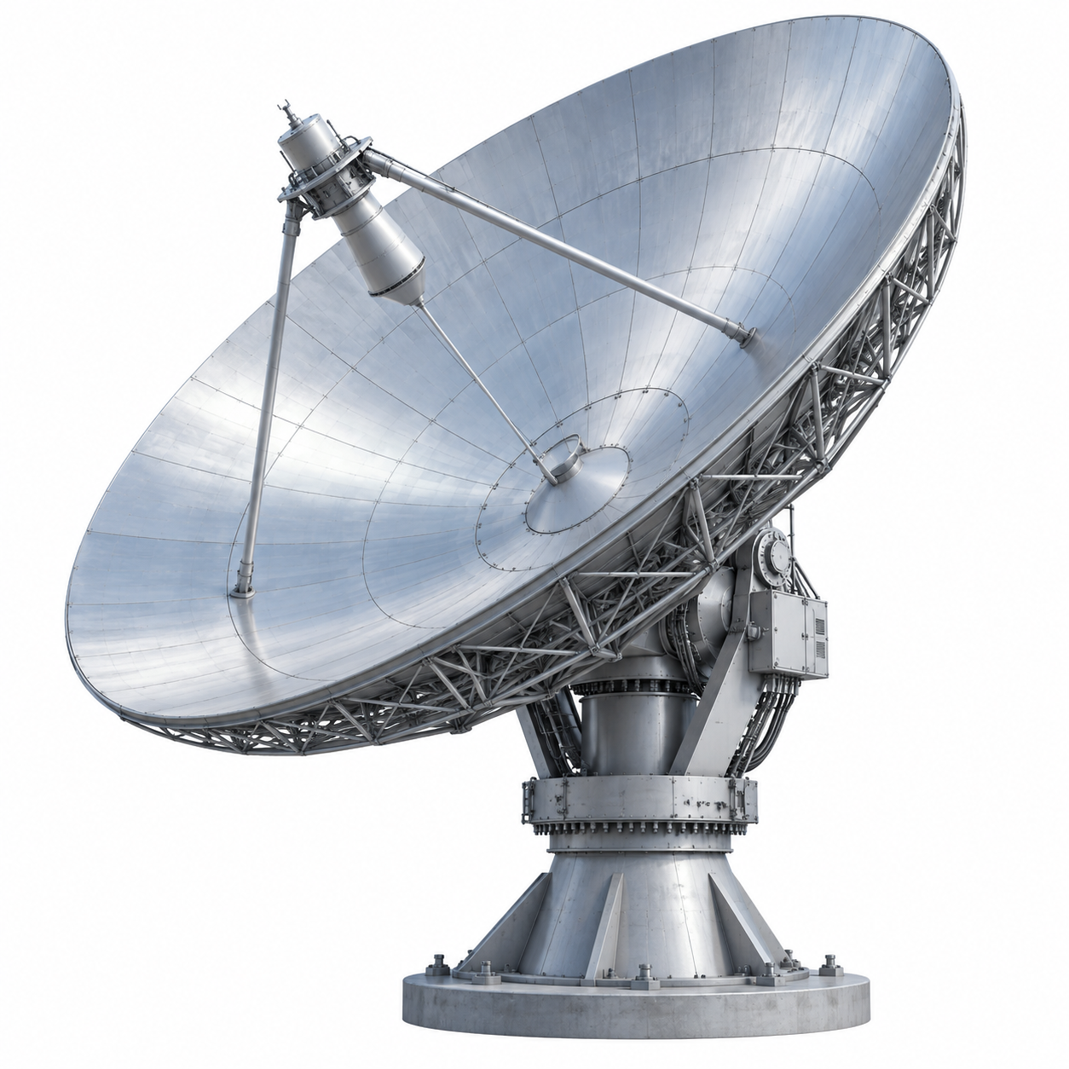
Collecting the Power
Only the field crossing the
effective collecting area is captured.
Pᵣ = S Aₑ (linear quantities)
S = EIRP / (4πR²), in W/m²

Slide 18
Calculating Free-Space Path Loss
[Lₚ] = 20 log₁₀(4πR / λ)
In km and GHz: [Lₚ] = 92.45 + 20 log₁₀(R) + 20 log₁₀(f)
For TERPSat: R = 2574 km and f = 8.4 GHz.
[Lₚ] is a positive loss; subtract it in the power ledger.

Slide 19
The Received-Power Equation
Spacecraft: [EIRP]
Receive Antenna: [Gᵣ]
Transmitter + Feed + Antenna
Free-Space Path Loss: [Lₚ]
Range and Frequency
[EIRP] = [Pₜ] − [Lₜ] + [Gₜ]
Transmit Power − Feed Loss + Antenna Gain
[Pᵣ] = [EIRP] − [Lₚ] + [Gᵣ] − [Lₒₜₕₑᵣ]
Power: dBW Antenna Gain: dBi Losses: dB
Other losses exclude the transmit feed loss already included in EIRP.

Slide 20
Work the TERPSat Link
At 5° elevation: d = 2,574 km
Frequency: f = 8.4 GHz
Pₜ = 10 W • [Gₜ] = 8 dBi • [Lₜ] = 1 dB
[Gᵣ] = 45 dBi • [Lₒₜₕₑᵣ] = 2 dB
Calculate [EIRP], [Lₚ], and [Pᵣ].

Slide 21
Step 1: EIRP
[Pₜ]
+[Gₜ]
−[Lₜ]
[EIRP]
17 dBW
10 dBW
+
+8 dBi
+
−1 dB
The spacecraft still transmits 10 W. Antenna gain changes the on-axis equivalent.

Slide 22
Step 2: Free-Space Path Loss
At one frequency, free-space loss changes only because range changes.
S/C
S/C
2,574 km
705 km
EDGE COST
Δ[Lₚ] = 11.2 dB
[Lₚ] = 167.9 dB
[Lₚ] = 179.1 dB

Slide 23
Step 3: Received Power
[EIRP]
−[Lₚ]
+[Gᵣ]
−[Lₒₜₕₑᵣ]
[Pᵣ]
−119.1 dBW
+17 dBW
+
−179.1 dB
+
+45 dBi
+
−2 dB
Does the link work? We still need noise, required performance, and margin.

Slide 24
Check the Complete Ledger
Follow the reference point. Write every gain and loss with its sign.
[Pₜ]
−[Lₜ]
+[Gₜ]
−[Lₚ]
+[Gᵣ]
−[Lₒₜₕₑᵣ]
10 dBW
−1 dB
+8 dBi
−179.1 dB
+45 dBi
−2 dB
[P] = 10 dBW
[P] = 9 dBW
[P] = 17 dBW
[P] = -162.1 dBW
[P] = -117.1 dBW
[P] = -119.1 dBW
The path loss is enormous; antenna gains make the link plausible.

Slide 25
Mission and Provider Trades
MISSION-OWNED
SHARED PROVIDER
MISSION
MISSION
MISSION
MISSION
SITE
ONE SITE
SITE
SITE
Direct control • tailored interface • dedicated capacity
Capital and operations burden • limited geography
Geographic diversity • scalable shared assets
Scheduling, interfaces, and service dependence

Slide 26
Predict Before Calculating
What happens to received power if we double transmit power?
What happens if we double range instead?
What do we gain—and lose—by raising the elevation mask?
Does adding a ground station necessarily strengthen this link?

Slide 27
References and Further Reading
CITATIONS & REFERENCES
OPTIONAL FURTHER READING
• ITU-R P.525-4, Calculation of Free-Space Attenuation (2019)
• JPL 810-005, DSN Telecommunications Link Design Handbook
• CCSDS 401.0-B-29, RF and Modulation Systems—Part 1 (2019)
• Friis, “A Note on a Simple Transmission Formula,” Proc. IRE 34(5), 1946
• Cheung, “The Role of Margin in Link Design and Optimization” (2015)
• NASA, Small Spacecraft Technology State of the Art: Communications (2026)
• Pratt, Bostian & Allnutt, Satellite Communications, 2nd ed.
• Vallado, Fundamentals of Astrodynamics and Applications, 5th ed.
Selected References and Optional Further Reading

