Slide 1
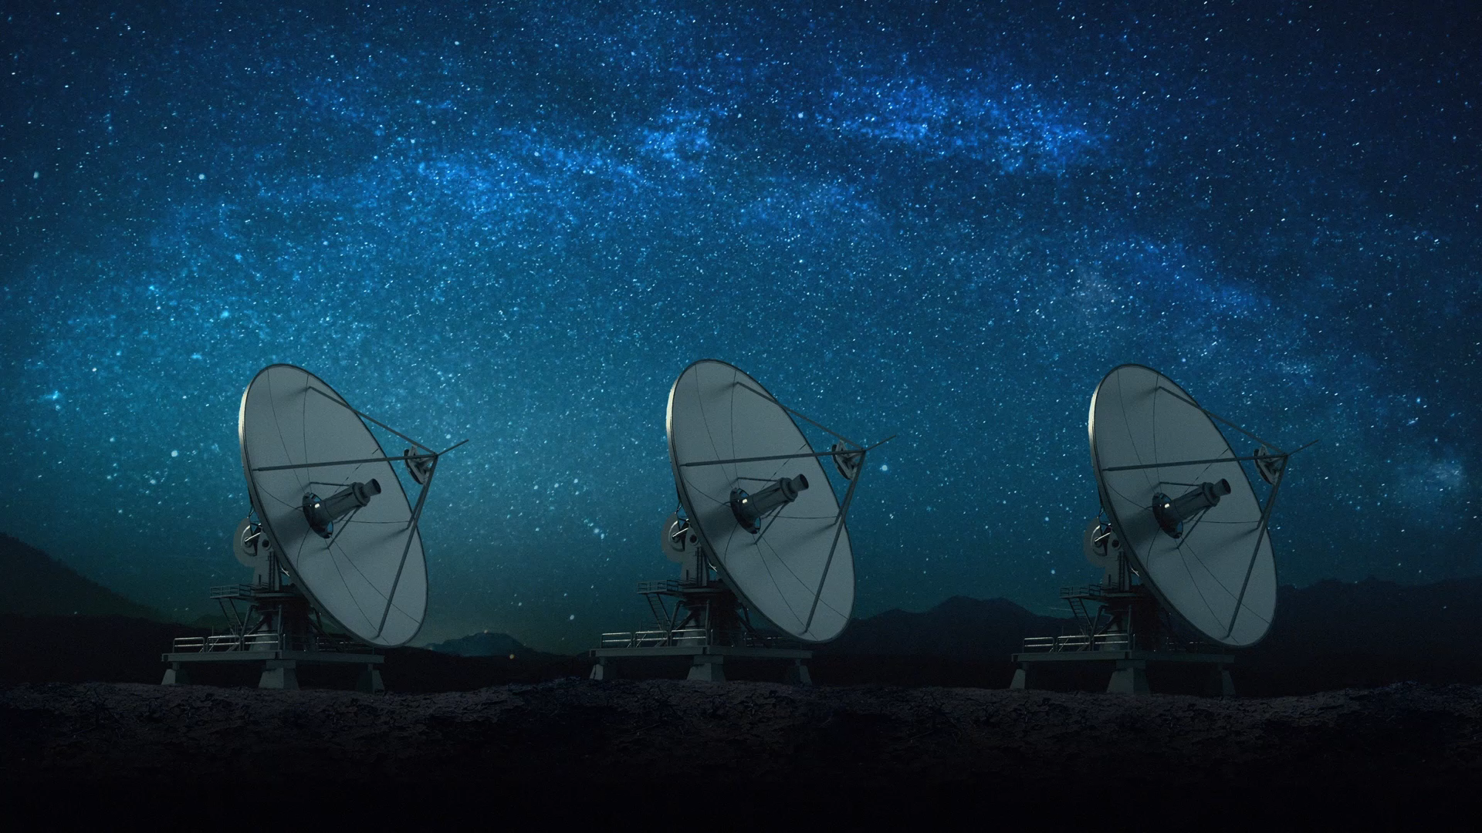
Spacecraft Communications
ENAE 694
Antennas
Dave Israel (disrael@umd.edu)
September 28, 2026

Slide 2
Tonight’s Agenda
Homework Review
Antenna Tour
Gain, Beamwidth, and Polarization
Coverage, Steering, and Mission Trades
2

Slide 3
Homework 2: Slant Range
A spacecraft is in a circular orbit 500 km above Earth. Calculate its slant range from a ground station when its elevation angle is 10°.
Earth Radius = 6,378 km Altitude = 500 km Elevation = 10°
$$R = \sqrt{((Rₑ + h)² − Rₑ² cos² e)}− Rₑ sin e$$
R ≈ 1,695 km
Why does a higher minimum elevation reduce maximum path loss?
What happens to contact time?
3

Slide 4
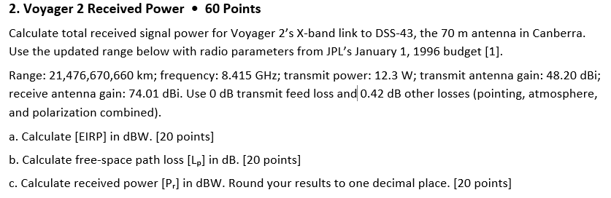
Homework 2: Voyager 2
4

Slide 5
Homework 2: Voyager 2
Quantity | Calculation | Result
[EIRP] | 10 log₁₀(12.3) + 48.20 | 59.10 dBW
[Lₚ] | 32.45 + 20 log₁₀ R + 20 log₁₀ f | 317.59 dB
[Pᵣ] | 59.10 − 317.59 + 74.01 − 0.42 | −184.90 dBW
R = 21,476,670,660,000 m f = 8.415 GHz
Is received power alone enough to predict data recovery?
Homework uses the supplied September distance with historical radio parameters [1].
5

Slide 6
Quantities and Their Units
Quantity | Linear Form | Logarithmic Form
Power or EIRP | W | dBW or dBm
Antenna Gain | Ratio to Isotropic | dBi
Loss | Power Ratio ≥ 1 | dB, Subtracted
Power Flux Density, S | W/m² | Linear Form Today
Effective Area, Aₑ | m² | Linear Form Today
Course notation: brackets denote logarithmic quantities. 0 dBW = 1 W = 30 dBm.
6

Slide 7
What Does Antenna Gain Mean?
How can an antenna increase the signal
without increasing transmitter power?
Gain describes radiation in a particular direction,
relative to a lossless isotropic antenna with the same input power.
The engineering question: where does that stronger signal need to go?
7

Slide 8
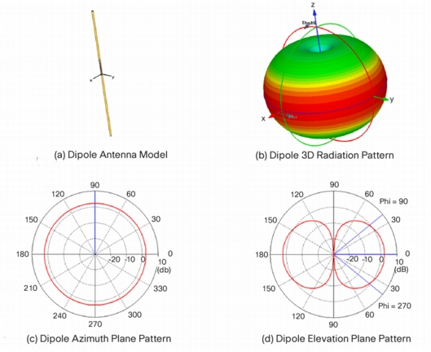
Isotropic and Omnidirectional
Isotropic
Equal radiation in every direction
Omnidirectional
Uniform in one plane
A dipole still has nulls
along its axis.
8

Slide 9
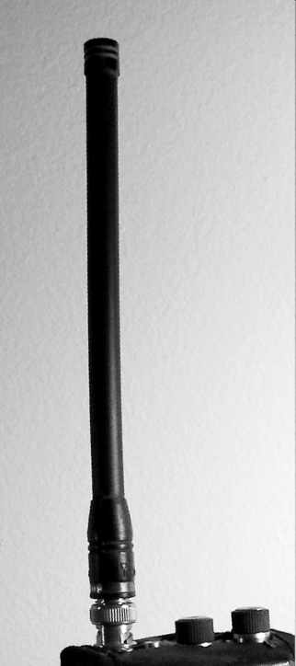
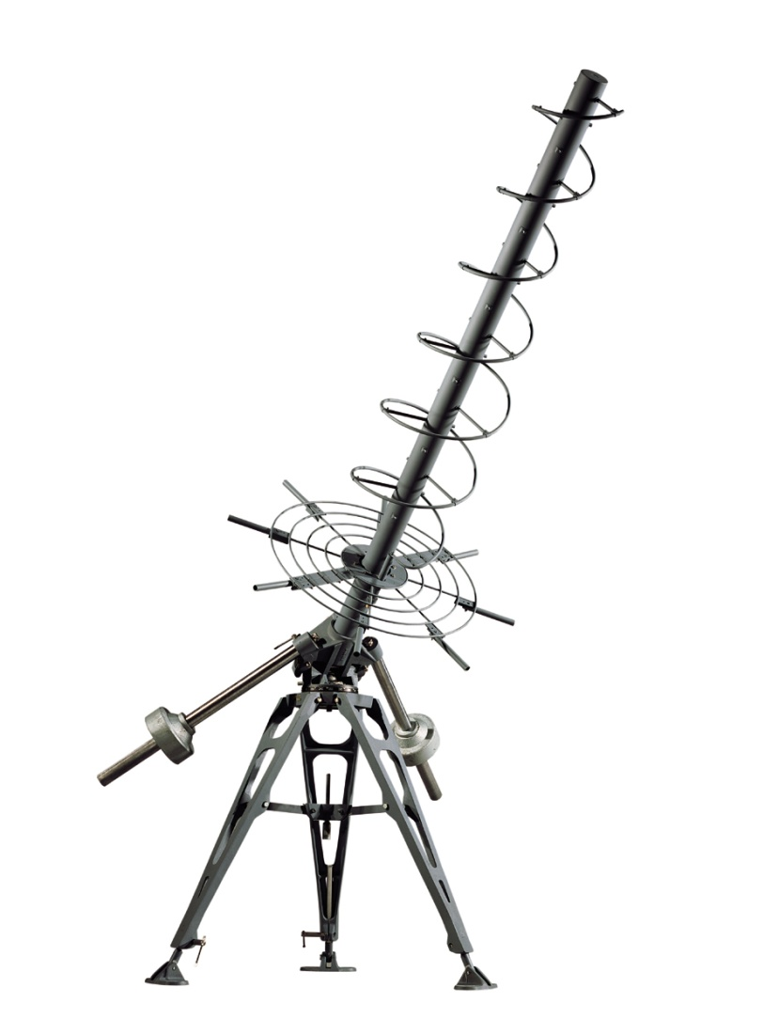
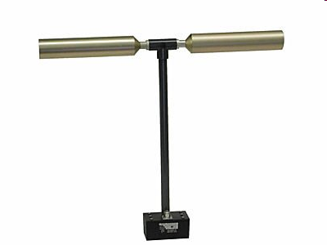
Wire Antennas
Monopole
Dipole
Helical
Uses a ground plane
Two conducting arms
Axial mode can give
a directional circularly
polarized beam
9

Slide 10
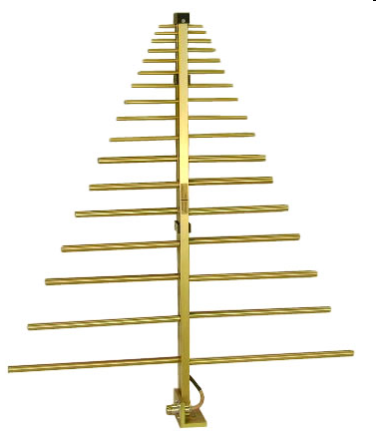
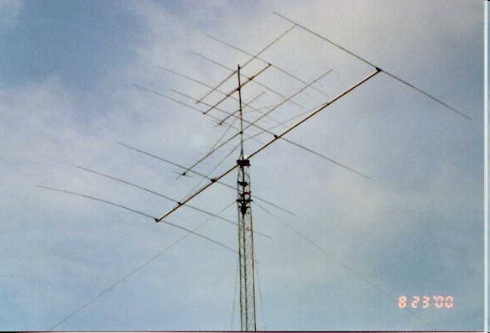
Log-Periodic and Yagi Antennas
Log-Periodic
Yagi
Broad frequency coverage
Driven element with parasitic elements
10

Slide 11
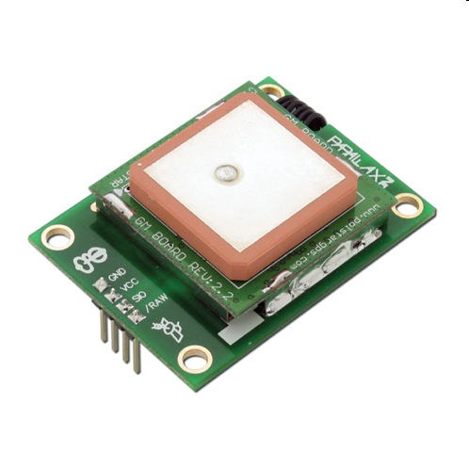
Patch Antennas
A radiating patch above a ground plane
Low profile and easy to mount
Can serve as an array element
11

Slide 12
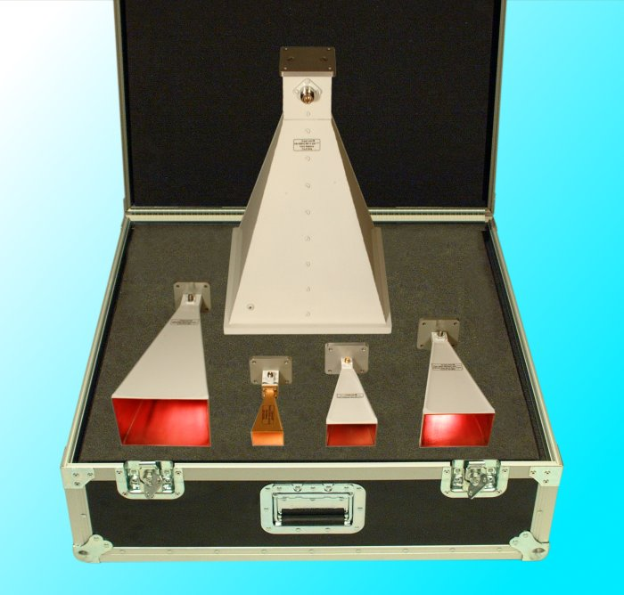
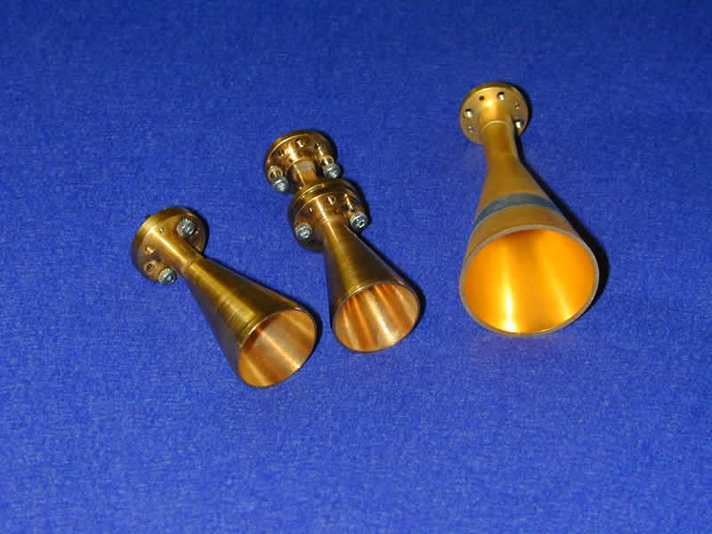
Horn Antennas
Pyramidal Horns
Conical Horns
12

Slide 13
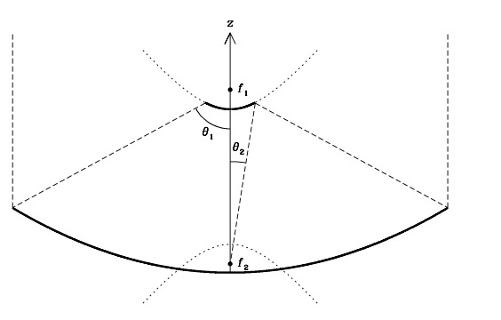
Reflector Configurations
f₁: Prime Focus
Feed at the main reflector’s focus
f₂: Cassegrain Focus
A subreflector redirects
the path to a feed near
the main reflector.
13

Slide 14
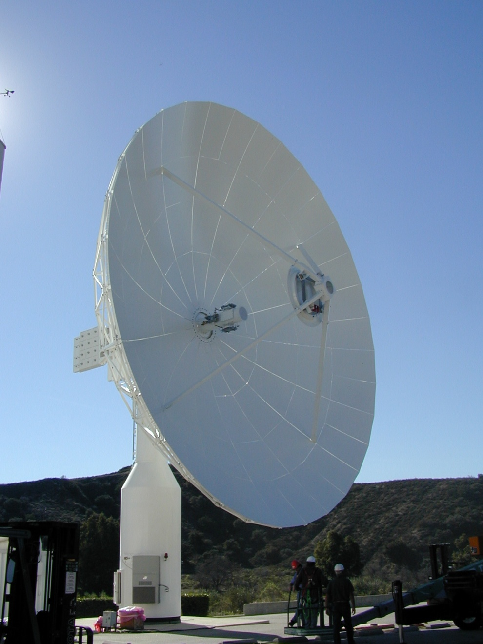
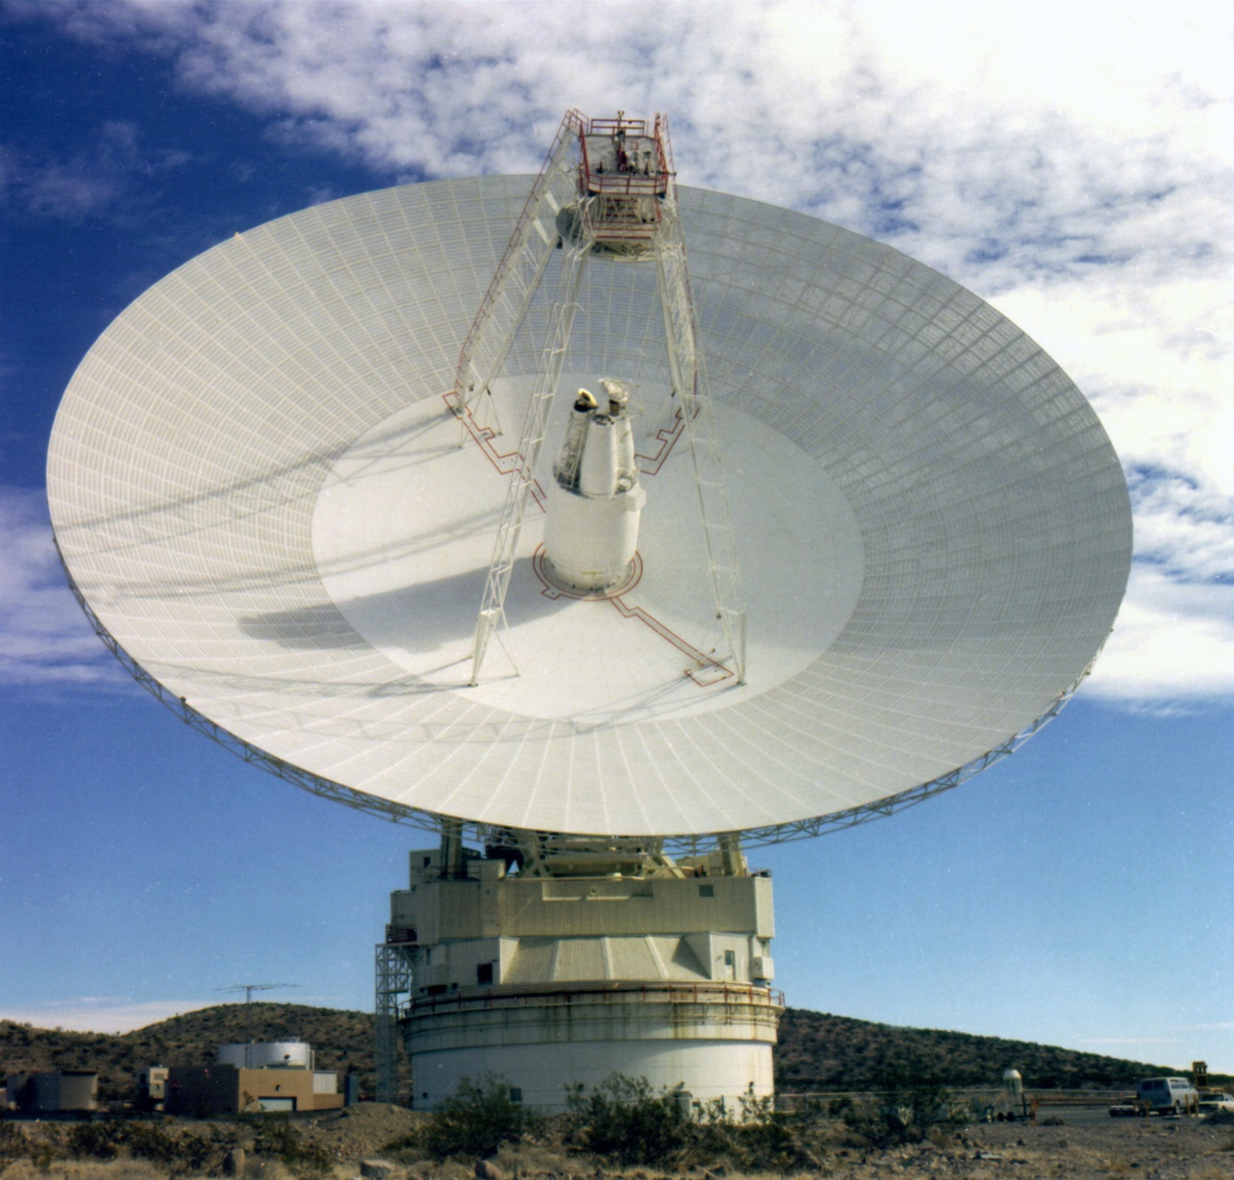
Ground Antenna Hardware
Ground Station Reflector
DSN 70 m Reflector
14

Slide 15
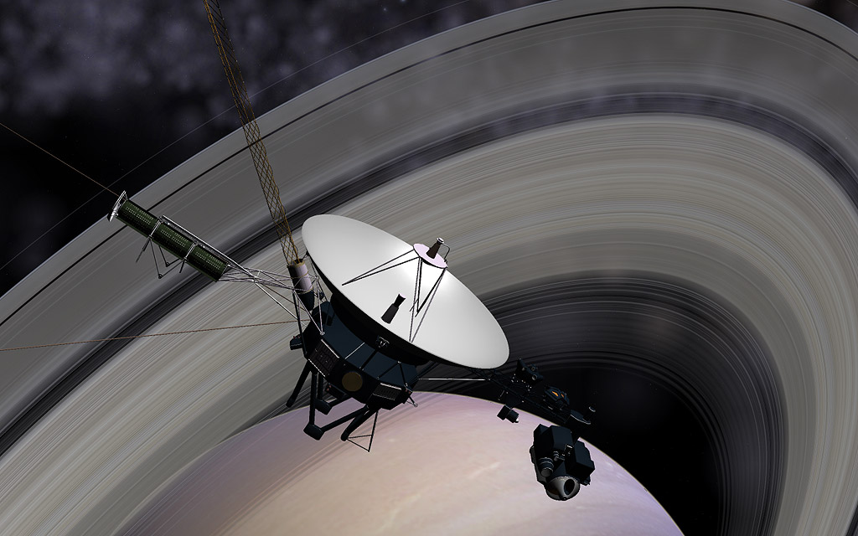
Antenna Pointing with the Spacecraft
Voyager’s high-gain antenna
is fixed to the spacecraft.
The spacecraft turns
to point the antenna.
What else moves when
the antenna moves?
15

Slide 16
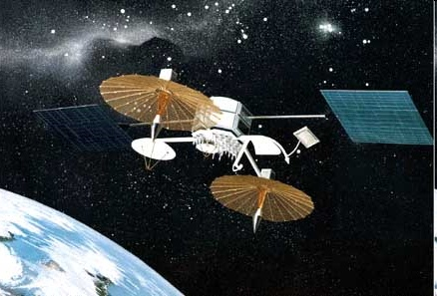
Gimbaled Antennas
TDRS Reflectors
Boom mounted, two-axis gimbals
Pointing can change without
turning the whole spacecraft.
Mechanisms add limits on
motion, reliability, and routing.
16

Slide 17
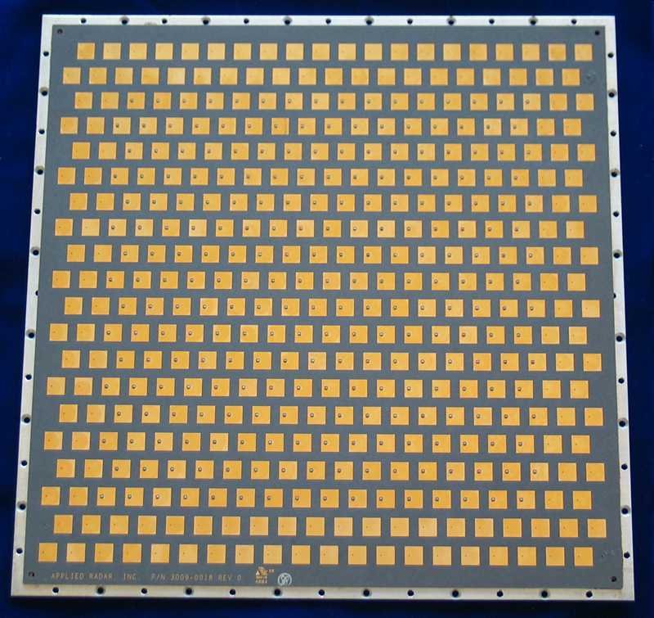
Phased-Array Hardware
Many elements form one aperture.
Electronics control how their
signals combine.
The aperture can remain fixed
while the beam moves.
We will return to the steering
mechanism in Part 3.
17

Slide 18
Reading an Antenna Pattern
Boresight
Peak direction
Main Lobe
Near the peak
Sidelobes and Nulls
Other directions
18

Slide 19
The Receive Antenna
Pᵣ = S Aₑ
S: Incident Power Flux Density (W/m²)
Aₑ: Effective Collecting Area (m²)
Pᵣ: Available Received Power (W)
19

Slide 20
Physical Area and Effective Area
For a Circular Aperture: A = πD² / 4
Aₑ = ηₐₚ A
Use ηₐₚ = 0.55 for our examples.
Illumination, spillover, blockage, and surface accuracy
affect how well the physical aperture contributes.
ηₐₚ is aperture efficiency. Its meaning differs from radiation efficiency alone [5].
20

Slide 21
Frequency and Antenna Size
λ ≈ 0.300 / f f in GHz, λ in m
Frequency | Wavelength | A 1 m Aperture Spans
2.1 GHz | 0.143 m | 7 Wavelengths
8.4 GHz | 0.0357 m | 28 Wavelengths
The antenna’s size in wavelengths determines much of its behavior.
21

Slide 22
Gain from Diameter and Frequency
Gain = Effective Area ÷ Isotropic Effective Area
[G] = 17.81 + 20 log₁₀(D) + 20 log₁₀(f)
D in meters. f in GHz. [G] in dBi.
17.81 includes efficiency 0.55 and all constants.
Double Diameter or Frequency: Gain Increases 6.02 dB
Circular aperture; efficiency assumed to be 0.55. All logs are base 10 [4].
22

Slide 23
A 1 m Antenna at 8.4 GHz
Given: D = 1.00 m f = 8.4 GHz
[G] = 17.81 + 20 log₁₀(D) + 20 log₁₀(f)
Calculate [G] in dBi. Then Predict:
Double D, with frequency fixed: How much does gain change?
Double frequency, with D fixed: How much does gain change?
This gain formula assumes aperture efficiency ηₐₚ = 0.55.
23

Slide 24
The 1 m Antenna: Results
[G] = 17.81 + 20 log₁₀(1.00) + 20 log₁₀(8.4)
[G] = 17.81 + 0.00 + 18.49 = 36.30 dBi
Double D, Fixed Frequency: Δ[G] = 20 log₁₀(2) = +6.02 dB
Double Frequency, Fixed D: Δ[G] = 20 log₁₀(2) = +6.02 dB
Double Both D and Frequency: Gain Increases 12.04 dB
D in meters; f in GHz. Efficiency is assumed to be 0.55.
24

Slide 25
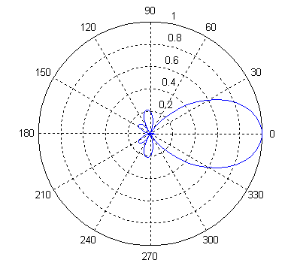
Beamwidth
HPBW = Full angle between
the two half-power points
Reflector Rule: f in GHz, D in m
HPBW ≈ 21 / (f D) degrees
Approximate; depends on illumination.
1 m at 8.4 GHz: about 2.5°
Half-angle: about 1.25°
25

Slide 26
What Is Pointing Loss?
θ is the angle between
boresight and the link.
The actual direction
has lower gain.
Boresight: Peak-Gain Direction
θ
Antenna
Direction to the Other Terminal
[Lₚₒᵢₙₜ] = [Gₚₑₐₖ] − [G(θ)]
Loss is positive in dB. Evaluate pointing at both ends. The actual pattern may depend on two angles.
26

Slide 27
Pointing Away from the Peak
Offset / Full HPBW
¼: about 0.75 dB loss
½: about 3 dB loss
At 0.5° error:
2° beam: 0.75 dB
1° beam: 3 dB
Gaussian main-lobe illustration: relative power = −12(offset / HPBW)² dB. Actual patterns differ.
27

Slide 28
How an Antenna Tracks a Spacecraft
Method | What Drives It? | Practical Issue
Program Track | Predicted position vs. time | Orbit and alignment accuracy
Step Track | Small moves to seek peak signal | Needs usable signal and time
Autotrack | Measured angular error | Special feed/receiver hardware
Prediction can acquire the target before signal-based tracking takes over.
28

Slide 29
What Is Polarization?
The electric field pushes charges. Its arrow shows direction and strength.
Polarization describes the arrow’s motion at one fixed point.
Linear
Circular
Elliptical
Back and forth
along a fixed line
Rotates with
constant length
Rotates with
changing length
End-on view, perpendicular to wave travel. Colors show different instants. Gray traces show the tip’s path [6, 11].
29

Slide 30
Polarization Loss for Linear Antennas
A linear receiver responds to the field component along its polarization axis.
0°
45°
90°
100% Power
50% Power
0% in the Ideal Case
0 dB Loss
About 3 dB Loss
Complete Rejection
Blue: Incident E Field Teal: Receiver Axis
ηₚₒₗ = cos²ψ [Lₚₒₗ] = −10 log₁₀(ηₚₒₗ)
ψ is rotation about the line of sight, with pointing fixed. Real antennas have finite isolation [6, 11].
30

Slide 31
Circular Polarization and Real Antennas
Wave / Receive Polarization | Ideal Coupled Power | Mismatch Loss
Same Circular Sense | 100% | 0 dB
Opposite Circular Senses | 0% | Complete Rejection
Circular / Linear | 50% | About 3 dB
Matched circular pairs tolerate rotation about the line of sight.
RHCP / LHCP = Right- / Left-Hand Circular Polarization.
Real polarization is often elliptical. Axial ratio describes its shape.
AR = Major / Minor Field Amplitude. A circle has AR = 1 (0 dB).
Use a consistent viewing convention for handedness. Actual mismatch depends on both polarizations [6, 11].
31

Slide 32
Pointing and Polarization in the Link Budget
[Pᵣ] = [Pᵣ₀] − [Lₚₜ] − [Lₚᵣ] − [Lₚₒₗ]
Illustrative Link | Value
[Pᵣ₀]: Aligned, Polarization-Matched Power | −120 dBW
Pointing Loss: [Lₚₜ] Transmit / [Lₚᵣ] Receive | 1 dB / 2 dB
[Lₚₒₗ]: Polarization Mismatch Loss | 3 dB
Actual Received Power | −126 dBW
For a −125 dBW threshold, the margin is −1 dB.
These losses change whether this link supports the selected service.
Aligned power includes other terms. Use peak gains with pointing losses, or actual direction gains without subtracting them again.
32

Slide 33
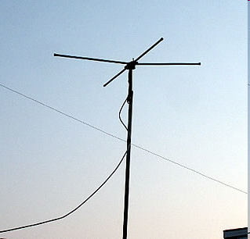
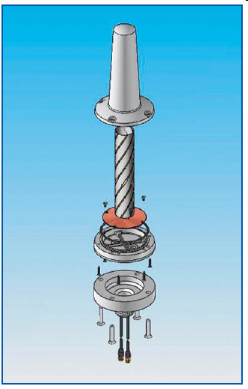
Hemispherical Coverage
Crossed Dipoles
Quadrifilar Helix
33

Slide 34
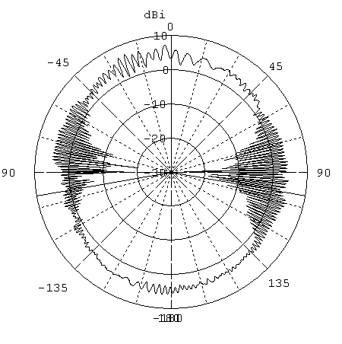
Broad Coverage from Multiple Antennas
Antenna 1
Transmitter
Power Divider
Antenna 2
Opposite-facing antennas
34

Slide 35
Shaping Gain for an Earth Pass
Longer slant range
near the limb needs
more gain.
A shaped pattern can
reduce the received-
power variation.
Assumes nadir pointing.
35

Slide 36
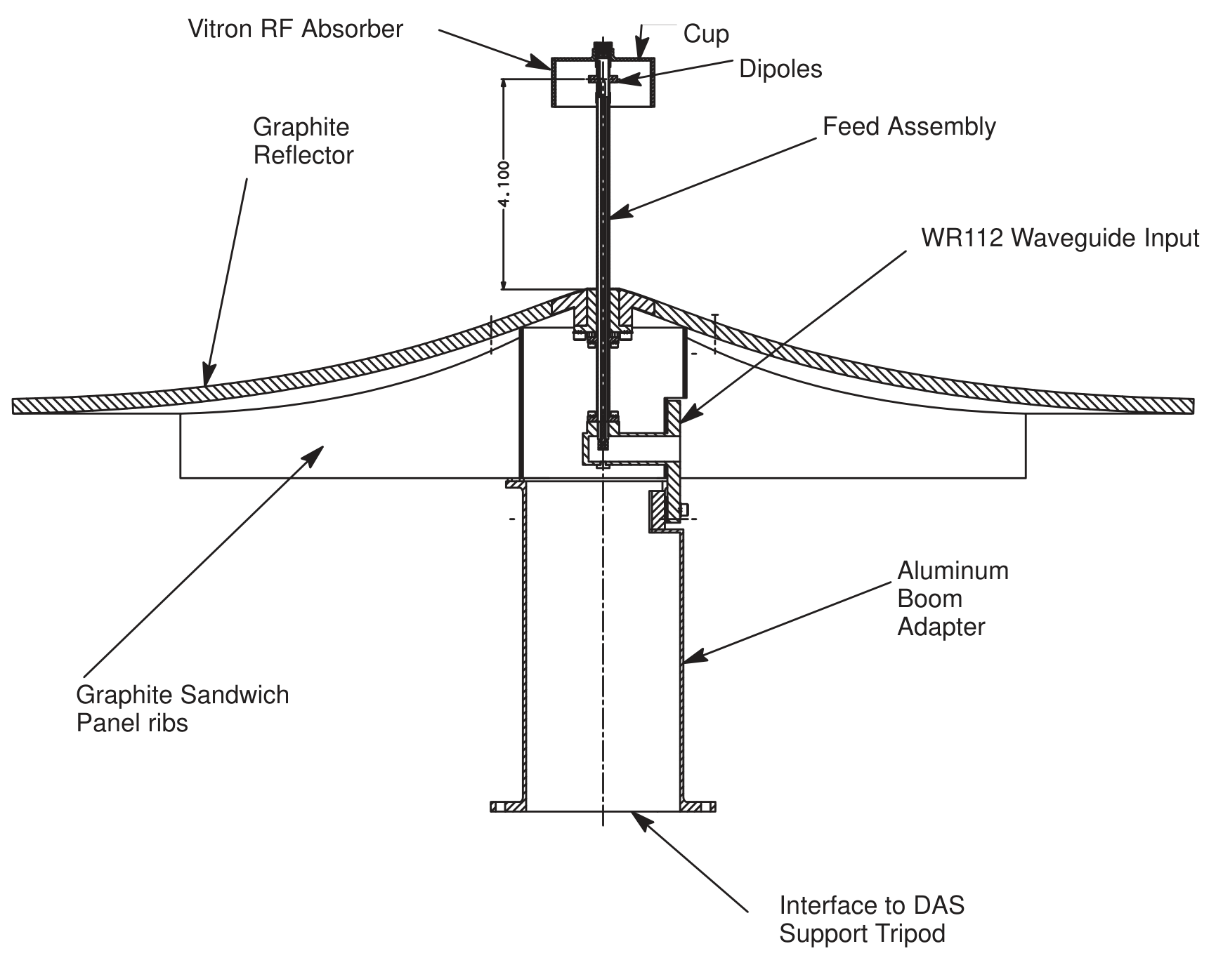
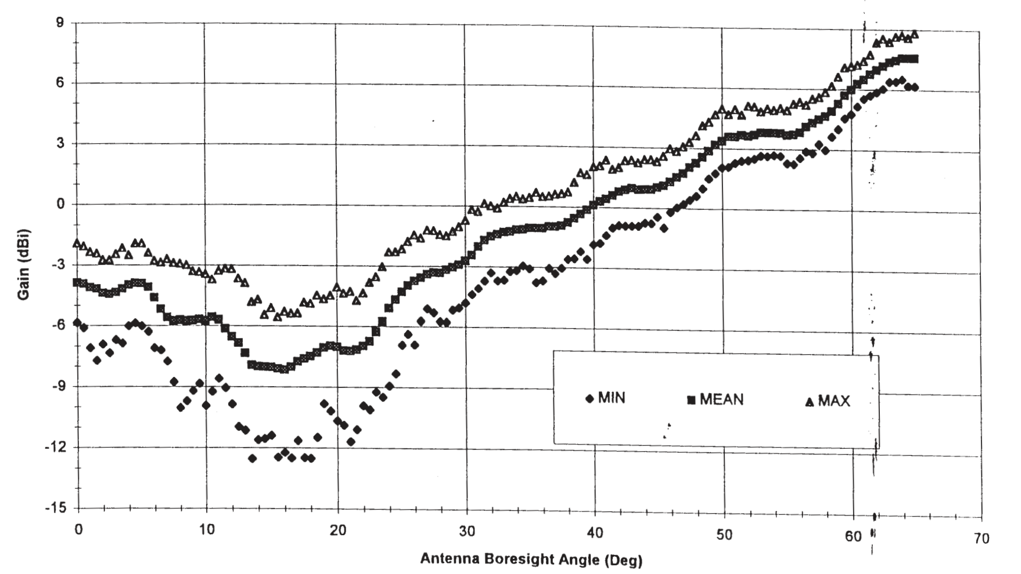
The Earth-Science Shaped Omni
Terra (EOS-AM) Direct Access System, 8.2125 GHz
Shaped Reflector and Dipole Feed
Measured Gain Pattern
More gain toward the limb helps compensate for greater range.
1998 design record. The dip near 20° off nadir also constrained planned direct playback [12, §6, Figs. 2 & 14].
36

Slide 37
Antenna Patterns and Usable Coverage
The pattern gives gain
for each direction.
The link budget sets
how much gain is enough.
This null creates a gap
even with clear
line of sight.
Illustrative pattern, not measured hardware. Hold range and other terms fixed. Peak margin = 6 dB. Nulls may arise from interference.
37

Slide 38
Coverage Becomes Availability over Time
Assume the link direction sweeps from −50° to +50° in 10 minutes.
Clear Line of Sight
Pattern Null
Usable Link
0
1
4.5
5.5
9
10
Time (min)
Usable time = 3.5 + 3.5 = 7 minutes
Availability during this visible interval = 7 / 10 = 70%
State the denominator. Mission availability also includes visibility, attitude, tracking, polarization, weather, and scheduled resources.
38

Slide 39
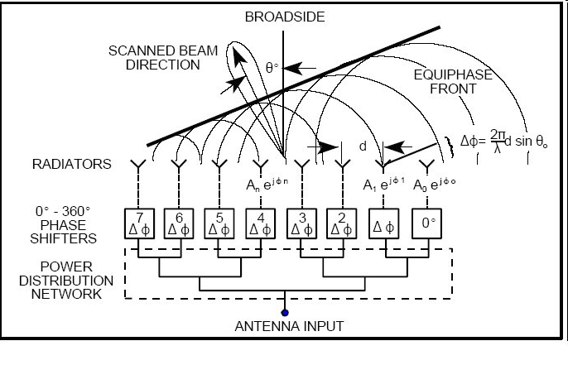
Electronic Beam Steering
Relative phase or delay
sets the direction of
constructive combination.
The elements stay fixed.
Transmit and receive
use the same principle.
Beam-steering explanation: [10].
39

Slide 40
The Same Array, a Different Beam
Eight elements
Spacing = λ/2
Change the phase
progression to move
the peak.
Real scan performance
also depends on each
element’s pattern.
Calculated uniform linear-array factor, equal element amplitudes. Each trace is a separate steering setting [10].
40

Slide 41
Multiple Beams from One Aperture
Weights for Beam A
Beam A
Receiver
Common Array
Element Signals
Weights for Beam B
Beam B
Receiver
Separate combining weights select different directions.
41

Slide 42
Arraying Ground Antennas
Antenna 1 + Receiver
Delay / Phase
Alignment
Antenna 2 + Receiver
Delay / Phase
Alignment
Signal
Combiner
Antenna 3 + Receiver
Delay / Phase
Alignment
All antennas observe the same spacecraft signal.
Combine aligned voltages or baseband signals. Voyager used ground-antenna arraying [1, sections 6.3.2–6.3.3].
42

Slide 43
What Arraying Buys Us
Equal Receive Antennas | Ideal SNR Improvement | Equivalent Area
1 | Reference | Aₑ
2 | About +3 dB | 2Aₑ
4 | About +6 dB | 4Aₑ
Four equal 34 m apertures collect like one 68 m aperture
if efficiencies match. That does not make their patterns identical.
Assumes equal signals/noise, uncorrelated receiver noise, ideal alignment and combining. SNR = Signal-to-Noise Ratio.
43

Slide 44
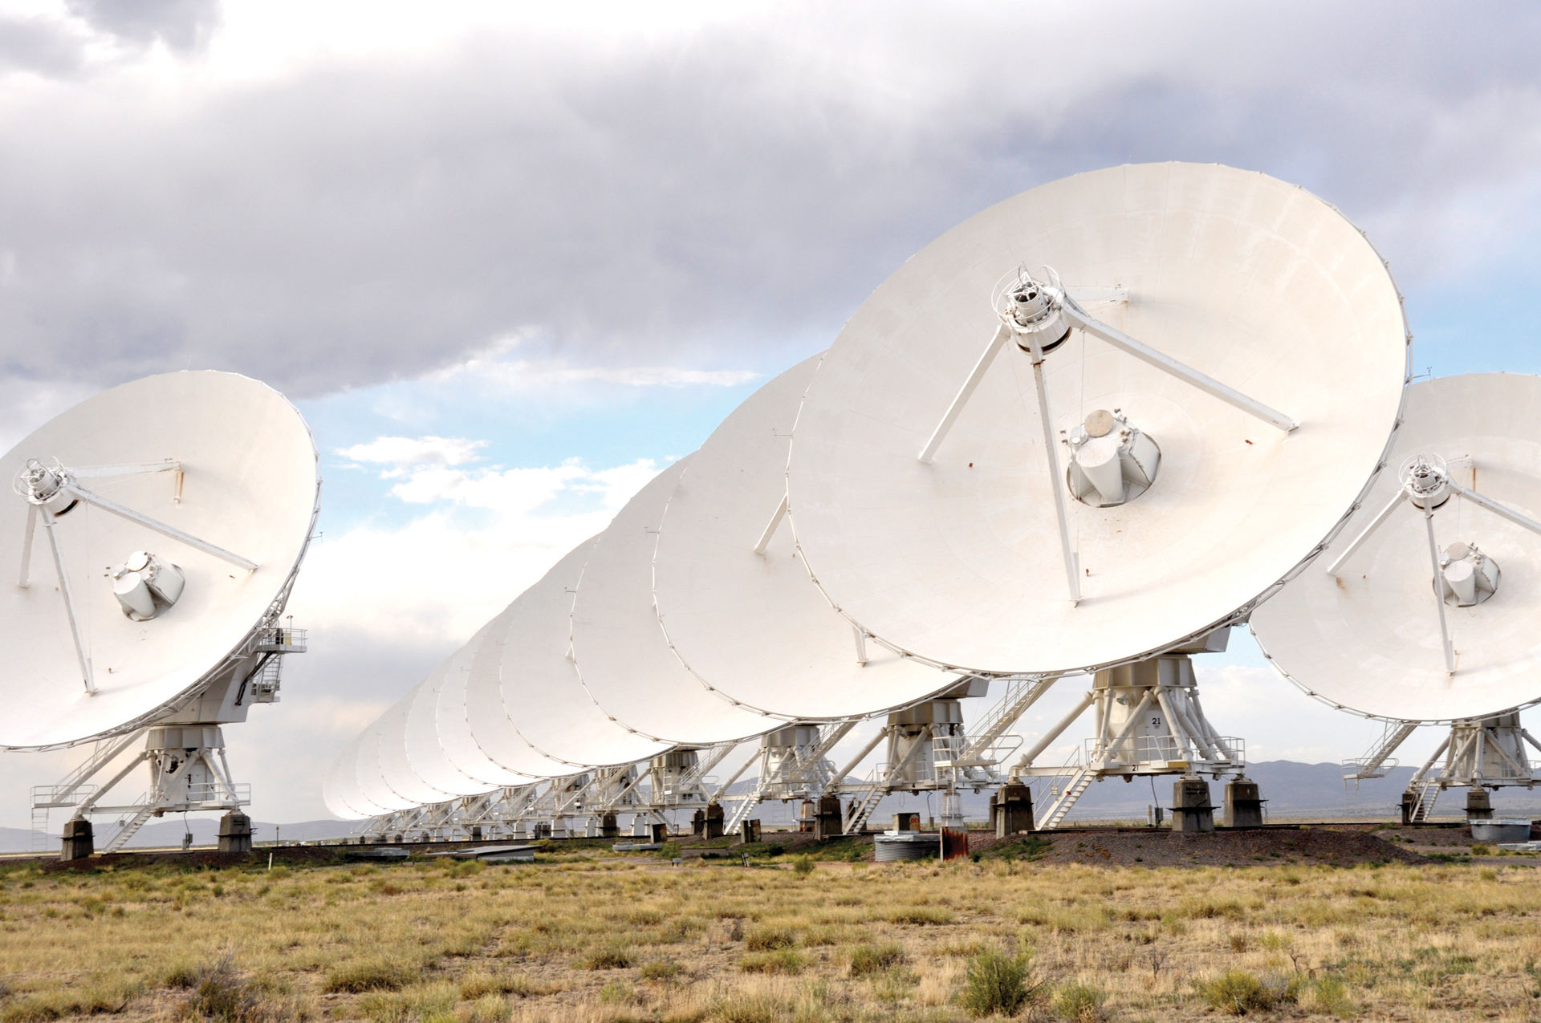
The Very Large Array
27 Antennas
25 m Each
New Mexico
Signals Combine for
Radio Astronomy
Photo: NRAO/AUI/NSF [14]
ENAE 694 • Antennas
44

Slide 45
What Changes When Frequency Changes?
[Pᵣ] = [Pₜ] − [Lₜ] + [Gₜ] − [Lₚ] + [Gᵣ] − [Lₒₜₕₑᵣ]
Free-Space Path Loss Increases with Frequency.
For Fixed Apertures, Antenna Gains Also Increase.
We must say what stays fixed before comparing links.
The next comparison holds range, transmit power, and other losses constant [4, 5, 7].
45

Slide 46
Doubling Frequency: Three Comparisons
What Stays Fixed? | Δ[Gₜ] | Δ[Gᵣ] | Δ[Lₚ] | Δ[Pᵣ]
Both Antenna Gains | 0 | 0 | +6 dB | −6 dB
Tx Gain and Rx Aperture | 0 | +6 dB | +6 dB | 0
Both Physical Apertures | +6 dB | +6 dB | +6 dB | +6 dB
For fixed apertures, assume unchanged efficiency and accurate pointing.
Rounded changes. Free-space comparison with constant transmit power and other losses [4, 5, 7].
46

Slide 47
Fixed Apertures at Two Frequencies
Quantity | 2.1 GHz | 8.4 GHz
Tx Gain: 1 m Aperture | 24.25 dBi | 36.30 dBi
Rx Gain: 3 m Aperture | 33.80 dBi | 45.84 dBi
Path Loss: 2,000,000 m | 164.91 dB | 176.96 dB
Received Power: 10 W Tx | −96.86 dBW | −84.82 dBW
Four Times the Frequency: About 12 dB More Received Power Here
ηₐₚ = 0.55. Use gain constant 17.81; path-loss constant 32.45 with R in m, f in GHz.
47

Slide 48
Frequency Choices in a Real Mission
Pointing and Surface Accuracy Become More Demanding
as frequency increases.
Atmospheric Attenuation Depends on Frequency and Weather.
Available Spectrum and Compatible Ground Equipment
also constrain the choice.
The free-space calculation isolates one part of this trade [5, 8].
48

Slide 49
Antenna Selection Choices
Choice | Examples | What It Affects
Radiating Structure | Wire, patch, horn, reflector | Pattern, gain, bandwidth
Coverage Control | Body, gimbal, beamforming | Pointing, power, complexity
Deployment | Fixed, hinged, unfurlable | Mass, packaging, reliability
Feed and Polarization | Single/multiple feeds, linear/circular | Losses and compatibility
49

Slide 50
Antenna Trades Across the Spacecraft
Mass: Aperture + Supports + Deployment + Pointing Hardware
Attitude Control: Can We Keep the Beam on the Ground Station?
Structures: Can We Package, Deploy, and Support the Antenna?
Power and Thermal: What Does the Chosen Architecture Require?
Operations: What Link Is Available During Acquisition or Safe Mode?
Which trade would matter most for a small Earth orbiter? For a distant planetary mission?
50

Slide 51
Antenna Choices for the Mission
The ground station can see the spacecraft, but the link drops.
What would you check besides range?
Would a broader beam help? What would it cost?
Would circular polarization help if the spacecraft rolls?
What must still match at the receiver?
Possible checks: installed pattern, attitude, pointing, polarization, receiver threshold, and resource availability.
51

Slide 52
What We Can Now Explain
Pointing loss comes from gain in the actual link direction.
Polarization loss comes from incomplete field coupling.
A pattern and a link threshold define usable directions.
Motion through those directions determines usable time.
Orbit and attitude connect antenna coordinates to mission coverage. Availability always needs a defined time interval.
52

Slide 53
Before We Finish
A larger antenna gives us more gain.
What might prevent us from using it?
Which part of today’s calculation would you like to revisit?
Homework Questions and Next Steps
53

Slide 54
Optional: The Far-Field Model
For an Electrically Large Aperture: R ≳ 6.67 D² f
D and R in meters, f in GHz. Also require R ≫ D and R ≫ 0.300/f.
At 8.4 GHz: 3 m Aperture: About 504 m
70 m Aperture: About 274,000 m
54

Slide 55
Additional References
[10] Delos, Broughton, and Kraft, Phased Array Antenna Patterns, Part 1.
analog.com/en/resources/analog-dialogue/articles/
phased-array-antenna-patterns-part1.html
[11] Raymond Rumpf, Antenna Parameters and Figures of Merit, Continued.
empossible.net/wp-content/uploads/2018/03/
Topic-2-Figures-of-Merit-Continued.pdf
[12] NASA, EOS-AM Direct Access System User’s Guide, 20 Nov 1998.
directreadout.sci.gsfc.nasa.gov/terra_documents/DAS_UG.pdf
[13] NASA, EOS Aqua X-Band Direct Broadcast IDD, June 2002.
directreadout.sci.gsfc.nasa.gov/aqua_documents/IDD_Aqua-DB.pdf
[14] NRAO, Lining up the VLA antennas. Photo: NRAO/AUI/NSF.
public.nrao.edu/gallery/vla-mirror-trick/
55

Slide 56
References
[1] Ludwig and Taylor, Voyager Telecommunications, JPL DESCANSO, 2002.
Table 5-3. descanso.jpl.nasa.gov/DPSummary/Descanso4--Voyager_new.pdf
Antenna-Theory.com, Antenna Fundamentals (antenna-theory.com):
[2] basics/gain.php [3] basics/radPatDefs.php
[4] basics/aperture.php [5] antennas/reflectors/dish3.php
[6] basics/polarization.php [9] basics/fieldRegions.php
[7] ITU-R P.525-5, Calculation of Free-Space Attenuation, 2024.
itu.int/rec/R-REC-P.525-5-202411-I/en
[8] ITU-R P.840-9, Attenuation Due to Clouds and Fog, 2023.
itu.int/rec/R-REC-P.840/en
Optional references. Numerical antenna examples and pattern plots are teaching calculations.
56

