Slide 1
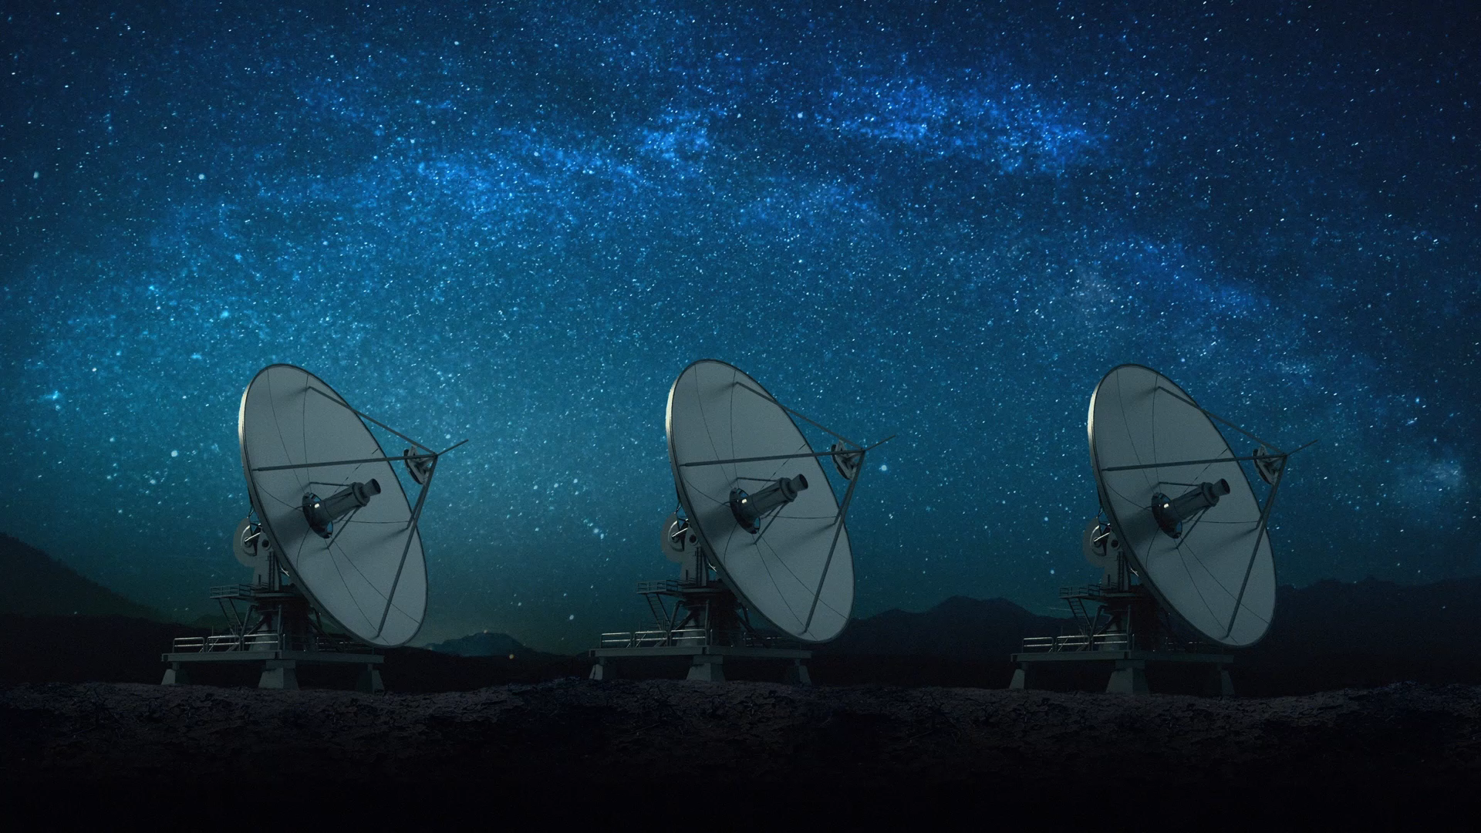
Spacecraft Communications
ENAE 694
Noise and the Complete Link Budget
Dave Israel (disrael@umd.edu)
October 5, 2026

Slide 2
Received Power Is Only Half the Story
Desired signal
Received power S
Receiver
Both arrive
together
Compare
S/N₀
Noise density
N₀ in W/Hz
S/N₀ compares received signal power with noise per hertz.
ENAE 694 • Noise and the Link Budget
3

Slide 3
Room-Temperature Noise
Question: Will the Receiver Read Zero?
Room-temperature
noise source
290 K*
No transmitted
signal
Receiver
Noise bandwidth B
Power measurement
Thermal motion creates random electrical fluctuations.
What power reaches the receiver?
* Matched connection: the receiver accepts the source’s available noise power.
ENAE 694 • Noise and the Link Budget
4

Slide 4
Room-Temperature Noise
Random Fluctuations Carry Real Power
Noise voltage versus time
Noise density versus frequency
Height: N₀ = kT
Collected area
N = kTB
No repeating cycle.
Mean voltage is approximately zero.
Width: B hertz
The squared fluctuations have a positive average: the noise power is real.
ENAE 694 • Noise and the Link Budget
5

Slide 5
Thermal Noise Density: N₀ = kT
Thermal noise has density N₀ = kT, in W/Hz.
[N₀] = −228.6 + 10 log₁₀(T/K), in dBW/Hz.
At 290 K: [N₀] = −204.0 dBW/Hz = −174.0 dBm/Hz.
Doubling T raises the noise density by 3.0 dB.
Total noise across bandwidth B is N = N₀B = kTB.
ENAE 694 • Noise and the Link Budget
6

Slide 6
Noise Figure: The Component Specification
A component adds noise and degrades the input SNR.
Noise factor measures that degradation: F = SNR_{in}/SNR_{out}.*
Noise figure expresses it in dB: NF = 10 log₁₀F.
Lower NF means less added noise under the same conditions.
Component noise figure and gain describe each receiver stage.
* NF uses a source at T₀ = 290 K and the same noise bandwidth at input and output.
ENAE 694 • Noise and the Link Budget
7

Slide 7
Three Different Meanings of Temperature
Physical temperature
T_{physical}
Actual hardware temperature.
A thermometer could measure it.
Example: 290 K
Equivalent noise temperature
T_{e}
Receiver-added noise expressed
as an equivalent input temperature.
Example: 50 K
Reference temperature
T₀
The fixed convention for defining
noise factor and noise figure.
Always 290 K
One receiver can have 290 K hardware, 50 K equivalent noise, and a 290 K reference.
ENAE 694 • Noise and the Link Budget
8

Slide 8
Equivalent Noise Temperature
A Useful Way to Describe Added Noise
1. Noise arrives
The receiver amplifies the incoming noise.
2. The receiver adds noise
The output contains both contributions.
3. Express that addition at the input
T_{e} tells us the strength of an equivalent thermal source.
NF = 0.69 dB gives T_{e} = 290(10^{NF/10} − 1) ≈ 50 K.
ENAE 694 • Noise and the Link Budget
9

Slide 9
Equivalent Noise Temperature
Two Models, Exactly the Same Output
ACTUAL RECEIVER
Input signal
+ source noise
Physical receiver
Gain G; adds noise
Output signal
+ total noise
EQUIVALENT CALCULATION MODEL
Same input
+ equivalent added density
kT_{e}
Noiseless amplifier
Same gain G
Same output
signal and noise
We relocate added noise in the model. The hardware and its output are unchanged.
ENAE 694 • Noise and the Link Budget
10

Slide 10
Equivalent Noise Temperature
Which Noise Contribution Matters Most?
Same receiver: NF = 0.69 dB.
Convert once: T_{e} ≈ 50 K for the system-noise sum.*
Cold-sky source: 30 K
T_{sys} = 80 K (19.0 dB-K)
Receiver noise is the larger part.
Room-temperature source: 290 K
T_{sys} = 340 K (25.3 dB-K)
Source noise is the larger part.
Lowering receiver noise helps most when receiver noise dominates.
* Equivalent-input model: JPL DESCANSO, Vol. 10, Ch. 2. The added source is a calculation model.
ENAE 694 • Noise and the Link Budget
11

Slide 11
Antenna Noise Need Not Be 290 K
Same receiver: NF = 0.69 dB
290 K source
340 K (25.3 dB-K)
30 K source
80 K (19.0 dB-K)
Source
Receiver-added
Lower antenna noise gives lower total noise with the same receiver NF.
ENAE 694 • Noise and the Link Budget
12

Slide 12
Antenna Noise: The Practical Picture
The antenna collects noise as well as the wanted signal.
Sky, atmosphere, ground, and the Moon can change T_{A}.
The antenna pattern and pointing determine how much enters.
Use a specified antenna temperature for the link calculation.
Keep external antenna noise separate from receiver noise figure.
ENAE 694 • Noise and the Link Budget
13

Slide 13
Reference Planes in the Receiving System
Plane A
Plane B
Antenna
collects signal
and scene noise
Receive feed
1 dB loss
290 K physical
Receiver / LNA
NF = 0.69 dB
(T_{e} ≈ 50 K)
Antenna terminal
[S_{A}], T_{sys,A}
Receiver input
[S_{B}], T_{sys,B}
Use signal and total equivalent noise at the same plane.
ENAE 694 • Noise and the Link Budget
14

Slide 14
Antenna Temperature
The Pattern Weights the Whole Scene
Sky brightness
T_{sky}
Antenna pattern
weights each direction
then sums the noise*
Antenna port
N₀ = kT_{A}
Ground brightness
T_{ground}
Sky temperature describes radiation from a direction.
Antenna temperature describes the noise delivered at the port.
* Lossless-antenna model. Source: Condon & Ransom, Essential Radio Astronomy, Ch. 3.
ENAE 694 • Noise and the Link Budget
15

Slide 15
Antenna Temperature
Question: How Much Does Ground Matter?
Sky: 10 K
95% pattern weight
Weighted sum
Σ*
Antenna port
T_{A} = ?
Ground: 290 K
5% pattern weight
* Lossless antenna. Weights represent integrated antenna response in each region.
ENAE 694 • Noise and the Link Budget
16

Slide 16
Antenna Temperature
Worked Answer: The Weighted Noise
T_{A} = Σ w_{i}T_{i} (lossless antenna)
Sky: 0.95 × 10
9.5 K
Ground: 0.05 × 290
14.5 K
T_{A} = 0.95(10) + 0.05(290) = 24.0 K
The 5% ground pickup contributes more noise than the 95% sky pickup.
ENAE 694 • Noise and the Link Budget
17

Slide 17
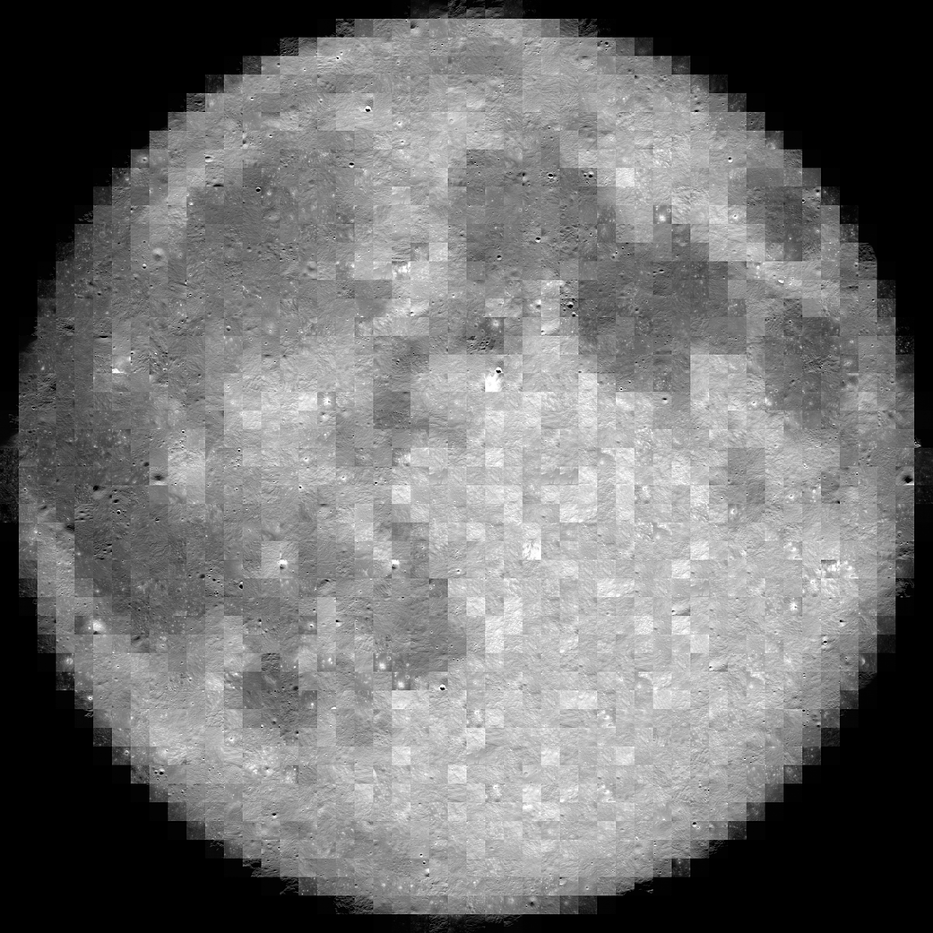
The Moon and Antenna Beam Coupling
OFF the Lunar Disk
ON the Lunar Disk
Assume T_{A} = 30 K*
Assume T_{A} = 230 K
* Assumed scene temperatures. Beam outlines are schematic. Moon image: NASA SVS / LRO.
ENAE 694 • Noise and the Link Budget
18

Slide 18
Atmosphere at 270 K
Question: What Reaches the Antenna?
Absorbing layer
0.1 dB loss
270 K physical
Thermal emission*
Incoming signal
+ background noise
T_{background} = 3 K
Signal: lower
Noise: ?
Antenna input
The layer attenuates incoming radiation and generates its own thermal noise.
* Isothermal layer model. Sources: NRAO Essential Radio Astronomy, Ch. 1; DSN 810-005.
ENAE 694 • Noise and the Link Budget
19

Slide 19
Atmosphere at 270 K
Worked Answer: Loss and Emission
Signal ledger: [S_{out}] = [S_{in}] − 0.1 dB
Transmitted background
T_{bg} × 10^{−A/10}
3 × 10^{−0.1/10} ≈ 2.93 K
Total
9.1 K
Noise seen
by antenna
Layer emission
T_{phys}(1 − 10^{−A/10})
270(1 − 10^{−0.1/10}) ≈ 6.15 K
T_{seen} = T_{bg}10^{−A/10} + T_{phys}(1 − 10^{−A/10}) ≈ 9.1 K.
ENAE 694 • Noise and the Link Budget
20

Slide 20
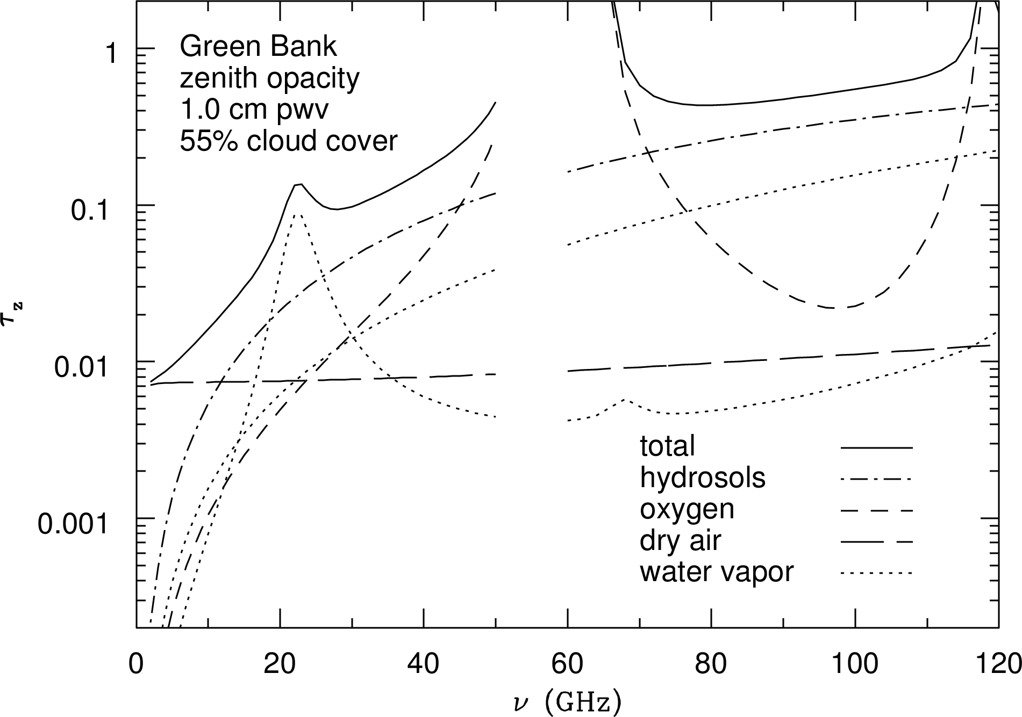
Weather and Frequency
Atmospheric Absorption
Water vapor has a feature
near 22 GHz.
Oxygen absorbs strongly
around 60 GHz.
Cloud liquid water adds loss.
Dry, high sites reduce water
along the atmospheric path.
This curve is gas/cloud opacity,
not rain attenuation.*
* Green Bank summer example. Attenuation in dB = 4.3 × opacity τ. Source: Condon & Ransom, Fig. 1.2.
ENAE 694 • Noise and the Link Budget
21

Slide 21
Weather and Frequency
Rain Attenuation
Specific attenuation (dB/km)
Same rain rate: 25 mm/h.*
For these microwave bands,
higher frequency gives much
more rain attenuation.
Total fade also depends on
rain-path length and elevation.
Ka-band generally needs more
rain margin than X-band.
6
5.1
4
2.8
2
1.1
0.4
0
8
12
20
30
Frequency (GHz)
* ITU-R P.838-3, Table 5; horizontal polarization. Connected model samples, not station fade predictions.
ENAE 694 • Noise and the Link Budget
22

Slide 22
Weather and Ground Stations
Rain Margin and Site Selection
Rain margin is extra allowance for weather fades at a chosen availability.
Choose it using frequency, local rain statistics, elevation, and path geometry.
Dry climates and high sites often reduce atmospheric attenuation and noise.
Higher elevation shortens the path through the lower atmosphere.
Site diversity can keep service available when rain affects one station.*
Weather reduces S and can raise antenna noise, lowering G/T.
* ITU-R P.618-14. Required S/N₀ and adequacy come later; no universal rain margin is assigned here.
ENAE 694 • Noise and the Link Budget
23

Slide 23
What Attenuates Signal? What Adds Noise?
Mechanism
Signal
Noise
Free space, pointing,
polarization mismatch
Less received power
No thermal emission
implied by this loss
Room-temperature feed /
absorbing atmosphere
Attenuated
Incoming noise attenuated;
thermal emission added
Receiver amplifier
Amplified
Incoming noise amplified;
receiver noise added
ENAE 694 • Noise and the Link Budget
24

Slide 24
Break
ENAE 694 • Noise and the Link Budget
25

Slide 25
Lunar Link
Feed Loss and Noise at Two Planes
Antenna noise: 30 K
Signal: [S_{A}]
Signal: [S_{A}] − 1 dB
Antenna noise: 23.8 K
A: feed input
B: feed output
Room-temperature feed
1.0 dB loss
290 K physical
Feed noise referred to input A:
(L_{f} − 1)T_{physical} = 75.1 K
Feed noise delivered at output B:
(1 − 1/L_{f})T_{physical} = 59.6 K
L_{f} = 10^{[L_f]/10}. Both terms represent the same feed noise at different planes.
ENAE 694 • Noise and the Link Budget
26

Slide 26
Lunar Link
One System, Two Noise Ledgers
T_{sys,A} = T_{A} + (L_{f} − 1)T_{phys} + L_{f}T_{e,rx}; T_{sys,B} = T_{sys,A}/L_{f}
Contribution
At A: before feed
At B: after feed
Antenna
30.0 K
23.8 K
Feed emission
75.1 K
59.6 K
Receiver
63.0 K
50.0 K
T_{sys}
[T_{sys}]
168.0 K
22.3 dB-K
133.5 K
21.3 dB-K
A to B: [S] and [T_{sys}] both fall 1.0 dB. [S/N₀] stays unchanged.
ENAE 694 • Noise and the Link Budget
27

Slide 27
Receiver Cascade
Where Each Stage Adds Noise
Source noise passes through both stages.
Each stage also adds its own noise.
Source
Signal + kT_{A} per Hz
LNA
Gain [G₁], NF₁
Later receiver
Gain [G₂], NF₂
The LNA boosts the signal before later stages add their noise.
That makes later-stage noise less important relative to the signal.
Input referral expresses all added noise at one common reference plane.
ENAE 694 • Noise and the Link Budget
28

Slide 28
Receiver Cascade
The Model: Friis Noise Equations
1. Convert catalog values: F = 10^{NF/10}, G = 10^{[G]/10}.
2. Combine the stages using their linear factors:
F_{total} = F₁ + (F₂ − 1)/G₁ + (F₃ − 1)/(G₁G₂) + …
3. Return to dB: NF_{total} = 10 log₁₀F_{total}.
The first stage enters directly. Early gain reduces later terms.
ENAE 694 • Noise and the Link Budget
29

Slide 29
Receiver Cascade
Question: How Much Early Gain Helps?
LNA NF = 0.68 dB. Following receiver NF = 6.48 dB.
Keep both noise figures fixed as LNA gain changes.
Calculate combined NF for LNA gains of 10, 20, and 30 dB.
How much improvement does each extra 10 dB provide?
What sets the limit as LNA gain becomes very large?
ENAE 694 • Noise and the Link Budget
30

Slide 30
Receiver Cascade
Worked Answer: 10, 20, and 30 dB Gain
F_{i} = 10^{NF_i/10}; G₁ = 10^{[G_1]/10}; NF_{total} = 10 log₁₀F_{total}.
F_{total} = F₁ + (F₂ − 1)/G₁ ≈ 1.17 + 3.45/G₁.
10 dB: G₁ = 10; NF_{total} ≈ 1.8 dB.
20 dB: G₁ = 100; NF_{total} ≈ 0.80 dB.
30 dB: G₁ = 1000; NF_{total} ≈ 0.69 dB.
The limit is the first LNA’s NF ≈ 0.68 dB.
ENAE 694 • Noise and the Link Budget
31

Slide 31
Receiver Cascade
From Component noise figure to the Link Budget
LNA
Gain: 30 dB
NF: 0.68 dB
Following receiver
NF: 6.48 dB
Cascade NF ≈ 0.69 dB.
Convert once for G/T: T_{e,rx} = 290(F_{total} − 1) ≈ 50 K.
NF is the component figure of merit; kelvins combine receiver and antenna noise.
ENAE 694 • Noise and the Link Budget
32

Slide 32
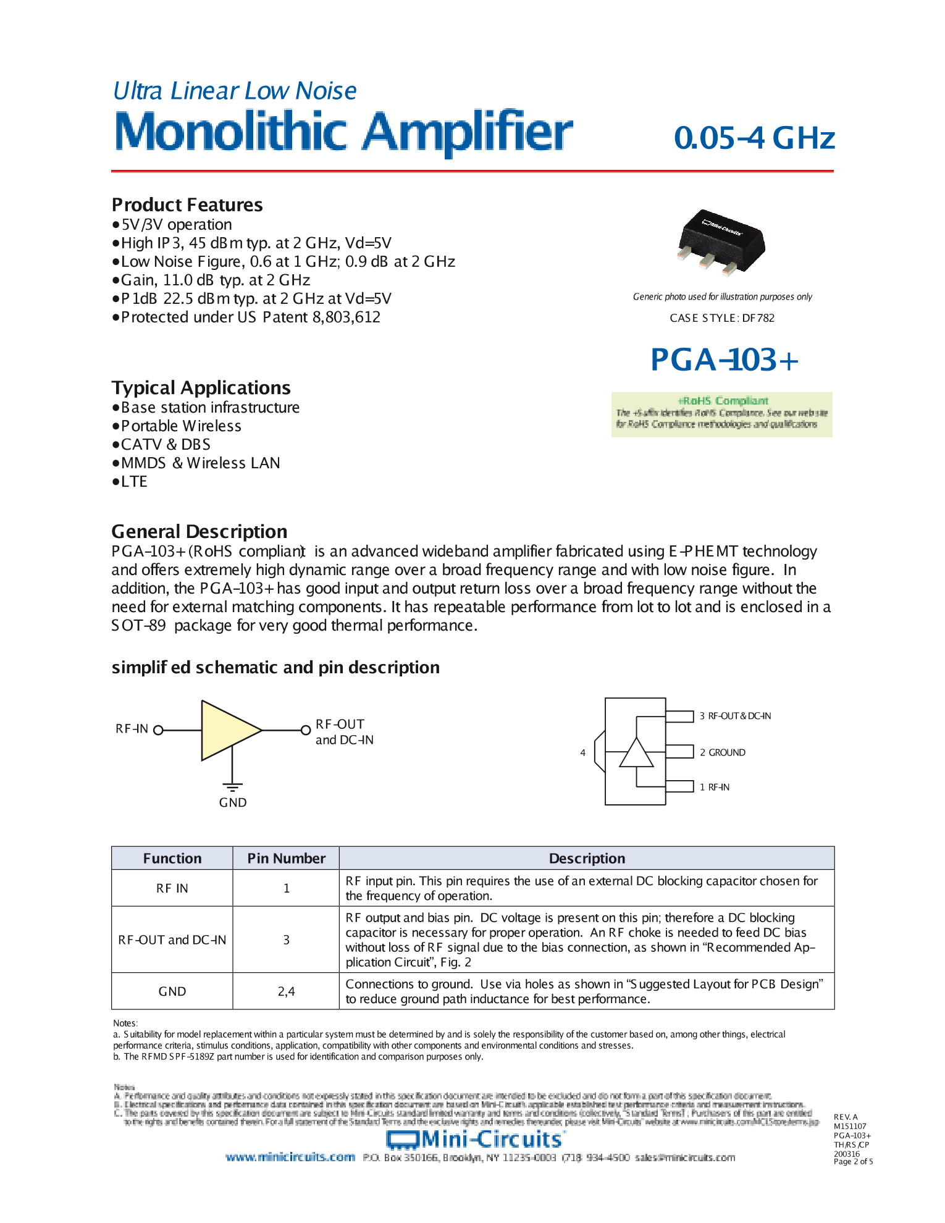
Receiver Components
Reading an LNA Datasheet
The catalog gives NF and gain
at specified frequencies and bias.
This PGA-103+ example lists:
NF: 0.6 dB at 1 GHz
NF: 0.9 dB at 2 GHz
Gain: 11 dB at 2 GHz
Also check power, matching,
linearity, and operating band.*
* Catalog-reading example, not the 8.4 GHz link LNA. Mini-Circuits PGA-103+ datasheet; image hosted by LCSC.
ENAE 694 • Noise and the Link Budget
33

Slide 33
LNA Placement
Question: Where Should the LNA Go?
Source: 30 K. Cable: 290 K physical. LNA NF: 0.69 dB.
A
Cable: 3.0 dB loss*
LNA: 20 dB gain
B
LNA: 20 dB gain
Cable: 3.0 dB loss
Both give 20 − 3.0 = 17.0 dB signal gain.
Will they give the same output noise?
* Cable loss is exactly half power (3.0 dB). A/B identify arrangements on this slide.
ENAE 694 • Noise and the Link Budget
34

Slide 34
LNA Placement
Worked Answer: Both Component Orders
Friis: F_{total} = F₁ + (F₂ − 1)/G₁; NF_{total} = 10 log₁₀F_{total}.
A
Cable: 3.0 dB loss
LNA: 20 dB gain
Cable first: F_{total} = 2 + (F_{LNA} − 1)/0.5; NF_{total} ≈ 3.7 dB.
B
LNA: 20 dB gain
Cable: 3.0 dB loss
LNA first: F_{total} = F_{LNA} + (2 − 1)/100; NF_{total} ≈ 0.73 dB.
Combined receiver NF: 3.7 dB with cable first; 0.73 dB with LNA first.
NF improvement ≈ 3.0 dB, using the 290 K reference source.*
* Matched 290 K cable: F = 2, G = 0.5. LNA: F ≈ 1.17, G = 100.
ENAE 694 • Noise and the Link Budget
35

Slide 35
LNA Placement
Why Our Link Improves by 7.0 dB
T_{e,total} = 290(F_{total} − 1); T_{sys} = T_{source} + T_{e,total}.
Cable first adds 390 K. LNA first adds 52.9 K.
NF compares both arrangements with a 290 K reference source:
10 log₁₀[(290 + 390)/(290 + 52.9)] ≈ 3.0 dB.
Our antenna has only 30 K, so the actual [S/N₀] improves by:
10 log₁₀[(30 + 390)/(30 + 52.9)] ≈ 7.0 dB.
* Same signal gain in both arrangements. A quieter antenna makes receiver-added noise more important.
ENAE 694 • Noise and the Link Budget
36

Slide 36
LNA Placement
What It Means for Receiver Layout
Shortest practical
low-loss connection
Antenna
feed
Low-noise
amplifier
Long cable
and later receiver
Low LNA noise figure sets a low receiver-noise floor.
Enough early gain reduces later input-referred noise.
Check overload, stability, bandwidth, and input filtering.*
* Design guidance: JPL DESCANSO, Vol. 10, Ch. 2; Analog Devices AN-2622.
ENAE 694 • Noise and the Link Budget
37

Slide 37
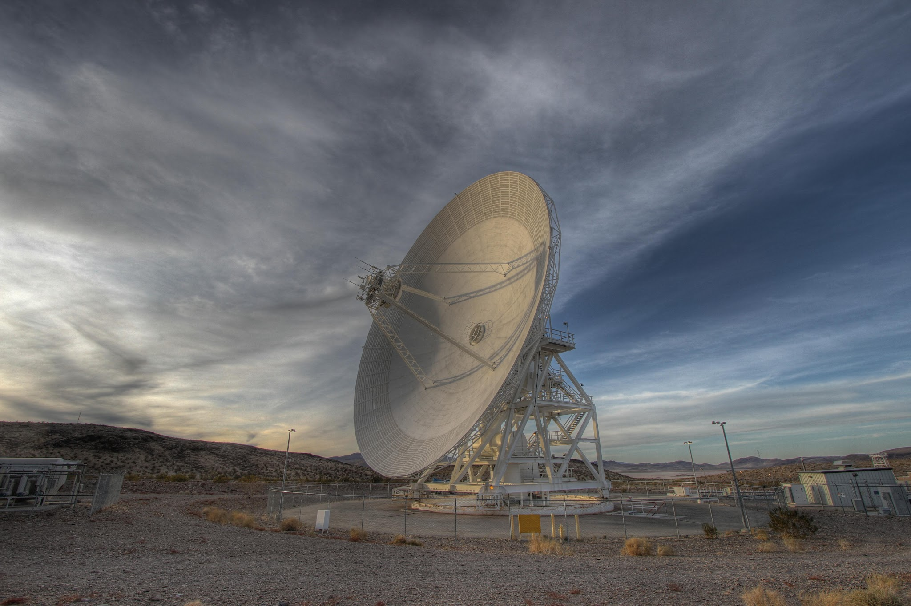
Why DSN Uses Cryogenic LNAs
Low-Noise Amplifier (LNA)
A refrigerator cools the LNA.
Physical cooling can lower its NF
and receiver-added noise.*
Physical Cooling, Lower Noise
A lower LNA NF reduces the receiver contribution.
The remaining antenna and feed noise limit
the improvement in total system sensitivity.
* Cryogenic LNA sources: JPL DESCANSO Ch. 5; S10. DSN photo: NASA/JPL-Caltech, PIA17791.
ENAE 694 • Noise and the Link Budget
38

Slide 38
Receiving Sensitivity: G/T
G/T is the receiving system’s figure of merit.
Combine receive antenna gain with total system noise.
[T_{sys}] = 10 log₁₀(T_{sys}/K), in dB-K.
[G/T] = [G_{r}] − [T_{sys}], in dB/K.*
A 1.0 dB gain in [G/T] adds 1.0 dB to [S/N₀].
* Use antenna-system gain and total noise at the same plane. Hold other link terms fixed.
ENAE 694 • Noise and the Link Budget
39

Slide 39
Lunar Link
Worked Example: Cryogenic Cooling
Receiver NF: 0.69 to 0.15 dB.* T_{e} = 290(10^{NF/10} − 1).
T_{e,rx}: about 50 K to 10 K.
T_{sys,A} = T_{A} + (L_{f} − 1)T_{phys} + L_{f}T_{e,rx}.
168.0 K (22.3 dB-K) becomes 117.7 K (20.7 dB-K).
Δ[G/T] = Δ[S/N₀] = 10 log₁₀(168.0/117.7) ≈ 1.5 dB.
* Illustrative receiver specifications. Equivalent noise temperature differs from hardware temperature.
ENAE 694 • Noise and the Link Budget
40

Slide 40
Improving Sensitivity
Question: Which Change Helps?
A. Increase receive antenna gain by 3 dB; hold T_{sys} fixed.
B. Halve total system noise temperature; hold gain fixed.
C. Add 20 dB of ideal gain after the receiver.
Which changes G/T and S/N₀? Which changes only output levels?
ENAE 694 • Noise and the Link Budget
41

Slide 41
Improving Sensitivity
Worked Answer: Gain versus Noise
A. Adding 3 dB of antenna gain raises [G/T] and [S/N₀] by 3 dB.
B. Halving T_{sys} raises [G/T] and [S/N₀] by 3.0 dB.
C. Ideal final gain raises signal and noise equally. The ratio is unchanged.
Sensitivity improves when more signal is collected or less noise is added.
ENAE 694 • Noise and the Link Budget
42

Slide 42
Lunar Link
Example Inputs and Assumptions
384,400 km
Spacecraft → Earth
8.4 GHz return link
1 W transmitter
0.3 m TX dish
34 m receive dish
Aperture efficiency 0.55
TX line: 0.60 dB. T_{A} = 30 K. Feed: 1 dB at 290 K.
Receiver NF = 0.69 dB (T_{e,rx} ≈ 50 K). Off the lunar disk.*
* Illustrative link assumptions. Images: NASA SVS / LRO; NASA/JPL-Caltech, PIA17791.
ENAE 694 • Noise and the Link Budget
43

Slide 43
Lunar Link
The Tools: Antenna Gain and Path Loss
G = η(πDf/c)²
For η = 0.55:
[G] = 17.8 + 20 log₁₀(D/m) + 20 log₁₀(f/GHz)
[L_{p}] = 92.4 + 20 log₁₀(R/km) + 20 log₁₀(f/GHz)
Use diameter in meters and range in kilometers.
ENAE 694 • Noise and the Link Budget
44

Slide 44
Lunar Link
Question: Build the Signal Budget
Let’s calculate [G_{tx}], [G_{r}], and [L_{p}].
Other losses: 0.1 dB atmosphere + 0.8 dB pointing
+ 0.5 dB polarization = 1.4 dB.
Where do the 0.6 dB TX loss and 1 dB receive-feed loss go?
At terminal A, has the signal passed through the receive feed?
ENAE 694 • Noise and the Link Budget
45

Slide 45
Lunar Link
Worked Answer: Signal Power at A
[S_{A}] = [P_{tx}] − [L_{tx}] + [G_{tx}] − [L_{p}] − [L_{other}] + [G_{r}]
Transmitter power
+0.0 dBW
Transmitter line loss
−0.6 dB
Transmit antenna gain
+25.8 dBi
Free-space loss
−222.6 dB
Atmosphere + pointing + polarization
−1.4 dB
Receive antenna gain
+66.9 dBi
Received S_{A*}
−131.9 dBW
* Plane A precedes the receive feed. At B, the signal is 1 dB lower.
ENAE 694 • Noise and the Link Budget
46

Slide 46
Lunar Link
Worked Answer: System Noise at A
All noise referred to antenna terminal A
L_{f} = 10^{1.0/10}; T_{sys,A} = T_{A} + (L_{f} − 1)T_{phys} + L_{f}T_{e,rx}.
Feed: (L_{f} − 1)290 ≈ 75.1 K; receiver via feed: L_{f}(50) ≈ 62.9 K.
30.0
75.1
62.9
Antenna
Feed emission
Receiver via feed
[T_{sys,A}] = 10 log₁₀(168.0) = 22.3 dB-K.
[G/T]_{A} = [G_{r}] − [T_{sys,A}] ≈ 44.7 dB/K.
ENAE 694 • Noise and the Link Budget
47

Slide 47
Lunar Link
Worked Answer: Signal-to-Noise Density
N_{0,A} = kT_{sys,A}; [N_{0,A}] = [k] + [T_{sys,A}].
With [k] = −228.6: [N_{0,A}] ≈ −206.35 dBW/Hz.
[S/N₀] = [S_{A}] − [N_{0,A}].
= −131.87 − (−206.35) = 74.48 ≈ 74.5 dB-Hz.
ENAE 694 • Noise and the Link Budget
48

Slide 48
When Bandwidth Is Needed
N₀ tells us the noise power per hertz.
Bandwidth B tells us how much noise a receiver or instrument admits.
We need total noise N = N₀B to compare measured powers as S/N.
[S/N] = [S/N₀] − 10 log₁₀(B/Hz).
At 1 MHz: [S/N] = 74.5 − 60.0 = 14.5 dB.*
* Narrowing B helps only while passing the needed signal. Use equivalent noise bandwidth.
ENAE 694 • Noise and the Link Budget
49

Slide 49
Lunar Link
The Complete Budget in One View
TRANSMIT
[EIRP] = 25.2 dBW
PROPAGATE
Free space: −222.6 dB
Other losses*: −1.4 dB
COLLECT
+66.9 dBi
[S_{A}] = −131.9 dBW
NOISE AT A
T_{sys} = 168.0 K
[T_{sys}] = 22.3 dB-K
[N₀] = −206.3 dBW/Hz
COMPARE
[S/N₀] = 74.5 dB-Hz
DESIGN TRADES
More EIRP or G/T helps
More propagation loss hurts
* Other losses: atmosphere 0.1 dB + pointing 0.8 dB + polarization 0.5 dB.
This is the calculated S/N₀. Modulation will determine what value is sufficient.
ENAE 694 • Noise and the Link Budget
50

Slide 50
Lunar Link
What Changes When We Point at the Moon?
Same Signal Power
T_{A}: 30 K to 230 K
T_{sys,A}: 168.0 K to 368.0 K
[T_{sys,A}]: 22.3 to 25.7 dB-K*
T_{sys,new} = T_{sys,old} + (230 − 30) = 368.0 K.
Δ[S/N₀] = −10 log₁₀(368.0/168.0) = −3.4 dB.
[S/N₀]_{new} = 74.5 − 3.4 = 71.1 dB-Hz.
* Assumed antenna temperatures at fixed signal power. Visible-light Moon image: NASA SVS / LRO.
ENAE 694 • Noise and the Link Budget
51

Slide 51
Lunar Link
Questions: What Changes in the Budget?
1. Double received signal power; hold noise density fixed.
2. Double range; hold antenna gains and temperatures fixed.
3. Double T_{sys}; hold the signal budget fixed.
4. Add 0.5 dB atmospheric loss. Does N₀ also change?
ENAE 694 • Noise and the Link Budget
52

Slide 52
Lunar Link
Worked Answers: Changes in S/N₀
Double S: Δ[S/N₀] = 10 log₁₀(2) = +3.0 dB.
Double range: Δ[L_{p}] = 20 log₁₀(2) = +6.0 dB.
Double T_{sys}: Δ[G/T] = −10 log₁₀(2) = −3.0 dB.
Weather: Δ[S/N₀] = −Δ[L_{atm}] + Δ[G/T].*
Update both atmospheric signal loss and antenna noise.
* Other link terms held fixed. Atmospheric emission can change G/T.
ENAE 694 • Noise and the Link Budget
53

Slide 53
Questions for a Ground-Network Provider
What is G/T at our frequency, elevation, and weather condition?
Which losses and reference plane are included?
What receiver NF and input losses underlie the specification?
What antenna-noise assumptions were used?
ENAE 694 • Noise and the Link Budget
54

Slide 54
Lesson Review
Questions: Putting It All Together
Why should the LNA be close to the antenna?
Which LNA parameters reduce total receiver noise?
What does G/T tell us that receiver NF alone cannot?
Which S/N₀ terms can the spacecraft or ground provider change?
How would range, weather, or pointing affect the budget?
ENAE 694 • Noise and the Link Budget
55

Slide 55
Lesson Takeaways
LNA Design and Receiving Sensitivity
LNA placement: minimize loss before the first amplifier.
LNA parameters: low NF and enough early gain reduce receiver noise.*
Receiving system: G/T combines antenna gain with all system noise.
Link trades: more EIRP or G/T improves S/N₀.
Propagation, pointing, and polarization losses reduce it.
* Gain must also satisfy overload and stability limits. Antenna and feed noise remain.
ENAE 694 • Noise and the Link Budget
56

Slide 56
The Complete Link Calculation
The Terms Behind the Trades
[S/N₀] = [EIRP] − [L_{p}] − [L_{atm}] − [L_{point}] − [L_{pol}] + [G/T] + 228.6
EIRP: transmitter power, transmit-line loss, and transmit antenna gain.
Losses: free space, atmosphere, pointing, and polarization.
G/T: receive gain and total system noise at one plane.*
25.2 − 222.6 − 0.1 − 0.8 − 0.5 + 44.7 + 228.6
[S/N₀] = 74.5 dB-Hz
* Receive-feed effects are already in G/T. The constant is −[k] for EIRP in dBW and G/T in dB/K.
ENAE 694 • Noise and the Link Budget
57

Slide 57
References: Noise and Receiver Models
JPL DESCANSO, Vol. 10, Ch. 2: System Noise Concepts with DSN Applications
NIST: Johnson-noise thermometry and SI defining constants
JPL, Report 42-143: Follow-up Receiver Noise-Temperature Contribution
Keysight: Noise Figure Application / Noise Concepts
JPL DESCANSO, Ch. 5: HEMT Low-Noise Amplifiers
Analog Devices AN-2622: Selecting an RF Low Noise Amplifier
Complete publication links are in the separate Trusted Sources document.
ENAE 694 • Noise and the Link Budget
58

Slide 58
References and Further Reading
DSN 810-005, Modules 104 and 105: station and environmental noise
ITU-R P.838-3: rain attenuation; P.618-14: Earth-space propagation
Condon & Ransom, Essential Radio Astronomy, Chs. 1–3
Mini-Circuits PGA-103+: manufacturer LNA specifications
ITU-R P.525-5: free-space attenuation
Images: NASA SVS / LRO; NASA/JPL-Caltech; Mini-Circuits via LCSC
Figures and image credits accompany their slides. Full source links are in the source list.
ENAE 694 • Noise and the Link Budget
59

