Slide 1
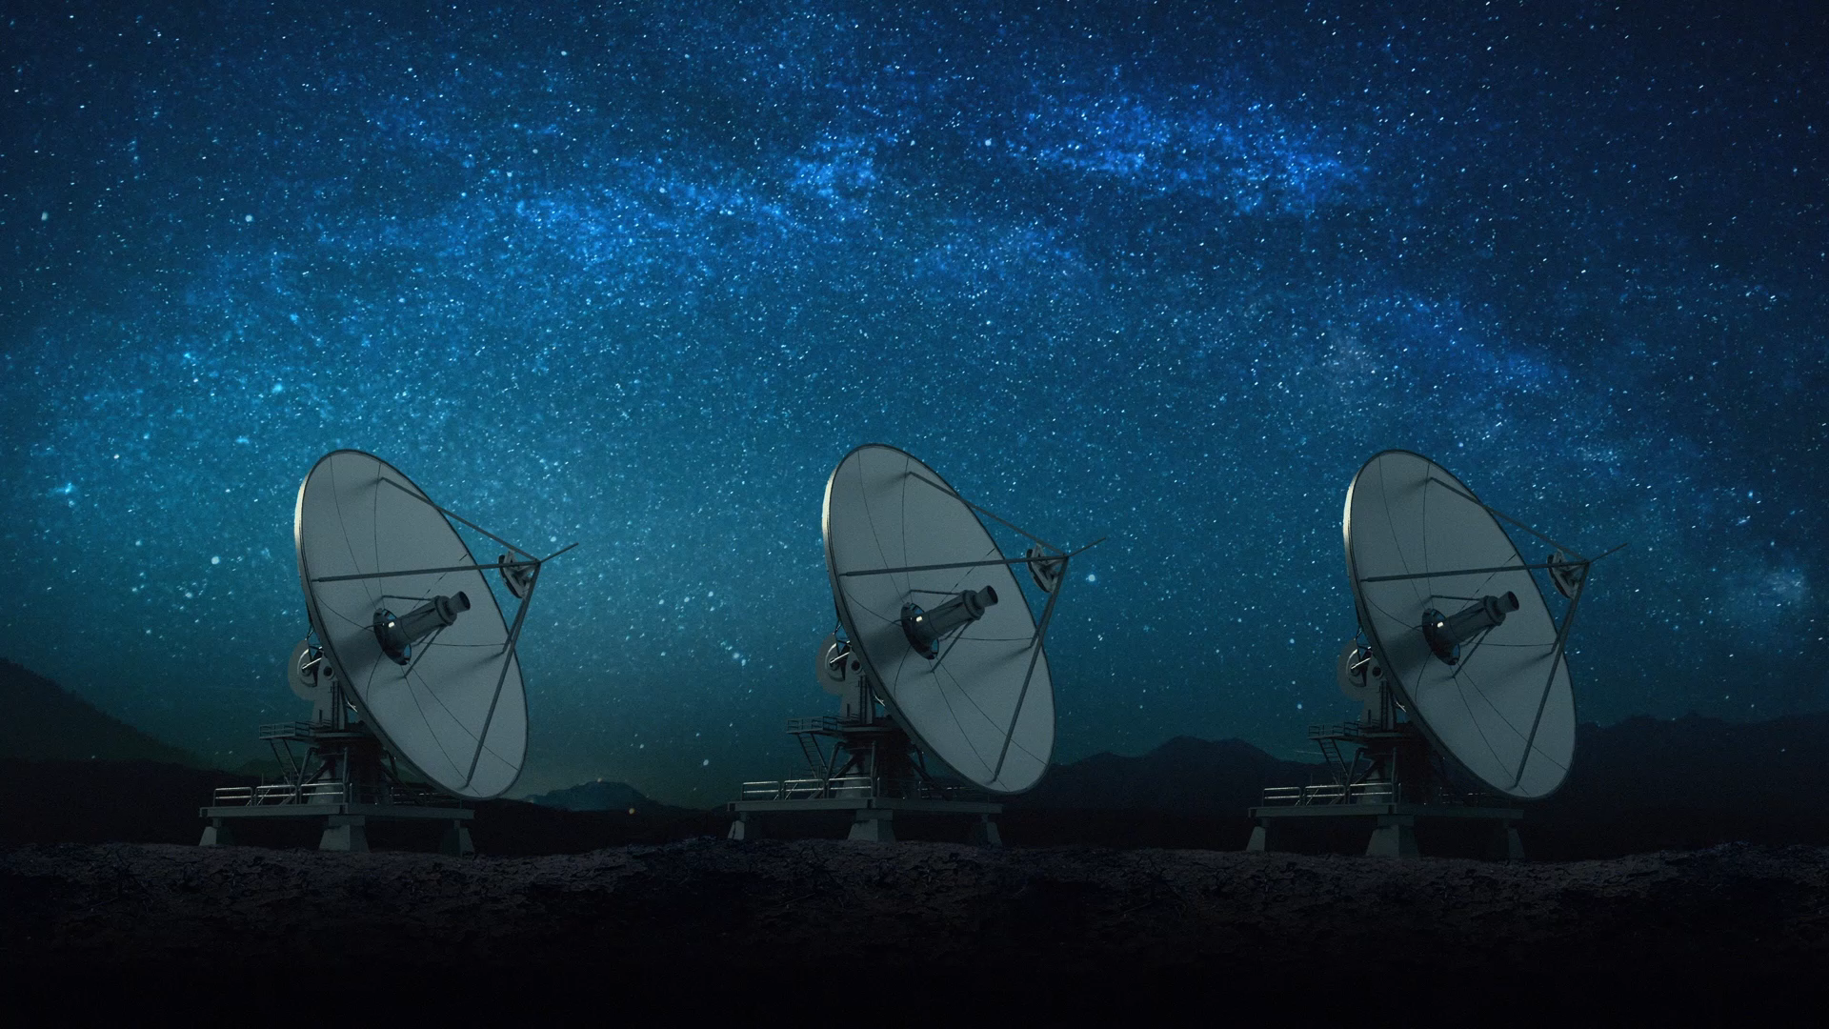
Spacecraft Communications
ENAE 694
Signals, Modulation,
and Bandwidth
Dave Israel (disrael@umd.edu)
October 19, 2026

Slide 2
Tonight’s Agenda
Self-Contained Homework 3 Review
Part 1: Carriers, Bits, Symbols, and Digital Modulation
Part 2: Pulse Shaping, Bandwidth, and Link Performance
ENAE 694 • Signals, Modulation, and Bandwidth
2

Slide 3
Homework 3, Problem 1: The Question
A circular reflector has D = 0.80 m, f = 7.50 GHz, and aperture efficiency 0.55.
(a) Find peak gain in dBi and full half-power beamwidth (HPBW) in degrees.
(b) Double D at fixed f. Find gain change, new gain, and new HPBW.
(c) Restore D and double f to 15.00 GHz. Find gain change and HPBW. Why is this insufficient to determine the received-power change?
ENAE 694 • Signals, Modulation, and Bandwidth
3

Slide 4
Homework 3: Gain and Beamwidth
Worked Answer
Case | Gain [G] (dBi) | Change (dB) | HPBW (°)
D = 0.80 m, f = 7.50 GHz | 33.37 | Reference | 3.50
Double D to 1.60 m | 39.39 | +6.02 | 1.75
Double f to 15.00 GHz | 39.39 | +6.02 | 1.75
[G] = 17.81 + 20 log₁₀(D) + 20 log₁₀(f)
HPBW ≈ 21/(fD)°. D in m, f in GHz; efficiency 0.55 included.
ENAE 694 • Signals, Modulation, and Bandwidth
4

Slide 5
Homework 3: Why Gain Alone Is Insufficient
Doubling f changes both antenna gain and free-space loss.
Δ[S] = Δ[G_{TX}] + Δ[G_{RX}] − Δ[L_{p}] − Δ[L_{other}]
What Stays Fixed? | Changes at Twice the Frequency | Received Power
Ground antenna gain | +6.0 + 0.0 − 6.0 dB | 0.0 dB change
Both physical apertures | +6.0 + 6.0 − 6.0 dB | +6.0 dB change
We must know the ground-antenna assumption and any other frequency-dependent losses.
ENAE 694 • Signals, Modulation, and Bandwidth
5

Slide 6
Homework 3, Problem 2: The Question
Aligned, polarization-matched [P_{r0}] = −118.00 dBW. Required received power = −123.50 dBW. All other losses are included.
Transmit HPBW = 3.50°, error = 0.875°. Receive HPBW = 1.40°, error = 0.350°. Both polarizations are linear.
(a) Find each pointing loss. (b) At 45° polarization misalignment, find polarization loss, actual received power, and margin. Does it meet the threshold?
(c) Repeat power and margin for 60°. Explain how polarization realignment can restore the link without changing peak antenna gain.
ENAE 694 • Signals, Modulation, and Bandwidth
6

Slide 7
Homework 3: Pointing Loss
Worked Answer
[L_{point}] = 12(θ / HPBW)², using full HPBW and consistent angular units.
Transmit: [L_{pt}] = 12(0.875 / 3.50)² = 0.75 dB
Receive: [L_{pr}] = 12(0.350 / 1.40)² = 0.75 dB
Total pointing loss = 0.75 + 0.75 = 1.50 dB. Subtract it once.
The supplied near-boresight approximation does not describe sidelobes or nulls.
ENAE 694 • Signals, Modulation, and Bandwidth
7

Slide 8
Homework 3: Polarization and Margin
Worked Answer
Axes Differ By | [L_{pol}] (dB) | [P_{r}] (dBW) | Margin (dB)
45° | 3.01 | −122.51 | +0.99: meets threshold
60° | 6.02 | −125.52 | −2.02: fails threshold
[L_{pol}] = −10 log₁₀(cos²ψ)
[P_{r}] = −118.00 − 1.50 − [L_{pol}]
Margin = [P_{r}] − (−123.50 dBW)
ENAE 694 • Signals, Modulation, and Bandwidth
8

Slide 9
Homework 3, Problem 3: The Question
Nadir-pointed science + continuous communications through a 12-minute overhead pass.
Time (min) | Fixed Gain Offset | Extra Path Loss
0–2 / 10–12 | −8 dB | 4 dB
2–5 / 7–10 | −2 dB | 1 dB
5–7 | 0 dB | 0 dB
At midpass, peak margin = +5 dB. Margin ≥ 0 is usable.
Find fixed and ideal gimbaled margins. Which meets both requirements?
The gimbal holds peak gain, with no added loss. Why can’t we rotate the spacecraft?
ENAE 694 • Signals, Modulation, and Bandwidth
9

Slide 10
Homework 3: Margin During the Pass
Worked Answer
Time (min) | Fixed Gain (dB) | Extra [L_{p}] (dB) | Fixed Margin (dB) | Gimbal Margin (dB)
0–2 | −8 | 4 | −7 | +1
2–5 | −2 | 1 | +2 | +4
5–7 | 0 | 0 | +5 | +5
7–10 | −2 | 1 | +2 | +4
10–12 | −8 | 4 | −7 | +1
Margin = 5 + gain relative to peak − extra path loss.
Fixed: usable only 2–10 min. Gimbal: usable throughout the pass.
The gimbal restores peak gain; it does not remove the extra path loss.
ENAE 694 • Signals, Modulation, and Bandwidth
10

Slide 11
Homework 3, Problem 4: The Question
Keep the science and continuous-communications requirements from Problem 3. Installed antenna-system mass limit = 5.0 kg.
Option A: 2.0 kg fixed antenna. Option B: 6.0 kg gimbaled antenna. Both have the RF performance used in Problem 3. Mass includes feed, supports, and mechanisms.
(a) Which requirements does each option meet? Does either meet all? (b) Recommend a feasible change and state its cost or performance consequence.
(c) Why does antenna mass location affect spacecraft slewing and pointing even when total mass is unchanged?
ENAE 694 • Signals, Modulation, and Bandwidth
11

Slide 12
Homework 3: Mass and Pointing
Worked Answer
Option | Installed Mass | Communications + Science | All Requirements?
A: Fixed | 2.0 kg; 3.0 kg below limit | Cannot maintain both through full pass | No: loses link at pass ends
B: Gimbaled | 6.0 kg; 1.0 kg above limit | Tracks station while science stays nadir-pointed | No: exceeds mass limit
Neither option meets every requirement as proposed.
The limit is 5.0 kg. Turning the spacecraft toward the station would violate the required nadir science attitude.
ENAE 694 • Signals, Modulation, and Bandwidth
12

Slide 13
Homework 3: The Engineering Trade
Reallocate at least 1.0 kg to permit the 6.0 kg gimbaled system. Other hardware must give up that mass allocation.
Alternatively, redesign the gimbaled system to 5.0 kg or less while retaining RF and pointing performance. Verify the redesigned hardware.
Mass farther from a rotation axis contributes more rotational inertia: I = Σmr² for point masses. This affects slew torque and settling.
*Problem 4(c) is outside this course’s scope. Everyone receives full credit for that part.
ENAE 694 • Signals, Modulation, and Bandwidth
13

Slide 14
Clarifications From October 5
An absorbing atmosphere weakens the signal and emits thermal noise.
Off the lunar disk means the line of sight is outside the apparent Moon.
S/N₀ compares signal power with noise per hertz. Its units are dB-Hz.
Noise factor F is linear. Noise figure NF = 10 log₁₀(F) is in dB.
T₀ = 290 K: a common reference near room temperature.
It makes component NF values comparable. It is not the actual antenna or hardware temperature.
Another reference changes reported NF; consistent T_{e} = (F − 1)T₀ gives the same physical noise.
[1, 2]
ENAE 694 • Signals, Modulation, and Bandwidth
14

Slide 15
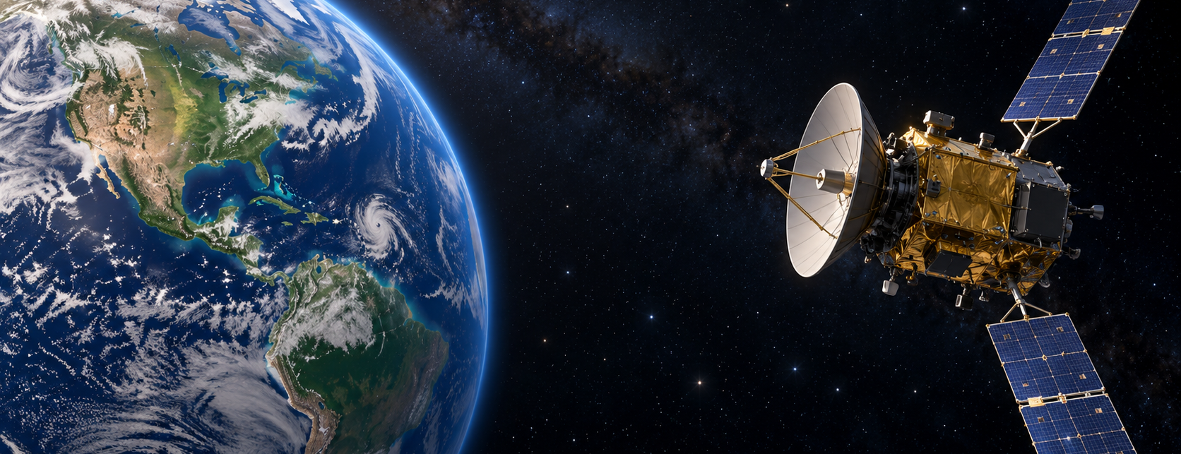
What Information Does a Signal Carry?
Command Uplink
Telemetry / Science Return
The waveform also provides timing, range, and Doppler measurements.
*Conceptual AI-generated illustration [15]. Sizes, distance, and signal paths are schematic.
[3, 4]
ENAE 694 • Signals, Modulation, and Bandwidth
15

Slide 16
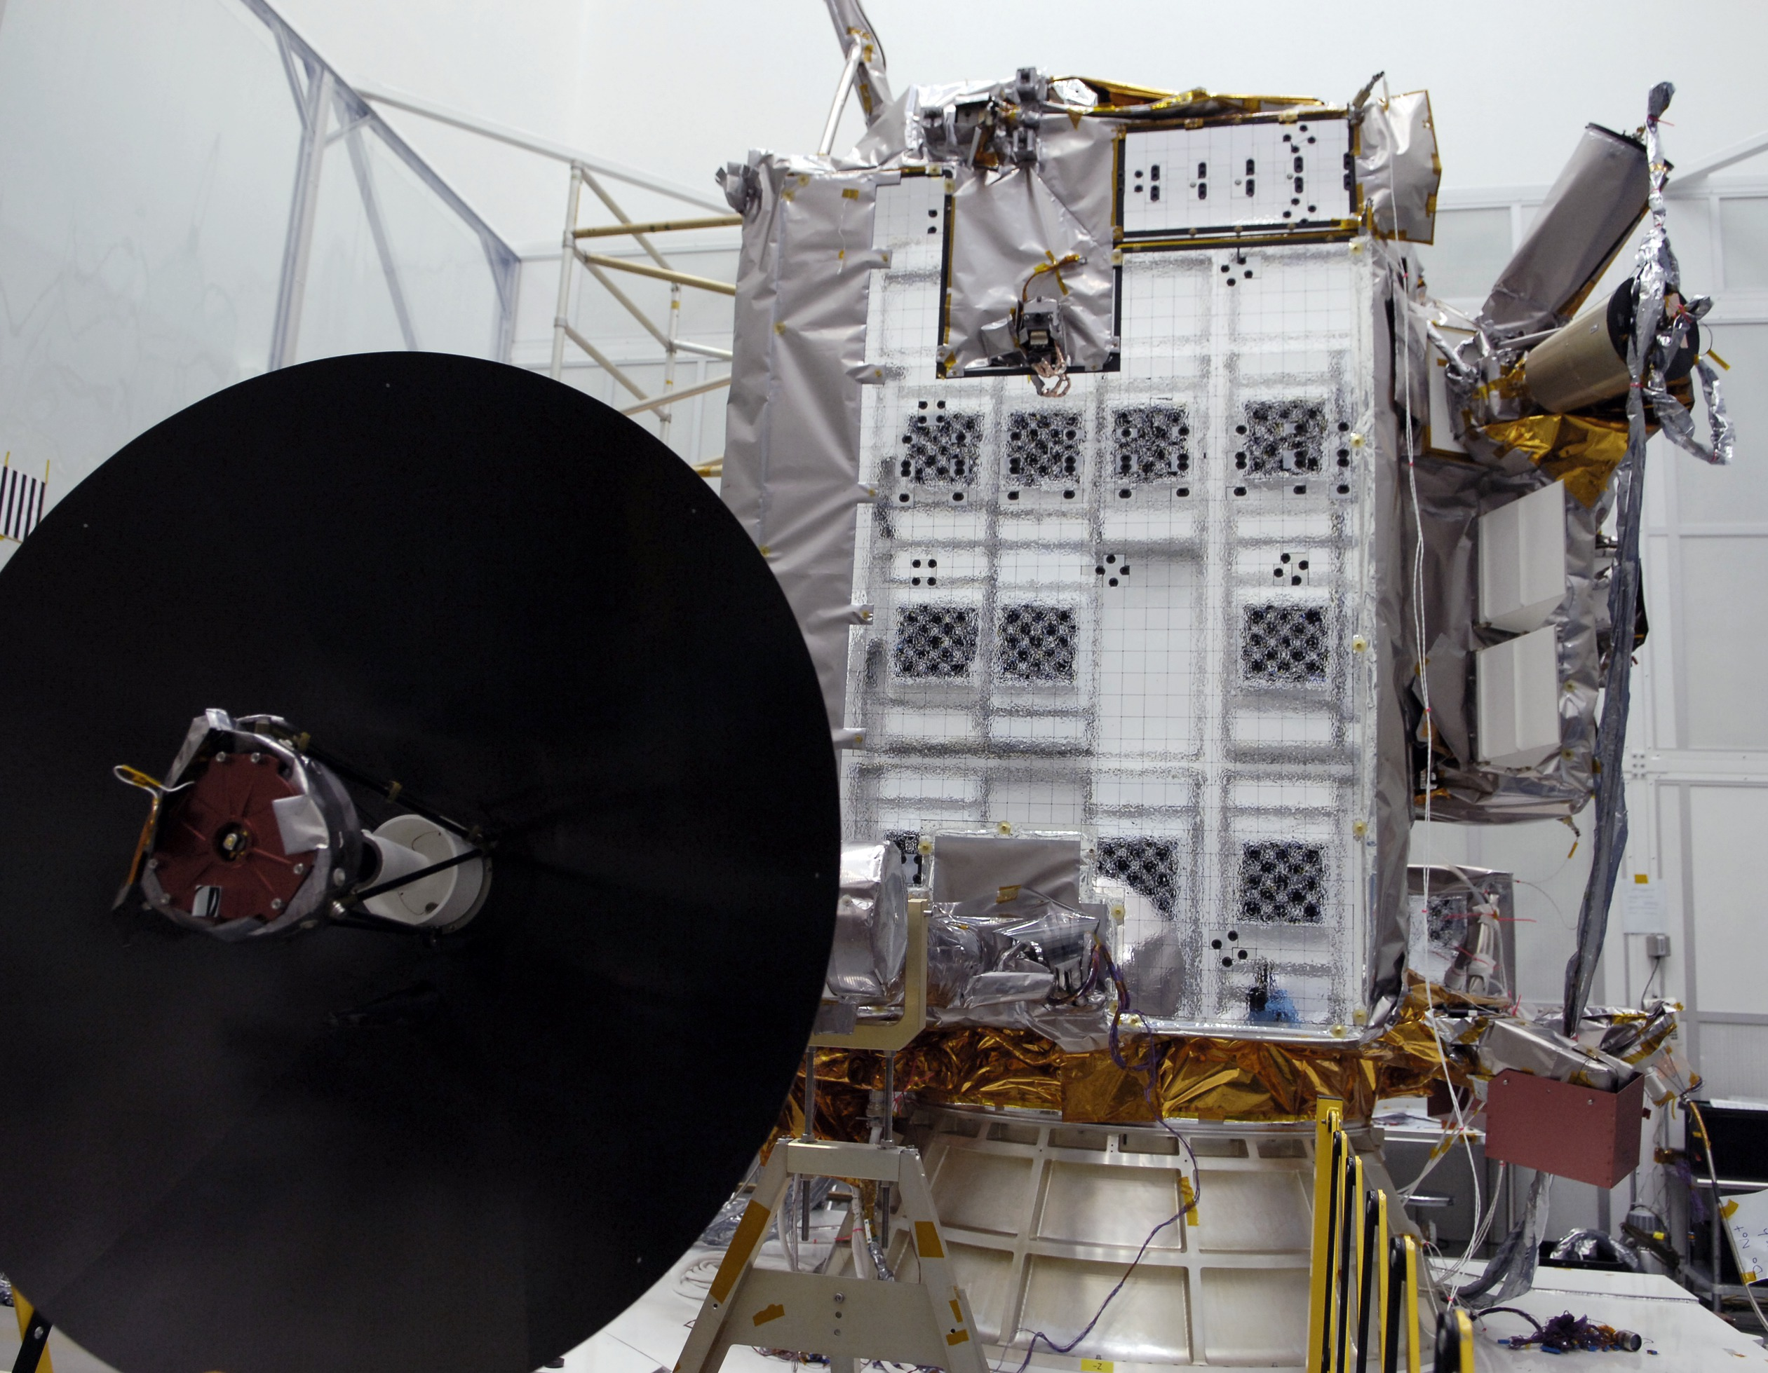
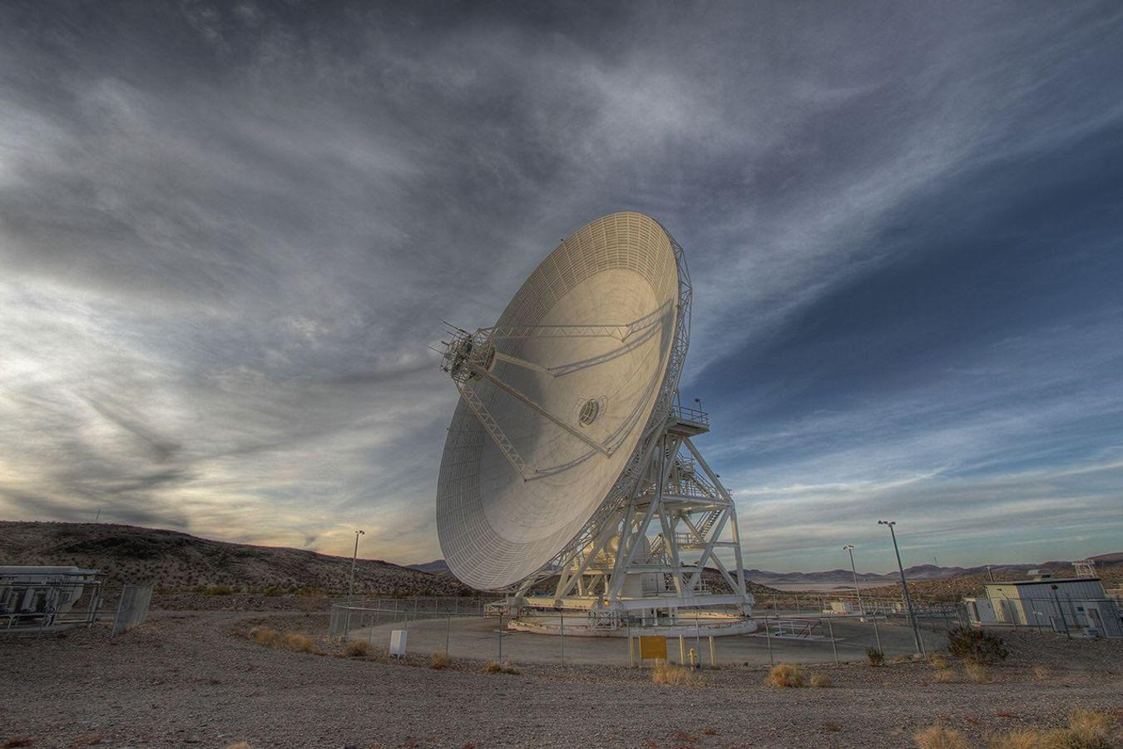
The Spacecraft Communications Chain
SPACECRAFT
GROUND STATION
Avionics and RF hardware
inside the spacecraft bus
Antenna and feed
launch the radio wave
Return Link
C&DH
Encode /
Modulate
PA
TX
Antenna
RX
Antenna
LNA
Demodulate /
Decode
C&DH collects data. PA = power amplifier.
Low-loss RF feed connects PA to antenna.
Ground receiver and mission-data processing.
Keep loss before the LNA small.
Photos: LRO, NASA/GSFC [11]; Goldstone, NASA/JPL-Caltech [12]. Functional locations are schematic; DSN beam-waveguide optics carry RF to receiver equipment.
[11, 12]
ENAE 694 • Signals, Modulation, and Bandwidth
16

Slide 17
Why Put Information on a Carrier?
Modulator
×
The data selects the carrier phase.
The antenna radiates the RF output.
Low-rate information moves to a band suited to antennas and spectrum allocation.
Illustrative BPSK. Only a few RF cycles per bit are drawn so the phase changes are visible. f_{c} is the carrier frequency.
[3]
ENAE 694 • Signals, Modulation, and Bandwidth
17

Slide 18
Bits, Line Coding, and Symbols
Bits: 1 0 1 1 0 0 1 0
A bit is a binary value. A symbol is one selected transmitted waveform.
Line coding turns a bit stream into a baseband waveform.
NRZ and Manchester encode the same bits with different transitions.
[3, 6]
ENAE 694 • Signals, Modulation, and Bandwidth
18

Slide 19
Bit Rate and Symbol Rate
Bit rate R_{b}: information bits per second.
Symbol rate R_{s}: selected waveforms per second.
SAME EIGHT BITS
1
0
1
1
0
0
1
0
BPSK: 1 bit / symbol
1
0
1
1
0
0
1
0
8 symbols
QPSK: 2 bits / symbol
1 0
1 1
0 0
1 0
4 symbols
R_{s} = R_{b} / (bits per symbol)
At 1.0 Mbit/s: BPSK = 1.0 Msymbol/s; QPSK = 0.5 Msymbol/s.
Two identical consecutive states still occupy two symbol intervals.
[3, 6]
ENAE 694 • Signals, Modulation, and Bandwidth
19

Slide 20
Line Coding Changes the Transitions
Bits: 1 0 1 1 0 0 1 0
NRZ-L holds a level for each bit interval.
NRZ-M changes level on a chosen bit value. Manchester changes at every bit center.
More transitions can aid timing recovery, but require more bandwidth.
[3, 6]
ENAE 694 • Signals, Modulation, and Bandwidth
20

Slide 21
Time Domain and Frequency Domain
A waveform shows how the signal changes with time.
The Fourier transform gives its frequency-domain description.
Abrupt transitions spread signal energy into sidelobes.
[3]
ENAE 694 • Signals, Modulation, and Bandwidth
21

Slide 22
On-Off Keying
One state sends a carrier. The other sends no carrier.
The information changes the carrier amplitude.
For unbalanced on/off levels, a residual carrier component may remain.
[3, 6]
ENAE 694 • Signals, Modulation, and Bandwidth
22

Slide 23
Frequency-Shift Keying
A 0 and a 1 select different carrier frequencies.
The receiver decides which tone is present.
Required bandwidth depends on tone spacing and pulse shaping.
[3, 6]
ENAE 694 • Signals, Modulation, and Bandwidth
23

Slide 24
BPSK: A Bit Selects the Carrier Phase
Binary phase-shift keying uses two phases separated by 180°.
One bit per modulation symbol.
For rectangular bit pulses, null-to-null RF bandwidth is approximately 2R_{b}.
[3, 6]
ENAE 694 • Signals, Modulation, and Bandwidth
24

Slide 25
BPSK: Two Possible Decisions
A constellation shows symbol states after carrier removal.
I = in-phase (horizontal). Q = quadrature (vertical), relative to the carrier reference.
Ideal BPSK has two I values and Q = 0. Each point represents one possible symbol.
Q
I
[3, 6]
ENAE 694 • Signals, Modulation, and Bandwidth
25

Slide 26
QPSK: Two Bits per Symbol
Four carrier phases represent four possible two-bit symbols.
Each transmitted symbol carries two bits.
For an uncoded QPSK link, R_{s} = R_{b} / 2.
Q
I
[3, 6]
ENAE 694 • Signals, Modulation, and Bandwidth
26

Slide 27
Summary: Amplitude, Frequency, and Phase
Data
0 / 1
1
0
1
1
0
0
1
0
Amplitude
ASK
Frequency
FSK
Phase
BPSK
Vertical lines mark bit boundaries. The data waveform shows actual transitions; adjacent equal bits need no state change. Waveforms are illustrative.
[3, 6]
ENAE 694 • Signals, Modulation, and Bandwidth
27

Slide 28
The I and Q View of a Modulator
Serial bits
Serial-to-
Parallel
I(t)
×
cos(2πf_{c} t)
+
RF Output
Q(t)
×
−sin(2πf_{c} t)
Carrier
Oscillator
+90°
s(t) = I(t) cos(2πf_{c} t) − Q(t) sin(2πf_{c} t)
[3, 6]
ENAE 694 • Signals, Modulation, and Bandwidth
28

Slide 29
Question: BPSK or QPSK
Uncoded information rate = 1.0 Mbit/s. Keep received power, noise density, and pulse shaping fixed. Change BPSK to QPSK. Which statement is correct?
A. Symbol rate halves, so the RF bandwidth is about halved.
B. The received energy per information bit doubles.
C. The symbol rate doubles.
ENAE 694 • Signals, Modulation, and Bandwidth
29

Slide 30
Worked Answer: BPSK or QPSK
A. Half the Symbol Rate and RF Bandwidth
R_{s} = R_{b} / bits per symbol: BPSK = 1.0 Msymbol/s; QPSK = 0.5 Msymbol/s.
B is false: fixed power and information rate give the same energy per bit. C is false: symbol rate halves.
At a fixed SYMBOL rate instead, QPSK carries twice as many information bits per second.
ENAE 694 • Signals, Modulation, and Bandwidth
30

Slide 31
Break
Next: Pulse Shaping, RF Bandwidth, and the Complete E_{b}/N₀ Budget
ENAE 694 • Signals, Modulation, and Bandwidth
31

Slide 32
Pulse Shaping: The Same Bits in Time
Abrupt
transitions
Smooth,
overlapping
pulses
Same eight bits and symbol rate. Only the transmit pulse shape changes.
Normalized baseband voltage, uncoded BPSK. RRC roll-off α = 0.35. Pulse overlap is intentional; a matched receiver controls interference at decision instants.
[3, 13]
ENAE 694 • Signals, Modulation, and Bandwidth
32

Slide 33
Pulse Shaping: RF Bandwidth and Sidelobes
Rectangular: first-null span = 2R_{s} = 2.0 MHz; sidelobes extend beyond it.
Ideal RRC: RF span = (1 + α)R_{s} = 1.35 MHz. Practical filters need allowances.
[3, 13]
ENAE 694 • Signals, Modulation, and Bandwidth
33

Slide 34
Pulse Shaping: Benefits and Costs
Benefit | Cost or Constraint
Lower out-of-band emissions | Transmit and receive filters must work together
More controlled channel bandwidth | Filter memory and timing affect symbol decisions
Closer channel spacing | Conventional RRC-shaped BPSK* can need amplifier backoff
More efficient use of spectrum | Choose a waveform compatible with the spacecraft amplifier
*RRC = root-raised cosine. Saturation can distort envelope variations and regrow sidelobes.
GMSK (Gaussian minimum-shift keying) and selected shaped OQPSK (offset QPSK) can offer favorable amplifier behavior.
[13, 14]
ENAE 694 • Signals, Modulation, and Bandwidth
34

Slide 35
Bandwidth Example: BPSK and QPSK
Assumptions | BPSK | QPSK
Information rate R_{b} | 1.0 Mbit/s | 1.0 Mbit/s
Bits per symbol | 1 | 2
Symbol rate R_{s} | 1.0 Msymbol/s | 0.5 Msymbol/s
B_{RF} at α = 0.35 | 1.35 MHz | 0.68 MHz
Uncoded examples. B_{RF} = (1 + α)R_{s}. Both transmit the same number of information bits each second.
[3]
ENAE 694 • Signals, Modulation, and Bandwidth
35

Slide 36
Direct Modulation and Subcarriers
Data spectrum is centered on the RF carrier.
Data sidebands move to ±70 kHz.
*Calculated average spectra: uncoded 10 kbit/s NRZ, no pulse shaping. PSD relative to unit complex-envelope power/Hz. No receiver noise; display stops at −80 dB/Hz.
[4, 6]
ENAE 694 • Signals, Modulation, and Bandwidth
36

Slide 37
Residual Carrier With a BPSK Subcarrier
Lower Sideband
Residual Carrier
Upper Sideband
−1.024 MHz
0
+1.024 MHz
32 kbit/s BPSK on a 1.024 MHz subcarrier
*Illustrative power allocation. Unshaped NRZ data: each sideband has a 64 kHz first-null span.
[4]
ENAE 694 • Signals, Modulation, and Bandwidth
37

Slide 38
Data Power Is Part of Total Signal Power
Illustrative Allocation of Total Received RF Power
100% of Total RF Power
Ranging 20%
q = S_{data} / S_{total} = 0.5
Residual Carrier 30%
[S_{data}/N₀] = [S_{total}/N₀] + 10 log₁₀(q)
Data 50%
For q = 0.5, data-channel S/N₀ is 3.0 dB lower.
*Assumed power fractions sum to 100%. Modulation indices and waveform design determine the actual split. The diagram shows allocation, not signal flow.
[4]
ENAE 694 • Signals, Modulation, and Bandwidth
38

Slide 39
Modulation Selection Is a Mission Trade
Need | Signal Design Implication
Weak signal acquisition | Consider tracking aids and residual-carrier power
High data rate in limited spectrum | More bits per symbol and appropriate pulse shaping
Efficient spacecraft power amplifier | Control envelope variation and amplifier backoff
Navigation or tracking on the same link | Allocate signal power and spectrum to each function
Choose the waveform with the receiver, amplifier, and mission requirements in view.
[3, 4, 6]
ENAE 694 • Signals, Modulation, and Bandwidth
39

Slide 40
The Receiver Must Recover the Bits
RF / IF
Conversion
Carrier + Timing
Recovery
Filter + Symbol
Decisions
Channel
Decoder
The receiver needs carrier and timing references before making symbol decisions.
Its error performance depends on signal energy relative to noise.
Next class examines the receiver and decoder in detail.
[3, 5]
ENAE 694 • Signals, Modulation, and Bandwidth
40

Slide 41
Bit Errors and Mission Performance
Measured BER = erroneous bits / tested bits
A theoretical bit-error probability predicts long-run behavior under stated assumptions.
At BER = 10⁻⁵, one million bits contains 10 errors on average.
A mission may require frame or packet error performance, not only raw BER.
1,000,000 Bits
BER = 10⁻⁵
10 Bit Errors on Average
[5, 7]
ENAE 694 • Signals, Modulation, and Bandwidth
41

Slide 42
Energy per Information Bit
Energy per Bit = Received Data Power ÷ Information Bit Rate
E_{b} = S_{data} / R_{b}
J/bit = (J/s) ÷ (bit/s)
E_{b}/N₀ = (S_{data}/N₀) / R_{b}
[E_{b}/N₀] = [S_{data}/N₀] − 10 log₁₀(R_{b} / 1 bit/s)
At fixed data power, twice as many bits each second means half the energy per bit: −3.0 dB.
[3, 7]
ENAE 694 • Signals, Modulation, and Bandwidth
42

Slide 43
Lunar Link: Available E_{b}/N₀
Carry forward [S_{data}/N₀] = 74.5 dB-Hz. Assume all signal power carries data.
At R_{b} = 1.0 Mbit/s:
[E_{b}/N₀] = 74.5 − 10 log₁₀(1,000,000) = 14.5 dB
At R_{b} = 2.0 Mbit/s: 74.5 − 63.0 = 11.5 dB
ENAE 694 • Signals, Modulation, and Bandwidth
43

Slide 44
Question: Doubling the Information Rate
Keep received data power and noise density fixed. Double information rate from 1.0 to 2.0 Mbit/s. What changes?
A. E_{b}/N₀ improves by 3.0 dB
B. E_{b}/N₀ worsens by 3.0 dB
C. S/N₀ worsens by 3.0 dB
ENAE 694 • Signals, Modulation, and Bandwidth
44

Slide 45
Worked Answer: Doubling the Information Rate
B. Available E_{b}/N₀ Falls by 3.0 dB
[E_{b}/N₀] = [S_{data}/N₀] − [R_{b}]. Rate rises from 60.0 to 63.0 dB(bit/s).
S_{data}/N₀ stays 74.5 dB-Hz. Available E_{b}/N₀ falls from 14.5 to 11.5 dB.
A has the sign reversed. C is false because the received power and noise density stay fixed.
ENAE 694 • Signals, Modulation, and Bandwidth
45

Slide 46
The Ideal BPSK and QPSK BER Curve
Coherent BPSK and Gray QPSK in AWGN:
P_{b} = ½ erfc(√(E_{b}/N₀))
E_{b}/N₀ inside the square root is a linear ratio.
At BER = 10⁻⁵, the ideal requirement is approximately 9.6 dB.
−5 on the vertical axis means BER = 10⁻⁵.
[7]
ENAE 694 • Signals, Modulation, and Bandwidth
46

Slide 47
Reading a BER Curve
E_{b}/N₀ | Ideal Uncoded BER | Interpretation
6.0 dB | 2.4 × 10⁻³ | About 2,400 errors per million bits
9.6 dB | 9.7 × 10⁻⁶ | About 10 errors per million bits
12.0 dB | 9.0 × 10⁻⁹ | Far fewer errors under this ideal model
Coherent BPSK, AWGN, perfect synchronization. Actual equipment adds implementation effects.
[7]
ENAE 694 • Signals, Modulation, and Bandwidth
47

Slide 48
Available and Required E_{b}/N₀
Available E_{b}/N₀ comes from received data power, noise density, and information rate.
Required E_{b}/N₀ comes from a performance curve or a tested receiver specification.
Example: ideal coherent uncoded BPSK needs about 9.6 dB for BER = 10⁻⁵ in AWGN.
Real receiver losses and design reserve must also fit in the budget.
[3, 7]
ENAE 694 • Signals, Modulation, and Bandwidth
48

Slide 49
Lunar Link: Closing the Margin
Available [E_{b}/N₀] = [S_{data}/N₀] − [R_{b}] = 74.5 − 60.0 = 14.5 dB
Assume BER ≤ 10⁻⁵ requires 9.6 dB for ideal uncoded BPSK.
Assume a separate implementation loss of 1.0 dB.
Margin = 14.5 − 9.6 − 1.0 = 3.9 dB
ENAE 694 • Signals, Modulation, and Bandwidth
49

Slide 50
Lunar Link: Rate and Margin
Information Rate | Available E_{b}/N₀ | Margin*
1.0 Mbit/s | 14.5 dB | 3.9 dB
2.0 Mbit/s | 11.5 dB | 0.9 dB
4.0 Mbit/s | 8.5 dB | −2.1 dB
*Margin = 74.5 − 10 log₁₀(R_{b}) − 9.6 − 1.0 dB. Bandwidth and lock must also be adequate.
ENAE 694 • Signals, Modulation, and Bandwidth
50

Slide 51
Question: The 4 Mbit/s Link
We need 3.0 dB reserve, but the 4.0 Mbit/s case has −2.1 dB margin. Which change alone is enough?
A. Switch BPSK to QPSK at the same information rate
B. Reduce the information rate to 1.0 Mbit/s
C. Add 20 dB of ideal gain after the receiver front end
ENAE 694 • Signals, Modulation, and Bandwidth
51

Slide 52
Worked Answer: The 4 Mbit/s Link
B. Reduce the Information Rate
The 1.0 Mbit/s case has 3.9 dB margin and exceeds the 3.0 dB reserve.
A reduces bandwidth but does not change ideal bit-energy performance.
C amplifies signal and existing noise together.
ENAE 694 • Signals, Modulation, and Bandwidth
52

Slide 53
Lunar Link: The Remaining Trades
Change | Budget Effect | Mission Cost
More data-channel EIRP | More available E_{b}/N₀ | Spacecraft power or antenna demands
Better G/T or lower losses | More available E_{b}/N₀ | Ground hardware, siting, or operations
Lower information bit rate | More energy per information bit | Longer delivery time
Different modulation / coding | May lower required E_{b}/N₀ | Bandwidth, complexity, or latency
A lower requirement must come from a justified performance comparison at the same delivered error target.
[3, 5, 7]
ENAE 694 • Signals, Modulation, and Bandwidth
53

Slide 54
The Complete Link Equation
[E_{b}/N₀] = [EIRP] − [L_{p}] − [L_{other}] + [G/T] − [k] + [q] − [R_{b}]
[q] = 10 log₁₀(q), where q is the fraction of received signal power allocated to data.
[R_{b}] = 10 log₁₀(R_{b} / 1 bit/s), using the information bit rate.
[k] = −228.6 dBW/Hz/K. G and T_{sys} use the same reference plane.
Available E_{b}/N₀ must cover the requirement, implementation loss, and reserve.
[3, 4, 7]
ENAE 694 • Signals, Modulation, and Bandwidth
54

Slide 55
What If the Link Still Does Not Close?
We have optimized power, antennas, receiver noise, losses, and data rate.
Our available E_{b}/N₀ still falls short of the requirement.
Could we transmit the bits in a way that requires less E_{b}/N₀?
Next Class: Demodulation, BER, and Coding
ENAE 694 • Signals, Modulation, and Bandwidth
55

Slide 56
Optional Reference Slides
Additional Signal Examples and Calculation Details
ENAE 694 • Signals, Modulation, and Bandwidth
56

Slide 57
Why the 290 K Reference Cancels
Chosen Reference T₀ | Reported Noise Factor F | Recovered Receiver T_{e}
290 K | 2.0 (NF = 3.0 dB) | (2.0 − 1) × 290 = 290 K
Hypothetical 580 K | 1.5 (NF = 1.8 dB) | (1.5 − 1) × 580 = 290 K
T_{e} = (F − 1)T₀. Same hardware, different reporting convention. Actual output noise = GkB(T_{A} + T_{e}), unchanged by the reference choice.
[2]
ENAE 694 • Signals, Modulation, and Bandwidth
57

Slide 58
Pulse-Shape Mismatch: A Numerical Example
Receive Filter | Required E_{b}/N₀ at BER = 10⁻⁵
Matched root-raised-cosine filter | 9.6 dB
Rectangular integrate-and-dump filter | 10.5 dB
Additional required E_{b}/N₀ | About 1.0 dB
*Teaching calculation: uncoded BPSK, RRC transmit roll-off 0.35, AWGN, perfect carrier/timing, independent bits, no equalizer. This penalty is specific to these assumptions.
[3, 13]
ENAE 694 • Signals, Modulation, and Bandwidth
58

Slide 59
Navigation and Tracking Signals
Purpose | Observable or Reference | Example
Navigation | Known timing/code/phase references | GPS time-tagged ranging codes
Historical navigation | Carrier Doppler over a pass | Transit navigation
Bearing reference | Carrier/subcarrier phase relationship | VOR
Spacecraft tracking | Range and Doppler over time | Orbit estimation
Range is a line-of-sight distance measurement. Doppler constrains line-of-sight velocity; a trajectory solution uses measurements over time.
[4]
ENAE 694 • Signals, Modulation, and Bandwidth
59

Slide 60
Frequency Bands and Spectrum Access
S, X, Ku, and Ka are useful space-communications bands. L, VHF, and UHF also serve particular missions.
Available bandwidth depends on the allocated service, direction, region, and authorization.
Higher-frequency links can offer wider allocations while facing tighter pointing and weather trades.
A band name alone does not guarantee a usable bandwidth or non-line-of-sight coverage.
[10]
ENAE 694 • Signals, Modulation, and Bandwidth
60

Slide 61
Subcarrier Examples and Ranging Tones
Direct example: 100 kbit/s telemetry modulates the RF carrier without an added subcarrier.
Subcarrier example: place 100 kbit/s data on a 1.024 MHz subcarrier. Account for both RF sidebands.
Combined example: 20 kbit/s telemetry on a 70 kHz subcarrier, plus ranging tones at 4, 20, 100, and 500 kHz.
These are illustrative plans. Modulation indices set the power split; receiver compatibility sets usable combinations.
PN ranging uses a known pseudo-random pattern and correlation. It need not use a telemetry subcarrier.
[4]
ENAE 694 • Signals, Modulation, and Bandwidth
61

Slide 62
Analog Modulation Equations
AM: s(t) = A[1 + μm(t)] cos(2πf_{c} t)
FM: s(t) = A cos[2πf_{c} t + 2πk_{f} ∫m(τ)dτ]
PM: s(t) = A cos[2πf_{c} t + k_{p} m(t)]
For FM, Carson’s approximation is B ≈ 2(Δf + f_{m},max).
No blanket AM/FM/PM performance ranking applies without assumptions.
[3, 6]
ENAE 694 • Signals, Modulation, and Bandwidth
62

Slide 63
Manchester, NRZ, and Timing Recovery
Bits: 1 0 1 1 0 0 1 0
Long runs without transitions make timing recovery harder.
Manchester guarantees a transition at each bit center.
NRZ schemes can use scrambling or other structure to aid timing.
A line-code symbol, a coded bit, and an RF modulation symbol are different concepts.
[3, 6]
ENAE 694 • Signals, Modulation, and Bandwidth
63

Slide 64
Higher-Order Constellations
M-PSK places more phase states on a circle. QAM uses amplitude and phase.
More coded bits per symbol can reduce the required symbol rate.
At fixed average symbol energy, more closely spaced states are harder to distinguish.
Envelope variation and amplifier linearity become important.
Q
I
[3, 6]
ENAE 694 • Signals, Modulation, and Bandwidth
64

Slide 65
Lunar Link: Maximum Rate With Reserve
Require 3.0 dB design reserve beyond the BER requirement and implementation loss.
[R_{b},max] = 74.5 − 9.6 − 1.0 − 3.0 = 60.9 dB(bit/s)
R_{b},max = 10^{60.9/10} ≈ 1.2 Mbit/s
This is a power-limited result. Spectrum, coding, hardware, and acquisition can lower it.
ENAE 694 • Signals, Modulation, and Bandwidth
65

Slide 66
Lunar Link: Reference Planes
Quantity | Antenna Terminals A | LNA Input B
Received signal | −131.9 dBW | −132.9 dBW
Equivalent system temperature | 168.0 K / 22.3 dBK | 133.5 K / 21.3 dBK
Equivalent noise density | −206.3 dBW/Hz | −207.3 dBW/Hz
S/N₀ | 74.5 dB-Hz | 74.5 dB-Hz
Same complete system represented at two planes. B includes receiver-added noise referred to its input. Inserting a lossy cable physically still degrades the link.
ENAE 694 • Signals, Modulation, and Bandwidth
66

Slide 67
References and Further Reading
[1] NRAO. Essential Radio Astronomy, Chapter 1: atmospheric attenuation and emission.
[2] Keysight. Noise Figure application help: thermal noise and the 290 K reference.
[3] R. Gallager. MIT 6.450, Chapter 6: Channels, Modulation, and Demodulation.
[4] JPL. DSN Telecommunications Link Design Handbook, 810-005, Module 206: Telemetry General Information.
[5] CCSDS 131.0-B-5 (2023). TM Synchronization and Channel Coding.
ENAE 694 • Signals, Modulation, and Bandwidth
67

Slide 68
References and Further Reading
[6] Keysight. Digital Modulation in Communications Systems, Application Note 1298.
[7] MathWorks. Analytical Expressions Used in berawgn Function and Bit Error Rate Analysis App.
[8] CCSDS 130.1-G-3 (2020), with technical corrigendum: TM Synchronization and Channel Coding, Summary of Concept and Rationale.
[9] MIT 6.450, Lecture 23: channel capacity and the wideband energy limit.
[10] NTIA. United States Frequency Allocation Chart and Table of Frequency Allocations.
ENAE 694 • Signals, Modulation, and Bandwidth
68

Slide 69
References and Image Credits
[11] NASA/Goddard Space Flight Center. LRO Assembly and Testing Stills, SVS 10408. Spacecraft photograph.
[12] NASA/JPL-Caltech. Goldstone 34-meter Beam Waveguide, PIA17791. Ground antenna photograph.
[13] MathWorks. Raised Cosine Filtering and Raised Cosine Receive Filter documentation.
[14] CCSDS 413.0-G-3, with Technical Corrigendum 1. Bandwidth-Efficient Modulations, Sections 3 and Annex B.
[15] Spacecraft–Earth scene: AI-generated conceptual illustration. Distances and sizes are not to scale.
ENAE 694 • Signals, Modulation, and Bandwidth
69

