Slide 1
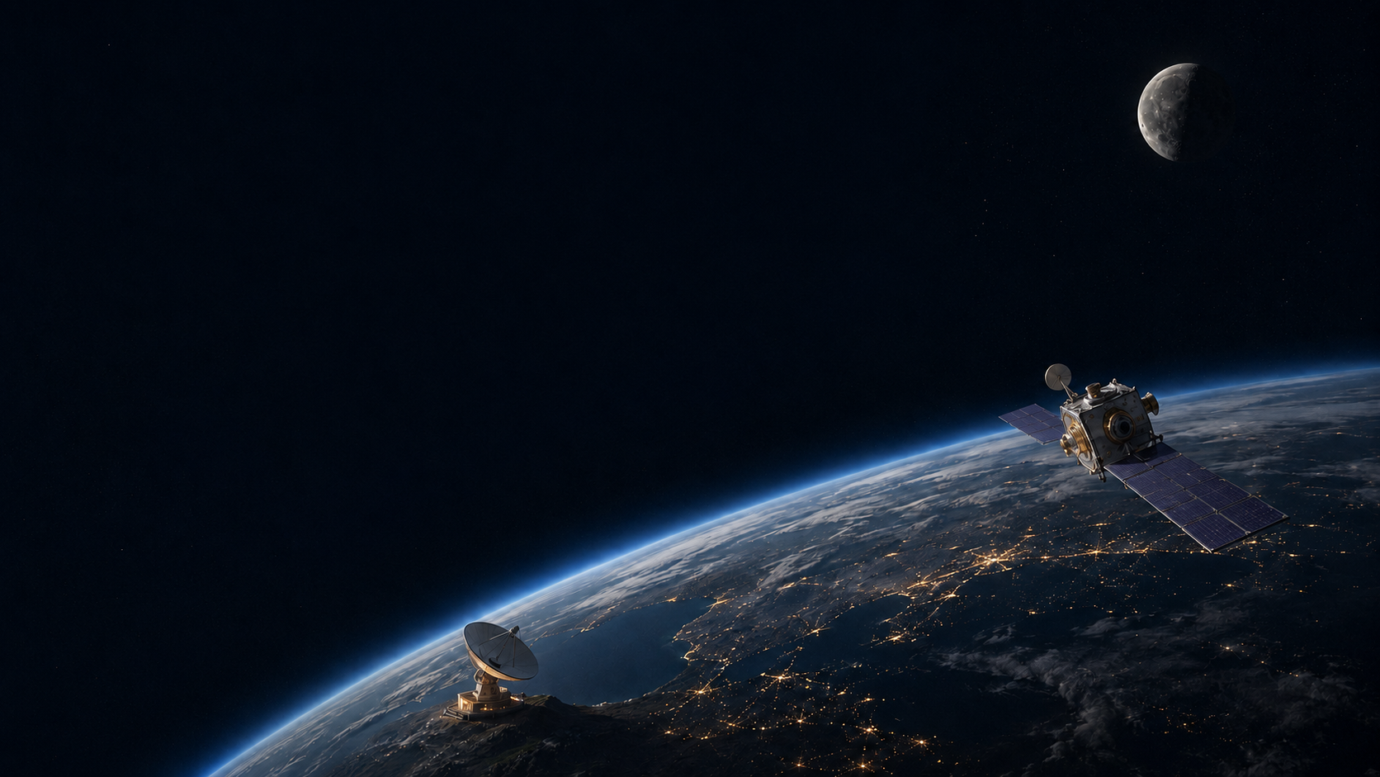
ENAE 694
Spacecraft Communications
Class 1 • The Spacecraft Communications Problem
Dave Israel • August 31, 2026

Slide 2
Tonight Has Three Parts
Part 1 — Welcome, syllabus, and introductions
Part 2 — Communications as a mission system
Part 3 — Lunar orbiter: volume, rate, latency, and architecture

Slide 3
Introductions
Dave Israel
disrael@umd.edu
(443)895-1864

Slide 4
Not Simply Radio. Not Simply Networking.
This course is about moving mission information
through a complete system.

Slide 5
The Semester Leads to a Complete Network
COURSE GRADE • Homework & applied work 70% • Final project 30%
MEETING | CLASS FOCUS | MEETING | CLASS FOCUS
Aug. 31 | Mission system | Nov. 2 | Demodulation, BER & coding
Sept. 14 | Received power & geometry | Nov. 9 | Multiple access, crosslinks & relays
Sept. 28 | Antennas & pointing | Nov. 16 | Coverage & availability
Oct. 5 | Optical communications | Nov. 23 | Data services & end-to-end flow
Oct. 19 | Noise, G/T & complete link budget | Nov. 30 | Routing, store-and-forward & DTN
Oct. 26 | Signals, modulation & bandwidth | Dec. 7 | Interoperable networks + architecture studio
NO CLASS • Sept. 7 — Labor Day • Sept. 21 — Yom Kippur • Oct. 12 — Fall Break

Slide 6
What You Will Be Able to Do
Translate mission needs and provider capabilities into communications design targets
Build and interpret complete link budgets
Analyze coverage, availability, capacity, and latency
Trace data from its source to its final user
Compare architectures and defend the trades

Slide 7
Two Perspectives, One Complete System
Mission view: what information must arrive—and when?
↓
Provider view: what services can shared assets deliver?
↓
Radio links
+
Networks and operations
↓
Mission information reaches its user

Slide 8
We Will Do the Engineering in the Room
Introduce the principle
Work an example together
Change one assumption
Predict what changes—and why
Use homework to extend the example

Slide 9


The Communications Problem

Slide 10
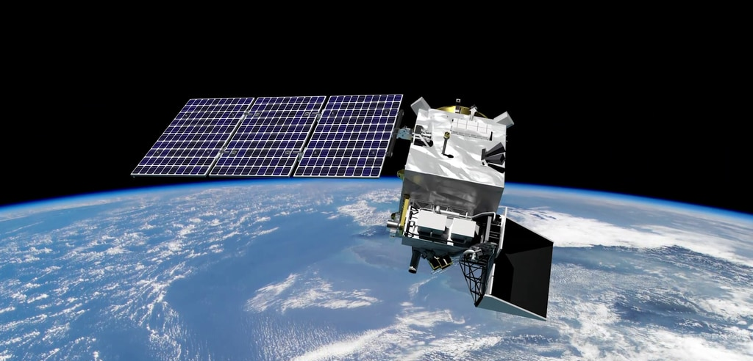

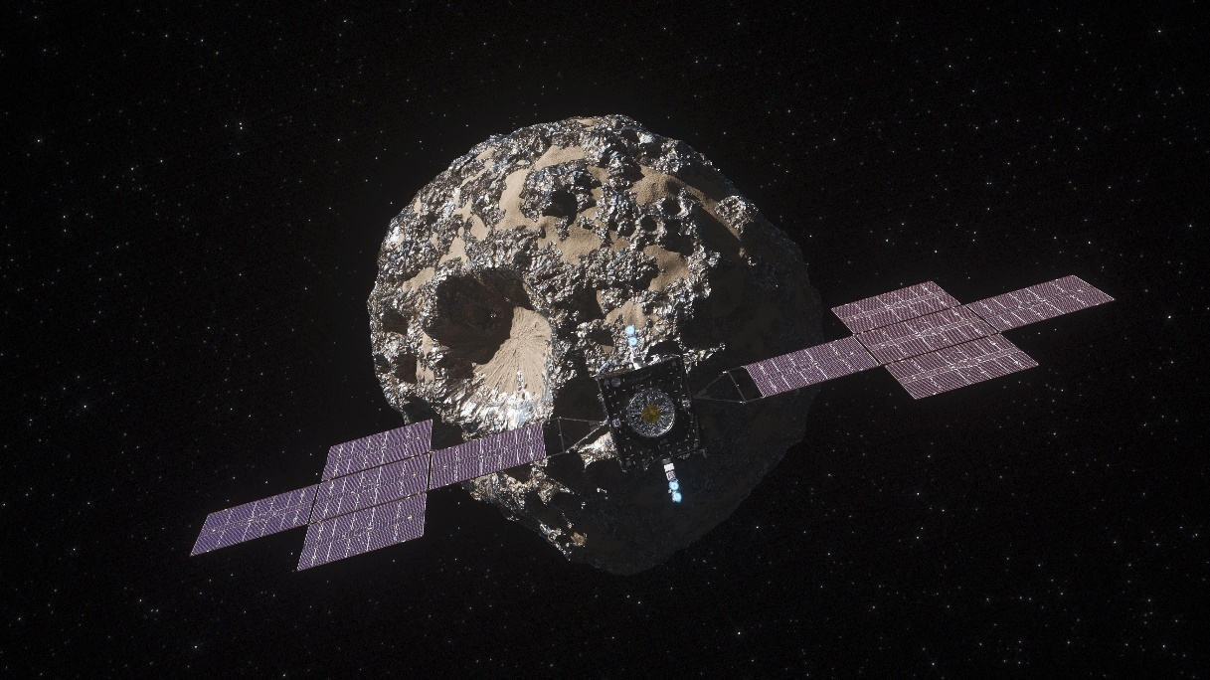
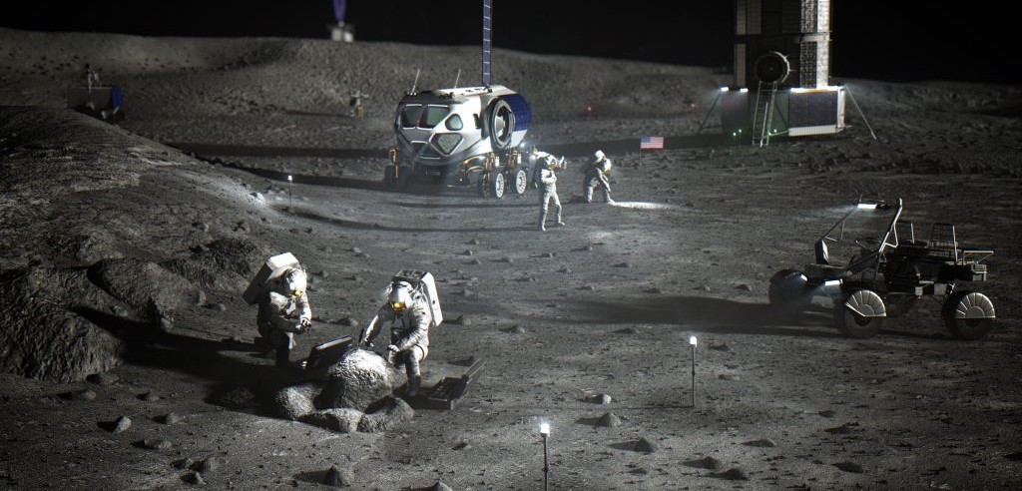

Slide 11
Mission Needs Come First
“Use Ka-band” is an implementation choice.
“Use a relay” is an architecture choice.
Start with what information must reach whom, how much, how quickly, and how dependably.
Then compare ways to make that happen.

Slide 12
Start With Eight Questions
1 Where is the information produced?
2 Where must it ultimately go?
3 How much must be delivered?
4 How soon must it arrive?
5 How complete and reliable must delivery be?
6 Are some data more important than others?
7 What security is required?
8 What resources and constraints limit the design?

Slide 13
Start With Source and Destination
Geometry sets range, visibility, and propagation time
Interfaces identify the systems and organizations involved
The final destination may be far beyond the ground antenna
Different sources may need different paths and services

Slide 14
Data Volume Is Not a Data Rate
A volume becomes a rate only after we know
how much communication time is available.

Slide 15
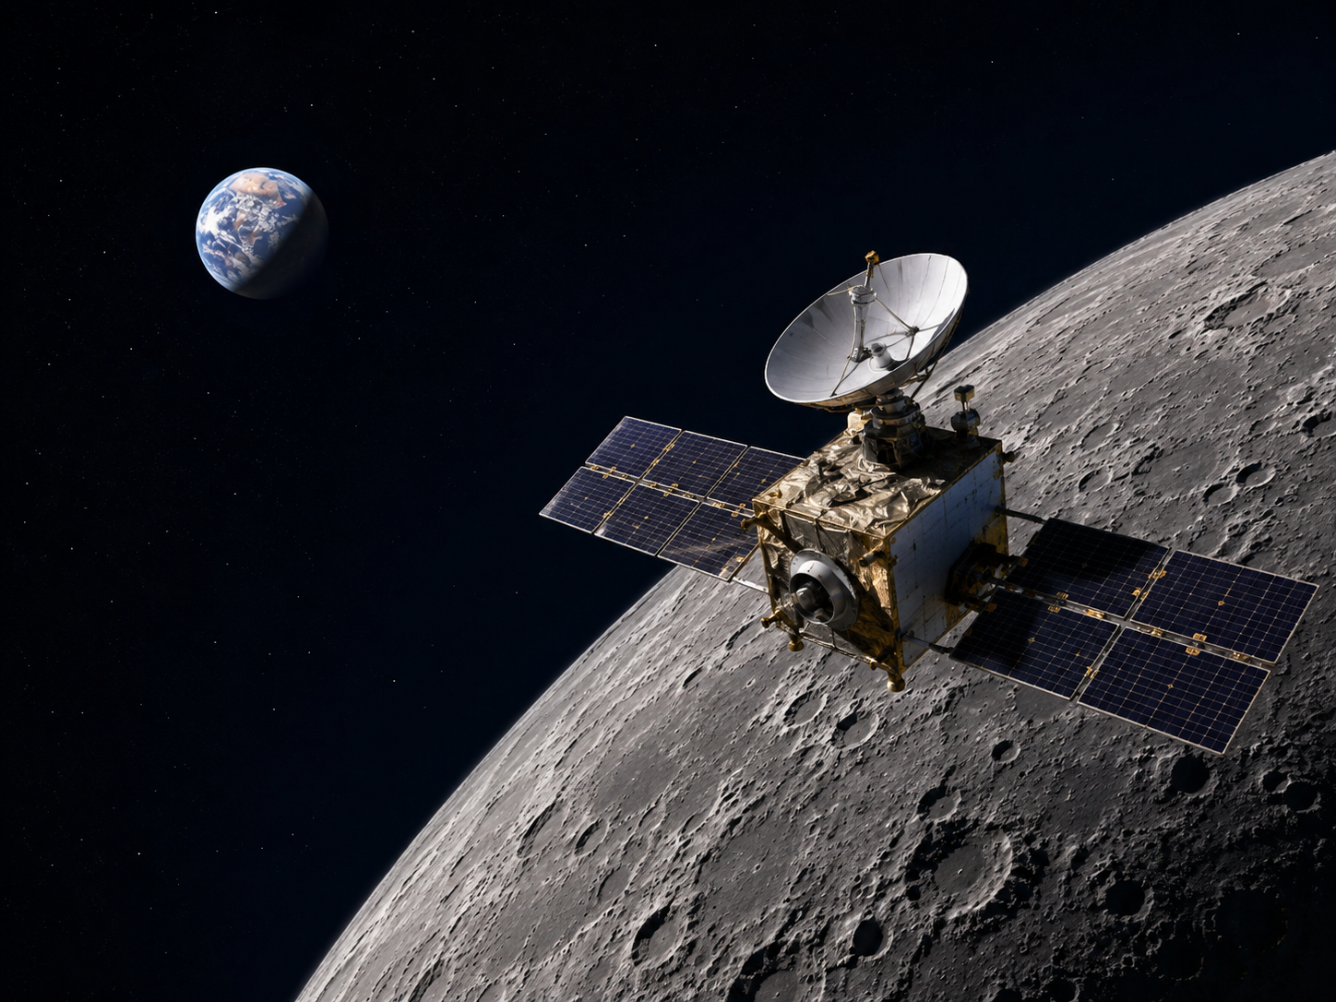
First Worked Example: A Lunar Orbiter
8 GB of science data each day
Two scheduled 10-minute Earth contacts per day
Assume every scheduled second can carry science data
What is the minimum data rate?

Slide 16
First Convert the Daily Volume
8 GB/day × 8 bits/byte
= 64 Gbit/day
Keep the units visible. They are often the first line of defense against nonsense.

Slide 17
Then Divide by Available Contact Time
Contact time = 2 × 10 min × 60 s/min = 1,200 s
Minimum rate = 64 × 10⁹ bits ÷ 1,200 s
≈ 53.3 Mbit/s

Slide 18
53.3 Mbit/s Is Only a Lower Bound
Protocol and coding overhead
Acquisition and handover time
Changing geometry and link performance
Lost or shortened contacts
Telemetry, commands, and competing users
Variation in data production

Slide 19
Now Add a Latency Need
The orbiter also produces an event alert.
Very small data volume
Ten-minute delivery deadline
Does the twice-daily contact schedule satisfy the mission?

Slide 20
Capacity and Availability Are Different
Capacity asks: how much?
Availability asks: when?
Enough total capacity does not guarantee a usable path at the critical moment.
Scheduled Service Across a Day
Alert generated
Earlier
No contact available — alert waits
Later
Scheduled contact
Next contact

Slide 21
Different Data Need Different Services
Science imagery — high volume, hours of latency, very high completeness
Event alert — tiny volume, 10-minute latency, urgent
Housekeeping — moderate volume, priority changes with spacecraft state
Command — tiny volume, mission-dependent latency, authorized and correct
The smallest data product may drive the most expensive design choice.

Slide 22
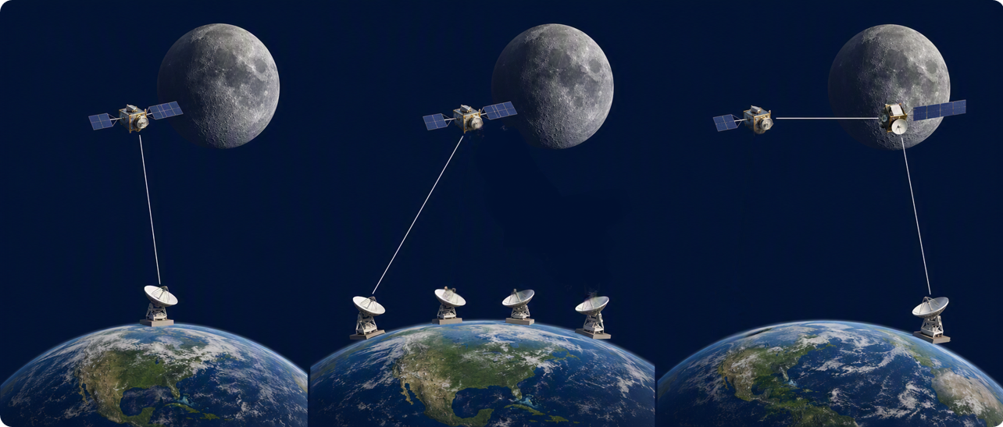
Three Plausible Architectures
1 Mission-owned direct-to-Earth ground station
2 Shared provider ground-station network
3 Relay provider plus direct-to-Earth for bulk data
1
2
3

Slide 23
Architecture Discussion
Which option meets the mission’s alert deadline?
Which uses shared capacity well across missions?
Which creates the greatest provider dependence?
Which offers the greatest resilience?
What do the mission and provider still need to know?

Slide 24
Not Enough Information Is a Result
Name the uncertainty.
Identify the decision it affects.
Ask for the evidence that would resolve it.
Recognizing that we cannot choose yet is engineering judgment.

Slide 25
Constraints Are Part of the Design
Size, weight, and power
Spectrum and interference
Cost, schedule, complexity, and risk
Shared provider capacity and scheduling
Everything is a trade. The equations help us make the trade honestly.

Slide 26
Spectrum and Security Shape Design
Spectrum: allocation, bandwidth, and interference
Commands: authorization and integrity
Telemetry and science: confidentiality may differ
Networks: every provider interface creates a trust boundary
Resilience and security are related—but they are not the same thing

Slide 27
A Design Must Work End to End
Link budget — can a representative link work?
Coverage — is the service available when needed?
Data delivery — can information arrive in time?
Mission use — does the result support operations?
Assumptions — what could change the answer?

Slide 28
A Working Vocabulary
Link — one transmitter-to-receiver connection
Service — a capability delivered to a user
Provider — shared assets and operations serving multiple missions
Network — connected assets and rules that move data end to end
Architecture — the chosen arrangement of functions, interfaces, and resources

Slide 29
Six Questions Test the Complete System
1 Does the link close?
2 Is service available when needed?
3 Can the network carry the offered load?
4 Does the data reach the final user on time?
5 Can the provider serve this mission along with the others?
6 Can we defend the complete architecture?

Slide 30
Before You Leave
Name one mission communications need
for a mission you know
— and —
one fact still missing
before you could design the system.

Slide 31
Homework 1 Extends Tonight's Example
1 — Daily data volume
2 — Contact time and ideal payload rate
3 — Capacity and timeliness
Due September 14 before class • Show calculations and units • Revise until correct

