Slide 1
AMBA BUS PROTOCOL
Vaishnavi R Katti

Slide 2
CONTENTS
Introduction
AMBA Bus Protocol
APB
Block Diagram
Simulation Result in Verilog, SV and UVM
Coverage Report in SV and UVM
AHB
Block Diagram
Simulation Result in Verilog, SV and UVM
Coverage Report in SV and UVM
Conclusion
Future Work
References

Slide 3
Introduction
A | Advance
M | Microcontroller
B | Bus
A | Architecture
To connect and control various System-on-Chip (SoC) components, ARM developed the open standard AMBA.
It helps ensure fast and efficient communication within an SoC, which is why it’s widely used in chips found in smartphones, IoT devices, and other electronics.
Types of AMBA Buses
Advanced Peripheral Bus (APB)
Advanced High Performance Bus (AHB)
Advanced eXtensible Interface (AXI)

Slide 4
Bus Architecture
High Bandwidth
on-chip RAM
Timer
High performance ARM processor
B
R
I
D
G
E
UART
High Bandwidth
external memory
interface
AHB
APB
Decoder
Arbiter
Keypad
PIO
DMA bus master

Slide 5
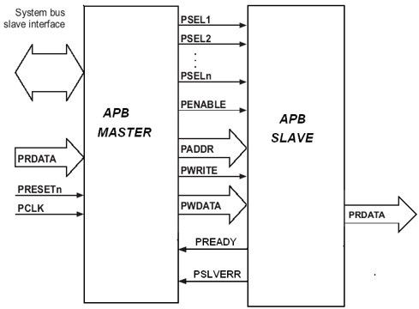
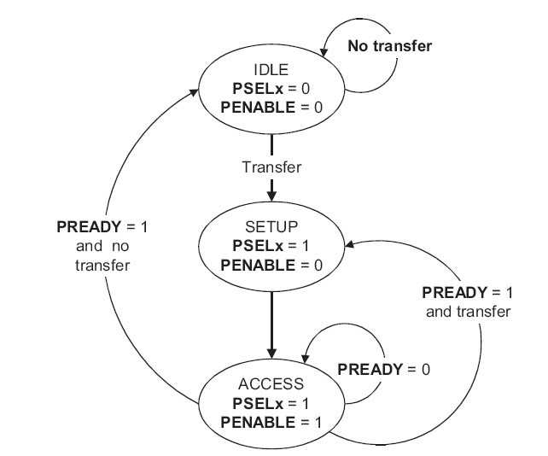
APB - Block Diagram
Fig 1 (a): Block Diagram
Fig 1 (b): FSM

Slide 6
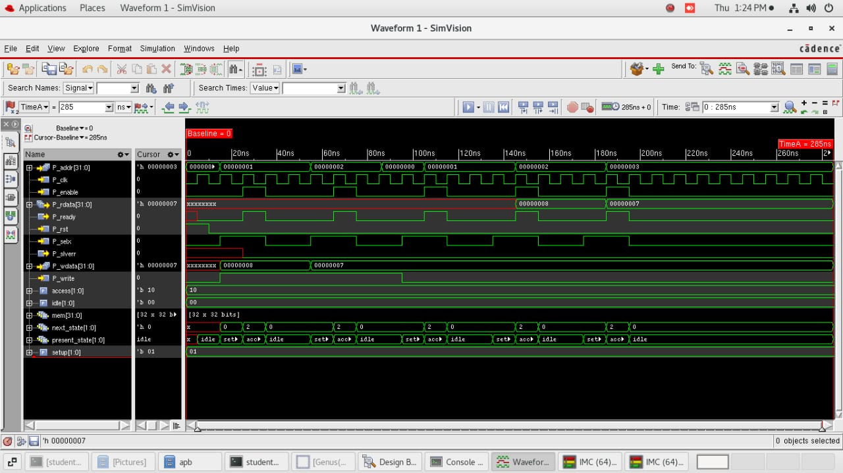
APB - Simulation
Fig 2: Simulation Result (Verilog)

Slide 7
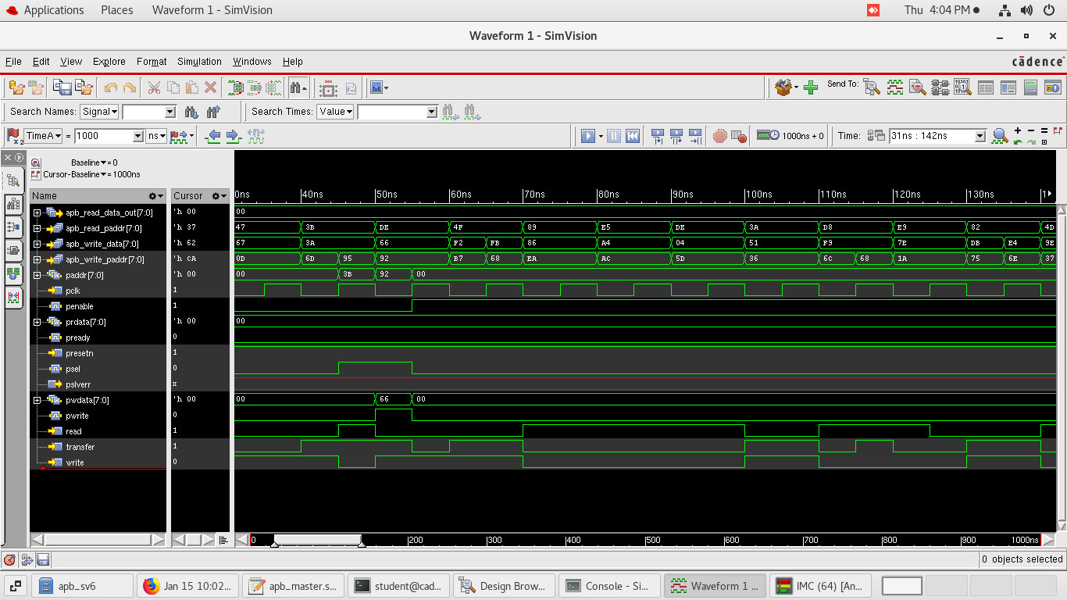
Fig 3: Simulation Result (SV)

Slide 8
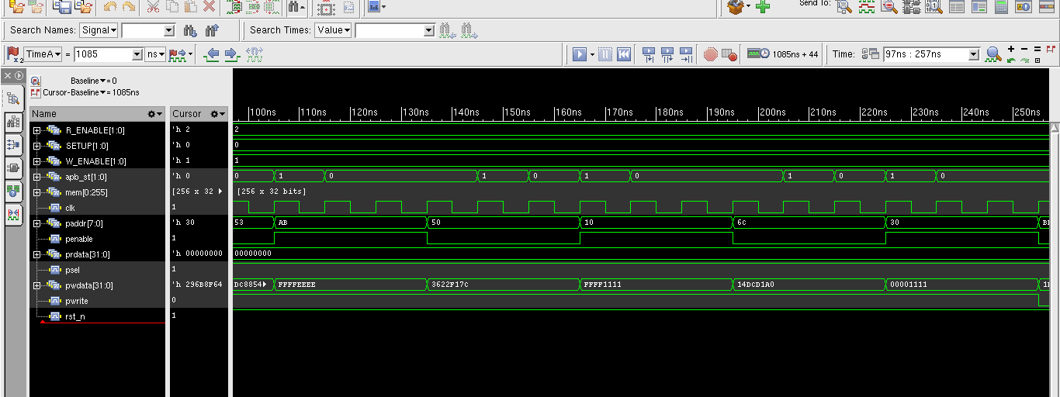
Fig 4: Simulation Result (UVM)

Slide 9
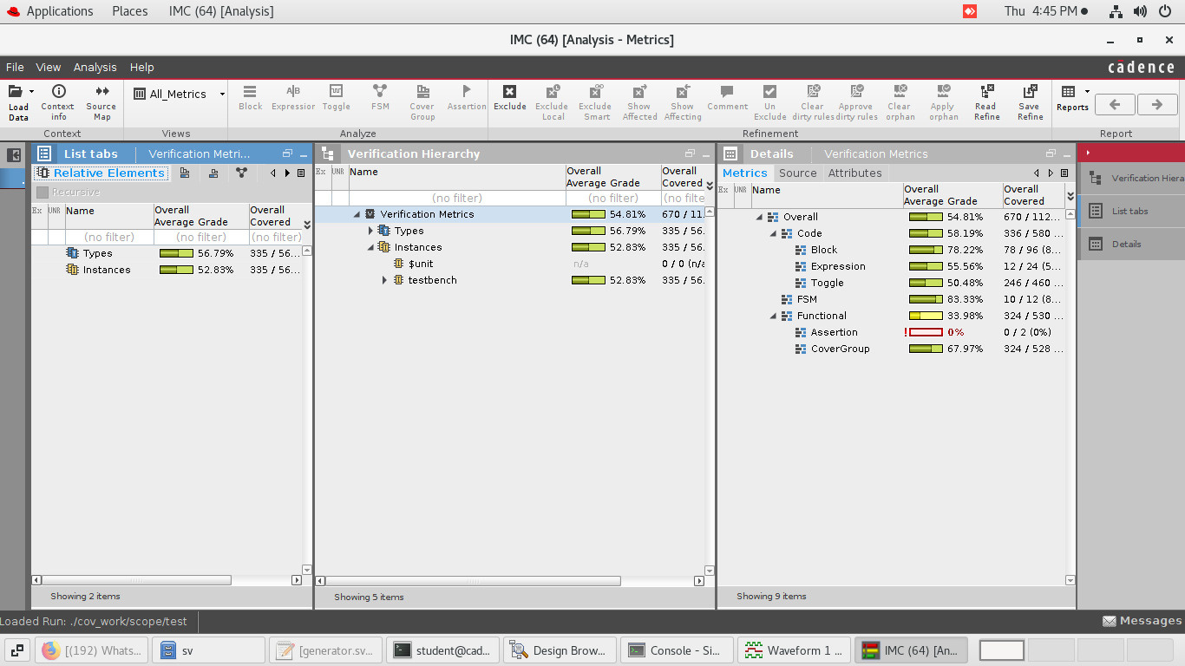
APB - Coverage Report
Fig 5: Coverage Report (SV)

Slide 10
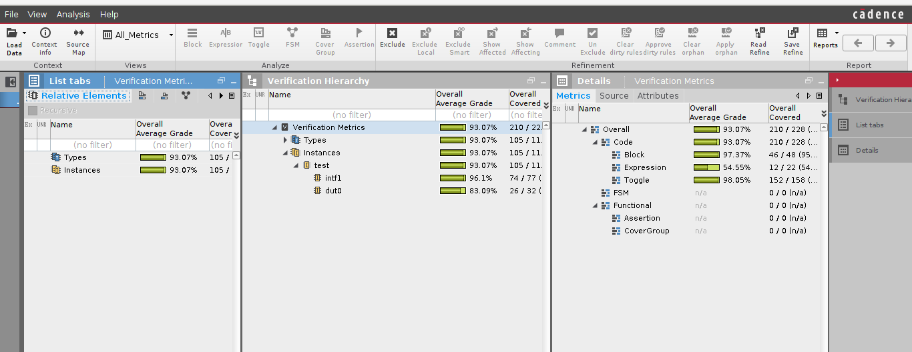
Fig 6: Coverage Report (UVM)

Slide 11
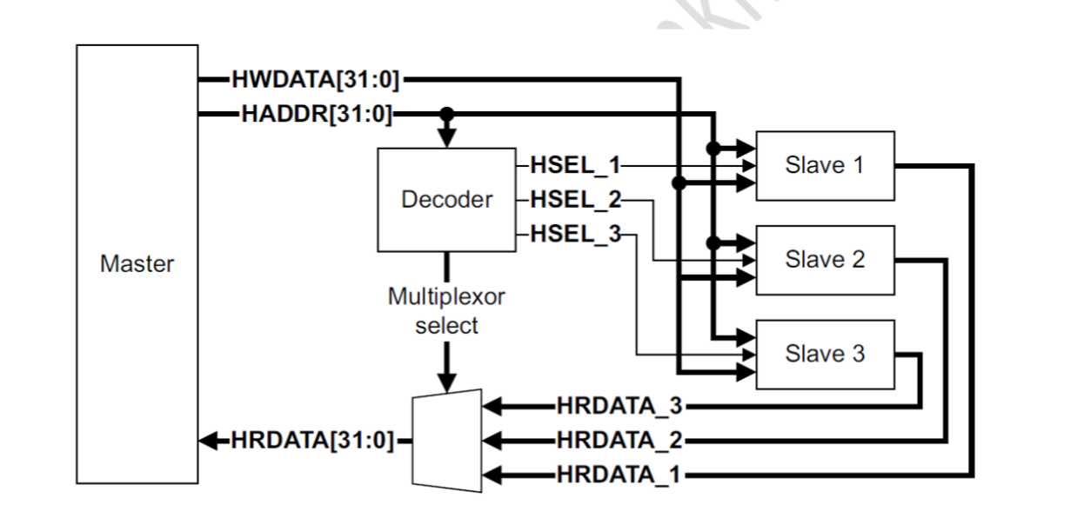
AHB - Block Diagram
Fig 7(a): AHB Block Diagram

Slide 12
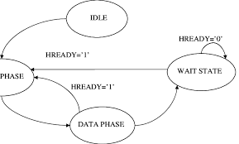
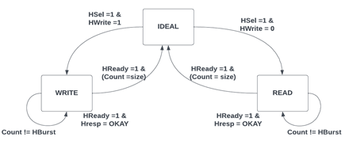
AHB - State Diagram
Fig 7(b): AHB master FSM
Fig 7(c): AHB slave FSM

Slide 13
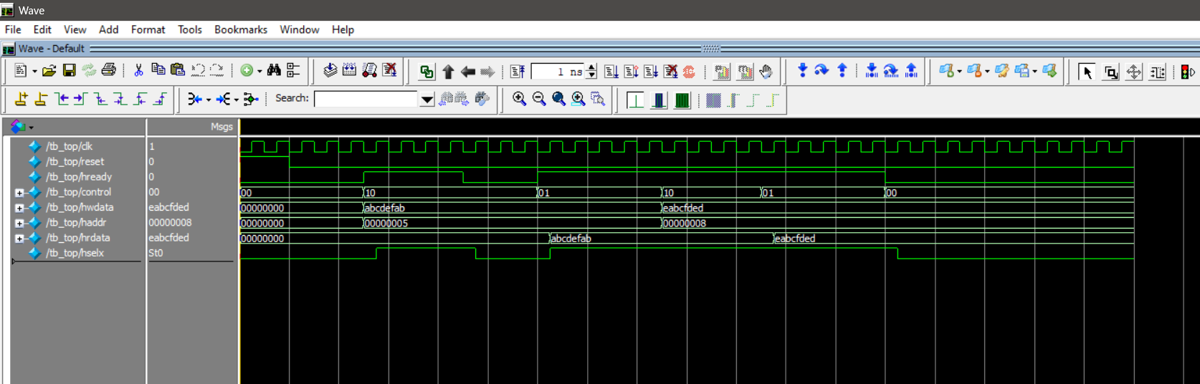
AHB - Simulation
Fig 8: Simulation Result (Verilog)

Slide 14
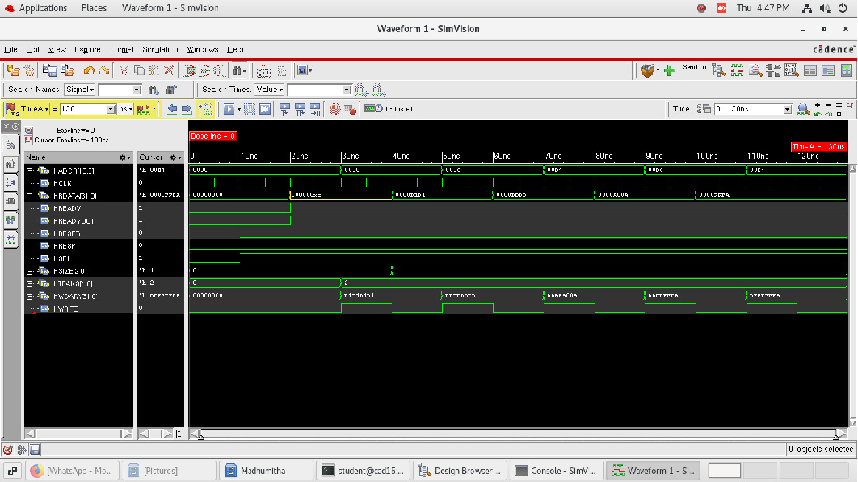
Fig 9: Simulation Result (SV)

Slide 15
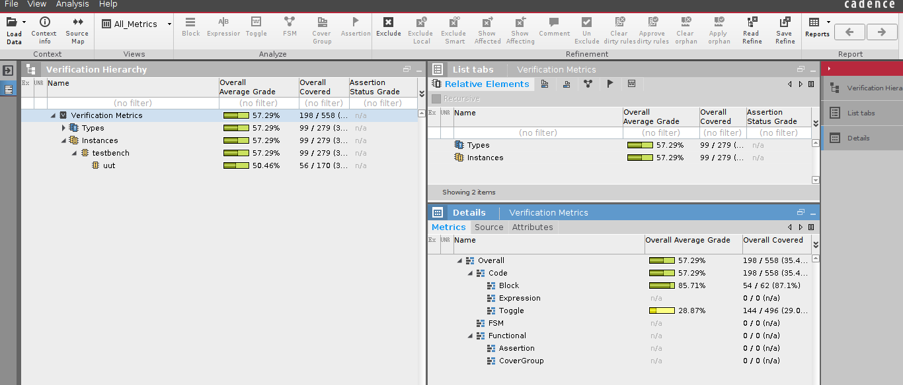
AHB - Coverage Report
Fig 11: Coverage Report (SV)

Slide 16
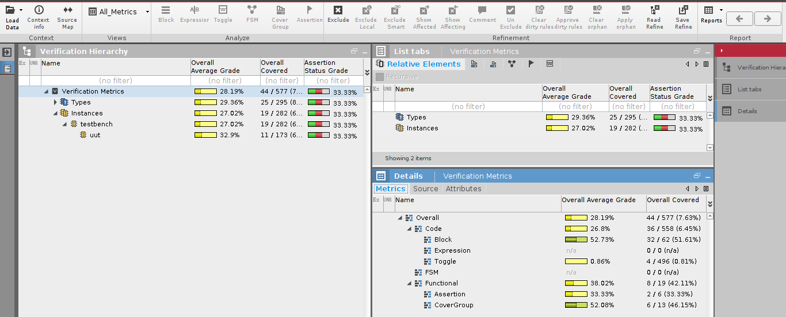
Fig 11: Coverage Report (UVM)

Slide 17
Conclusion
Summary of APB Verification
The functionality and reliability of the APB protocol were verified using Verilog.
Created testbenches to simulate various scenarios focusing on data transfer, and timing.
Simulations were conducted using Cadence tools on RedHat OS.
Results showed that the APB protocol met all specified requirements, ensuring accurate and efficient communication between the processor and peripheral devices.
The project enhanced understanding of APB protocol design, Verilog, and the importance of protocol testing.

Slide 18
Conclusion
Summary of AHB Verification
The high speed and high-bandwidth capabilities of the AHB protocol were validated using Verilog.
Test scenarios assessed burst transfers, split transactions, and arbitration, focusing on data integrity and timing.
Cadence tools on RedHat OS facilitated simulations.
Results confirmed that the AHB protocol effectively handled high-performance data transactions, maintaining reliable and efficient communication within the SoC architecture.
This work deepened knowledge of AHB protocols, advanced Verilog skills, and emphasized the value of performance testing in complex designs.

Slide 19
Future Works
AXI (Advanced eXtensible Interface): Focus on verifying burst transactions, Quality of Service (QoS) features, and handling multiple outstanding transactions.
CHI (Coherent Hub Interface): Investigate its use in cache-coherent interconnects for advanced ARM cores. Ensure efficient synchronization and communication between multiple processors.
AHB to APB Bridge: Ensure smooth and efficient data transfer between AHB and APB buses. Validate the bridge's capability to interface pipelined AHB transfers with non-pipelined APB operations.
AXI to APB Bridge: Verify seamless communication between high-performance AXI masters and low-power APB slaves.

Slide 20
References
L. Deeksha and B. R. Shivakumar, "Effective Design and Implementation of AMBA AHB Bus Protocol using Verilog," 2019 International Conference on Intelligent Sustainable Systems (ICISS), Palladam, India, 2019, pp. 1-5, doi: 10.1109/ISS1.2019.8907975.
E. Ravikumar, K. B. Ganesha, C. Y. Chethana and T. M. Parikshith Roy, "Design and Verification of Advanced Microcontroller Bus Architecture (AMBA) Advanced Peripheral Bus (APB) Protocol," 2024 International Conference on Smart Systems for applications in Electrical Sciences (ICSSES), Tumakuru, India, 2024, pp. 1-5, doi: 10.1109/ICSSES62373.2024.10561369.
https://www.allaboutcircuits.com/technical-articles/introduction-to-the-advanced-microcontroller-bus-architecture/
ARM, “AMBA Specification Overview”
ARM, “AMBA AHB Protocol Specification”

Slide 21
Thank You!

