Slide 1
Development of electrochemical treatment to remove the total dissolved solids from kaleesuwari refineries surface water
By
Nitheesh T.R. [160301065]
Vaithiyanathan P [160301105]
YeswanthKumar J [160301113]
Department of Chemical Engineering
Sri Venkateswara college of Engineering
Mentor
Dr. N. P. Kavitha
Department of Chemical Engineering
Sri Venkateswara college of Engineering

Slide 2
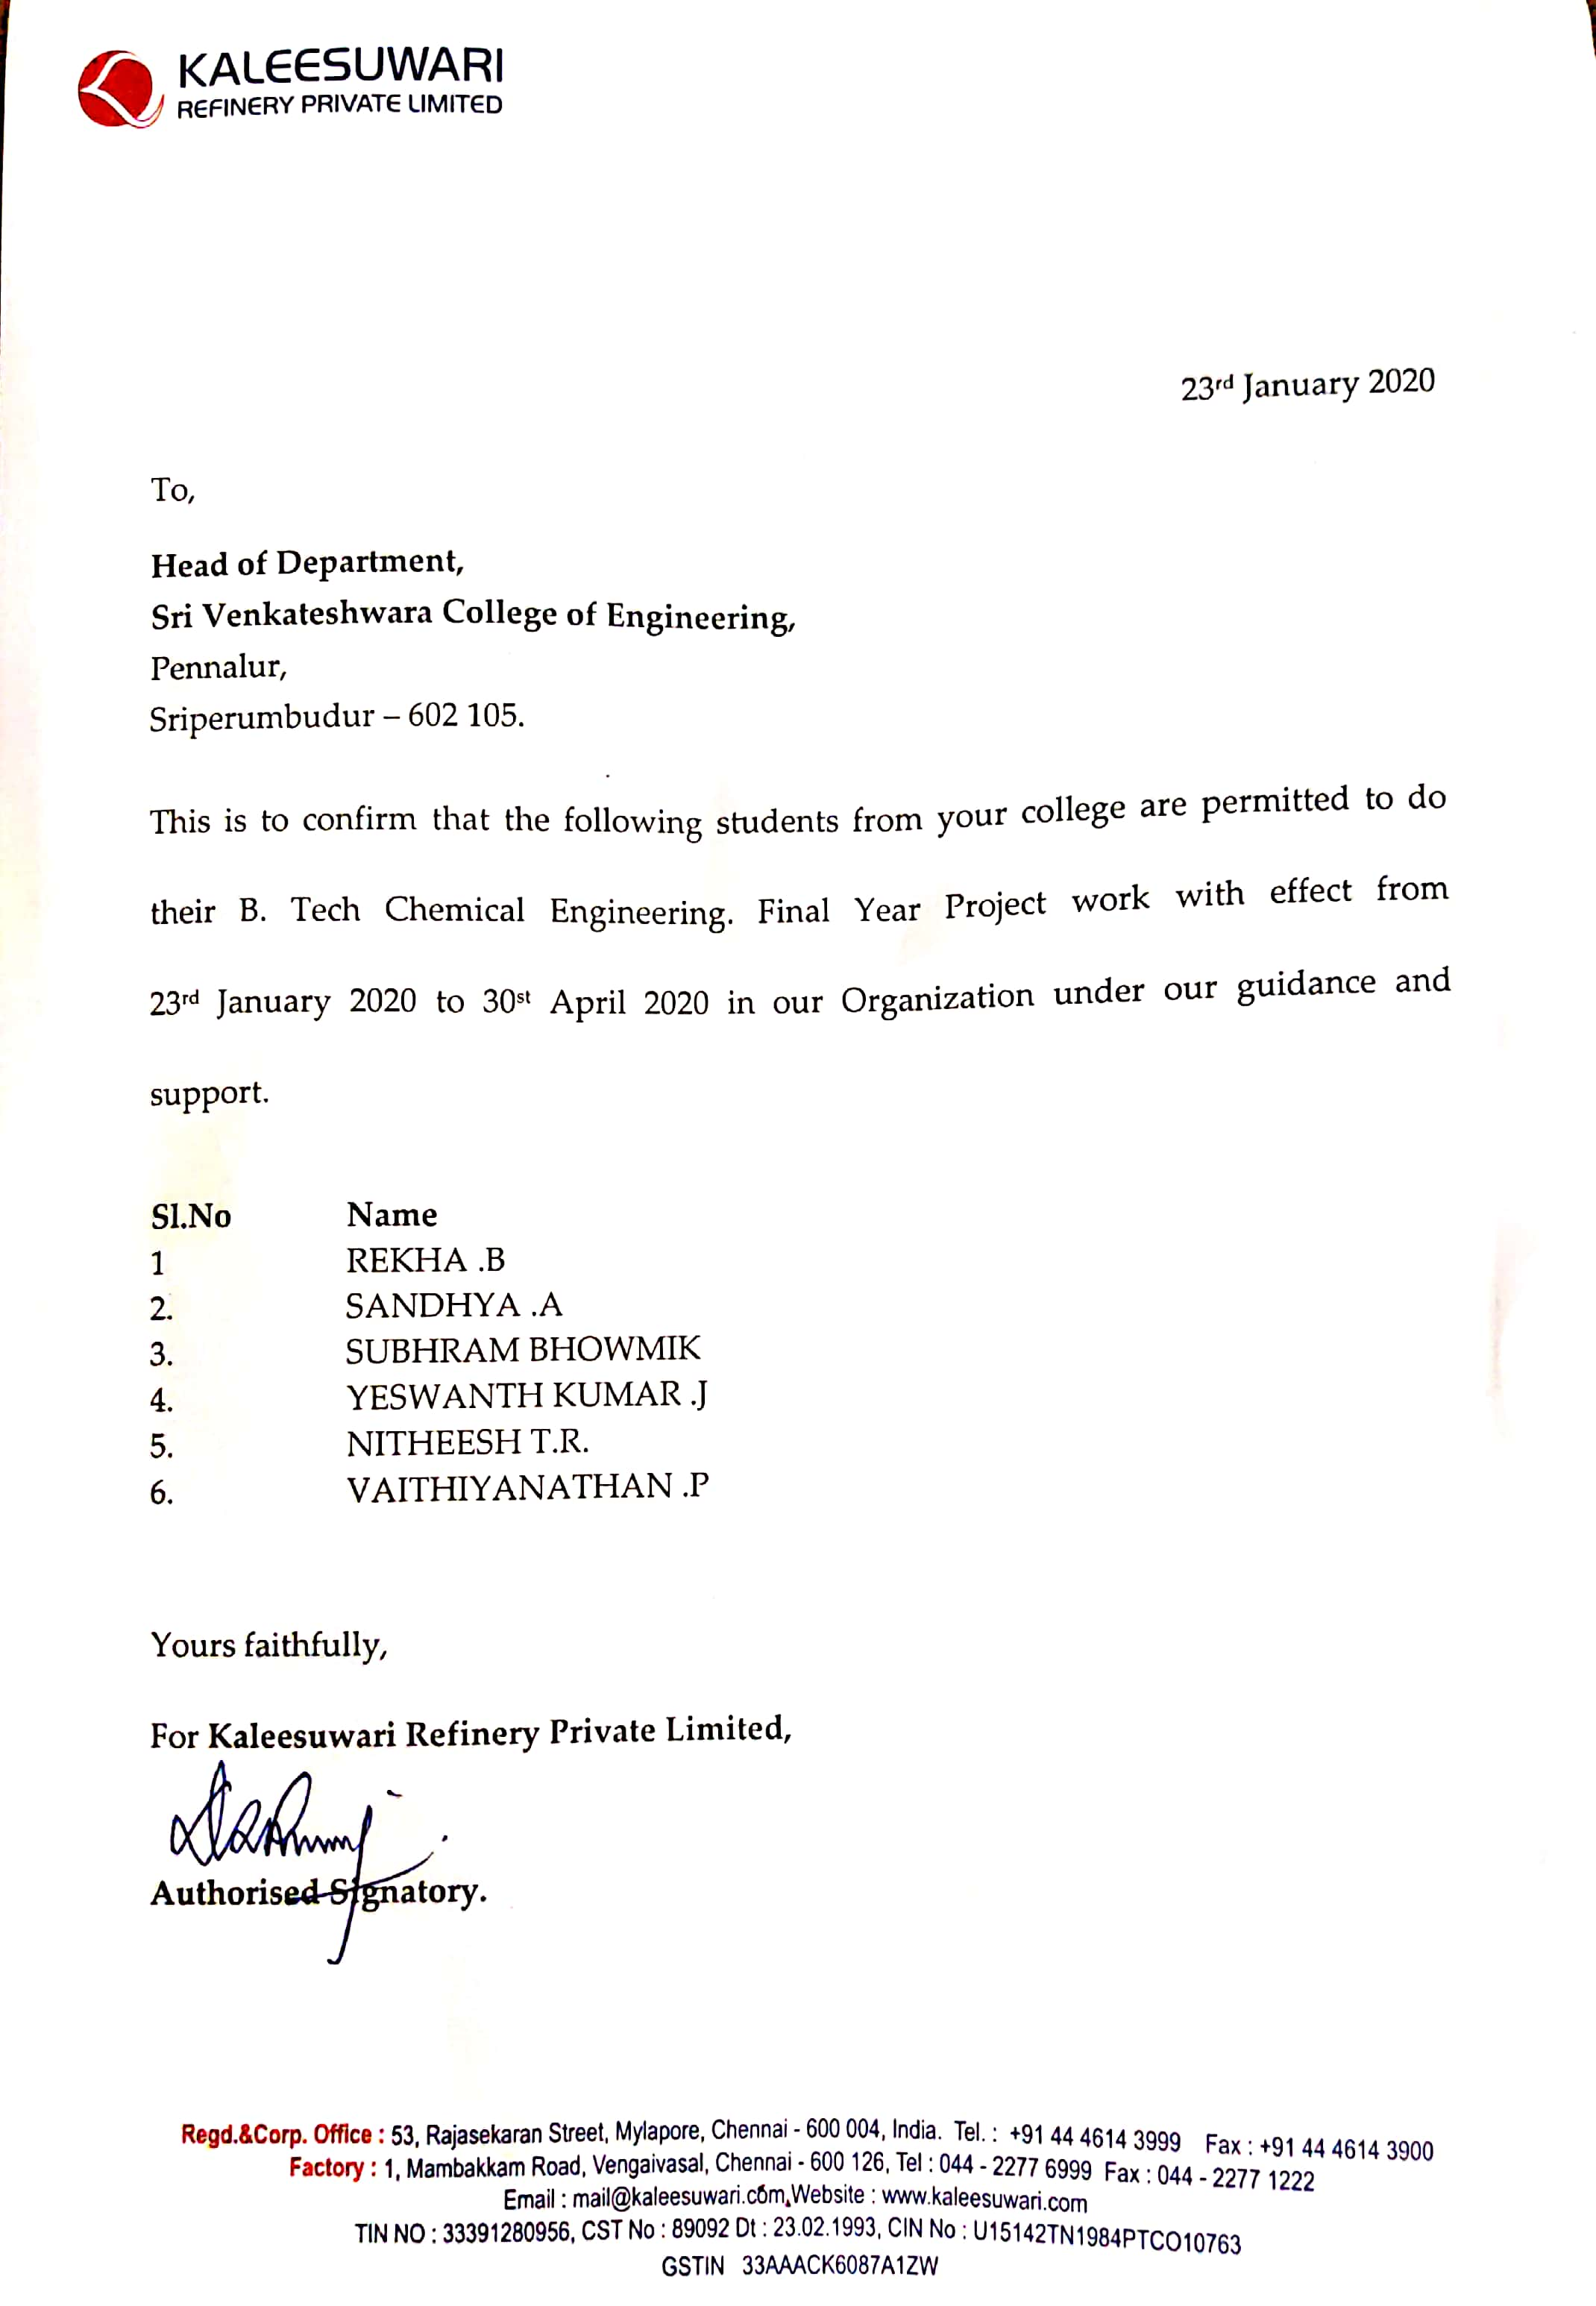

Slide 3
PROBLEM STATEMENT
KALEESUWARI REFINERIES LTD., currently uses multi-stage RO system to remove the dissolved solids from their surface water as it causes scale formation, staining in boilers and pipelines. They have planned to implement other techniques for further optimised system by reducing the number of stages without affecting the required water parameters to reduce the operating cost and energy consumption. We decided to carry out electrochemical pre-treatment process namely electrofenton, electrocoagulation, electro-oxidation, ozonation and suggest the best suitable method.

Slide 4
INTRODUCTION
Industrial electrochemistry has undergone development towards cleaner processes and more environmentally friendly products, which is one of the strategies for purification of water and waste water.
From the viewpoint of high efficiency and low resource consumption, electrochemical technologies can be used either as a pre-treatment step to increase the biodegradability of a pollutant or as an advanced treatment method further to reduce COD, TDS , color in the water to achieve relevant effluent standards.
Water quality is characterized by the presence of parameters such as TDS, TSS, COD, BOD.
High TDS level in water leads to adverse effects. Calcium and magnesium, two minerals commonly found in TDS, can cause water hardness, scale formation, and staining and leads to loss of efficiency in heat transfer and boiler equipments.
Thus our work is to reduce the TDS in the water used by KALEESUWARI REFINERIES.LTD, in order to avoid the fouling inside the pipelines ,boiler, heat exchangers in the plant.

Slide 5
LITERATURE SURVEY
TITLE & YEAR | AUTHOR | HIGHLIGHTS
Uses of Ozone in drinking water treatment – 1981. | Rice et al., | Eliminate wide variety of inorganic , organic and microbiological waste. Strong oxidizing power in short reaction time
Removal of arsenic from drinking water by Electrocoagulation using Fe and Al electrodes - 2010. | Kobya et al., | Efficiency of removal – 92% No need of chemicals Low operating and maintainence cost
Effect of Ruthenium oxide/Titanium anode on electro oxidation of pharmaceutical effluent – 2015. | Vahidhabanu et al., | Efficiency on removal – 80%
Efficacy of organic pollutant removal from pharmaceutical wastewater using rotating disc electrochemical reactor – 2018 | Kavitha et al., | Efficiency on removal – 95% Shorter operating time High removal efficiency compared to others

Slide 6
OBJECTIVE
The main objective is
To develop an electrochemical treatment method to remove the total dissolved solids and organic content from Kaleesuwari Refineries surface water.
The sub-objectives are
Optimisation of observed results of Electrofenton, Electro-oxidation and ozonation.

Slide 7
Kaleesuwari Refineries underground water
Electro-Oxidation
Electro-Fenton
Electrocoagulation
Ozonation
Optimized Parameters
1]Current density
2]pH
3]Time
Optimized parameters
Fe-H₂ O₂ratio
2]Current density
3]pH
4]Time
Optimized parameters
1]Comparison of electrodes Al & Fe
2]Current density
3]pH
4] Time
Optimized parametrs
1]Flowrate
2]Time
Water treatment analysis
1]COD
2]TDS
3]TSS
4]TOC
Electro-Oxidation
+
Ozonation
Electro-Fenton
+
ozonation
Electrocoagulation +
ozonation
Comparative & Feasibility studies
Project Report & Manuscript preparation

Slide 8
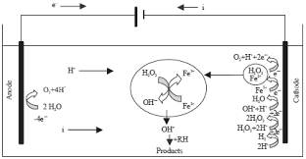
MECHANISM OF ELECTROFENTON
Electro-Fenton process is an emerging treatment technology for water and wastewater treatment.
The most general layout comprises two electrodes, operating as anode and cathode, connected to a power source.
Electro-Fenton utilizes hydroxyl radicals to oxidize hazardous contaminants and is especially useful to treat recalcitrant compounds that are not easily degraded in conventional water and wastewater treatment plants.
Fe²⁺ + H₂O₂ → Fe³⁺ + OH⁻ + HO
RH + HO. → R. + H₂O
Fig 1. Schematic representation of electrofenton mechanism

Slide 9
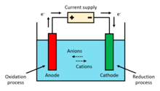
MECHANISM OF ELECTRO-OXIDATION
Electro-oxidation (EO), also known as anodic oxidation, is a technique used for wastewater treatment, mainly for industrial effluents, and is a type of advanced oxidation process (AOP).
The most general layout comprises two electrodes, operating as anode and cathode, connected to a power source.
When an energy input and sufficient supporting electrolyte are provided to the system, strong oxidizing species are formed, which interact with the contaminants and degrade them.
RuO_{x} – TiO_{x} + H₂O → RuO_{x} – TiO_{x}(OH) + H⁺ + e⁻
RuO_{x} – TiO_{x}(OH) + Cl⁻ → RuO_{x} – TiO_{x}(*OCl) + H⁺ + 2e⁻
Fig 3. Schematic representation of Electro-oxidation mechanism

Slide 10
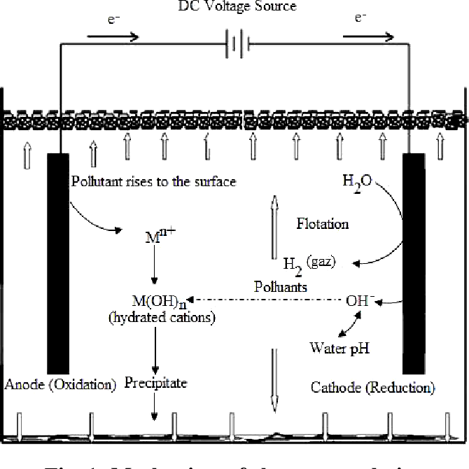
MECHANISM OF ELECTROCOAGULATION
The electrocoagulation process operates on the base of the principle that the cations produced electrochemically from iron and/or aluminum anodes, which is responsible for the increasing of the coagulation of contaminants from an aqueous medium.
These cations neutralize the negative charge of the particles moved towards the anodes by production of polyvalent cations from the oxidation of the sacrificial anodes (Fe and Al) and the electrolysis gases like Hydrogen evolved at the anode and oxygen evolved at the cathode.
Anode:
4Fe(s) → 4Fe +2(aq) + 8e
4Fe+2 (aq) + 10H₂O(l) + O₂(g) → 4Fe( OH)₃(s) + 8H + (aq)
Cathode:
8H+ (aq) + 8e → 4H₂(g)
Overall:
4Fe(s) + 10 H₂O(l) + O₂(g) → 4Fe(OH)₃(s) + 4H₂(g)
Fig 2. Schematic representation of Electrocoagulation mechanism

Slide 11
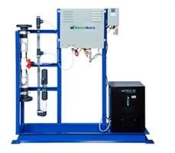
MECHANISM OF OZONATION
Ozone [O₃] has a greater disinfection effectiveness against bacteria and viruses compared to chlorination.
In addition, the oxidizing properties can also reduce the concentration of iron, manganese, sulfur and reduce or eliminate taste and odour problems.
Ozone oxides the iron, manganese, and sulfur in the water to form insoluble metal oxides or elemental sulfur.
These insoluble particles are then removed by post-filtration.
Fig 4. Schematic representation of Ozonation mechanism

Slide 12
INITIAL PARAMETERS ANALYSIS
Table 1. Initial parameters of the sample
SAMPLE | TDS [ppm] | TSS [ppm] | COD [ppm] | TS [ppm] | pH
Sample 1 | 2300 | 50 | 640 | 2350 | 7.5
Sample 2 | 2130 | 60 | 576 | 2190 | 7.3

Slide 13
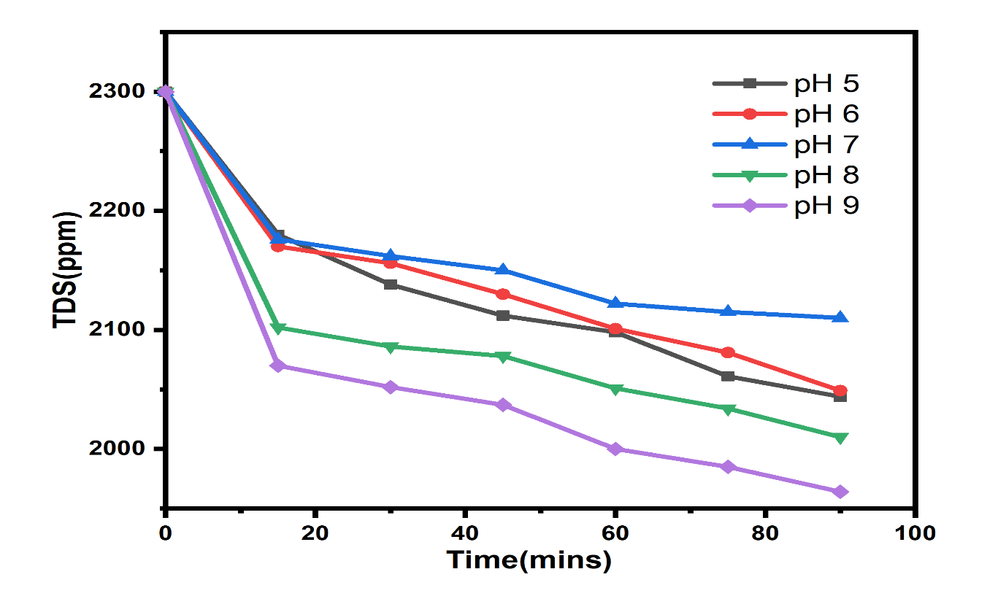
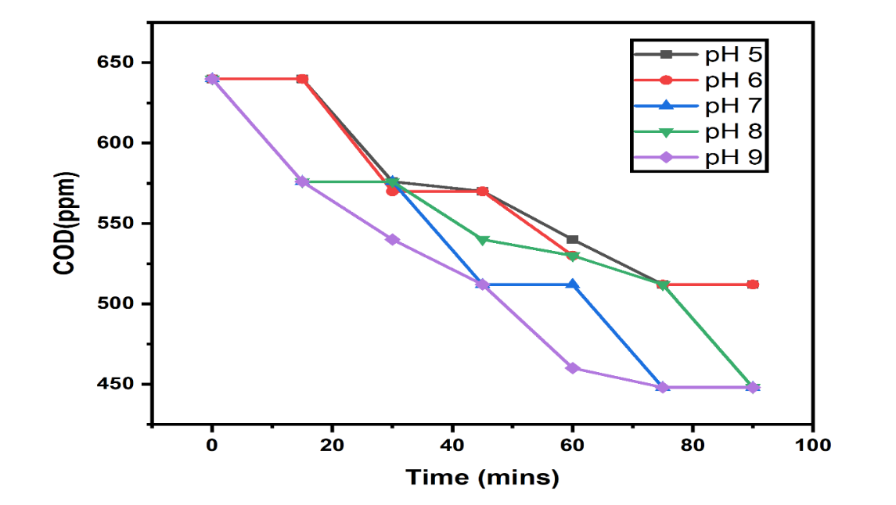
OZONATION – OPTIMIZED PARAMETERS
EFFECT OF pH IN OZONATION

Slide 14
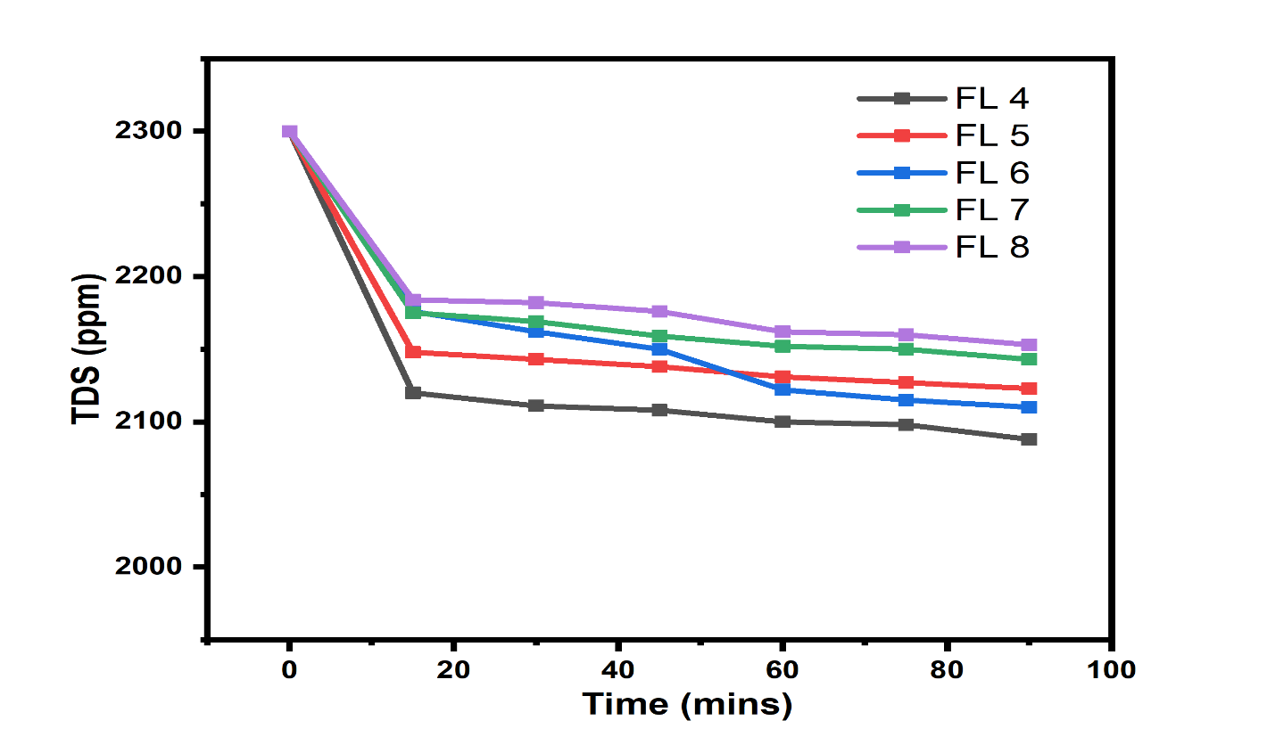
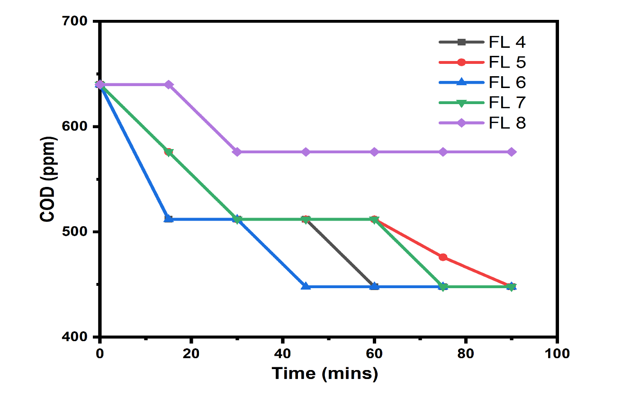
OZONATION – OPTIMIZED PARAMETERS
EFFECT OF FLOWRATE IN OZONATION

Slide 15
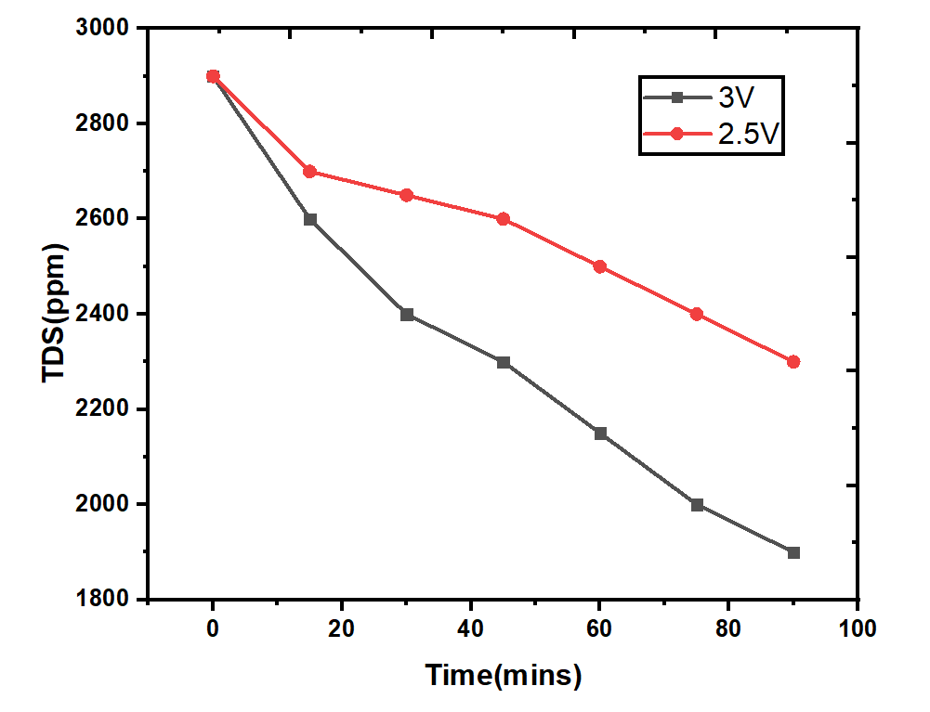
ELECTROFENTON - RESULTS EFFECT OF VOLTAGE ON TDS

Slide 16
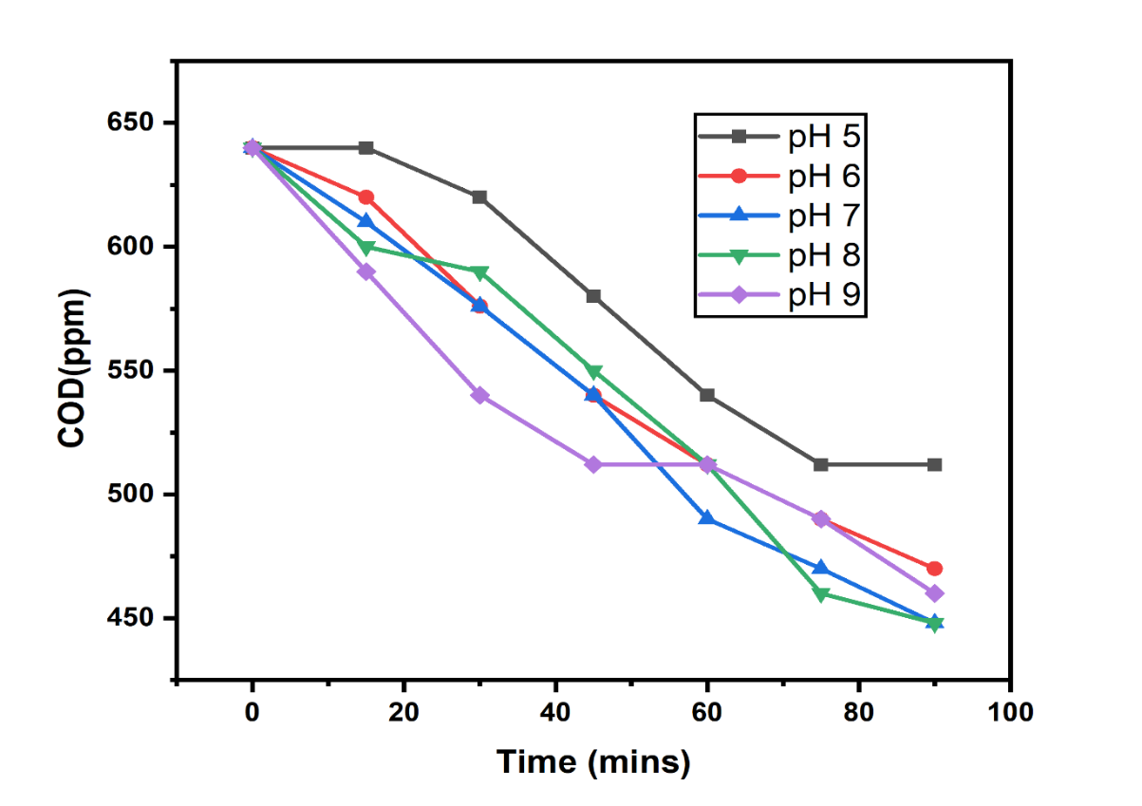
ELECTRO-OXIDATION – RESULTS EFFECT OF pH ON COD

Slide 17
CONCLUSION
SUMMARY
Three electrochemical treatments were done for the surface water of Kaleesuwari Refineries Limited and the results obtained were mentioned below
Ozonation-28.5% of COD reduction, 30% of TDS reduction
Electro-Fenton-35% of TDS reduction and
Electro-Oxidation-30.1% of COD removal, does not impact TDS much.
The removal efficiency obtained from the two electrochemical treatments for the surface water was around 30%.Ozonation process acts as a supporting process in removing the COD and TDS as its main purpose is to avoid the biofilm formation in the system. In future, if these electrochemical treatments were integrated with ozonation process, we could obtain high percentage of COD and TDS reduction.
SCOPE & FUTURE OF THE WORK
Developed a electrochemical treatment for Kaleesuwari Refineries Ltd., to remove TDS and COD from their surface water which was used for steam generation.
Various Electrochemical processes such as Adsorption, Electro Dialysis, Sand Filtration, Non Thermal Plasma process, Reverse Osmosis, Electro Coagulation and Membrane Technology could be adopted for the treatment of surface water which will increase the removal of total dissolved solids and total organic contents.

Slide 18
WORK TO BE DONE
Electro-oxidation
To determine the optimized current density , reaction time to obtain required removal efficiency.
Electrofenton, Electrocoagulation
To determine the optimized current density, pH ,reaction time to obtain required removal efficiency.
To carry out integrated process EO+O, EF+O and a comparative study among these methods.

Slide 19
REFERENCE
1] Kavitha Nagarasampatti Palani et al., Thanigaivel, Shanmugam Sundar, Balasubramanium – Efficacy of organic pollutant removal from pharmaceutical wastewater using rotating disc electrochemical reactor – 2018.
2] M.Kobya et al., F.Ulu, U.Gebologu – Removal of arsenic from drinking water by Electrocoagulation using Fe and Al electrodes – 2010.
3] Vagidhabanu S et al., Abilash Stephen Johnson, AnanthaKumar S, Ramesh Babu B – Effect of Ruthenium oxide/Titanium anode on electro oxidation of pharmaceutical effluent – 2015.
4] Rice et al., - Uses of Ozone in drinking water treatment – 1981
5] Yujie Feng et al.,Lisha yang - Electrochemical Technologies for Wastewater Treatment and Resource Reclamation – 2016.

Slide 20
THANK YOU

