Slide 1

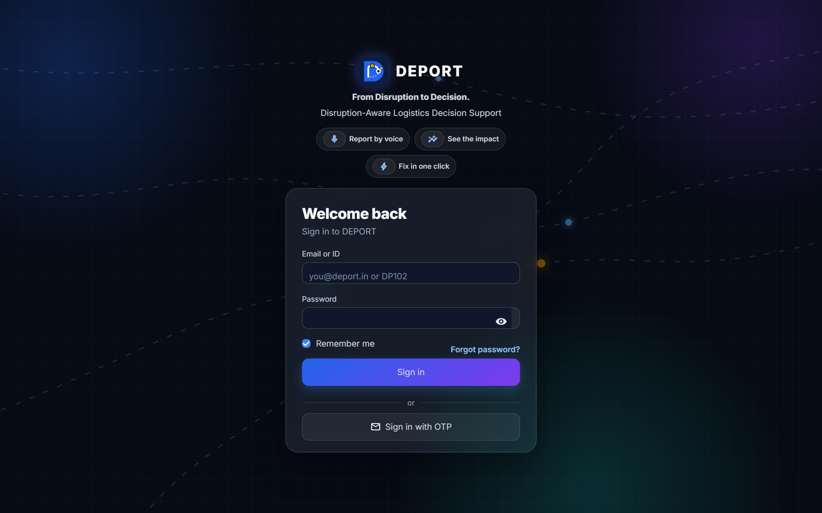
DEPORT
Disruption-Aware Logistics
Decision Support System
From Disruption to Decision.
🎙️ Report by voice
📊 See the impact
⚡ Fix in one click
HackNext'26 · Coimbatore Presented by: Inovix
Notes:
Good morning. We are presenting DEPORT – a Disruption-Aware Logistics Decision Support System for delivery companies in Coimbatore. Our promise is in the tagline: From Disruption to Decision. When something goes wrong on the road, DEPORT helps the team decide what to do in under a minute.

Slide 2
WHY THIS MATTERS
The problem
Deliveries break down on the road, and today the fix depends on phone calls.
🚧
📞
⏱️
One block, many late parcels
Information is stuck in calls
Decisions come too late
A single accident on a main road delays every delivery planned behind it on that route.
Drivers phone the office in Tamil or English. Nobody sees the full picture at once.
By the time someone works out a plan, the medicine or the milk is already late.
REAL EXAMPLE FROM OUR DEMO
1 accident on Avinashi Road → 9 deliveries hit → 3 deadlines missed (one is hospital insulin)
DEPORT · Disruption-Aware Logistics Decision Support
2 / 17
Notes:
Here is the problem in simple words. One accident on a main road like Avinashi Road does not delay just one parcel – it delays every stop planned after it. The driver calls the office, the dispatcher tries to work out where it is and which parcels are affected, and by the time a plan is ready, important deliveries like hospital insulin are already late. In our demo one accident hits 9 deliveries and 3 would miss their deadline.

Slide 3
OUR SOLUTION
DEPORT in one line
“DEPORT turns a driver's voice note into a ready-to-approve recovery plan — in under a minute.”
1
Report by voice
2
See the impact
3
Fix in one click
● Tap a tile, speak or type
● Tamil, English or both
● Spelling mistakes are fine
● Which deliveries will be late
● By how many minutes
● Risk: Critical · High · Medium · Low
● AI plan: backup van, reroute, notify
● Admin taps Accept
● Everyone is updated at once
DEPORT · Disruption-Aware Logistics Decision Support
3 / 17
Notes:
DEPORT turns a driver's voice note into a ready-to-approve recovery plan in under a minute. It works in three steps. One: the partner reports by voice or one tap, in Tamil, English or both – even with spelling mistakes. Two: DEPORT shows the impact – which deliveries will be late, by how much, and how risky each one is. Three: the AI suggests a plan, the branch admin taps Accept, and every screen and phone is updated together.

Slide 4
WHO USES DEPORT
Three users, three simple screens
🛡️
Super Admin
🧭
Branch Admin
🛵
Delivery Partner
Laptop · hidden /console page
Laptop · normal sign-in
Phone · big buttons
SEES
SEES
SEES
All branches – summary only
Only their own branch
Only their own deliveries
DOES
DOES
DOES
● Creates branches and branch admins
● Switches accounts on / off
● Reads the audit log
● Reviews alerts, accepts AI plans
● Watches the live map
● Assigns new work to partners
● Reports problems by voice
● Accept → Picked up → Start → Delivered
● Gets 'Route changed' instantly
🔒 One sign-in page, own screens per role – checked in the server code, not just hidden buttons.
DEPORT · Disruption-Aware Logistics Decision Support
4 / 17
Notes:
DEPORT has three kinds of users. The Super Admin manages the company: branches, branch admins and the audit log, and sees all branches only as summaries. The Branch Admin runs one branch: alerts, the live map and work assignment – and can never see another branch. The Delivery Partner uses a phone app with big buttons and sees only their own deliveries. The role comes from the account, and the rules are enforced in the server code.

Slide 5
HOW IT WORKS
From a voice note to an updated route – 8 simple steps
1
Voice / text
2
Speech to text
3
Understand
4
Ripple Impact
Partner taps a tile, speaks or types
Whisper or free Google speech; Tamil + English
What happened, which road, how long – typos OK
Which stops come after the block and how late
5
Risk score
6
Recovery plan
7
Admin approves
8
Everyone updated
0–100 from deadline, priority, closeness, severity
Backup van, reroute, prioritise or notify – with reasons
One tap: Accept, Modify or Reject
Routes, ETAs, map, phones, customer SMS – in one save
AI suggests, a person decides – nothing changes until the admin taps Accept.
DEPORT · Disruption-Aware Logistics Decision Support
5 / 17
Notes:
This is the full journey. The partner reports by voice, text or one tap. Speech becomes text with Whisper or free Google speech. DEPORT understands what happened, on which road and for how long – it handles Tamil, English and spelling mistakes. Then the Ripple Impact finds every stop that comes after the block on each route and how late it gets. Each delivery gets a risk score from 0 to 100. The recommender builds a plan – backup van, reroute, prioritise or notify – with short reasons. A person always decides: only when the admin taps Accept do routes, ETAs, the map, partner phones and customer messages update, all in one save.

Slide 6
LIVE DEMO STORY
One accident, fixed in one click
THE SCENARIO
Missed deadlines
Average delay per delivery
9:00 AM, Coimbatore East. Karthik (DP102) records:
“avinasi rd la accident, full block, rendu mani neram aagum”
DEPORT understood: Accident · Avinashi Road · ~2 hours · critical
The plan: insulin + milk move to backup van V6; 3 vehicles reroute via Peelamedu–Hope College; other customers get a new ETA by SMS.
Admin taps Accept → done.
3 → 0
+95 → +17
after the plan
minutes late, on average
Critical deliveries at risk
Hospital insulin (KMCH)
3 → 0
10:44
no critical stop left
delivered · deadline 11:30
DEPORT · Disruption-Aware Logistics Decision Support
6 / 17
Notes:
This is our live demo. At 9 AM Karthik records a voice note mixing Tamil and English, with a spelling mistake in Avinashi. DEPORT understands: an accident on Avinashi Road, about two hours, critical. The plan moves the insulin and milk to the backup van, reroutes three vehicles around the block, and sends other customers a new time. Results: missed deadlines go from 3 to 0, the average delay drops from 95 to 17 minutes, and the hospital insulin arrives at 10:44 – before its 11:30 deadline.

Slide 7
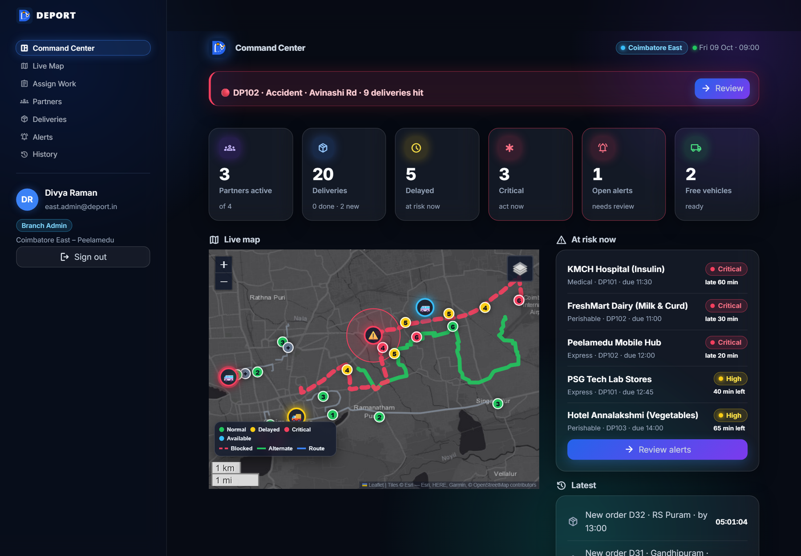
BRANCH ADMIN · LAPTOP
Command Center – everything urgent on one screen
1
Alert banner
Only when something is wrong: who, what, where and how many deliveries are hit.
2
Six live numbers
Active partners, deliveries, delayed, critical, open alerts, free vehicles.
3
Live map
Every vehicle and stop on real Coimbatore roads, coloured by status.
4
At risk now
The five most urgent deliveries, worst first – with how late they will be.
DEPORT · Disruption-Aware Logistics Decision Support
7 / 17
Notes:
This is the branch admin's Command Center. At the top, a red banner appears only when there is an open alert – here: DP102, accident, Avinashi Road, 9 deliveries hit. Below are six live numbers, then the live map and the list of the most urgent deliveries. The page refreshes by itself within four seconds when anything changes on another device.

Slide 8
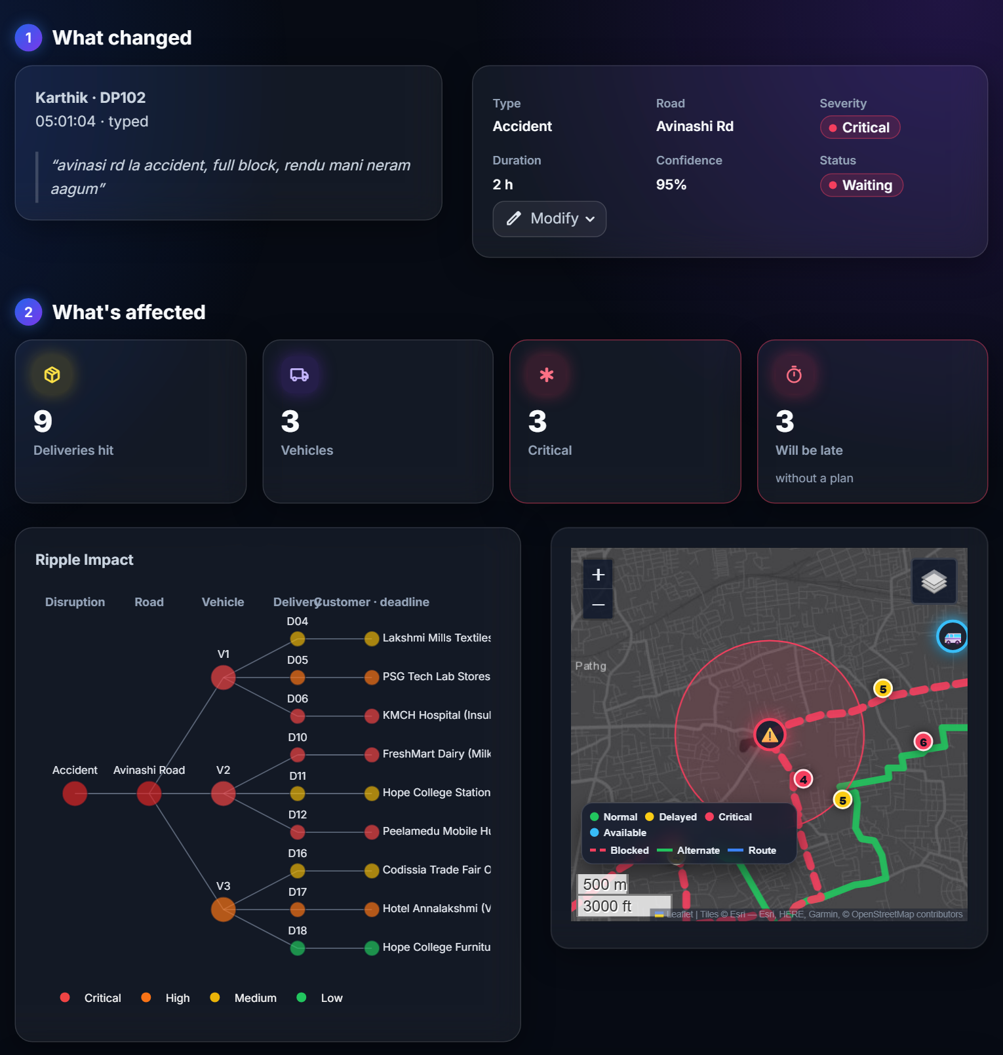
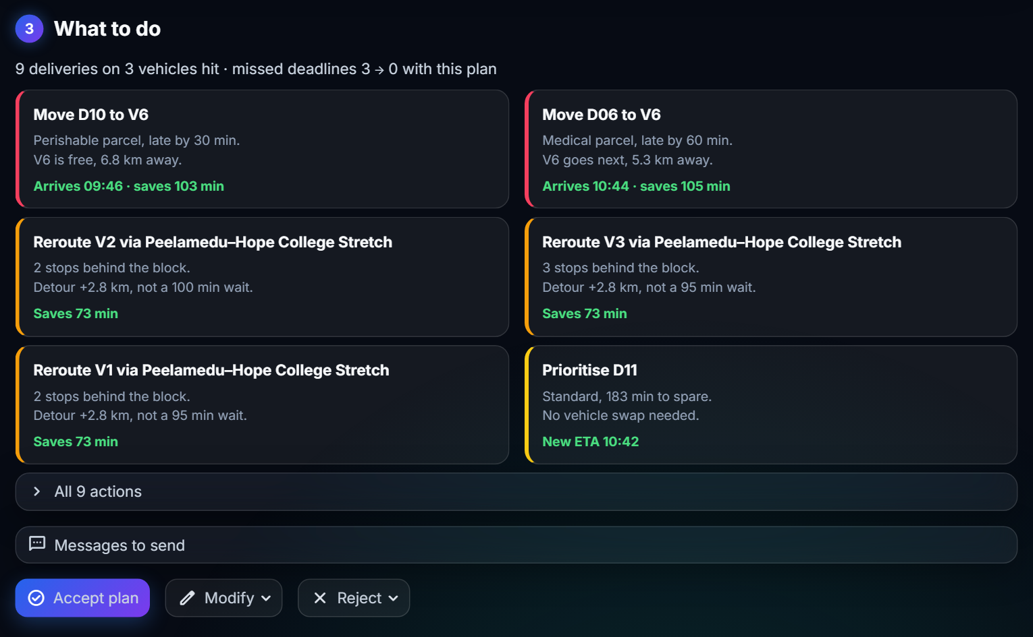
BRANCH ADMIN · ALERTS
Alerts in 3 simple steps
① What changed → ② What's affected → ③ What to do (Accept plan)
Every action has a 2-line reason with numbers, e.g. “Medical parcel, late by 60 min. V6 is free, 5.3 km away.”
DEPORT · Disruption-Aware Logistics Decision Support
8 / 17
Notes:
The Alerts page follows three numbered steps. Step one: what changed – the partner's own words and what the AI understood, with a Modify button if it got something wrong. Step two: what is affected – the Ripple Impact graph shows how one accident spreads to vehicles and customers, next to a mini map. Step three: what to do – each action has a short, number-based reason, for example 'Medical parcel, late by 60 minutes. V6 is free, 5.3 km away.' One tap on Accept plan applies everything.

Slide 9
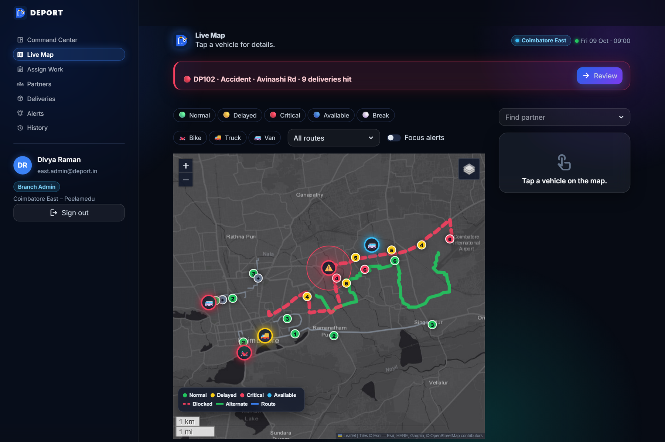
BRANCH ADMIN · LIVE MAP
A real map of Coimbatore – status at a glance
Green ring – partner on time
Yellow ring – delayed
Red ring (pulsing) – critical – needs action
Blue ring – free / backup vehicle
Red dashed road + circle – blocked road and affected area
Green line – suggested alternate route
Numbered pins – stop order, coloured by risk
Tap a vehicle for its route, stops, ETA and Call. Real road shapes, cached – works offline.
DEPORT · Disruption-Aware Logistics Decision Support
9 / 17
Notes:
The live map uses real road shapes of Coimbatore. Each vehicle is a circle with a coloured ring: green on time, yellow delayed, red critical – red ones pulse – and blue for free or backup vehicles. The blocked road is red and dashed with the affected area, the green line is the suggested alternate route, and numbered pins show the stop order. Tap a vehicle to see the partner's details. Road shapes were fetched once from OSRM and are cached, so the demo never waits for the internet.

Slide 10
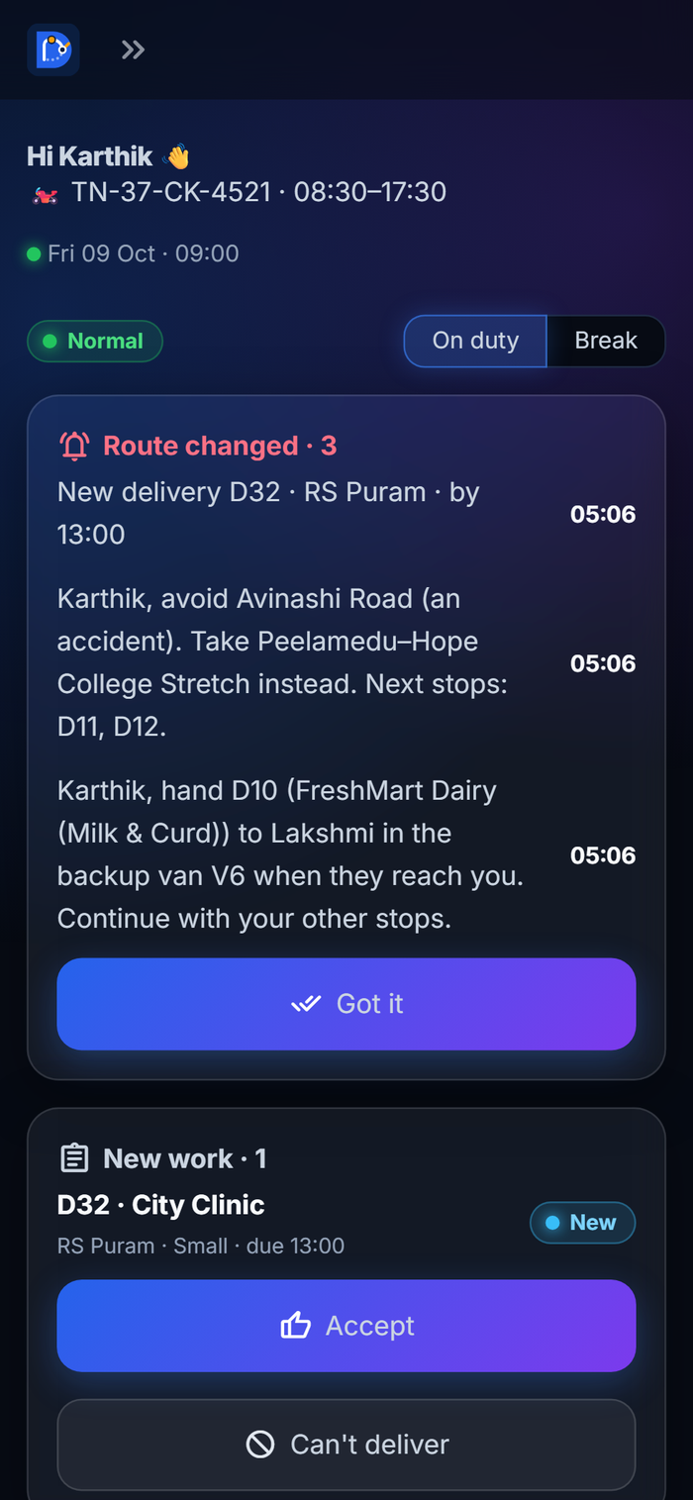
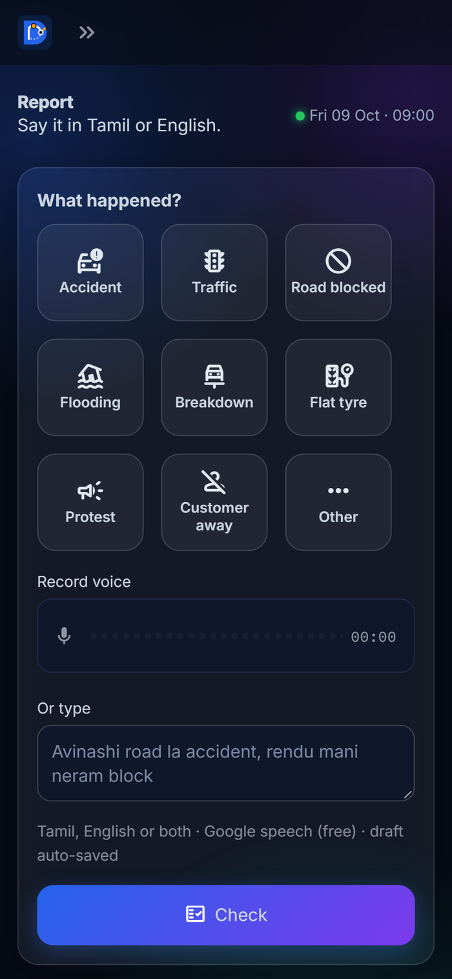
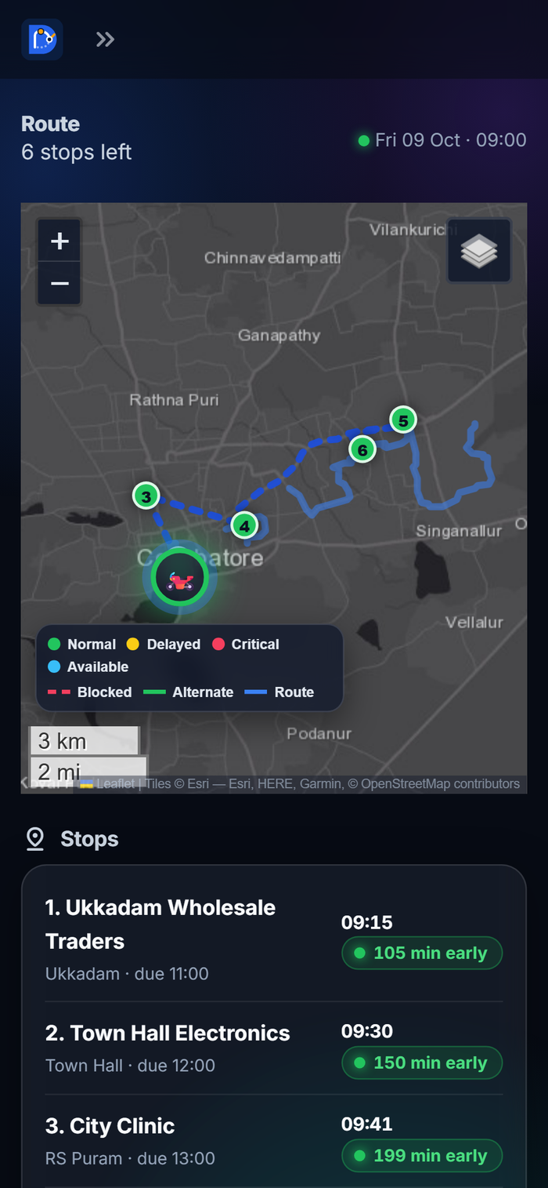
DELIVERY PARTNER · PHONE
A phone app built for one thumb
🟢
Big buttons
52 px tall, one hand, bright on a dark screen
🎙️
Speak naturally
Tamil, English or both; typos understood
✅
Step by step
Accept → Picked up → Start → Delivered (no skipping)
🔔
Route changed
Instructions arrive the moment the admin accepts
🚫
Can't deliver
Opens Report already filled in
💾
Never loses work
Half-typed reports and voice notes are saved
Today: route changed + new work
Report: 9 tiles, voice or text
Route: own map and stops
DEPORT · Disruption-Aware Logistics Decision Support
10 / 17
Notes:
This is the partner's phone. Today shows 'Route changed' messages and new work with an Accept button, then the next stop with Navigate, Call and Delivered. Report has nine big tiles – accident, traffic, flooding and so on – plus voice or text. Route shows only the partner's own map and stops. Steps can't be skipped, 'Can't deliver' opens a pre-filled report, and half-written reports are saved even if the app is closed.

Slide 11
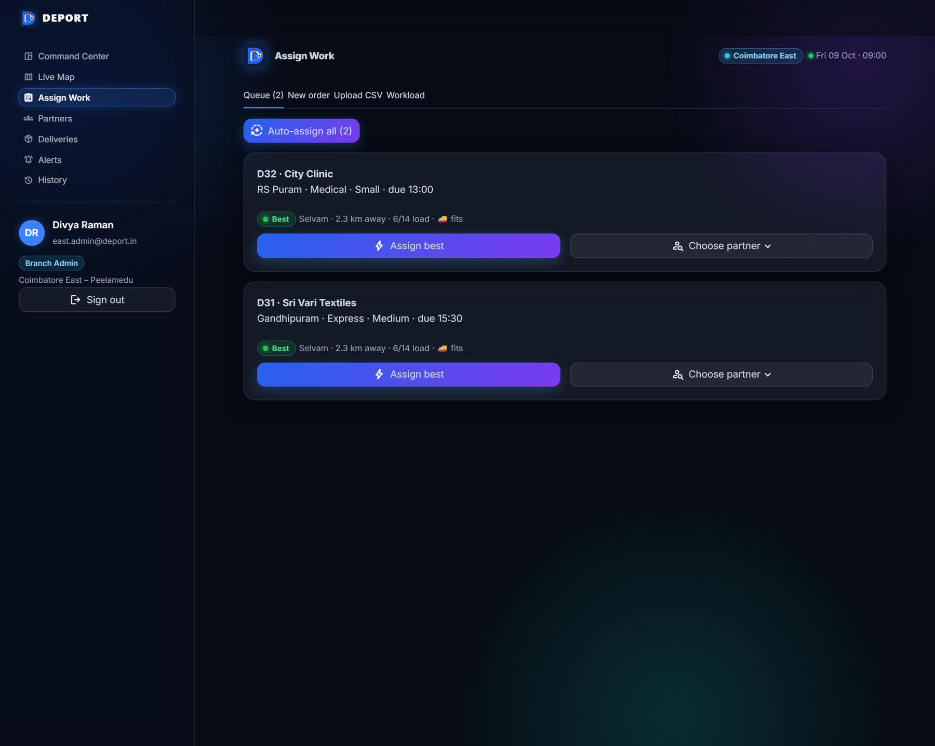
NEW IN V3 · WORK ASSIGNMENT
Who should take the new order?
📍
Distance – from the partner's position or next stops
📦
Load – stops vs. capacity (bike 8 · car 10 · van 12 · truck 14)
🚚
Vehicle fits – bike = small parcels only; large needs a van or truck
🚫
Not busy – skips partners with an alert, on break or off
🛣️
Same route – bonus when the order is on their route
⏰
Deadline – must still arrive in time
Best Karthik · 0.4 km away · 6/8 load · 🏍️ fits
New
›
Accept
›
Picked up
›
Start
›
Delivered
DEPORT · Disruption-Aware Logistics Decision Support
11 / 17
Notes:
Version 3 adds work assignment. The branch admin creates an order – the area can be typed with mistakes and DEPORT shows the matched place on a map – or uploads a CSV. For each order DEPORT suggests the best partner and explains why: distance, current load against capacity, whether the vehicle fits the parcel – a bike only takes small parcels – whether the partner is free, a same-route bonus, and whether the deadline can still be met. Auto-assign does all orders at once without overloading anyone. The partner then steps through Accept, Picked up, Start and Delivered.

Slide 12
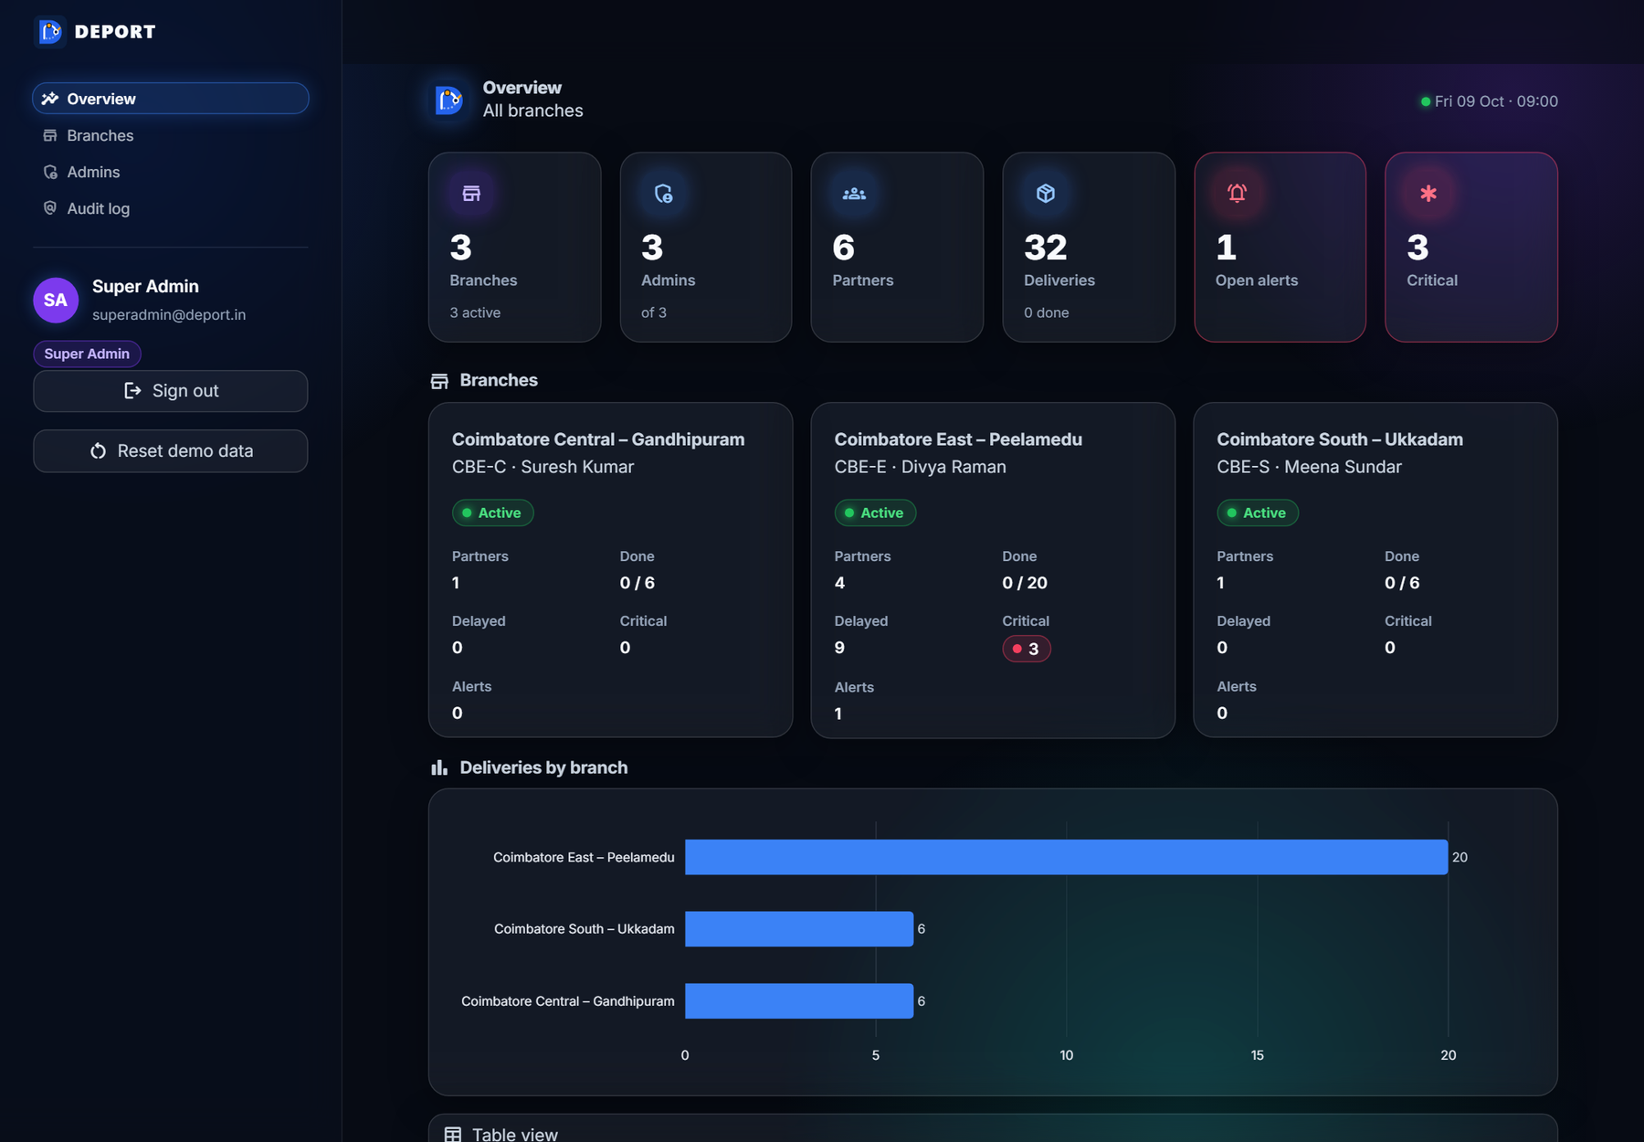
SUPER ADMIN · SECURITY
Safe by design
🔐
Passwords
PBKDF2-SHA256, 200,000 rounds, unique salt
🎟️
Sessions
random token, only its hash is stored; sign-out revokes it
🚦
Lockout
5 wrong tries → wait 2 minutes
🏢
Branch walls
admins see only their branch – checked in server code
📜
Audit log
every sign-in and admin action is recorded
💾
No data loss
one database file, backup before any reset, drafts saved
Super Admin overview: every branch at a glance (summary only).
DEPORT · Disruption-Aware Logistics Decision Support
12 / 17
Notes:
Security was designed in from the start. Passwords are stored only as PBKDF2 hashes with 200,000 rounds. Sessions use random tokens, and the database keeps only their hash. Five wrong passwords lock the account for two minutes. Branch admins can only see their own branch, and that is checked in the server code, not just hidden in the screen. Every sign-in and admin action is in the audit log, and data is never lost: one database file, a backup before any reset, and drafts saved automatically.

Slide 13
TECHNOLOGY
Built with simple, reliable tools
🐍
🗄️
🎙️
🔎
Python + Streamlit
SQLite (WAL)
Whisper + LLM (Groq)
RapidFuzz
Web app for laptop and phone
One database file, safe writes
Voice to text and smarter understanding
Finds places even with typos
🗺️
📈
⚙️
✅
Folium + OSRM
Plotly + NetworkX
FastAPI
Pytest
Maps on real roads, cached
Ripple Impact graph and charts
REST API ready for a native app
150 automated tests
No AI key? It still works: rule-based understanding + free speech recognition.
DEPORT · Disruption-Aware Logistics Decision Support
13 / 17
Notes:
We kept the technology simple and reliable. Python and Streamlit for the web app, SQLite as a single database file, Whisper and a language model from Groq for voice and understanding, RapidFuzz to match misspelt places, Folium with OSRM road shapes for the map, Plotly and NetworkX for the graphs, FastAPI for a future mobile app, and Pytest with 150 automated tests. Even without any AI key, DEPORT keeps working with rules and free speech recognition.

Slide 14
QUALITY
Tested like a product, not a demo
150
3 × all
1
0
automated tests
roles × pages clicked
transaction per plan
data lost
parsing, impact, risk, roles, API, persistence, assignment
a script presses every button for every role
deliveries, routes, messages saved all-or-nothing
sign-out and restarts keep everything; reset makes a backup
WHAT THE TESTS PROVE
✓ Voice notes with spelling mistakes are understood (avinasi rd → Avinashi Road)
✓ A branch admin can never open or change another branch's data
✓ A partner can't act on someone else's delivery or skip a step
✓ Restarting the app keeps every order, report, draft and setting
DEPORT · Disruption-Aware Logistics Decision Support
14 / 17
Notes:
We tested DEPORT like a real product. There are 150 automated tests covering voice understanding, the impact and risk engine, roles and security, the API, persistence and work assignment. A script also signs in as each role and presses every button on every page. Accepting a plan is a single database transaction, so it either fully happens or not at all. And data is never lost on sign-out or restart.

Slide 15
IMPACT
Who benefits, and how
🧑‍⚕️
🛵
🧭
🏢
Customers
Partners
Branch admins
Business
● Medicine and food arrive on time
● Get a new time by SMS before they wait
● No long phone calls – just speak
● Clear next step and route changes
● Decision in under a minute
● One screen for alerts, map and work
● Fewer missed deadlines
● Better use of backup vans; many branches
In our demo: 3 missed deadlines → 0, and the average delay falls from 95 to 17 minutes.
DEPORT · Disruption-Aware Logistics Decision Support
15 / 17
Notes:
Everyone benefits. Customers get medicine and food on time, and a message before they start waiting. Partners don't need long calls – they just speak, and they always know the next step. Branch admins decide in under a minute from one screen. The business misses fewer deadlines and uses its backup vans better, across many branches. In our demo, missed deadlines fall from three to zero.

Slide 16
WHAT'S NEXT
Future scope
NEXT
THEN
LATER
● Live traffic and weather feeds
● Send real SMS / WhatsApp messages
● Google sign-in for all staff
● Native Android app on our API
● Live GPS position of vehicles
● Photo proof of delivery
● Predict delays before they happen
● More cities, cloud database
● Learn from past decisions
DEPORT · Disruption-Aware Logistics Decision Support
16 / 17
Notes:
Next, we want to add live traffic and weather, and send real SMS and WhatsApp messages. Then a native Android app on top of our existing API, live GPS tracking and photo proof of delivery. Later, DEPORT can predict delays before they happen, grow to more cities with a cloud database, and learn from past decisions.

Slide 17
Thank you
From Disruption to Decision.
🌐 ripple-coimbatore.streamlit.app
Questions?
Demo logins are in our handout · source: github.com/vaiu0412/hack_inovix
Notes:
Thank you. DEPORT takes a disruption on the road to a decision in under a minute. You can try it live at ripple-coimbatore.streamlit.app – the demo logins are in our handout. We are happy to take your questions.

