Slide 1
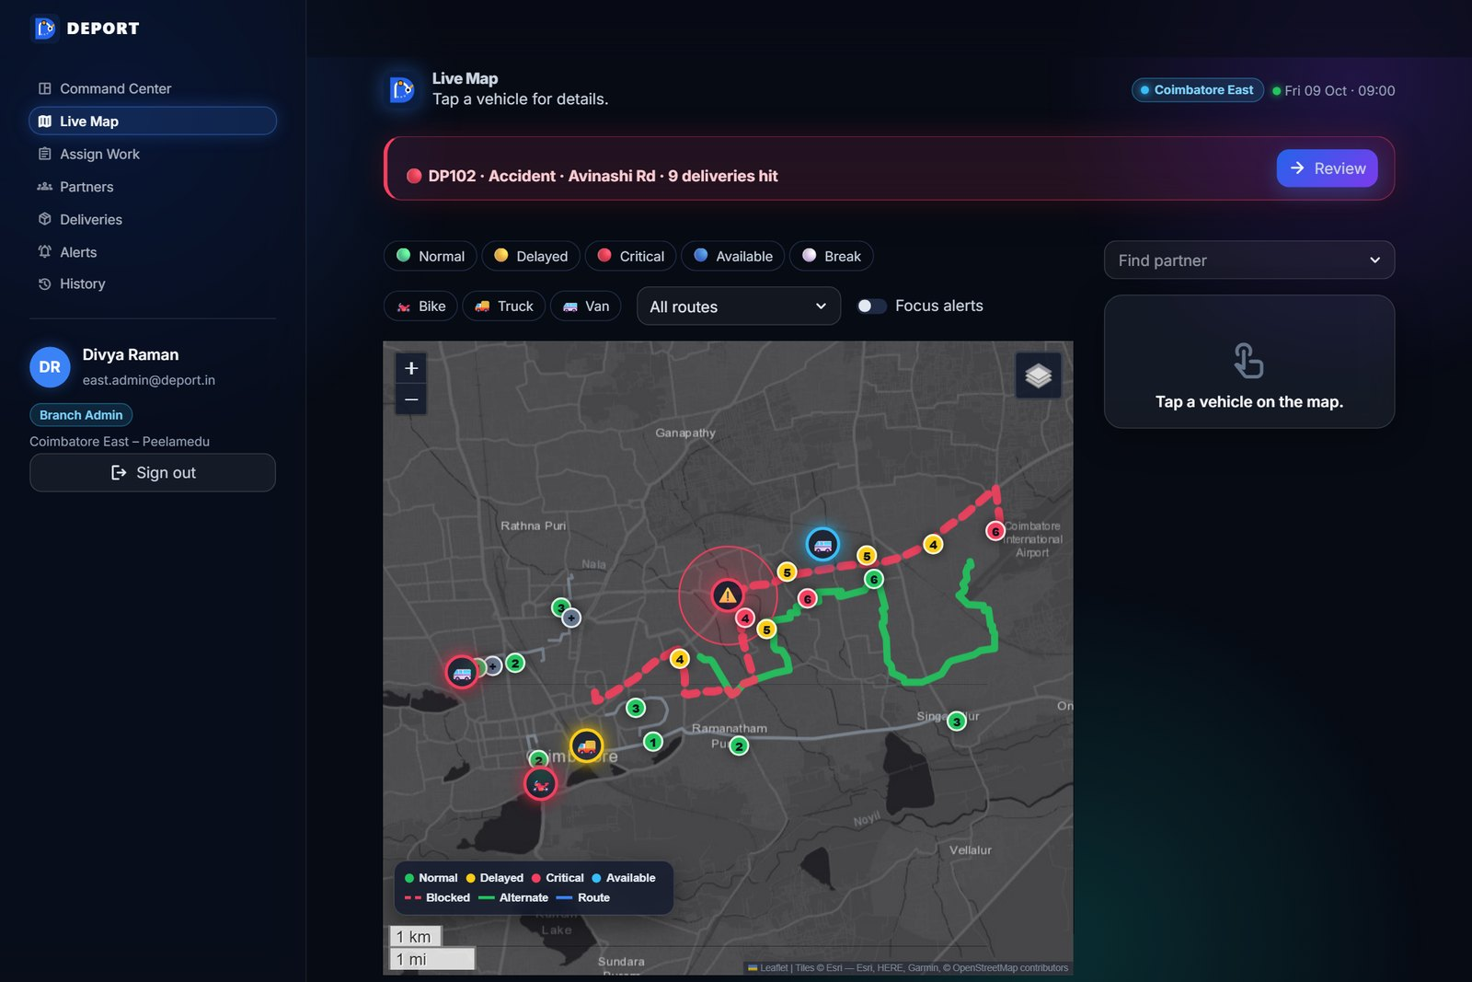
HACKNEXT'26 · SNS COLLEGE OF ENGINEERING, COIMBATORE
PS02 – Disruption-Aware Logistics Planning
AI-Powered
Disruption-Aware Logistics
Planning System
Domain: Transportation & Logistics
TEAM INOVIX
AI & DS · 3rd Year
V
Vaidharshini S
M
Manikandan R
📦
🚚
📍
Role: to be added
Role: to be added
P
Pranesh T
Y
Yuvaraj N
Report → Analyse → Recommend → Approve → Update
Role: to be added
Role: to be added
Coimbatore Institute of Engineering and Technology
PS02 – Disruption-Aware Logistics Planning · Team Inovix
1 / 5
Notes:
Good morning. We are Team Inovix, AI & DS third year from Coimbatore Institute of Engineering and Technology. Our problem statement is PS02, Disruption-Aware Logistics Planning. We built a working prototype that turns a delivery disruption into a decision in minutes: a partner reports the problem, AI understands it, the system recommends what to do and the operator approves it. (Add each member's role on this slide before presenting.)

Slide 2
PROBLEM STATEMENT
When one road closes, the whole plan breaks
HackNext'26 · Inovix
🚧
📍
📝
⏱️
🧭
Unexpected disruptions
No live visibility
Manual incident handling
Slow decisions
No smart suggestions
Accidents, traffic, flooding and protests delay deliveries without warning.
Hard to track delivery personnel and the status of every delivery.
Complaints come by phone calls and messages – slow and easy to lose.
Managers work out the impact by hand while deadlines slip.
No guidance on which route or delivery to change, and why.
Result: missed deadlines, unhappy customers and urgent parcels (e.g. medicines) arriving late.
PS02 – Disruption-Aware Logistics Planning · Team Inovix
2 / 5
Notes:
Last-mile delivery in a city like Coimbatore is fragile. One accident on a main road delays many deliveries at once. Today the manager often does not know where each partner is, complaints arrive as calls and messages, the impact is worked out by hand, and there is no system that suggests the best next action. The result is missed deadlines – including urgent ones like medicines.

Slide 3
PROPOSED SOLUTION
From disruption to decision – in one click
HackNext'26 · Inovix
🗺️
Dashboard + live map
👥
Personnel & delivery status
🎙️
Complaints by text or voice
Branch view with every vehicle, route and alert on a real-road map.
Partners, vehicles, load and a delivery status table.
Partner taps an issue type and types or records (Tamil / English).
🤖
AI issue understanding
💡
Next-best-action plan
✅
Operator approval → update
Finds the issue type, road, duration and severity from the report.
Backup vehicle, reroute, prioritise, notify – each with a reason.
On Accept: routes, ETAs, map and partner phones update together.
HOW IT WORKS
Delivery
Person
Complaint
Submission
AI Issue
Analysis
Recommended
Action
Operator
Approval
Updated Delivery
Information
AI suggests – the operator decides. Nothing changes until the plan is accepted.
PS02 – Disruption-Aware Logistics Planning · Team Inovix
3 / 5
Notes:
Our system has two sides. The branch admin gets a dashboard with a live map, partner details and a delivery status table. The delivery partner reports a problem by tapping an issue type and typing or recording a voice note in Tamil or English. AI extracts the issue, road, duration and severity, the system measures which deliveries are affected and recommends actions such as a backup vehicle or a reroute, each with a short reason. Only when the operator clicks Accept do the routes, ETAs, map and partner phones update – the human stays in control.

Slide 4
TECHNICAL STACK
Built with a simple, open Python stack
HackNext'26 · Inovix
🖥️
Frontend
⚙️
Backend
🧠
AI / NLP
▸ Streamlit (multi-page, role-based)
▸ Custom CSS – dark glass UI
▸ Mobile-friendly partner screens
▸ Python
▸ FastAPI + Uvicorn (REST API)
▸ Impact, risk and recommendation engine
▸ Groq LLM or Google Gemini (optional key)
▸ Rule-based Tamil/English parser (offline)
▸ SpeechRecognition (voice), RapidFuzz
🗄️
Database
🗺️
Maps & Visualization
🚀
Version Control & Deployment
▸ SQLite (WAL mode)
▸ One transaction per accepted plan
▸ Hashed passwords & sessions (PBKDF2)
▸ Folium + streamlit-folium
▸ OSRM road shapes (cached), Esri tiles
▸ Plotly charts, NetworkX impact graph
▸ Git + GitHub
▸ Streamlit Community Cloud
▸ pytest (automated tests)
PS02 – Disruption-Aware Logistics Planning · Team Inovix
4 / 5
Notes:
Everything is Python. Streamlit is the web front end for admins and partners, FastAPI exposes the same logic as a REST API for a future mobile app, and SQLite stores all data with one transaction per accepted plan. For AI, a Groq or Gemini language model reads the report when a key is set, with an offline rule-based Tamil/English parser as fallback; SpeechRecognition turns voice into text and RapidFuzz matches misspelled places. Maps use Folium with real road shapes from OSRM. Code is on GitHub and the demo is deployed on Streamlit Community Cloud.

Slide 5
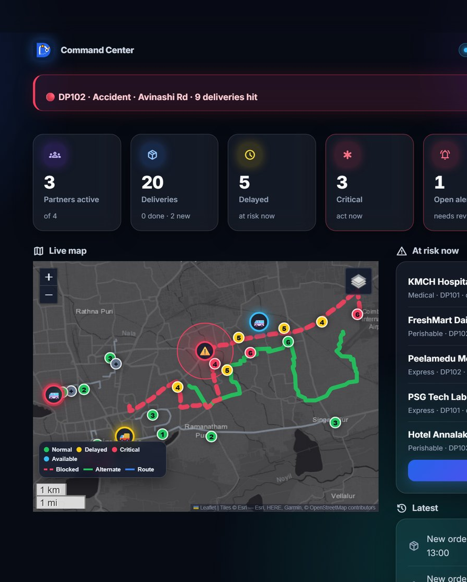
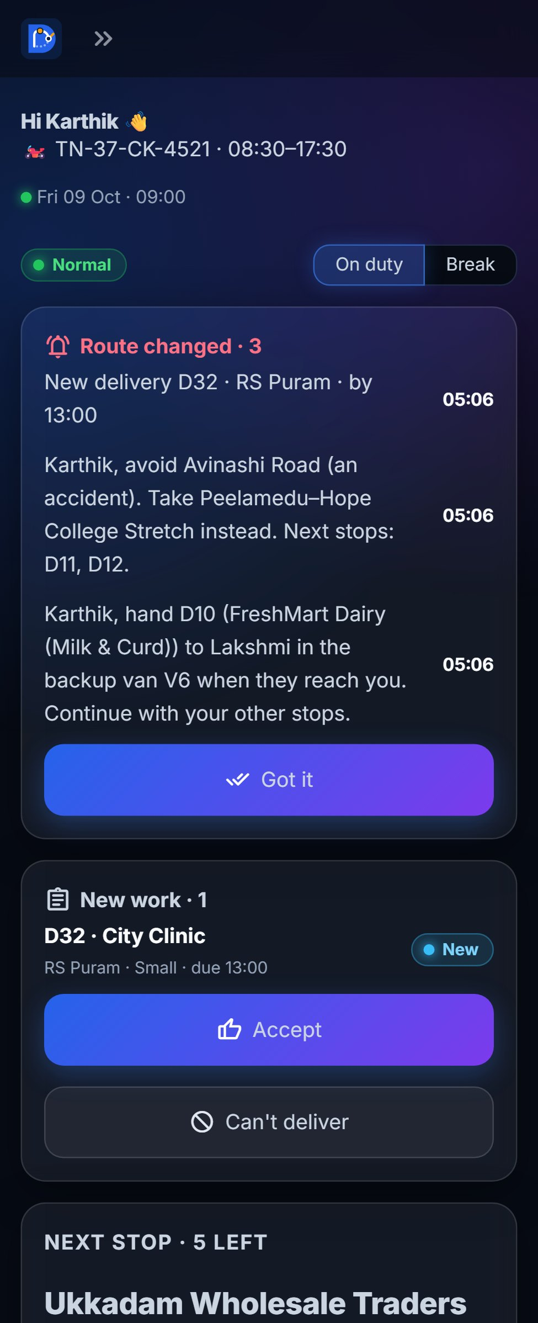
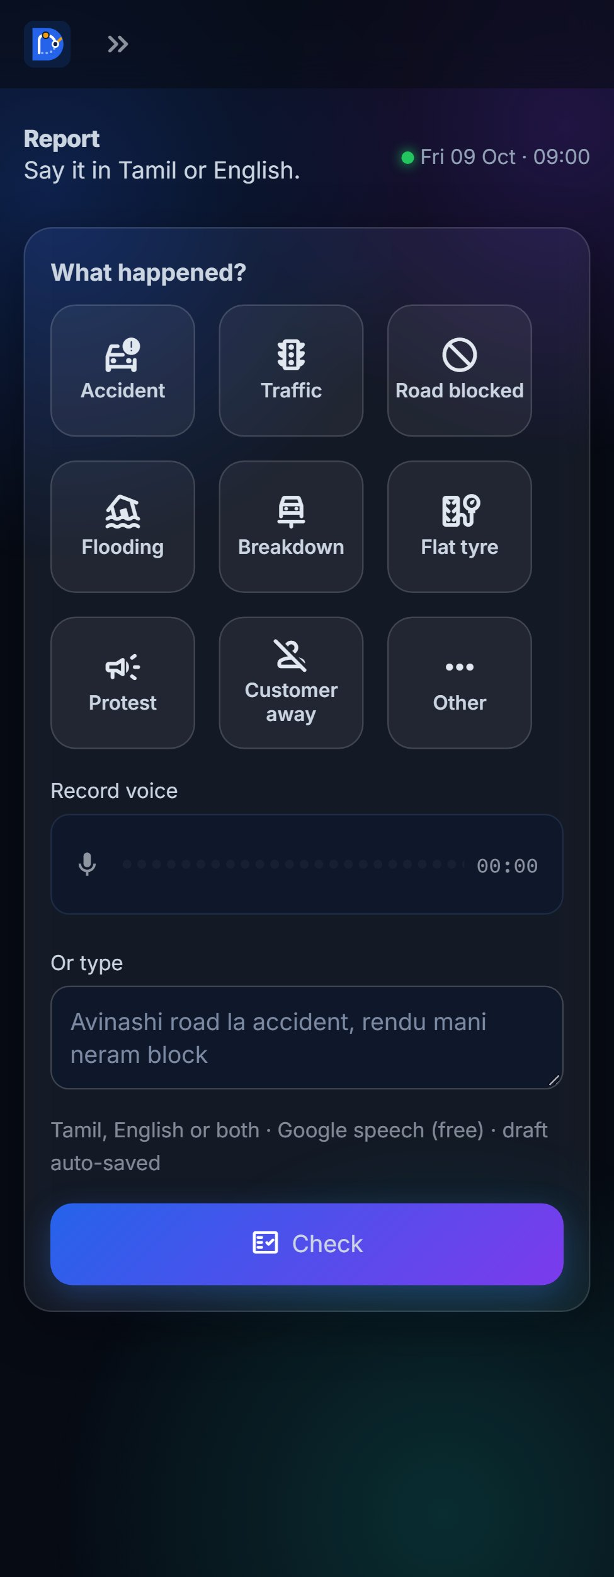
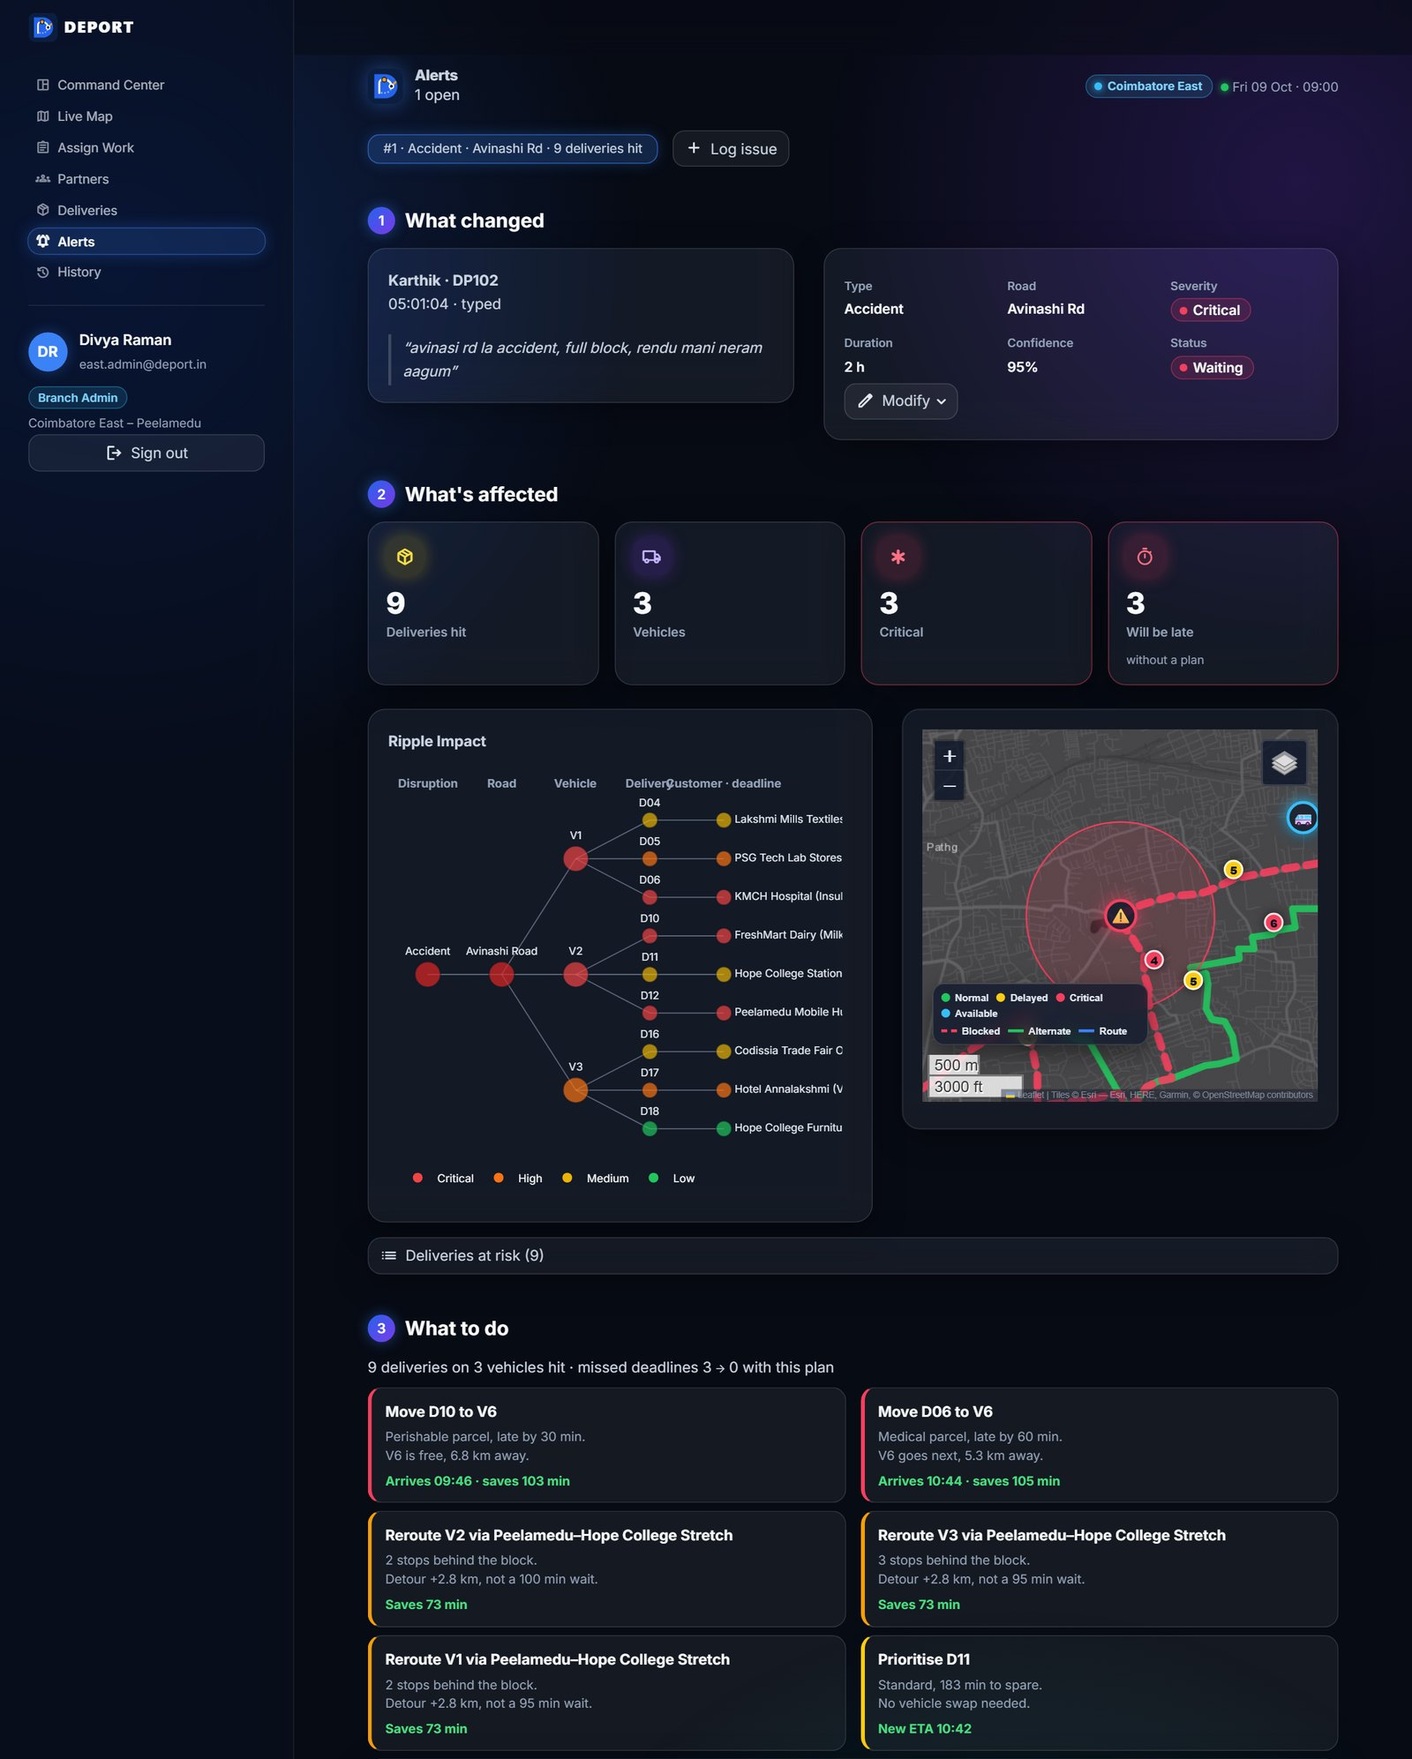
PROTOTYPE / WORKING MODEL
Working prototype – live demo
HackNext'26 · Inovix
1
Admin Dashboard & Map
2
Personnel Details
3
Complaint Submission
4
AI Recommendation & Route Update
Live: ripple-coimbatore.streamlit.app · Screenshots from the running prototype (demo data)
PS02 – Disruption-Aware Logistics Planning · Team Inovix
5 / 5
Notes:
These are screenshots of the running prototype with demo data. (1) The admin's Command Center with KPIs, at-risk deliveries and the live map. (2) The delivery partner's own screen with vehicle, next stop and status. (3) The Report screen: tap an issue type, then type or record a voice note. (4) The Alerts page: what changed, what is affected, and the recommended plan with reasons – the operator clicks Accept plan and routes, ETAs and partner phones update. Then switch to the live demo.

