Slide 1
Smart Sensory Furniture Based on WSN for Ambient Assisted Living
(IEEE SENSORS JOURNAL,SEPTEMBER 1, 2017)
DEEPIKA R
MANUSHREE L
VAIYAVI V
GUIDED BY MRS.ASHWINI

Slide 2
OVERVIEW
SSF is an ambient assisted living system that allows inferring a potential dangerous action of an elderly person living alone at home.
The basic idea behind the SSF project is that by integrating networked sensors and actuators in objects like furniture, a system can be built providing supervision similar to a caregiver.

Slide 3
PROPOSED SYSTEM
  The proposed system consists of three layers:
  HARDWARE LAYER
  SOFTWARE LAYER
  UI LAYER

Slide 4
HARDWARE LAYER
The lowest layer is the hardware layer.
The software obtains contextual information provided by sensors.
The middle level software layer, model of user behavior, obtains the actual state of the attendee, detecting if the resident is in an emergency situation which must be solved.

Slide 5
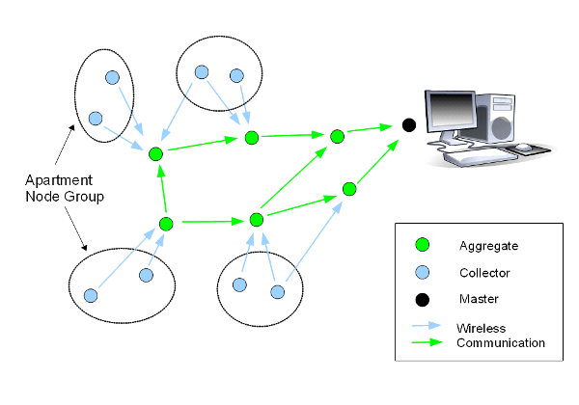

Slide 6
SOFTWARE LAYER
The Java application can monitor the events to determine if an unusual situation has occurred.
If a non common behaviour is detected, then the Ambient intelligent station will immediately query the user and send an emergency signal if there is no response within a certain (short) period of time

Slide 7
HARDWARE REQUIREMENTS
TEMPERATURE SENSORS
INFRARED SENSORS
LED
CONDUCTIVE YARNS

Slide 8
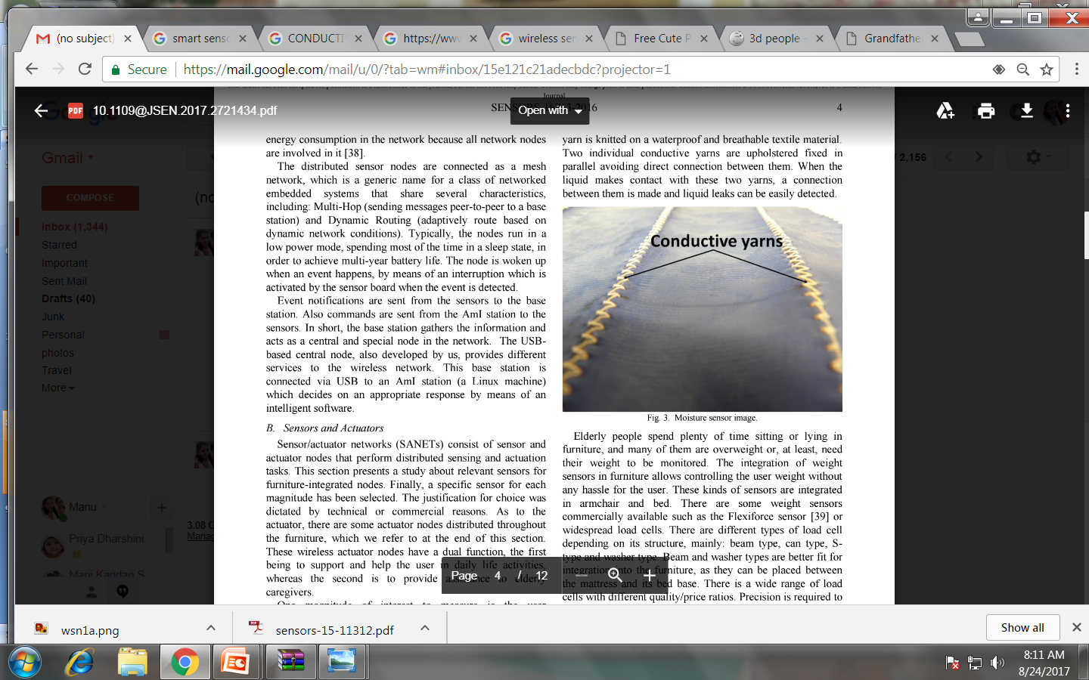
CONDUCTING YARN
Conducting yarns are used to manufacture carpets and other items that dissipate static electricity.

Slide 9

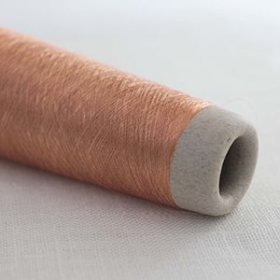
CONDUCTING YARN

Slide 10
INFRARED LIGHT
The bed height is monitored by two infrared distance sensors placed at both ends of the bed.
The sensors are directly fixed to the bed structure which makes the movement up and down and points towards the floor.

Slide 11
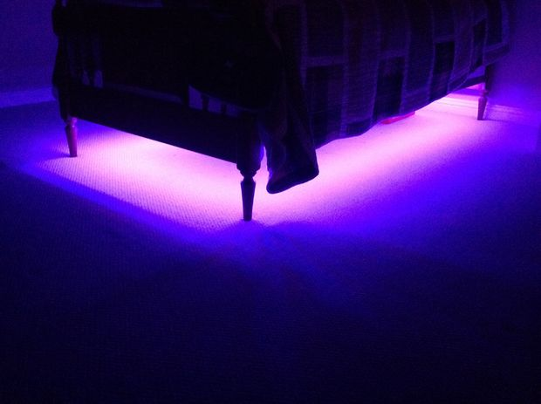

SMART BED

Slide 12
OVERALL MODEL
Elderly people spend most of their time in their bedrooms or living-rooms using these furniture types, so the system will monitor them for most of the time.
Event notifications are sent from the sensors to the base station.
This base station is connected via USB to an AmI station (a Linux machine) which decides on an appropriate response by means of an intelligent software.

Slide 13
SPECIFICATIONS:
WSN
  Temperature sensors(NTCLE100E3103JB0)
  Infrared Sensor(MLX90614)
MICROCONTROLLER
  MSP430
Light Emitting Diode
  3-Watt LED via PCB(Printed Circuit board)

Slide 14
CONCLUSION
This system ensures safety measures for people in case of abnormal activities encountered while he stays alone or when everybody is asleep.
This system also consumes low power and is affordable

Slide 15
THANKYOU

