Slide 1
LifeDesk
A persistent AI memory layer for your life
From remembering what you did to helping you act on it.

Slide 2
The Problem
AI often feels like a blank slate
• Users repeatedly explain their context, preferences, devices and past solutions.
• Important information is scattered across chats, PDFs, receipts, screenshots and apps.
• The missing capability is persistent, cross-domain memory that stays useful over time.

Slide 3
The LifeDesk Vision
One trusted memory layer for a person’s life
• LifeDesk stores meaningful facts, experiences, documents and solutions.
• It connects people, devices, purchases, warranties, fixes and preferences.
• The goal is continuity: the AI remembers the past and uses it responsibly in the present.

Slide 4
Core Architecture
Four layers working together
• 1. Ingestion — text, voice, receipts, PDFs, screenshots and connected APIs.
• 2. Memory — vector search for meaning + knowledge graph for relationships.
• 3. Reasoning — decides what to retrieve, when to search, and when to update memory.
• 4. Action — connects calendars, reminders, tasks and other tools to execute solutions.

Slide 5
The Ingestion Layer
The senses of LifeDesk
• Active logging: users record what happened, what they bought, fixed or learned.
• Passive logging: permitted integrations can capture useful events such as receipts.
• Multimodal support turns everyday information into structured, searchable memory.

Slide 6
The Memory Layer
Semantic recall + connected facts
• Vector database: answers vague questions such as “How did I fix this last time?”
• Knowledge graph: links entities such as Device → Model → Purchase → Warranty → Manual.
• Memory should include timestamps, confidence, source and importance so old facts can be handled safely.

Slide 7
The Reasoning Layer
From retrieval to useful decisions
• An orchestration layer determines whether to use memory, search for new information, or ask the user.
• It can reconcile conflicting memories and prefer recent, authoritative sources.
• A controlled memory-update policy prevents the system from blindly recording everything.

Slide 8
The Action Layer
Turn answers into outcomes
• Create reminders for maintenance and renewals.
• Connect tasks, calendars and budgeting tools.
• Move from “here’s what you could do” toward “here’s the next useful action.”

Slide 9
High-Value Use Case 1
“What did I do last time?”
• A recurring software bug appears months later.
• LifeDesk retrieves the previous incident and the exact successful steps.
• The user gets continuity instead of starting troubleshooting from zero.

Slide 10
High-Value Use Case 2
Proactive maintenance
• A maintenance receipt is linked to a specific vehicle or device.
• LifeDesk combines the receipt with the relevant manual or maintenance schedule.
• It can propose a reminder for the next service event, with user approval before action.

Slide 11
High-Value Use Case 3
Expense & subscription audit
• LifeDesk notices recurring charges alongside the user’s activity and records.
• It can surface potentially unused subscriptions or renewal dates.
• The user decides whether to investigate, change or cancel anything.

Slide 12
Critical Challenge
Trust is the product
• Privacy and security: sensitive documents and personal history require strong protection.
• Context drift: preferences and circumstances change over time.
• Information overload: remembering everything can make retrieval worse.
• Transparency: users need to know what was remembered, why it was retrieved, and where it came from.

Slide 13
MVP Strategy
Start narrow and prove the memory loop
• Domain 1: Devices & Manuals — add household devices and identify the correct manuals/models.
• Domain 2: Fix-It Log — record problems, solutions and outcomes.
• Core loop: Capture → Retrieve → Explain → Resolve → Update memory.
• Only after this works reliably should LifeDesk expand into expenses, documents and scheduling.

Slide 14
Example MVP Flow
A simple end-to-end experience
• User: “My washing machine is showing E21.”
• LifeDesk identifies the stored device model and retrieves the relevant manual.
• It checks the user’s previous fix history for that device.
• It gives model-specific steps and records the outcome after the user confirms the fix.

Slide 15
Future Expansion
From personal memory to a life operating layer
• Documents & warranties
• Expenses & subscriptions
• Travel and preferences
• Home maintenance
• Personal projects and learning
• Proactive reminders and cross-domain assistance

Slide 16
Closing
LifeDesk is about continuity
• The differentiator is not simply another chatbot.
• It is a persistent memory system that connects context across time and domains.
• Build trust first. Prove retrieval quality. Then expand the agent’s ability to act.

Slide 17
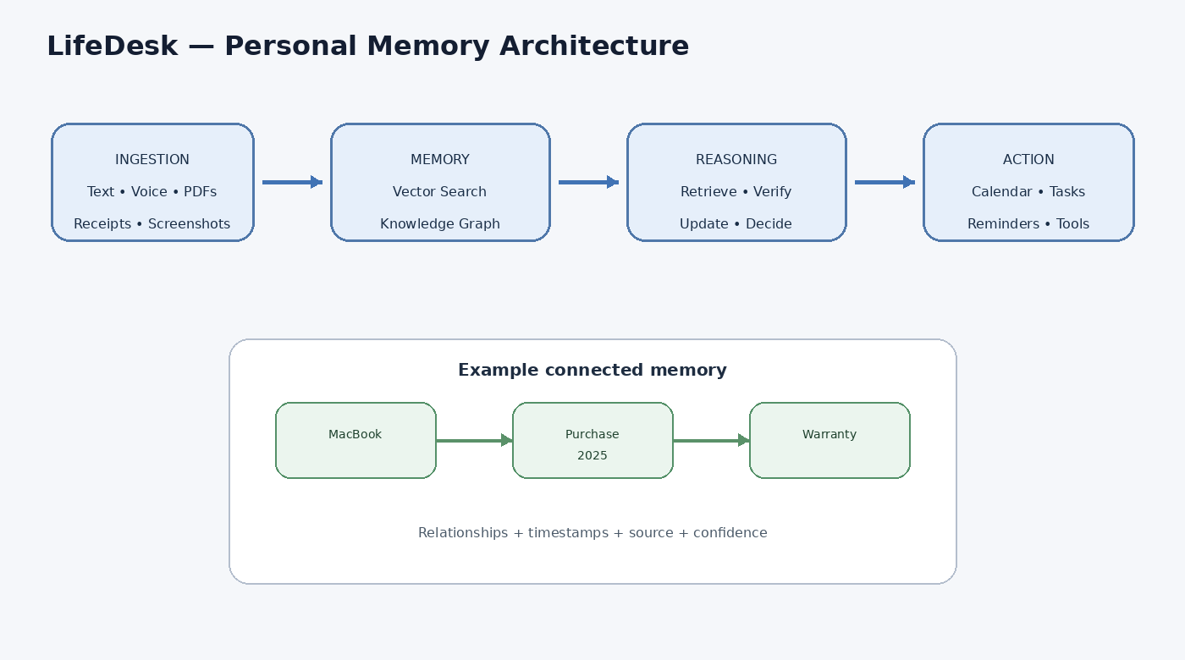
Visual Architecture
How information flows through LifeDesk

Slide 18
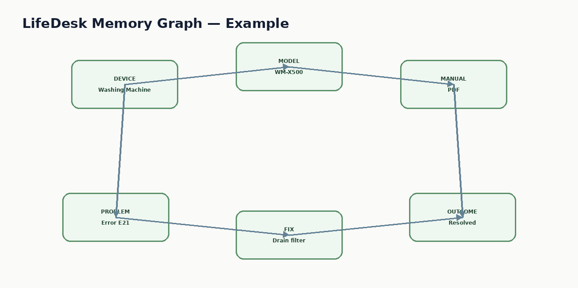
Memory Graph Example
LifeDesk connects entities instead of storing isolated notes

Slide 19
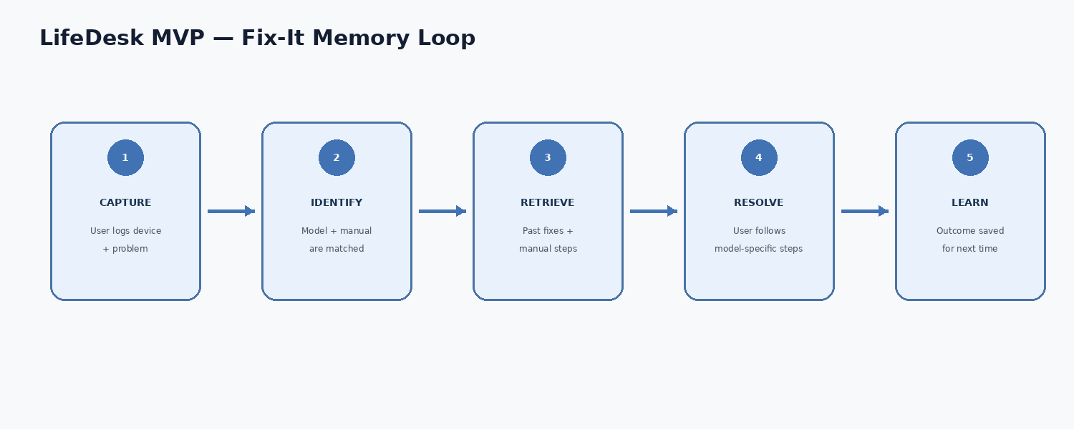
MVP Flow Chart
The core Capture → Retrieve → Resolve → Learn loop

