Slide 1
Digital Forensics
Vinit Kakde

Slide 2
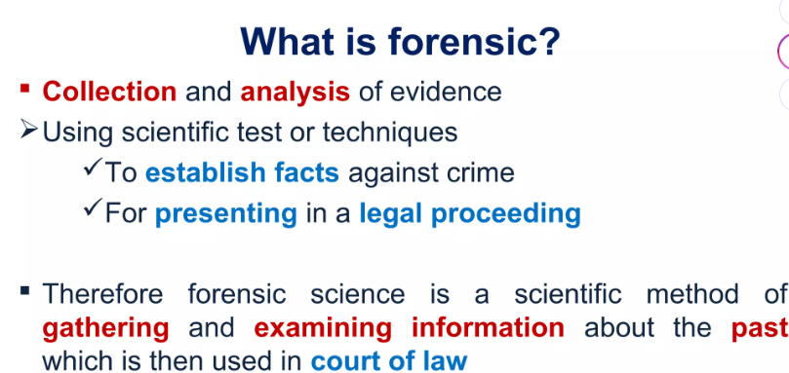

Slide 3
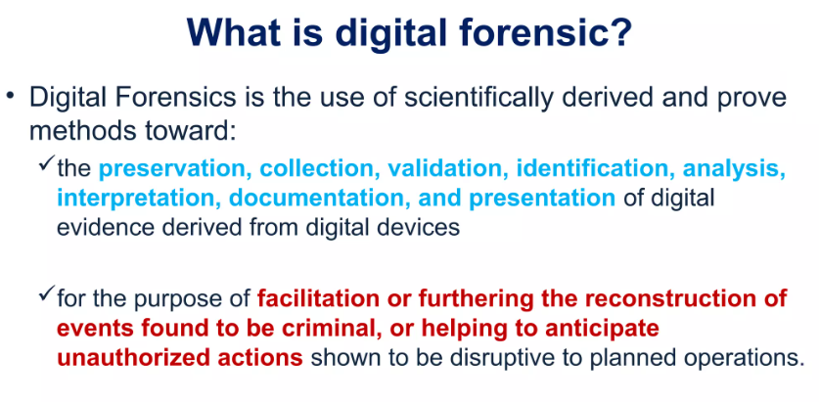

Slide 4
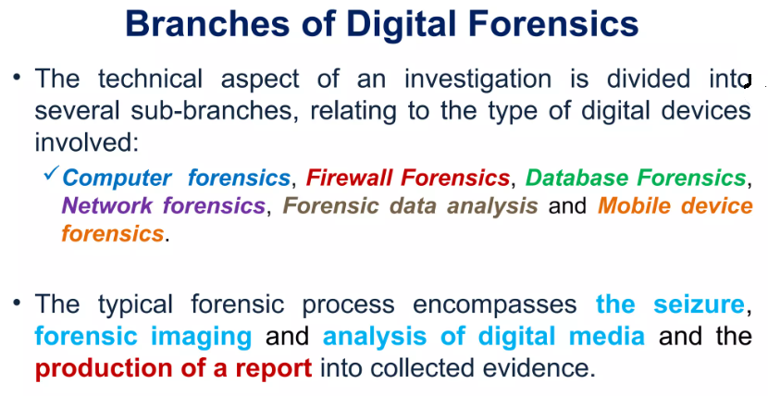

Slide 5
Types of Cyber Forensics
Disk Forensics: Involves extracting data from storage devices, including hard drives, to recover active, modified, or deleted files.
Network Forensics: Focuses on monitoring and analyzing network traffic to trace unauthorized access or data breaches.
Database Forensics: Examines databases and their metadata to uncover evidence of tampering or unauthorized access.
Malware Forensics: Analyzes malicious software to understand its behavior and impact, helping to develop countermeasures.
Email Forensics: Involves recovering and analyzing emails, including deleted messages and attachments, to gather evidence.
Mobile Forensics: Examines smartphones and tablets to retrieve data such as contacts, messages, and call logs.

Slide 6
Process of Cyber Forensics:
Identification: Determining what evidence is present, where it is stored, and in what format.
Preservation: Securing the data to prevent tampering, including creating a bit-for-bit copy of the original evidence.
Analysis: Analyzing the data to reconstruct events and draw conclusions based on the evidence collected.
Documentation: Keeping a detailed record of all findings and procedures to ensure the integrity of the investigation.
Presentation: Presenting the documented findings in a court of law in a clear and understandable manner.

Slide 7
Importance of Cyber Forensics
Cyber forensics plays a vital role in solving digital crimes, including identity theft, fraud, and cyberbullying.
It helps organizations track security breaches, recover lost data, and protect their assets.
The evidence collected through cyber forensics can be crucial for legal proceedings, helping to ensure that justice is served.

Slide 8
Challenges in Cyber Forensics
The rapid evolution of technology means that forensic techniques must continually adapt to new threats and methods used by cybercriminals.
Ensuring the integrity of digital evidence is paramount, as any sign of tampering can render it inadmissible in court.

Slide 9

Historical background of Cyber forensics
1980s – Beginning of Cyber Forensics
Emerged with the widespread use of personal computers.
Increasing cybercrimes created the need to investigate digital evidence.
1984: FBI established the Computer Analysis and Response Team (CART).
UK Metropolitan Police established a computer crime unit within the Fraud Squad.
Early investigations relied mainly on ad-hoc methods without standardized procedures.
1990s – Establishment of Standards
Investigators recognized the need for standardized digital forensic methods.
1994–1995: UK Police Staff College conferences at Bramshill contributed to modern digital forensic methodology.
1998: UK Association of Chief Police Officers (ACPO) published the Good Practice Guide for Digital Evidence.
These guidelines became the foundation for digital forensic standards and best practices.
Training and Professional Development
IACIS (International Association of Computer Investigative Specialists) was established in the US.
Development of specialized training for Seized Computer Evidence Recovery Specialists (SCERS).
Expansion of Cyber Forensics
Evolved from informal/ad-hoc investigations into a structured forensic discipline.
Adoption of standard procedures, specialized forensic tools, and trained professionals.
Expanded beyond law enforcement to corporate investigations and civil litigation.
Digital evidence became increasingly important in criminal investigations and legal proceedings.

Slide 10

Digital Forensics Science
Digital forensics, also known as digital forensic science, is a branch of forensic science focused on the recovery, investigation, and analysis of digital evidence found in digital devices. It encompasses a wide range of techniques and methodologies used to collect, preserve, and examine digital data in a manner that is legally admissible in court.

Slide 11
Key Aspects of Digital Forensics Science
Key Aspects of Digital Forensics Science
Identification and Collection
The first step in digital forensics is to identify relevant digital devices and data that may contain evidence. Law enforcement agencies often seize devices from crime scenes to ensure a proper chain of custody. Forensic teams then create forensic duplicates of the data using specialized tools to avoid tampering with the original evidence.
Preservation
Preserving the integrity of digital evidence is crucial in digital forensics. Forensic teams use various techniques, such as write-blockers and hashing algorithms, to ensure that the data remains unaltered during the investigation process. This is essential for maintaining the admissibility of evidence in court.
Analysis
Forensic examiners use a variety of tools and techniques to analyze the collected digital evidence. This may include recovering deleted files, analyzing metadata, and uncovering hidden data. Specialized software and hardware are often used to extract and process data from various types of digital devices, such as computers, mobile phones, and IoT devices.
Reporting and Presentation
Once the analysis is complete, forensic experts create a formal report detailing their findings. The report must be clear, concise, and legally admissible. In court, forensic experts may be called upon to present their findings and defend their methodology under cross-examination.

Slide 12
Branches of Digital Forensics Science
Computer Forensics: Focuses on the recovery and analysis of data from computers and storage media.
Mobile Device Forensics: Specializes in extracting and analyzing data from mobile phones, tablets, and other portable devices.
Network Forensics: Involves the monitoring and analysis of network traffic to detect and investigate security incidents.
Database Forensics: Focuses on the forensic study of databases and their metadata to uncover evidence of tampering or unauthorized access.
IoT Forensics: Deals with the identification and extraction of digital information from Internet of Things (IoT) devices for use in forensic investigations.

Slide 13
Challenges in Digital Forensics Science
Rapidly evolving technologies: The pace of technological change requires forensic experts to continuously update their skills and tools to keep up with new devices and data formats.
Encryption and anti-forensics techniques: Cybercriminals often use encryption and other techniques to hide their activities, making it more difficult for forensic experts to recover and analyze evidence.
Large volumes of data: The increasing amount of digital data generated by modern devices can make it challenging for forensic teams to efficiently process and analyze all relevant evidence.
Jurisdictional issues: Cybercrimes often transcend national borders, complicating legal and jurisdictional issues related to evidence collection and sharing.

Slide 14

The Need for Computer Forensics
Rising Cybercrime
Increasing incidents of identity theft, financial fraud, hacking, and data breaches.
Helps investigate and combat cybercriminal activities.
Digital Evidence
Computers, smartphones, servers, and IoT devices contain valuable evidence.
Helps recover deleted files, analyze communications, and identify criminal activities.
Complex Digital Environments
Cloud computing, mobile devices, and interconnected systems make investigations more complex.
Forensic tools help uncover hidden and deleted evidence.
Legal Requirements
Digital evidence must be properly collected, preserved, and documented.
Maintains chain of custody and ensures evidence is admissible in court.
Corporate Security & Compliance
Helps organizations investigate cyberattacks and data breaches.
Identifies vulnerabilities, recovers data, and supports regulatory compliance.
Protection of Intellectual Property
Helps investigate theft, unauthorized access, and misuse of confidential information.
Supports identification of offenders and legal action.
National Security
Used to investigate cyberattacks, cyberterrorism, and threats from hostile entities.
Supports national security investigations and strengthens cybersecurity.

Slide 15
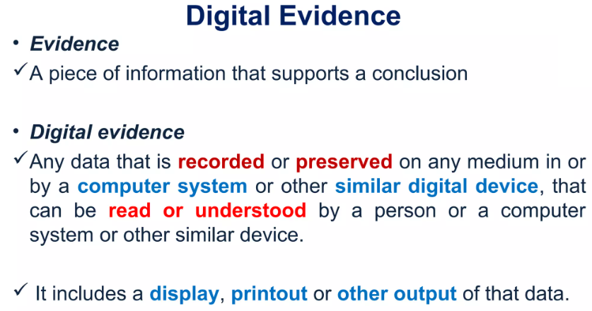

Slide 16

Cyber Forensics and Digital evidence
Digital evidence refers to any information or data that is stored, received, or transmitted by electronic devices. This includes:
Emails and Text Messages: Communications that can provide insights into relationships, intentions, and timelines.
Files and Documents: Digital files, including images, videos, and documents, which may contain relevant information about criminal activities.
Internet Activity: Browsing history, search queries, and social media interactions that can reveal a suspect's behavior and connections.
Metadata: Data that provides information about other data, such as timestamps and file origins, which can help establish timelines and authenticity.

Slide 17
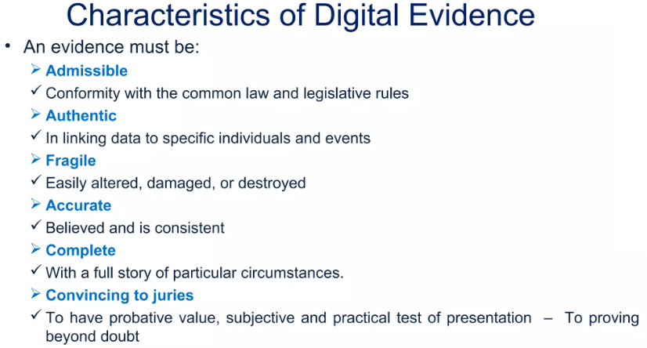

Slide 18
Importance of Digital Evidence in Cyber Forensics
Comprehensive Investigations: Digital evidence allows investigators to piece together a comprehensive picture of events leading up to and following a crime. For instance, data from a suspect's smartphone can reveal their location and communications at the time of an offense, aiding in establishing intent and motive.
Admissibility in Court: Properly collected and preserved digital evidence is crucial for legal proceedings. Cyber forensics ensures that evidence is handled according to legal standards, maintaining its integrity and admissibility in court.
Tracing Cybercriminals: Digital evidence plays a vital role in identifying and apprehending cybercriminals. Forensic analysis can uncover hidden data, recover deleted files, and trace online activities back to individuals or groups.
Supporting Other Investigations: Digital evidence is not limited to cybercrimes; it is increasingly used in traditional criminal investigations. For example, digital footprints can provide leads in cases of theft, fraud, or even violent crimes.

Slide 19
Challenges in Digital Evidence Collection
Data Volatility: Digital evidence can be easily altered or deleted. Investigators must act quickly to capture data before it is lost, which requires specialized tools and techniques.
Encryption and Security Measures: Many devices and files are protected by encryption, making it difficult to access data without proper authorization. Forensic experts often need to employ advanced decryption methods to retrieve relevant information.
Legal and Ethical Considerations: The collection of digital evidence must comply with legal standards to ensure that it is admissible in court. This includes adhering to chain of custody protocols and obtaining necessary warrants or permissions.
Rapid Technological Changes: The fast-paced evolution of technology means that forensic techniques must continually adapt. Investigators must stay updated on the latest tools and methods to effectively analyze new types of digital evidence.

Slide 20
Digital Forensics Lifecycle
1. Preparation and Identification
Before any evidence can be collected, investigators must prepare by understanding the context of the investigation and identifying potential sources of digital evidence.
2. Collection and Recording
To collect and record it systematically.
3. Storing and Transporting
Proper handling of digital evidence during storage and transportation is vital to maintaining its integrity.
4. Examination/Investigation
Forensic experts analyze the collected data to uncover relevant information.
5. Analysis, Interpretation, and Attribution
To analyze and interpret the findings
6. Reporting
A comprehensive report is generated.
7. Testifying
In many cases, forensic experts may be required to testify in court regarding their findings.

Slide 21
Preparation and Identification
Before any evidence can be collected, investigators must prepare by understanding the context of the investigation and identifying potential sources of digital evidence. This phase involves:
Planning: Determining the scope of the investigation and the types of evidence that may be relevant.
Identification: Recognizing devices and data that may contain pertinent information, including computers, mobile devices, servers, and cloud storage.

Slide 22
Collection and Recording
Seizing
Seizing Devices: Physically securing devices that may contain evidence while ensuring that no alterations occur.
Creating
Creating Forensic Images: Making bit-for-bit copies of digital media to preserve the original data. This is crucial to prevent data loss or corruption.
Documenting
Documenting the Process: Keeping detailed records of the collection process, including the time, date, and individuals involved.

Slide 23
Storing and Transporting
Secure Storage: Storing evidence in a controlled environment to prevent unauthorized access or damage.
Chain of Custody: Maintaining a documented trail of who handled the evidence and when, ensuring that it can be verified in court.
Proper handling of digital evidence during storage and transportation is vital to maintaining its integrity. This phase involves:

Slide 24
Examination/Investigation
Data Recovery: Extracting deleted or hidden files and analyzing file systems.
Metadata Analysis: Examining metadata to understand file creation, modification dates, and user activity.
Using Forensic Tools: Employing specialized software like EnCase, FTK, and The Sleuth Kit to assist in the analysis.

Slide 25
Analysis, Interpretation, and Attribution
Identifying Patterns: Recognizing sequences of events that may indicate criminal activity.
Attribution: Linking evidence to specific individuals or actions, helping to establish intent or involvement in a crime.

Slide 26
Reporting
Findings: Detailed descriptions of the evidence analyzed and conclusions drawn.
Methodology: An outline of the techniques and tools used during the investigation.
Recommendations: Suggestions for further action or security improvements based on the findings.

Slide 27
Testifying
In many cases, forensic experts may be required to testify in court regarding their findings. This phase includes:
Expert Testimony: Presenting evidence in a clear and understandable manner, explaining the methods used and the significance of the findings.
Cross-Examination: Responding to questions from legal representatives to validate the credibility of the evidence and the investigation process.

Slide 28
Challenges in Computer Forensics
1. Technical Challenges
Data Volume and Complexity: The sheer volume of data generated by modern devices poses significant challenges for forensic investigators. Identifying relevant information within vast datasets can be daunting, requiring advanced techniques such as data carving and machine learning to extract pertinent evidence efficiently.
Data Encryption: Many cybercriminals use encryption to protect their data, making it difficult for forensic experts to access and analyze relevant information. Specialized decryption tools may be necessary, and even then, access is not guaranteed.
Anti-Forensics Techniques: Criminals often employ anti-forensics methods to hinder investigations, such as data wiping, steganography, and file renaming to evade detection. These techniques complicate the recovery of digital evidence and require forensic experts to stay updated on the latest countermeasures.
Real-Time Data Analysis: Investigators must often analyze data in real-time, especially in cases involving network forensics. Current forensic tools may struggle to capture and analyze large volumes of data as it flows through networks, necessitating the development of new methodologies.

Slide 29
Challenges in Computer Forensics
1. Legal Challenges
Jurisdictional Issues: Digital evidence can span multiple jurisdictions, complicating the legal landscape. Determining which laws apply and which authorities have the right to seize and analyze data can be challenging, especially in cross-border investigations.
Privacy Concerns: The collection of digital evidence often raises privacy issues. Investigators must navigate the delicate balance between thorough investigations and respecting individuals' rights to privacy, which can lead to legal complications if not handled properly.
Data Authenticity and Admissibility: Unlike physical evidence, digital evidence can be easily altered or manipulated. Maintaining a strict chain of custody is essential to ensure that evidence remains admissible in court. Any lapses in this process can lead to challenges regarding the integrity of the evidence presented.

Slide 30
Challenges in Computer Forensics
1. Resource Challenges
Skill Shortages: There is a growing demand for skilled professionals in the field of computer forensics. However, the rapid evolution of technology often outpaces the training available to forensic investigators, leading to a skills gap that can hinder effective investigations.
Time Constraints: Investigating cybercrimes can be time-consuming, especially when dealing with large volumes of data or complex cases. Delays in investigations can impact the ability to gather evidence before it is lost or altered, potentially affecting case outcomes.
Cost of Tools and Resources: High-quality forensic tools and software can be expensive, and not all organizations have the budget to invest in the latest technologies. This can limit the effectiveness of forensic investigations, particularly for smaller law enforcement agencies or organizations

Slide 31
Rules of Digital Evidence
Admissibility – Evidence must be legally obtained and relevant to the case.
Authenticity – Prove that the evidence is genuine and has not been altered.
Integrity – Maintain the original evidence without modification.
Chain of Custody – Record every person who collects, handles, transfers, or examines the evidence.
Proper Collection – Use approved forensic tools and procedures while acquiring evidence.
Preservation – Protect evidence from accidental or intentional alteration, damage, or deletion.
Documentation – Maintain complete records of the collection, analysis, and handling process.
Repeatability – Forensic examination should be reproducible and produce consistent results.
Use of Original/Forensic Copy – Preserve the original device or data and perform analysis on a verified forensic copy whenever possible.
Confidentiality & Privacy – Protect sensitive personal and organizational information during investigation.

Slide 32
Example of Digital Evidence
Cybercrime Investigation:
A suspect sends a fraudulent email to a victim.
Digital evidence may include:
Email content and metadata
Sender's IP address
Browser history
Login records
Deleted files
Chat messages
Server/network logs
Forensic analysis: These sources can be correlated to establish the timeline, activity, and potential source of the attack.

Slide 33
Digital evidence is valuable only when its authenticity, integrity, legality, and chain of custody can be demonstrated
Digital Forensics = Collect + Preserve + Analyze + Verify + Present

Slide 34
Thank you

