Slide 1
Chirstmas
Naqiyah

Slide 2
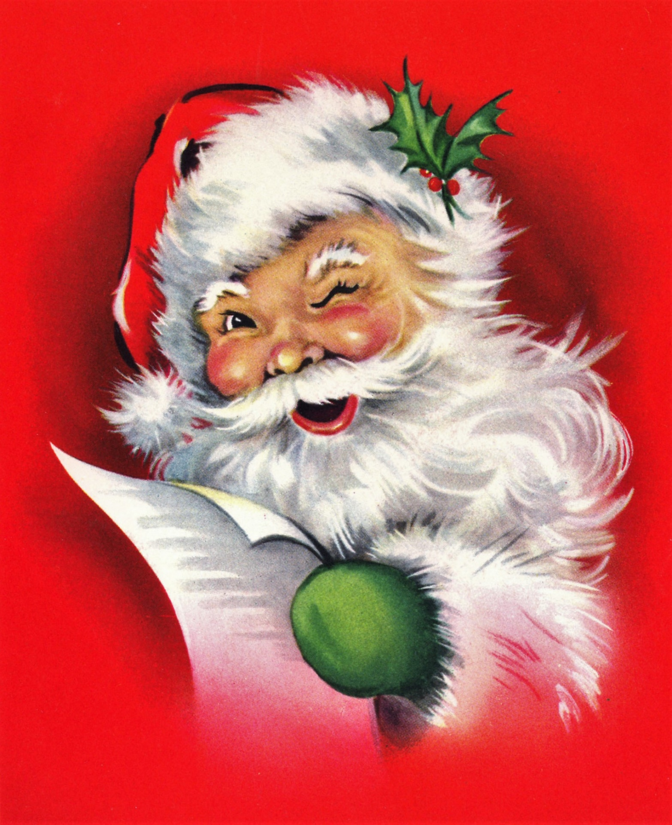
1
Chirstmas is celebrate on the 25th of December every by the Christian.

Slide 3
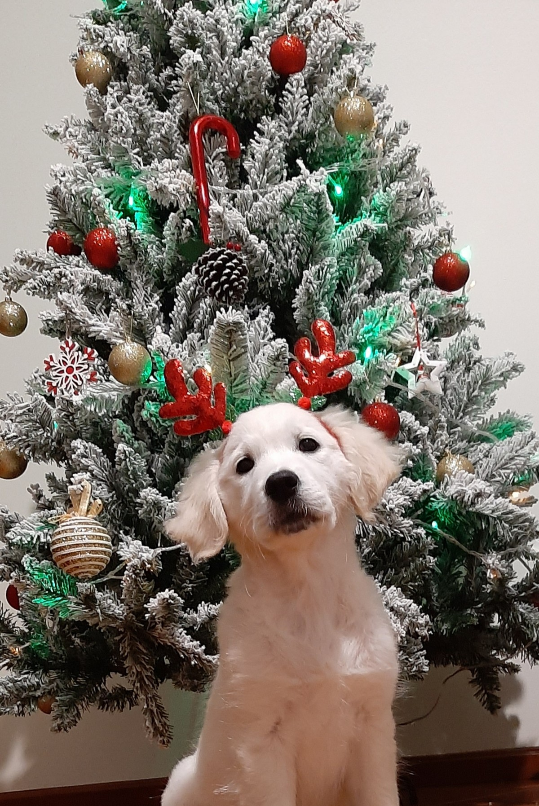
2
The day holds much significance for the Chirstmas as they beiieve that Jesus Chirst was born on the same day at Bethlehem.

Slide 4
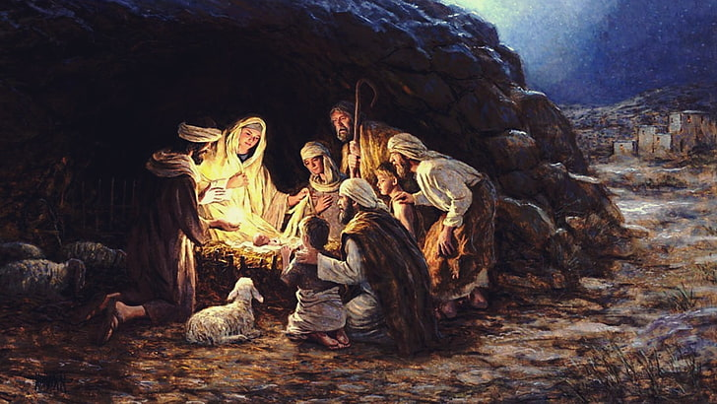
3
Chirstmas is celebrated to remember the birth of Jesus Chirst,who Chirstians believe is the Son of God.

Slide 5
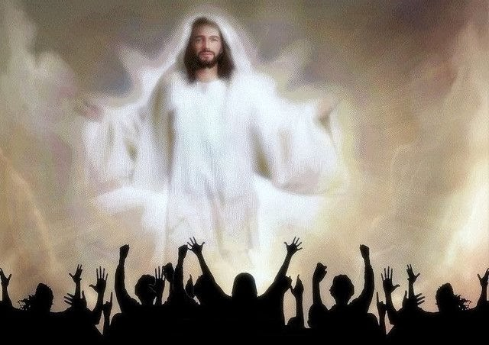
4
Chirstmas is being celebrate for thousands of year and has mostly evolved from an old pagan festival celebrate the winter solstice.
This Photo by Unknown Author is licensed under CC BY

Slide 6
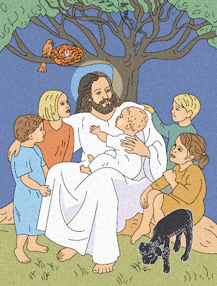
5
It is considered that Jesus was sent on earth to save the lives and protect mankind from their sins and sorrows.
This Photo by Unknown Author is licensed under CC BY-NC-ND

Slide 7
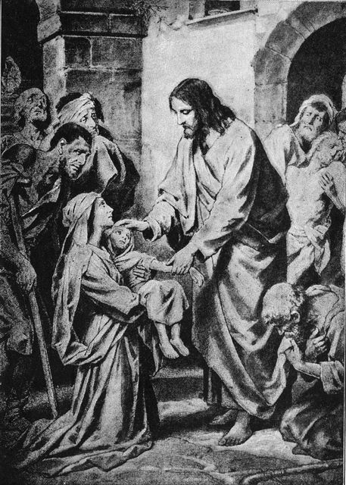
6
Chirstmas is a time to remember Jesus and take out some time for his worship.
This Photo by Unknown Author is licensed under CC BY-NC

Slide 8
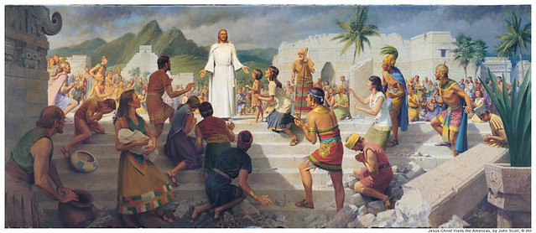
7
It is a time to introspect on his teachings and what he tried to teach humanity.
This Photo by Unknown Author is licensed under CC BY-NC

Slide 9
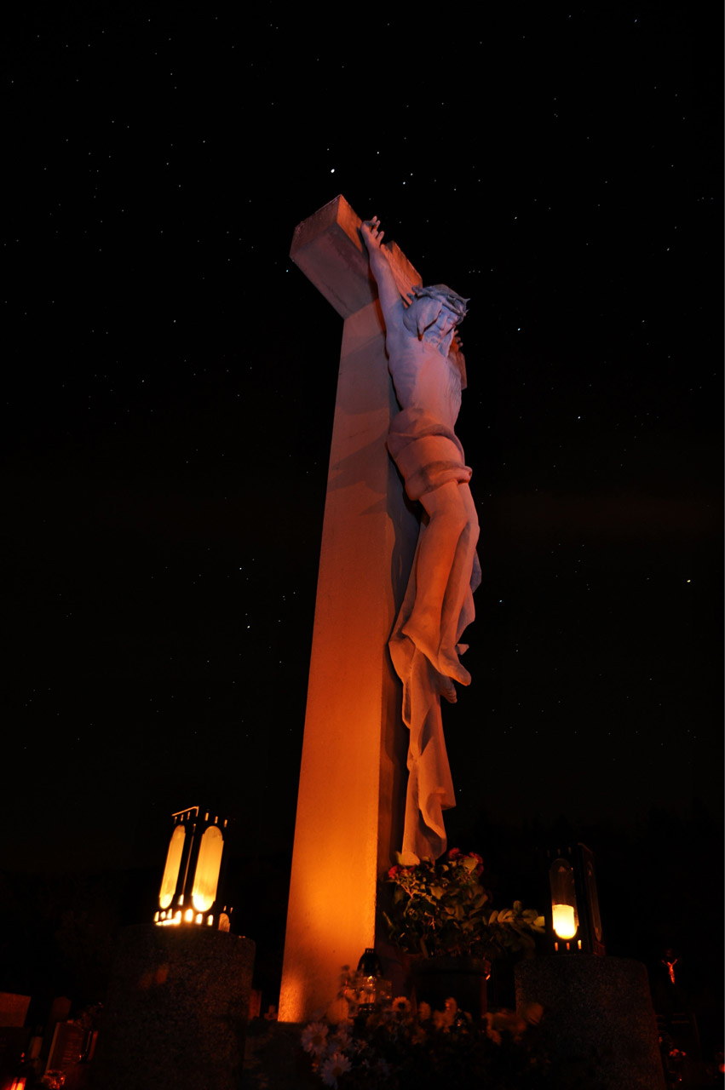
8
Therefore,Chirstamas is celebrate with a spirit of togetherness and compassion for the poor and needy.

Slide 10
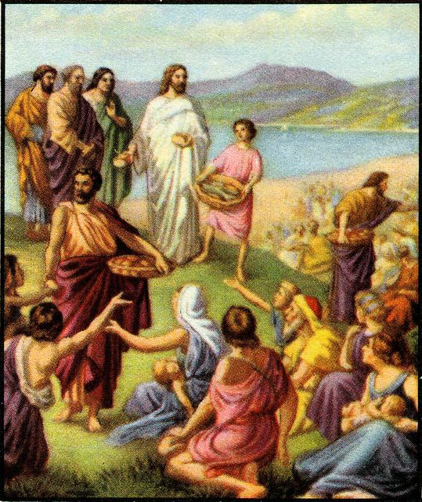
9
Therefore,Chiestmas is celebrate with a spirit of togetherness for the poor and needy.
This Photo by Unknown Author is licensed under CC BY

