Slide 1


Employment and Income Assistance (EIA) Overview
Fareedah Sulaiman, CUHC Advocate

Slide 2
Who we are
We are a non-profit organization, independent of the Federal and Provincial Government.​
  We work with the government, not for them.​
We offer public advice & education on both systems​
Refer people to the appropriate agency to meet their needs​
Advocate for people having problems with EI or EIA​
Represent clients at appeals ​
Communicate with both systems on your behalf. ​
Determine if you were wrongfully denied any type of benefit despite being eligible and advocate for your rights to receive said benefits​
All CUHC services are free of charge​

Slide 3
Disclaimer
All the information provided today is based on information from MB legislation, the EIA Administration Manual and collaborations with the department​
Please take into consideration that this information can change at any time​
Some EIA decisions are made on a case-by-case basis. The department considers individual circumstances & expenses (we can help with this too)​

Slide 4
EIA – How to apply
In person ​
  111 Rorie Street office or 128 Market Ave ​if you have children.
If you have a disability that prevents you from attending in person you can contact the call center at (204) 948-2888​ to arrange an over-the phone appointment. ​
All Manitoba Residents are entitled to an intake appointment regardless of their financial situation or ability to work.​

Slide 5
Prior to Intake
Review the EIA Checklist to get the mandatory documentation according to the category you are applying for
The bank statements have to be up to the date of your Intake appointment ​

Slide 6
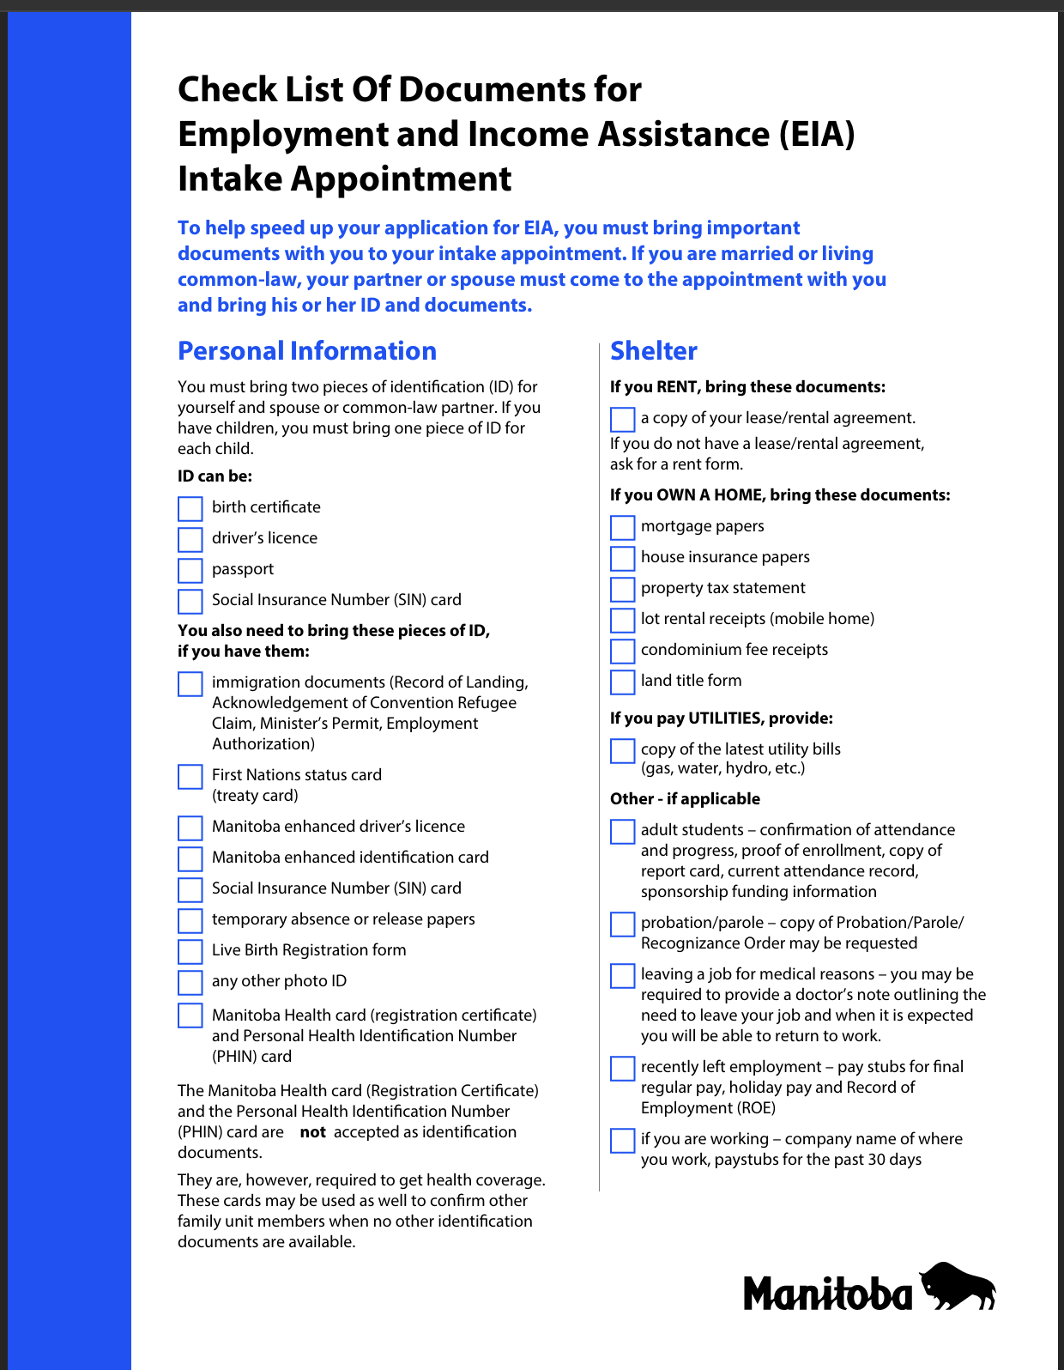
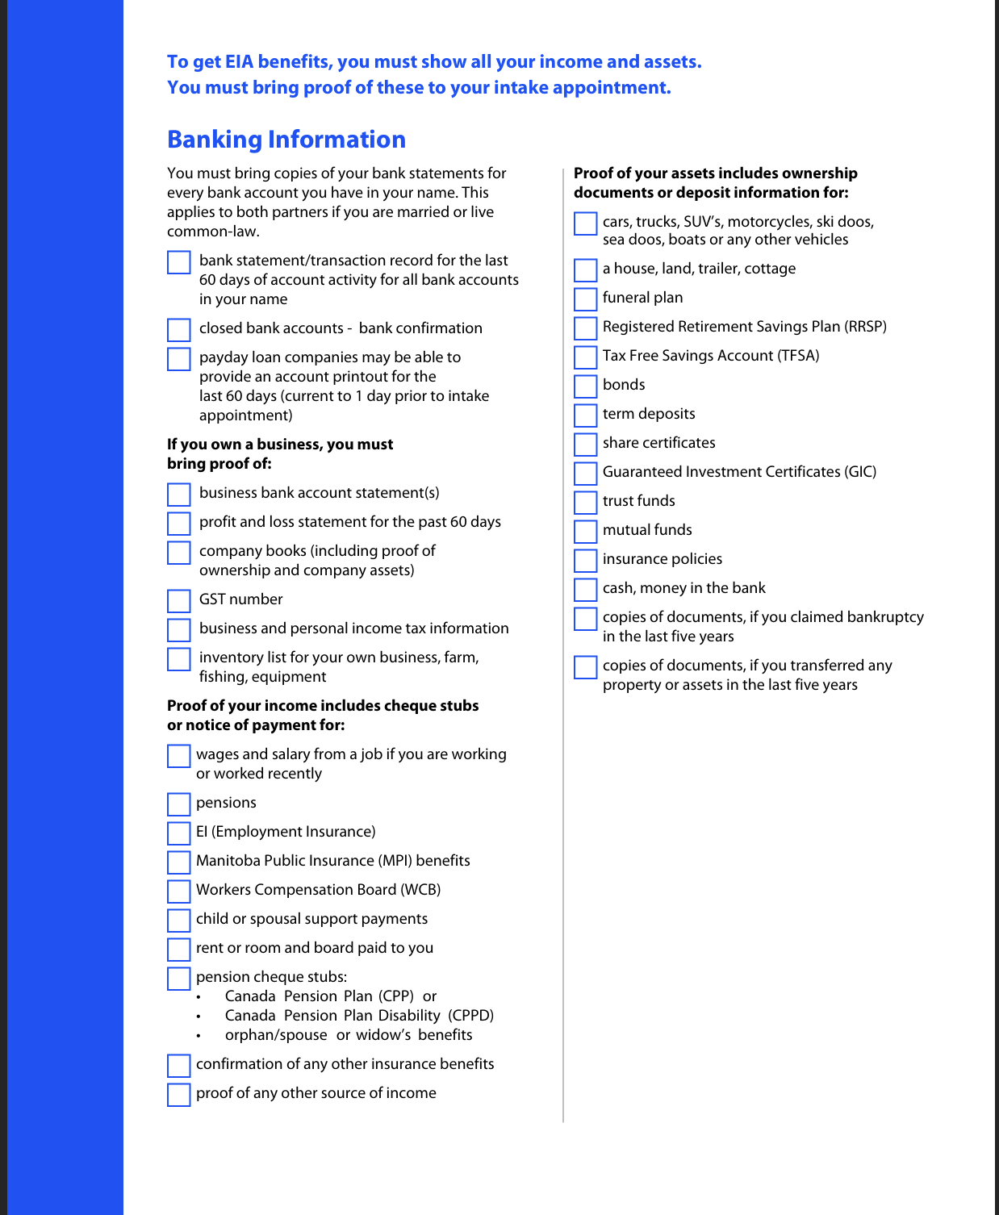
EIA Checklist

Slide 7

Identification
If you do not have your ID’s, you can provide written confirmation that you have applied for new ones. (e.i. Citizens Bridge, SEED Winnipeg, etc.)
Some 3rd Party confirmation of your identity (e.i. End Homelessness Winnipeg staff, AFM, CFS, could write a short document to inform EIA, they know their client to be “Jane Doe/John Doe” and for how long they have interacted with them).

Slide 8
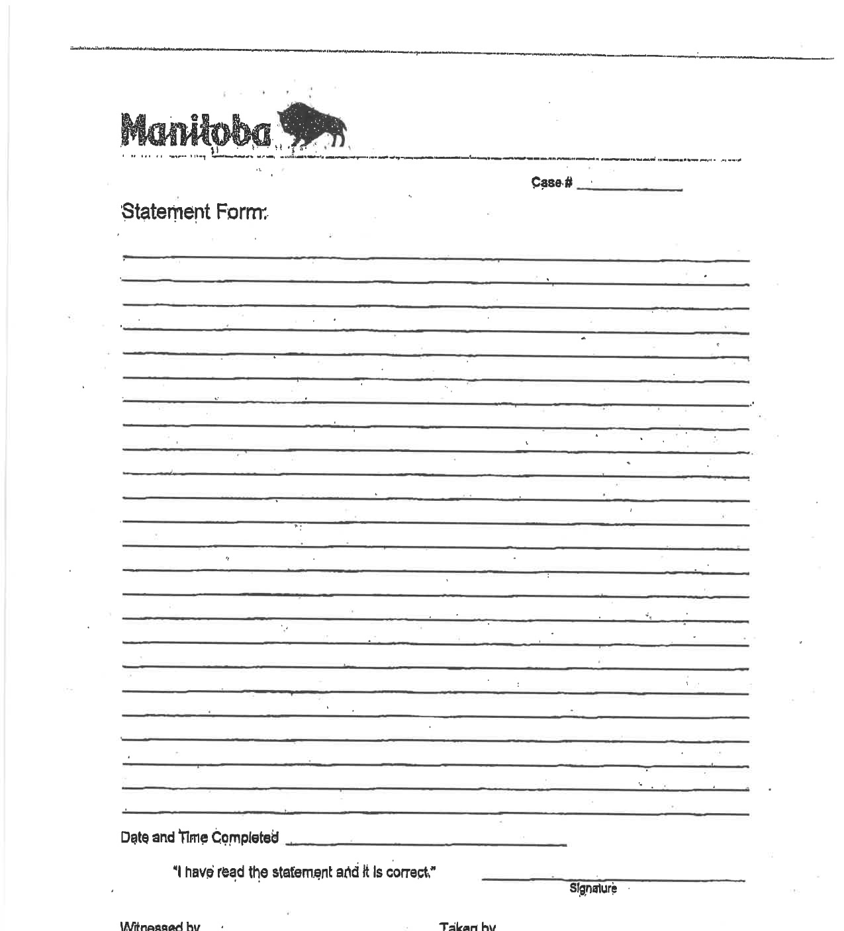
During Intake
The bank statements provided have to be up to the date of your Intake​, from the last 60 days
In the absence of a bank account, you can use this template form to document all cash or assets you have.
Make sure you bring papers for all assets and income you may have under your name (bank accounts, vehicles, properties, investments, pension plans, RRSPs, child support, spousal support, etc.)
If you are not able to work due to health reasons, you may wish to provide a medical note (whenever possible) and request a Medical Package to apply for the Disability Status Category under EIA.​
At your intake appointment, you are able to request the following:
  Emergency food vouchers
  Case number to get your medications covered
  Medical Package: in case you have a medical condition that limits your capability of working enough to support yourself and your dependents
  Rent Funds
Notes:
On an emergency basis you can request at 111 Rorie
Emergency food vouchers (the amount will be deducted from your first EIA cheque)
Emergency medication coverage
An extension to the Intake Application deadline (e.i. cut off date for providing intake documents)

Slide 9
EIA – Forms
Rent Form
Direct Deposit form
Income Declaration Form
Relationship Assessment Form (for people living in shared accommodations)
Therapeutic Diet Form
Medical Supply Request Form
Medical Equipment Request Form

Slide 10
After Intake
Never drop off any documents at the 111 Rorie office. They get lost all the time, instead you can email your documents directly to the Intake Specialist or upload them on the EIA portal
  Submit documents online: https://www.gov.mb.ca/fs/contacting-eia.html​
In doubt about your assets or income?
  Just declare them and let the EIA Department sort through all the documentation regardless. EIA will determine what counts towards assets and what does not. ​

Slide 11
EIA Streams
EIA General
EIA Disability Categories
  Medical Barriers to Full Employment (MBTE)
  MB Supports

Slide 12
EIA General Assistance
You live in Manitoba and are 18 and 65 years of age.
You do not have a disability (or are waiting for your Disability Status approval) and are a:
  single person without dependents/children
  couple without dependents/children
  two parent family
You are in financial need.

Slide 13
EIA General Assistance
Basic needs: $195
Miscellaneous needs: $25 (replacement of ”job seekers allowance)
Health phone allowance: $32.44 (with a simple prescription)
Health transportation to medical appointments: by providing confirmation of appointment in advance, participants can get bus/cab fares as applicable.
Therapeutic Diet allowances/Supplements for chronic conditions

Slide 14
EIA – GENERAL ASSISTANCE - Work expectations
Between the ages of 18 and 55, having work expectations means that you are considered employable and need to be looking for any kind of work.
You have to comply with any Work Readiness program that EIA refers them to: OFE (Opportunities for Employment, Wpg Transition Centre, Jobs on Market, etc.)
Able to attend training programs through MB Jobs and Skills Development, Adult Education upgrading (Grade 12)
If you get approved for such programs, you can get full transportation coverage.
Work Readiness program attendance is mandatory.
Notes:
We have to remember that EIA is designed as a last resort program. They will encourage thosewho are able to work, to find employment or enroll in a skills building class intended to help find employment. The department can stop or hold benefits if these expectations are not met. ​
​

Slide 15
Employment Expectations do not apply to:
Aged participants and participants with disabilities;
01
Children 17 & 18 attending education or training;
02
Participants with dependants in need of special care;
03
Participants residing in crisis intervention facilities;
04
Minor single parents in the last trimester of pregnancy or with a child under six years old
05

Slide 16
EIA – WORK INCENTIVE PROGRAM
Myth: “If you work you get cut off from EIA”
You are allowed to earn $200 of net work earnings and still get their full EIA benefits.
You will also be able to keep 30% of whatever you make over those $200 and EIA will deduct the remaining 70% from their budget.
Once you get a job offer, you need to send it to their Case Counsellor as soon as possible in order to get the following add-ons to their budget:
  Full rent for the first month
  Full bus pass
  Work clothes allowance as needed.

Slide 17
EIA – General assistance Money exempt
$100 occasional gift from family and/or friends (not ex spouses or current spouses)
Up to $4,000 in liquid assets per household member up to $16,000
Child Care Benefits
GST Credits
Income Tax Returns
Money Settlements as a result of Courts Decisions in most of cases related to Indigenous issues (e.i. Sixty’s Scoop, Residential Schools Survivors, Cows & Plows etc.)
Canada Student Grants, etc.

Slide 18
EIA – GENERAL ASSISTANCE DON’ts
Do not stop attending the Work Readiness program that EIA referred you to.
Do not refuse an employment without a documented justification.
If you feel that your health condition does not allow you to follow through with EIA’s expectations, talk to your doctor and ask for a medical note detailing your limitations.
With that on hand, request a Medical Package to your Case Counsellor. Once you receive it, your working expectations should be waved until the EIA Interdisciplinary Panel decides whether or not you get the Disability Status.

Slide 19
EIA FOR SINGLE PARENTS
The parent requesting social assistance at intake, must provide the following mandatory documents:
  Proof of having the child’s custody on a full-time or part-time basis (court order or private agreement)
  Child’s birth certificate (if you don’t have it, please request EIA to provide the basic fee to get one)
  Marital status: Divorce papers and/or separation agreement as applicable
  Proof of request for child support (at least an application for Legal Aid) if applicable

Slide 20
EIA FOR SINGLE PARENTS – don’ts
The parent requesting social assistance should not:
  Refuse to pursue child support
  Fail to report child apprehension and loss of custody
  Fail to report any financial resource that the other parent provides at any given time (even if the Child Care Benefit is being shared informally)
  Fail to report that the child support has been interrupted or reinstated
  Fail to report any changes in family size (marriage, common-law partner, new baby, etc)

Slide 21
Medical Barriers to Full Employment - Formerly Disability status
Section 5(1) of the Manitoba Assistance Act defines the eligibility criteria for the Disability Status under EIA as follows:
    (a) who, by reason of age or by reason of physical or mental ill health, or physical or mental incapacity or disorder likely to continue for a period of more than one year,
(i) is unable to earn an income sufficient to meet the basic necessities of themselves and their dependants, if any;…”
This means we need to be able to show the department that your disability is prolonged and severe. Which indicates a high impact on your daily living. This needs to be supported by medical evidence provided by your doctor or specialist.

Slide 22
EIA INTAKE – MBTE
You should request an intake appointment as a person with a disability if:
  You live in Manitoba and are 18 years of age or older.
  If you by reason of age or by reason of physical or mental ill health, or physical or mental incapacity or disorder that is likely to continue for more than 12 months
    is unable to earn an income sufficient to meet the basic necessities of himself and his dependants, if any; or
    is unable to care for himself and requires to be cared for by another person or in an institution or home for the aged or the infirm

Slide 23
EIA – INTAKE FOR persons with a disability
At intake you have to request a Medical Package if you have a health condition that will last more than 12 months and prevents you from working enough to support yourself
The medical package includes:
  Self Report: Always take time to fill this out. That is your only chance to explain to theMedical Panel, in your own words, how your disability affects your daily living.​
  Medical Assessment Report: A medical practitioner can fill it out. This includes a Registered Nurse.
  Bill for service: This is also for the medical practitioner to send to EIA
The Medical Panel will assess your medical info and determine whether you are eligible for Medical Barriers to Full Employment or for the MB Supports program.​
This application process can take up to 4 months. In the meantime, you can still remain on General Assistance benefits.​
  Unless you are receiving CPP-Disability Benefits, you will be put in the General Assistance Category until a decision is made regarding your Disability Status
Notes:
At point of Medical assessment report ;
Always keep your family doctor and/or registered nurse updated on your past and current health conditions.
If you have been granted Disability Status temporarily, it is your responsibility to request and follow the applicable treatment depending on the nature of your illness.
Request evaluations to your doctor, as needed (ei. MRI’s, CT Scan’s, Ultrasounds, etc.)
Remember, it is always better to ask a specialist to fill out the Disability Assessment Report instead of your family doctor and/or registered nurse.
Your doctor has to provide a very specific description of how your medical condition does not allow you to work enough to support yourself & your dependents.
Always take time to fill out the Self Assessment Report. That is your only chance to explain to the Medical Panel in your own words how affected is your daily living.

Slide 24
EIA – MBTE status Money exempt
part of employment earnings
part of rent or room and board paid to the participant
up to $500 gift per month from family or friends
foster home maintenance payments
Rent Assist while receiving EIA benefits
Canada Child Tax Benefit
Universal Child Care Benefit
tax credit refunds
Manitoba Prenatal Benefit Program benefits
earnings of children who are in school or an EIA‑approved program, full-time
Registered Disability Savings Plan withdrawals

Slide 25
EIA – MBTE – VOLUNTEER ALLOWANCE
If you have the MBTE status, you are eligible for a monthly volunteer allowance as follows:
  4 to 7 ongoing times per month: $50
  8 or more ongoing times per month: $100
To release this allowance, the volunteer activities must meet the following conditions:
  Proof of ongoing attendance must be provided through a Volunteer Log Sheet.
  The approved volunteer placement must take place in a non-for-profit agency outside of your place of residence.
  If you are already engaged in a job readiness program; such as EAPD, you cannot receive the volunteer allowance at the same time.
  The volunteer log sheet must be handed in to the CC every month to get the allowance.

Slide 26
EIA – Applying for CPP at age 60
As of July 1, 2020 it is not mandatory to access CPP benefits at age 60 for people that have the Disability Status.
However, at the age of 65, participants are required to apply for CPP
EIA can “top up” the amount received from CPP if it is below your budget.

Slide 27
EIA – MB Supports
Participants of this program will have:
  an assigned financial worker to issue monthly benefits;
  increased basic needs benefits of approximately $100 per month
  laundry and phone allowances automatically added to budgets
  ability to earn up to $12,000 per year before benefits are impacted
  access to health benefits for two years after a file closes.

Slide 28
EIA – Disability status don’ts
Getting the Disability Status is not easy.
If you don’t comply with what the medical practitioners are recommending as a treatment plan, it will be very difficult to get your Disability Status renewed.
If you wish to work, that is OK, as long as it is at a limited capacity and you report it every month you your Case Counsellor.

Slide 29
EIA – How to represent yourself
Always keep a record of all the conversations/documents you have with your Case Counsellor.
All the decisions that affect your monthly budget have to be mailed to you.
It is OK to ask WHY? Absolutely!
  The Case Counsellor has to provide you with a reason backed by a regulation and/or policy.
Most decisions at EIA are made on a “case by case” basis. Therefore, it all depends on how good of a case you can make for yourself.
Always ask your Case Counsellor what can you provide in order to change a decision (eg Disability Denial).
If after requesting a reconsideration of the decision, you get denied again, you can proceed to the Social Services Appeal Board
You can appeal a decision directly to the Social Services Appeal with chances of winning only if your argument is supported by the current legislations and regulations.

Slide 30
EIA – How to represent yourself
If you feel that your Case Counsellor is not being fair or mistreating you, you can contact the Fair Practices Office and file a complaint:
Fair Practices Office
Phone: 204-945-1047
Toll Free: 1-800-282-8069
ext. 1047
Fax: 204-948-3713
Email: fairpractices@gov.mb.ca

Slide 31

☺ Questions? ☺
For more information/directions you may contact us 204-942-6556

