Slide 1


Slide 2
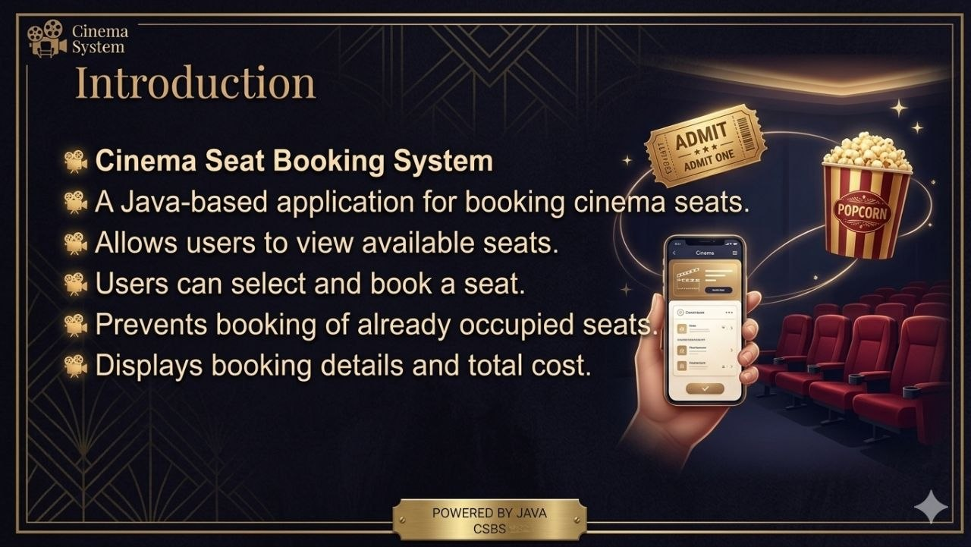

Slide 3
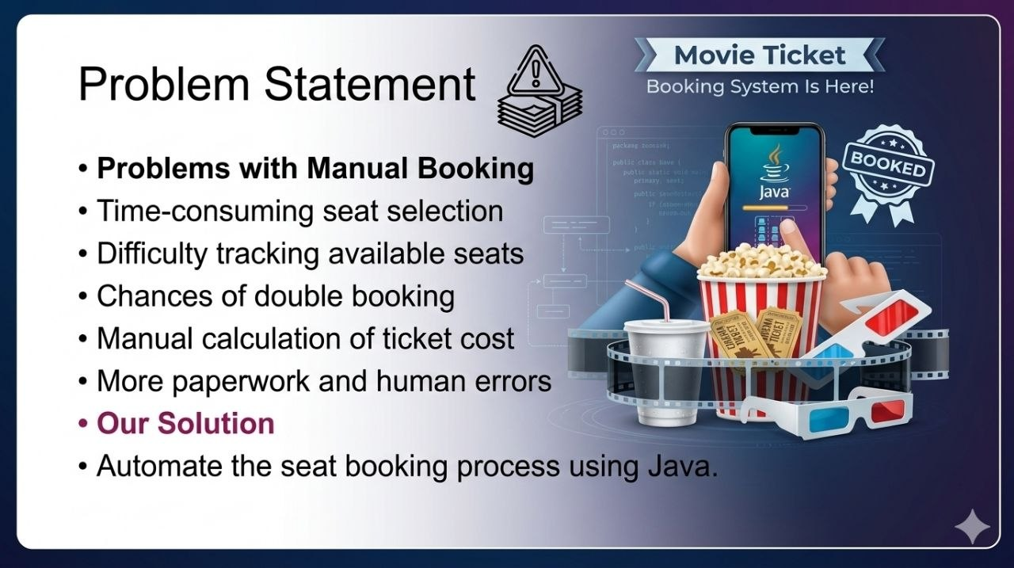

Slide 4
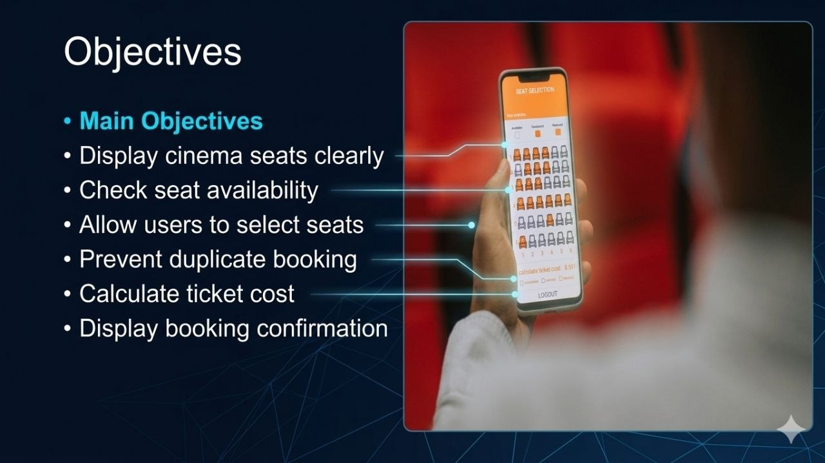

Slide 5


Slide 6


Slide 7
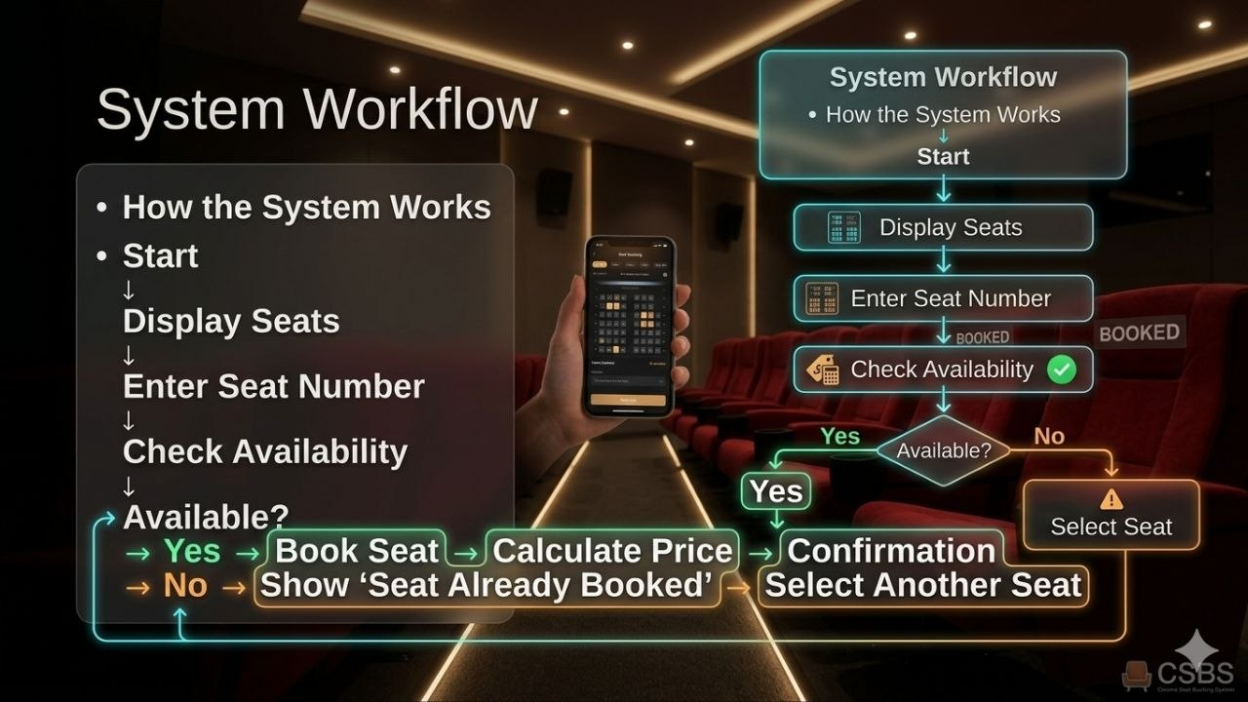

Slide 8
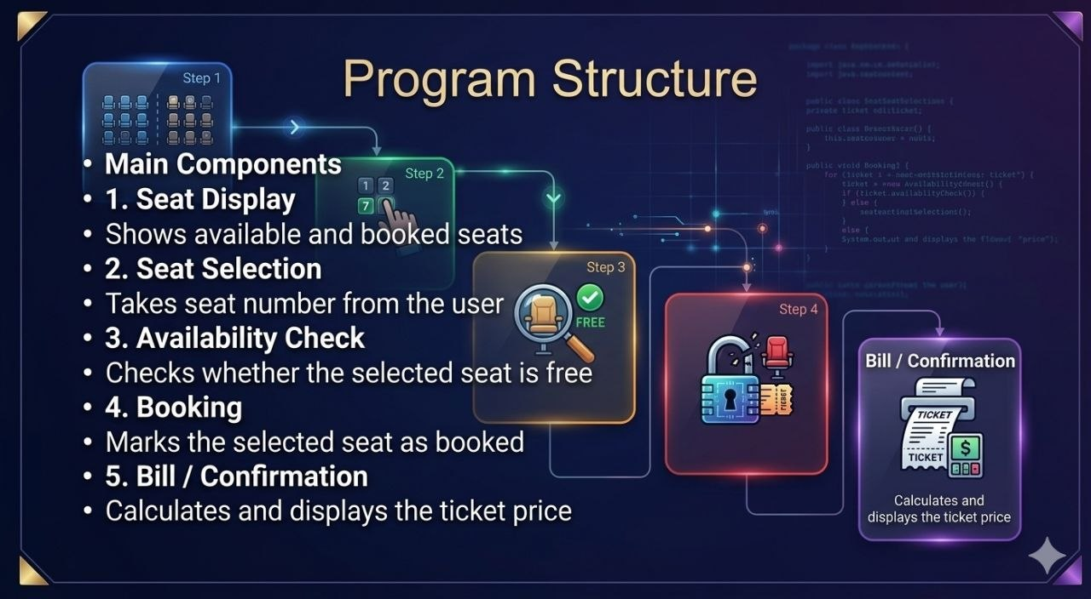

Slide 9


Slide 10
CINEMA SEAT BOOKING SYSTEM
CO1 • JAVA FUNDAMENTALS
Variables, Data Types & Operators
Variables
Store seat number, movie name and ticket cost.
Data Types
Use int for seat numbers, String for movie names, boolean for booking status.
Operators
Use + to calculate total price and == to compare values.
JAVA MINI PROJECT • CINEMA BOOKING

Slide 11
CINEMA SEAT BOOKING SYSTEM
CO2 • DECISION MAKING
Conditions & Loops
if / else
Check whether the selected seat is available.
switch
Choose menu options such as View, Book and Exit.
for / while
Display seats and allow repeated bookings.
JAVA MINI PROJECT • CINEMA BOOKING

Slide 12
CINEMA SEAT BOOKING SYSTEM
CO3 • METHODS & ARRAYS
Organising Seats and Reusing Code
Arrays
Store seat availability in an array.
Methods
Create displaySeats() and bookSeat() functions.
Parameters
Pass the selected seat number into a method.
JAVA MINI PROJECT • CINEMA BOOKING

Slide 13
CINEMA SEAT BOOKING SYSTEM
CO4 • OBJECT-ORIENTED JAVA
Classes, Objects & Constructors
Class
A CinemaBooking class groups data and actions.
Object
A booking object can manage seats for a show.
Constructor
Set up initial seat availability when the object is created.
JAVA MINI PROJECT • CINEMA BOOKING

Slide 14
CINEMA SEAT BOOKING SYSTEM
CO5 • STRINGS & INPUT
Customer Choices and Validation
Scanner
Read the seat choice from the keyboard.
String
Store and display movie or customer names.
Validation
Reject invalid seat numbers and repeat bookings.
JAVA MINI PROJECT • CINEMA BOOKING

Slide 15
CINEMA SEAT BOOKING SYSTEM
CO6 • INTEGRATION & TESTING
Complete Booking Workflow
Workflow
Display seats → choose seat → validate → confirm.
Output
Show updated seats and booking confirmation.
Testing
Check available, occupied and invalid seat cases.
JAVA MINI PROJECT • CINEMA BOOKING

Slide 16
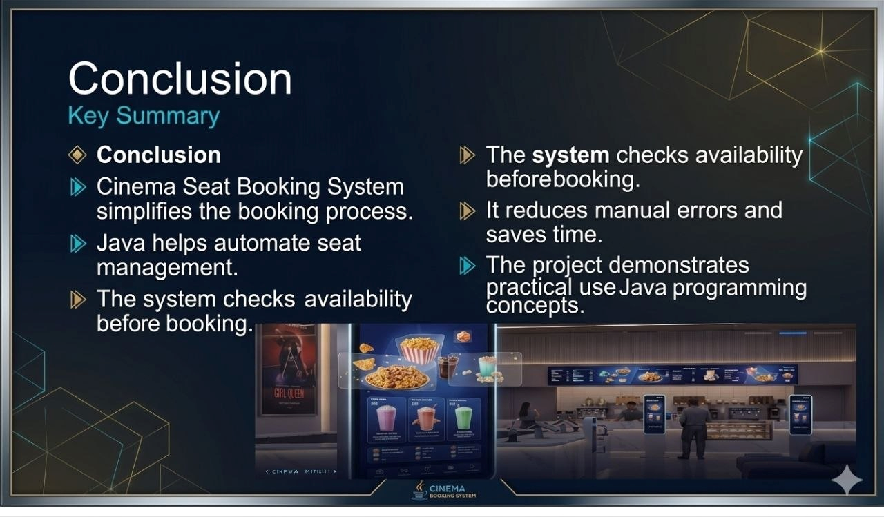

Slide 17


Slide 18
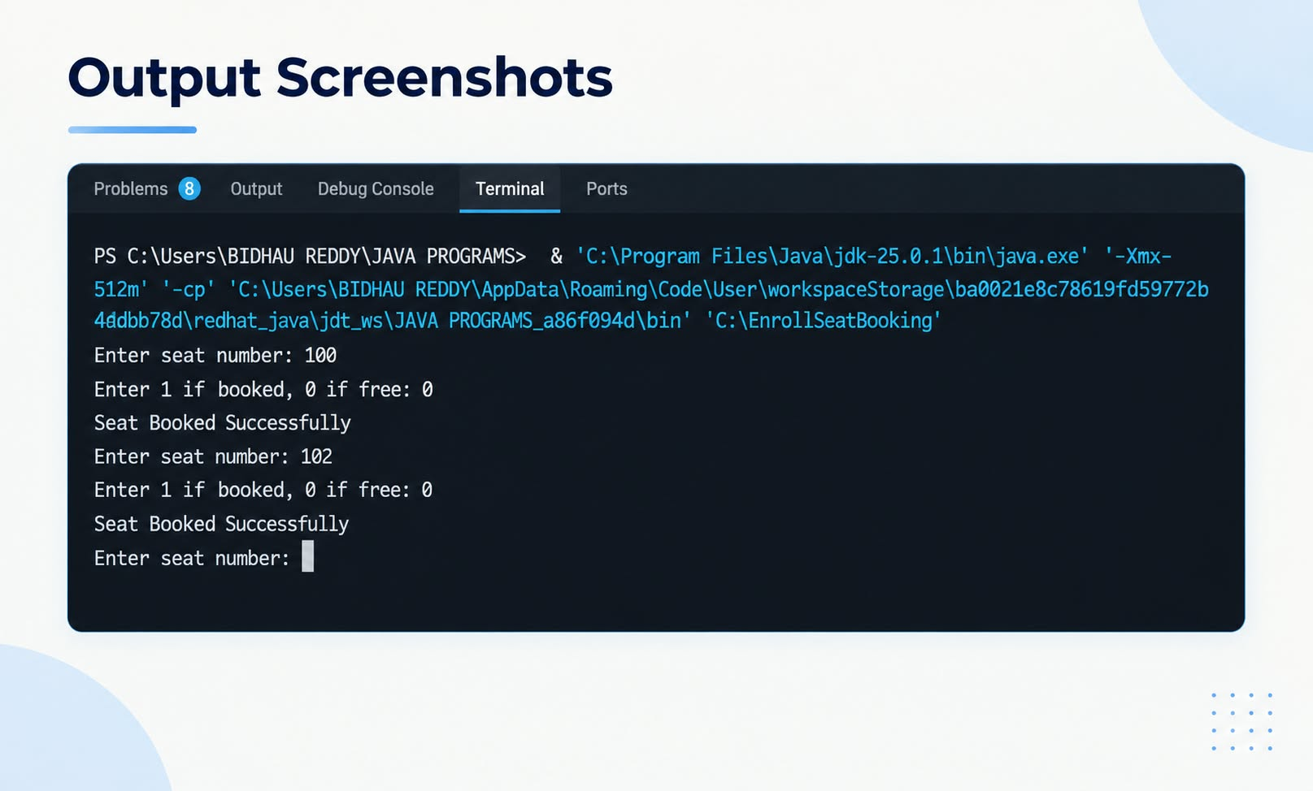

Slide 19
GEO-TAG PHOTO & GITHUB LINK
CINEMA SEAT BOOKING SYSTEM • JAVA MINI PROJECT
GEO-TAGGED PROJECT PHOTO
GITHUB REPOSITORY
GH
INSERT GEO-TAGGED PHOTO HERE
Add a project/team photo with location metadata
GitHub Repository URL
PASTE YOUR GITHUB LINK HERE
Geo-tag / location details: add here
KLH UNIVERSITY • LEARN | INNOVATE | TRANSFORM
20

Slide 20


