Slide 1
ST1 Capstone Project
Dylan Colwill

Slide 2
Capstone Project
Predict various types of cancer using machine learning techniques
Using Python libraries
Pandas : data manipulation
NumPy : numerical operations
Matplotlib & Seaborn : visualisation
Scikit-learn & Keras : machine learning
Tkinter : GUI

Slide 3
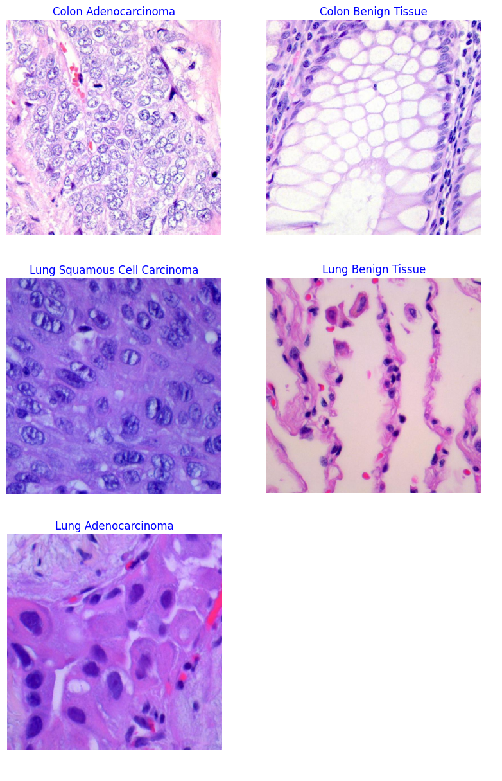
Dataset Details
Images of HIPAA compliant colon and lung tissues
Colon Adenocarcinoma
Colon Benign Tissue
Lung Adenocarcinoma
Lung Benign Tissue
Lung Squamous Cell Carcinoma

Slide 4
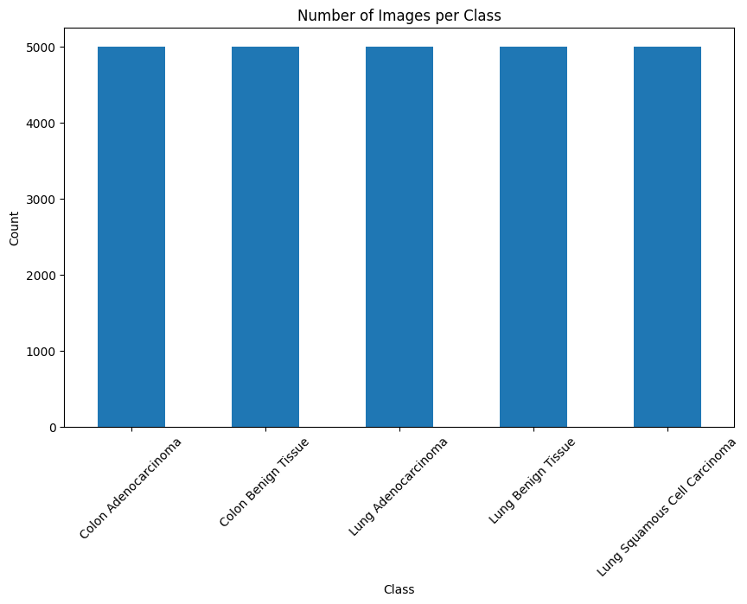
EDA
Visualising images
t-SNE scatter
Analysing lighting artifacts
Plots

Slide 5
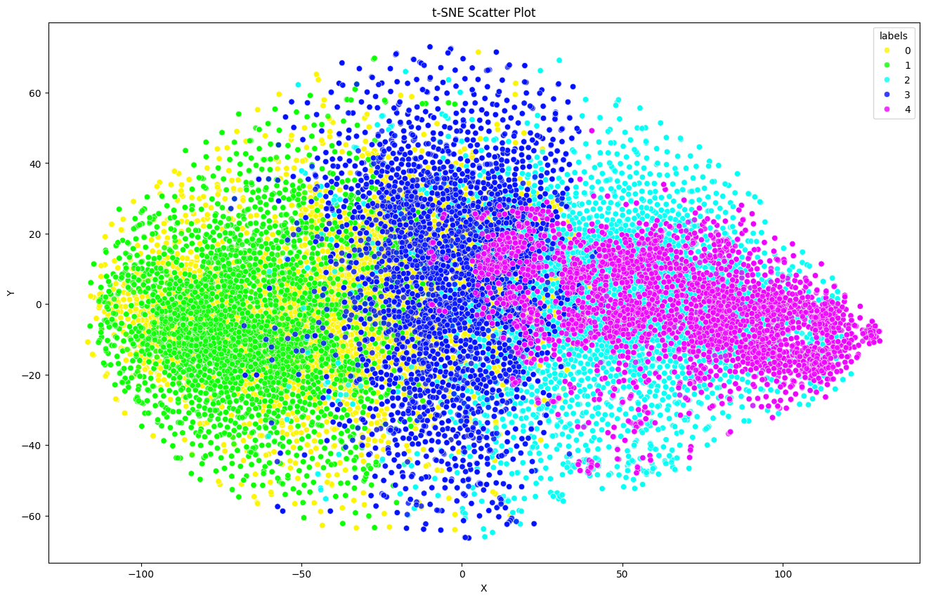
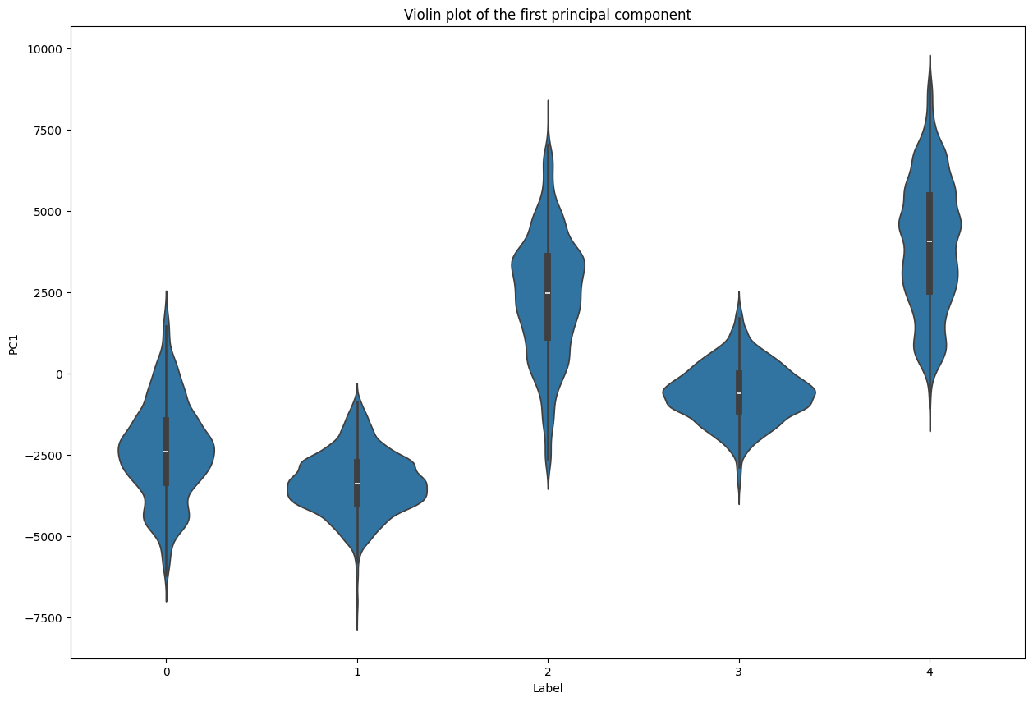
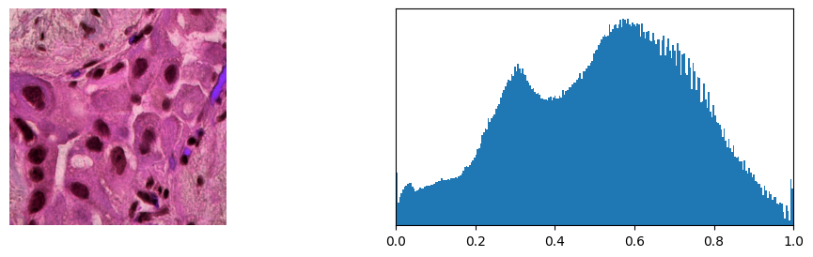
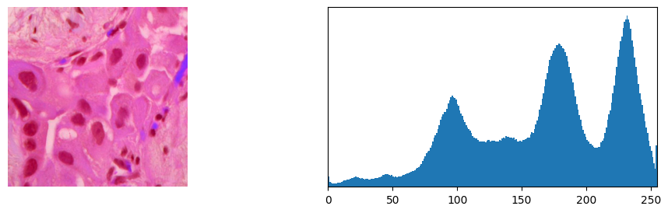
EDA Output

Slide 6
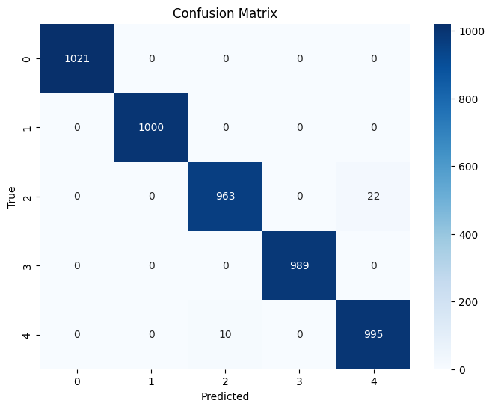
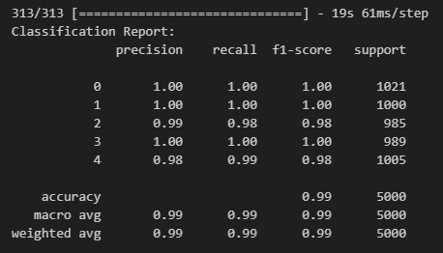
PDA
Convolutional neural network (CNN) model using Keras
Accuracy of 99%

Slide 7
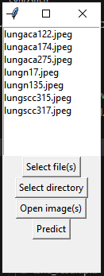
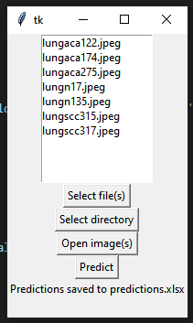
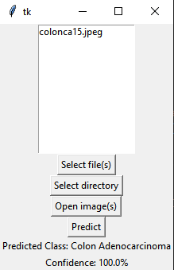
GUI

Slide 8
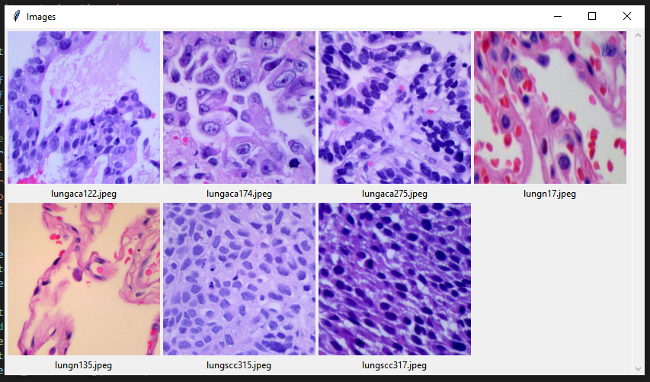
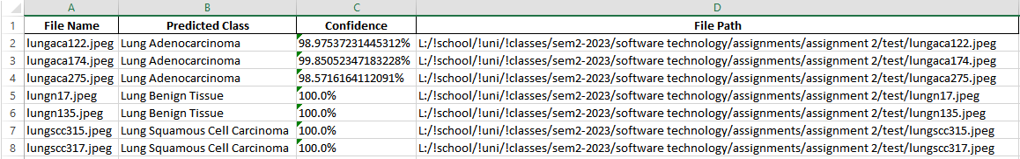
GUI

