Slide 1

Valentin Monod, Axel Hall, James Zeiger, Florian Favre, Gonçalo Arieira Esteves

Slide 2
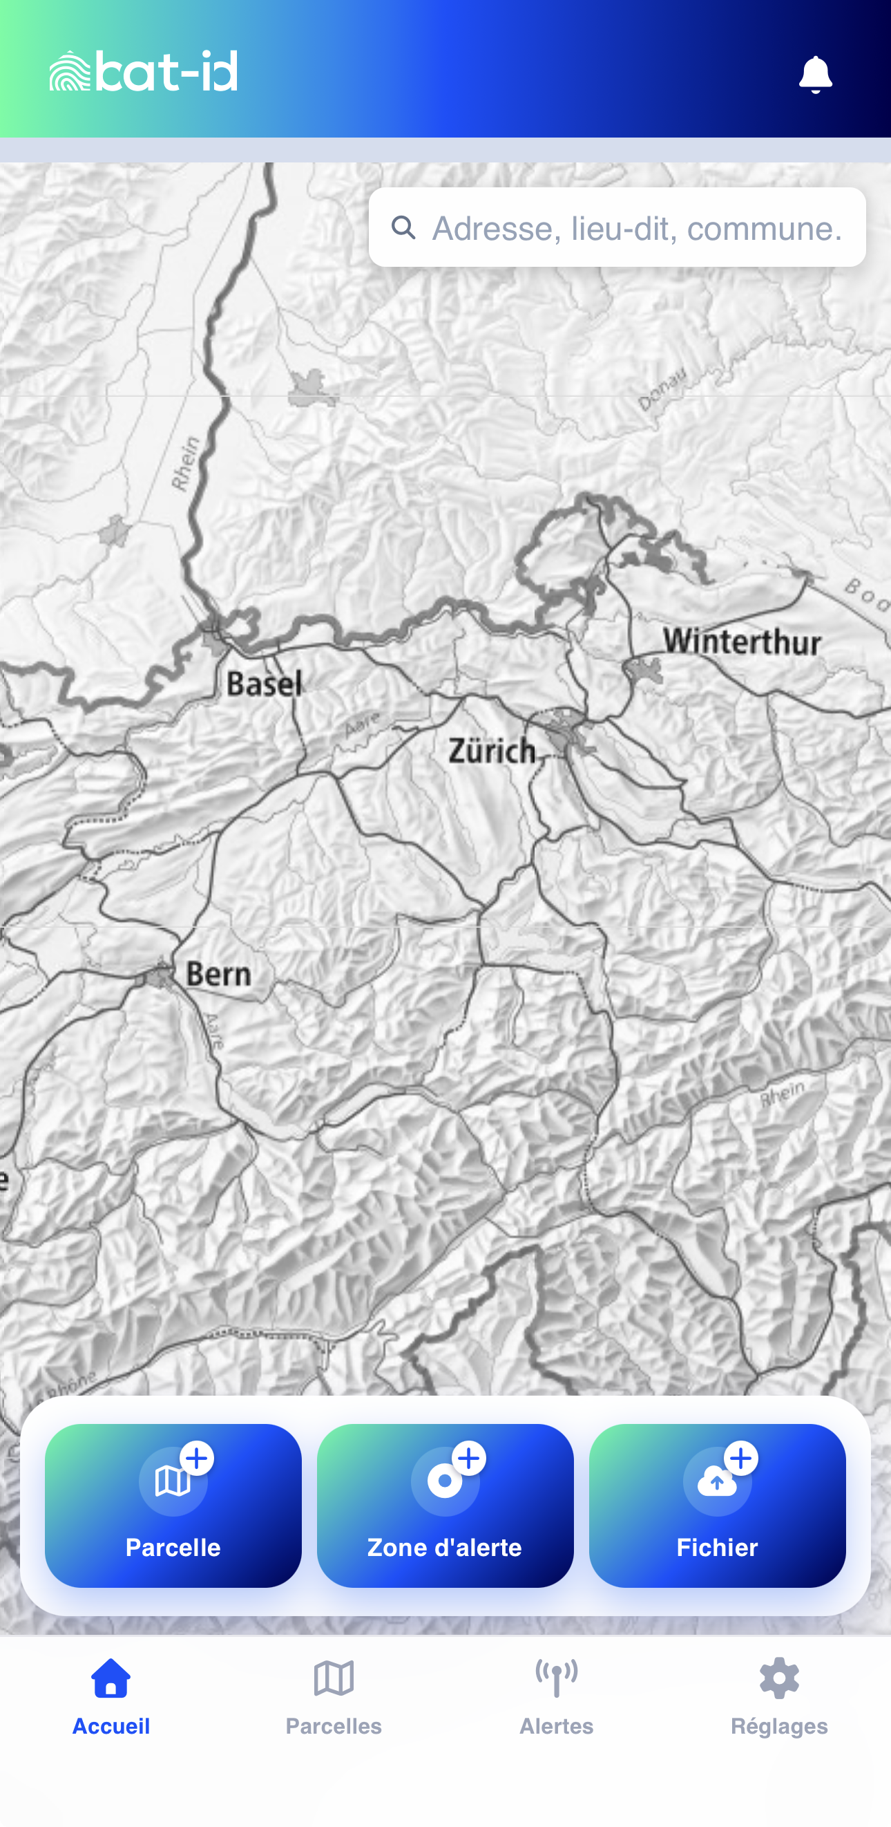


Slide 3
Questions ?

