Slide 1
Irony Regulates Negative Emotion – in Speakers and Listeners
Valeria A. Pfeifer & Vicky T. Lai
Department of Psychology & Cognitive Science Program
University of Arizona
vpfeifer@email.arizona.edu

Slide 2
Verbal irony: literal meaning contrasts with intended meaning
e.g.: “How sunny!” when it’s raining
Irony is primarily used to express negative emotions
mildens negativity compared to literal (tinge hypothesis)
irony dilutes negativity for speakers (e.g. eyetracking, ERP, ratings)
What’s the Mechanism?
cognitive reappraisal; a form of emotion regulation
Reinterpreting the emotional cue to make it less negative
Participant = involved as listener

Slide 3
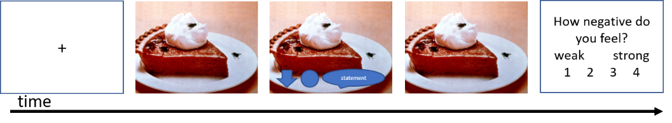
Design
Verbal /
Non-verbal
132 negative images
“imagine that the negative situation in the image is happening to you”
2 blocks
1. verbal: irony, literal
statements matched for length, frequency, orthographic and phonological neighborhood
[A cracked phone screen]: “Such skillful handling”
[Dropped food]: “How yummy!”
[A flat tire]: “Pretty filled!”
2. non-verbal: attend, reinterpret
Instructions given how to use the reappraisal strategy in line with prior literature
Task: “How negative do you feel?” (1 = weak – 4 = strong)

Slide 4
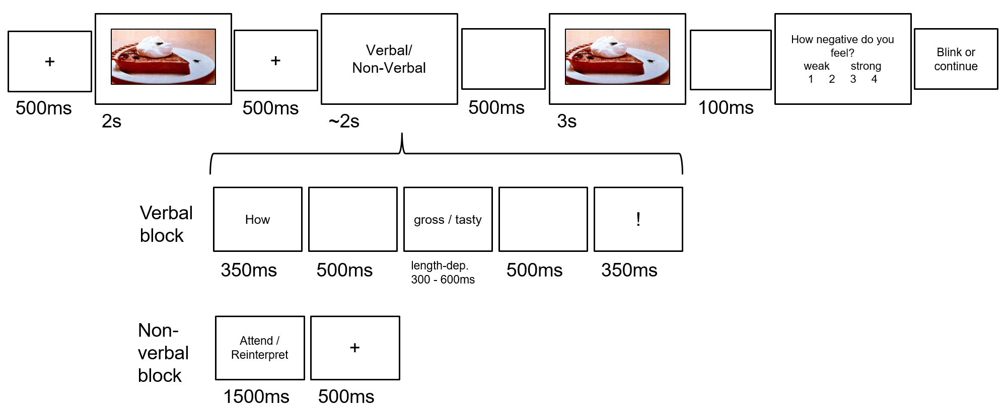
Predictions: behavioral and ERP effects for cognitive reappraisal are comparable to those for irony

Slide 5
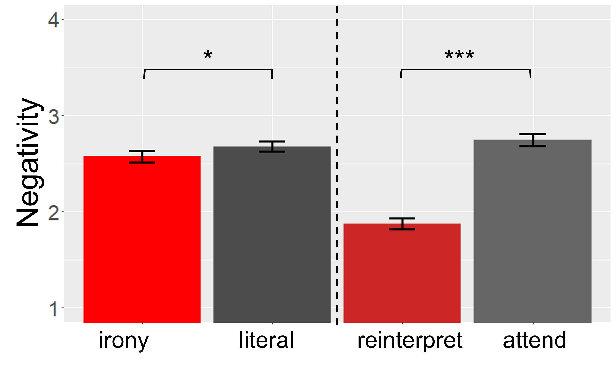
Behavioral Results (N = 54)
irony < literal (p = .03)
literal = attend
reinterpret < attend (p < .001)
reinterpret < irony (p < .001)

Slide 6
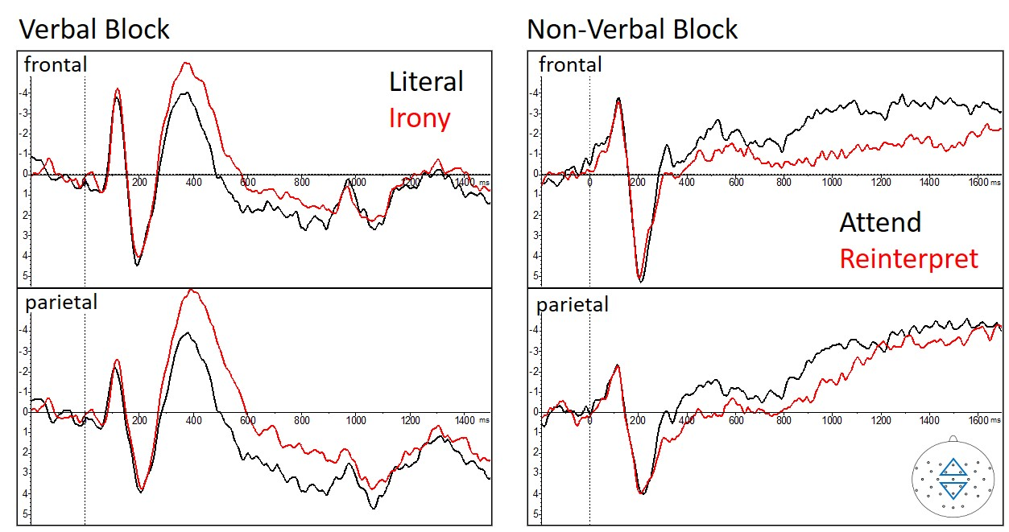
ERP results (N = 43)
Irony > literal: N400 (300-500 ms)
Irony < literal: LPC (600-900 ms)
Sustained negativity
reinterpret < attend: N400 (300-550 ms)
reinterpret > attend: frontal LPP (800-1500 ms)
Decreased negativity

Slide 7
Behavior: IRONY < LITERAL
in line with tinge hypothesis
expands previous research from bystanders to listeners
But: irony is not as effective as reappraisal
ERP: irony and reappraisal act in related, yet different ways
Ironic words contrast the scene depicted by the image
contrast continued to be processed (elaborate or integrated) reflected by the sustained negativity
Cognitive reappraisal recruits later and more frontal resources, potentially linked to executive control or imagination

Slide 8
Conclusion:
Irony is indirect yet effective tool in reducing negative emotions in others
Does not require active participation from the listener
Irony mildens negativity in speakers and in recipients
Irony’s pragmatic functions can be both self- and other serving

