Slide 1
HVAC Management App
Valentin Atanasov

Slide 2






TABLE OF CONTENTS
01
02
03
04
05
06
Team
Features
Chosen technologies
Work division
Major difficulties
Easiest Parts

Slide 3
01
Valentin & ChatGPT

Slide 4
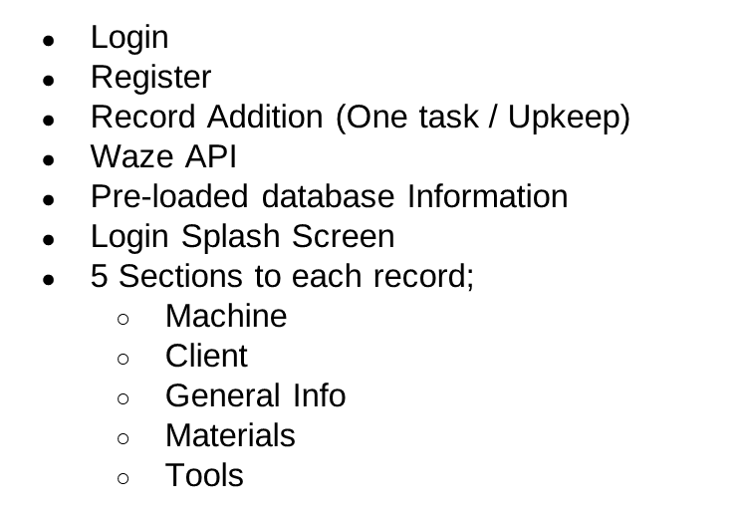
07

Slide 5
Login
Register
Record Addition (One task / Upkeep)
Waze API
Pre-loaded database Information
Login Splash Screen
5 Sections to each record;
  Machine
  Client
  General Info
  Materials
  Tools

Slide 6




Database and APIs
Local SQFlite file: Pre-entered information about the records & Private installations
Waze API as it allows for users to post information pertaining to road conditions and hazards

Slide 7

App Planning, Page Design, Database configuration, API (Future), Splash Screen (Future), User logic, Navigation, etc. VALENTIN
Debugging & Automation ChatGPT

Slide 8

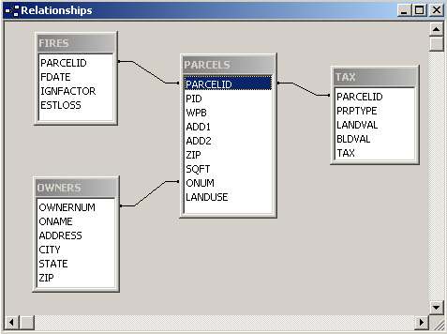
Multiple table database (Foreign Keys & Relations)
Waze API
Navigation Pages (Array)

Slide 9

Page Creation
Database Design
Deciding which features
Teamwork

Slide 10
07
No

Slide 11
08
Everything is on the main

Slide 12
09
Demonstration

Slide 13
Thank you!
Questions?

Slide 14

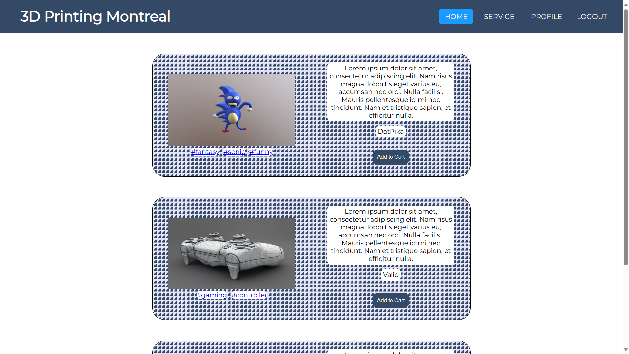
Home
The home page is a centerspace where users can browse templates of different kinds and from different users.

Slide 15
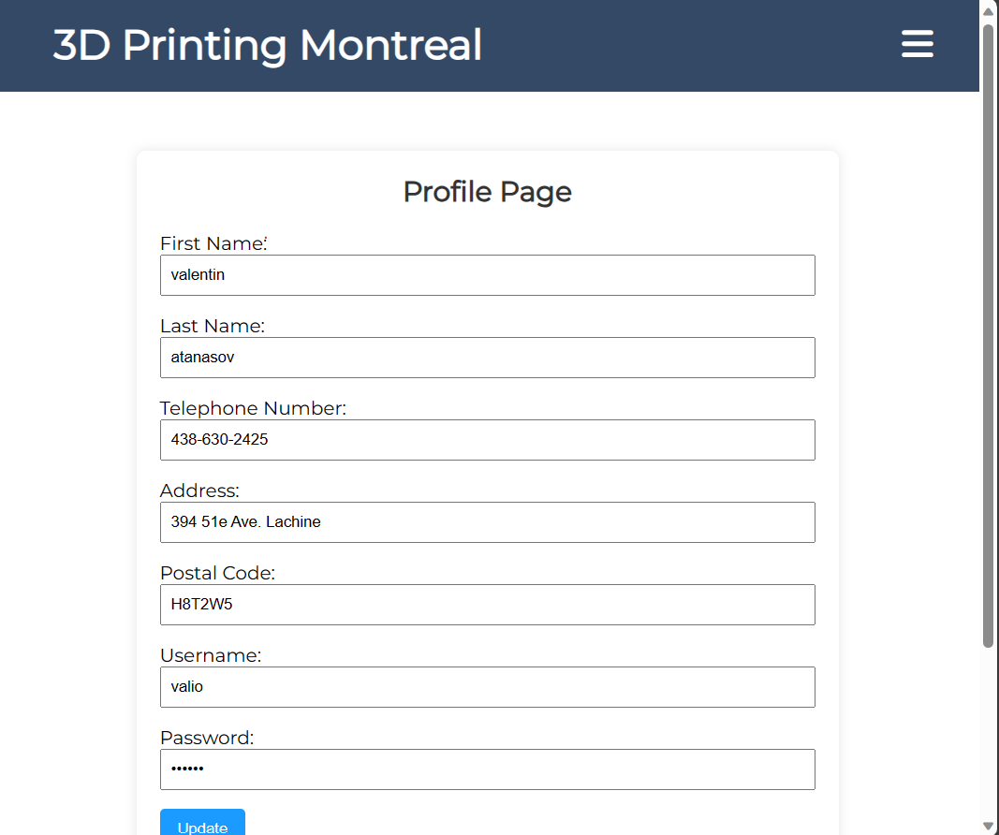
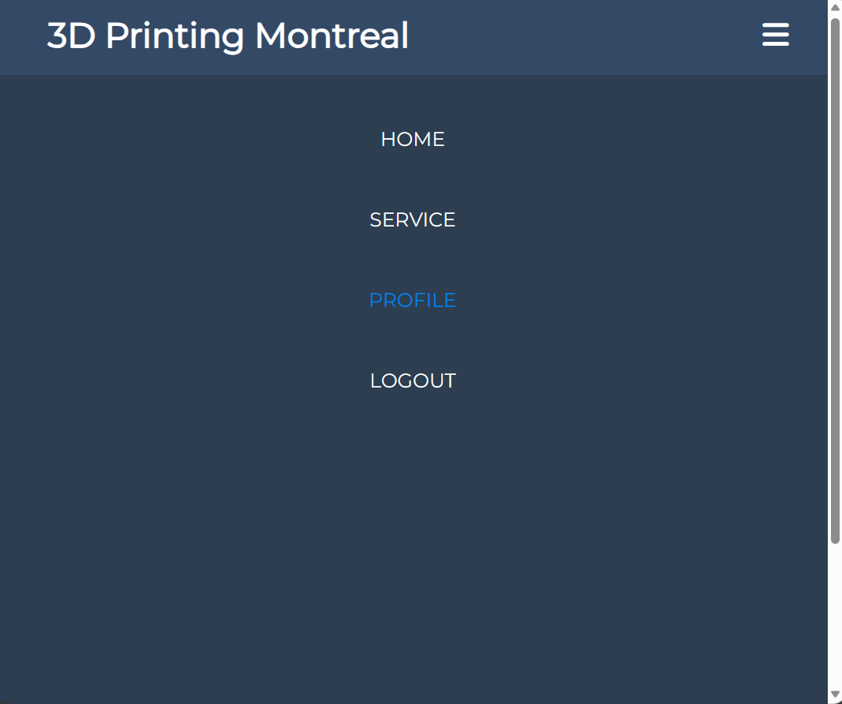
Home-Display
The navigation bar changes dynamically

Slide 16
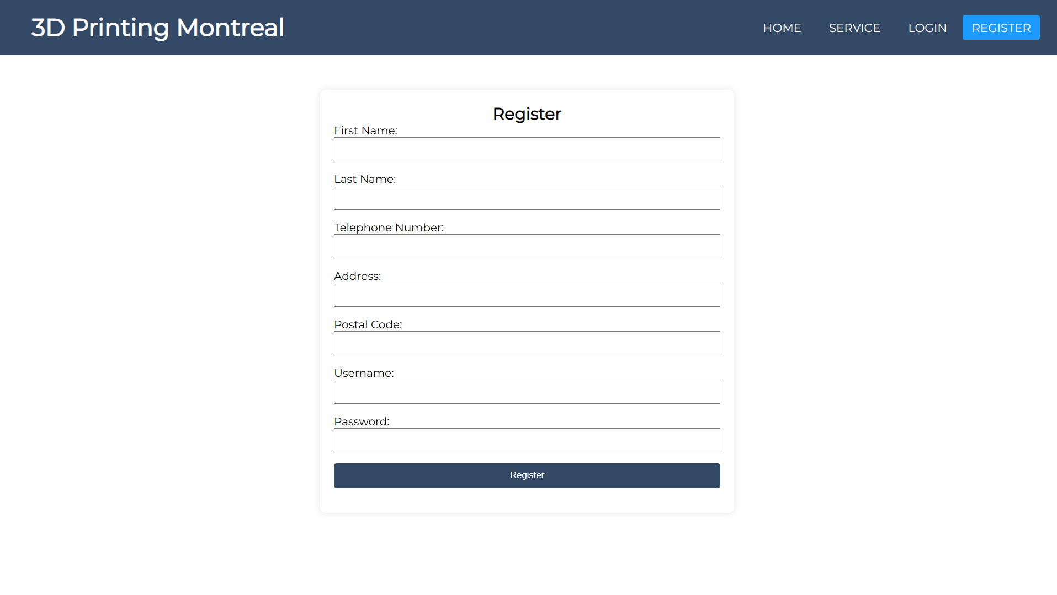
Register
Registering as a new user

Slide 17
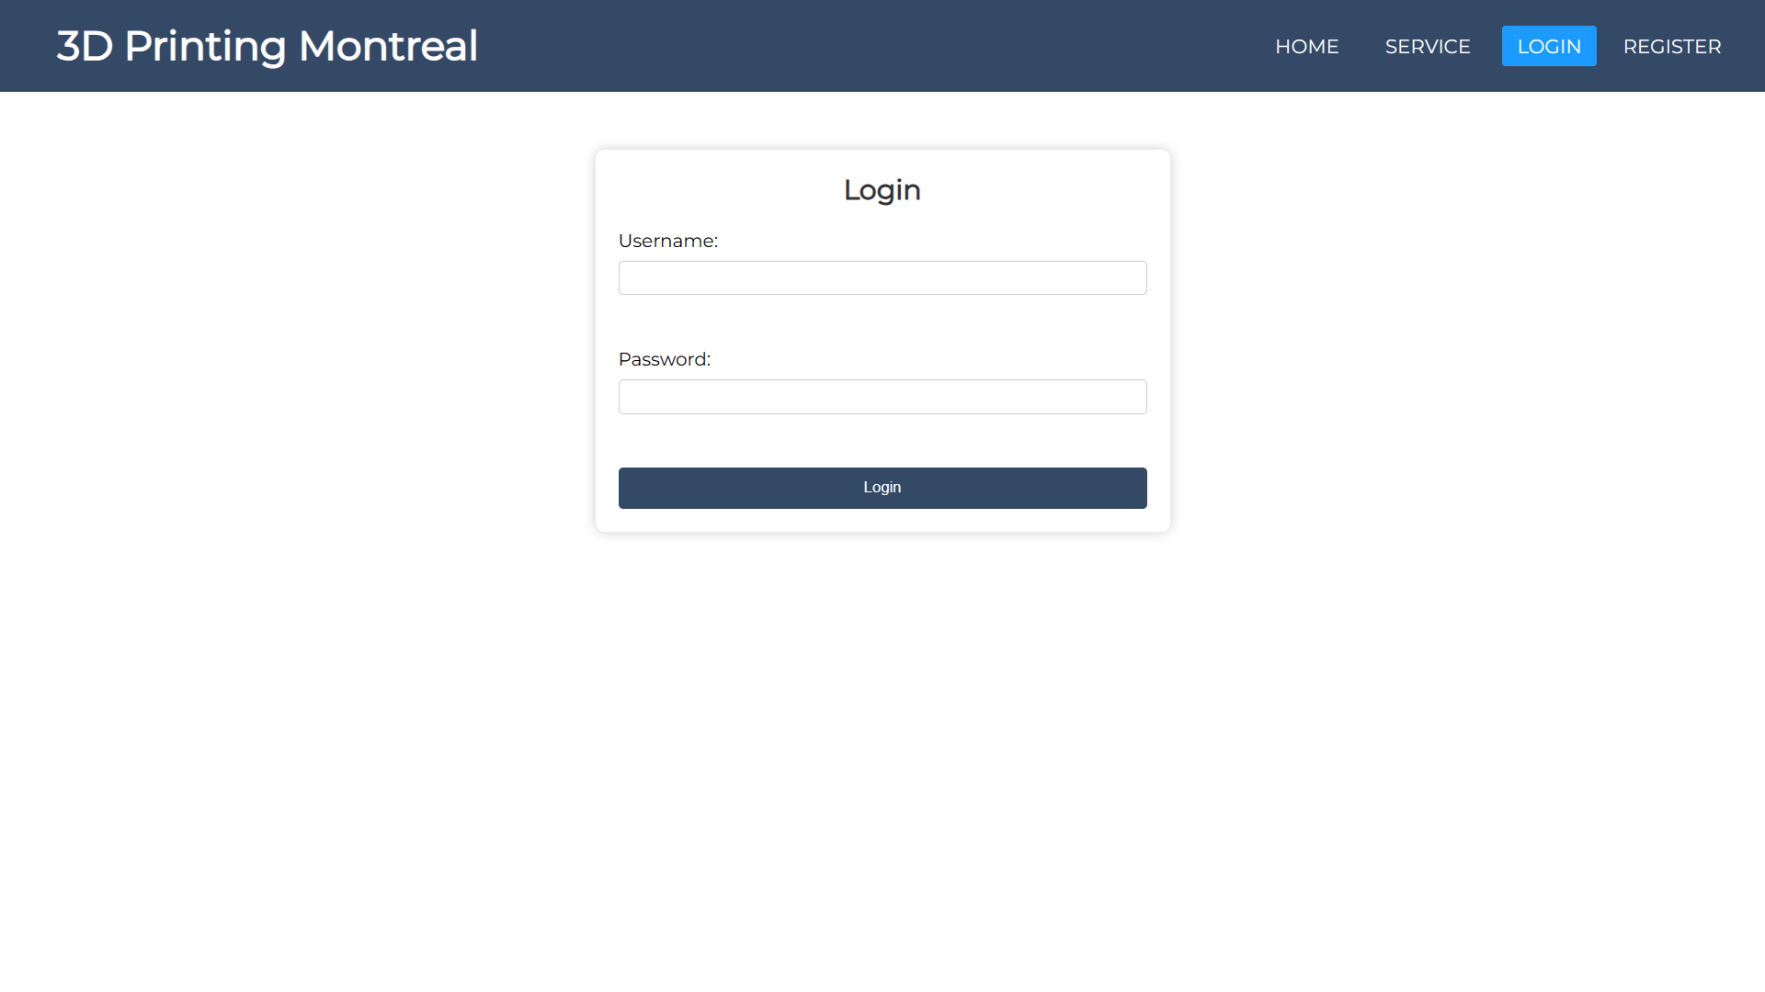
Login
Logging in as an existing user

Slide 18
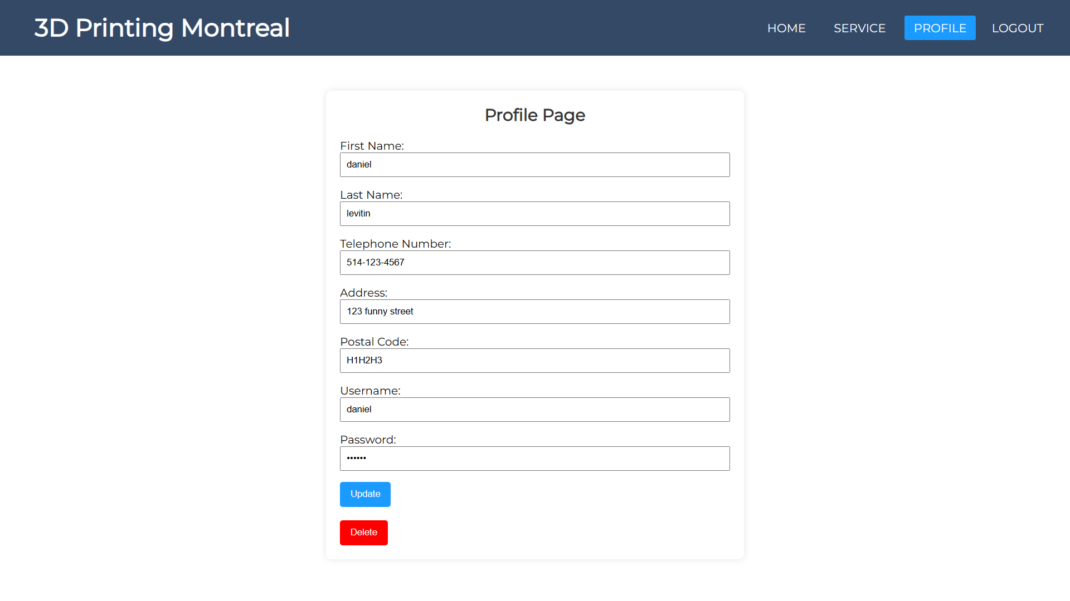
Profile
Users can view information about their account, along with their previous orders/prints

Slide 19
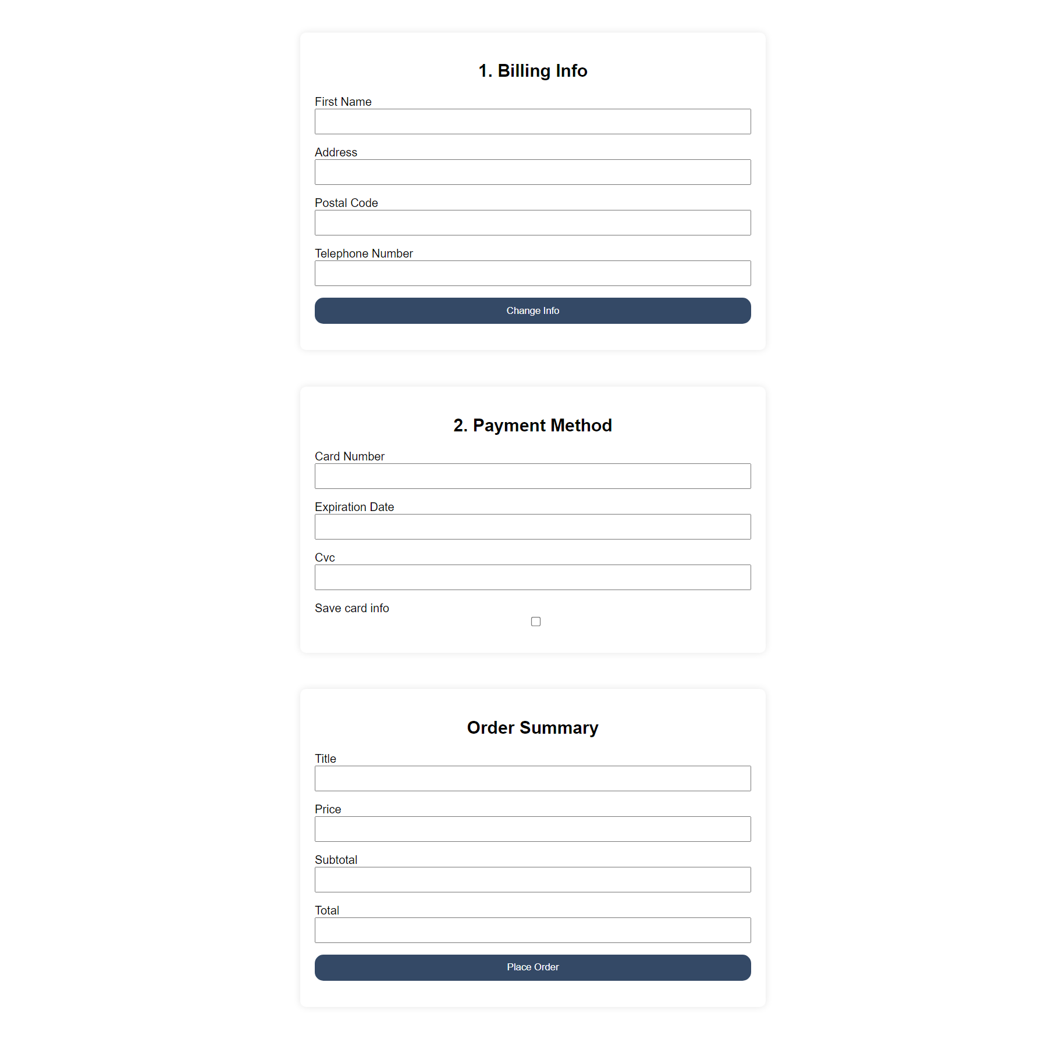
Checkout
When requesting a print, users get redirected to a checkout page to confirm their order.

Slide 20
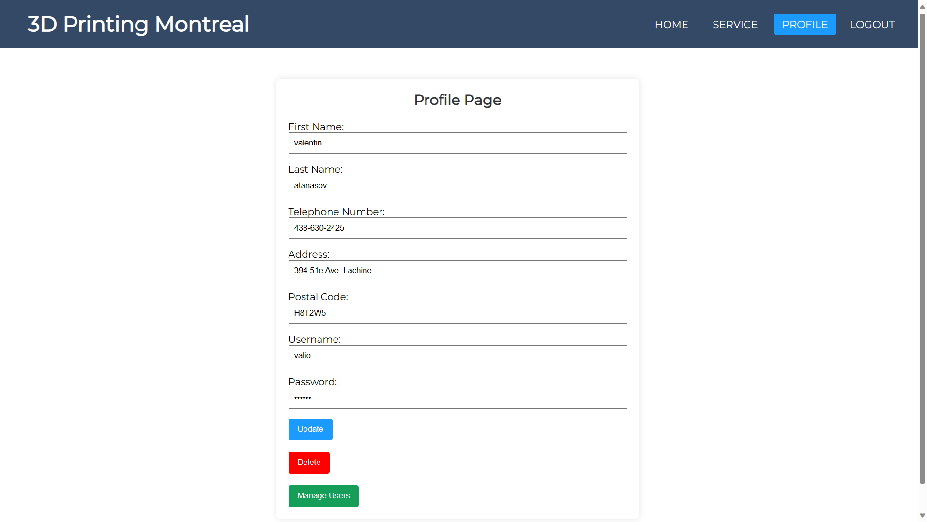
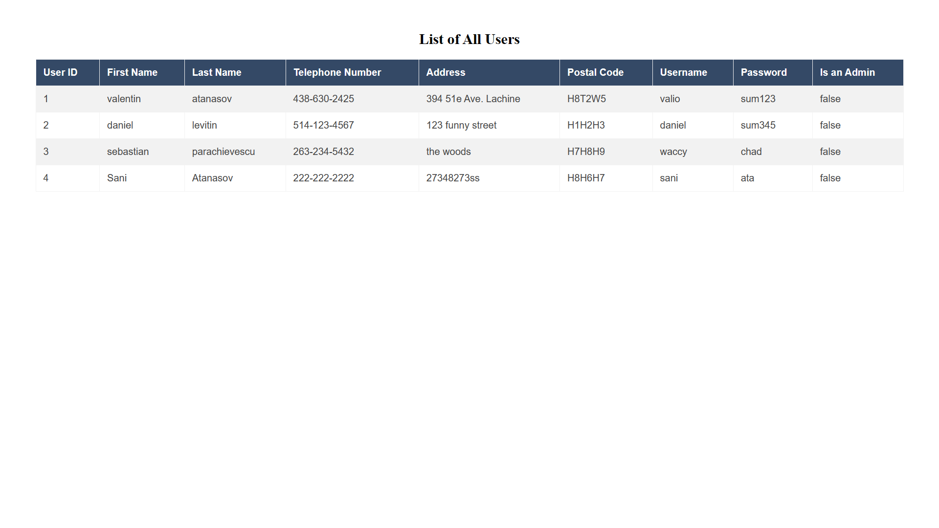
Managing System
Admin users get an extra option to manage the system from their profile.

Slide 21
06
Core Features

Slide 22
MODULES
ORDER/PRINT
MANAGEMENT
USER
Add to cart
Edit billing info
Place order
Users
Prints
Reports
Printers (online/offline)
Register
Login
Logout
Profile

