Slide 1
TextHack
High-Performance Pattern Matching & Duplicate Document Detection
B.TECH FINAL YEAR PROJECT REVIEW · DEPARTMENT OF AI & DATA SCIENCE · KL UNIVERSITY
2510080014-MANOHAR CHOWDARY KROTHAPALLI
2510080009-AKHIL
2510080040-PAVAN KOWSHIK
2510080047-B.JESHWANTH REDDY
PRESENTER: VALAKONDA PAVAN KOWSHIK

Slide 2
Legacy plagiarism tools lose time in two places
Search: brute-force matching scales at O(N × M)
Registration: database-heavy validation adds latency
OBJECTIVE
Deliver O(N + M) pattern search and O(1) duplicate registration

Slide 3
02 · THE RESOLUTION
TextHack pairs algorithmic efficiency with in-memory validation
LIMITATION
RESOLUTION
OPTIMIZATION
Disk-based SQL indexing
JVM HashSets
KMP prefix tables
Creates memory overhead in commercial tools.
Enable fast duplicate checks in memory.
Reduce redundant comparisons during search.
O(N + M)
O(1)
PATTERN SEARCH
DUPLICATE REGISTRATION

Slide 4

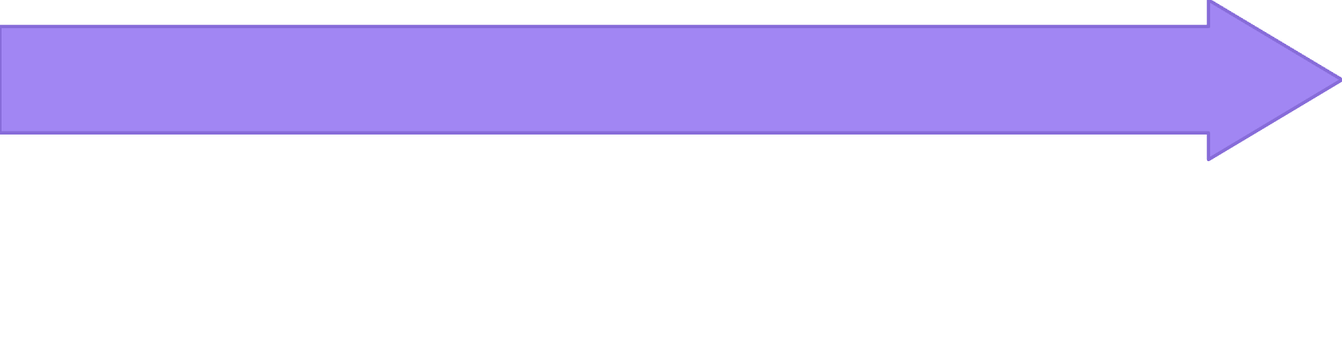


03 · SYSTEM DESIGN
A modular pipeline separates ingestion, search, and auditability
Normalization
Text Ingestion
Audit Trail Registry
Processing Engine
SEPARATION OF CONCERNS
Pattern matching and duplicate validation remain cleanly decoupled.

Slide 5

04 · CORE ALGORITHMS
KMP skips comparisons; HashSet makes registration constant-time
O(N + M)
KMP
KMP
HashSet
KMP: LPS prefix tables enable O(N + M) pattern search
Registry: normalized document strings map to JVM memory
Lookup: duplicate validation targets true O(1) access

Slide 6
05 · IMPLEMENTATION STACK
A lightweight stack keeps the system practical to build and extend
BACKEND
CLIENT
ENVIRONMENT
Java data structures
JavaScript interactivity
HTML5 + Tailwind CSS
Java data structures and processing logic.
JavaScript interactivity keeps validation responsive.
HTML5, Tailwind CSS, VS Code, and Git.
A FOCUSED STACK SUPPORTS PRACTICAL IMPLEMENTATION AND FUTURE EXTENSION.

Slide 7
06 · OBSERVABILITY
Implementation turns performance into visible audit feedback
LOOKUP LATENCY
AUDIT_TRAIL.LOG
< 0.1 ms
REAL-TIME UI LOGS
UNIQUE
New entry registered
DUPLICATE
Instant duplicate alert
sub-millisecond execution
AUDIT TRAILS DISTINGUISH UNIQUE ENTRIES FROM INSTANT DUPLICATE ALERTS.
PER LOOKUP

Slide 8
07 · APPLICATIONS
TextHack scales from academic screening to enterprise analytics
Advantages
Applications
zero speed scaling degradation
minimal memory footprint
high accuracy
assignment screening
code repository checks
enterprise text analytics
ACADEMIC
Assignment screening
ENTERPRISE
Code repository checks and enterprise text analytics

Slide 9
08 · FUTURE SCOPE
The next challenge is semantic similarity at larger scale
CURRENT CHALLENGE
Manage memory allocation during large text-block parsing.
FUTURE SCOPE
Integrate TF-IDF and Cosine Similarity.
Exact
today.
Semantic
next.
DIRECTION
Extend exact matching toward advanced semantic fuzzy matching.
CURRENT IMPLEMENTATION → FUTURE DIRECTION

Slide 10
FINAL REVIEW
TextHack delivers fast exact matching and duplicate prevention
Fast exact
matching.
Duplicate
prevention.
A high-performance text analytics and duplicate prevention framework, built for responsive validation and clear auditability.
THANK YOU · OPEN FOR QUESTIONS AND DISCUSSION
TEXTHACK

