Slide 1

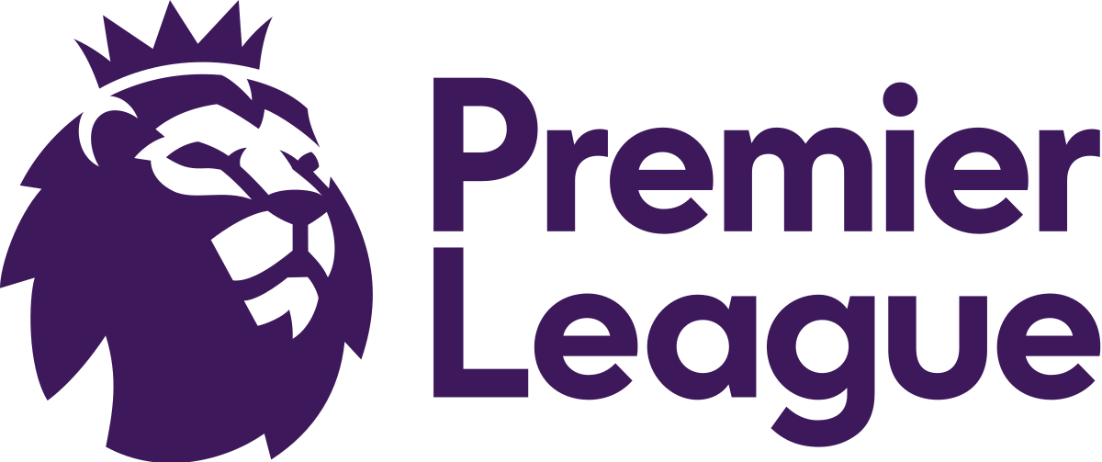

FOOTBALL BETS
Artjom Valdas & Eduard Rudi
Introduction
Today, almost everyone has faced sports betting. Some people believe that if you constantly analyze, for example, football teams, you can make money on it. With this project, we wanted to know if this is actually so.
Goals
Data preprocessing
Make data human readable
Try to find what the outcome of the match depends on
Create a model that will predict future matches
Data
The data itself was gotten from football-data.co.uk/ website. We decided to take the data for the last 5 English Premier League seasons including the current. we had to drop quite a few columns as they were not needed. For example, there were different bookmakers, who gave their coefficient on who would win (difference in 0.1 decimal). Unfortunately, the data files did not have any information about the players, so only teams and coefficients were taken into account for prediction.
What did we finally get…
This is perhaps the only bet that has the highest percentage of accuracy. This means that if Man City or Liverpool plays in the English Premier League, then with the highest probability these teams will score a goal.
Fun facts
In every fifth game, a weaker team wins the match
45% of games end in a draw or loss of stronger team
The more training data, the worse the model predicts
Most often, when weaker teams won stronger teams were, when referee Martin Atkison was on the field
Conclusion
In the end, we can say that making money through football betting is very risky. You can never be sure that a weak team with a coefficient of 11.0 will lose to a team with a coefficient of 1.10.
We also found out, that you can not take too old data as teams have changed their roster, so you have to find the sweet spot.
We used from 2015 to 19 England Premier data to train our model, that we used to try to predict current season match outcome.
Our predictions for next week matches

