Slide 1
Football bets
Artjom Valdas, Eduard Rudi
About
Today, bookmakers provide many different betting options on sports, including football. Such companies always give out three bet odds - one team wins, the other team wins or both teams play a draw.
The goal of the project was to find interesting and meaningful patterns as well as most dominating team per season. In addition, we wanted to create out own prediction model based on previous matches and their outcome.
We also took bet odds into consideration. Graphs were also made to make it more eye catching, easy on the eyes and easier to understand.
Data
For data preparation, we had to drop quite a few columns as they were not needed. For example, there were different bookmakers, who gave their coefficient on who would win. We only left one bookmaker as every bookmaker coefficient was very similar (difference in 0.1 decimal). The data itself was gotten from football-data.co.uk/ website. The claim that the data was gathered from sources such as BBC, ESPN Soccer, Bundesliga.de, Gazzetta.it and Football.fr and the match coefficient taken for weekend games are collected Friday afternoons, and on Tuesday afternoons for midweek games.
On left graph, we have our prediction model versus the actual data for England Premier League 2018-19. For prediction model we used 5 seasons worth of data (2015 to 2020). We also put every team play against each other so every combination while in reality, not every team plays against all others.

Slide 2
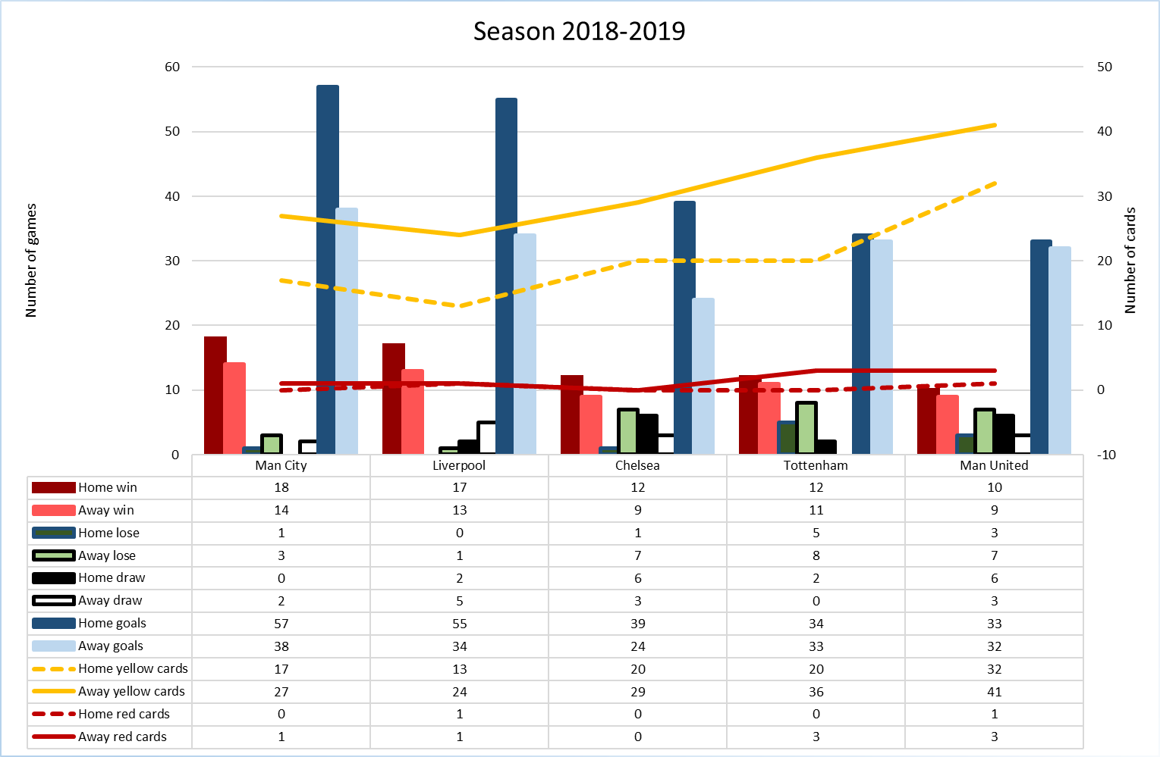
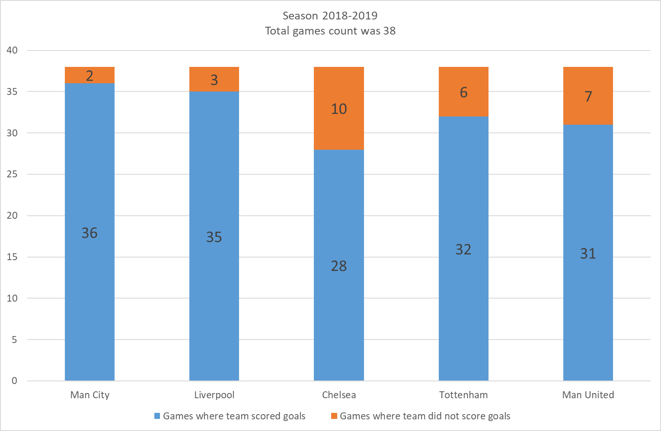
FOOTBALL BETS
Artjom Valdas & Eduard Rudi
Introduction
Today, almost everyone has faced sports betting. Some people believe that if you constantly analyze, for example, football teams, you can make money on it. With this project, we wanted to know if this is actually so.
Goals
Data preprocessing
Make data human readable
Try to find what the outcome of the match depends on
Create a model that will predict future matches
What did we finally get…
This is perhaps the only bet that has the highest percentage of accuracy. This means that if Man City or Liverpool plays in the English Premier League, then with the highest probability these teams will score a goal.

