Slide 1
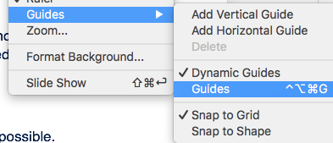
Template Instructions
Follow these instructions in order to create consistency and harmony across all presentations.
Each template slide will have an example below for guidance. Questions? Email: Ricardo.cortes@maxpoint.com
1.
4.
Work from a New File.
Optimize Images
Do not modify your main template. Instead, save this template as a new file:
“File > Save As > project name”
Large images increase your overall presentation file size. Use “File > compress pictures” to optimize file size.
5.
2.
Color
Typography
6.
Refer to Color slide
Refer to typography slide (7).
In order to maintain font sizes, click on text boxes and replace placeholder content with your document content. When pasting, use option “keep text only” from clipboard.
Iconography
There is a comprehensive iconography library included with this template. Copy and paste icons as needed. Refer to typography slide (4)
7.
3.
Header & Footer
Refer to guides for layout
Try to keep logo, website, pagination wherever possible. Legal classification (e.g. Public, Confidential) is required on all slides.
For a consistent layout, right click to turn on guides and place elements within margins.

Slide 2
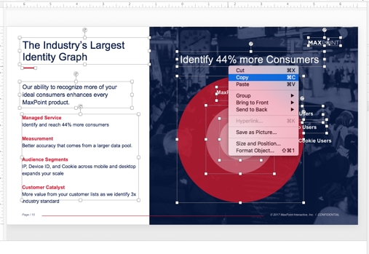

Template Instructions
8.
Copy Slide Content not Slides
Select content from slide then copy content to your “latest” template / slide.
If you copy slides, the master from original slide willcreate multiple masters increasing your file size

Slide 3
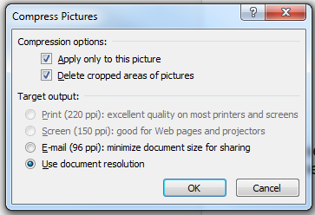
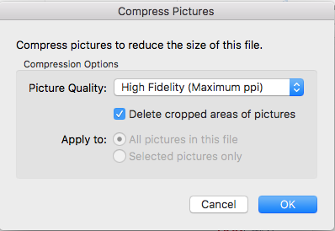
Manage Your PowerPoint File Size
9.
Compress high-resolution pictures
Using pictures with incredibly high resolutions will definitely have an effect on the size of your PowerPoint file. You may want to use clear and crisp images, but you don’t have to opt for anything that’s too large. Edit and re-size the pictures that have resolutions that might be way too large.
Windows
Click on Adjust groupthen click Compress Pictures.
Mac
Click on File tab then click on Compress Pictures.
When the dialogue box appears, choose from the different target output options.
Windows
10.
Convert PowerPoint file to PDF
You can convert your PowerPoint file to a PDF if you’re planning to share your slides via Slide Share or email when the actual presentation is over.
This will strip your presentation of any animation and transition effects, so make necessary tweaks to your PowerPoint first.
After that, all you have to do is head to the File tab and click Save As. From there, choose PDF under Save as type.
Mac

Slide 4
Iconography

Slide 5
Iconography
Notes:
JHVAKHBAVKA

Slide 6
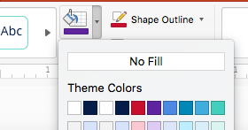
Color
Core Colors
Secondary Colors
MXPT Red
HEX: #C8102E
Purple
HEX: #5F259F
Teal
HEX: #0087B5
Navy
HEX: #071D49
Indigo
HEX: #4C89E3
Sea Green
HEX: #43CEBD
To access and change colors refer to your Theme colors

Slide 7
Typography
Text title for cover pages
Arial Regular / size 36
Text title for content slides
Arial Regular / size 28
Body Copy: Based on your needs only use body copy as described below:
Description text for cover pages
Arial Regular / size 16
Text for body titles
Arial Regular / size 16
Text title for quotes and highlights
Arial Regular / size 20
Text for body content
Arial Regular / size 16
Text title for quotes and highlights
Arial Regular Italic / size 20
Text for body titles
Arial Bold / size 13
Text for legends or captions
Arial Regular Italic / size 10
Text for body content
Arial Regular / size 13

Slide 8
Click here to
add a title
Click here to add a description
© 2017 MaxPoint Interactive, Inc. | CONFIDENTIAL

Slide 9
Click here to add title
Place title here
Place title here
Place title here
Place title here
Place title here
Place title here
Place title here
Place title here
Place title here
Place title here
Place title here
Place title here

Slide 10
Click here to
add a title
Click here to add a description

Slide 11
Click to add a title
Place your intro text if necessary
Place highlighted title here
Place body copy here
© 2017 MaxPoint Interactive, Inc. | CONFIDENTIAL

Slide 12
Click here to add a title
Place title here
Place title here
Place title here
Place your body copy here
Place your body copy here
Place your body copy here

Slide 13
Click here to add a title
Place title here
Place title here
Place body copy here
Place body copy here
Place body copy here
Place body copy here
Place title here
Place title here
Place body copy here
Place body copy here
Place body copy here
Place body copy here

Slide 14
Click here to add a title
“ Place your text inside this text box, Place your text inside this text box ”
“ Place your text inside this text box, Place your text inside this text box ”
“ Place your text inside this text box, Place your text inside this text box ”
Place body copy here
Place body copy here
Place body copy here

Slide 15
Click here to add a title
Place your body copy here
Place title here
Place title here
Place title here
Place title here
Place your body copy here
Place your body copy here
Place your body copy here
Place your body copy here
Place your body copy here
Place your body copy here
Place your body copy here
Place your body copy here
Place your body copy here
Place your body copy here
Place your body copy here
Place your body copy here

Slide 16
Click here to add a title

Slide 17
Click here to add a title
Place your intro text if necessary

Slide 18
Click here to add a title
Place your intro text if necessary
Place your body copy here
Place your body copy here
Place your body copy here
Place your body copy here

Slide 19
Click here to add a title
Place your intro text if necessary
Place your body copy here
Place your body copy here
Place your body copy here
Place your body copy here
Place title here
Place email here
Place title here
Place email here
Place title here
Place email here
Place title here
Place email here

Slide 20
Click here to
add a title
Click here to add a description
© 2017 MaxPoint Interactive, Inc. | CONFIDENTIAL

