Slide 1



Solar Power Prediction Using Linear Regression

Slide 2

Learning Objectives
Understand the impact of environmental factors on solar power generation.
Develop a predictive model using Linear Regression.
Analyze and visualize key trends in solar energy production.
GOAL
To build a machine learning model that accurately predicts solar power output based on environmental factors like temperature, cloud cover, and radiation, enabling efficient energy planning.
GOAL
Source :

Slide 3
Tools and Technology used
Programming Language: Python
Libraries: Pandas, NumPy, Scikit-learn, Matplotlib, Seaborn.
Platform: Google Colab
Algorithms: Linear Regression

Slide 4
Methodology
1.Data Collection: Gather historical solar power data.
2.Preprocessing: Handle missing values, normalize data, and extract key features.
3.Model Development: Train a Linear Regression model to predict solar power output.
4.Evaluation: Assess performance using R² score, Mean Absolute Error (MAE), and Mean Squared Error (MSE).
5.Visualization: Analyze trends with scatter plots and correlation heatmaps.

Slide 5
Problem Statement:
Solar power generation is highly dependent on environmental factors such as temperature, humidity, cloud cover, and solar radiation.
These fluctuations make it challenging to predict energy output accurately, leading to inefficiencies in energy planning and grid management.
A reliable predictive model is needed to estimate solar power generation and optimize resource allocation.

Slide 6
Solution:
A Linear Regression model that predicts solar power output based on:
1.Temperature
2.Cloud Cover
3.Humidity
4.Solar Radiation
This enables energy providers to plan better and optimize resource allocation.

Slide 7
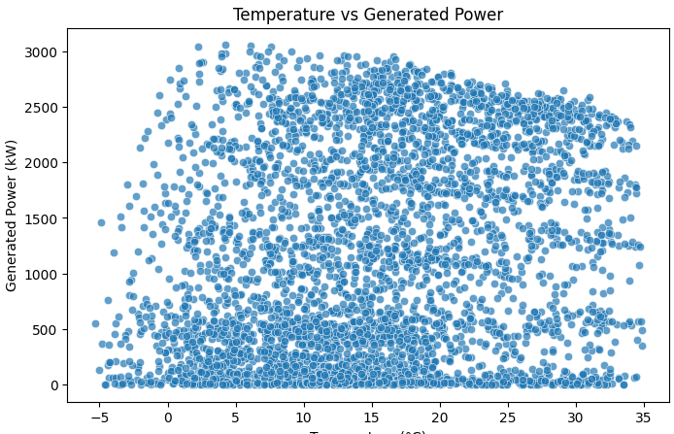
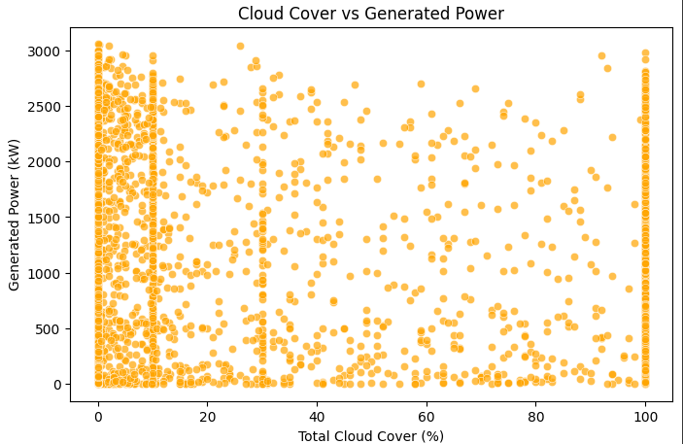
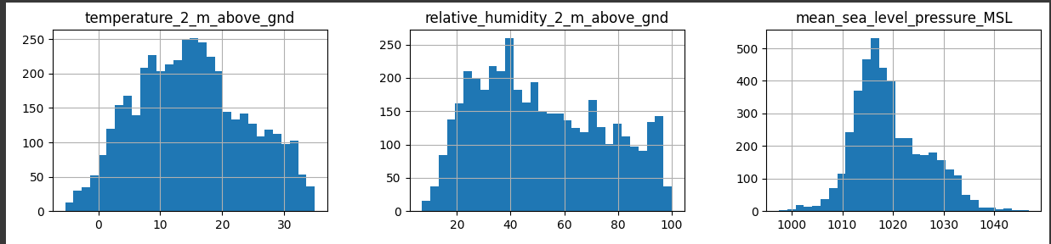
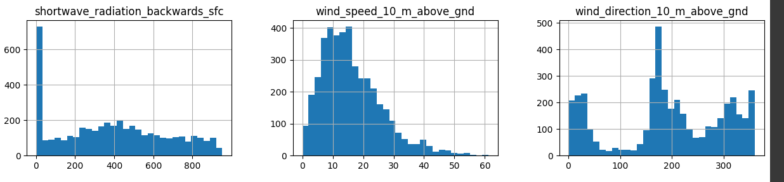
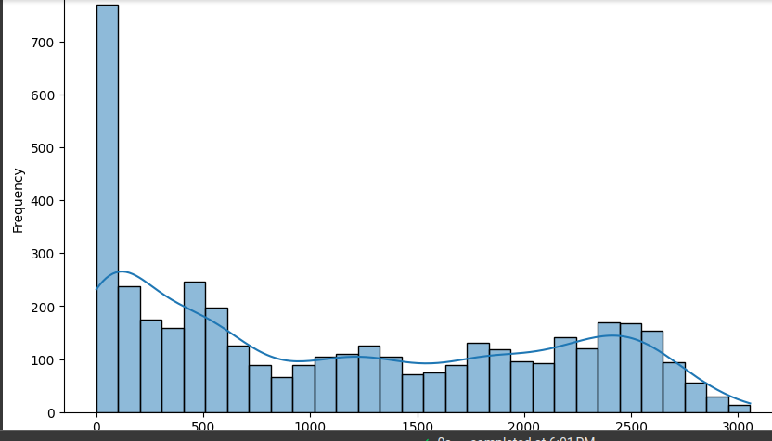
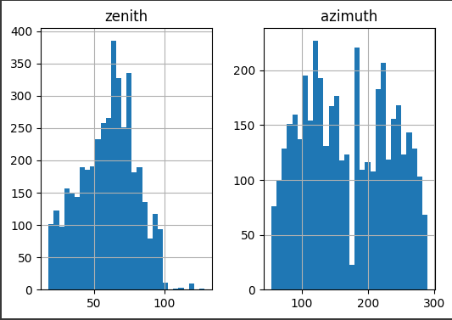
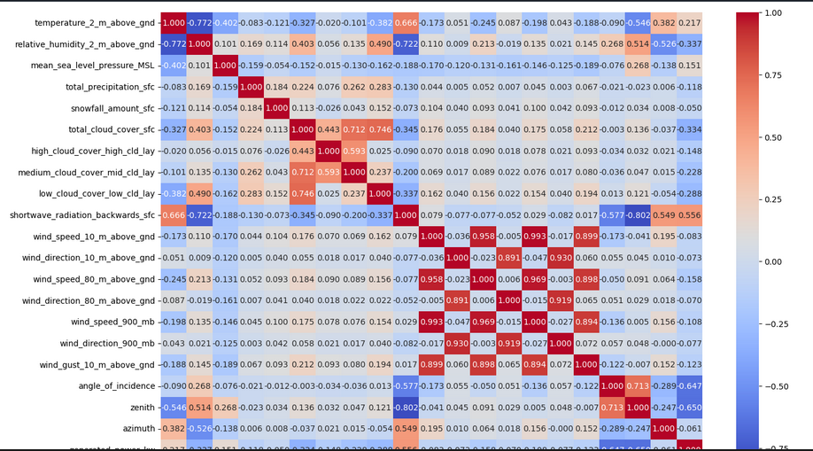
Screenshot of Output:

Slide 8
Conclusion:
The model successfully predicts solar power output with reasonable accuracy.
Helps in better energy utilization and grid management.
Can be improved with more features and advanced ML models like Decision Trees or Neural Networks.

