Slide 1
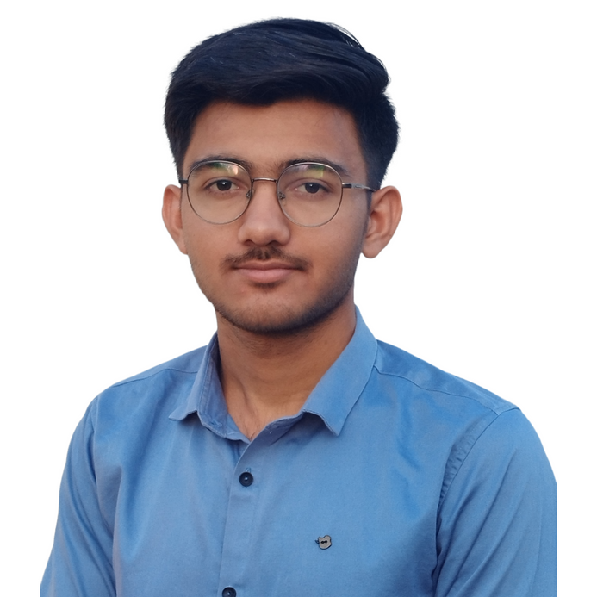


VIVEKKUMAR VALA
+91 9313290519
valavivek2019@gmail.com
LINKS
SKILLS
https://www.linkedin.com/
vivekkumar vala
Good in programming lan.
python
java
https://www.github.com/
valavivekkumarj
Intermediate
OBJECTIVE
Statistics
Machine Learning
Deep Learning
Seeking a challenging position in a reputed organization where I can learn new skills, expand my knowledge, and leverage my learnings.
Seeking the position to utilize my skills and abilities in the Computer and Information Technology industry that offers professional growth while being resourceful, innovative and flexible.
Other programming lan.
javascript , html ,css
php,mysql
c++
COURSES
Data Structure & Algorithm
Object Oriented Programming
Computer Network
Operating System
DBMS
EDUCATION
Bachelors of Engineering in Information technology | Gujarat Technological University
2020 – 2024
current CGPA 9.04
HSC | Gujarat Board
2019– 2020
66.92% in HSC
SSC | Gujarat Board
2017– 2018
83.83% in SSC
ACTIVITIES & LEARNING
Currently i am doing pwskills data science course.
I just finished Apna College's Alpha course on Data Structure & Algorithm
EXPERIENCE
Fresher , Seeking a challenging position in a reputed organization where I can learn new skills, expand my knowledge.

