Slide 1
Valatility Stream 1
By: Vala

Slide 2
Background
Immigrant
Trading bitcoin @15
Non-target Undergrad but top 1% and super involved
First Internship (hardest one to get)
Target Grad School
Second + third Internship (good ones)
First Job (trader @ ABCD)
Second Job (HF analyst)

Slide 3
Coding Lesson
Code Here
Watch livestream to know how to download anaconda or google collab

Slide 4
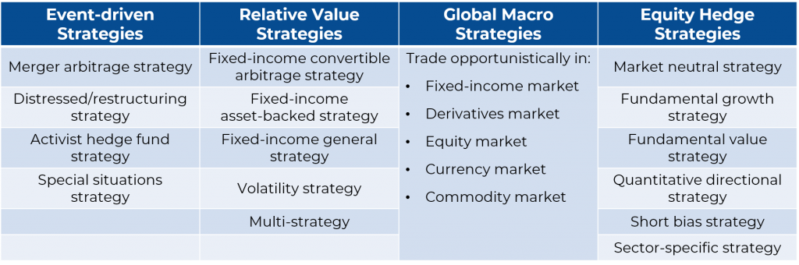
Different Types of Hedge Funds
What I do.
https://365financialanalyst.com/knowledge-hub/trading-and-investing/what-are-the-most-common-hedge-fund-strategies/

Slide 5
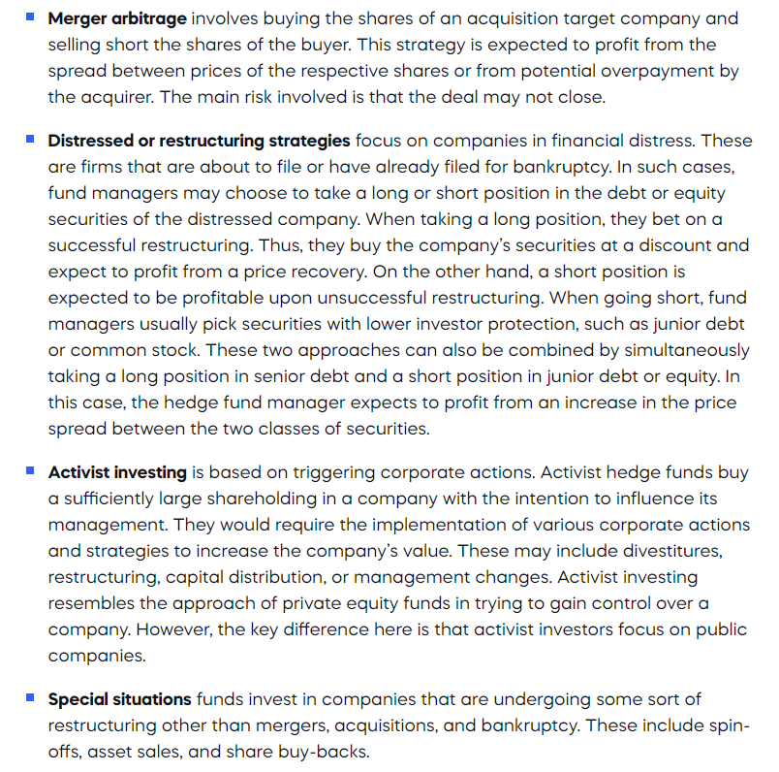
Event Driven HFs
They are based on various corporate actions such as mergers, acquisitions, or restructuring. They entail taking long or short positions in equity or debt securities of the companies involved.

Slide 6
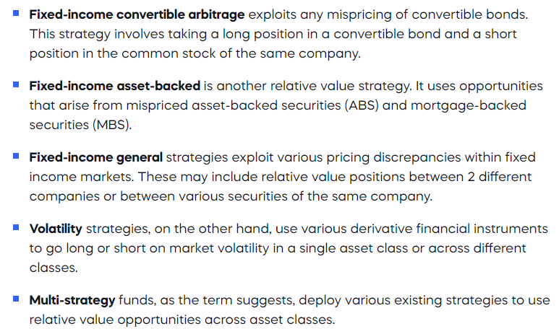
Relative Value HFs
They focus on taking long and short positions in related securities and profiting from a temporary discrepancy in their perceived price relationship. Again, we have several sub-categories:

Slide 7
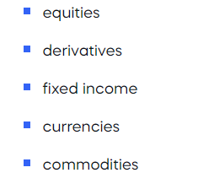
Global Macro (Big Picture Trader)
Rather than examining specific companies, macro hedge funds look for opportunities arising from global economic and political events. They bet on global market trends by taking long or short positions across:

Slide 8
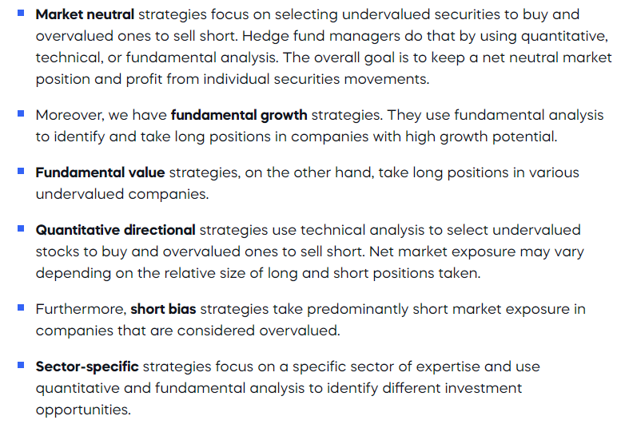
Equity Hedge Fund
They involve taking long and short positions in public equities and related derivatives. They differ from the event-driven or macro strategies in the use of a bottom-up rather than a top-down approach. Here are the most common variations of the equity hedge fund strategies:

Slide 9
More Strategies Below
I found this video well done on covering different types of strategies.
https://www.youtube.com/watch?v=J1v89nUWrBA&t=8s

Slide 10
Q+A
Thank you, my bros, soon we rally on the Island.

