Slide 1
Valatility Stream 2
By: Vala
April 22nd, 2023

Slide 2
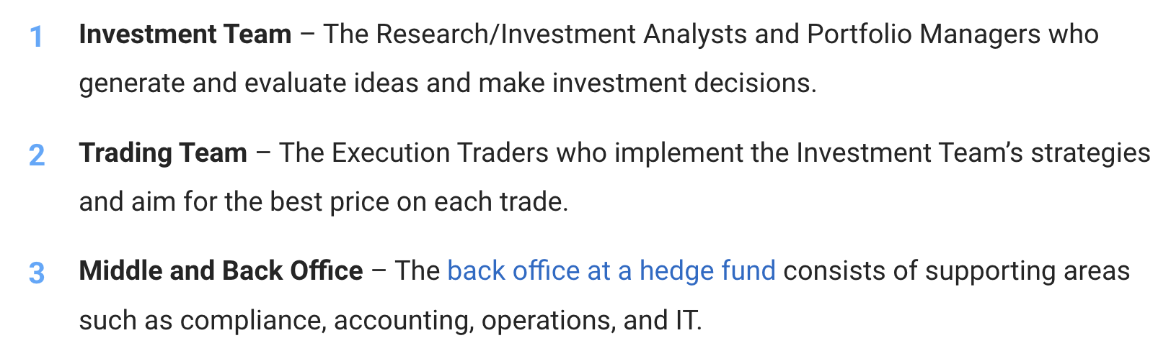
Positions at Hedge Funds
What I do.
What I used to do @ABCD.
https://mergersandinquisitions.com/hedge-fund-career-path/

Slide 3
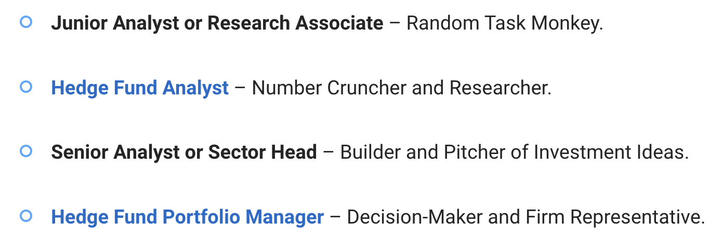
Investment Professionals

Slide 4
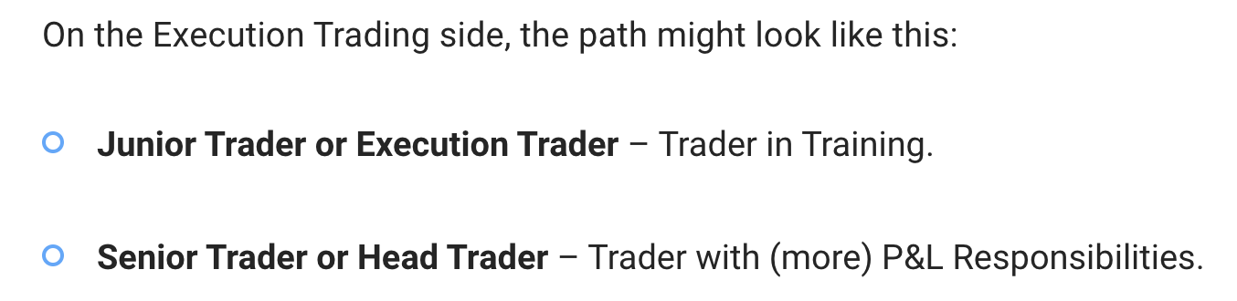
Trading Professionals

Slide 5
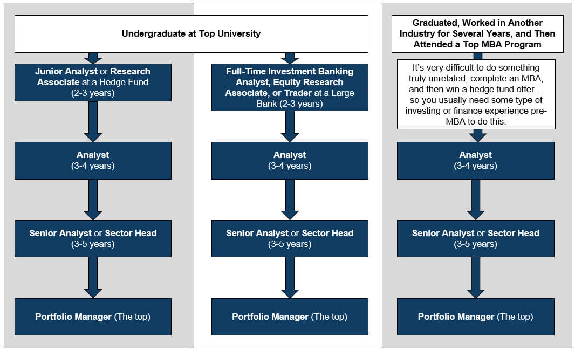
Path to BIG BUCKS
Or grad school

Slide 6
Coding lesson
Week two coding lesson. Will be also uploaded to youtube and the GitHub
https://www.youtube.com/channel/UCjAaTQKIJhe5xWL8A8h5lCQ
https://github.com/valazeinali/Valatility

Slide 7
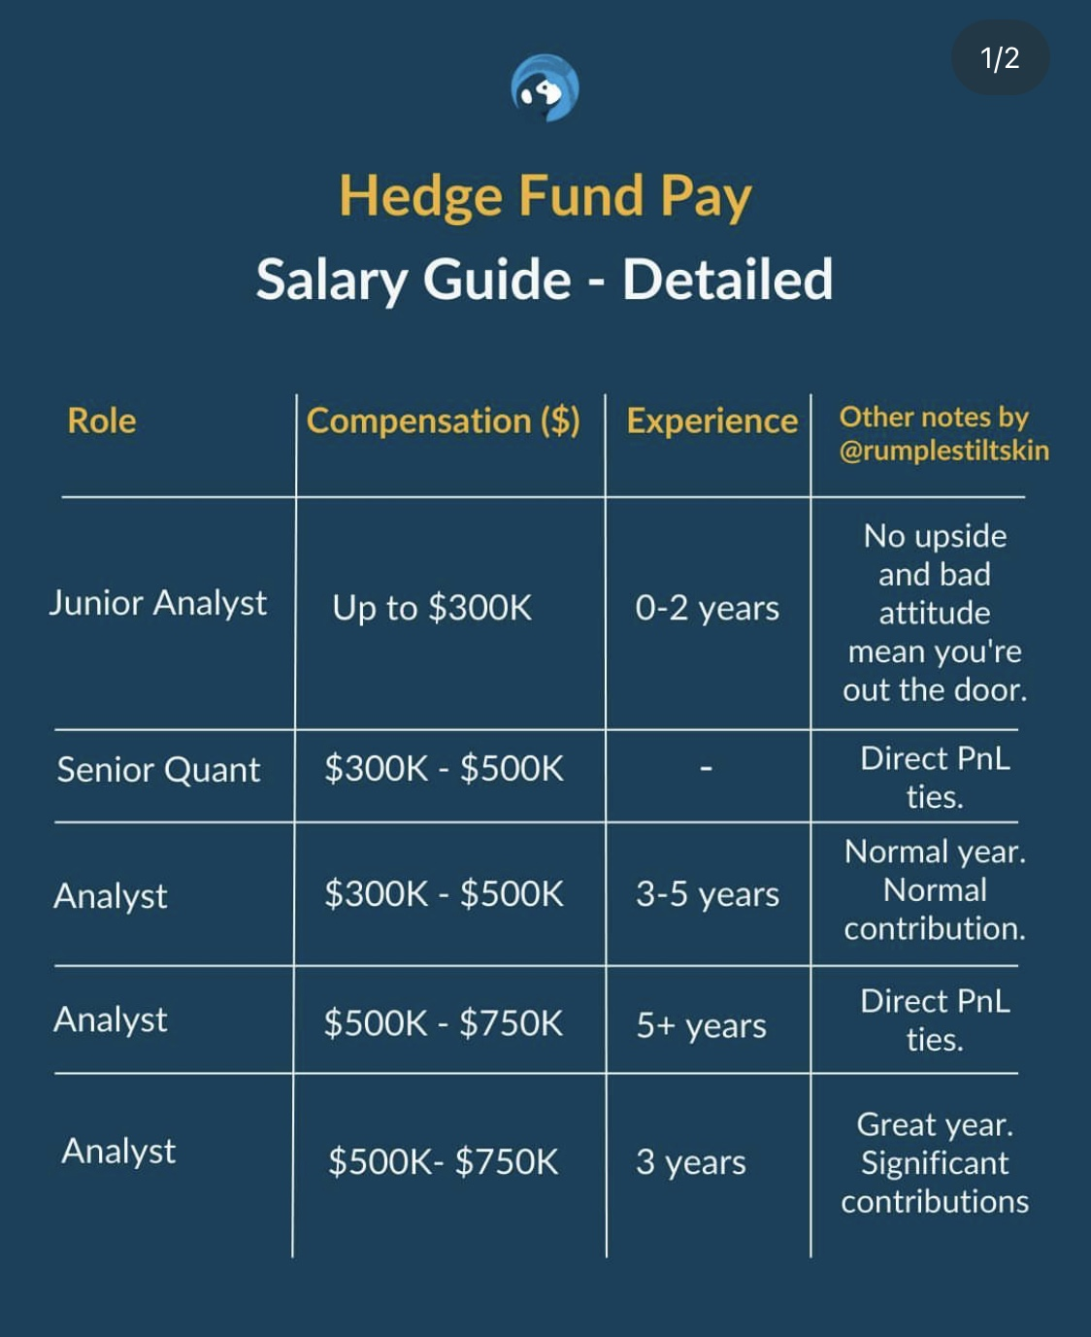
Hedge Fund Comp – Investment Side

Slide 8
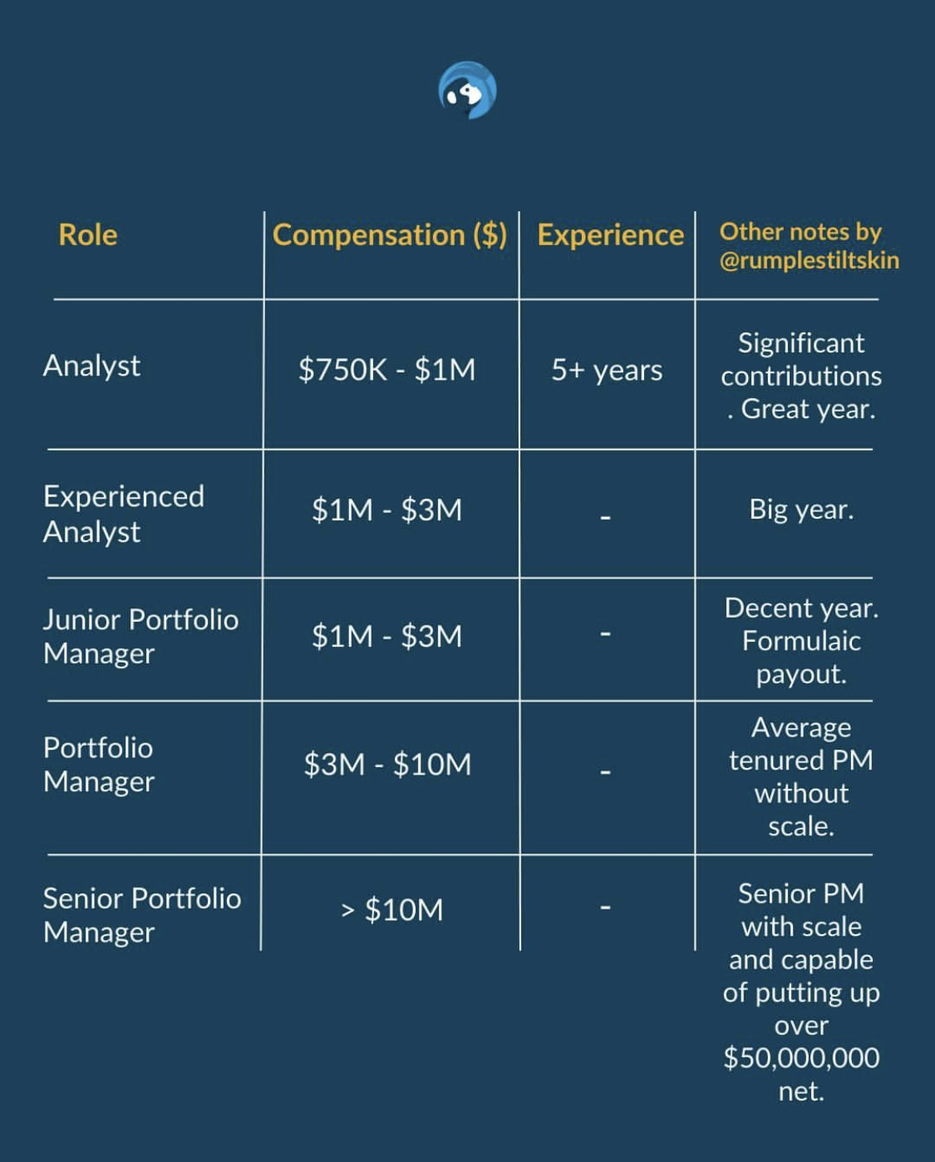
Hedge Fund Comp – Investment Side

Slide 9
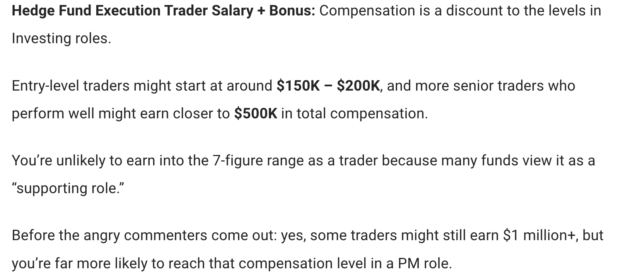
Hedge Fund Comp – Execution Trading

Slide 10
Q+A
Thank you, my bros, soon we rally on the Island.

