Slide 1

Demo open source applications with Intel RealSense capabilities Emotion tracker application
Arkhangelsk, 2016

Slide 2
Emotion tracker application
The main aim of this project is to develop a library and demo applications to track and write users emotions (sadness, smile, laugh, etc.) during watching movie. Test recognition of emotions with different conditions. Implement logic to “merge” files with emotions and provide average rating. Implement logic to gather eyes track and to build heat map for user’s attention. All of that should be done by using Intel RSSDK tools.
Arkhangelsk, 2016

Slide 3
Objectives
Emotions records format
Emotions tracking library
Implementation of logic to merge files with emotions and its averaging
Implementation of building heat map for user’s attention
Demos

Slide 4
Emotions records
TTML (https://www.w3.org/TR/ttml2/)
“The Timed Text Markup Language is a content type that represents timed text media for the purpose of interchange among authoring systems. Timed text is textual information that is intrinsically or extrinsically associated with timing information.”
Pros
Can be used as subtitles
Windows 10 Movies & TV
Is one of W3C's standards regulating timed text on the internet.
Cons
It is not wide used standard
Entail to produce large files
~50M per 5 minutes of tracking

Slide 5
Emotions records. Structure
<?xml version = "1.0" encoding = "UTF-8" ?>
<tt xmlns = "http://www.w3.org/ns/ttml"
xmlns:tts = "http://www.w3.org/ns/ttml#styling"
xmlns:ttm = "http://www.w3.org/ns/ttml#metadata" >
<head>
<metadata xmlns:ttm = "http://www.w3.org/ns/ttml#metadata">
<ttm:title>Timed Text TTML Example</ttm:title>
<ttm:copyright>The Authors(c) 2006</ttm:copyright>
</metadata>
</head>
<body>
<div>
<p begin="00:00:00.00" end="00:00:32.59">
<data type="text/plain; charset = us-ascii">
<metadata id="1"></metadata>
<![CDATA[
]]>
</data>
Neutral
</p>
</div>
</body>
</tt>
Timing information
Emotion
data
Emotion text

Slide 6
Emotions records. Data
<Face id="3">
<Brow_Raised_Left>0</Brow_Raised_Left>
<Brow_Raised_Right>0</Brow_Raised_Right>
<Brow_Lowered_Left>0</Brow_Lowered_Left>
<Brow_Lowered_Right>0</Brow_Lowered_Right>
<Smile>0</Smile>
<Kiss>0</Kiss>
<Mouth_Open>0</Mouth_Open>
<Closed_Eye_Left>0</Closed_Eye_Left>
<Closed_Eye_Right>0</Closed_Eye_Right>
<Eyes_Turn_Left>0</Eyes_Turn_Left>
<Eyes_Turn_Right>57</Eyes_Turn_Right>
<Eyes_Up>0</Eyes_Up>
<Eyes_Down>100</Eyes_Down>
<Tongue_Out>0</Tongue_Out>
<Puff_Right_Cheek>100</Puff_Right_Cheek>
<Puff_Left_Cheek>0</Puff_Left_Cheek>
<Landmark>
<Point>313.160400 255.806610</Point>
…………
<Point>367.559509 262.087280</Point>
</Landmark>
…
…
<Yaw>-0.641311</Yaw>
<Pitch>-0.965361</Pitch>
<Roll>6.649949</Roll>
<HeadX>-7.352272</HeadX>
<HeadY>-41.289234</HeadY>
<HeadZ>588.979553</HeadZ>
<Pulse>88.608482</Pulse>
<Gaze>78.696925 171.614583</Gaze>
</Face>
<Person id="0">
<Neutral>858993460</Neutral>
<Happiness>858993460</Happiness>
<Sadness>858993460</Sadness>
<Surprised>858993460</Surprised>
<Disgusted>858993460</Disgusted>
<Contemptful>858993460</Contemptful>
<Fearful>858993460</Fearful>
<Angry>858993460</Angry>
</Person>

Slide 7
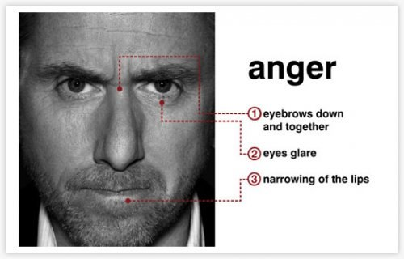
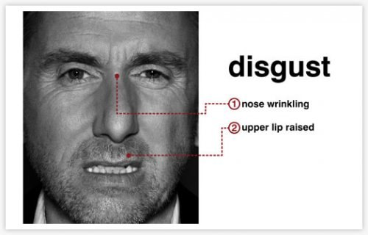
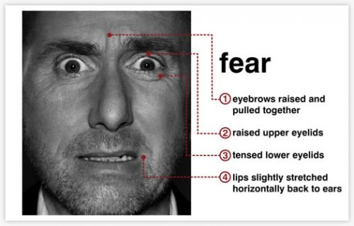
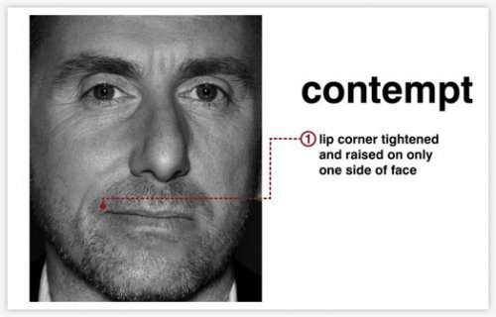
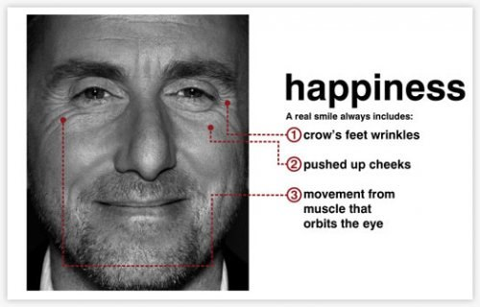
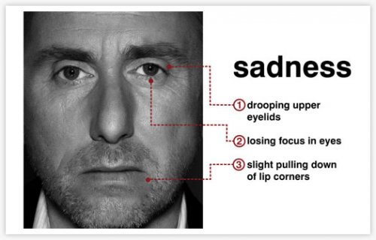
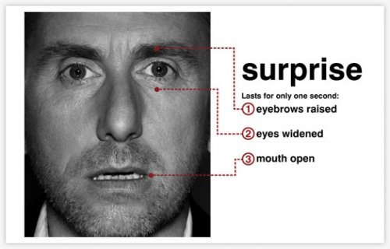
Emotions detection

Slide 8
Emotions detection
Can’t be percept
by RealSense API

Slide 9
Emotions tracking library
Native library
C# wrapper

Slide 10
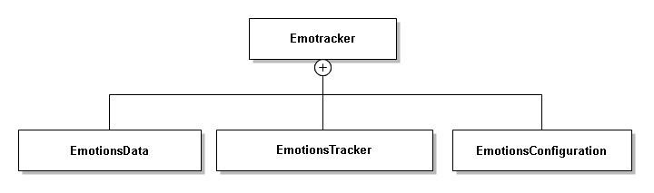
C# Class Diagram

Slide 11
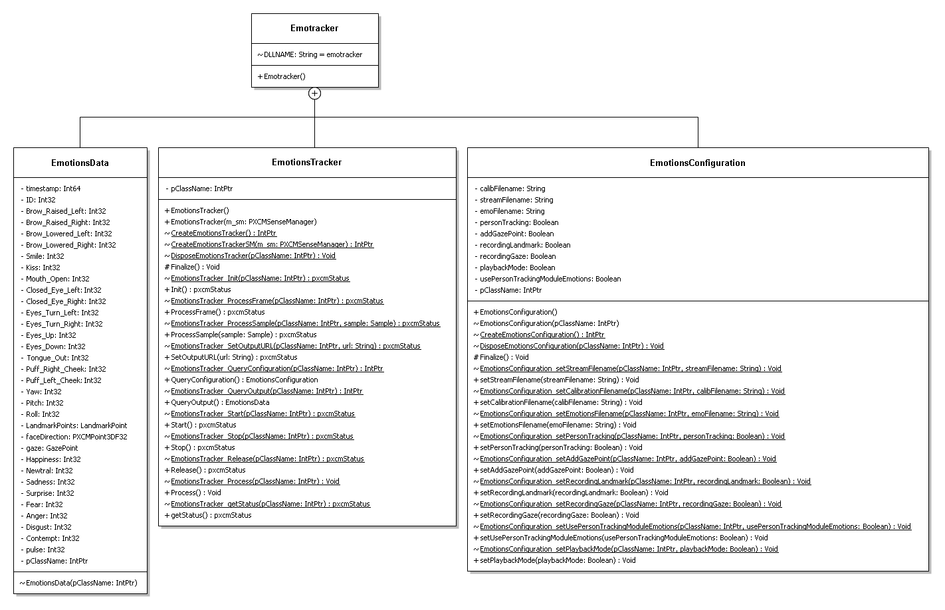
C# Class Diagram

Slide 12
Merging and averaging
Main primitives
Merge
Average
Smooth

Slide 13
Heat map
Two varieties
Set of gaze points
Blurring the 2D histogram of gaze points occurrences by convolution with arithmetic mean filter response

Slide 14
Gaze tracking
Calibration
Saccades

Slide 15
Processing with MATLAB
function [b,e,v]=getEmoElement(fname,el)
function [b,e,v]=getEmoElementStr(fname,el)
Slow (it takes about hour to process 50M file = 5minutes of records )
One can use ttml2csv utility to convert data in csv format
Load data in MATLAB to do its examination
One can also use it f.ex. with Excel

Slide 16
Additional utilities
rssdk2video
ttml2srt

