Slide 1
1.10 Unit 1
Assessment
1.10 Unit 1 Assessment
1

Slide 2











Contents
The Branches of Government
3
The Houses of Congress
7
How an idea becomes law
10
Becoming a Supreme Court Justice
11
Checks & Balances
12
The Bill of Rights
13
Amendments
15
The Constitution
16
Sources & Notes
17
1.10 Unit 1 Assessment
2

Slide 3

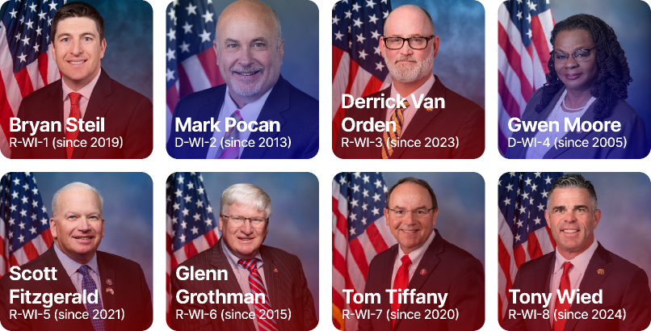

The Branches of Government
Legislative
Exectutive
Judicial
Main Duty: Write and Pass Laws
People/Positions: Representatives and Senators
Wisconsin’s Representatives
Wisconsin’s Senators
1.10 Unit 1 Assessment
3

Slide 4

The Branches of Government
Legislative
Exectutive
Judicial
Main Duty: Sign bills into law or veto bills
People/Positions: President, Vice President, and Cabinet Members
1.10 Unit 1 Assessment
4

Slide 5
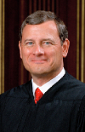
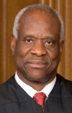
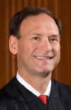
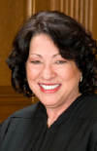
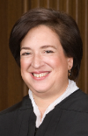


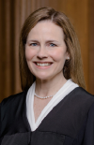

The Branches of Government
Legislative
Exectutive
Judicial
Main Duty: Interpret laws & rule them constitutional or not
People/Positions: Justice
John Roberts
since 2005
Clarence Thomas
since 1991
Samuel Alito
since 2006
Sonia Sotomayor
since 2009
Elena Kagan
since 2010
Neil Gorsuch
since 2017
Brett Kavanaugh
since 2018
Amy Coney Barrett
since 2020
Ketanji Brown Jackson
since 2022
1.10 Unit 1 Assessment
5

Slide 6

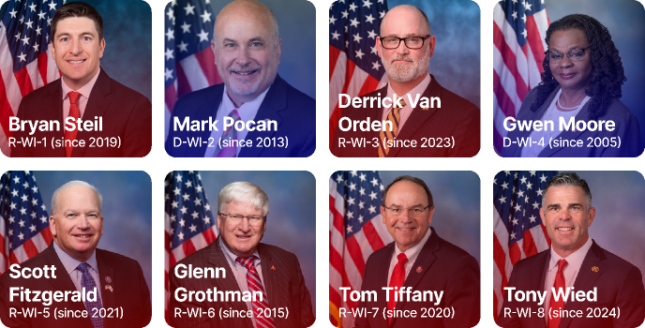
The Houses of Congress
House of Representatives
Senate
How Members Selected: Democratically in elections
How many: 435 representatives (219 Republican, 213 Democrat, 3 Vacant*)
Key powers: Must start all revenue bills
Wisconsin’s Representatives
*1 representative, Adelita Grijalva (D-AZ-7) has yet to be sworn in. Seat considered Vacant.
Representative count sourced from Wikipedia: https://en.wikipedia.org/wiki/United_States_House_of_Representatives
1.10 Unit 1 Assessment
6

Slide 7
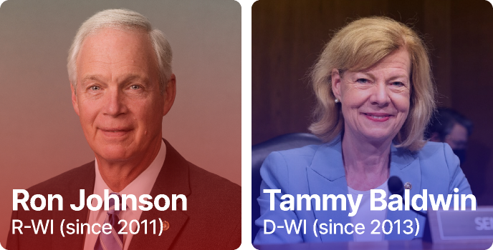
The Houses of Congress
House of Representatives
Senate
How Members Selected: Democratically in elections
How many: 100 senators (53 Republican, 45 Democrat, 2 Independent*)
Key powers: Acts as jury in impeachment trials (2/3 vote needed)
Wisconsin’s Senators
*2 Independent Senators, Angus King of Maine and Bernie Sanders of Vermont caucus with the Democrats.
Senator count sourced from Wikipedia: https://en.wikipedia.org/wiki/United_States_Senate
1.10 Unit 1 Assessment
7

Slide 8



How an idea becomes a law
START
House of Representatives
Begins in a Committee
The bill can fail to pass.
!
House of Representatives
Debated and Amended
House of Representatives
Congressional Budget Office confirms budget
START*
Senate
Committee meets about the bill
The bill can fail to pass.
The president can veto a bill.
!
!
Senate
The President
Debated and Amended
If amended, go back to HOR
Final approval
*If bills start in the Senate, they must go to the HOR before final approval
1.10 Unit 1 Assessment
8

Slide 9

Becoming a Supreme Court Justice
Sitting Justice resigns or passes away
Executive Branch (President)
Appoints a nominee
Legislative Branch (Senate)
Hold hearings with the nominee
The nominee could fail to get confirmed
!
Legislative Branch (Senate)
Vote to approve the nominee, simple majority neeeded
Nominee is sworn in as Justice
1.10 Unit 1 Assessment
9

Slide 10



Checks & Balances
Legislative
Exectutive
Judicial
On Judicial
On Executive
Can initiate constitutional
amendments
Can impeach the President
1.10 Unit 1 Assessment
10

Slide 11



Checks & Balances
Legislative
Exectutive
Judicial
On Judicial
On Executive
Can nominate Supreme
Court Justices
Can veto laws
1.10 Unit 1 Assessment
11

Slide 12

Checks & Balances
Legislative
Exectutive
Judicial
On Legislative
On Executive
Can rule laws
unconsitutional
Can rule actions
unconsitutional
1.10 Unit 1 Assessment
12

Slide 13

The Bill of Rights
Forming the first 10 amendments to the constitution, the Bill of Rights includes basic rights for individuals and states. They are as follows:
Amendment 1: Congress can not make a law that favors any religion, prevents the ‘free exercise’ of any religion, limit speech, limit the press, prevent peaceful assemblies to ask the government to change something.
Amendment 2: Congress can’t prevent people from carrying or having weapons.
Amendment 3: Soldiers can not forcibly live in your house, except in times of war. Even in times of war, congress will pass a law and set the rules.
Amendment 4: No one can forcibly search you or your property without a judge’s approval or a good reason.
Continues on next slide
1.10 Unit 1 Assessment
13

Slide 14
The Bill of Rights (cont.)
Amendment 5: You can not be tried for any serious crime without a Grand Jury meeting and agreeing that there is enough evidence against you; if you are found innocent, the government can not try you again for the same crime; you can not be forced to admit guilt; you can not be jailed, fined, or killed unless found guilty by a jury, all proper legal steps were taken during your arrest and trial; the government can not take your property, or anything of yours, unless you are paid a fair amount.
Amendment 6: If arrested and charged: you have a right to a trial in public; your trial to be decided by a jury, if wanted; you have the right to know what you are accused of and to cross-examine, see, and hear those who are witnesses against you; you have a right to a lawyer, if you can not afford one, one will be appointed to you at no cost.
Continues on next slide
1.10 Unit 1 Assessment
14

Slide 15
The Bill of Rights (cont.)
Amendment 7: You can have a jury in a civil case if you wish.
Amendment 8: The government can not make you pay an unreasonable amount in fines or bail, and can not enact unusual or cruel punishments, even if found guilty.
Amendment 9: Just because these rights are in the constitution, does not mean you do not have other rights too.
Amendment 10: Anything not said in the constitution that congress can do, is the duty of states and the people.
Adapted from ACLU Delaware: https://www.aclu-de.org/en/know-your-rights/bill-rights-simple-language
1.10 Unit 1 Assessment
15

Slide 16

Amendments
Amendments are essentially just edits. They may address something that wasn’t addressed in the original text.
For example in Congress, you’ll see bills get amended. This could be part of a compromise between political parties to get the bill passed.
Also, you’ll commonly hear about the constitution’s amendments. The most common amendments mentioned are the first (see slide 13) and second. (see slide 13)
1.10 Unit 1 Assessment
16

Slide 17

The Constitution
The constitution, also known as ‘the law of the land’, is a document that establishes the federal government and its boundaries.
It contains a Preamble, which states the purpose of the government. (it also has those famous words, “We The People”)
The preamble is followed by 3 articles.
Article 1 establishes the legislative branch, or Congress. (see slide 3)
Article 2 establishes the executive branch, or the Presidency. (see slide 4)
Article 3 establishes the judicial branch, or the Supreme Court. (see slide 5)
The constitution has received many updates over its 240 year life, these are called amendments and there is 27 of them, the first ten being part of the Bill of Rights. (see slides 13-15)
Many sources were used in this slide, see slide 19 for all sources.
1.10 Unit 1 Assessment
17

Slide 18

Sources and Notes
Slide 6:
1 representative, Adelita Grijalva (D-AZ-7) has yet to be sworn in. Seat considered Vacant.
Representative count sourced from Wikipedia: https://en.wikipedia.org/wiki/United_States_House_of_Representatives
Slide 7:
2 senators, Angus King (I-ME) and Bernie Sanders (I-VT) caucus with the Democrats.
Senator count sourced from Wikipedia: https://en.wikipedia.org/wiki/United_States_Senate
Continues on next slide
1.10 Unit 1 Assessment
18

Slide 19

Sources and Notes (cont.)
Slide 8:
If a bill starts in the Senate, it must go to the House of Reps. before final approval from the President.
Slides 13-15:
Content adapted from ACLU Delaware: https://www.aclu-de.org/en/know-your-rights/bill-rights-simple-language
Slide 17:
Many sources were used, including the National Constitution Center, and the National Archives. (https://constitutioncenter.org/the-constitution & https://www.archives.gov/founding-docs/constitution/what-does-it-say)
1.10 Unit 1 Assessment
19

Slide 20
The
End
1.10 Unit 1 Assessment
20

