Slide 1
Project Week 7
Fake News Dataset
Team: Jianing Bao, Victor Grapin, Octavian Lazarescu, Bernardo Ortega
Date: 2026 - 07 - 31 (Fri.)

Slide 2
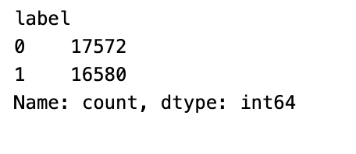
CONTENT
Fake News Dataset:
Contains 34,152 news headlines (0: 17572, 1: 16580)
Preprocessing + Feature Extraction
Logistic Regression
XGBoost
Comparison of models
FAKE
REAL

Slide 3
Preprocessing + Feature Extraction

Slide 4
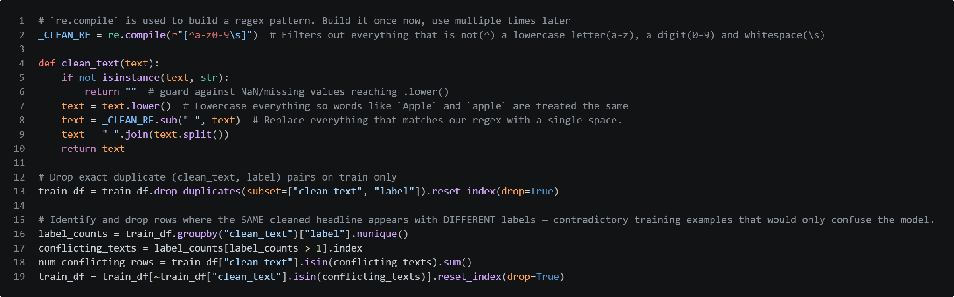
Data Cleaning
Preparing and sanitizing raw headline data
Text Cleaning
Deduplication
Noise Reduction
Regex filtering, lowercasing, missing value safety
Removed identical headline-label pairs
Filtered contradictory samples (same text, opposing targets)
Fake vs. Real News Headline Classifier
8

Slide 5
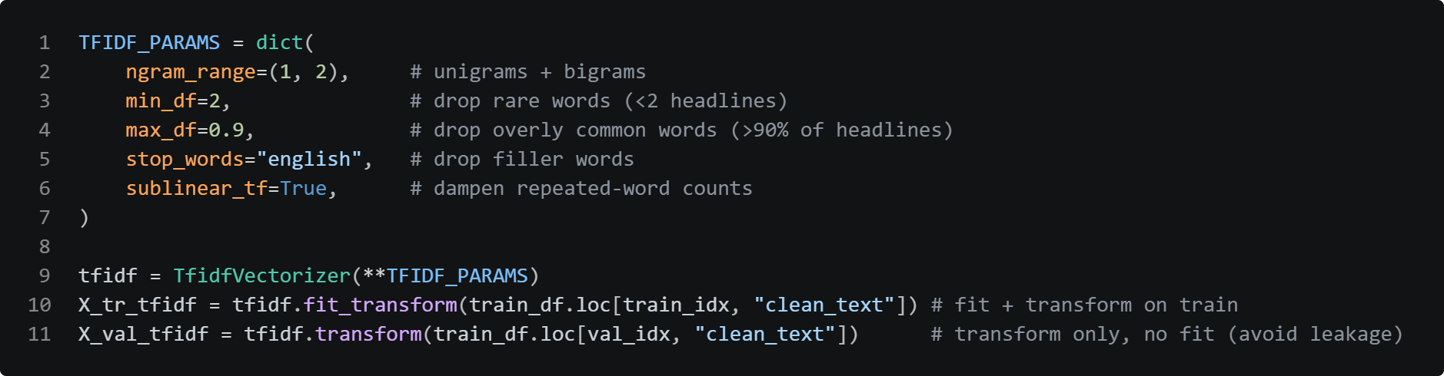
TF-IDF
Baseline TF-IDF configuration and data leakage prevention
N-Gram Strategy
TF-IDF vs. Embeddings
Leakage Prevention
Unigrams + bigrams with sublinear scaling to capture phrase context without over-weighting repeated words.
Keyword presence and rare-word weighting gave stronger signal than dense vectors for short headlines.
Vectorizer fit strictly on training set; validation set transformed independently.
Fake vs. Real News Headline Classifier
8

Slide 6
Logistic Regression

Slide 7
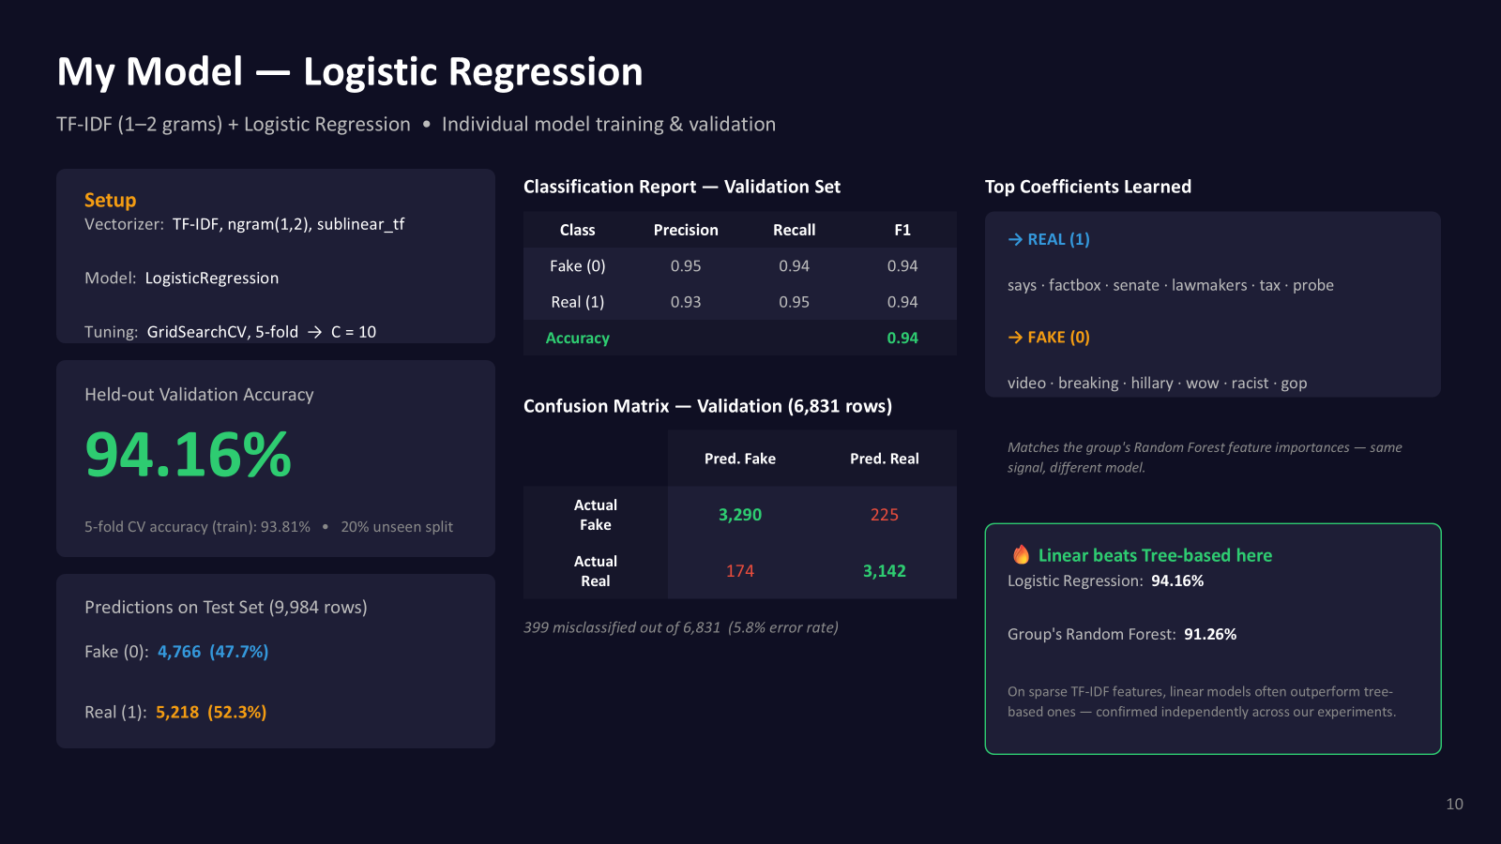

Slide 8
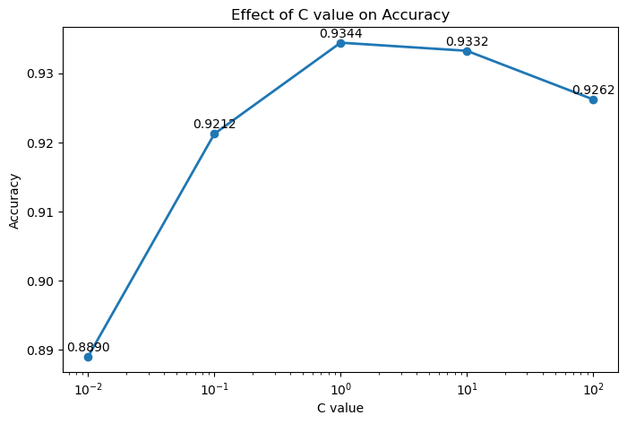
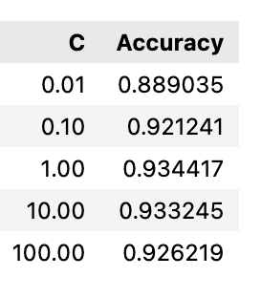
Hyperparameter Tuning:
TF-IDF + Logistic Regression
LogisticRegression(C, max_iter=1000)
Too small → making the model simpler, underfitting.
Too large → fit more closely, but it may increase the risk of overfitting.
controls the strength of regularization in Logistic Regression
default: 1
Best C Value: C = 1 (Default)

Slide 9
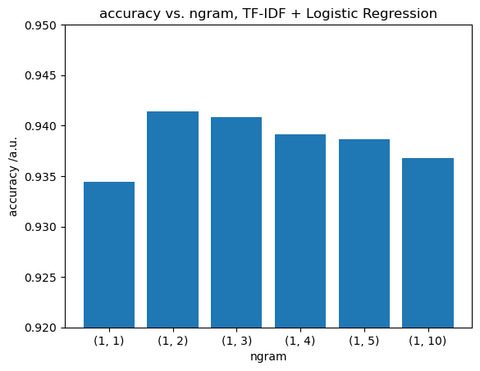
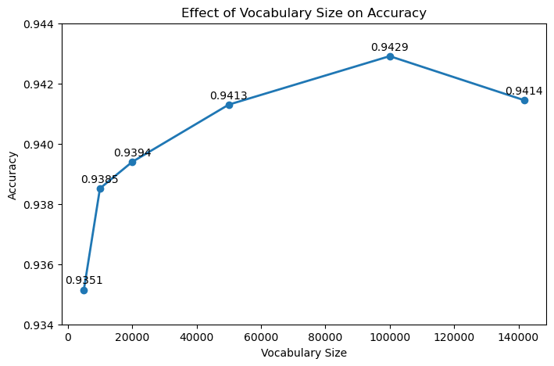
Hyperparameter Tuning:
TF-IDF + Logistic Regression
vectorizer = CountVectorizer( ngram_range=(1,2), max_features=feature)
max. length of word combinations
size of the vocabulary used for training
Best parameters: ngram_range = (1,2), max_features = 100000
→ Improve the model performance

Slide 10
XGBoost

Slide 11
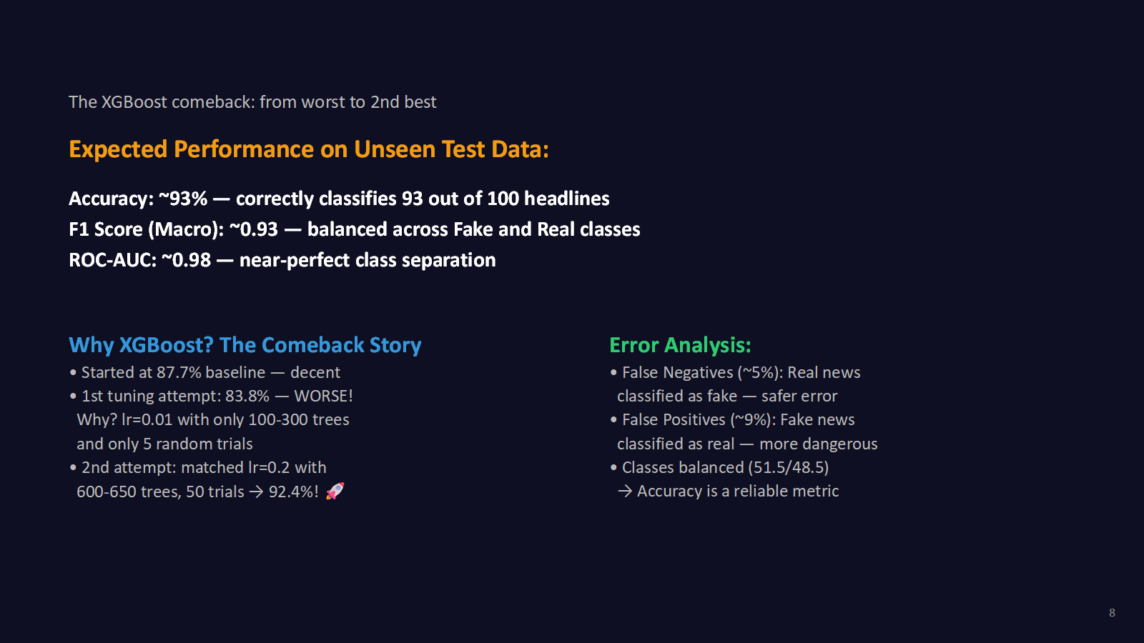

Slide 13
Comparison

Slide 14
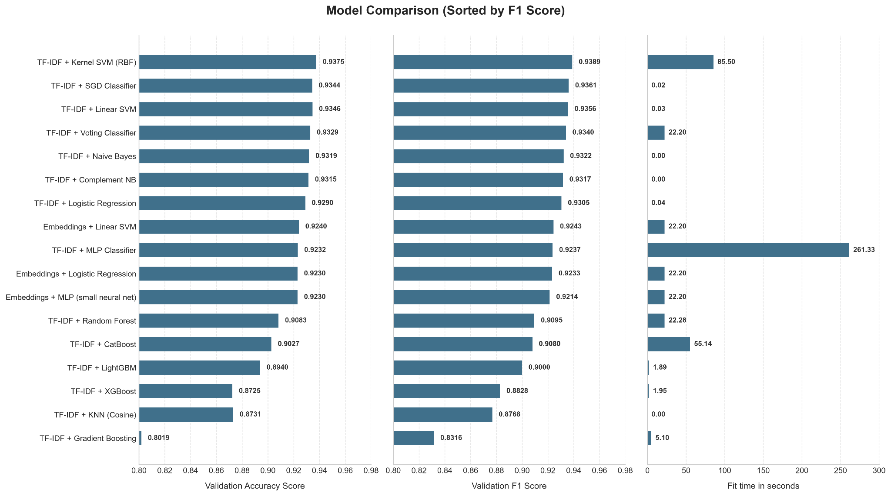

Slide 15
THANKS

