Slide 1
DELIVERABLES
GCM - ECMWF
NIGHT: Forecast at 1d, 2d, 3d
8 parameters: WS (@30m), WD (@30m), RH (@30m), PWV, sky transparency, seeing, wavefront coherence time, GLF
Short time scale with an upgrade forecast with a temporal sampling of 1h
Forecast temporal sampling: 10 minutes
All the other parameters done with
Astro-Meso-NH
DAY: Forecast at 1d, 2d, 3d
5 parameters: WS (@30m), WD (@30m), RH (@30m), PWV, sky transparency
Short time scale with an upgrade forecast with a temporal sampling of 1h
Forecast temporal sampling: 10 minutes

Slide 2
AUTOMATIC FORECAST SYSTEM
Different servers and
independent sub-networks
Initialisation and
forcing data
ECMWF
2a
(A)
2b
ESO
model outputs
data (*csv)
(Santiago)
ESO
model outputs
data (*csv)
Back-up
(Garching)
1a
1b
ESO
(Garching)
ESO: Back-up
(Garching)
Input and Ouput data
(B)
IP1
IP2
IP3
IP3
IP1
IP2
principal
network
IN/OUT
Automatic forecast
system
(C)
LaMMA
HPC facilities
IN/OUT
back-up
network
LaMMA
NAS storing data
INAF-OAA

Slide 3
MONTHLY AUTOMATIC REPORT

Slide 4
LOG FILES OUTPUTS
This table is useful to monitor the automatic system behaviour
AUTOMATIC SYSTEM CHECK-LIST
ECMWF initialisation data transmission
ftp access ESO - INPUT
ftp access ESO – OUPUT
principal network
server INPUT
servers OUTPUT
model: explosion of simulations
Current month | Incremental months
retrieving real-time observations
Possible solution:
Success: x
Failure: y
If everything was
ok during the month we should
have 31x and 0y.
If things goes correctly in the ioncremental column
The number of x grows while the number of y remain small.
…….
…….
To be filled with other items…….The idea is to prepare an exhaustive list
PS: Angel prefers to avoid in the terminology, words such as ‘problems’.

Slide 5
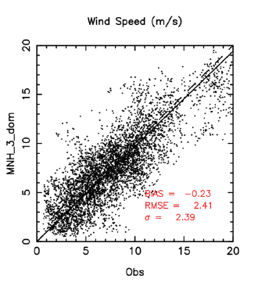
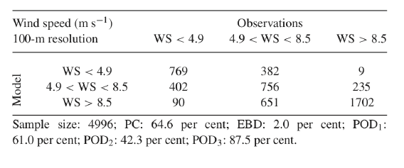
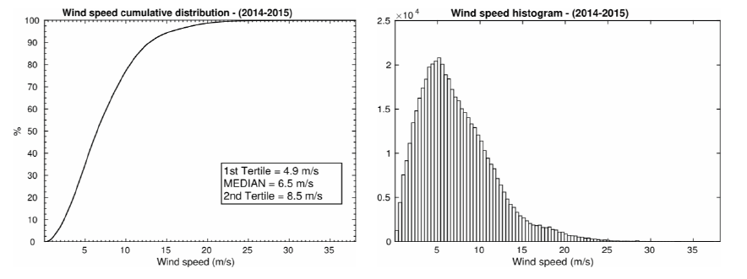
AUTOMATIC REPORT
Scattering plots
Contingency table
AR, ACC=0
AR, ACC=SD_{obs}
AR incremental, ACC=0
AR, incremental, ACC=SD_{obs}
Cumulative distribution and histogram
Probability estimates are
to be discussed with ESO

Slide 6
SCATTERING PLOTS
Night:
WS, WD, PWV,RH, 𝜀, 𝜏₀, GLF
Scattering plots
Day:
WS, WS,WD, PWV,RH, RHbis
Scattering plots with (bias, RMSE,SD):
1. Standard configuration current month (1d)
2. Standard configuration incremental month (1d)
3. Standard configuration current month (2d)
4. Standard configuration incremental month (2d)
5. Standard configuration current month (3d)
6. Standard configuration current month (3d)
7. AR
8. AR incremental
Cloud cover out
NIGHT
7 parameters x 8 fig. merit = 56 plots
DAY
4 parameters x 8 fig. merit = 32 plots
56 +32 plots + 3+3 TABLES (nights and day) for long fts and 2 TABLES for short fts (for night and day)
tables including the statistical operators (bias, RMSE, SD).
See next slides

Slide 7
NIGHT
LONG FTS: STANDARD CONFIGURATION
Current month
Incremental months since beginning service
RMSE
 | BIAS | RMSE | SD | BIAS | RMSE | SD
WS
WD
RH
PWV
𝜀
𝜏₀
GLF
prevision by persistence
Three tables: 1day, 2days, 3day.
𝜀=seeing
𝜏₀= wavefront coherence time
GLF=ground layer fraction

Slide 8
LONG FTS: STANDARD CONFIGURATION
DAY
Current month
Incremental months since beginning service
RMSE
 | BIAS | RMSE | SD | BIAS | RMSE | SD
WS
WD
RH
PWV
𝜀
𝜏₀
GLF
prevision by persistence
Three tables: 1day, 2days, 3day.

Slide 9
SHORT FTS (1h): AUTOREGRESSION
NIGHT
Current month
Incremental months since beginning service
RMSE
 | BIAS | RMSE | SD | BIAS | RMSE | SD
WS
WD
RH
PWV
𝜀
𝜏₀
GLF
prevision by persistence
One table for the night.
𝜀=seeing
𝜏₀= wavefront coherence time
GLF=ground layer fraction

Slide 10
SHORT FTS (1h): STANDARD CONFIGURATION
DAY
Current month
Incremental months since beginning service
RMSE
 | BIAS | RMSE | SD | BIAS | RMSE | SD
WS
WD
RH
PWV
𝜀
𝜏₀
GLF
prevision by persistence
One table for the day.

