Slide 1
C Pointers
Chapter 7 from “C How to Program"
Another ref:
http://pw1.netcom.com/~tjensen/ptr/pointers.htm

Slide 2
7.1 Introduction
7.2 Pointer Variable Definitions and Initialization
7.3 Pointer Operators
7.4 Passing Arguments to Functions by Reference
7.5 Using the const Qualifier with Pointers
7.6 Bubble Sort Using Call-by-Reference
7.7 sizeof Operator
7.8 Pointer Expressions and Pointer Arithmetic
7.9 Relationship between Pointers and Arrays
7.10 Arrays of Pointers
7.11 Case Study: Card Shuffling and Dealing Simulation
7.12 Pointers to Functions

Slide 3
7.1 Introduction
Pointers
  Powerful, but difficult to master
  Simulate call-by-reference
  Close relationship with arrays and strings

Slide 4
7.2 Pointer Variable Definitions and Initialization
Pointer variables
  Contain memory addresses as their values
  Normal variables contain a specific value (direct reference)
  Pointers contain address of a variable that has a specific value (indirect reference)
  Indirection – referencing a pointer value

Slide 5
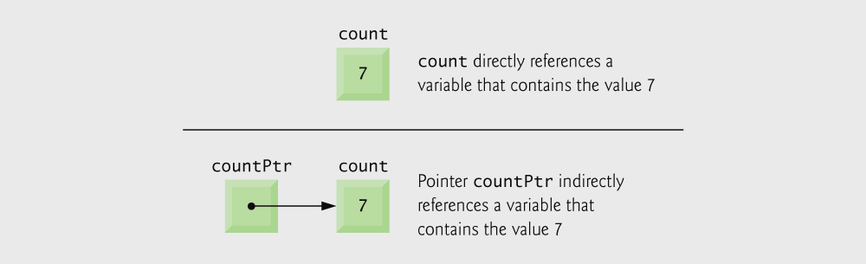
Fig. 7.1 | Directly and indirectly referencing a variable.

Slide 6
7.2 Pointer Variable Definitions and Initialization
Pointer definitions
  * used with pointer variables
      int *myPtr;
  Defines a pointer to an int (pointer of type int *)
  Multiple pointers require using a * before each variable definition
      int *myPtr1, *myPtr2;
  Can define pointers to any data type
  Initialize pointers to 0, NULL, or an address
    0 or NULL – points to nothing (NULL preferred)

Slide 7
Common Programming Error 7.1
The asterisk (*) notation used to declare pointer variables does not distribute to all variable names in a declaration. Each pointer must be declared with the * prefixed to the name; e.g., if you wish to declare xPtr and yPtr as int pointers, use int *xPtr, *yPtr;.

Slide 8
Good Programming Practice 7.1
Include the letters ptr in pointer variable names to make it clear that these variables are pointers and thus need to be handled appropriately.

Slide 9
Error-Prevention Tip 7.1
Initialize pointers to prevent unexpected results.

Slide 10
Assignment revisited – Pointers and Vars
X = 17;
lvalue = rvalue
lvalue: expression that evaluates to a location
rvalue: expression that evaluates to a value

Slide 11
Simple Pointers
Pointer is a value that points to a location in the memory
Pointer is associated with a type
int number ;
int * ptr_to_num ;
number = 23;
ptr_to_num = & number;
printf("Value is %d \n", (*ptr_to_num) );
23
number
003F45A8
ptr_to_num

Slide 12
More Pointers
int number ;
int * p1, * p2;
p1 = & number ;
number = 23;
p2 = & number ;
printf(" *p1 = %d *p2 = %d ", *p1, *p2);
/* Output ?? */
number
p1
p2

Slide 13
Pointers and Arrays
char str[32];
char *ptr;
ptr = str ;
strcpy( str, "test" );
strcpy( ptr, "test" ); /* does the same as above */

Slide 14
Pointers and Arrays
int table [8];
int *ptr ;
ptr = table ;
table [ 4 ] = 94;
*( ptr + 4 ) = 94;
How about
ptr = & table[0]?? vs. ptr=table;??
94
table
ptr
( ptr + 4 )

Slide 15
Pointer operations
Can add and subtract numbers (like array indices)
Can increment and decrement!
char str[] = "Test";
char * p ;
int i;
for( p = str, i=0; *p != '\0'; p++, i++);
printf(" The length of the string is %d ", i);

Slide 16
NULL pointer
A way to tell that pointer points to nothing
  void main()
  {
  char *msg = NULL;
  MyPrint( msg );
  }
  void MyPrint( char * txt )
  {
  if ( txt == NULL )
  printf( "Invalid parameters: NULL pointer received\n");
  else
  printf( "%s\n", txt );
  }

Slide 17
Command Line Arguments
/* MyProg.c */
int main ( int argc , char *argv[] )
{ ...
> myProg one two three
argc = 4
argv[0] = "myProg"
argv[1] = "one"
argv[2] = "two"
argv[3] = "three“
argv[4] = NULL

Slide 18
7.3 Pointer Operators
& (address operator)
  Returns address of operand
    int y = 5;
    int *yPtr;
    yPtr = &y; /* yPtr gets address of y */
    yPtr “points to” y

Slide 19

Fig. 7.2 | Graphical representation of a pointer pointing to an integer variable in memory.

Slide 20
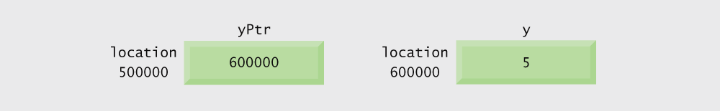
Fig. 7.3 | Representation of y and yPtr in memory.

Slide 21
7.3 Pointer Operators
* (indirection/dereferencing operator)
  Returns a synonym/alias of what its operand points to
  *yptr returns y (because yptr points to y)
  * can be used for assignment
    Returns alias to an object
      *yptr = 7; /* changes y to 7 */
  Dereferenced pointer (operand of *) must be an lvalue (no constants)
* and & are inverses
  They cancel each other out

Slide 22
Common Programming Error 7.2
Dereferencing a pointer that has not been properly initialized or that has not been assigned to point to a specific location in memory is an error. This could cause a fatal execution-time error, or it could accidentally modify important data and allow the program to run to completion with incorrect results.

Slide 23
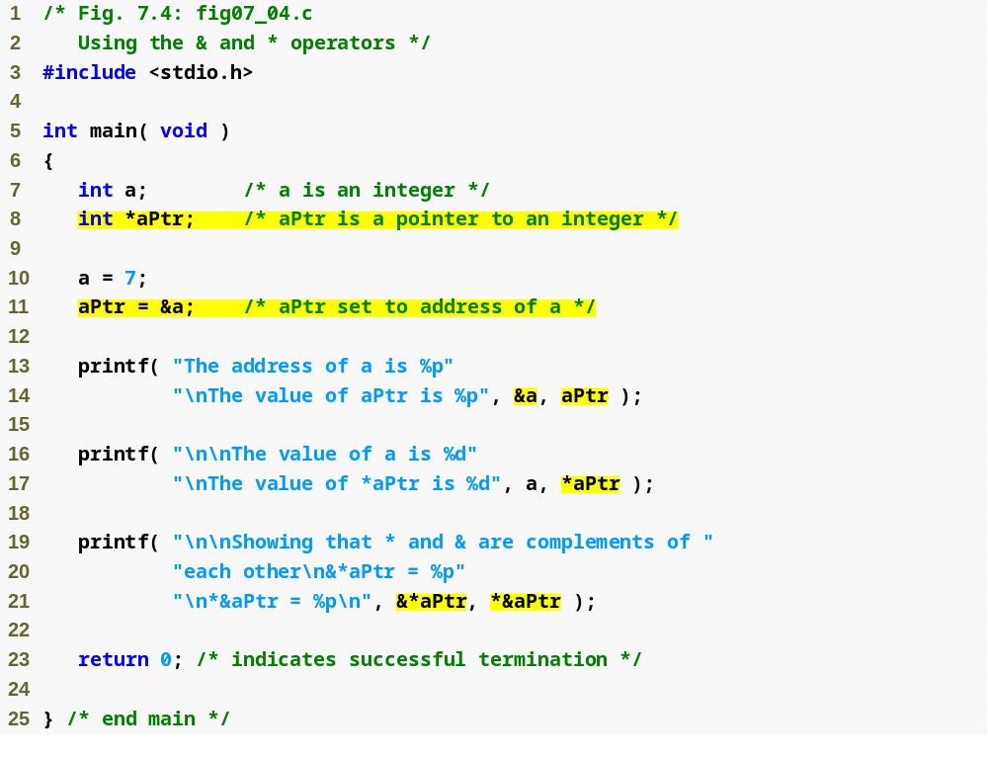
Outline
fig07_04.c
(1 of 2 )
If aPtr points to a, then &a and aPtr have the same value.
a and *aPtr have the same value
&*aPtr and *&aPtr have the same value

Slide 24
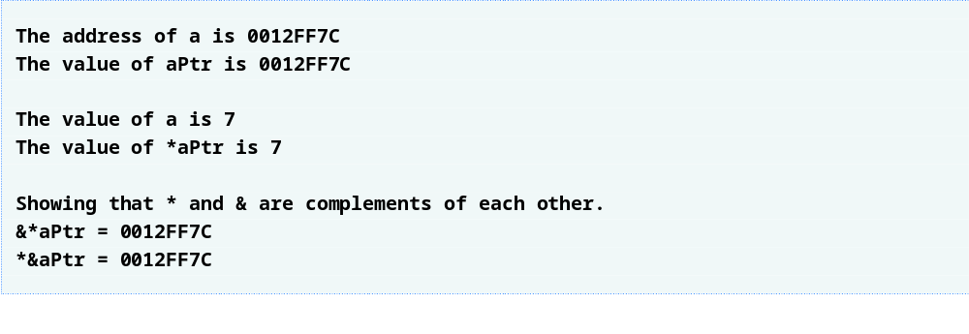
Outline
fig07_04.c
(2 of 2 )

Slide 25
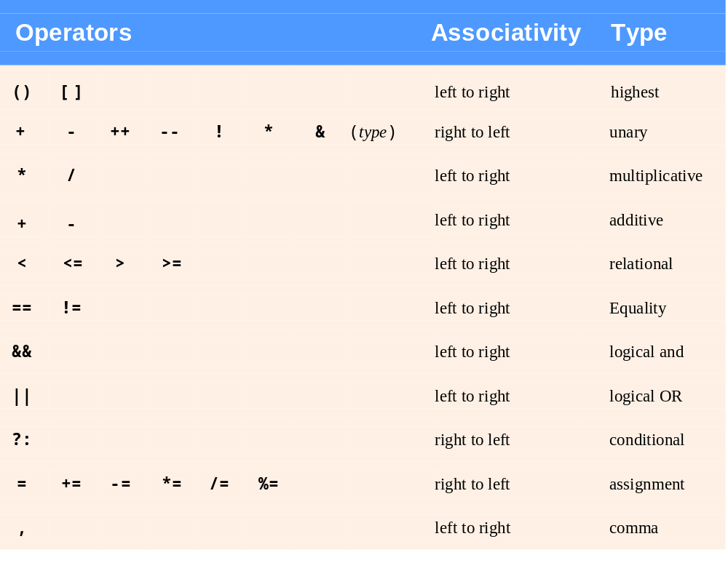
Fig. 7.5 | Operator precedence.

Slide 26
7.4 Calling Functions by Reference
Call by reference with pointer arguments
  Pass address of argument using & operator
  Allows you to change actual location in memory
  Arrays are not passed with & because the array name is already a pointer
* operator
  Used as alias/nickname for variable inside of function
      void double( int *number )
      {
      *number = 2 * ( *number );
      }
  *number used as nickname for the variable passed

Slide 27
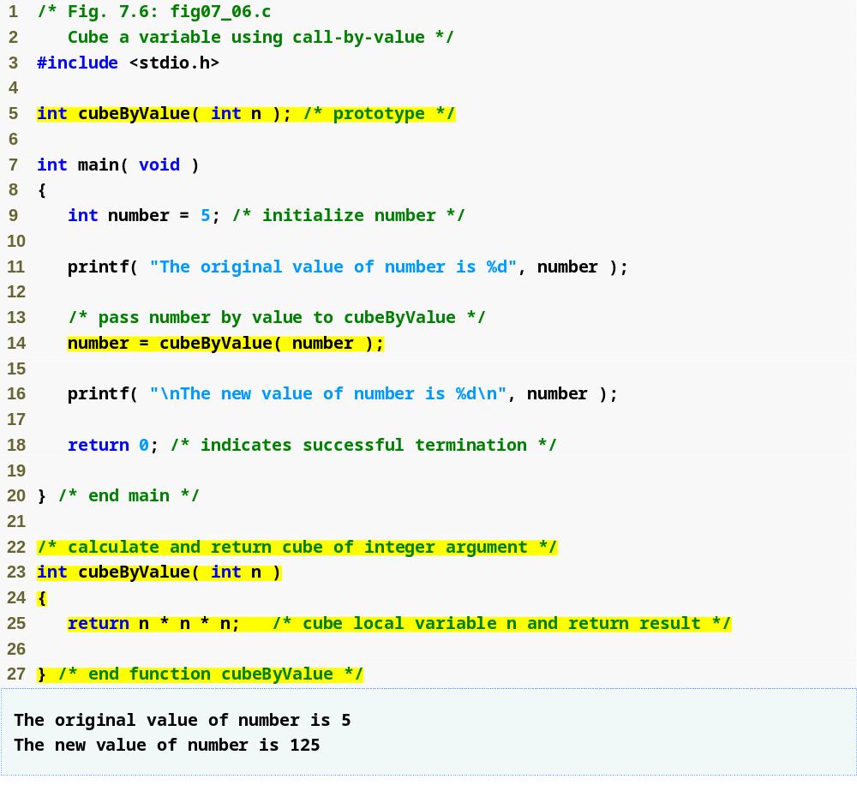
Outline
fig07_06.c

Slide 28
Common Programming Error 7.3
Not dereferencing a pointer when it is necessary to do so in order to obtain the value to which the pointer points is a syntax error.

Slide 29
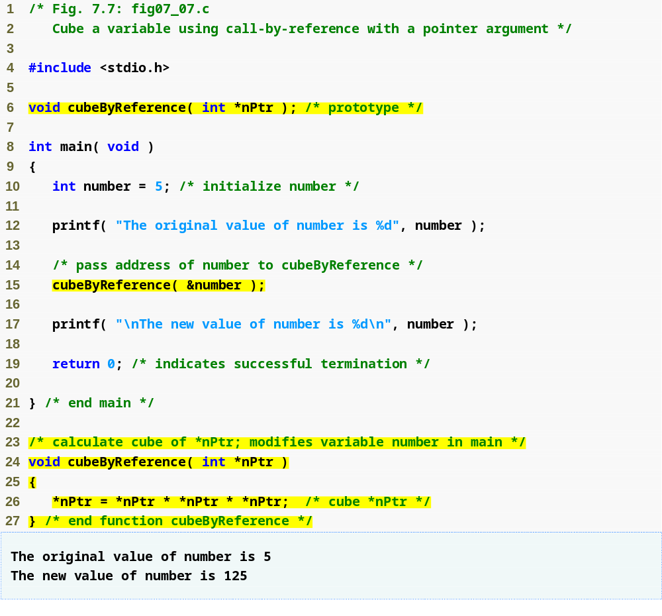
Outline
Function prototype takes a pointer argument
fig07_07.c
Function cubeByReference is passed an address, which can be the value of a pointer variable
In this program, *nPtr is number, so this statement modifies the value of number itself.

Slide 30
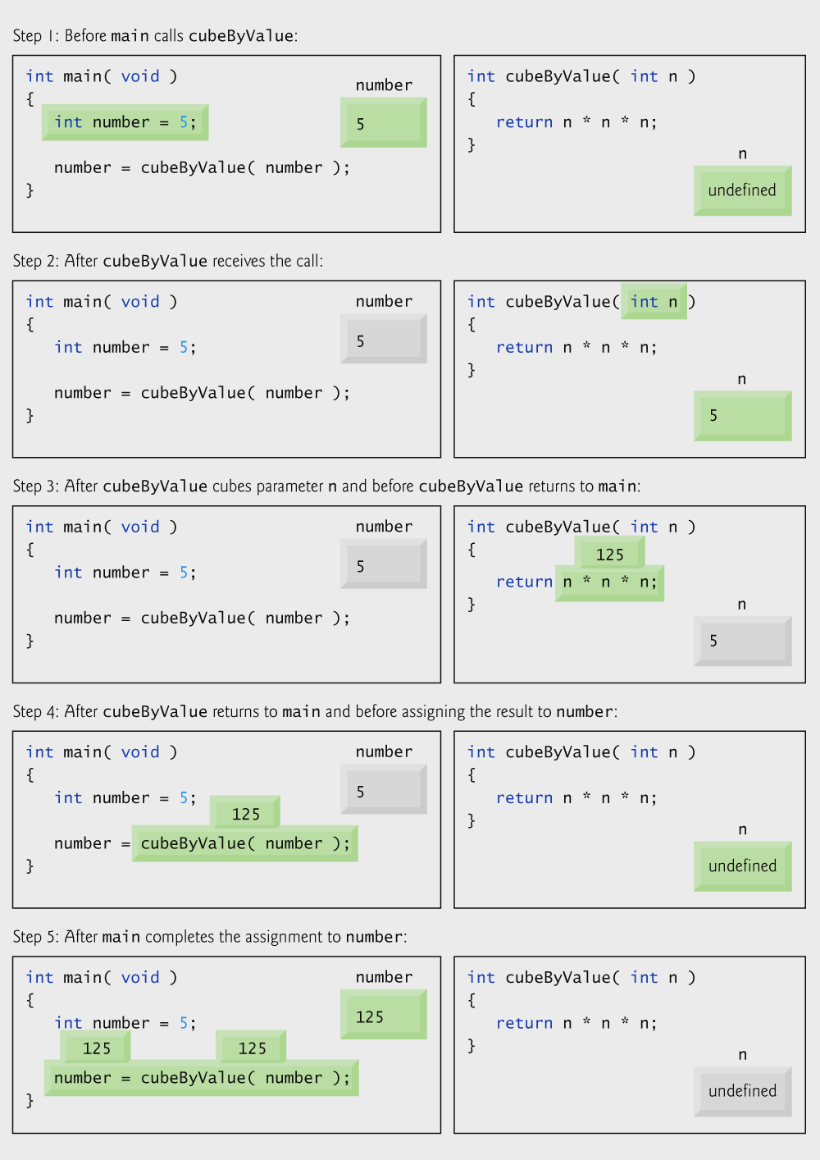
Fig. 7.8 | Analysis of a typical call-by-value.

Slide 31
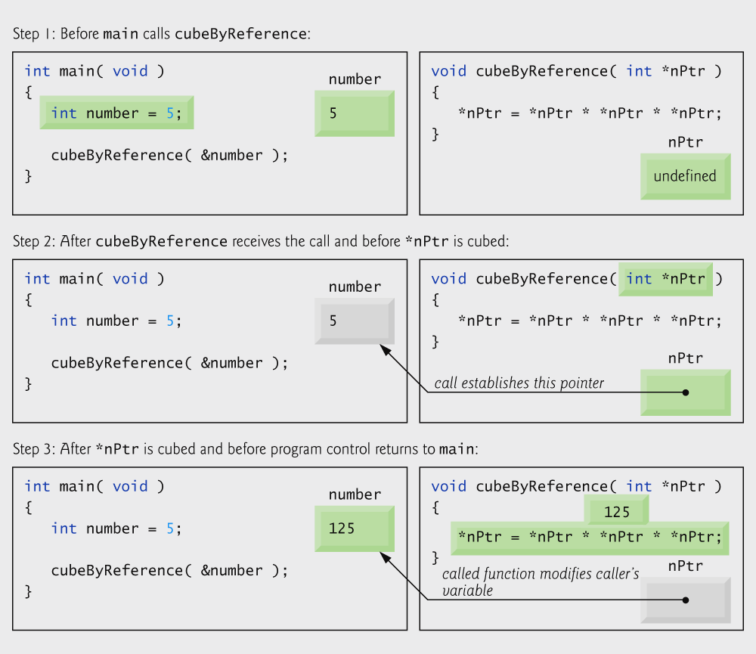
Fig. 7.9 | Analysis of a typical call-by-reference with a pointer argument.

Slide 32
Error-Prevention Tip 7.2
Use call-by-value to pass arguments to a function unless the caller explicitly requires
the called function to modify the value of the argument variable in the caller’s environment. This prevents accidental modification of the caller’s arguments and is another example of the principle of least privilege.

Slide 33
7.5 Using the const Qualifier with Pointers
const qualifier
  Variable cannot be changed
  Use const if function does not need to change a variable
  Attempting to change a const variable produces an error
const pointers
  Point to a constant memory location
  Must be initialized when defined
  int *const myPtr = &x;
    Type int *const – constant pointer to an int
  const int *myPtr = &x;
    Modifiable pointer to a const int
  const int *const Ptr = &x;
    const pointer to a const int
    x itself can be changed, but not *Ptr

Slide 34
Software Engineering Observation 7.1
The const qualifier can be used to enforce the principle of least privilege. Using the principle of least privilege to properly design software reduces debugging time and improper side effects, making a program easier to modify and maintain.

Slide 35
Portability Tip 7.1
Although const is well defined in Standard
C, some compilers do not enforce it.

Slide 36
Error-Prevention Tip 7.3
If a variable does not (or should not) change in the body of a function to which it is passed, the variable should be declared const to ensure that it is not accidentally modified.

Slide 37
Software Engineering Observation 7.2
Only one value can be altered in a calling function when call-by-value is used. That value must be assigned from the return value of the function. To modify multiple values in a calling function, call-by-reference must be used.

Slide 38
Error-Prevention Tip 7.4
Before using a function, check its function prototype to determine if the function is able to modify the values passed to it.

Slide 39
Common Programming Error 7.4
Being unaware that a function is expecting pointers as arguments for call-by-reference and passing arguments call-by-value. Some compilers take the values assuming they are pointers and dereference the values as pointers. At runtime, memory-access violations or segmentation faults are often generated. Other compilers catch the mismatch in types between arguments and parameters and generate error messages.

Slide 40
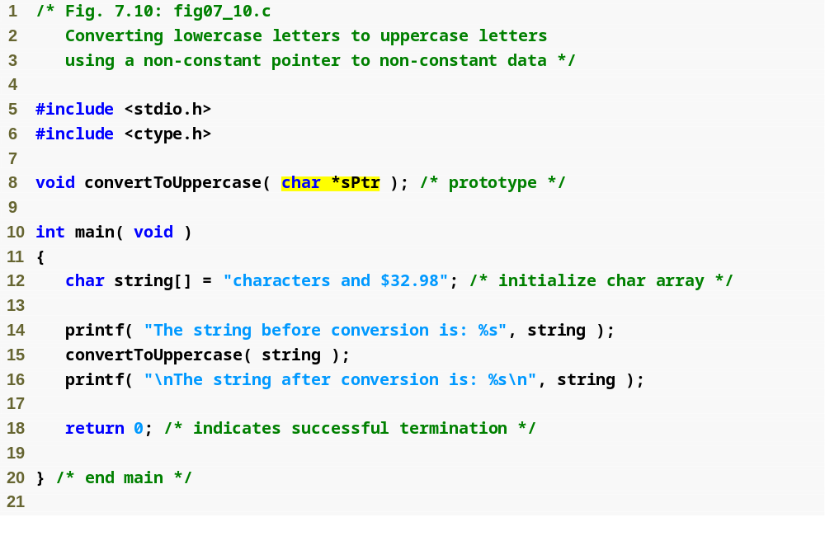
Outline
Both sPtr and *sPtr are modifiable
fig07_10.c
(1 of 2 )

Slide 41
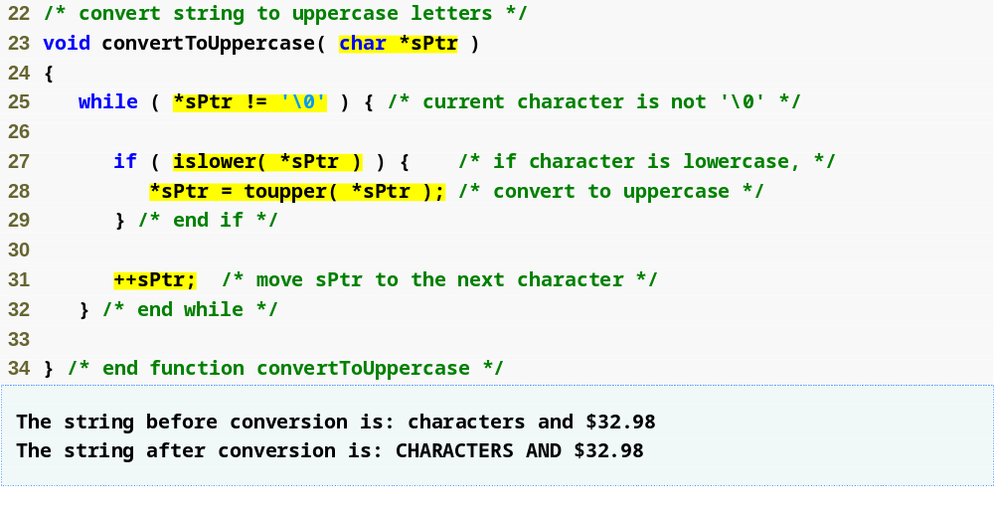
Outline
fig07_10.c
(2 of 2 )
Both sPtr and *sPtr are modified by the convertToUppercase function

Slide 42
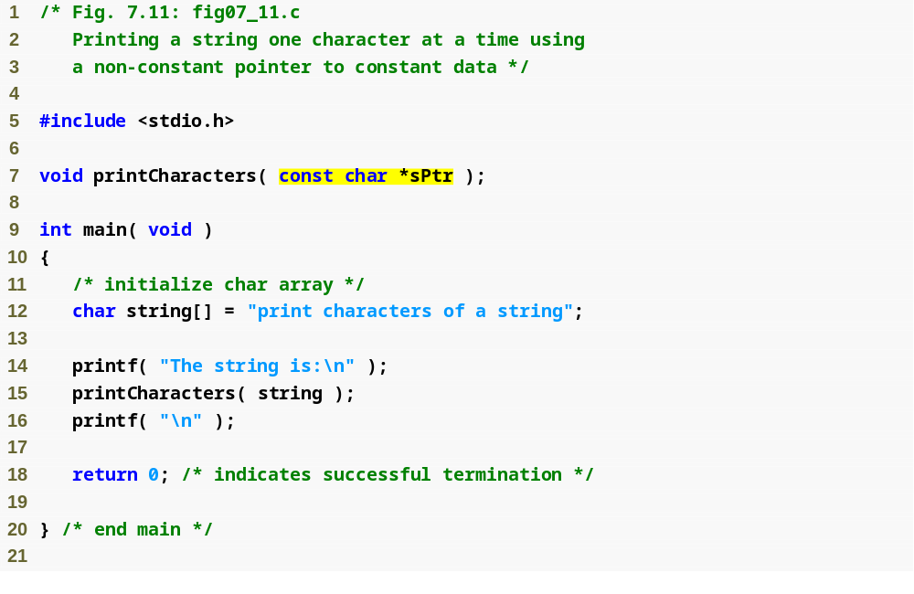
Outline
Pointer variable sPtr is modifiable, but the data to which it points, *sPtr, is not
fig07_11.c
(1 of 2 )

Slide 43
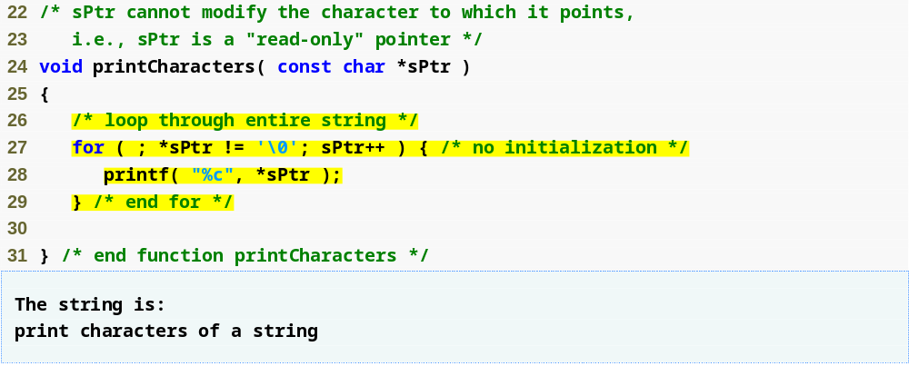
Outline
fig07_11.c
(2 of 2 )
sPtr is modified by function printCharacters

Slide 44
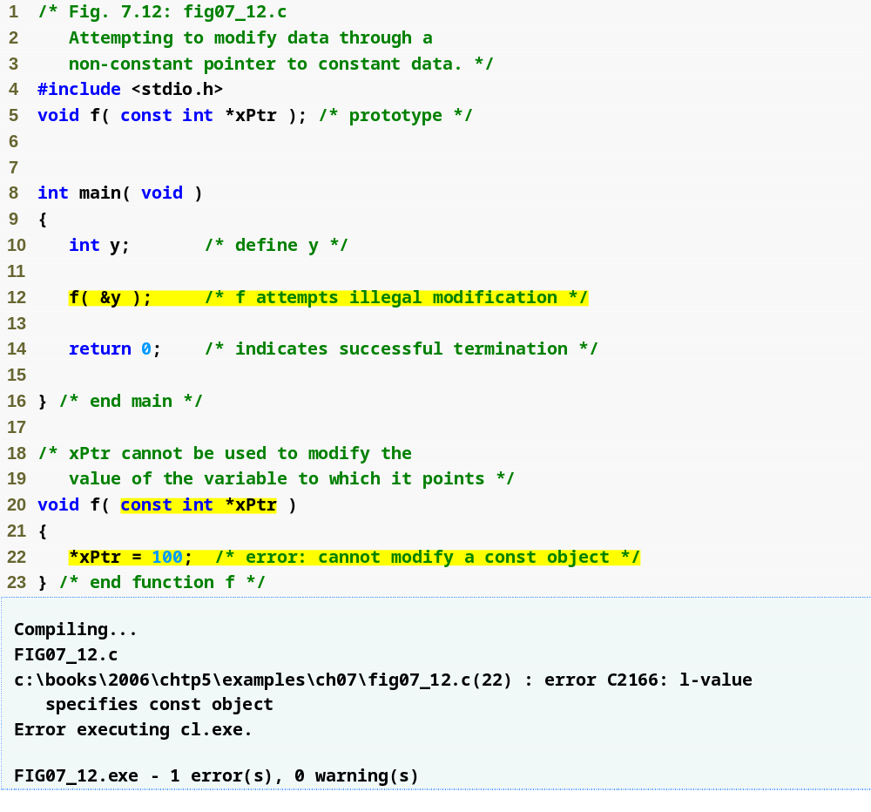
Outline
fig07_12.c
Pointer variable xPtr is modifiable, but the data to which it points, *xPtr, is not
*xPtr has the const qualifier, so attempting to modify its value causes an error

Slide 45
Performance Tip 7.1
Pass large objects such as structures using pointers to constant data to obtain the performance benefits of call-by-reference and the security of call-by-value.

Slide 46
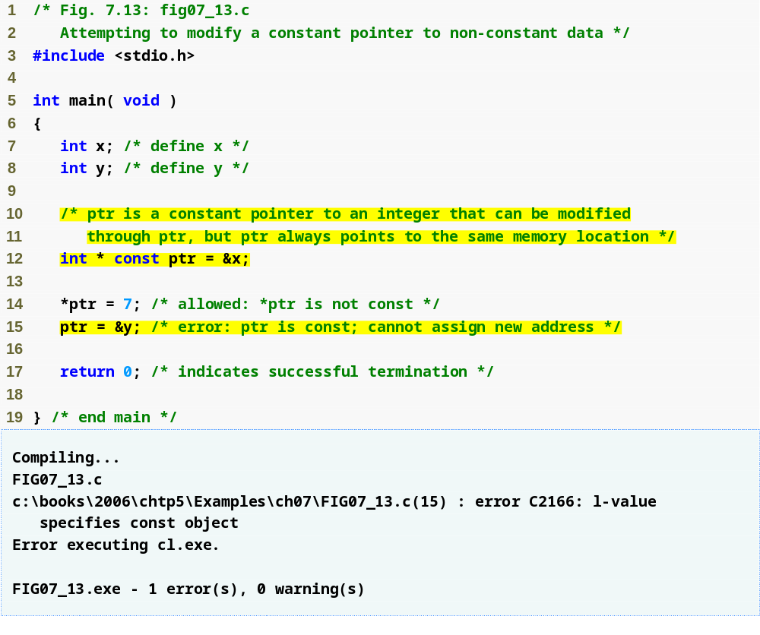
Outline
fig07_13.c
Pointer ptr is not modifiable, but the data to which it points, *ptr, can be changed

Slide 47
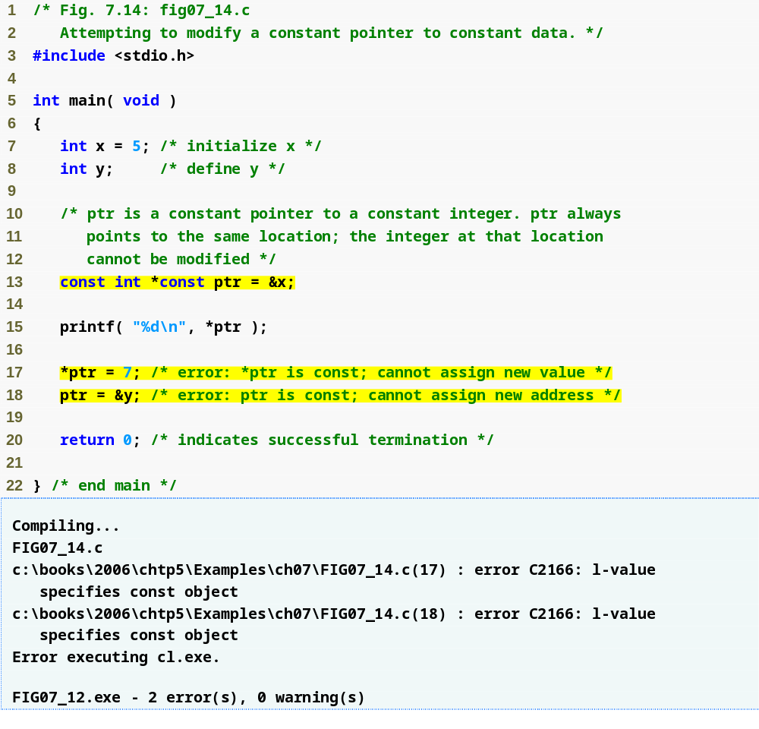
Outline
fig07_14.c
Neither pointer sPtr nor the data to which it points, *sPtr, is modifiable

Slide 48
7.6 Bubble Sort Using Call-by-Reference
Implement bubble sort using pointers
  Swap two elements
  swap function must receive address (using &) of array elements
    Array elements have call-by-value default
  Using pointers and the * operator, swap can switch array elements
Psuedocode
    Initialize array
    print data in original order
    Call function bubble sort
    print sorted array
    Define bubble sort

Slide 49
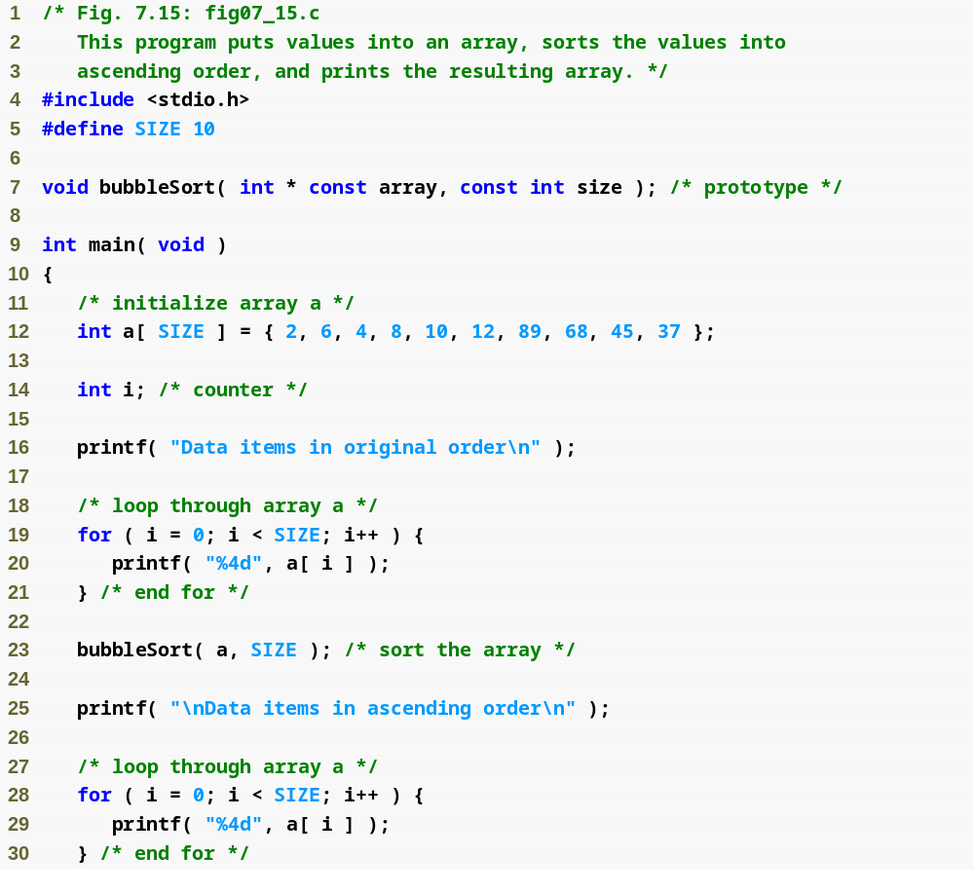
Outline
fig07_15.c
(1 of 3 )

Slide 50
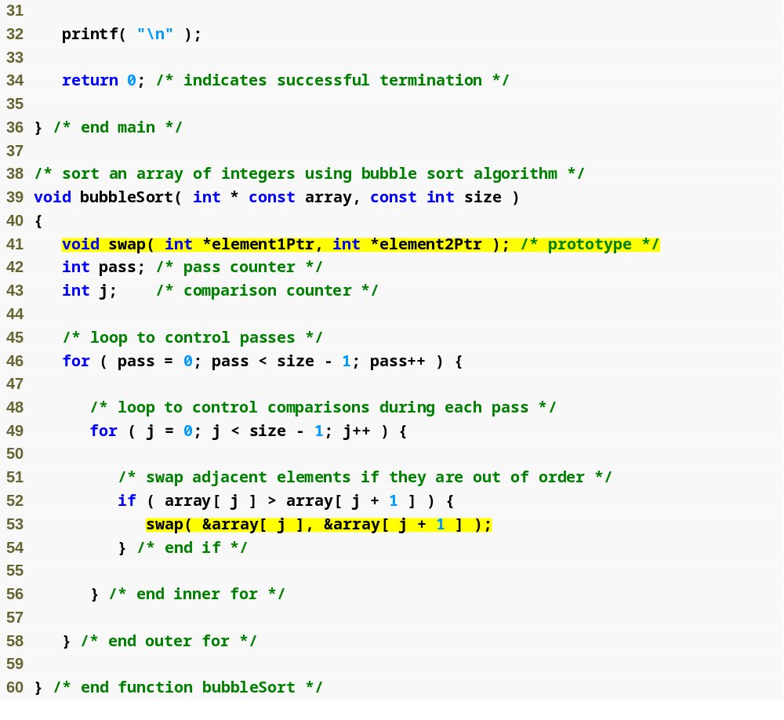
Outline
fig07_15.c
(2 of 3 )

Slide 51
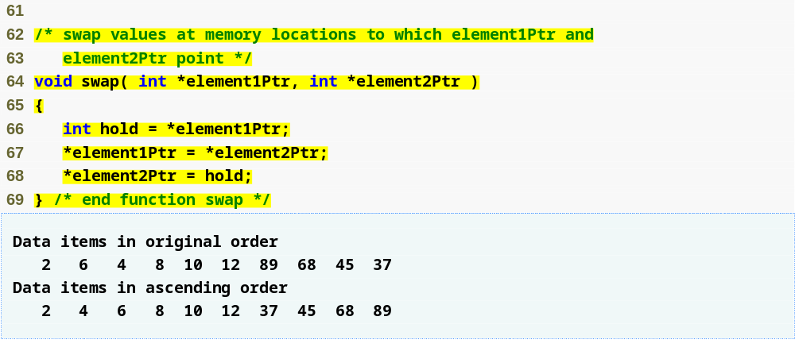
Outline
fig07_15.c
(3 of 3 )
Function swap changes the values of the ints that the two pointers point to

Slide 52
Software Engineering Observation 7.3
Placing function prototypes in the definitions
of other functions enforces the principle of least privilege by restricting proper function calls to the functions in which the prototypes appear.

Slide 53
Software Engineering Observation 7.4
When passing an array to a function, also pass the size of the array. This helps make the function reusable in many programs.

Slide 54
Software Engineering Observation 7.5
Global variables usually violate the principle of least privilege and can lead to poor software engineering. Global variables should be used only to represent truly shared resources, such as the time of day.

Slide 55
7.7 sizeof Operator
sizeof
  Returns size of operand in bytes
  For arrays: size of 1 element * number of elements
  if sizeof( int ) equals 4 bytes, then
      int myArray[ 10 ];
      printf( "%d", sizeof( myArray ) );
    will print 40
sizeof can be used with
  Variable names
  Type name
  Constant values

Slide 56
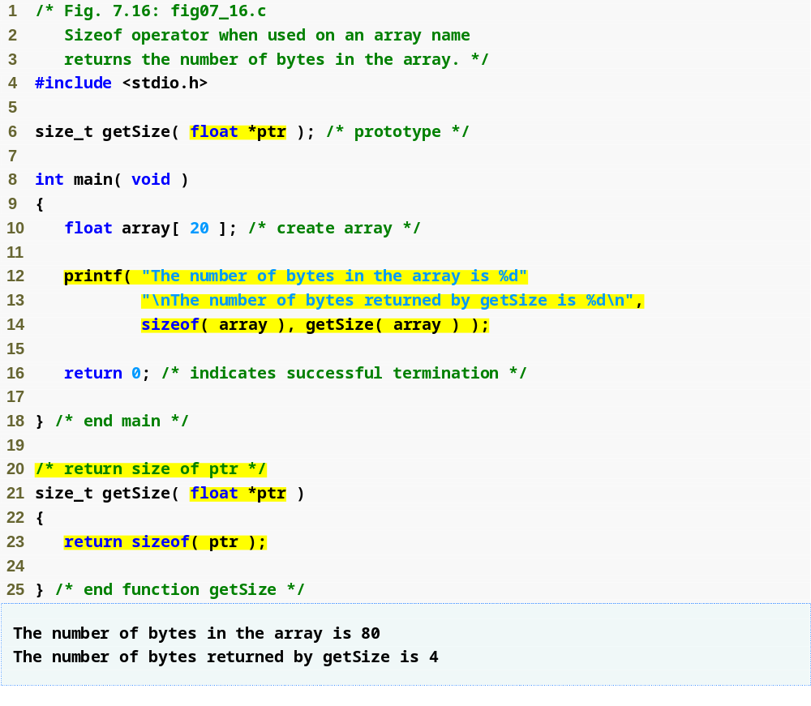
Outline
fig07_16.c
floats take up 4 bytes in memory, so 20 floats take up 80 bytes

Slide 57
Performance Tip 7.2
sizeof is a compile-time operator, so it does not incur any execution-time overhead.

Slide 58
Portability Tip 7.2
The number of bytes used to store a particular data type may vary between systems. When writing programs that depend on data type sizes and that will run on several computer systems, use sizeof to determine the number of bytes used to store the data types.

Slide 59
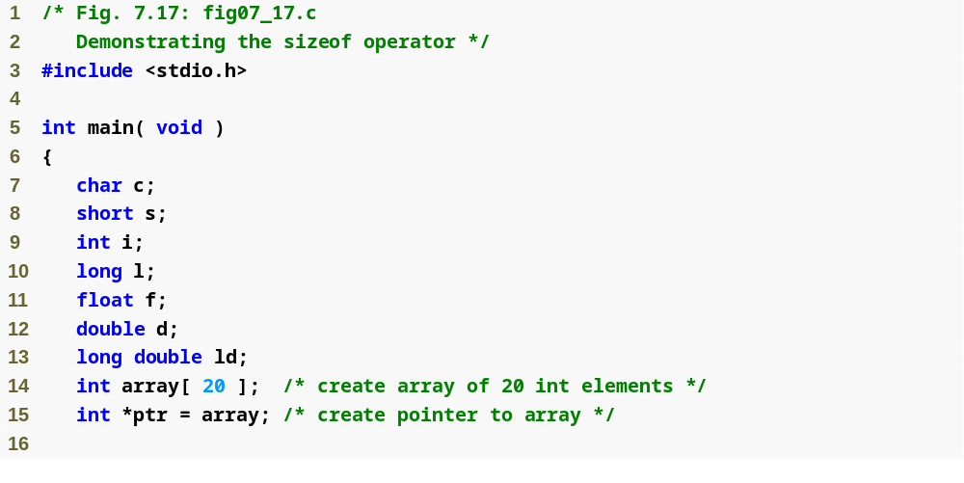
Outline
fig07_17.c
(1 of 2 )

Slide 60
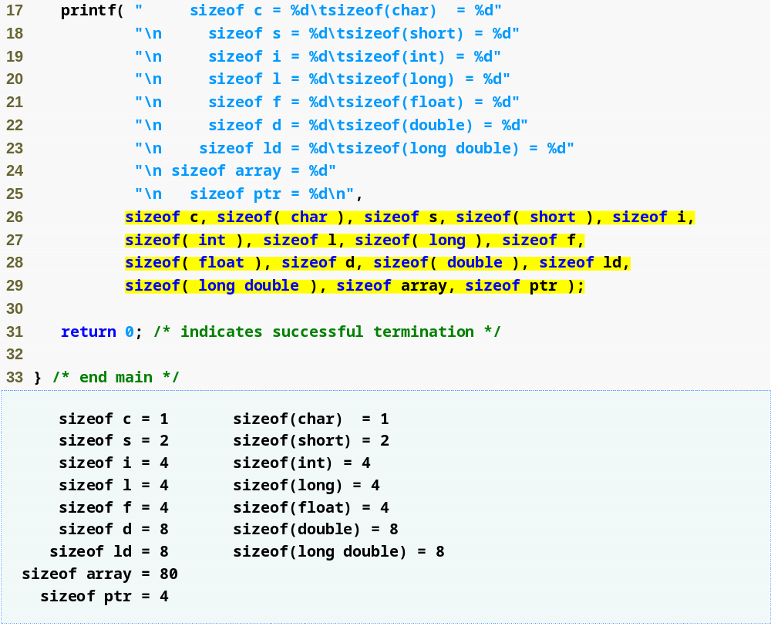
Outline
fig07_17.c
(2 of 2 )

Slide 61
7.8 Pointer Expressions and Pointer Arithmetic
Arithmetic operations can be performed on pointers
  Increment/decrement pointer (++ or --)
  Add an integer to a pointer( + or += , - or -=)
  Pointers may be subtracted from each other
  Operations meaningless unless performed on an array

Slide 62
7.8 Pointer Expressions and Pointer Arithmetic
5 element int array on machine with 4 byte ints
  vPtr points to first element v[ 0 ]
    at location 3000 (vPtr = 3000)
  vPtr += 2; sets vPtr to 3008
    vPtr points to v[ 2 ] (incremented by 2), but the machine has 4 byte ints, so it points to address 3008

Slide 63
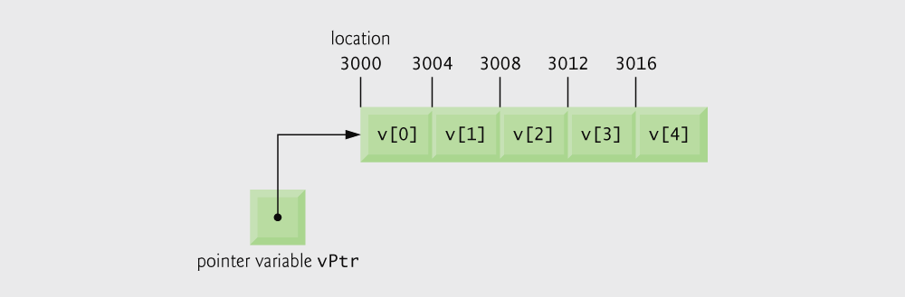
Fig. 7.18 | Array v and a pointer variable vPtr that points to v.

Slide 64
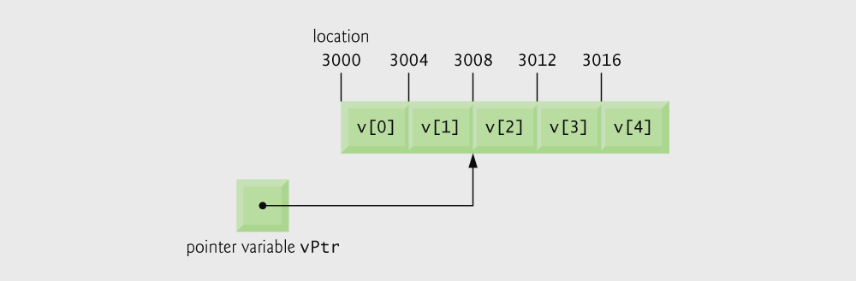
Fig. 7.19 | The pointer vPtr after pointer arithmetic.

Slide 65
Portability Tip 7.3
Most computers today have 2-byte or 4-byte integers. Some of the newer machines use 8-byte integers. Because the results of pointer arithmetic depend on the size of the objects a pointer points to, pointer arithmetic is machine dependent.

Slide 66
7.8 Pointer Expressions and Pointer Arithmetic
Subtracting pointers
  Returns number of elements from one to the other. If
    vPtr2 = v[ 2 ];
    vPtr = v[ 0 ];
  vPtr2 - vPtr would produce 2
Pointer comparison ( <, == , > )
  See which pointer points to the higher numbered array element
  Also, see if a pointer points to 0

Slide 67
Common Programming Error 7.5
Using pointer arithmetic on a pointer that does not refer to an element in an array.

Slide 68
Common Programming Error 7.6
Subtracting or comparing two pointers that do not refer to elements in the same array.

Slide 69
Common Programming Error 7.7
Running off either end of an array when using pointer arithmetic.

Slide 70
7.8 Pointer Expressions and Pointer Arithmetic
Pointers of the same type can be assigned to each other
  If not the same type, a cast operator must be used
  Exception: pointer to void (type void *)
    Generic pointer, represents any type
    No casting needed to convert a pointer to void pointer
    void pointers cannot be dereferenced

Slide 71
Common Programming Error 7.8
Assigning a pointer of one type to a pointer of another type if neither is of type void * is a syntax error.

Slide 72
Common Programming Error 7.9
Dereferencing a void * pointer is a syntax error.

Slide 73
7.9 Relationship Between Pointers and Arrays
Arrays and pointers closely related
  Array name like a constant pointer
  Pointers can do array subscripting operations
Define an array b[ 5 ] and a pointer bPtr
  To set them equal to one another use:
      bPtr = b;
    The array name (b) is actually the address of first element of the array b[ 5 ]
      bPtr = &b[ 0 ]
    Explicitly assigns bPtr to address of first element of b

Slide 74
7.9 Relationship Between Pointers and Arrays
  Element b[ 3 ]
    Can be accessed by *( bPtr + 3 )
      Where 3 is called the offset. Called pointer/offset notation
    Can be accessed by bptr[ 3 ]
      Called pointer/subscript notation
      bPtr[ 3 ] same as b[ 3 ]
    Can be accessed by performing pointer arithmetic on the array itself
      *( b + 3 )

Slide 75
Common Programming Error 7.10
Attempting to modify an array name with pointer arithmetic is a syntax error.

Slide 76
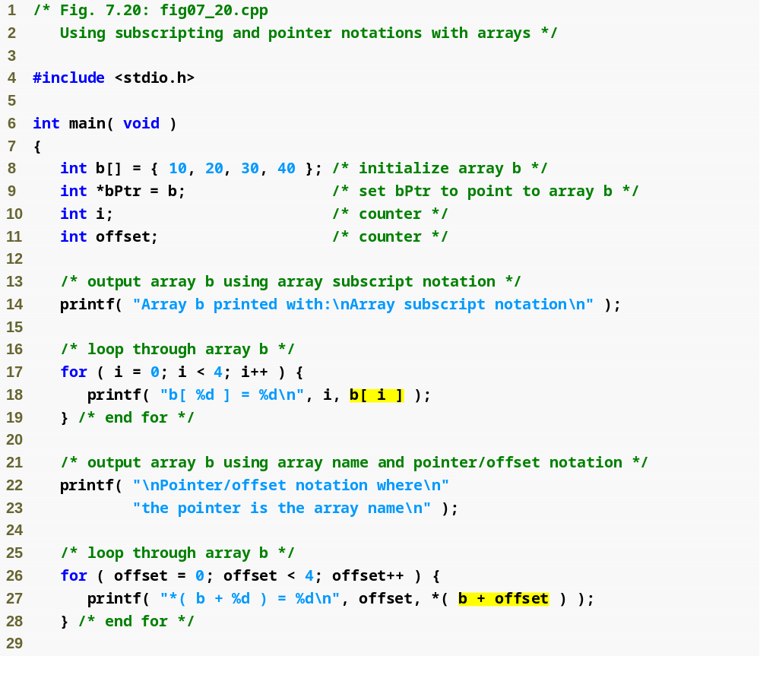
Outline
fig07_20.c
(1 of 3 )
Array subscript notation
Pointer/offset notation

Slide 77
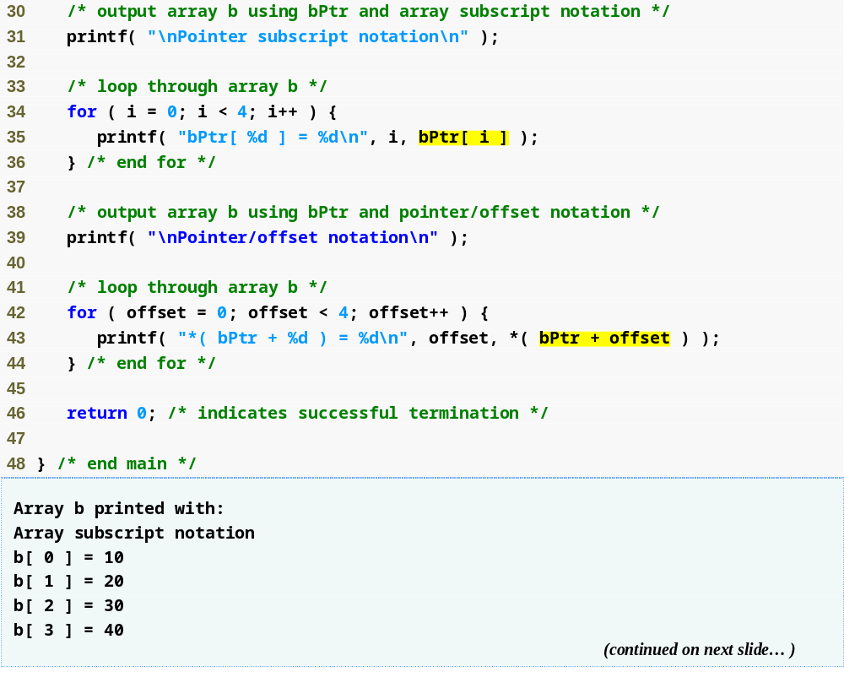
Outline
Pointer subscript notation
fig07_20.c
(2 of 3 )
Pointer offset notation

Slide 78
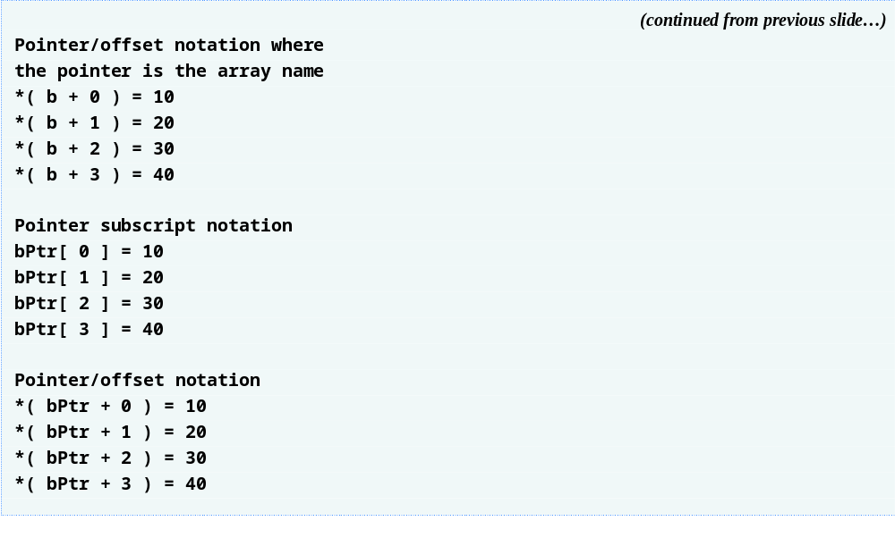
Outline
fig07_20.c
(3 of 3 )

Slide 79
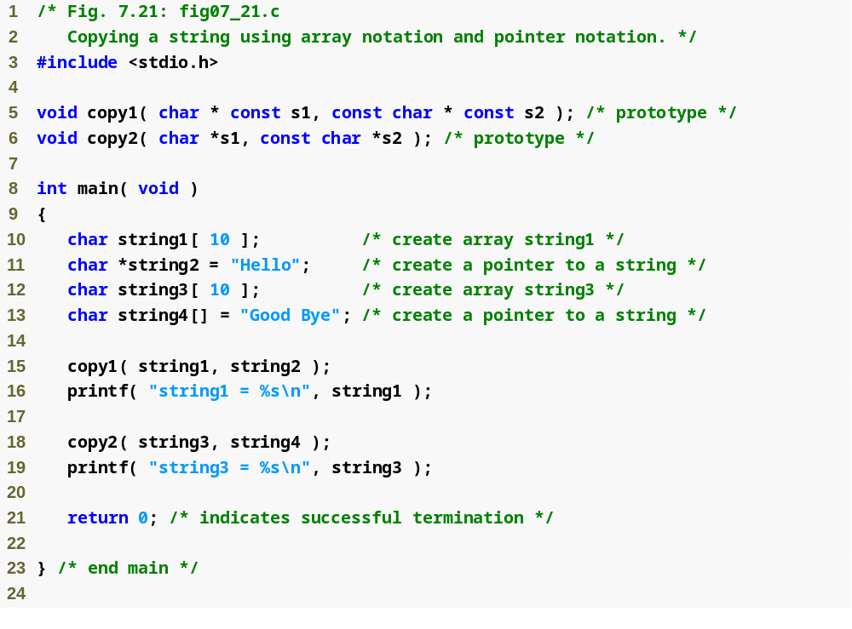
Outline
fig07_21.c
(1 of 2 )

Slide 80
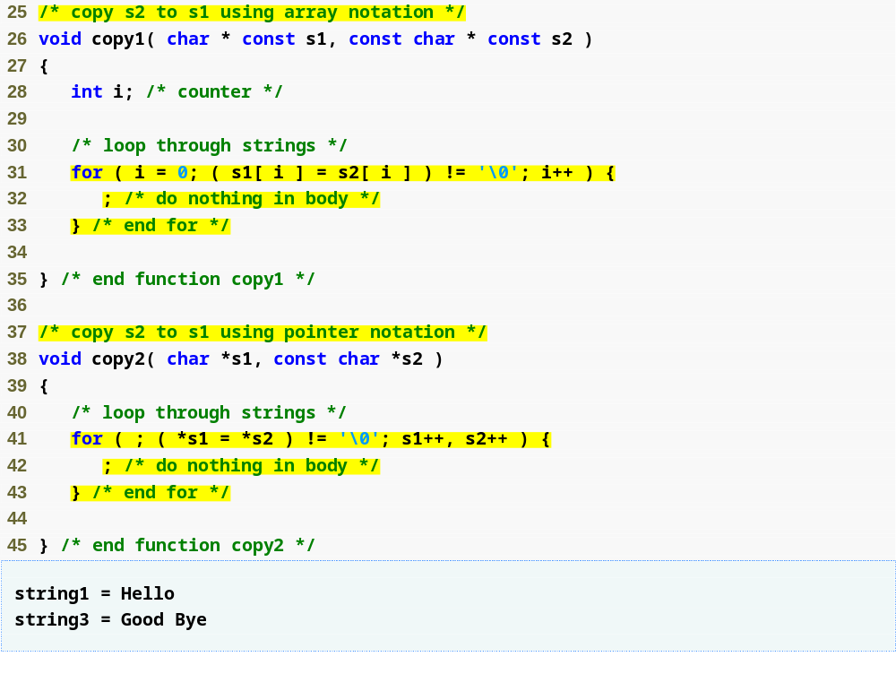
Outline
fig07_21.c
(2 of 2 )
Condition of for loop actually performs an action

Slide 81
7.10 Arrays of Pointers
Arrays can contain pointers
For example: an array of strings
    char *suit[ 4 ] = { "Hearts", "Diamonds",
    "Clubs", "Spades" };
  Strings are pointers to the first character
  char * – each element of suit is a pointer to a char
  The strings are not actually stored in the array suit, only pointers to the strings are stored

Slide 82
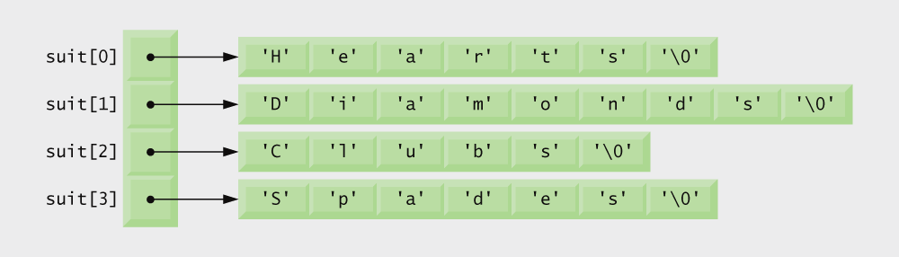
Fig. 7.22 | Graphical representation of the suit array.

Slide 83
7.11 Case Study: Card Shuffling and Dealing Simulation
Card shuffling program
  Use array of pointers to strings
  Use double subscripted array (suit, face)
  The numbers 1-52 go into the array
    Representing the order in which the cards are dealt

Slide 84
Performance Tip 7.3
Sometimes an algorithm that emerges in a “natural” way can contain subtle performance problems, such as indefinite postponement. Seek algorithms that avoid indefinite postponement.

Slide 85
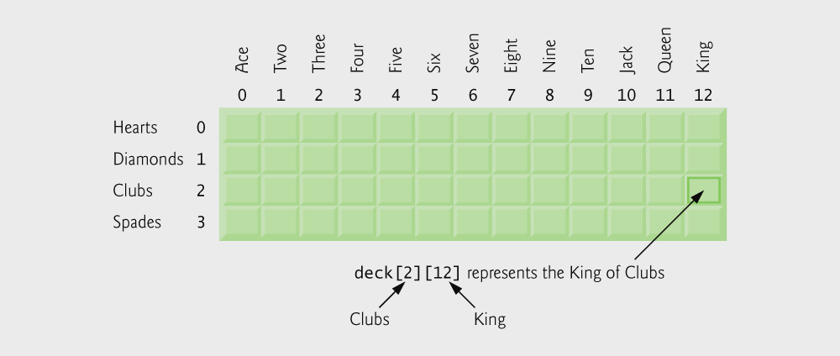
Fig. 7.23 | Double-subscripted array representation of a deck of cards.

Slide 86
7.11 Case Study: Card Shuffling and Dealing Simulation
Pseudocode
  Top level:
    Shuffle and deal 52 cards
  First refinement:
    Initialize the suit array
    Initialize the face array
    Initialize the deck array
    Shuffle the deck
    Deal 52 cards

Slide 87
7.11 Case Study: Card Shuffling and Dealing Simulation
  Second refinement
    Convert shuffle the deck to
      For each of the 52 cards
      Place card number in randomly selected unoccupied slot of deck
    Convert deal 52 cards to
      For each of the 52 cards
      Find card number in deck array and print face and suit of card

Slide 88
7.11 Case Study: Card Shuffling and Dealing Simulation
  Third refinement
    Convert shuffle the deck to
      Choose slot of deck randomly
      While chosen slot of deck has been previously chosen
      Choose slot of deck randomly
        Place card number in chosen slot of deck
    Convert deal 52 cards to
      For each slot of the deck array
      If slot contains card number
      Print the face and suit of the card

Slide 89
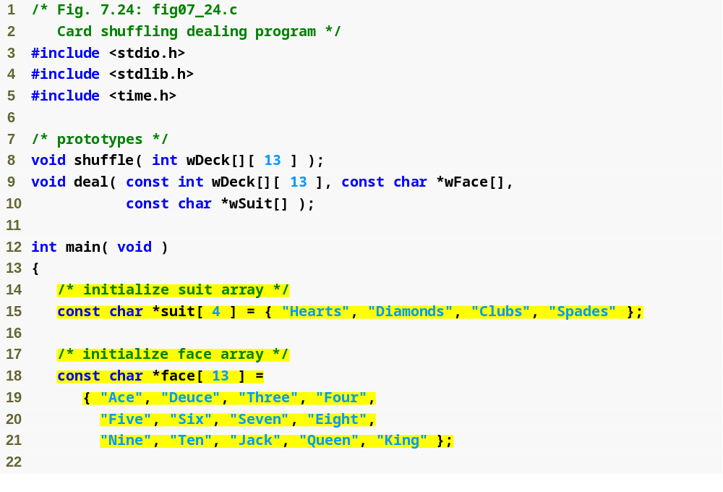
Outline
fig07_24.c
(1 of 4 )
suit and face arrays are arrays of pointers

Slide 90
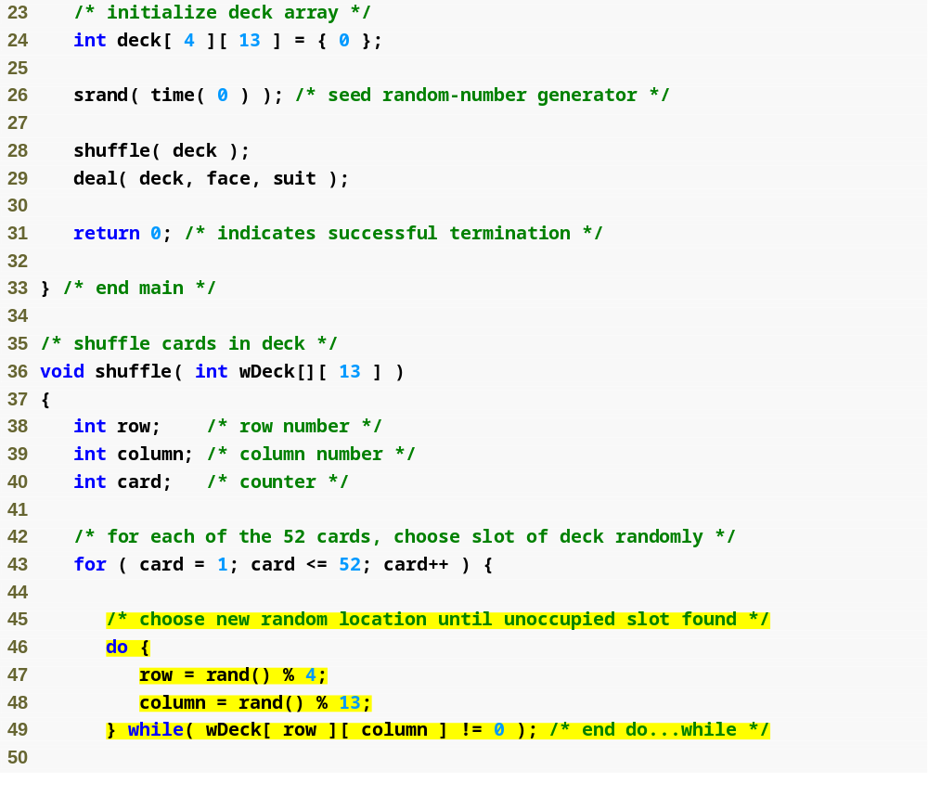
Outline
fig07_24.c
(2 of 4 )
do…while loop selects a random spot for each card

Slide 91
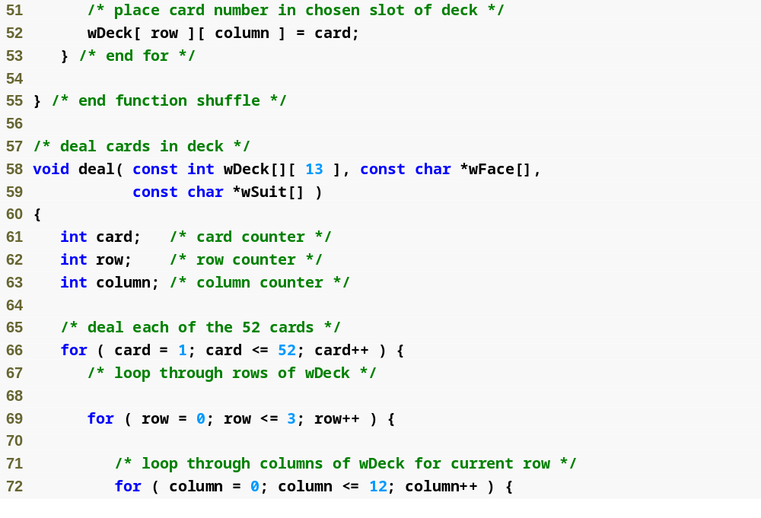
Outline
fig07_24.c
(3 of 4 )

Slide 92
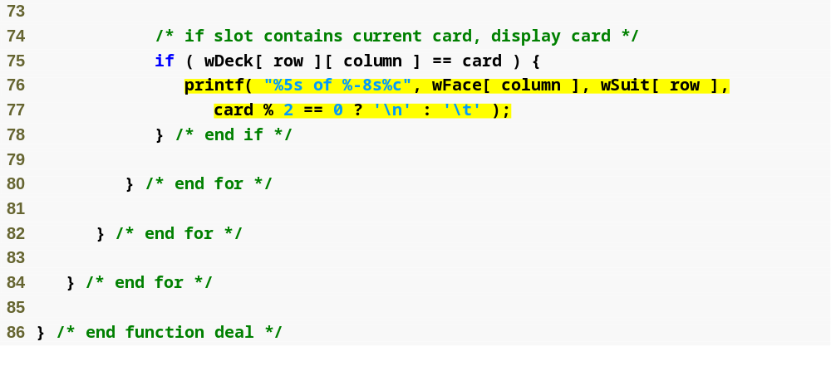
Outline
fig07_24.c
(4 of 4 )

Slide 93
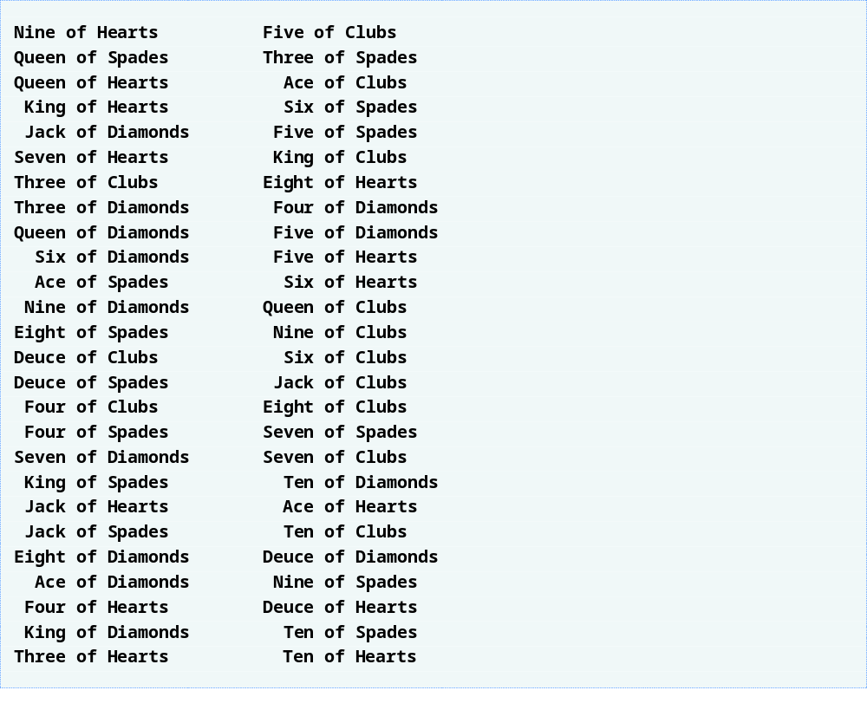
Outline

Slide 94
7.12 Pointers to Functions
Pointer to function
  Contains address of function
  Similar to how array name is address of first element
  Function name is starting address of code that defines function
Function pointers can be
  Passed to functions
  Stored in arrays
  Assigned to other function pointers

Slide 95
7.12 Pointers to Functions
Example: bubblesort
  Function bubble takes a function pointer
    bubble calls this helper function
    this determines ascending or descending sorting
  The argument in bubblesort for the function pointer:
      int ( *compare )( int a, int b )
    tells bubblesort to expect a pointer to a function that takes two ints and returns an int
  If the parentheses were left out:
      int *compare( int a, int b )
    Defines a function that receives two integers and returns a pointer to a int

Slide 96
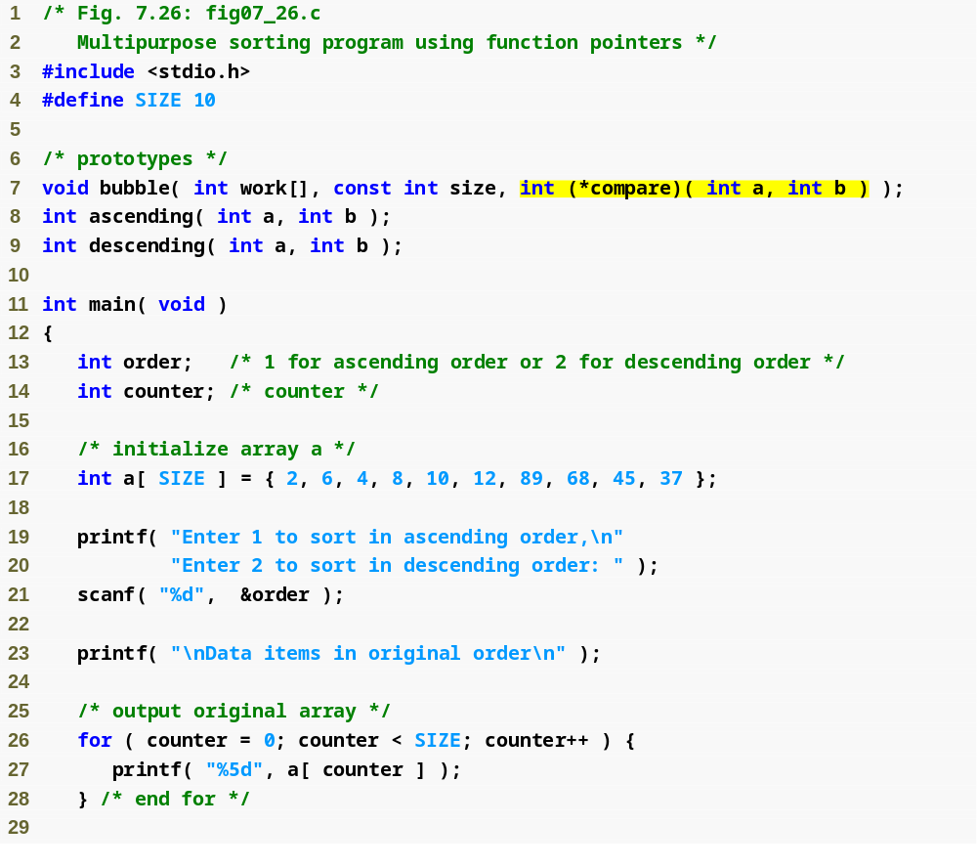
Outline
fig07_26.c
(1 of 4 )
bubble function takes a function pointer as an argument

Slide 97
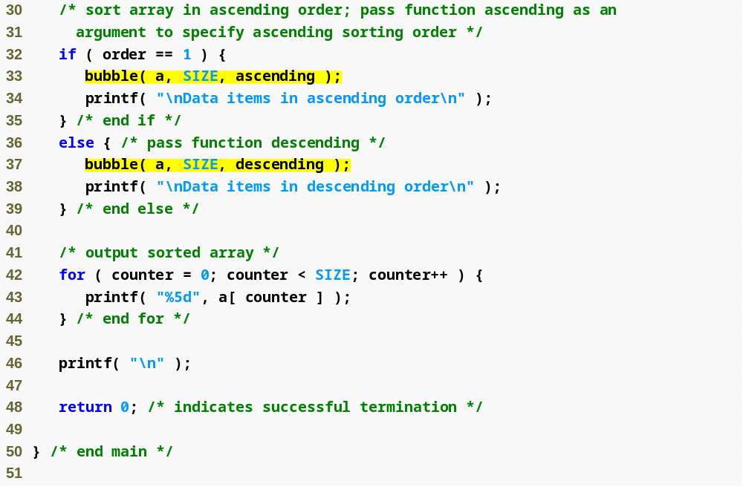
Outline
fig07_26.c
(2 of 4 )
depending on the user’s choice, the bubble function uses either the ascending or descending function to sort the array

Slide 98
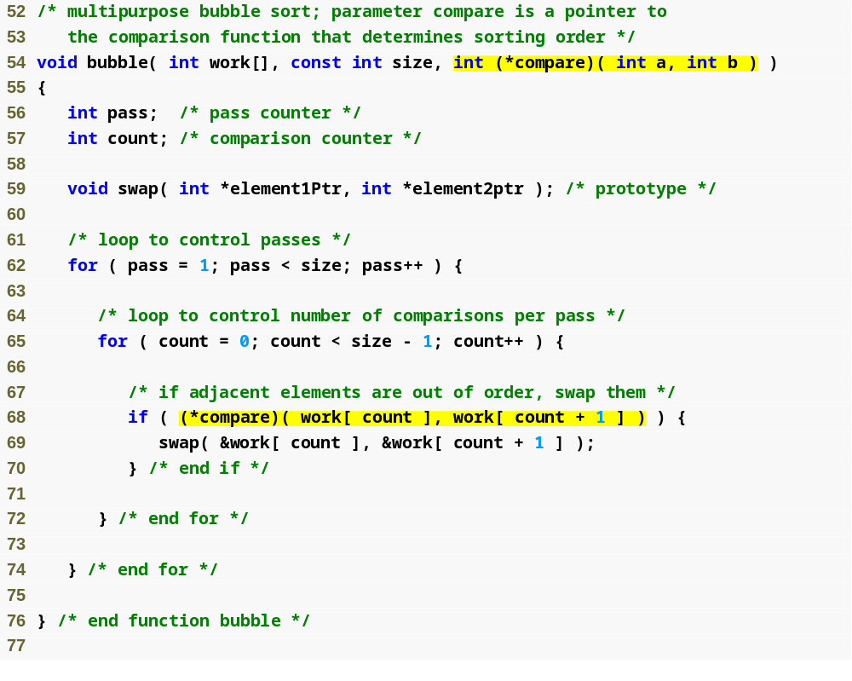
Outline
fig07_26.c
(3 of 4 )
Note that what the program considers “out of order” is dependent on the function pointer that was passed to the bubble function

Slide 99
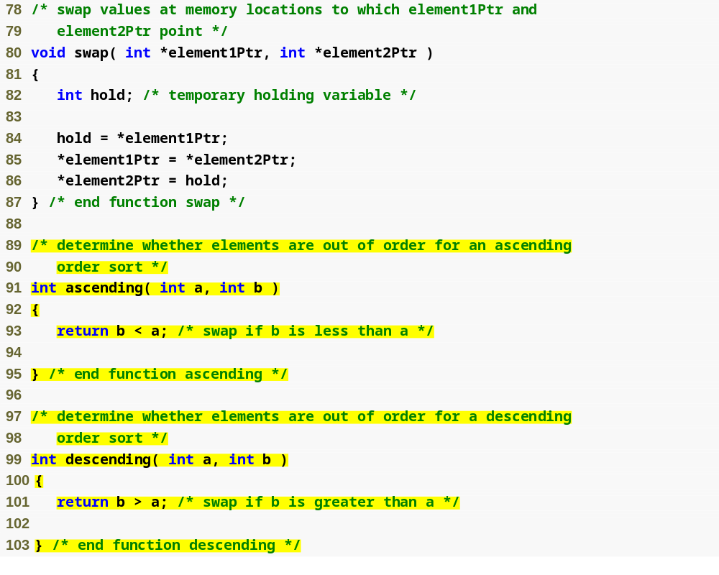
Outline
fig07_26.c
(4 of 4 )
Passing the bubble function ascending will point the program here
Passing the bubble function descending will point the program here

Slide 100
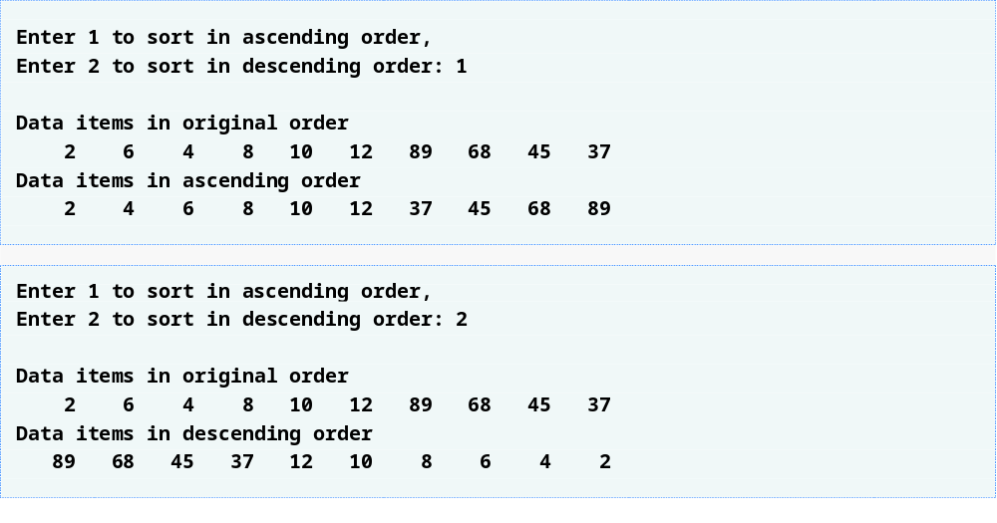
Outline

Slide 101
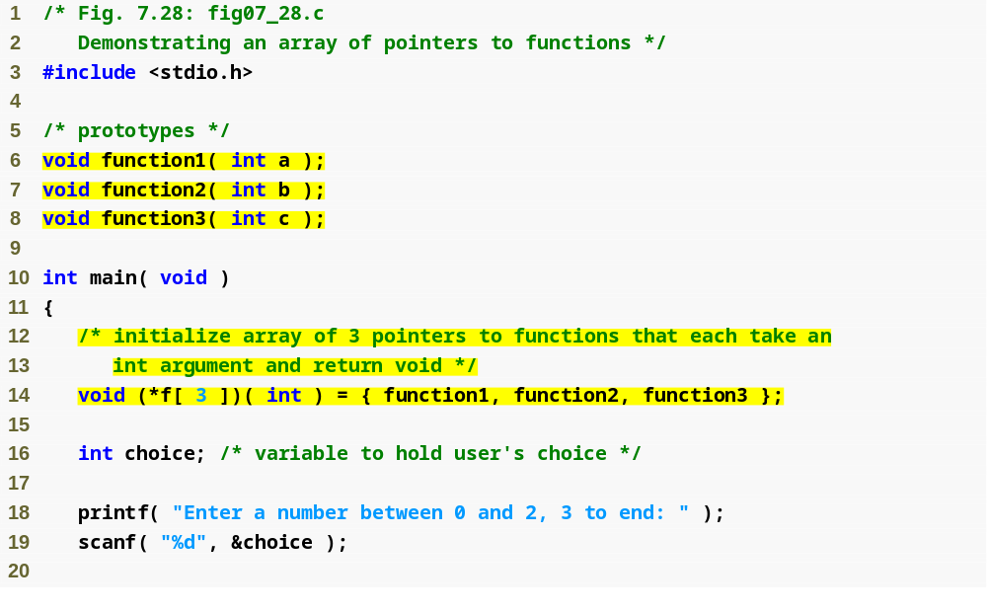
Outline
fig07_28.c
(1 of 3 )
Array of pointers to functions

Slide 102
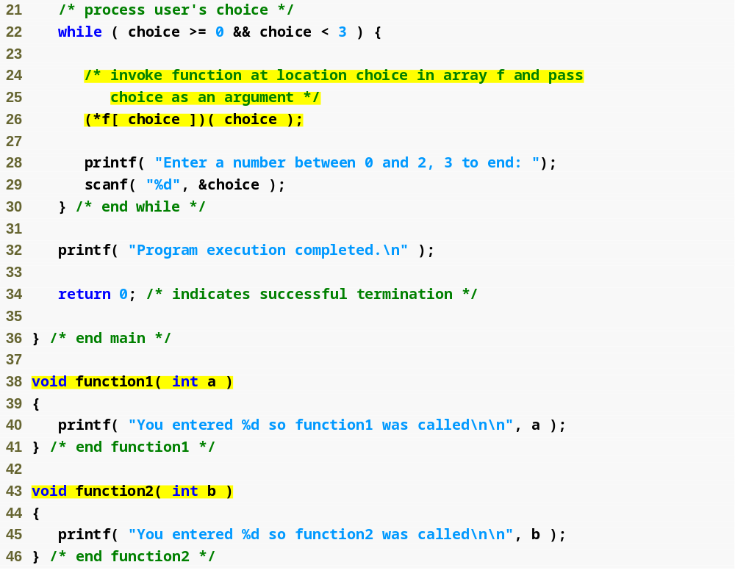
Outline
Function called is dependent on user’s choice
fig07_28.c
(2 of 3 )

Slide 103
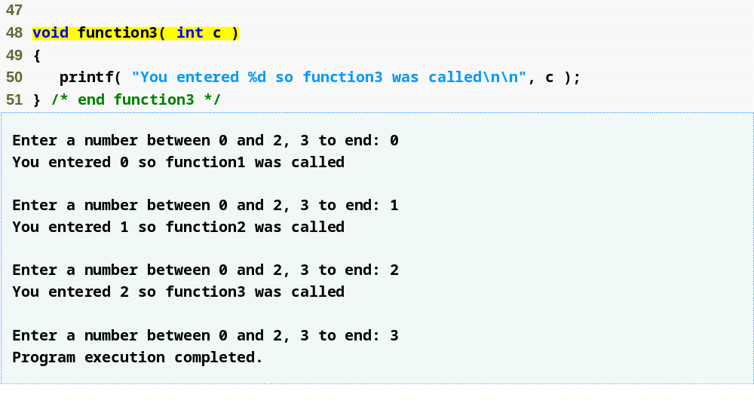
Outline
fig07_28.c
(3 of 3 )

