Slide 1
Azure NOTIFICATION HUB(ANH)
Scaled-out push engine , CROSS Backend

Slide 2
Agenda
Push Notification What – Working
Challenges
ANH–What– Why?
ANH Working
Demo

Slide 3
What is Push Notification
Form of app-to-user communication
Platform Notification Service
Apple Push Notification Service(APNS) for iOS.
Firebase Cloud Messaging(FCM) for Android.
Windows Notification Service(WNS) for windows.

Slide 4
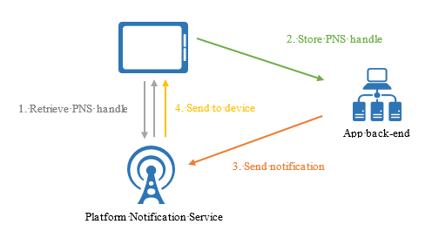
Working of Push Notification
Requests push handle.
Store in App back end
App back end with push handle contacts PNS to send notification
PNS forwards notification to client app

Slide 5
Challenges
Platform dependency
Maintaining Device information.
Not support broadcast to multiple devices
Maintain a registry to associate devices with interest groups, users, properties(Routing).

Slide 6
WHAT
Scaled-out push engine.
Cross backend(.NET, Node.js, Java, Python)

Slide 7
Why
Device token management.
Extreme scale(5 million devices).
Cross-platform.
Usable from any backend
Efficient tag-based multicast and pub/sub routing

Slide 8
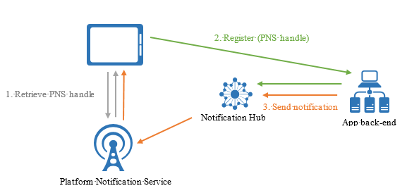
WORKING of ANH

Slide 9
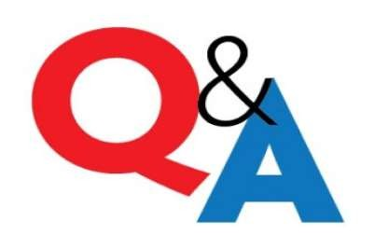

Slide 10


