Slide 1
Azure Cosmos Database
Globally distributed, NOSQL Database

Slide 2
Agenda
Cosmos –What– Why?
No SQL
Schema less
Azure Cosmos DB Feature
Global distribution
Data Model & Multi-model APIs
Partitioning
Indexing
Emulator Features – sample DB with SQL API - Functions

Slide 3
WHAT
Microsoft’s globally distributed database service.
Multi-Model database
No SQL
Schema less

Slide 4
Why
Offers 99.99% guarantees for availability, throughput, low latency, and consistency on both single and multi region accounts.
data-friendly pricing model that meters storage and throughput independently.
Elastically scaling provisioned throughput
No database service offers as much flexibility as Azure Cosmos DB in levels consistency
Secure by default

Slide 5
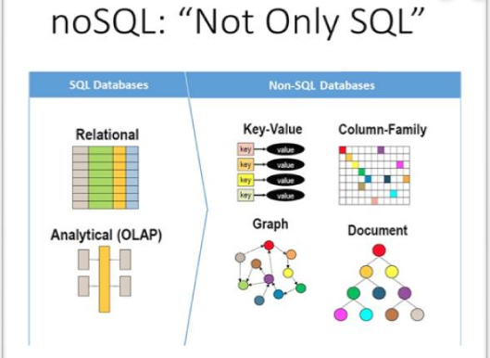
NO SqL
“Not Only SQL” or “Non SQL” or “Non Relational”
A NoSQL database provides a mechanism for storage and retrieval of data that is modeled

Slide 6
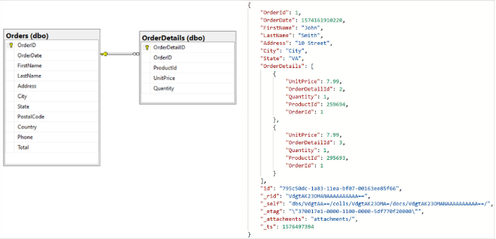
SCHEMA & Schemaless
How the data is organized and relations among them are associated.

Slide 7
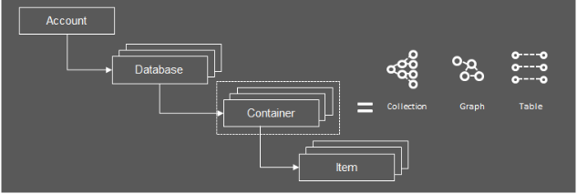
Database Representation

Slide 8
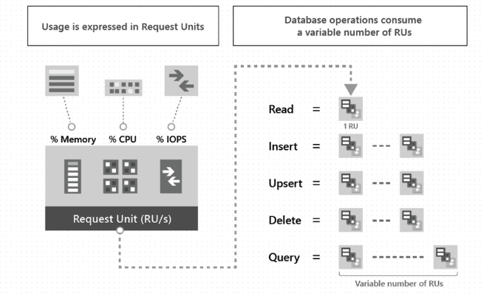
Latency & Throughput
Latency is a time interval between the stimulation and response.
99.99% latency within 10 -15 ms for writes and reads
Provisioned throughput is represented as request units/second(Rus).

Slide 9
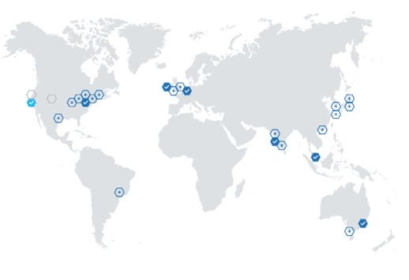
Global Distribution
Data distributed across globe(54 regions).
Add or Remove regions(Turnkey)
Manual and automatic failover feature
Low Latency
High Availability
Multi Master

Slide 10
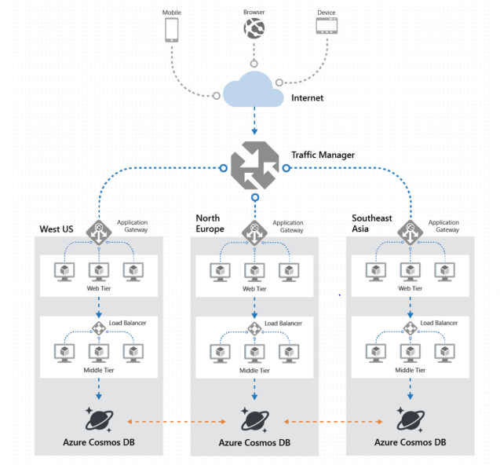
Global Distribution

Slide 11
Partitioning
Partition Key
Container in Database are divided into distinct subsets called Logical units.
One or more Logical units are stored in Physical Units
Scale individual containers in a database to meet the performance needs.

Slide 12
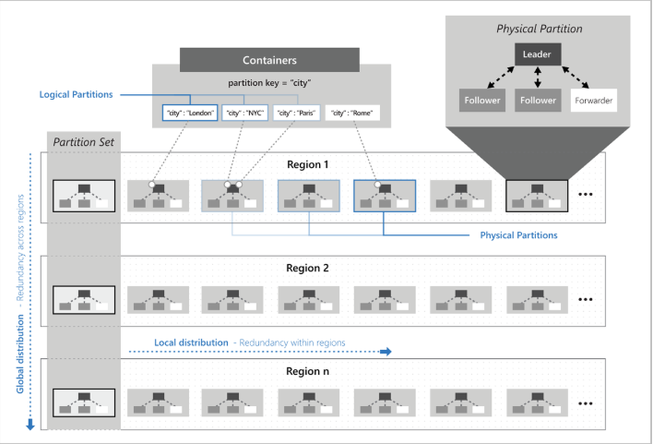
Partitioning

Slide 13
Consistency Levels
Strong
Bounded Staleness
Session
Consistent Prefix
Eventual

Slide 14
Indexing
Indexes all the property in the item by default.
Supports 2 modes
Consistent : Index gets updated synchronously as Item CUD.
None : Indexing is Disabled

Slide 15
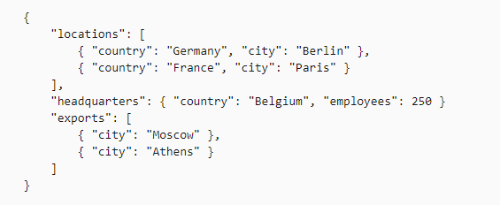

Slide 16
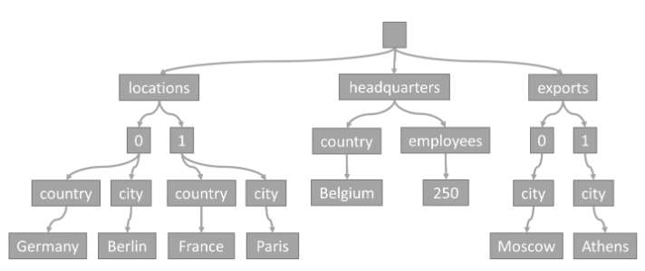

Slide 17
Multi-Model & Multi-Api
Supports multiple data models including documents, key-value, graph, and column-family
Supports below Api’s
SQL Api (Core)
Mango dB Api
Table Api
Cassandra Api
Gremlin Api

Slide 18
Sample Demo

Slide 19


Slide 20


