Slide 1
The Smart IDE
Group 6 – Zach Cowell, Ben Butler, Casey Corder, Arthur Otieno

Slide 2
Smart IDE(a)
Based on Dr. Menzies original idea → KNIT
He envisioned a particular IDE
Written within 10 thousand lines of code
A focus on scripting tools, such as AWK and Make
To show the power of scripting languages by creating a complex system using AWK.
Prove that its possible to write a language independent IDE that supports test-driven development

Slide 3
Problem Background
Bulky IDEs
Need for a new style of IDE that is more efficient
Scripting language
Never used to create an IDE
Teaching Tools
Lecture notes online
Sample code
Unix Tools
Makefile
Shell Scripting

Slide 4
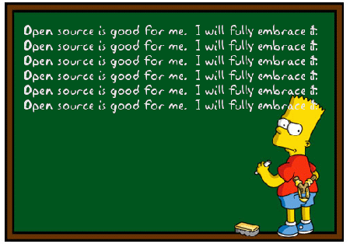
Problem Statement
Most IDEs are bulky and can be very difficult to use
Filled with plug-ins
Very complex software
Properties of a good IDE
Version Control
Debugging
Tool Support
Ability to compile different languages
Regression Testing
Open Source Software
Crowd Sourcing
Cuts down on cost of testing
100 Groups developing in Smart IDE
Tool support for over 100 groups

Slide 5
Functional requirements
Create, save, and edit projects
Compile, test and execute
Version tracker system with capabilities of rolling back
The bug-tracking module with
ID number
Description of the issue
Flag
Check for file dependencies

Slide 6
Engineering Requirements
Simple environment
Short learning curve
Handle small and large scale projects.
Specified permissions for projects and programs.
Makefiles
Multiple language support
Support tools
Regression and test suites

Slide 7
Marketing Requirements
Open source
Simple installation
Multiple language support
Low system requirements
Online code browsing
User guide & Help files
Customer support

Slide 8
An IDEa for Smart IDE Structure
Each application will be in its own directory
There will be a subdirectory for tests
Smart IDE
App directory
Source code
Test directory
MakeFile
System directory
Make Directory
Language Bindings
IDE source code (AWK)

Slide 9
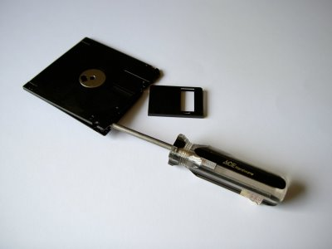
What is Make?
Unix dependency tool
Contains tools needed for building and testing code
Installing, updating, and committing of the system
Language bindings and processes

Slide 10
Technologies and Features
Smart IDE will provide a variety of useful features
Code manipulation
Writing/Reading
Compilation/Executing project
Syntax and editing tools
Test suites
Code storage via repository, such as Google Code.

Slide 11
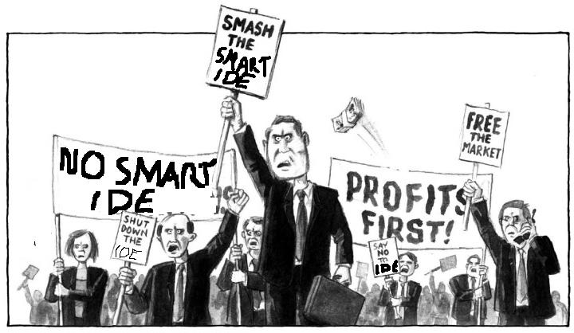
Challenges
User-friendly interface
Learning curve, User Friendliness, User Forgiveness, familiarity
Get the most out of scripting languages
Completing a large project using AWK
A community to use it
Developers
Teachers
Students
Competition
From other IDEs like Eclipse
Multiple Language compatibility
PHP, Python, Javascript, Lisp etc.

Slide 12

Conclusion
Visit our websites
http://code.google.com/SmartIDE
http://artofawk.net/
http://lcsee.wvu.edu/classes/ee480/spring2010/ide/web
We are very interested in an audience for this project; feedback is appreciated
Questions

