Slide 1
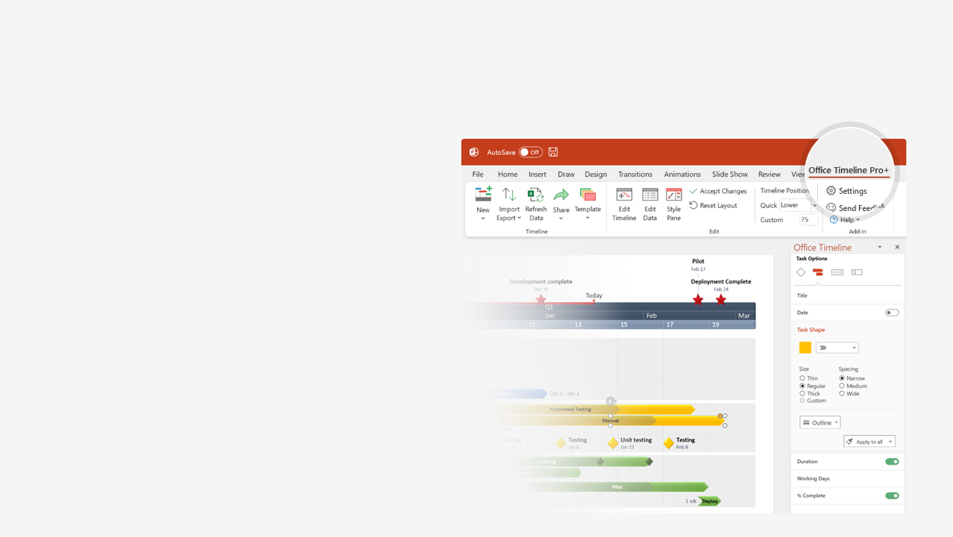

How to update this template in seconds
The Office Timeline add-in for PowerPoint will help you edit it with just a few clicks.
Get your free 14-day trial of Office Timeline here: https://www.officetimeline.com/14-days-trial Re-open this template, and create your impressive PowerPoint visual in 3 easy steps:
1
Click the Edit Data button on the Office Timeline tab.
2
Use the Data and Timeline views to edit swimlanes, milestones and tasks.
3
Click Save to instantly update the template.

Slide 2


history and timeline
Italy bans ChatGPT
Sam Altman removed and reappointed as CEO
Nov 17 - Nov 21
Mar 31 - Apr 28
ChatGPT
API
Bing to power
ChatGPT web browsing
GPT1 – 2018
GPT2 – 2019
GPT3 – 2020
InstructGPT - 2022
Mar 1
May 23
ChatGPT hits
100 million users
ChatGPT Android app
ChatGPT integrates with DALL-E 3
GPT4
ChatGPT iOS app
Jan 30
Mar 14
May 15
Jul 21
Sep 20
2022
2023
2023
Nov
Jan
Mar
May
Jul
Sep
Nov
Nov 30, 2022
Feb 1
Apr 25
Aug 28
ChatGPT is born
ChatGPT
Plus
ChatGPT users can control data inclusions
ChatGPT Enterprise
Mar 22
Open letter urges for pause
May 16
AI regulations in Senate hearing

