Slide 1
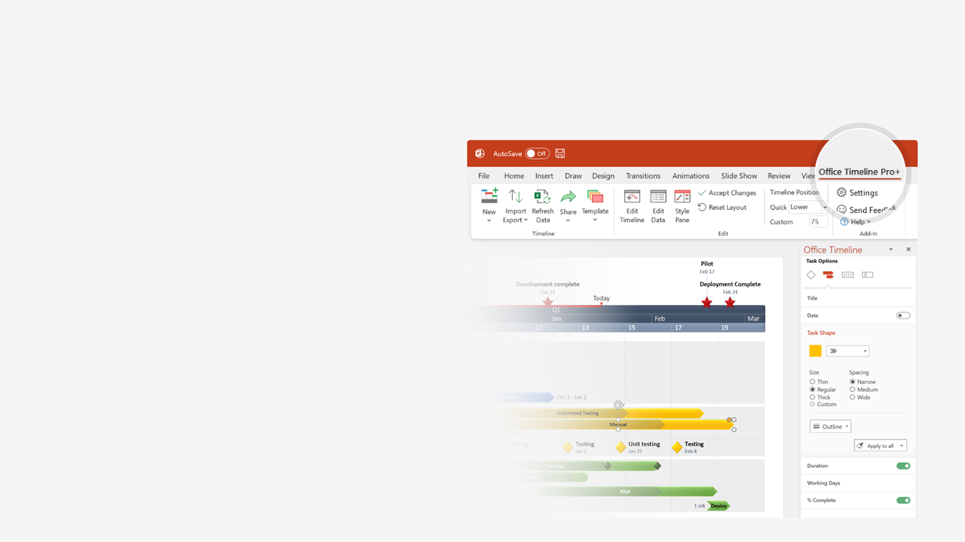

How to update this template in seconds
The Office Timeline add-in for PowerPoint will help you edit it with just a few clicks.
Get your free 14-day trial of Office Timeline here: https://www.officetimeline.com/14-days-trial Re-open this template, and create your impressive PowerPoint visual in 3 easy steps:
1
Click the Edit Data button on the Office Timeline tab.
2
Use the Data and Timeline views to edit swimlanes, milestones and tasks.
3
Click Save to instantly update the template.

Slide 2


The Turing Test
Deep Blue defeats Garry Kasparov
1950
The term “AI winter” is coined
The term “artificial intelligence“ is coined
1984
1997
Turing Natural Language Generation
1956
CNNs applicability demonstrated
A Neural Probabilistic Language Model
2019
The term “machine learning” is coined
Apple releases Siri
ChatGPT
1959
1989
2000
2011
2022
1950
1957
1964
1971
1978
1985
1992
1999
2006
2013
2020
SNARC
ELIZA and Shakey
1951
1966
Samuel Checkers-Playing Program
Artificial Intelligence: A General Survey
1950-1979
1952
1973
The Logic Theorist
The General Problem Solver
The first AI winter begins
1956
1957
1974
Symbolics Lisp machines commercialized
Fifth Generation Computer Systems
Large-Scale Deep Unsupervised Learning
1980-2009
1980
1982
2009
Bayesian networks causal analysis
A Statistical Approach to Language Translation
1985
1988
Watson wins on Jeopardy!
Googles's deep neural network project
2010-2014
2011
2012
History of Artificial Intelligence (AI) timeline
China's Tianhe-2 fastest system
Facebook introduces DeepFace
2013
2014
AlphaGo wins at Go
Sophia: the first robot with citizenship
2015-2019
2016
2017
Google introduces the Transformer
Cimon, GPT, Lovot
2017
2018
Curial GPT-3 LLM
Dall-E
2020-2025
2020
2021
GPT-4
2023

