Slide 1
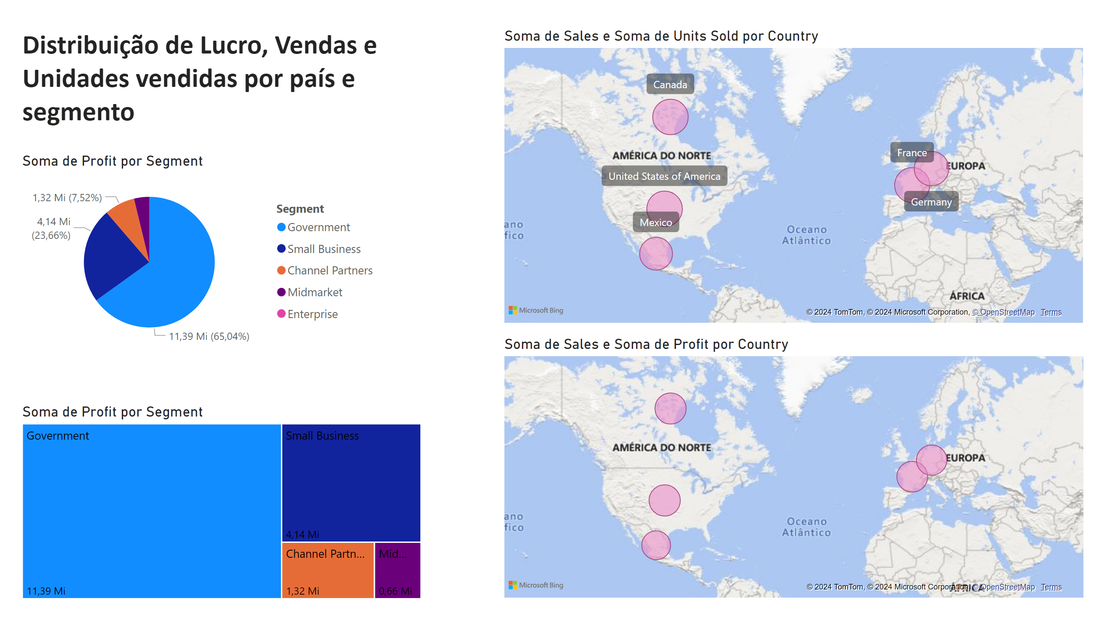
Vendas
Notes:
pieChart
No alt text provided
treemap
No alt text provided
map
No alt text provided
map
No alt text provided
textbox
No alt text provided

