Slide 1
DATA ENGINEER / STUDY CASE
THE OUTCOME
Reliable data for
retail finance
One dependable
version of the truth
An end-to-end warehouse design, grounded in the FinProject implementation.
03
business entities
02
warehouse layers
CURRENT: Dagster + ClickHouse → TARGET: trusted, scalable data
01
shared quality contract
Candidate presentation | November 2026
DESIGN FOR CORRECTNESS FIRST. SCALE WITH EVIDENCE.

Slide 2
01 / EXECUTIVE VIEW
The challenge is data trust—not just data movement
A small sample already demonstrates the failure modes in the brief.
19,430
100
300
80 + 80
source rows reviewed
repeated customer IDs
repeated transaction IDs
orphan transaction FKs
Across the three supplied CSVs
100 extra rows beyond unique IDs
300 extra rows beyond unique IDs
80 customer + 80 branch references
What the code gives us
What the target must add
• Dagster assets organize ingestion and warehouse loads.
• ClickHouse provides staging and DWH tables.
• DWH primary-key duplicate checks are defined.
• Replay-safe incremental processing and late-data recovery.
• Join-safe dimensions, foreign-key handling, and reconciliation.
• Freshness, volume, schema, and actionable alerting.
Snapshot audit of supplied CSVs; repeated IDs count extra rows. Findings are not a production incident diagnosis.
FINPROJECT / DATA ENGINEER STUDY CASE
02

Slide 3

02 / ARCHITECTURE
As implemented: local CSVs → staged → warehouse
Orchestrated by
The repository establishes a useful batch foundation, with production gaps made explicit.
SOURCE FILES
CLICKHOUSE STAGING
CLICKHOUSE DWH
branches.csv
customers.csv
transactions.csv
Load data as-is from the source
Deduplicated data. Aset checks
Branches
Customers
Transactions
• Staging and DWH are full refreshes.
• DWH table ordered by branch_id.
• DWH load is partitioned by registration_date.
• Deduplication prefers KYC/status, then registration date.
• DWH load is partitioned by updated_at date.
• Latest duplicate is selected within that date.
FINPROJECT / DATA ENGINEER STUDY CASE
03

Slide 4
03 / ETL & DATA FLOW
Use a hybrid load: snapshot masters, incremental facts, bounded replay
Choose the load pattern by data behavior—not one mechanism for every table.
Current repository behavior
Recommended processing
Why hybrid?
• CSV assets read complete files into memory.
• Each staging table is truncated and reloaded.
• Transactions filter by updated_at day.
• Retry deletes/reloads the selected target date.
• Dedupe ranks transaction_id within that day.
• Persist source file ID, checksum, run ID, and watermark.
• Read an overlap/lookback window for late updates.
• Rank each business key by source updated_at + tie-breaker.
• Rebuild affected target partitions deterministically.
• Advance watermark only after checks and reconciliation.
• Transactions: incremental by source change time + replay window.
• Customers: incremental changes with explicit survivorship/SCD policy.
• Branches: small full snapshot, or SCD if history is required.
• Periodic full reconciliation catches drift.
Retry safety = same input + same partition → same output; never append blindly.
FINPROJECT / DATA ENGINEER STUDY CASE
05

Slide 5
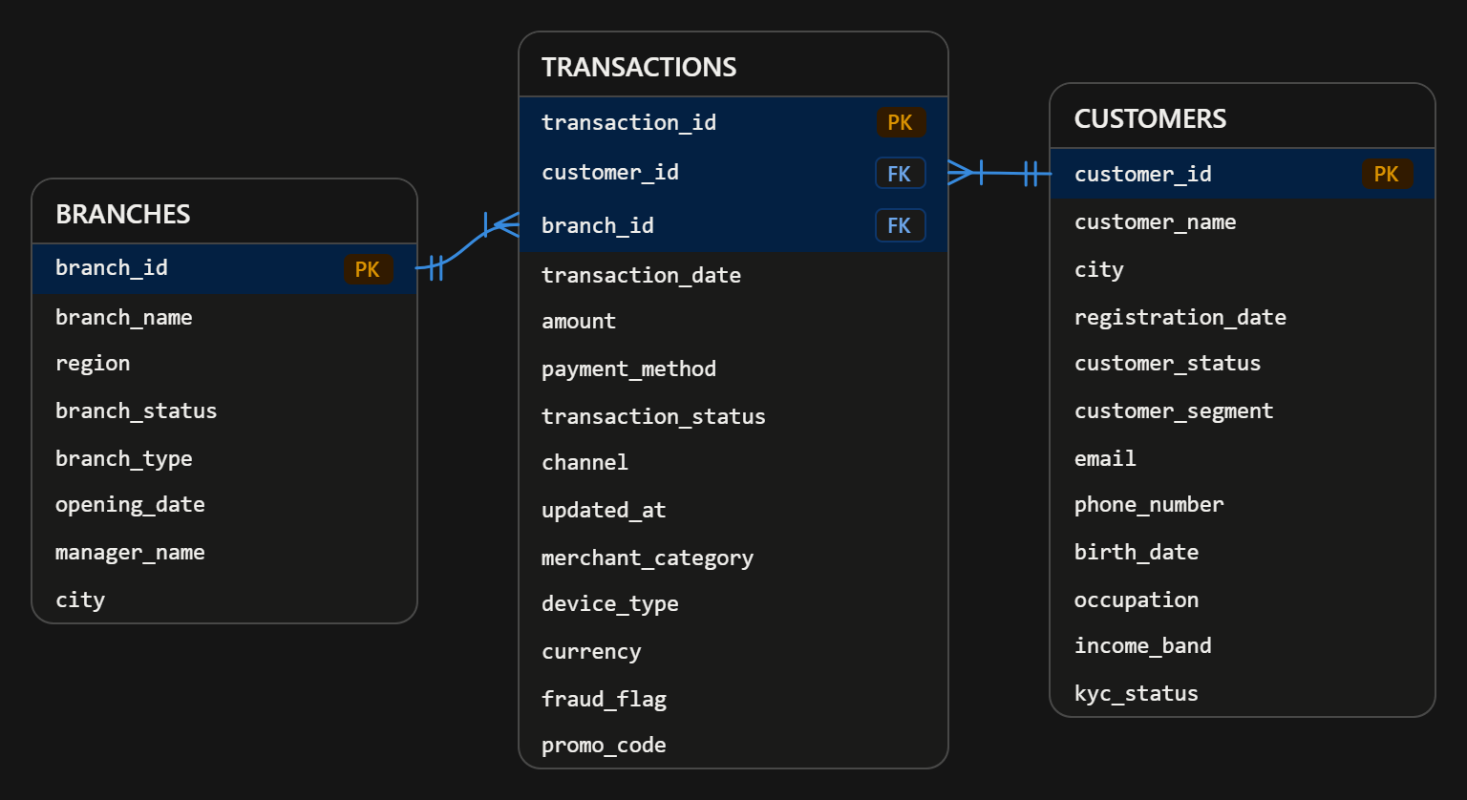
04 / MODELING & QUALITY
Declare grain and clean keys before joining
The ERD is a sound starting point; quality rules should protect its one-to-many relationships.
SAMPLE AUDIT / 19,430 ROWS
• Customers: 7,100 rows; 100 repeated customer IDs.
• Transactions: 12,300 rows; 300 repeated transaction IDs.
• Branches: 30 rows; 13 currently inactive.
• Transactions: 80 unmatched customer IDs + 80 unmatched branch IDs.
• 179 blank amounts; 84 negative amounts need business interpretation.
FACT GRAIN
One current transaction per transaction_id; dimensions join many-to-one.
Audit counts are from provided files. A negative amount may be a valid reversal; confirm the business rule before rejecting it.
FINPROJECT / DATA ENGINEER STUDY CASE
06

Slide 6
05 / MONITORING
Make freshness and correctness visible before dashboards break
Dagster provides run context; checks and alerts turn that context into action.
Already defined
Add per run / per partition
Alert and respond
• Dagster assets and a daily schedule definition.
• DWH duplicate-key checks for branch_id, customer_id, transaction_id.
• Check results include duplicate-key counts.
• Freshness: source arrival, last successful materialization, lag.
• Completeness: expected files/partitions, row counts, null rates.
• Integrity: duplicate PKs, orphan FKs, valid amount/status rules.
• Reconciliation: source vs target counts and control totals.
• Schema: required, optional, and newly observed columns.
• Page on missed freshness SLO or failed critical quality gate.
• Warn on volume drift, rising nulls, or quarantined records.
• Include asset, partition, run ID, source file, and failure reason.
• Route to an owner; provide rerun/backfill instructions.
Proposal: data ready by 07:30 Jakarta time when source files land by 05:30; measure and tune after observing real arrival patterns.
FINPROJECT / DATA ENGINEER STUDY CASE
07

Slide 7
06 / INCIDENT 1
Incremental-load mismatch: date filtering is not a complete watermark strategy
Symptoms: missing transactions, retry duplicates, mismatched totals, late arrivals.
Likely failure modes
Investigation sequence
Redesign / recover
• A late row lands after its updated_at partition already ran.
• A changed updated_at date can leave the prior-date row behind.
• Dedupe is scoped to one date, not the full business key.
• Retry and source replay may not be idempotent.
• Staging reload may not represent a complete immutable source.
• Trace one transaction_id across source, staging, and DWH.
• Compare counts/sums by transaction_date and updated_at date.
• Inspect run partitions, timestamps, retries, and file manifests.
• Check duplicate keys across the whole DWH—not only a day.
• Reconcile source change windows with loaded watermarks.
• Select latest row globally per transaction_id and version.
• Rebuild all affected target partitions deterministically.
• Quarantine unrecoverable records; replay safely.
Trade-off: overlap processing costs extra compute, but is simpler and safer than assuming source updates arrive on time.
FINPROJECT / DATA ENGINEER STUDY CASE
08

Slide 8
06 / INCIDENT 2
Join explosion: enforce one row per dimension key before enrichment
A 10× output increase is a cardinality signal; inspect joins before changing the dashboard.
Root causes to test
Debug with evidence
Prevent recurrence
• Duplicate customer_id creates one-to-many matches.
• Invalid foreign keys create dropped rows or unknown matches.
• Inactive branches are included without an as-of/status rule.
• Joining multiple non-unique dimensions multiplies rows.
• Record transaction count and distinct transaction_id before/after each join.
• Count duplicate keys in each dimension and run anti-joins for orphans.
• Check join predicates, null behavior, and effective dates.
• Quantify active/inactive records and matched/unmatched rates.
• Deduplicate dimensions with deterministic survivorship rules.
• Join on unique keys; model history with effective dates when needed.
• Map invalid FKs to an Unknown member or quarantine explicitly.
• Gate publication on join-cardinality and row-count expectations.
Never filter inactive master records blindly: use status/effective-date rules that match the reporting question.
FINPROJECT / DATA ENGINEER STUDY CASE
09

Slide 9
06 / INCIDENTS 3 & 4
Fail fast on contract breaks; alert on stale data before users do
Schema evolution / pipeline failure
Data freshness / SLA proposal
• Today: CSV readers require an exact column list; added or reordered fields can fail ingestion.
• Triage: capture file name/schema, Dagster run, failed asset, and first bad row.
• Recover: preserve raw input, fix mapping, replay affected partition, reconcile.
• Improve: versioned data contracts; tolerate safe optional columns; quarantine breaking changes.
• Alert immediately on failed run or schema drift—not after dashboard impact.
• Track file arrival time separately from last successful DWH update.
• Measure end-to-end lag, missed partitions, and last-good timestamp per asset.
• Source late → notify source owner; source ready + failed run → pipeline alert.
• Initial objective: daily data ready by 07:30 WIB, assuming source by 05:30.
• Define SLO only after measuring arrival distribution and business tolerance.
Schema policy should be explicit: allow compatible optional fields, reject/quarantine incompatible changes with an actionable alert.
FINPROJECT / DATA ENGINEER STUDY CASE
10

Slide 10
07 / SCALE & OPTIMIZE
20M rows/day > Improve the execution model
That is roughly 7.3B rows/year before retention, updates, and replication.
Ingestion & storage
Transform & query
Operate & control cost
• Land immutable, compressed columnar files (e.g., Parquet).
• Use manifests, file sizing, and parallel partition ingestion.
• Separate raw retention from curated serving storage.
• Partition by query/access pattern; avoid tiny partitions.
• Push set-based work into ClickHouse while volumes fit.
• Benchmark sort keys, partition pruning, and materialized aggregates.
• Use Spark when distributed joins/shuffles exceed warehouse or SQL limits.
• Scale workers/concurrency from measured bottlenecks.
• Bound backfills; parallelize by safe date/key partitions.
• Checkpoint progress and retry only failed partitions.
• Set retention, lifecycle, and compute schedules.
• Track cost per million rows and pipeline duration.
Spark is not the default: introduce it when measured data volume, complex distributed processing, or concurrency justifies the operational overhead.
FINPROJECT / DATA ENGINEER STUDY CASE
11

Slide 11
08 / DECISIONS
Make assumptions explicit; ship reliability in measurable steps
Preserve the working batch foundation while closing correctness gaps first.
Assumptions & trade-offs
0–30 days / correctness
30–90 days / scale
• transaction_id is the transaction grain; source updated_at is trustworthy enough to order versions.
• Negative amounts may be refunds; business validation is required.
• Daily batch is acceptable until freshness needs demand streaming.
• History for customer/branch changes is a business decision (SCD vs current-state).
• ClickHouse sort order does not itself enforce unique keys.
• Define grain, key rules, amount and active-status policies.
• Add duplicate/FK/null/freshness checks and reconciliation.
• Fix late-data replay and idempotent partition rebuild.
• Document failure ownership and runbook.
• Add immutable cloud landing + manifests and schema contracts.
• Add alerts, lineage, cost and SLO dashboards.
• Benchmark 20M/day; tune partitions, sort keys, and concurrency.
• Adopt distributed compute only when benchmarks justify it.
SUCCESS = complete, unique, reconciled, fresh data—with every run explainable and replayable.
FINPROJECT / DATA ENGINEER STUDY CASE
12

